Slide 1
1.5 The Ellipse
An ellipse is the set of all points on the plane, the sum of whose distances from two fixed points is a constant.
The fixed points referred to are called the foci of the ellipse.

Slide 2
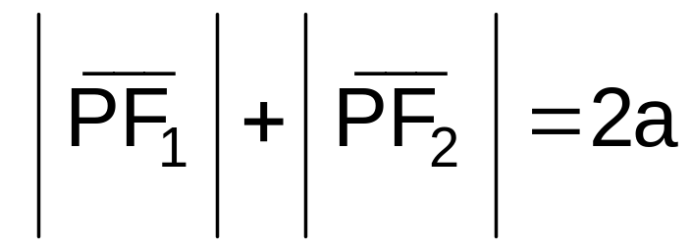
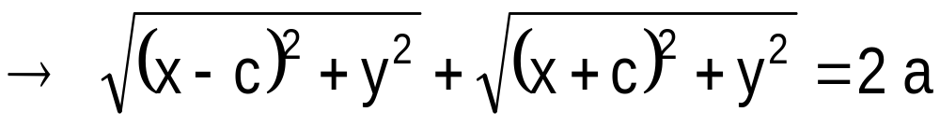
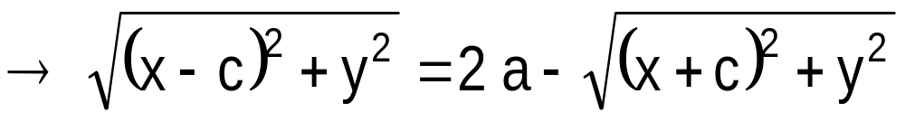
Suppose the foci have coordinates
(c,0) and (-c,0), 2a is the constant sum and if P(x,y) is any point in the ellipse then
P(x,y)
F₂(-c,0)
F₁ (c,0)

Slide 3
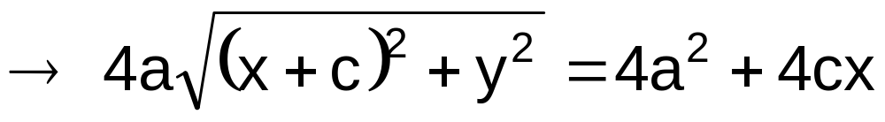
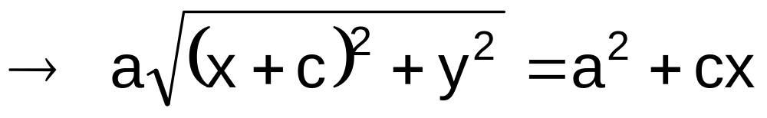

Slide 4
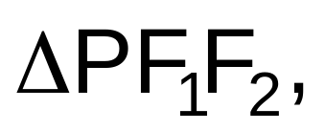
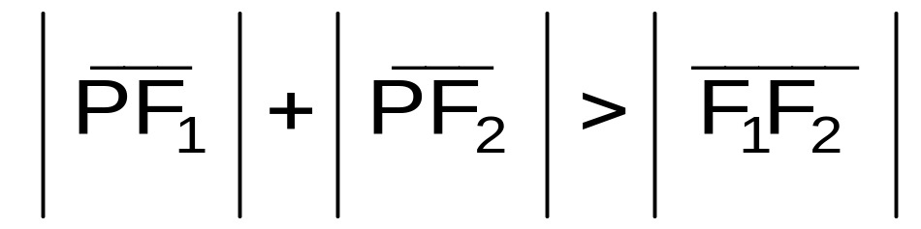
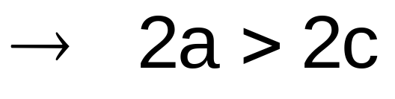
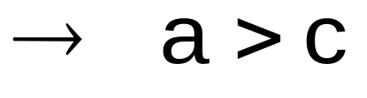
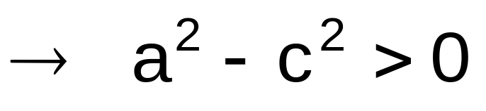

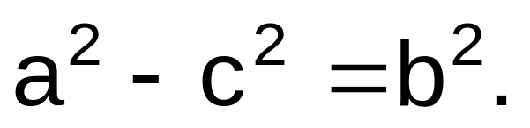
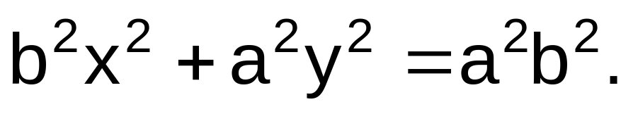
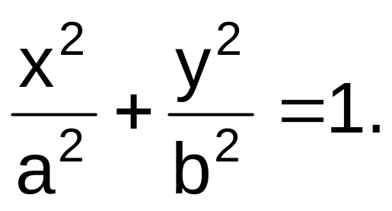
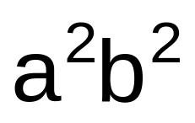
In the triangle
P(x,y)
F₂(-c,0)
F₁ (c,0)
Let
Then
Dividing (1) by
becomes

Slide 5

Consider
(0,b)
The x-intercepts of the graph are a and –a.
(-a,0)
(a,0)
The y-intercepts of the graph are b and –b.
(0,-b)
The points (a,0) and (-a,0) are the vertices of the ellipse.
The principal axis is the x-axis.

Slide 6
The line segment joining the vertices is called the major axis of the ellipse.
(0,b)
(-a,0)
(a,0)
(0,-b)
The line segment joining the points (0,b) and (0,-b) is called the minor axis of the ellipse.
The intersection of the
major axis and the minor
axis of the ellipse is called
its center.

Slide 7
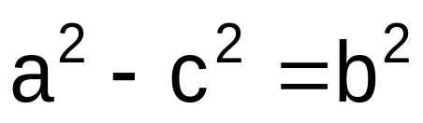
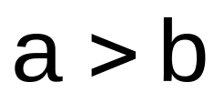
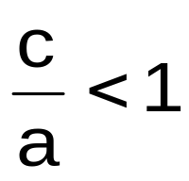
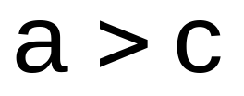

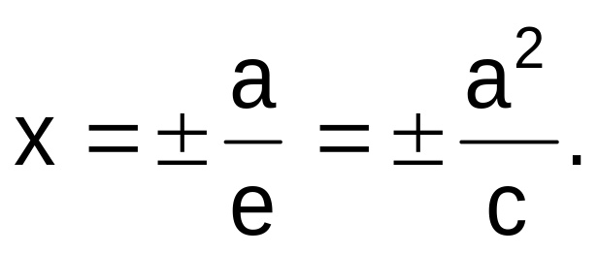
Since , then . Hence, the major axis of the ellipse is always longer than its minor axis.
Since , then . This ratio is
the eccentricity of the ellipse while the directrices of the ellipse are at the
lines

Slide 8
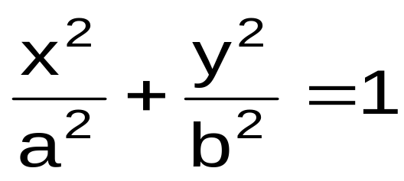
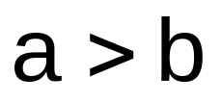
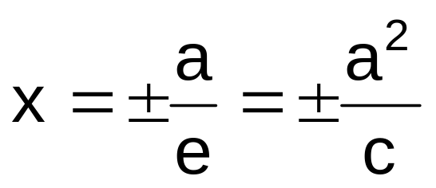
The equation
where
is the standard equation of the ellipse with
center at the origin
(0,b)
x-axis is the principal axis
(-a,0)
(a,0)
vertices at (a,0) and (-a,0)
(0,-b)
foci at (c,0) and (-c,0) with c² = a² - b²
endpoints of the minor axis at (0,b) and (0,-b)
equation of directrices given by

Slide 9
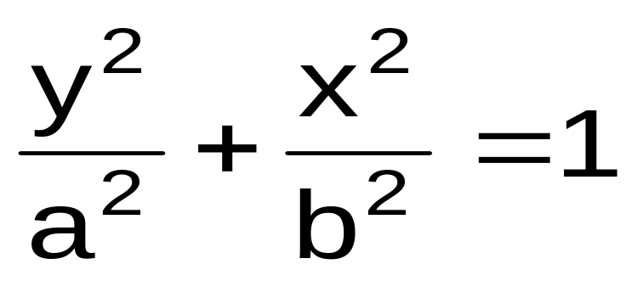
Interchanging the roles of x and y, the equation will become
How would this affect the properties of the ellipse?

Slide 10
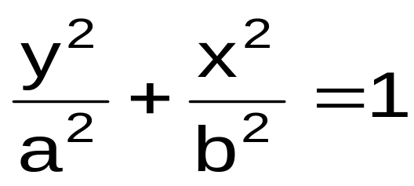
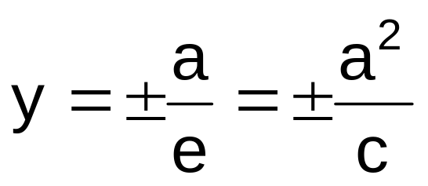
The equation
where
is the standard equation of the ellipse with
(0,a)
center at the origin
(-b,0)
(b,0)
y-axis is the principal axis
vertices at (0,a) and (0,-a)
foci at (0,c) and (0,-c) with c² = a² - b²
(0,-a)
endpoints of the minor axis at (b,0) and (-b,0)
equation of directrices given by

Slide 11

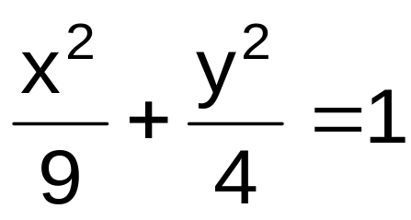
Example. Given the ellipse with equation
determine the principal axis, vertices, endpoints of the minor axis, lengths of the major and minor axes, foci, eccentricity and equations of directrices. Draw also a sketch of the ellipse.

Slide 12

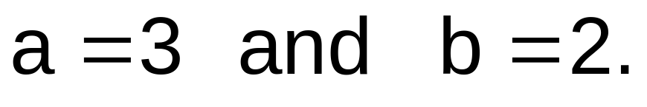
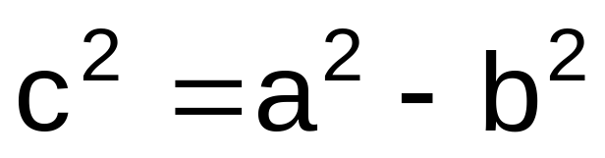
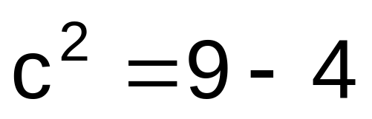
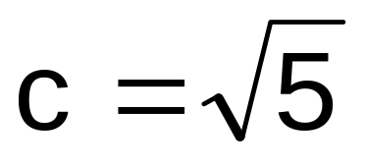
SOLUTION
From the standard equation,
Solving for the value of c,

Slide 13

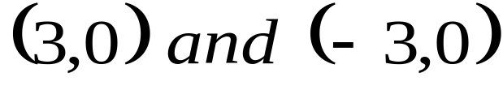
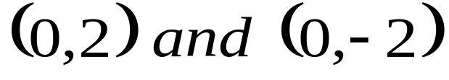
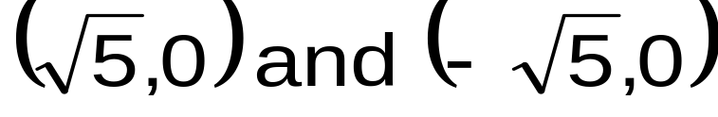


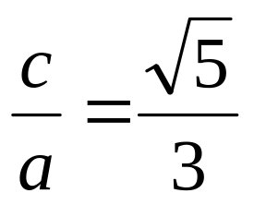
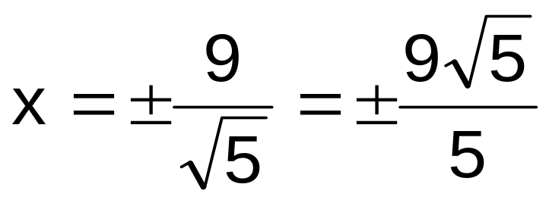
T h e r e f o r e ,
principal axis:
x-axis
vertices:
endpoints of the minor axis
foci
length of the major axis
length of the minor axis
eccentricity
equations of the directrices given by

Slide 14
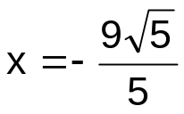
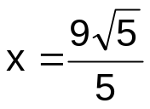



(0,2)
(-3,0)
(3,0)
(0,-2)

Slide 15
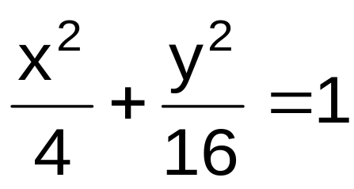
Example. Given the ellipse with equation
determine the principal axis, vertices, endpoints of the minor axis, lengths of the major and minor axes, foci, eccentricity and equations of directrices. Draw also a sketch of the ellipse.

Slide 16
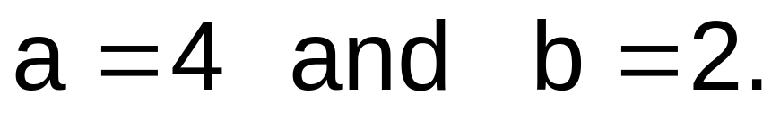
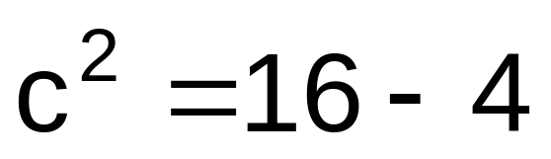
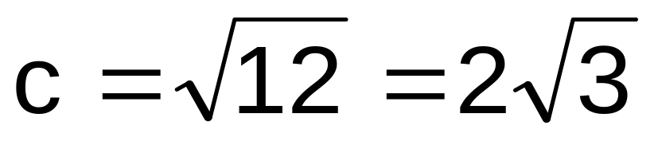
SOLUTION
From the standard equation,
Solving for the value of c,

Slide 17
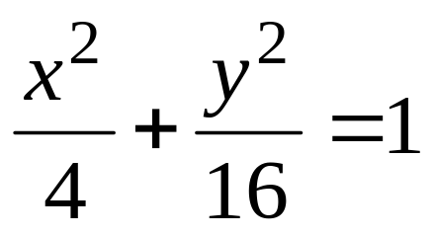
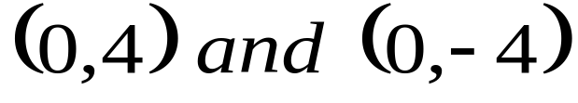
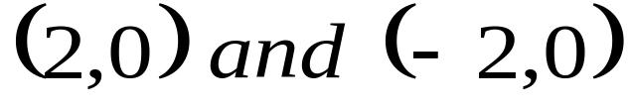
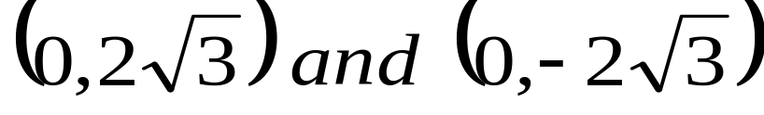

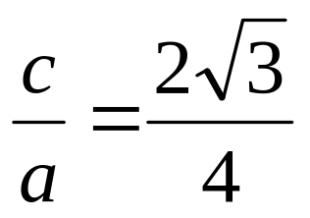
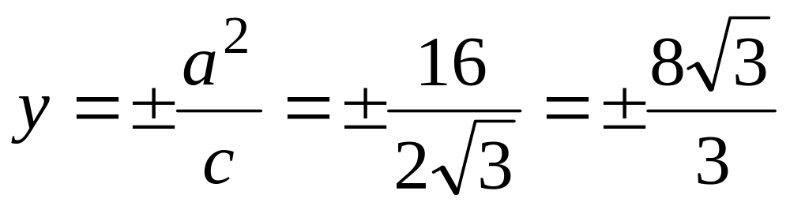
T h e r e f o r e ,
principal axis:
y-axis
vertices:
endpoints of the minor axis
foci
length of the major axis
length of the minor axis
eccentricity
equations of the directrices given by

Slide 18
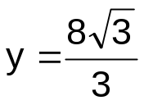


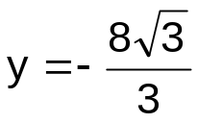
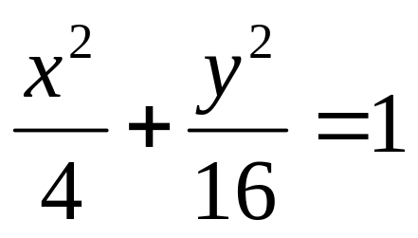
(0,4)
(-2,0)
(2,0)
(0,-4)

Slide 19


Example. Determine the standard equation of
the given ellipse
and give the properties as done in the
previous examples.
SOLUTION
To make the right-side of the equation equal to 1, divide both sides by 100.
After simplification, the equation becomes

Slide 20
I know you are smart enough and can easily give the properties of the ellipse. Try it at home, ok?

Slide 21

Let be the center of the ellipse
2a be the distance between the vertices
2b be the length of its minor axis
2c be the distance between its foci.
k
h
k
h

Slide 22


The standard equation of the ellipse with center at (h,k) is given by
if the principal axis is a horizontal line; or
if the principal axis is a vertical line.

Slide 23

Example. Given the standard equation of the
Determine the (a) principal axis, (b) vertices, (c) endpoints of the minor axis, (d) lengths of the major and minor axes, (e) foci, (f) eccentricity, and (g) equations of directrices. Draw also a sketch of the ellipse.

Slide 24








Center:
principal axis:
x=-2
vertices:
endpoints of the minor axis
foci
length of the major axis
length of the minor axis
eccentricity
equations of the directrices given by

Slide 25
(-2,7)
(-2,5)
(-8,-3)
(4,-3)
(-2,-11)
(-2,-13)

Slide 26

Example. Given the standard equation of the
Determine the (a) principal axis, (b) vertices, (c) endpoints of the minor axis, (d) lengths of the major and minor axes, (e) foci, (f) eccentricity, and (g) equations of directrices. Draw also a sketch of the ellipse.

Slide 27










Center:
principal axis:
y=-3
vertices:
endpoints of the minor axis
foci
length of the major axis
length of the minor axis
eccentricity
equations of the directrices given by

Slide 28


Slide 29

Example. Determine the standard equation of the ellipse with center at (1,-1), principal axis parallel to the x-axis and the lengths of the major and minor axes are 8 and 4, respectively.
SOLUTION
Since the principal axis is parallel to the x-axis then the standard equation is of the form

Slide 30

From the given, h = 1, k = -1, a = 4 and b = 2.
Thus, the standard equation of the ellipse is given by

Slide 31



Example. Write the equation of the ellipse
in standard form.
SOLUTION
From the given equation,

Slide 32


Using completing the square,
Dividing both sides by 36,

Slide 33
SUMMARY
k
h
Center C(h,k)
Vertices V(h±a,k)
Foci F(h±c,k)
Endpoints of minor axis B(h,k±b)
Directrices x=h±a/e

Slide 34
k
h
Center C(h,k)
Vertices V(h,k±a)
Foci F(h,k±c)
Endpoints of the minor axis B(h±b,k)
Directrices y=k±a/e

Slide 35
--------------END OF 1.5--------------

