Slide 1
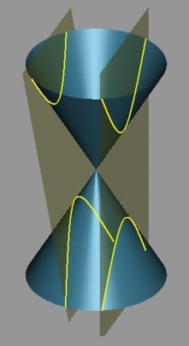
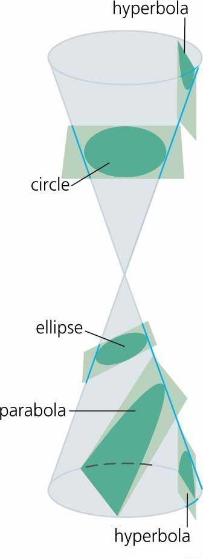
1.6 Hyperbola

Slide 2
1.6 Hyperbola
A hyperbola is the set of all points on the plane, the absolute value of the difference of whose distances from two fixed points is a constant.
The fixed points referred to are the foci of the hyperbola.

Slide 3


Choose the coordinate axes such that the foci lie on the x-axis.

Slide 4
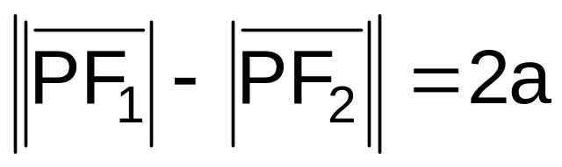
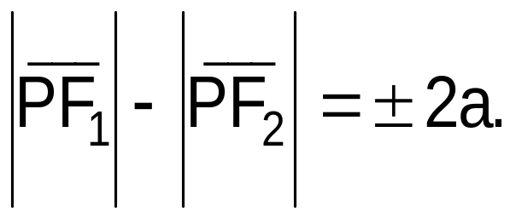
If P(x,y) is any point on the hyperbola, F₁ and F₂ be the foci, and 2a is the constant difference in the definition then
This implies that

Slide 5



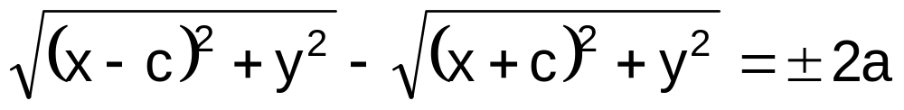
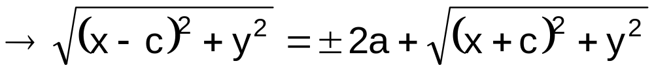
From the figure above,

Slide 6
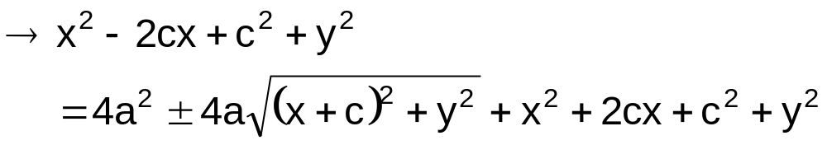
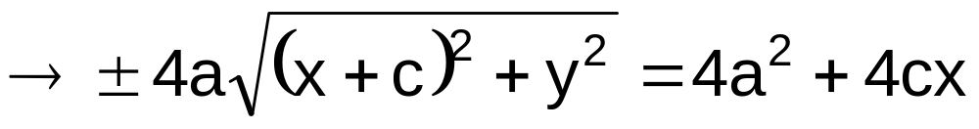
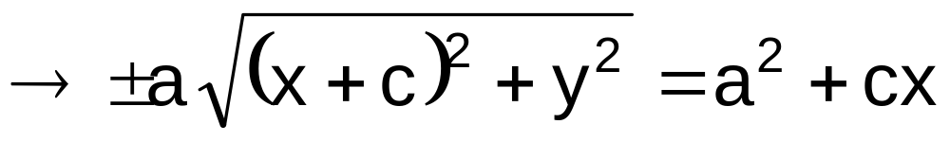

Slide 7
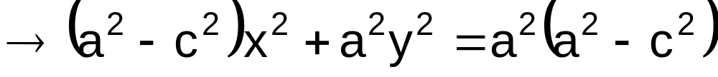
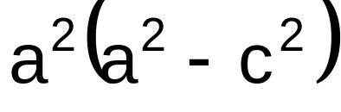
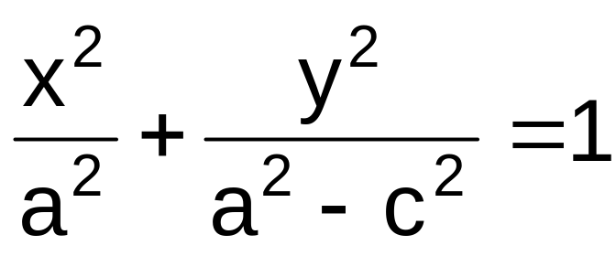
Dividing both sides of the equation by
,we have

Slide 8
From the equation,
the x-intercepts of the graph are a and –a.
Thus, the graph passes through the points (a,0) and (-a,0).

Slide 9





Slide 10
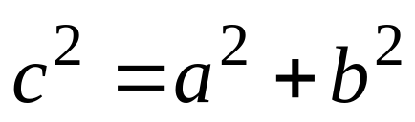
From the figure, it can be noted that
a < c.
Now, a² < c² and a² - c² < 0.
Let - b² = a² - c².
Equivalently, consider b² = c² - a².

Slide 11

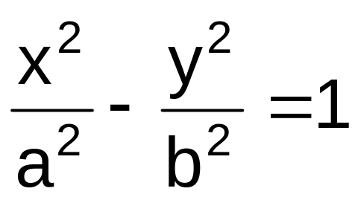
The equation
becomes

Slide 12
The points (a,0) and (-a,0) are the vertices of the hyperbola.
The line segment joining the vertices is called the transverse axis.
The line segment joining the points (0,b) and (0,-b) is called the conjugate axis.
Note that, the points (0,b) and (0,-b) are NOT points in the hyperbola.

Slide 13




The intersection of the transverse axis and the conjugate axis is called the center of the hyperbola.

Slide 14
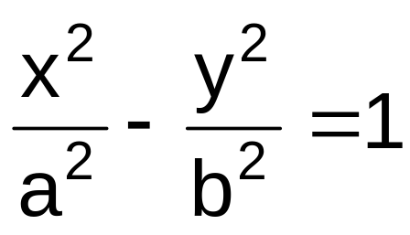
The equation
is the
standard equation of the hyperbola with
center at the origin
x-axis as the principal axis
vertices at (a,0) and (-a,0)
foci at (c,0) and (-c,0)

Slide 15

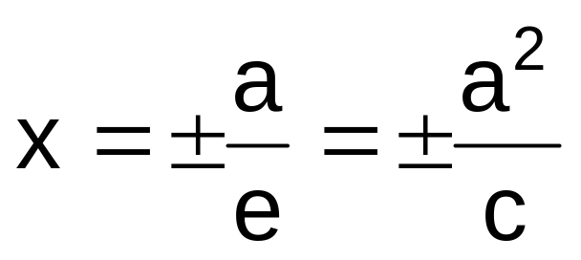
The equation
is the
standard equation of the hyperbola with
eccentricity e equal to
with directrices given by the line

Slide 16
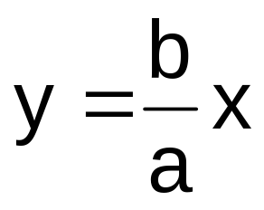
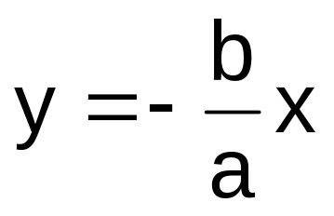
The equation
is the
standard equation of the hyperbola with
the lines
and
as its asymptotes.

Slide 17





Slide 18
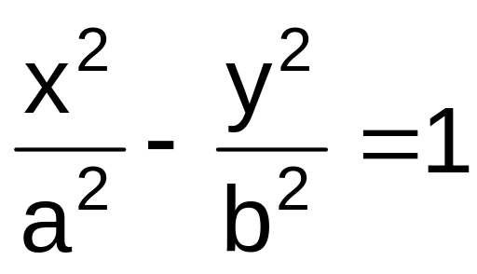
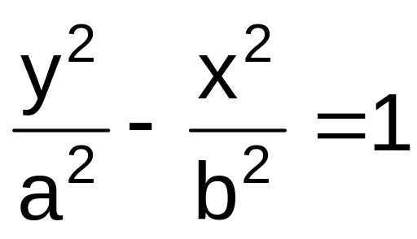
If we interchange the roles of x and y in the equation
then we have

Slide 19

The equation
is the
standard equation of the hyperbola with
center at the origin
y-axis as the principal axis
vertices at (0,a) and (0,-a)
foci at (0,c) and (0,-c)

Slide 20
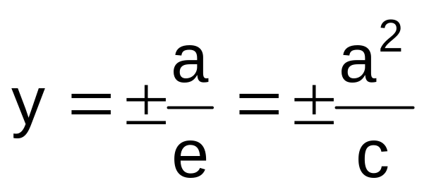
The equation
is the
standard equation of the hyperbola with
eccentricity e equal to
with directrices given by the line

Slide 21
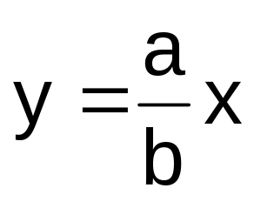
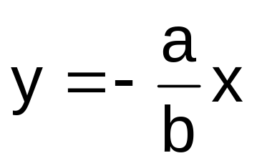
The equation
is the
standard equation of the hyperbola with
the lines
and
as its asymptotes.

Slide 22
We can easily graph the hyperbola by considering its asymptotes.
First determine the values of a and b from the given equation.
Then, form the auxiliary rectangle with dimensions 2a and 2b with center at the origin.

Slide 23





Slide 24

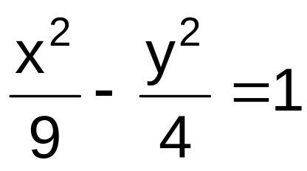
Example. Given the hyperbola
Determine the (a) center, (b) principal axis, (c) vertices, (d) endpoints of the conjugate axis, (e) foci, (f) eccentricity, and (g) equations of the directrices. Sketch also the graph.

Slide 25

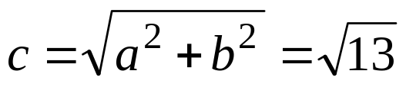

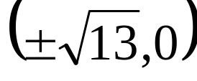
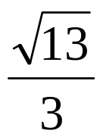
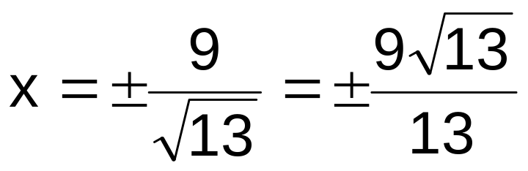
SOLUTION
center
(0,0)
principal axis
x-axis
vertices
(3,0) and (-3,0).
endpoints of conjugate axis
(0,2) and (0,-2)
foci
eccentricity
equations of the directrices

Slide 26
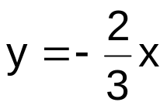
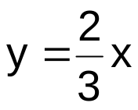


2
3
3
2

Slide 27
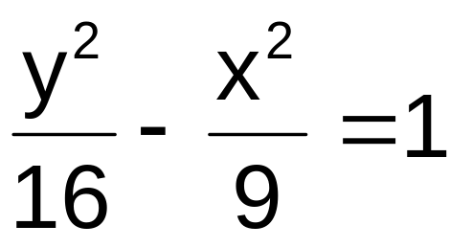
Example. Given the hyperbola
Determine the (a) center, (b) principal axis, (c) vertices, (d) endpoints of the conjugate axis, (e) foci, (f) eccentricity, and (g) equations of the directrices. Sketch also the graph.

Slide 28

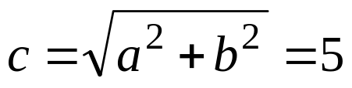
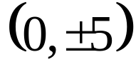
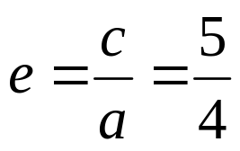
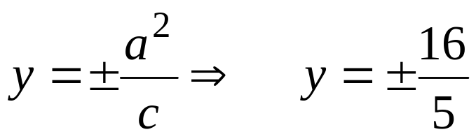
SOLUTION
center
(0,0)
principal axis
y-axis
vertices
(0,4) and (0,-4).
endpoints of conjugate axis
(3,0) and (-3,0)
foci
eccentricity
equations of the directrices

Slide 29
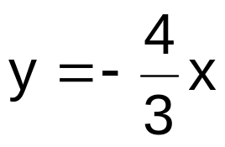
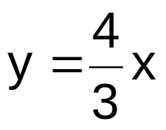


4
3
3
4

Slide 30
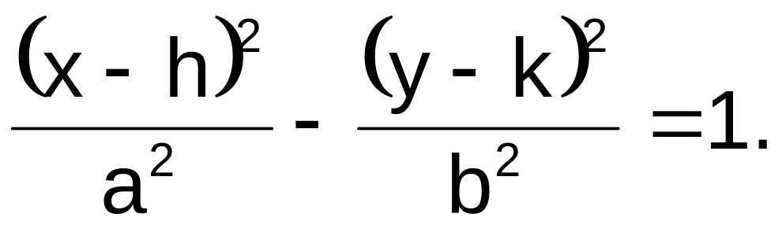
If the center of the hyperbola is at (h,k) and the line y = k as principal axis then the standard equation is given by

Slide 31
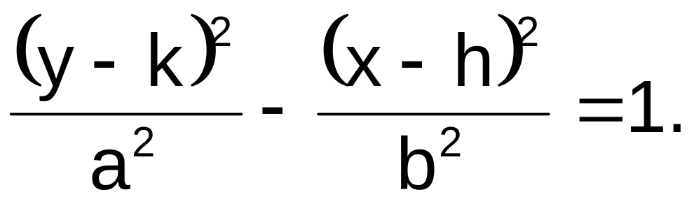
If the center of the hyperbola is at (h,k) and the line x = h as principal axis then the standard equation is given by

Slide 32
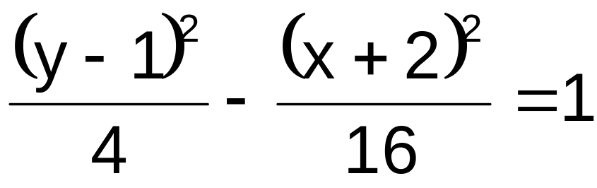
Example. Given the hyperbola
determine the (a) center, (b) principal axis, (c) vertices, (d) endpoints of the conjugate axis, (e) foci, (f) eccentricity, and (g) equations of the directrices. Sketch also the graph.

Slide 33

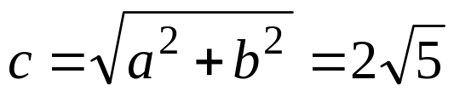
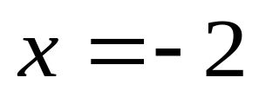
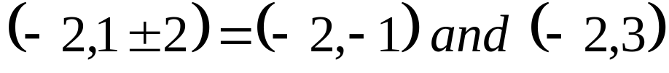
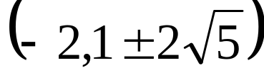
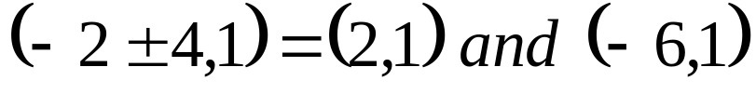
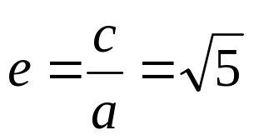
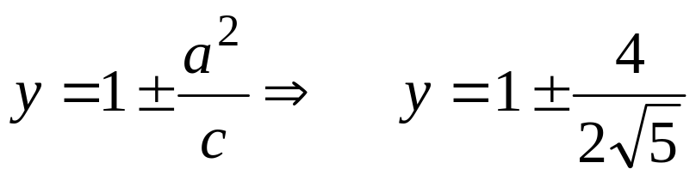
SOLUTION
center
(-2,1)
principal axis
vertices
foci
endpoints of conjugate axis
eccentricity
equations of the directrices

Slide 34
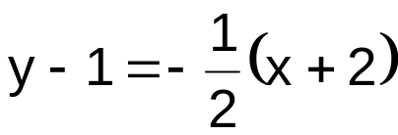
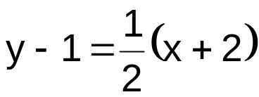



y
x

Slide 35
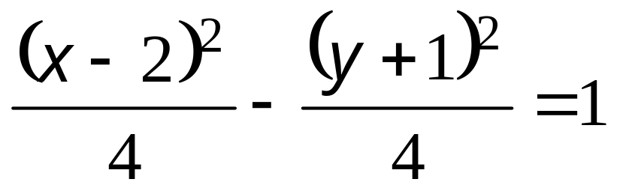
Example. Given the hyperbola
determine the (a) center, (b) principal axis, (c) vertices, (d) endpoints of the conjugate axis, (e) foci, (f) eccentricity, and (g) equations of the directrices. Sketch also the graph.

Slide 36








SOLUTION
center
(2,-1)
principal axis
vertices
foci
endpoints of conjugate axis
eccentricity
equations of the directrices

Slide 37





•
•
•
•
•

Slide 38
Example. Determine the standard equation of the hyperbola with center at ( 1,1), principal axis is vertical, length of the transverse axis and conjugate axis are 4 and 8, respectively.

Slide 39

SOLUTION
The principal axis is vertical then the standard equation is of the form
Since the center is at (1,1) then h=1 and k=1.

Slide 40


Since the lengths of the transverse and conjugate axes are 4 and 8, respectively, then a = 2 and b = 4.
Hence, the standard equation of the hyperbola is given by

Slide 41
Example. Determine the standard equation of the hyperbola with a vertex at ( 2,0), center at the origin and its eccentricity is 3/2.
SOLUTION
Since the center and the vertex are located on the same horizontal line then the principal axis is horizontal.

Slide 42

Therefore, the standard equation is of the form
Clearly, h = 0 and k = 0.
The distance between the center and a vertex will give the value of a.
Then, a = 2.
The eccentricity is equal to 3/2.

Slide 43






From the formula,
Since a = 2 then
Thus, c = 3.
Solving for the value of b,

Slide 44


Therefore, the standard equation of the hyperbola is given by

Slide 45

SUMMARY

Slide 46

The standard equation
has the following properties;
CENTER C(h,k)
VERTICES V(h±a,k)
FOCI F(h±c,k)
ENDPTS OF CONJUGATE AXIS B(h,k±b)
DIRECTRICES x=h±a/e

Slide 47

The standard equation
has the following properties;
CENTER C(h,k)
VERTICES V(h,k±a)
FOCI F(h,k±c)
ENDPTS OF CONJUGATE AXIS B(h±b,k)
DIRECTRICES y=k±a/e

Slide 48
-------------------END OF 1.6-------------------

