Slide 1
2.3 One-Sided Limits
MATH 26
ANALYTIC GEOMETRY
AND CALCULUS I

Slide 2
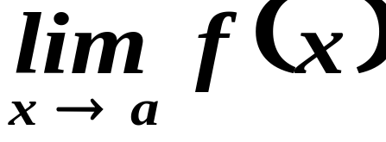
Recall that…
From the definition of a limit of a function, if we evaluate
the function f MUST be defined on some open interval containing a except possibly at a itself.

Slide 3
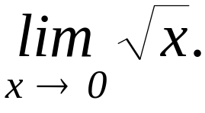



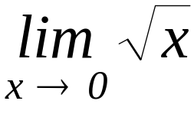
But look at this example…
Evaluate
SOLUTION
Let
The domain of f is
Therefore, there is no open interval containing 0 that satisfies the condition.
Hence,
does not exist.

Slide 4
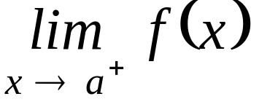
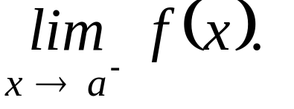
However…
We can get the limit of a function f as x approaches a from the right or from the left. In symbols,
or
… one-sided limits.

Slide 5
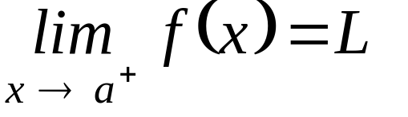
One-sided limit… from the right.
Let f be a function defined at every number in some open (a, c). The limit of the function f as x approaches a from the right is L, written as
if the values of f gets closer to L as the values of x gets closer to a, when these values are greater than a.

Slide 6

One-sided limit… from the right.
f(x)
L
a
x

Slide 7

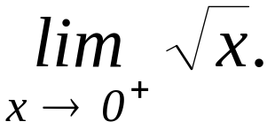
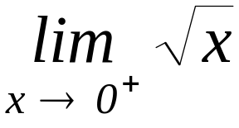
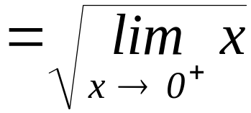


Illustration 1
Evaluate
SOLUTION
Let
The domain of f is
(Note that limit theorems also hold for one-sided limits, with minor modifications.)

Slide 8
One-sided limit… from the left.
Let f be a function defined at every number in some open (d, a). The limit of the function f as x approaches a from the left is L, written as
if the values of f gets closer to L as the values of x gets closer to a, when these values are lesser than a.

Slide 9

One-sided limit… from the left.
L
f(x)
x
a

Slide 10
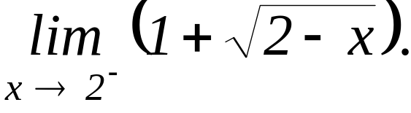


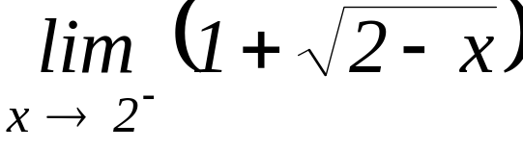
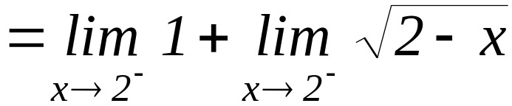


Illustration 2
Evaluate
SOLUTION
Let
The domain of g is

Slide 11
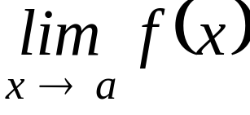
One-sided limits… Two-sided limit.
If the left-hand and the right-hand limits both exist and both are equal to L, then (the two-sided limit) exists and is also equal to L.
If the left-hand and the right-hand limits both exist but are not equal, or if one or both of them does not exist, then two-sided limit does not exist.

Slide 12
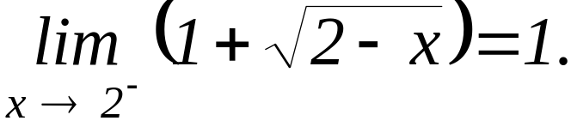
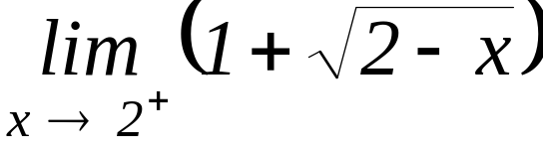
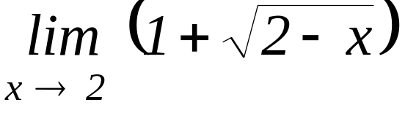
Illustration 3
Note that
On the other hand,
does not exist.
Therefore,
does not exist.

Slide 13

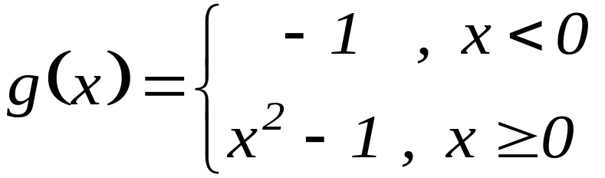
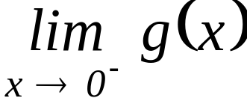
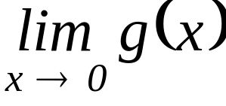
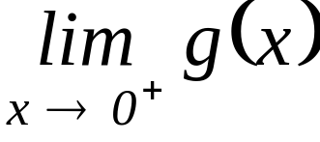
Example 1
Consider the function defined by
Determine the following:
a.
c.
b.

Slide 14
Example 1
Consider the function defined by
SOLUTION
a.
b.

Slide 15
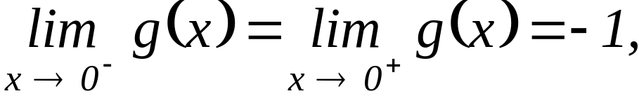
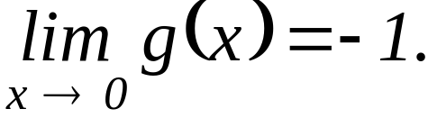
Example 1
Consider the function defined by
SOLUTION
c. since
then,

Slide 16
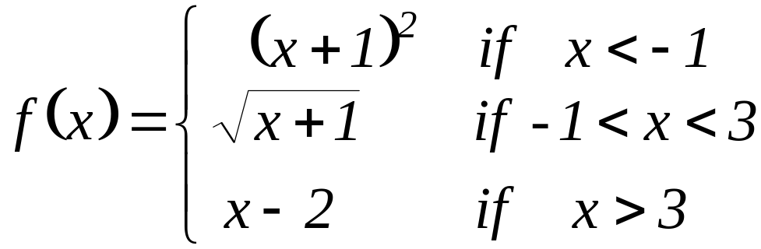

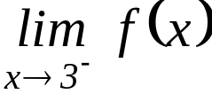



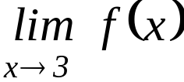
Example 2
Consider
Determine the following:

Slide 17
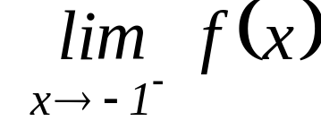
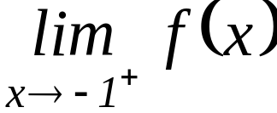
Example 2
Consider
SOLUTION

Slide 18
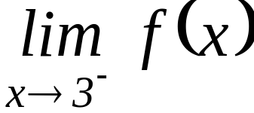
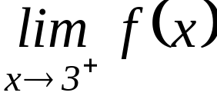
Example 2
Consider
SOLUTION

Slide 19
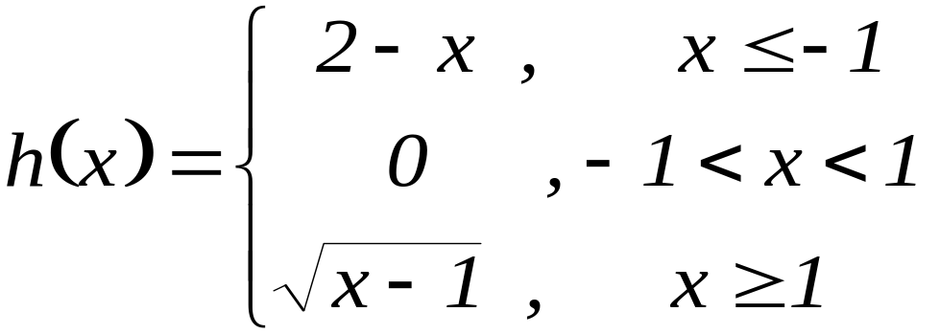
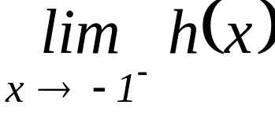
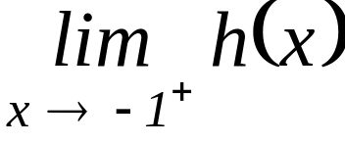
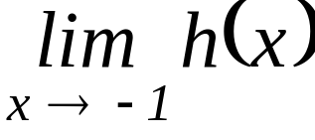
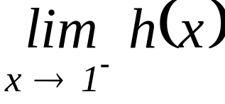
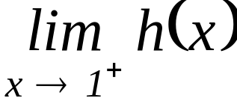
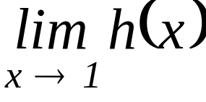
Example 3
T3y thezze!!!
Consider
Determine the following:
a.
b.
c.
d.
e.
f.

Slide 20

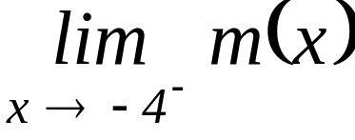
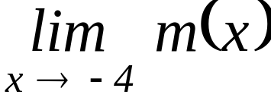
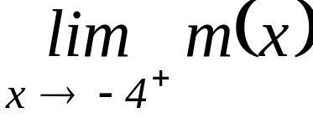
Example 4
Consider
Determine the following:
a.
c.
b.

Slide 21
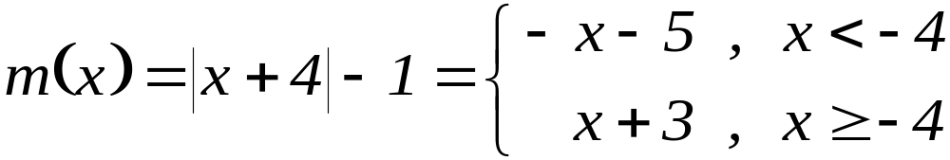
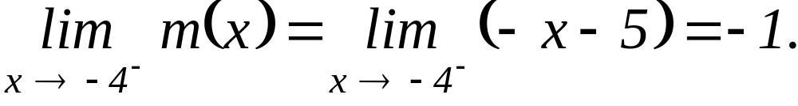
Example 4
Consider
SOLUTION
a.

Slide 22
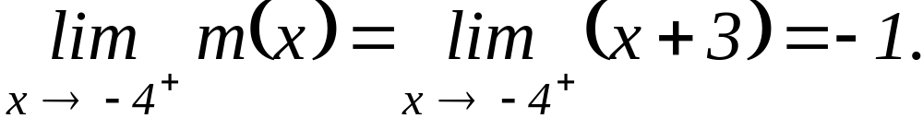
Example 4
Consider
SOLUTION
b.

Slide 23
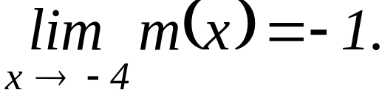
Example 4
Consider
SOLUTION
c.

Slide 24
------End of 2.3------

