Slide 1
2.4 Infinite Limits

Slide 2
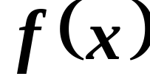
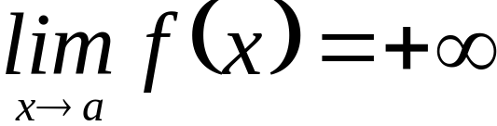
2.4 Infinite Limits
Def. Let a function f be defined at every number in some open interval I containing a, except possibly at the number a itself. Then increases without bound as x approaches a, written if the values of f get larger and larger as x moves closer and closer to a.

Slide 3
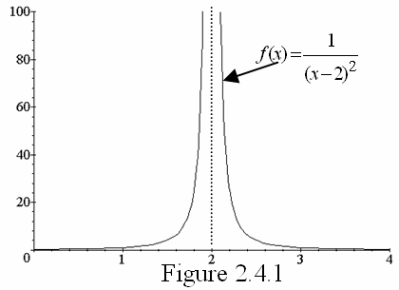
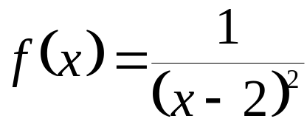
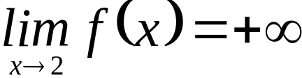
In the graph of the function f defined by
notice that
.

Slide 4
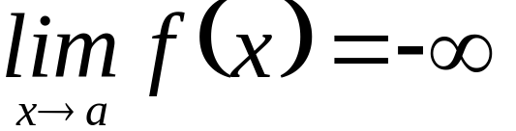
DEFINITION
Let a function f be defined at every number in some open interval I containing a, except possibly at the number a itself. Then decreases without bound as x approaches a, written if the values of f
get smaller and smaller as x moves closer and closer to the value a.

Slide 5
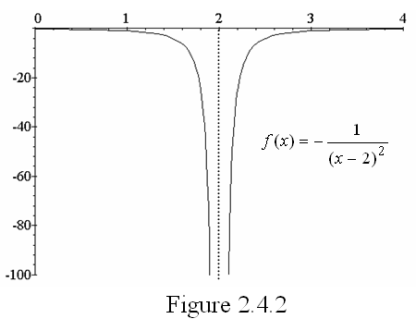
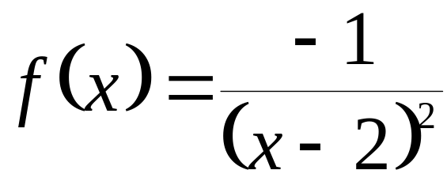

In Figure 2.4.2, we see that if
,
.

Slide 6
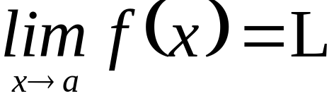
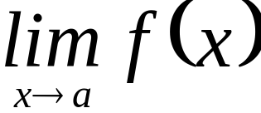
NOTE
Note that or
does not have the same meaning as where L is a real number.
When or ,
it means that actually does not exist.

Slide 7
The notations and
are just used to
indicate the behavior of the function as x moves closer and closer to a.

Slide 8
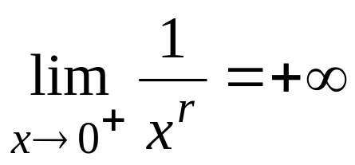
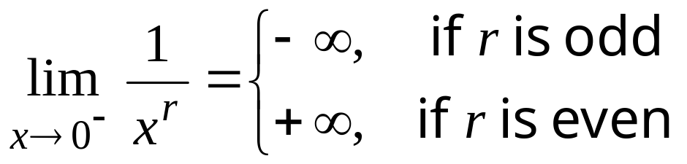
Theorem
If r is any positive integer, then
a.
b.

Slide 9
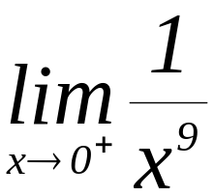
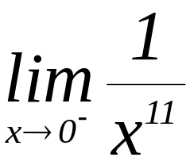
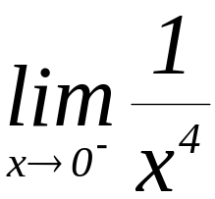
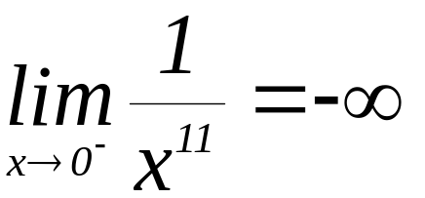
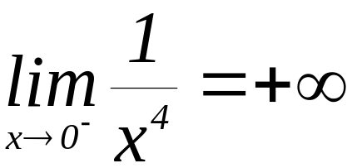
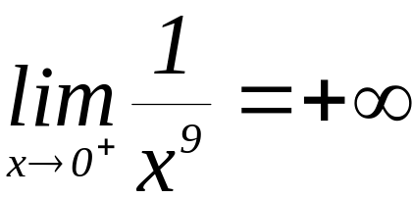
Example 2.4.1 Evaluate the following limits:
a. b) c)
solution:

Slide 10
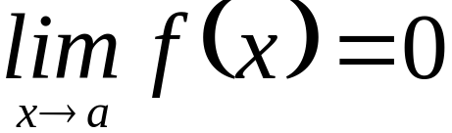
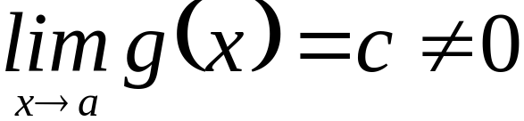
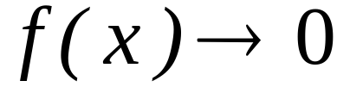
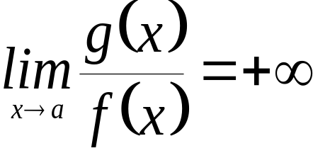
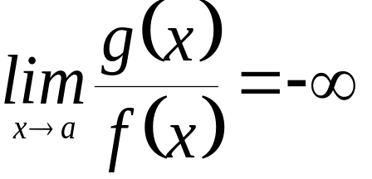
Theorem
If and , then
if c > 0 and if through positive values of f (x), then
if c > 0 and if through negative values of f (x), then

Slide 11


if c < 0 and if through positive values of f (x), then
if c < 0 and if through negative values of f (x), then

Slide 12
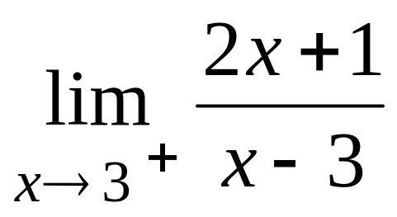
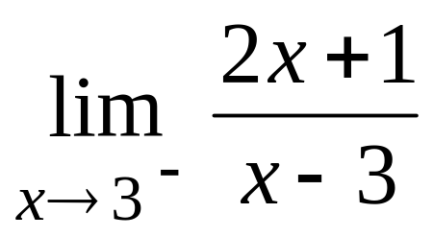
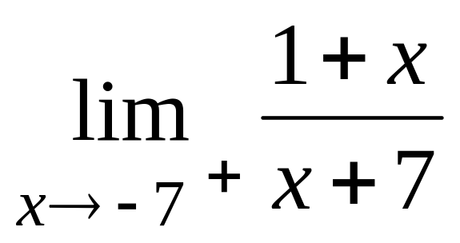
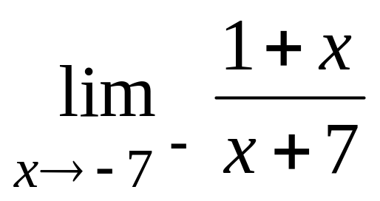
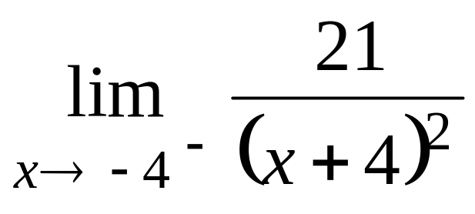
Example 2.4.2 Evaluate the following limits:
a. b.
c. d.
e.

Slide 13
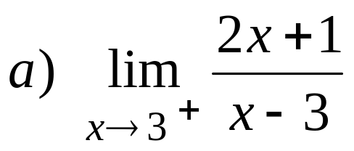
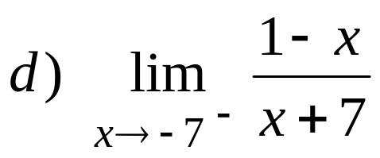
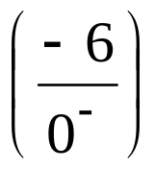
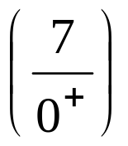

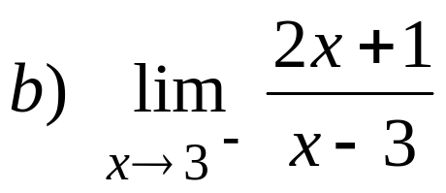
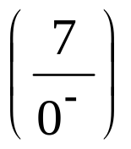
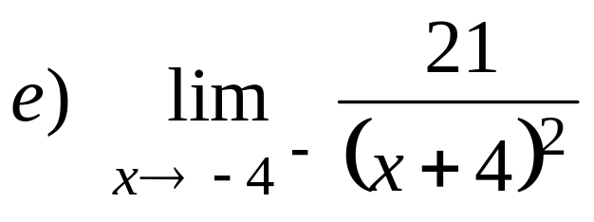
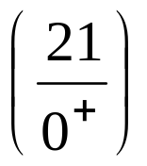

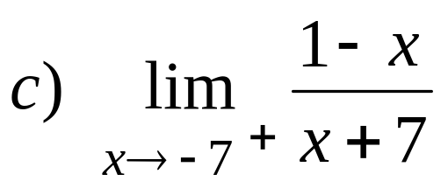
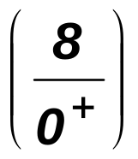
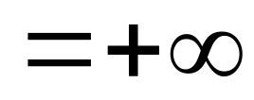

Slide 14
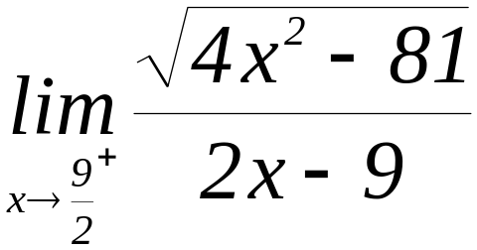
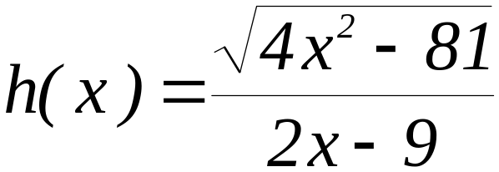

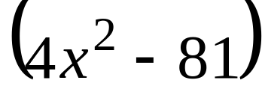
Example Evaluate .
solution:
Let . Note that as x
approaches from the right, both the
numerator and denominator will approach 0. By factoring , we get

Slide 15
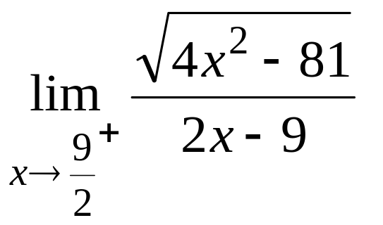
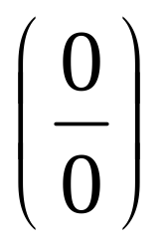
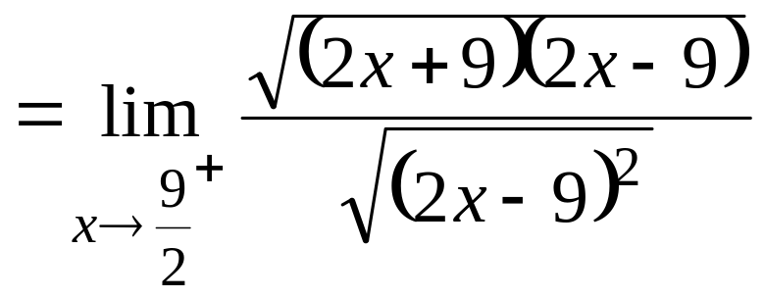
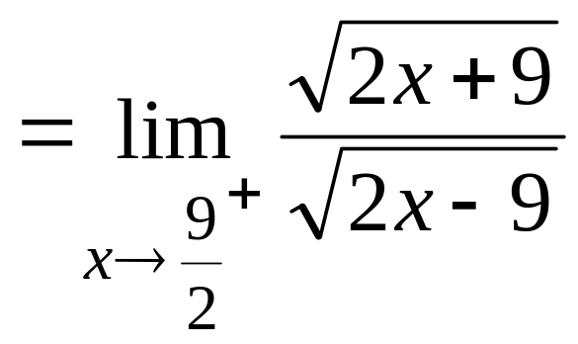
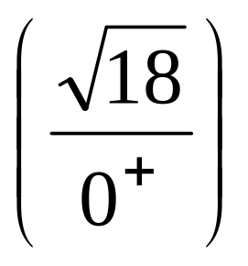


Slide 16

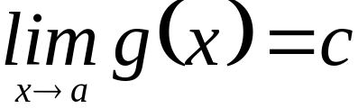
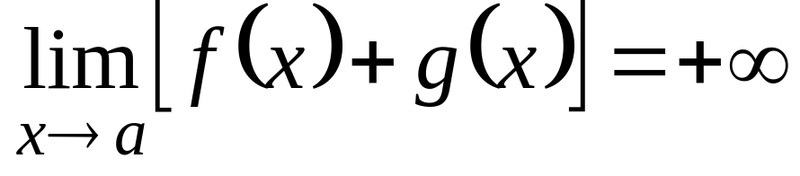

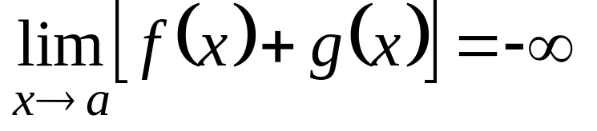



Theorem
If and , then
If and ,
then
NOTE: Also valid if is replaced by
or

Slide 17







Slide 18





Example Evaluate
Solution

Slide 19



Theorem
a. If and ,then
if c > 0 then
if c < 0 then .
b. If and , then
if c > 0 then
if c < 0 then
NOTE: Also valid if is replaced by
or

Slide 20




EXAMPLE: Evaluate

Slide 21




Example Evaluate
Solution:
In the absence of a theorem that we can apply to evaluate ,
we first transform the function to an equivalent expression before evaluating the limit.

Slide 22






Slide 23
DEFINITION
The line given by x = a is a vertical asymptote of the graph of f if at least one of the following statements is true:

Slide 24






Slide 25





Slide 26




Example 2.4.6 Let . Find the
vertical asymptote(s) of the graph of f.
solution:
The line given by is a vertical asymptote of the graph of f if either
or .
Thus the candidate for the vertical asymptote of the graph of f is the line given by x = 1.

Slide 27



To verify this, we get the limit of the given function as x approaches 1… we have
and .
Since we obtained an infinite limit, then the line given by is a vertical asymptote .

Slide 28



Slide 29
END

