Slide 1



Continuity of a Function at a Number

Slide 2

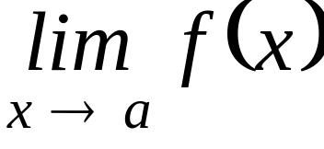
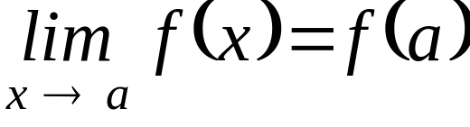
Continuity of a Function at a Number
A function f is continuous at the number a if and only if the following three conditions are satisfied:
i. f(a) exists
ii. exists
iii.

Slide 3

Remarks
  If one of the conditions is NOT satisfied then the function f is said to be discontinuous at the number a.
  A polynomial function is continuous at every real number.
  A rational function is continuous at every number in its domain.

Slide 4
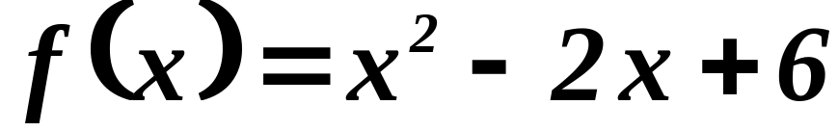

ILLUSTRATIONS : Consider the following functions;
1.
Since is a polynomial function then it is continuous at every real number.

Slide 5
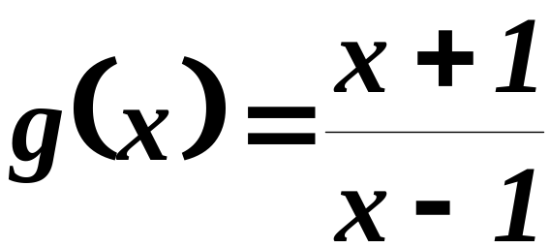


ILLUSTRATIONS : Consider the following functions;
2.
Since is a rational function then it is continuous at every real number except at .

Slide 6
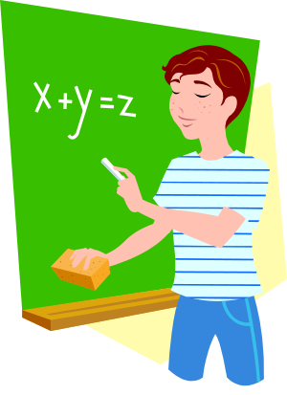
There are two types of discontinuity --- removable and essential.

Slide 7


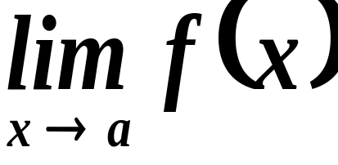

If the function is discontinuous at a number but exists then has a removable discontinuity at

Slide 8

If the function is discontinuous at a number and does not exist then has an essential discontinuity at

Slide 9
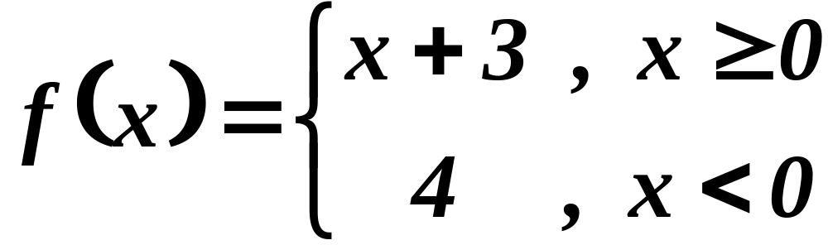
EXAMPLE 1 : Test the given function for continuity at 0;

Slide 10

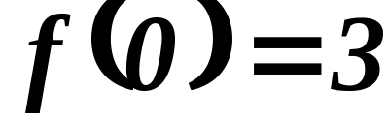
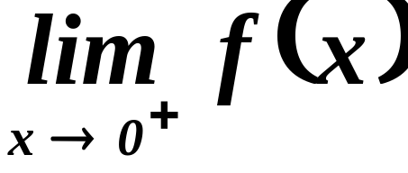
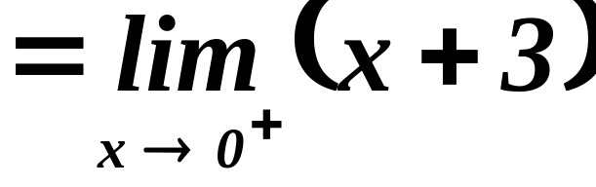

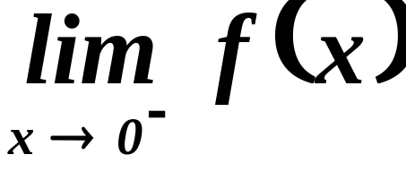
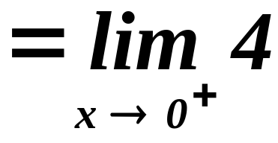

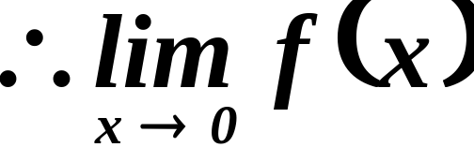
Test for continuity at
i.
ii.
does not exist.

Slide 11
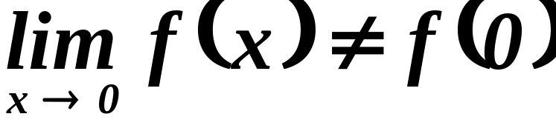
iii.
The function
has an essential
discontinuity at

Slide 12
Geometrically, a function is continuous at a number if its graph has NO BREAK at that number.

Slide 13
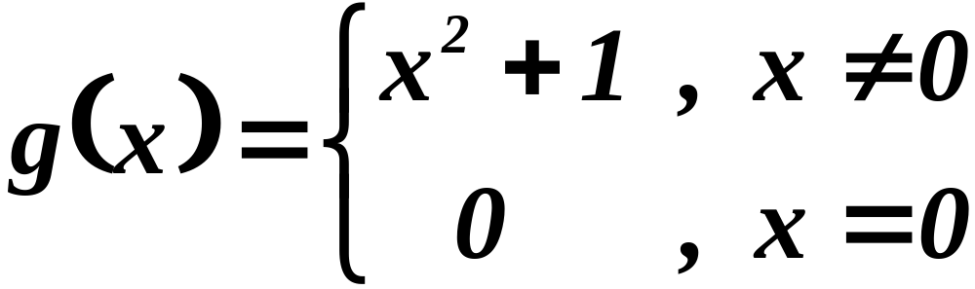
EXAMPLE 2: Test the given function for continuity at 0;

Slide 14
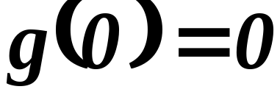
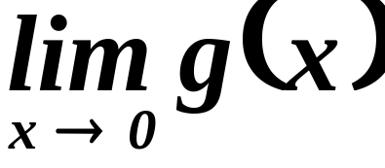
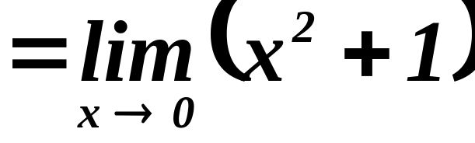

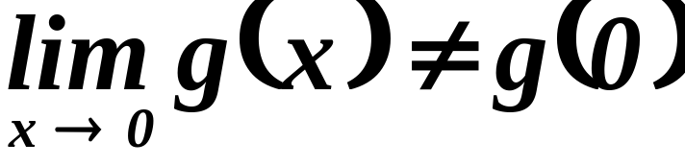
Test for continuity at
i.
ii.
iii.
The function
has a removable
discontinuity at

Slide 15
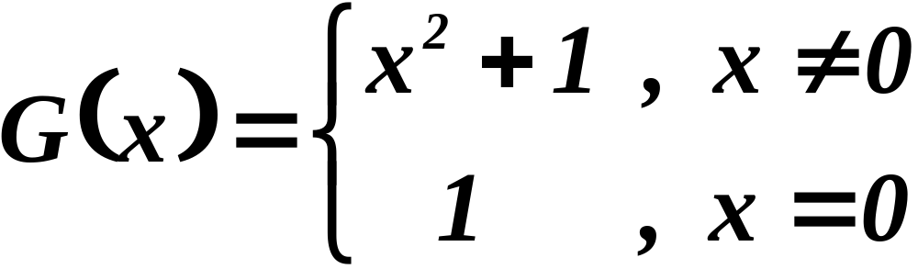
ORIGINAL FUNCTION
REDEFINED FUNCTION

Slide 16
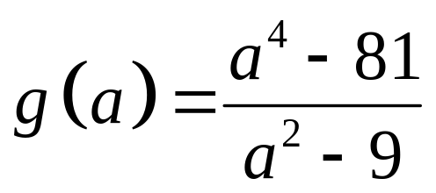
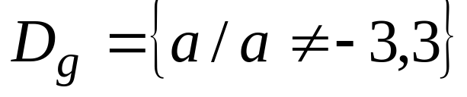
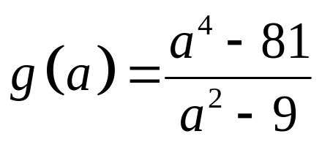
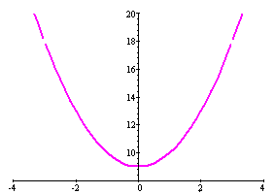
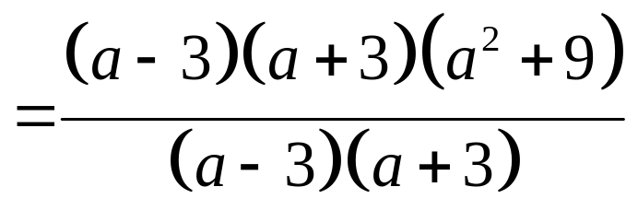
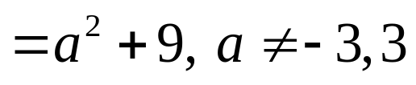
EXAMPLE 3: .
g is a rational function, g is continuous at each number in its domain.
Since g(-3) and g(3) are undefined, g is discontinuous at -3 and 3.

Slide 17
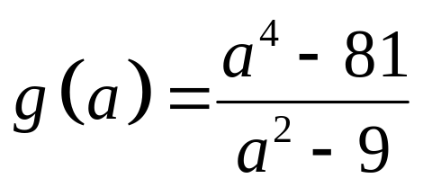
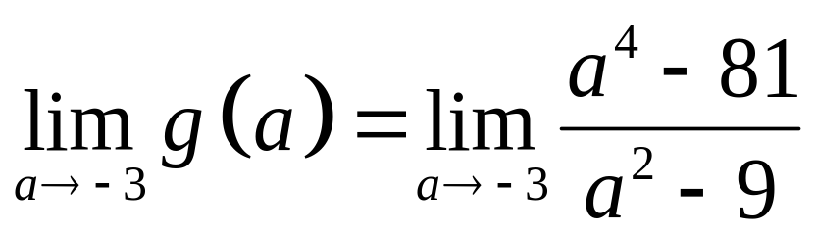
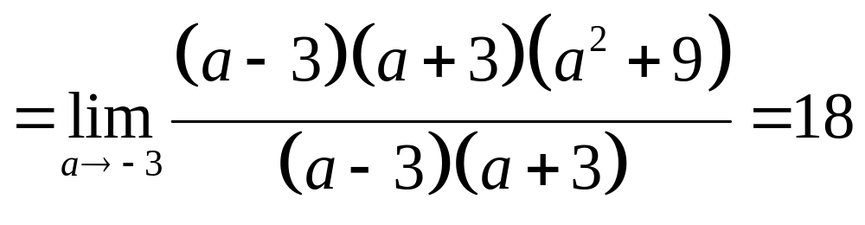
at a = -3:
g(-3) is undefined.
.
(The limit exists.)
Hence, g has a removable discontinuity at a = -3.

Slide 18
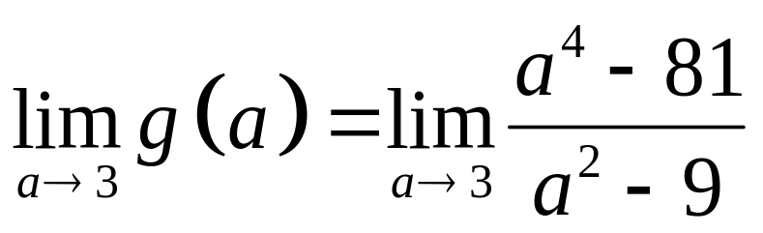
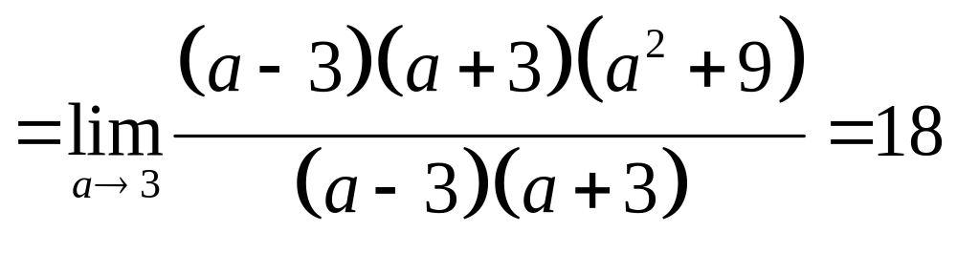
at a = 3:
g(3) does not exist.
.
(The limit exists.)
Hence, g has a removable discontinuity at a = 3.

Slide 19
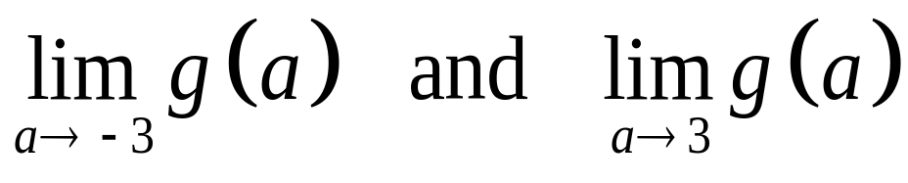
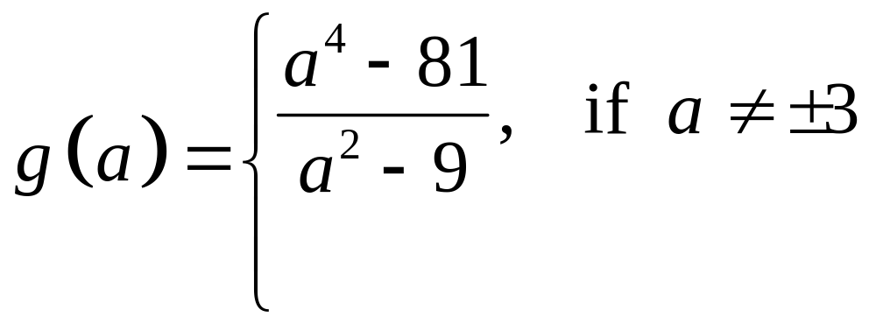
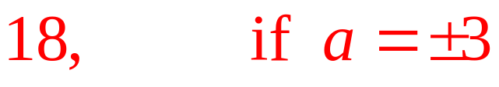
Since exist,
the discontinuities at -3 and 3 are removable. Redefining g by letting g(-3) = 18 and g(3) = 18 makes the new function
continuous at every number.

Slide 20
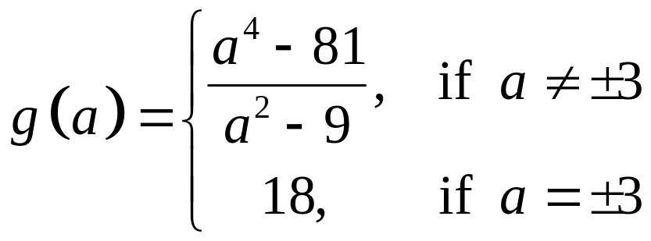

Slide 21
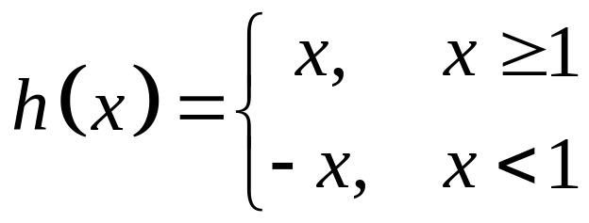
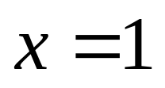
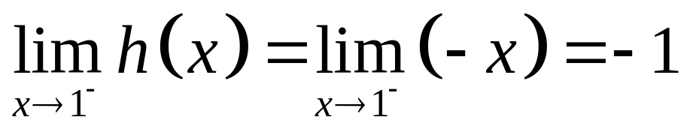
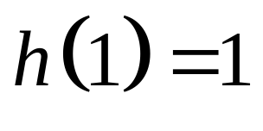
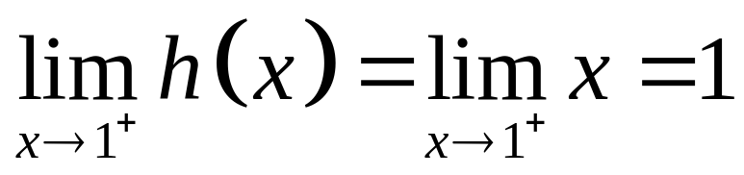
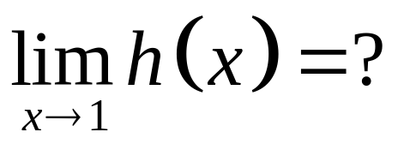
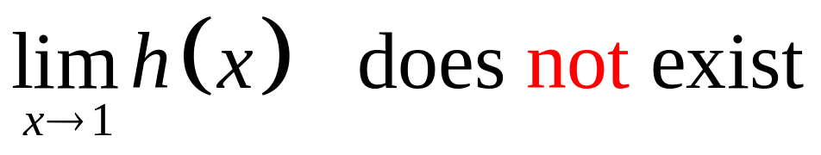
EXAMPLE 4:
The only possible discontinuity of h is at .
Thus, h is essentially discontinuous at x = 1.

Slide 22
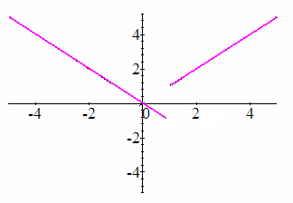
Note that the break in the graph of f cannot be bridged by the addition or replacement of a single point.

Slide 23
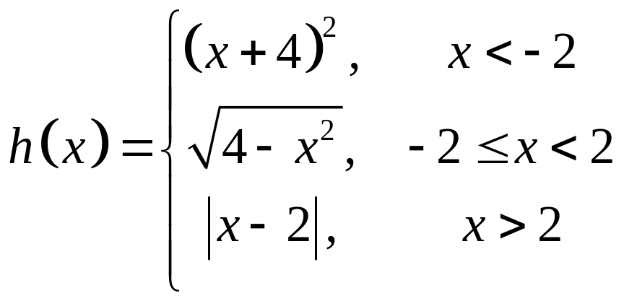
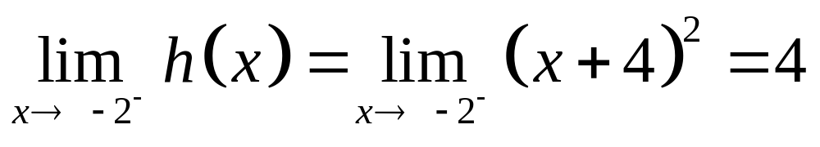
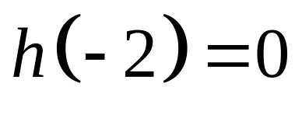
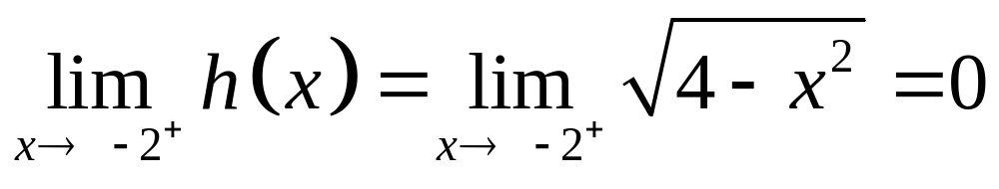
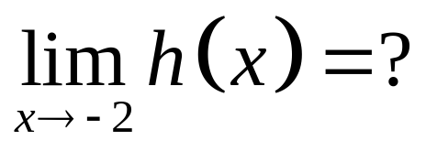
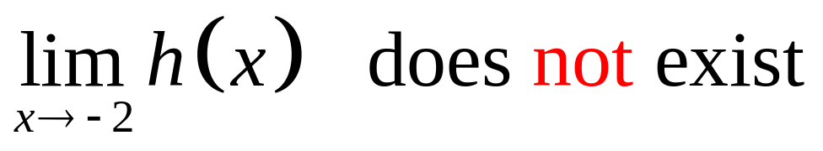
EXAMPLE 5:
Possible points of discontinuity: x = -2 or x = 2
at x = -2:
Thus, h has an essential discontinuity at x = -2.

Slide 24
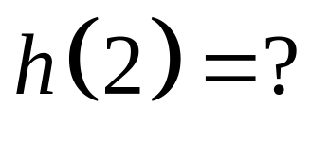




at x = 2:
It does not exist.
(The limit exists.)
Thus, h has a removable discontinuity at x = 2.

Slide 25



Slide 26



h can be redefined such that it will be continuous at x = 2.

Slide 27

Assignment 1.
Let . Find the
values of a and b so that f is continuous everywhere.

Slide 28

Assignment 2 : Test the given function for continuity at -1 and 1;

