Slide 1
2.7 Continuity on an Interval

Slide 2
DEFINITIONS

Slide 3

Continuity on an open interval
A function f is continuous on the open interval (a, b) if and only if f is continuous at every number between a and b.

Slide 4
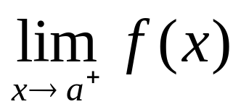
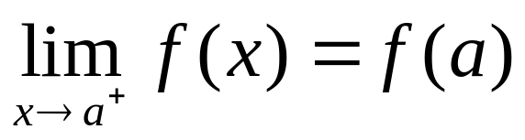
Continuous from the right
A function f is continuous from the right at a if the following three conditions are satisfied:
f (a) exists
exists

Slide 5
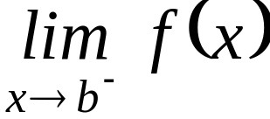
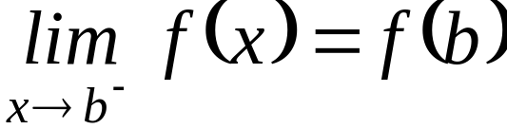
Continuous from the left
A function f is continuous from the left at b if the following three conditions are satisfied:
f (b) exists
exists

Slide 6
Continuity on a closed interval
A function f is continuous on the closed interval [a, b] if the following three conditions are satisfied:
f is continuous on the open interval (a,b);
f is continuous from the right at a;
f is continuous from the left at b.

Slide 7
Continuity on half-open interval
A function f is continuous on the half-open interval (a, b] if the following two conditions are satisfied:
f is continuous on the open interval (a,b);
f is continuous from the left at b.

Slide 8
Continuity on half-open interval
A function f is continuous on the half-open interval [a, b) if the following two conditions are satisfied:
f is continuous on the open interval (a,b);
f is continuous from the right at a.

Slide 9
EXAMPLES

Slide 10

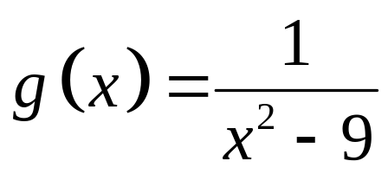
Examples
Let .Determine if g is
continuous on each of the following intervals:
a. (-3,3) b. [-3,3] c. (0,2)
d. [-3,3) e. (2,8) f. (0,+∞)
✓
✗
✓
✗
✗
✗
Note: g is continuous at all real numbers except at 3 and -3 where it has an essential discontinuity.

Slide 11
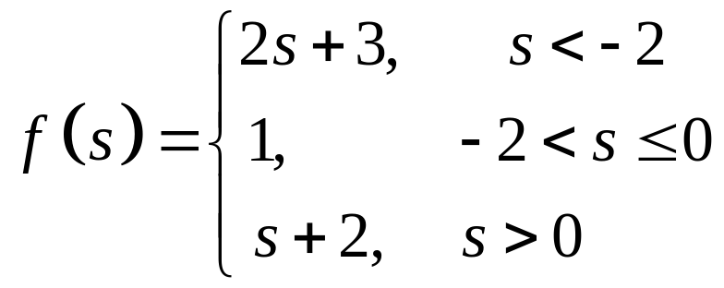
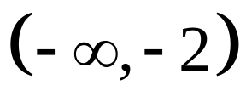
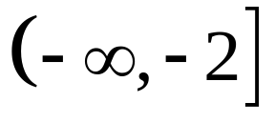
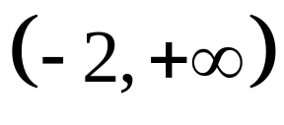
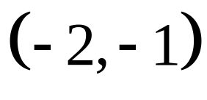
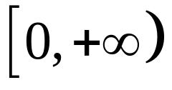
Examples
Determine if the given function is continuous on each of the following intervals:
a.
b.
c.
d.
e.

Slide 12




Solution
a.
Yes, by definition of continuity on an open interval.
b.
No, f(-2) is undefined.
e.
No.
c.
No, f is not continuous at 0.
d.
Thus, f is not continuous from the right at 0, since
Yes.

Slide 13
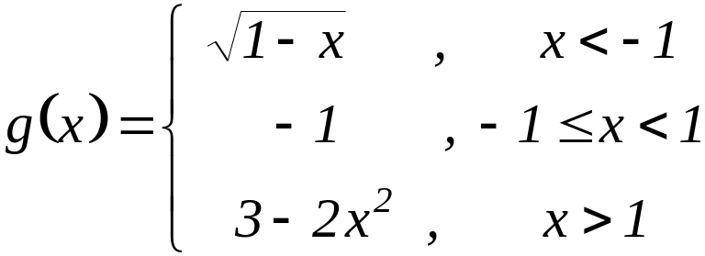
Assignment:
Determine if the given function is continuous on each of the given intervals:
[-1,0)
[0,2)
[-2,-1)
[1,3]
(1,5]

Slide 14
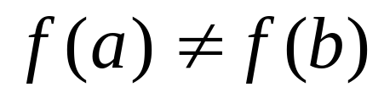
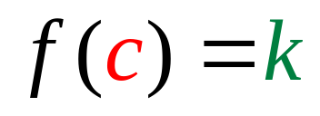
Intermediate Value Theorem
If a function f is continuous on the closed interval [a, b] and if , then for any number k between f(a) and f(b), there exists at least one number c between a and b such that

Slide 15
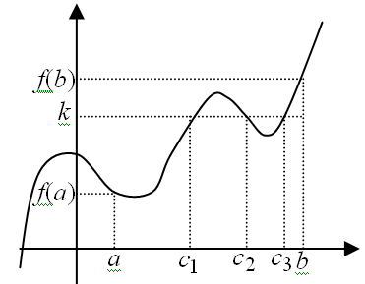
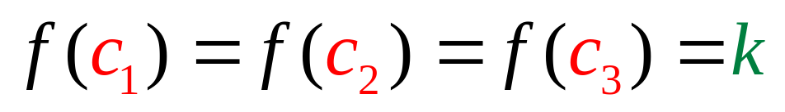
Intermediate Value Theorem

Slide 16
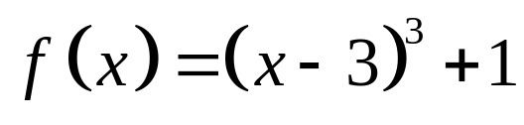
Example
Let .Determine if the IVT applies to f on the closed interval [4, 6] for k = 9 If it does, find a number c satisfying the theorem.
Solution:
Note: The IVT holds if two conditions are both satisfied:
i) f is continuous on [4, 6] and
ii) k must be between f(4) and f(6).

Slide 17
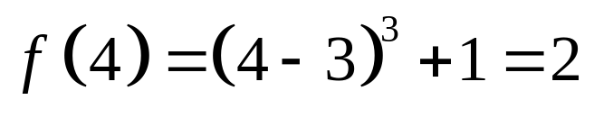
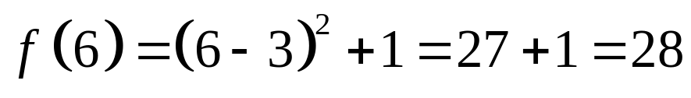
Example
Let .Determine if the IVT applies to f on the closed interval [4, 6] for k = 9 If it does, find a number c satisfying the theorem.
Solution:
Since f is a polynomial function, f is continuous everywhere. Thus, f is continuous on [4,6].
then 2 < 9 < 28.
Hence, IVT applies.

Slide 18
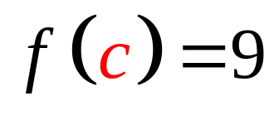
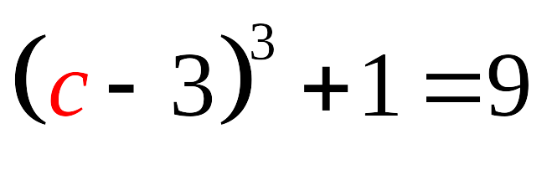
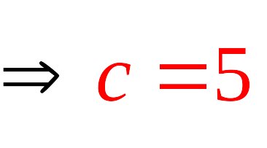
Example
Let .Determine if the IVT applies to f on the closed interval [4, 6] for k = 9 If it does, find a number c satisfying the theorem.
Solution:
Hence, we can find a number c such that 4 < c < 6 and f(c) = k =9
If
then

Slide 19
END OF 2.7

