Slide 1
3.1 Definition of the Derivative and its Geometric Interpretation
MATH 26
ANALYTIC GEOMETRY
AND CALCULUS I

Slide 2

Objectives
At the end of this chapter each of you should be able to:
demonstrate an understanding of the idea of the derivative of a function;
explain the geometric interpretation of the derivative of a function;
determine the derivative of a function using the definition.

Slide 3
Objectives
use basic differentiation theorems to determine the derivative of a function.
demonstrate an understanding of the idea one-sided derivatives;
explain the geometric interpretation of differentiability of a function;

Slide 4
Objectives
explain the relationship between differentiability and continuity;
determine one-sided derivatives of a function at a number.

Slide 5
Objectives
apply Chain Rule and its other forms in determining derivatives of composite functions.
determine derivatives of functions which are not explicitly defined in terms of their independent variables.

Slide 6
Objectives
determine higher order derivatives of a function and
Apply Rolle’s Theorem and Mean Value Theorem

Slide 7



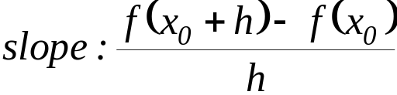




Introduction
What are the coordinates of the point?
What happened to the secant line as h approaches 0? It becomes what kind of line?
What do you call this line?
Fixed!
What is the slope of the tangent line?
What is the slope of the secant line?

Slide 8
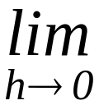
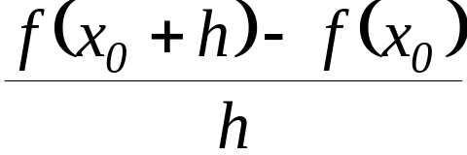
Introduction
slope of the tangent line:
What happened to the secant line as h approaches 0? It becomes what kind of line?
Fixed!
What is the slope of the tangent line?

Slide 9

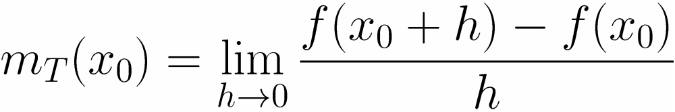
Definition
The tangent line of the graph of f at x₀ is the line with slope, denoted by m_{T}(x₀),
if this limit exists.

Slide 10


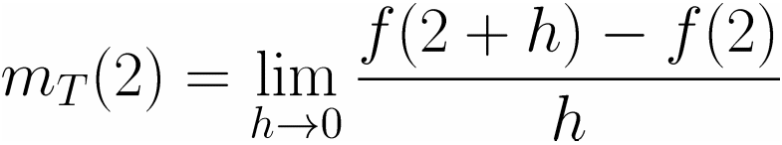
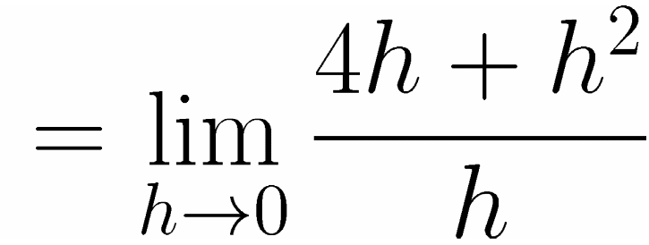
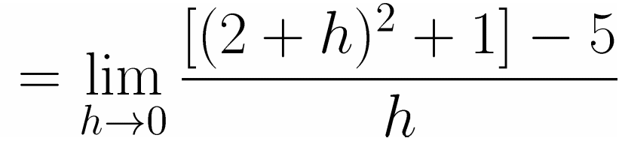
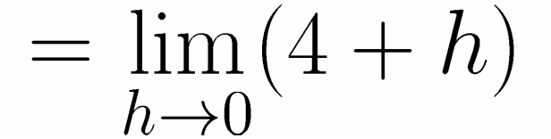
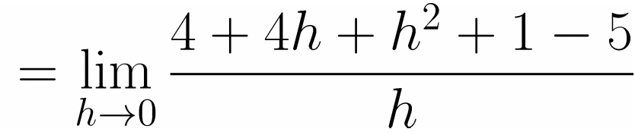
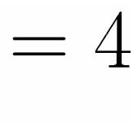
Illustration
Determine the slope of the tangent line of the graph of f(x) = x² + 1 at x₀ = 2.
Solution:

Slide 11
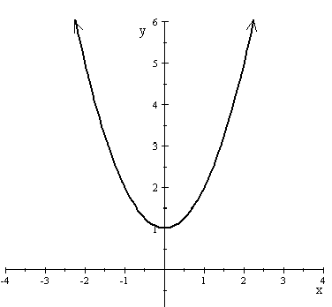
Illustration
Determine the slope of the tangent line of the graph of f(x) = x² + 1 at x₀ = 2.
Solution:
The slope of this tangent line is 4.

Slide 12
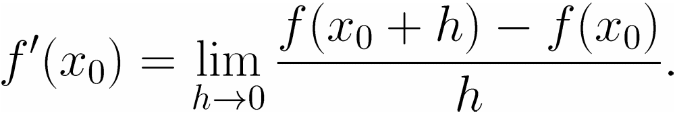
Derivative
Let f be a function defined on some open interval (a, b) containing x₀. The derivative of f at x₀ is given by the formula

Slide 13





Remark
Geometrically, if the derivative of a function f at a number x₀ exists then this derivative is the slope of the tangent line to the graph of f at the point (x₀, f(x₀)). Hence,
m_{T}(x₀) = f’(x₀)
Notations:
y’

Slide 14

Illustration
Determine the slope of the tangent line of the graph of f(x) = x² + 1 at x₀ = 2.
Solution:

Slide 15
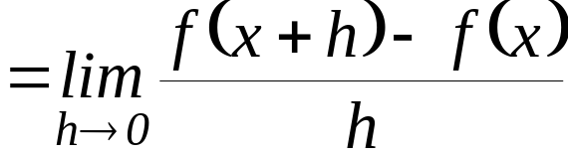

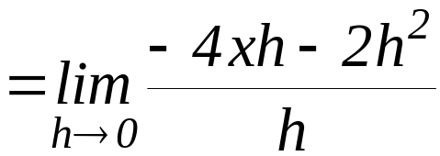
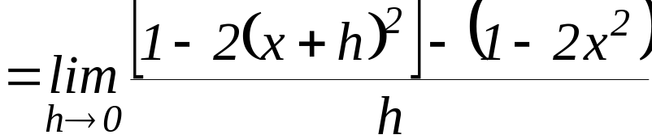
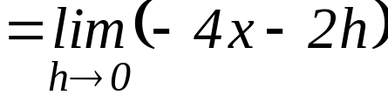
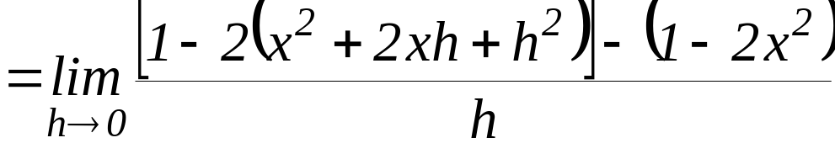

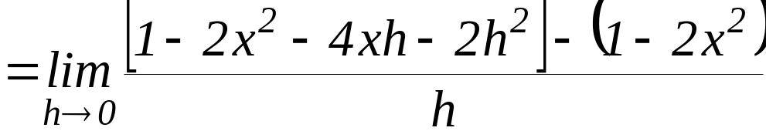
Illustration
Let f(x) = 1 – 2x². Determine f’(x).
Solution:

Slide 16




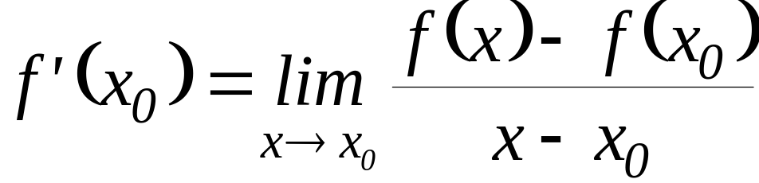
Remark
In the definition, if we let ,
then,
and as
Therefore,

Slide 17
For Practice
Use the formula in the previous remark to verify that given f(x) = x² + 1, f’(2) = 4.

Slide 18
End of 3.1

