Slide 1
3.2 Basic Differentiation Theorems
MATH 26
ANALYTIC GEOMETRY
AND CALCULUS I

Slide 2


Derivative of a Constant
Theorem 1 If f(x) = k, where k is any constant, then f’(x) = 0
Example:
f(x) = π

Slide 3
Power Rule
Theorem 2 If f(x) = x^{n}, where n is any real number, then f’(x) = nx^{n -1}
Example:
f(x) = x⁵

Slide 4
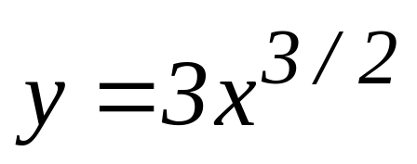
Constant x Function
Theorem 3 If f(x) = k g(x), where k is any constant, then f’(x) = k g’(x).
Example:

Slide 5
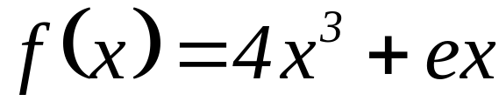
Derivative of
Sum and Difference
Theorem 4 If f(x) = g(x) ± h(x), then
f’(x) = g’(x) ± h’(x).
Example:

Slide 6
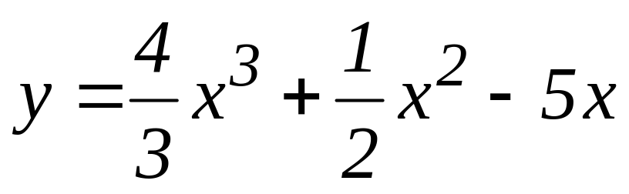
Derivative of
Sum and Difference (ext. ver.)
Theorem 5 If f(x) = f₁(x) ± f₂(x) ± … ± f_{n}(x), then f(x) = f₁(x) ± f₂(x) ± … ± f_{n}(x)
Example:

Slide 7
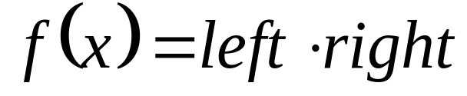
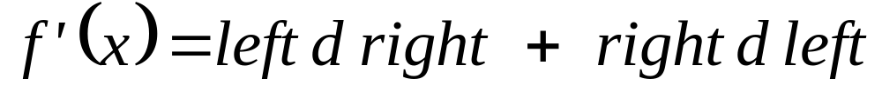
Product Rule
Theorem 6 If f(x) = g(x)·h(x), then
f’(x) = g(x)·h’(x) + h(x)·g’(x)
mnemonic device:
then

Slide 8
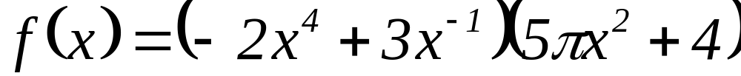
Product Rule
Example:

Slide 9
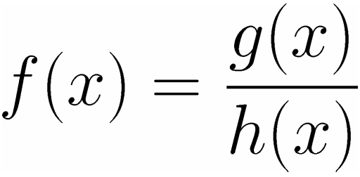
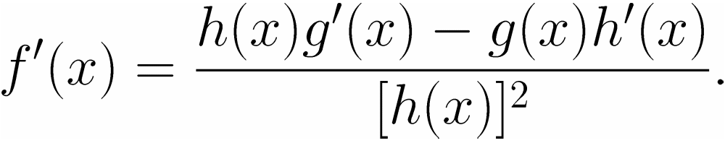
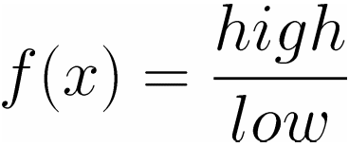
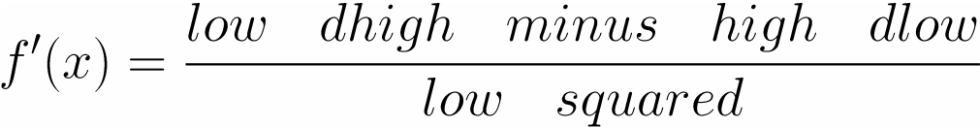
Quotient Rule
Theorem 6 If ,then
mnemonic device:
then

Slide 10
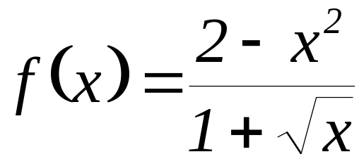
Quotient Rule
Example:

Slide 11
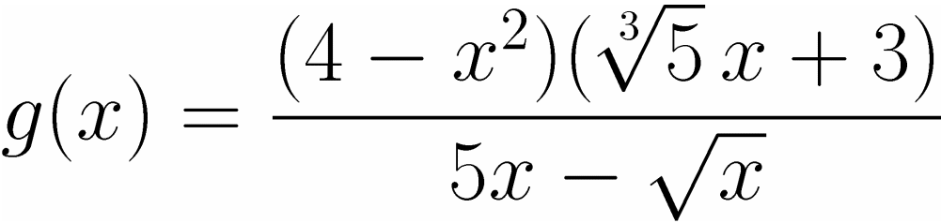
For Practice
Example:

Slide 12
End of 3.2

