Slide 1
CHAPTER 3
THE DERIVATIVE AND DIFFERENTIATION

Slide 2
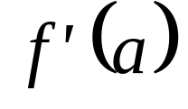
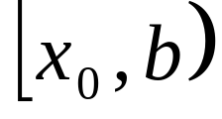
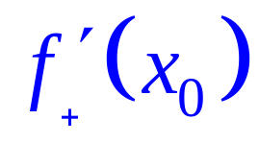
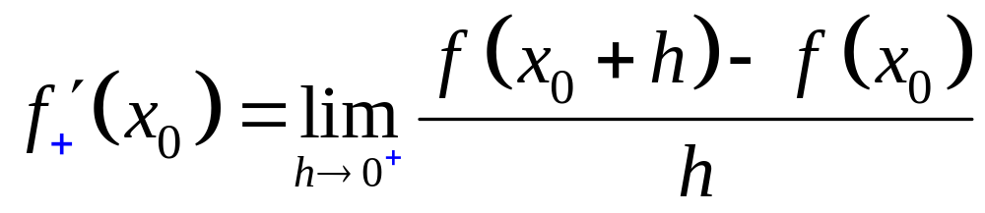
3.3 Differentiability and Continuity, Right-hand and Left-hand Derivatives
A function f is said to be differentiable at a number a if exists.
Let f be a function defined at every number in some interval .The right-hand derivative of f at x₀ denoted by is given by the formula
(4)
if this limit exists.

Slide 3
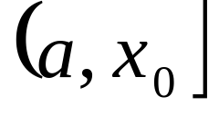
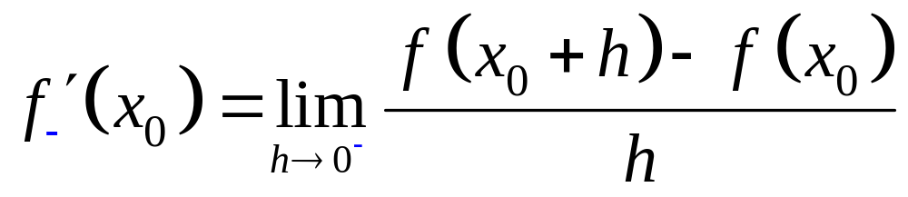
Now let f be a function defined at every number in some interval .The left-hand derivative of f at x₀ denoted by is given by the formula
(5)
if this limit exists.

Slide 4
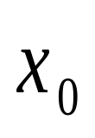
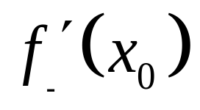
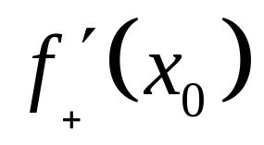
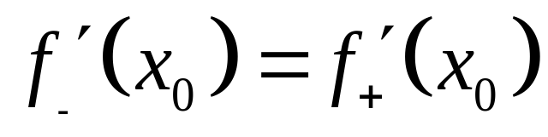
Remarks
A function f is differentiable at a number if and only if both the left- and right-hand derivatives exist and are equal, that is,
 and exist


Slide 5
Theorem 3.3.1
If a function f is differentiable at a number a, then f is continuous at a.
Note
The converse of Theorem 3.2.1 is not always true, that is, if a function f is continuous at a number, it does not follow that f is differentiable at that number.

Slide 6
Theorem 3.3.2 A polynomial function is differentiable everywhere.
Theorem 3.3.3 A rational function is differentiable at every number in its domain.

Slide 7
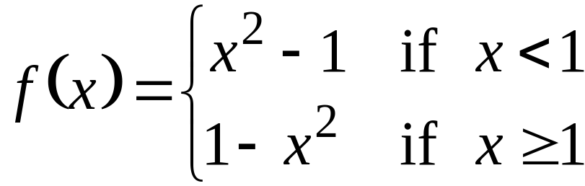
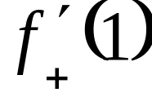
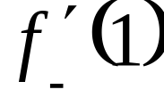
Example 3.3.1
Let . a. Find and . b. Is f differentiable at 1? Justify your answer.

Slide 8
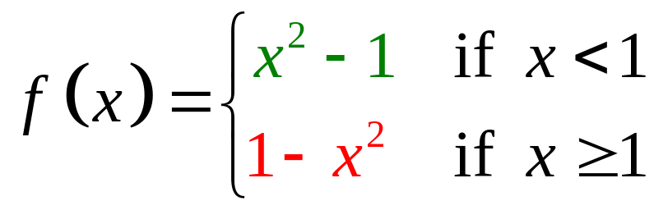
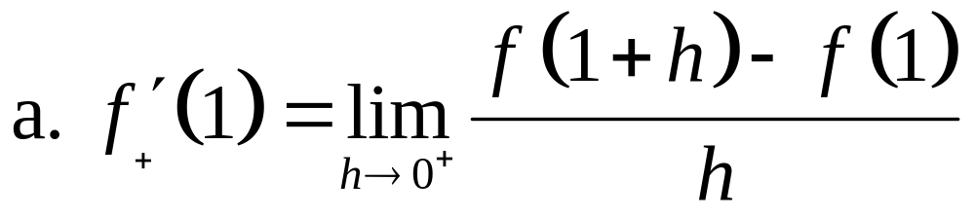
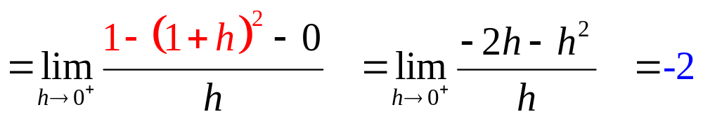
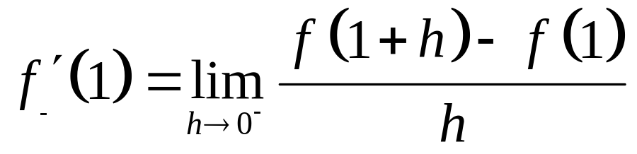
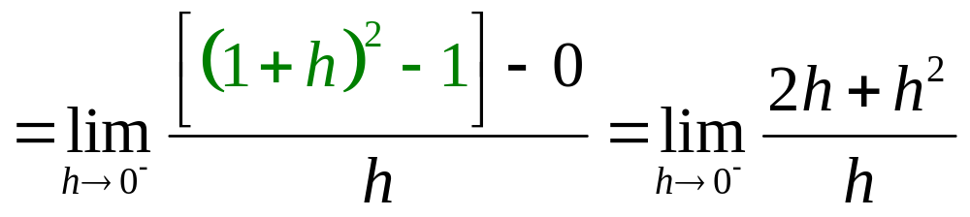
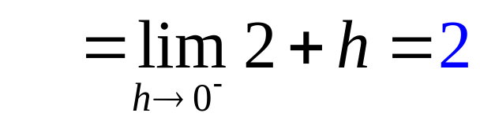
Solution:

Slide 9
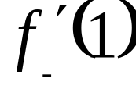
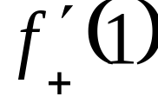

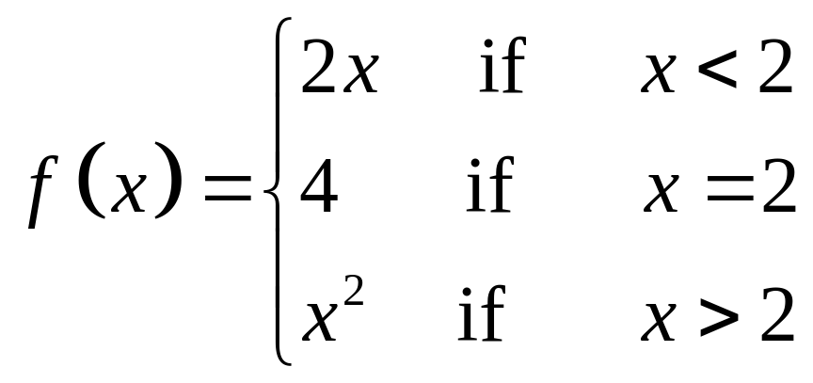
b. Since , f is not differentiable at 1.
Example 3.3.2
Let
Show that f is continuous at 2.
Is f differentiable at 2? Justify your answer.

Slide 10
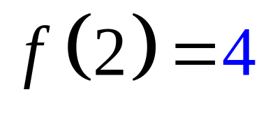
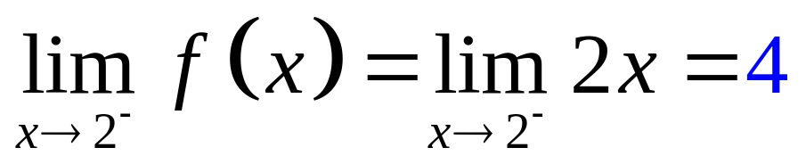
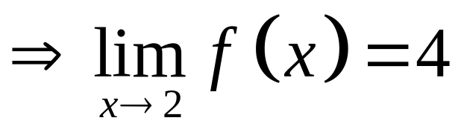
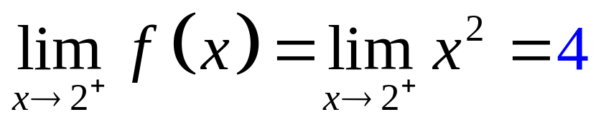
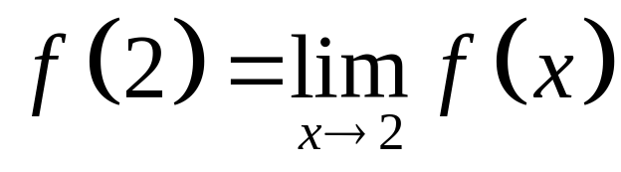
Solution:
Since , f is continuous at 2.

Slide 11
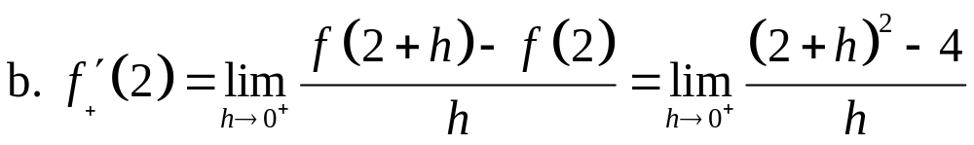
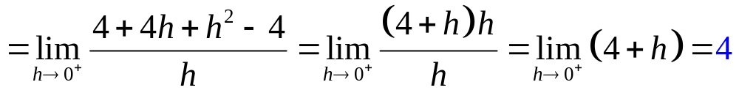
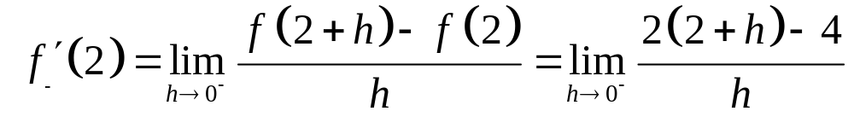
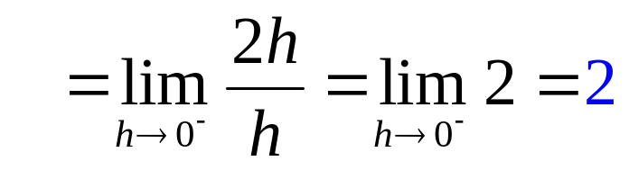
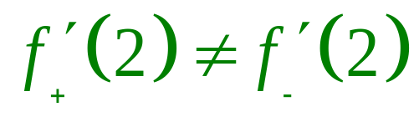
Since , f is not differentiable at 2.

Slide 12
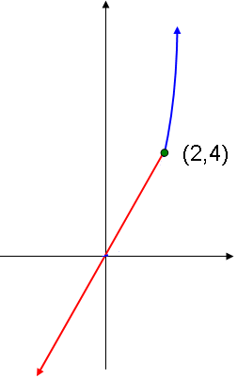

Slide 13
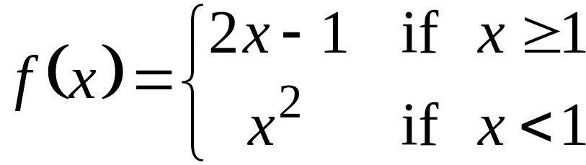
Example 3.3.3
Let .
Is f differentiable at 1? Justify your
answer.

Slide 14
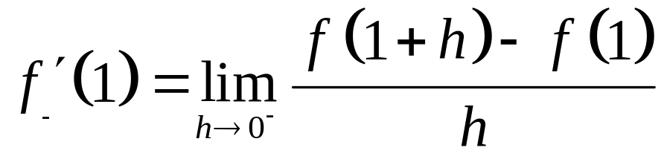
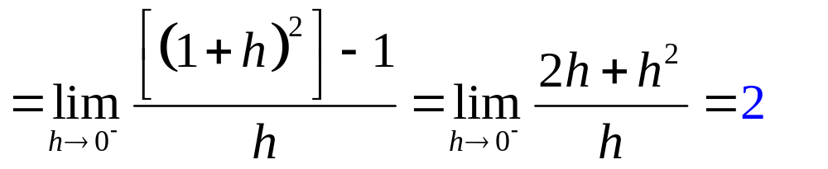
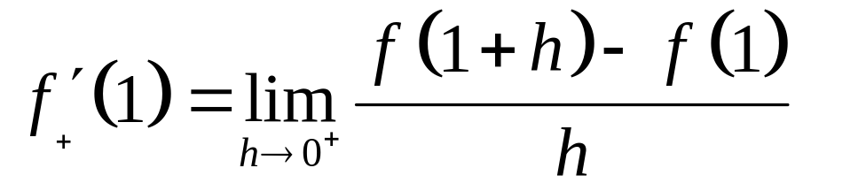
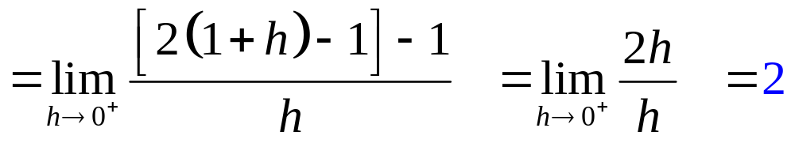
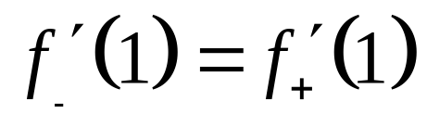
Solution:
Since then f is differentiable at 1.
Is f continuous at 1?
YES

Slide 15
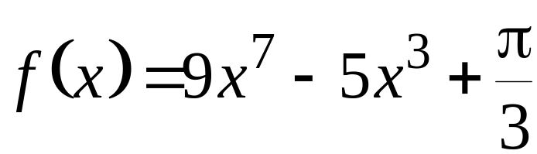
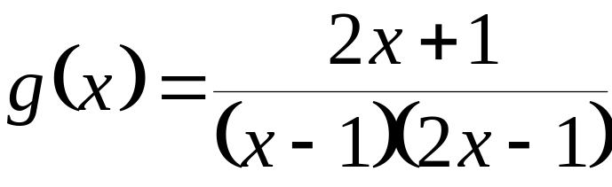
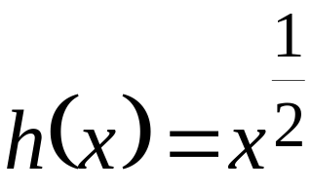
Example 3.3.4 Find all numbers where each indicated function is differentiable. a. b. c.
Solution:
a. f is a polynomial function so by Theorem 3.2.2, f is differentiable everywhere, that is, at all numbers.

Slide 16
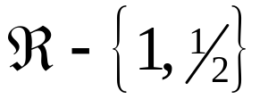
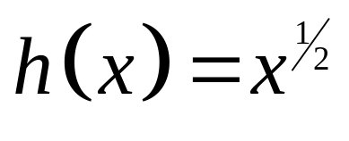
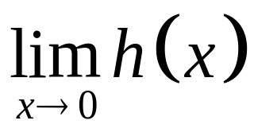
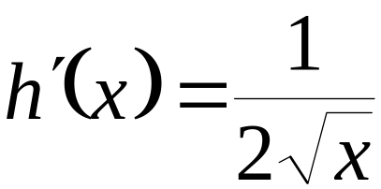


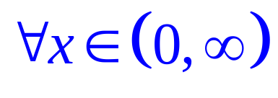
b. g is a rational function whose domain is . By Theorem 3.2.3, g is differentiable everywhere except at 1 and 1/2 .
c. Note that h is not continuous for all non positive real number. Also d.n.e.
Now, . Thus, will exist for all
positive real numbers. Therefore is differentiable .
.

Slide 17
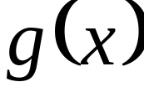

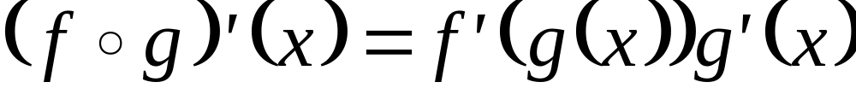
3.4 The Derivative of a Composite
Function and the Chain Rule
Theorem 3.4.1 (Chain Rule)
If a function g is differentiable at a number x and f is differentiable at , then is differentiable at x and

Slide 18
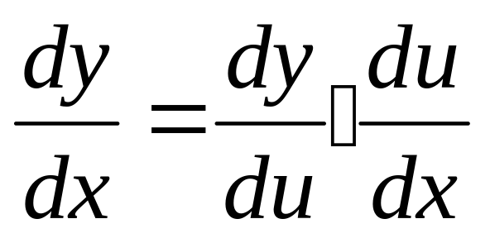
Theorem 3.4.2
(Another form of the Chain Rule)
If y is a differentiable function of u and u is a differentiable function of x, then

Slide 19









Example 3.4.1 If , find
Solution:
Let so that .

Slide 20





Example 3.4.2 If , find .
Solution:
Let
so that
.

Slide 21




Slide 22


Theorem 3.4.3
If y is a differentiable function of t and x is also a differentiable function of t, then
Theorem 3.4.4 If x is a differentiable function of y, then

Slide 23





Example 3.4.3
If , find .
Solution:

Slide 24



Example 3.4.4
If , find .
Solution:

Slide 25
end

