Slide 1
CHAPTER 3
THE DERIVATIVE AND DIFFERENTIATION

Slide 2
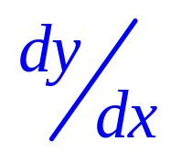
3.5 Implicit Differentiation
If y is a function of x but y cannot be expressed in terms of x explicitly, we can
still find by implicit differentiation.
Given an equation relating y and x, we differentiate both sides of the equation
and solve for by simple algebraic
manipulations.

Slide 3
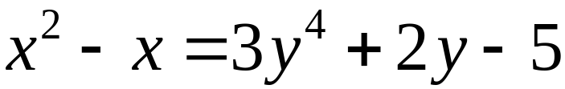

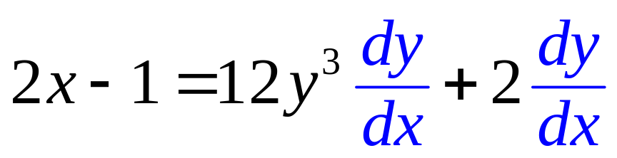
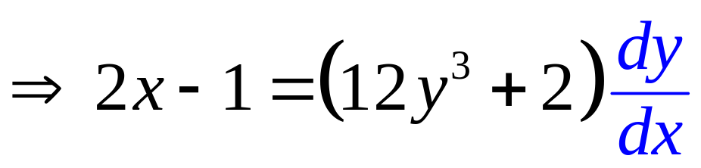
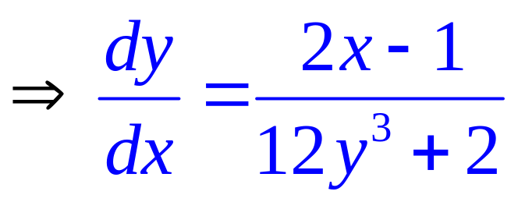
Example 3.5.1 If y is a function of x such that , find .
Solution:
Keeping in mind that y is a function of x, we get

Slide 4
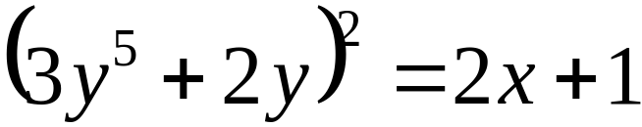
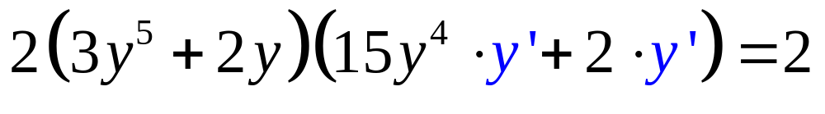
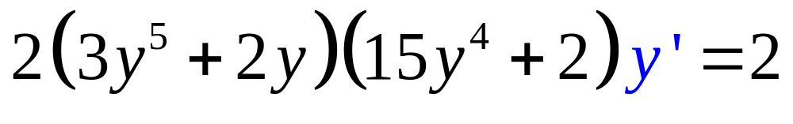
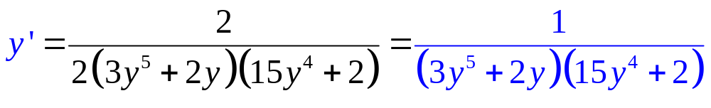
Example 3.5.2 If y is a function of x such that , find y’ .
Solution:
Differentiating with respect to x and keeping in mind that y is a function of x, we get

Slide 5
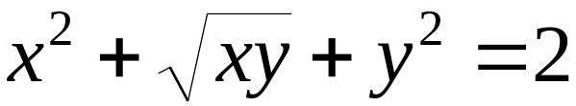
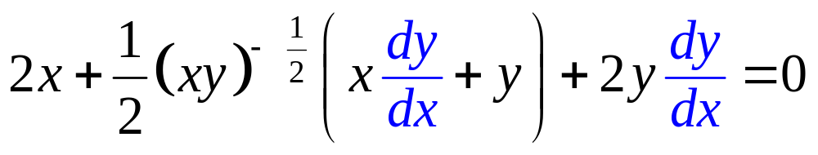
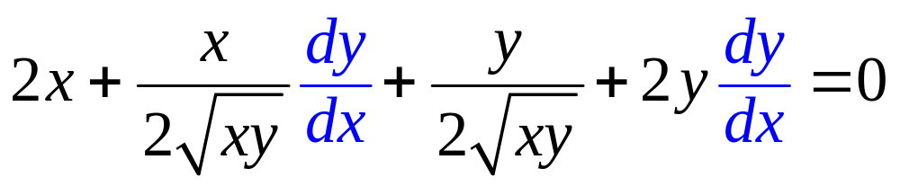
Example 3.5.3
If y is a function of x such that
, find .
Solution:
Differentiating, with respect to x and keeping in mind that y is a function of x, we get

Slide 6
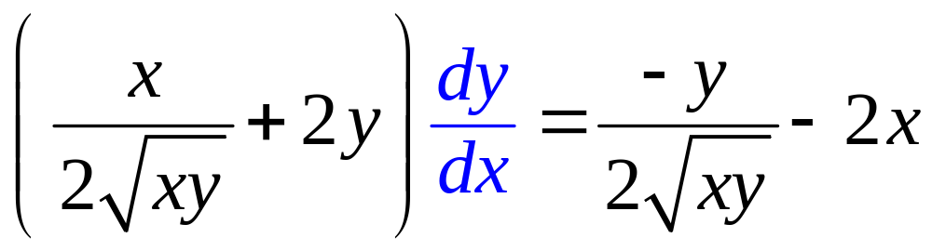
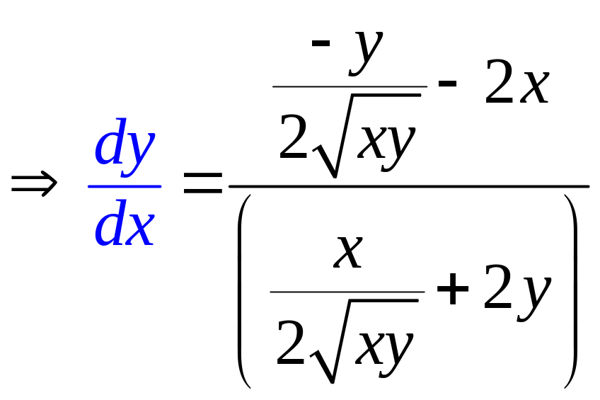
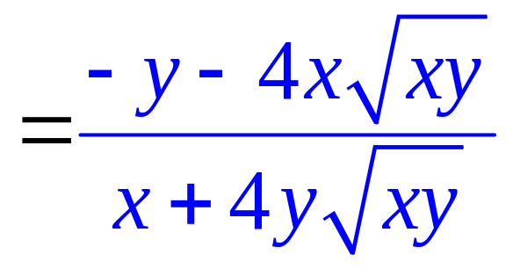

Slide 7
3.6 Higher-Order Derivatives
If a function f is differentiable, then its derivative f ‘ is also called the first derivative of f.
If the function f ‘ is again differentiable, its derivative denoted by f ‘’ is called the second derivative of f.

Slide 8
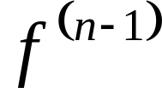
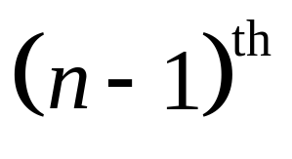
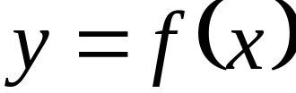
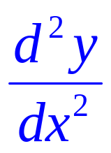
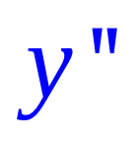
In general, the n^{th} derivative of a function f is the derivative of , where denotes the
derivative of f.
If , other notations for the
second derivative are or .

Slide 9
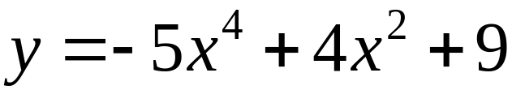

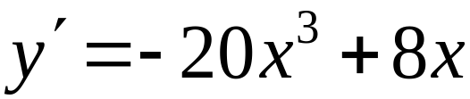
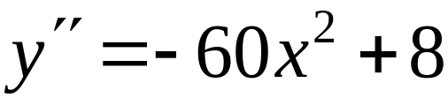
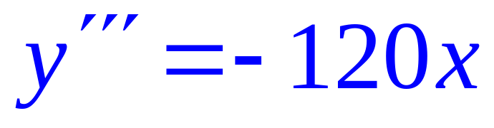
Example 3.6.1
If , find .
Solution:

Slide 10
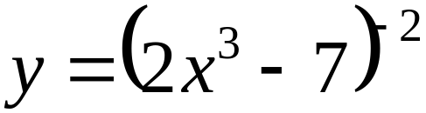

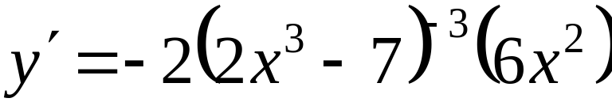
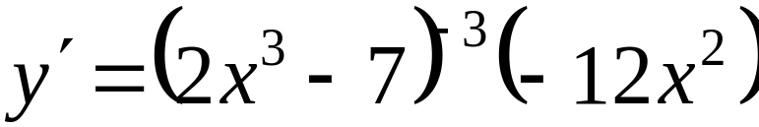
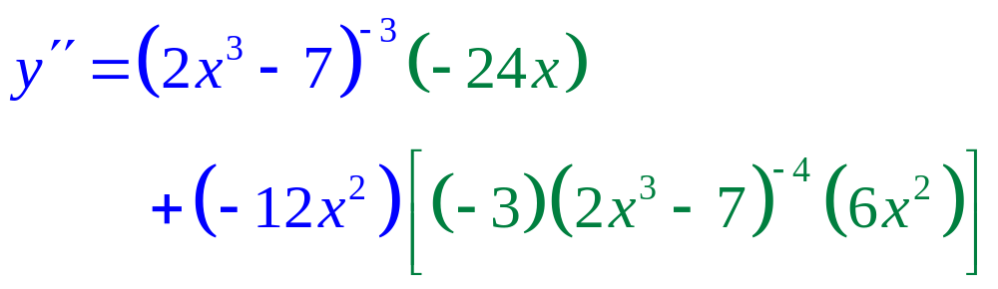
Example 3.6.2 If , find .
Solution:

Slide 11
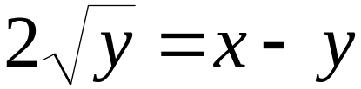
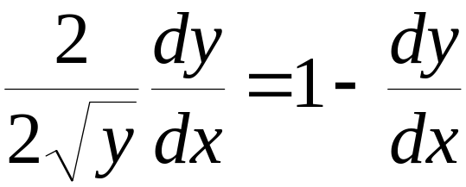
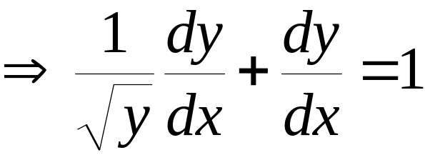
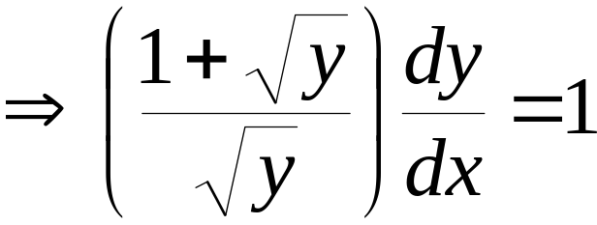
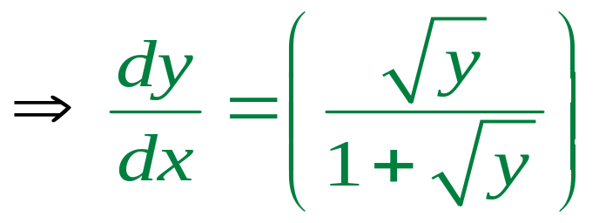
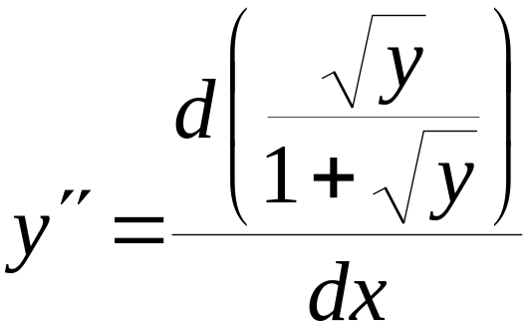
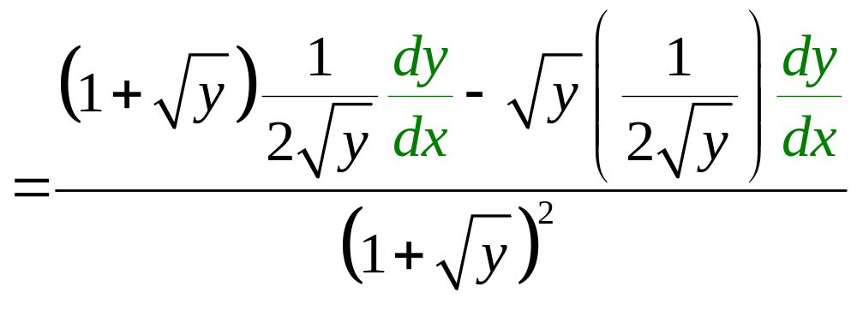
Example 3.6.3 If , find .
Solution:

Slide 12
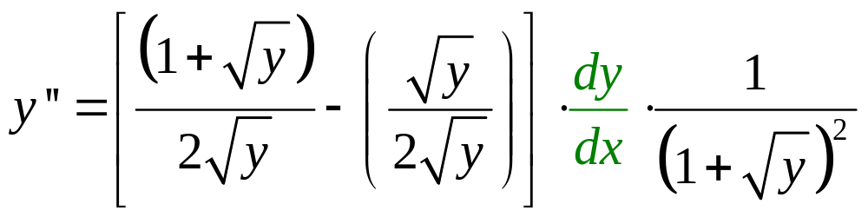
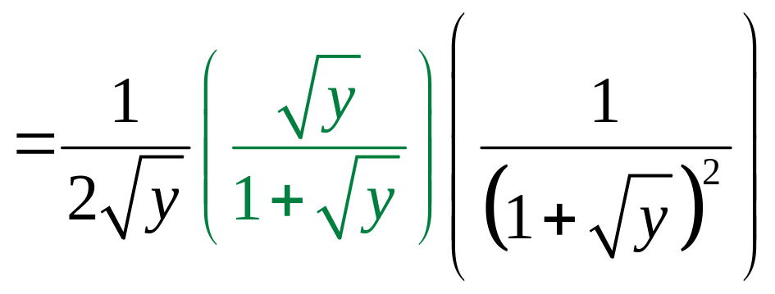
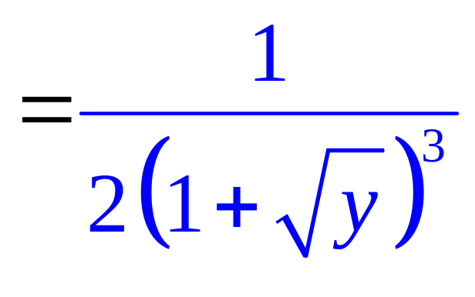

Slide 13
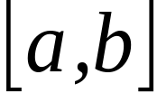
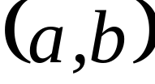
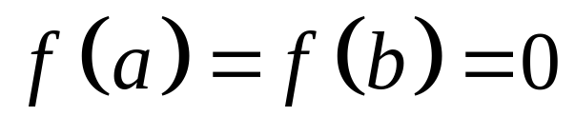
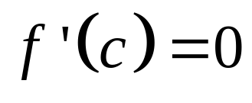
3.7 Rolle’s Theorem and the
Mean-Value Theorem
Theorem 3.7.1 (Rolle’s Theorem)
Let f be a function such that
f is continuous on the closed interval ,
f is differentiable on the open interval ,
Then there exists at least one number c in such that .

Slide 14
f ’(c₁) = f ’(c₂) = f ’(c₃) = 0
a
c₁
c₂
c₃
b

Slide 15
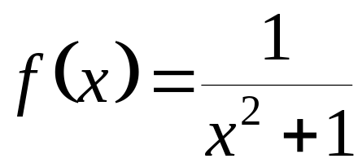
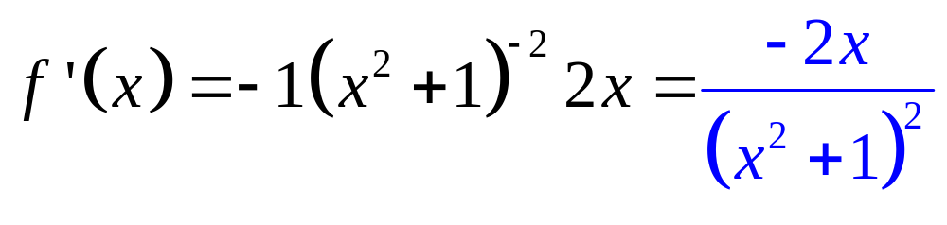
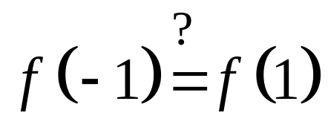
Example 3.7.1
Let . Does f satisfy the hypothesis of Rolle’s Theorem on the interval [-1,1] ?
YES
Solution:
Is f continuous on [-1,1] ?
Yes
Is f differentiable on (-1,1) ?
Yes
Yes

Slide 16
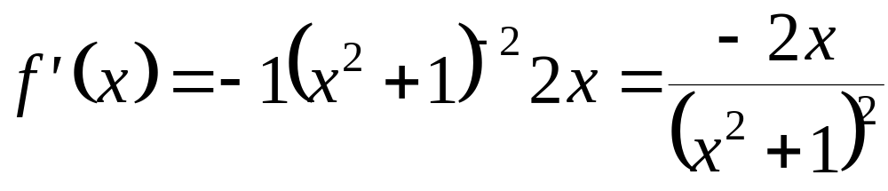
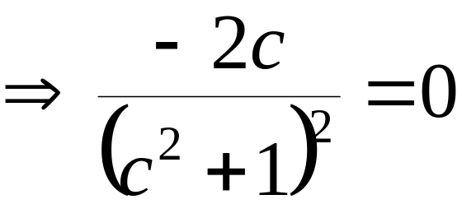
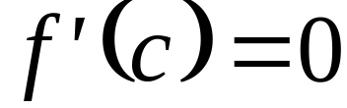
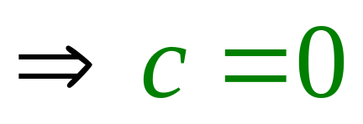
Example 3.7.2 For the function given in Example 3.7.1, find a number c in which satisfies the conclusion of Rolle’s Theorem.
Solution:

Slide 17
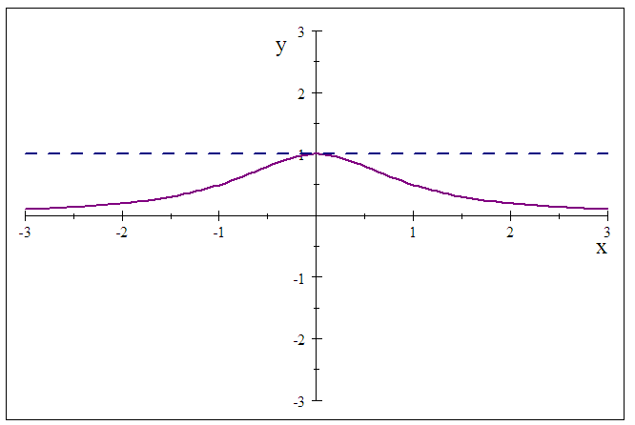

Slide 18

Theorem 3.7.2 (Mean-Value Theorem)
Let f be a function which is
continuous on the closed interval [a,b]
differentiable on the open interval (a,b)
Then there exists at least one number c in (a,b) such that

Slide 19

a
c₁
c₂
c₃
b
slope of secant line = slope of tangent line

Slide 20




Example 3.7.3 Let . Show that f satisfies the hypothesis of the Mean-Value on .
Solution:
Is f continuous on [-1,2] ?
Yes
Is f differentiable on (-1,2) ?
Yes
f ‘ is defined
Thus, f satisfies the hypothesis of MVT on [-1,2].

Slide 21






Example 3.7.4
For the function in Example 3.7.3, find a number c in which satisfies the conclusion of the Mean-Value Theorem
Solution:

Slide 22

1/4

Slide 23
end

