Slide 1
4.2 Related Rates
MATH 26
ANALYTIC GEOMETRY
AND CALCULUS I

Slide 2

Objective
At the end of this section each of you should be able to solve related rates problems using derivatives.

Slide 3

What are related rates?
involve rates of change of related variables
  rate of change = change in (?) / change in time
each of the variables involved has a specific relationship with values of t (t is a measure of time)
the relationship is usually expressed in the form of an equation, which represents the mathematical model of the situation

Slide 4
Strategy in solving related rates problems
  DEFINITION OF VARIABLES: Draw a diagram depicting the problem and name the variables and constants. Use the variable t for time. Assume all variables are differentiable functions of t.
  GIVEN: Write down any given numerical information in terms of the variables or rates of change of the variables.
  ASKED: Write down what is asked in the problem, usually a rate, expressed as a derivative.

Slide 5
Strategy in solving related rates problems
  4. RELATION: Write an equation that relates the variables.
  5. COMPUTATION: Differentiate implicitly with respect to t both sides of the equation obtained in Step 4. Then express the rate asked in terms of the variables, or rates of change of the variables whose values are known. Evaluate the expressed rate obtained to find the unknown rate.
  6. CONCLUSION: State the answer to what is
  being asked.

Slide 6

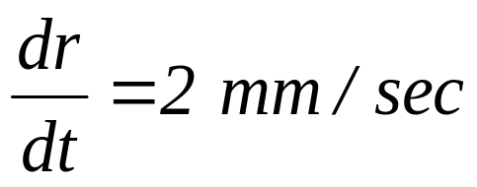
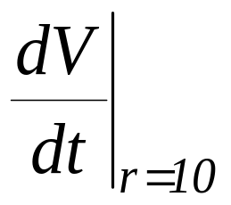
Example 1
The radius of a spherical cell is increasing at the rate of 2 mm/sec. How fast is the volume of the cell increasing when its radius is 10 mm?
DEFINITION OF VARIABLES:
r = radius of the sphere at time t
V = volume of the sphere at time t
r = 10
r
GIVEN:
ASKED:

Slide 7
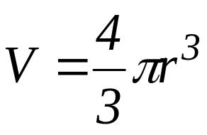
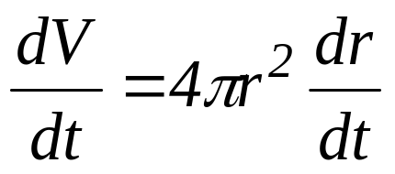

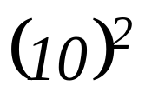
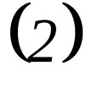
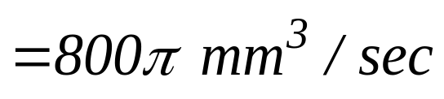
Example 1
The radius of a spherical cell is increasing at the rate of 2 mm/sec. How fast is the volume of the cell increasing when its radius is 10 mm?
RELATION:
r = 10
COMPUTATION:
r
CONCLUSION:
Therefore, the volume of the cell is increasing at the rate of 800πmm³/sec when the radius is 10 mm.

Slide 8
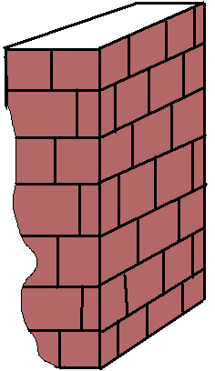
Example 2
A 13-ft ladder resting on a horizontal ground is leaning against a vertical wall when its base starts to slide away from the wall. By the time the base is 12 ft from the wall, the base is moving at the rate of 5 ft/sec.
a. How fast is the top of the ladder
sliding down the wall then?
b. How fast is the area of the triangle
formed by the ladder, wall, and
ground changing?

Slide 9
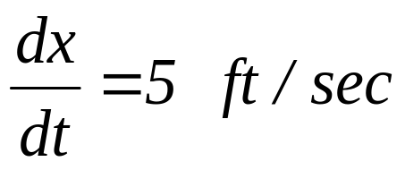
Example 2
A 13-ft ladder resting on a horizontal ground is leaning against a vertical wall when its base starts to slide away from the wall. By the time the base is 12 ft from the wall, the base is moving at the rate of 5 ft/sec.
a. How fast is the top of the ladder
sliding down the wall then?
DEFINITION OF VARIABLES:
x = distance of the base of the ladder from the wall at time t
y = distance of the top of the ladder from the ground at time t
13 ft
y
x
GIVEN:

Slide 10
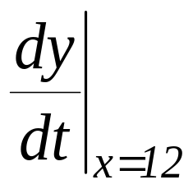
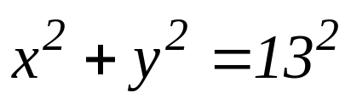
Example 2
A 13-ft ladder resting on a horizontal ground is leaning against a vertical wall when its base starts to slide away from the wall. By the time the base is 12 ft from the wall, the base is moving at the rate of 5 ft/sec.
a. How fast is the top of the ladder
sliding down the wall then?
ASKED:
13 ft
y
RELATION:
COMPUTATION: …
x
CONCLUSION: The top of the ladder is sliding down at the rate of 12 ft/sec

Slide 11
Example 2
A 13-ft ladder resting on a horizontal ground is leaning against a vertical wall when its base starts to slide away from the wall. By the time the base is 12 ft from the wall, the base is moving at the rate of 5 ft/sec.
b. How fast is the area of the triangle
formed by the ladder, wall, and
ground changing?
13 ft
y
x

Slide 12
Example 3
A stone is dropped into a still pond. Concentric circles ripples spread out and the radius of the disturbed region increases at the rate of 16 cm/sec. At what rate does the area of the disturbed region increase when its radius is 4 cm?

Slide 13
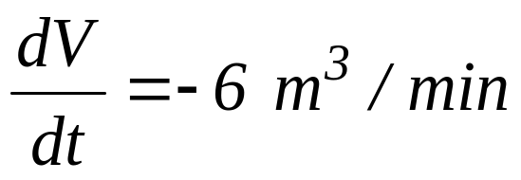
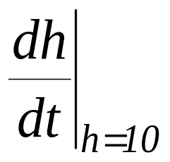
Example 4
A water tank in the form of an inverted cone is being emptied at the rate of 6 m³/min. The altitude of the cone is 24 meters, and the radius is 12 meters. Find how fast the water level is lowering when the water is 10 meters deep.
DEFINITION OF VARIABLES:
h = water level at time t
r = radius of the water surface at time t
V = water volume at time t
12 m
r
24 m
GIVEN:
h
ASKED:

Slide 14
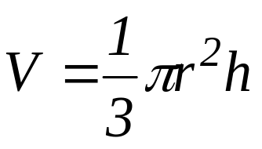
Example 4
A water tank in the form of an inverted cone is being emptied at the rate of 6 m³/min. The altitude of the cone is 24 meters, and the radius is 12 meters. Find how fast the water level is lowering when the water is 10 meters deep.
12 m
RELATION:
COMPUTATION: …
r
24 m
CONCLUSION: The water level is lowering at the rate of -6/25π m³/min when h = 10 m.
h

Slide 15
Example 5
A man 6 ft tall walks at the rate of 5 ft/sec toward a street light that is 16 ft above the ground. At what rate is the length of his shadow changing?

Slide 16
End of 4.2

