Slide 1
4.3 Curve Sketching

Slide 2
Relative Extrema

Slide 3
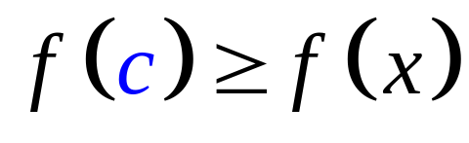
Definition. A function f has a relative
maximum value at a number c if there
exists an open interval I containing c
such that
∀x in I.
f(c)
f(c)
a
c
b
a
c
b

Slide 4
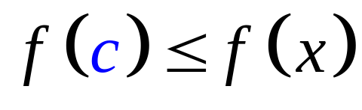
Definition. A function f has a relative
minimum value at a number c if there
exists an open interval I containing c
such that
∀x in I.
f(c)
f(c)
a
c
a
b
c
b
If a function has either a relative maximum or relative minimum value at c, then the function has a relative extremum at c.

Slide 5
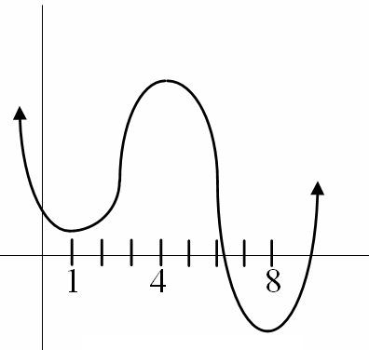
Illustration: Consider a function whose graph is shown below, at numbers does the function have relative extrema?
The function has relative minima at x = 1 and x = 8 and a relative maximum at x = 4.
B
A, C – relative minimum pts.
B – relative maximum pt.
A
C

Slide 6
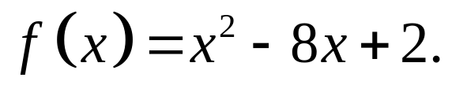
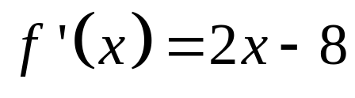
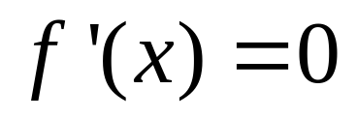

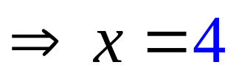
Definition. If c is a number in the domain of
the function f, and if either f ’(c) = 0 or f ’(c)
does not exist, then c is called a critical
number of f.
Illustration 1: Determine the critical numbers of the function defined by
Solution:
Note that f ’(x) is 0 when x = 4 and there is no value of x that will make f ’(x) undefined.
Thus, the only critical number of f is 4.

Slide 7
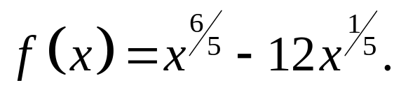
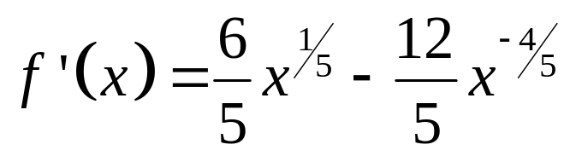
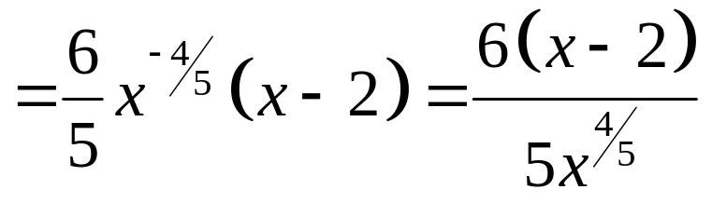
Illustration 2: Determine the critical numbers of the function defined by
Solution:
Note that f ’(x) is 0 when x = 2 and it is undefined when x = 0.
Thus, the critical numbers of f are 0 and 2.

Slide 8
Monotonicity

Slide 9
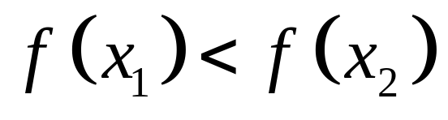
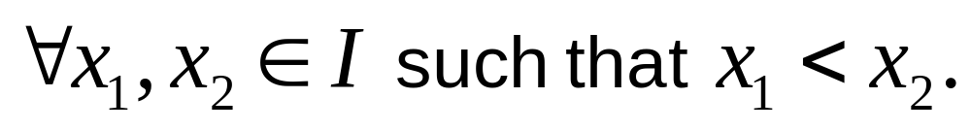
Definition. A function f is increasing on an
interval I if and only if
f(x₂)
f(x₂)
f(x₁)
f(x₁)
x₁
x₂
x₁
x₂

Slide 10
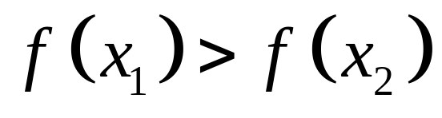
Definition. A function f is decreasing on an
interval I if and only if
f(x₁)
f(x₁)
f(x₂)
f(x₂)
x₁
x₂
x₁
x₂
Definition. A function f is said to be monotonic
on an interval I if it is either increasing or
decreasing on I.

Slide 11
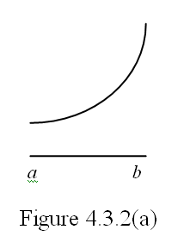
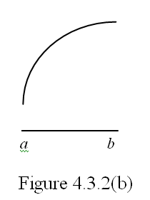
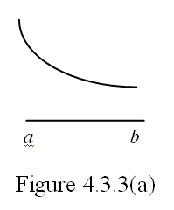
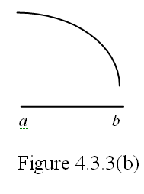
Illustration: Determine which of the following graphs represent an increasing or a decreasing function.

Slide 12


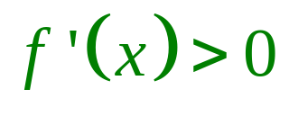
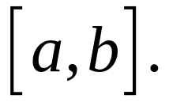
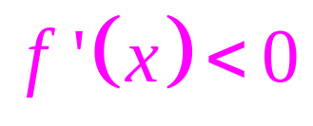
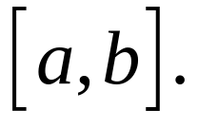
Theorem Suppose a function f is continuous on the closed interval and
differentiable on the open interval .
If
for all x in then f is
increasing on
b. If
for all x in then f is
decreasing on
.

Slide 13


Theorem The First-Derivative Test for
Relative Extrema
Let f be a function which is continuous at each number in some open interval containing the number c and suppose that exists at each number in except possibly at c.

Slide 14
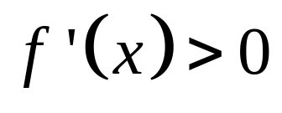
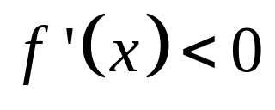
a. If for all values of x in some open interval having c as its right endpoint, and if for all values of x in some open interval having c as its left endpoint, then f has a relative maximum value at c.
a
c
b

Slide 15
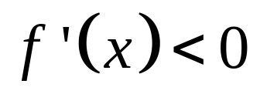

b. If for all values of x in some open interval having c as its right endpoint, and if for all values of x in some open interval having c as its left endpoint, then f has a relative minimum value at c.
a
c
b

Slide 16

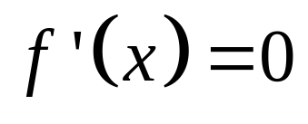
Procedure in determining the relative extrema of a function f:
1. Compute .
2. Determine the critical numbers of f (i.e., the value(s) of x for which or does not exist).
3. Apply the First-Derivative Test.

Slide 17
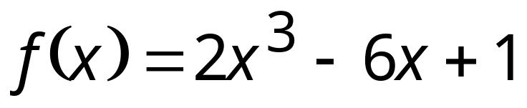
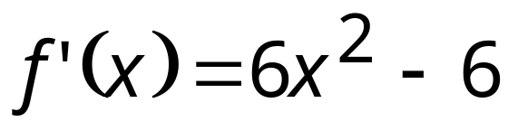
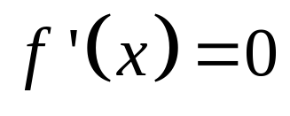
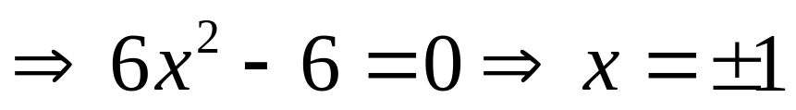
Example 1. Let .
Determine the intervals on which f is increasing and the intervals where f is decreasing. Also, determine the relative extrema of f, if any.
Solution:
Step 1. Find f ’(x).
Step2. Determine the critical numbers of f.
critical numbers: -1 and 1

Slide 18
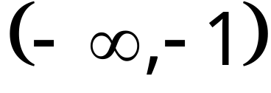
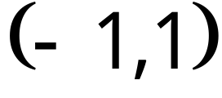
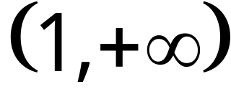
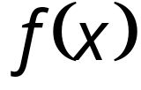
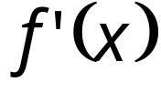


Step 3. Consider the intervals determined by -1 and 1.
Then determine the sign of f ’(x) in each
interval and apply Theorem and the First-Derivative Test.
 |  |  | Conclusion
 |  | + | f is increasing
 | 5 | 0 | f has a relative maximum value
 |  | - | f is decreasing
 | -3 | 0 | f has a relative minimum value
 |  | + | f is increasing

Slide 19
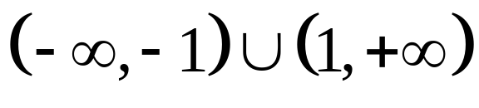
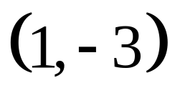
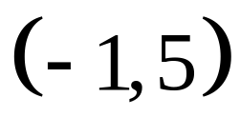
Interval where f is increasing:
 |  |  | Conclusion
 |  | + | f is increasing
 | 5 | 0 | f has a relative maximum value
 |  | - | f is decreasing
 | -3 | 0 | f has a relative minimum value
 |  | + | f is increasing
Interval where f is decreasing:
Relative minimum point :
Relative maximum point :

Slide 20
Concavity

Slide 21




Definition. The graph of a function f is said to be
concave upward at a point
if
a. exists and
b. there is an open interval I containing c such that for all values of x in I such
that , the point is above
the tangent line to the graph at .
c
c

Slide 22
Definition. The graph of a function f is said to be
concave downward at a point
if
a. exists and
b. there is an open interval I containing c such that for all values of x in I such
that , the point is below
the tangent line to the graph at .
c
c

Slide 23
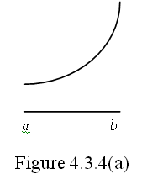
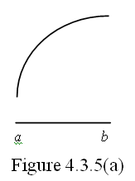
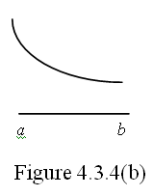
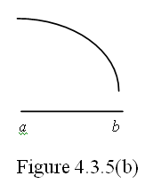
Illustration: Determine which of the following graphs are concave upward or concave downward.

Slide 24
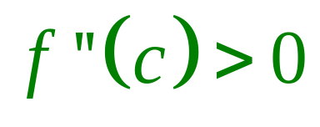

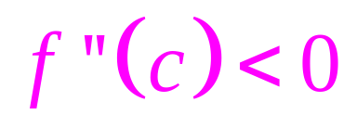
Theorem Let f be a function which is
differentiable on some open interval
containing c.
a. If , the graph of f is concave
upward at .
b. If , the graph of f is concave downward at .

Slide 25
Point of Inflection

Slide 26
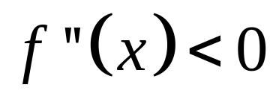

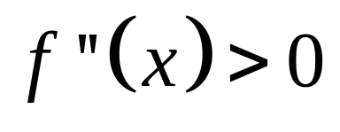


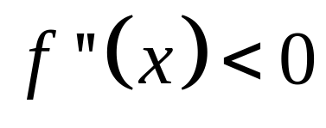
Definition. A point is a point of inflection of the graph of the function f if
a. the graph has a tangent line at and
b. there exists an open interval I containing
c such that if x is in I, then either
i. whenever , and whenever ; or
ii. whenever , and whenever .
(c,f(c))
(c,f(c))

Slide 27

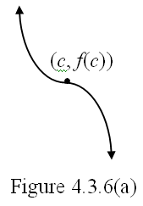
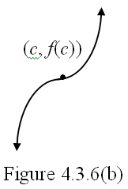
Illustration: In Figures 4.3.6(a) and 4.3.6(b), we see portions of the graphs of two different functions, each having a point of inflection at .

Slide 28
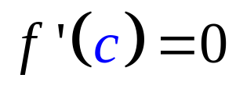
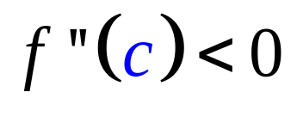

Theorem The Second-Derivative Test for Relative Extrema
Let c be a critical number of a function f at which .Suppose further that f ‘’ exists for each value of x in some open interval containing c.
a. If ,then f has a relative maximum value at c.
b. If , then f has a relative minimum value at c.

Slide 29


Example 2. Let .
Determine the intervals where the graph of f is concave upward and concave downward. Also, determine the inflection points of the graph of f, if any.
Solution:
Step 1. Find f ’’(x) and equate to zero to find the
possible “point(s) of inflection”.

Slide 30






Step 2. Consider the intervals determined by 0.
Then determine the sign of f ’’(x) in each
interval and apply Theorem and the Second-Derivative Test.
 |  |  |  | Conclusion
 |  |  | - | graph of f is concave downward
 | 1 |  | 0 | graph of f has point of inflection
 |  |  | + | graph of f is concave upward

Slide 31



 |  |  |  | Conclusion
 |  |  | - | graph of f is concave downward
 | 1 |  | 0 | graph of f has point of inflection
 |  |  | + | graph of f is concave upward
Interval where graph of
f is concave upward:
Interval where graph of
f is concave downward:
Inflection point :

Slide 32
In order to make the graphing of a given function f easier, we summarize the things we have done as follows.
Step 1. Solve for f ’(x) and f ’’(x).
Step 2. Consider all the critical numbers of f and the
solution to the equation f ’’(x) = 0. Arrange
these numbers in their natural order.
Step 3. Obtain the intervals determined by these
numbers.
Step 4. Apply theorems 2 and 3 and the first and
second derivative tests for relative extrema.

Slide 33






Example 3. Sketch the graph of the function f defined by
Solution:
Step 1.
Step 2.
Arrange these numbers in the real number line.
-1
0
1
Step 3.

Slide 34









Step 4.
Conclusion
f is increasing; graph is concave downward
f has relative maximum value
f is decreasing; graph is concave downward
graph has a point of inflection
f is decreasing; graph is concave upward
f has relative minimum value
f is increasing; graph is concave upward

Slide 35
Step 5.
Conclusion
f is increasing; graph is concave downward
f has relative maximum value
f is decreasing; graph is concave downward
graph has a point of inflection
f is decreasing; graph is concave upward
f has relative minimum value
f is increasing; graph is concave upward
(-1,5)
(0,1)
-1
0
1
(1,-3)

Slide 36





Conclusion
f is increasing; graph is concave downward
f has relative maximum value
f is decreasing; graph is concave downward
graph has a point of inflection
f is decreasing; graph is concave upward
f has relative minimum value
f is increasing; graph is concave upward
f ↓ :
(-1,1)
f ↑ :
Con D own
Con Up :
Rel min pt :
(1,-3)
Rel max pt :
(-1,5)
POI :
(0,1)

Slide 37


