Slide 1
MATH 26
ANALYTIC GEOMETRY AND CALCULUS 1
Institute of Mathematical Sciences and Physics
College of Arts and Sciences
U. P. Los Baños

Slide 2
CHAPTER 5
Antidifferentiation and the Definite Integral

Slide 3
5.1 Antidifferentiation and the Indefinite Integral

Slide 4
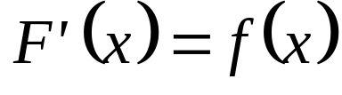
Def. A function F is called an antiderivative of the function f on an interval I if for all values of x in I.

Slide 5
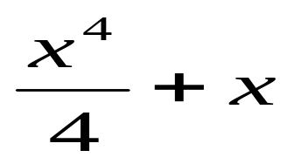
Example. If F(x) = then it is the
antiderivative of f(x)= x³ +1

Slide 6
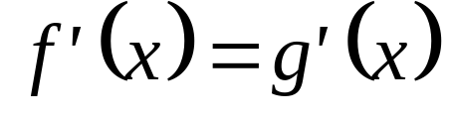

Theorem 5.1.1 If f and g are two functions defined on an interval I with for all values of x on the interval I, then there is a constant C such that for all x in I.

Slide 7
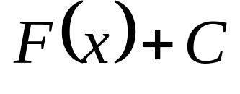
Theorem 5.1.2 If a function F is any antiderivative of the function f on an interval I, then every antiderivative of f on the interval I is of the form
(1)
where C is an arbitrary constant (or real number).

Slide 8
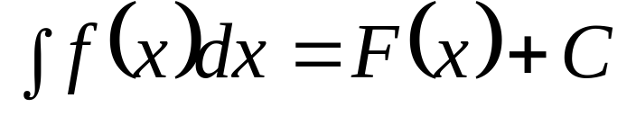

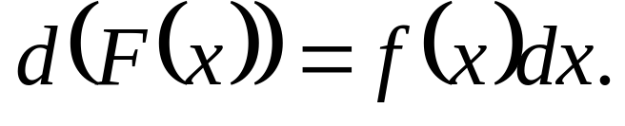
Remarks
Antidifferentiation (or integration) is the process of finding all antiderivatives of a given function.
We write to mean that
or

Slide 9
Examples

Slide 10
5.2 Basic Theorems on Antidifferentiation

Slide 11
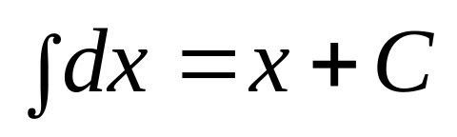
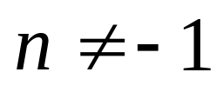
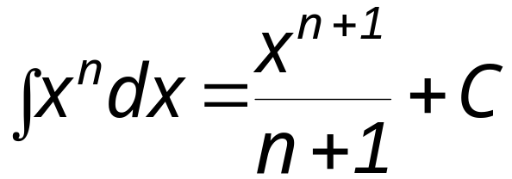
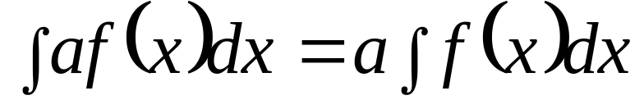
Thm 5.2.1
Thm 5.2.2 If n is any real number such that , then
Thm 5.2.3 , where a is any real number.

Slide 12
Thm 5.2.4 If f and g are defined on the same interval, then
Thm 5.2.5 If f₁ , f₂ , f₃ ,. . ., f_{n} are defined on the same interval, then

Slide 13
Examples

Slide 14
5.3 The Chain Rule for Antidifferentiation

Slide 15
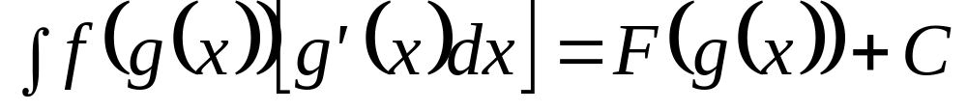
The Chain Rule
Thm. Let g be a differentiable function whose range includes the interval I. If f is a function defined on I and F is an antiderivative of f on I, then

Slide 16
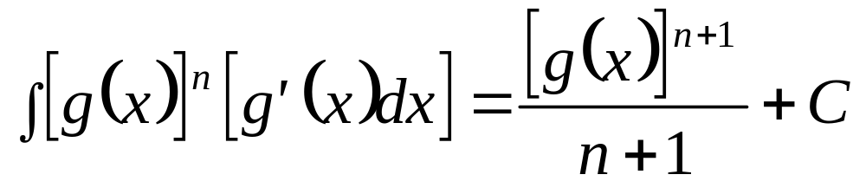
Remark
In particular, if g is differentiable on I and n is any real number such that , then

Slide 17
Examples

