Slide 1
4.4 Maxima and Minima Problems

Slide 2
Absolute Extrema

Slide 3
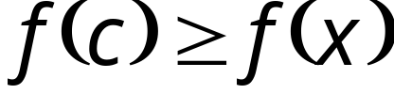

Def. A function f has an absolute maximum value on an interval I
if there is some number c in I such that for each x in I.
In such a case, the number is called the absolute maximum value of f on I.

Slide 4
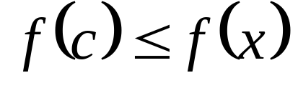
Def. A function f has an absolute minimum value on an interval I
if there is some number c in I such that for each x in I.
The number is called the absolute minimum value of f on I.

Slide 5
Def. An absolute extremum of a function f on an interval I is either an absolute maximum value or an absolute minimum value of f on I.

Slide 6
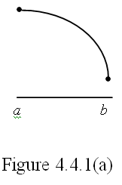
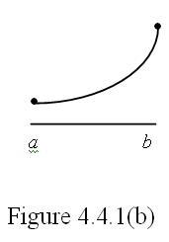
Illustration: Determine the absolute extrema of the functions represented by the following graphs.
The absolute maximum of the function occurs at a.
The absolute minimum of the function occurs at b.
The absolute minimum of the function occurs at a.
The absolute maximum of the function occurs at b.

Slide 7
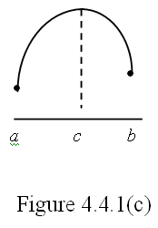
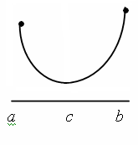
The absolute maximum of the function occurs at c.
The absolute minimum of the function occurs at a.
The absolute minimum of the function occurs at c.
The absolute maximum of the function occurs at b.
Figure 4.4.1(d)

Slide 8

Theorem 4.4.1 The Extreme-Value Theorem
If a function f is continuous on a closed interval then f has an absolute maximum value and an absolute minimum value on .

Slide 9
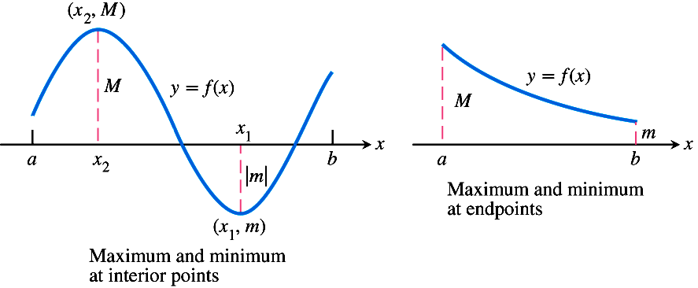
Some possibilities for a continuous function’s maximum and minimum on a closed interval [a, b].

Slide 10
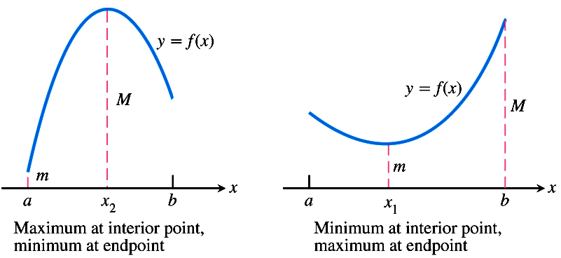

Slide 11



How do you find the absolute extrema of a continuous function f on the closed interval [a, b]?
1. Find the critical number(s) of f.
2. Find the value of f at each of the critical numbers of on .
3. Find the values of and .
4. The largest of the values from steps 2 and 3 is the absolute maximum value of f; the smallest of the values is the absolute minimum value of f.

Slide 12


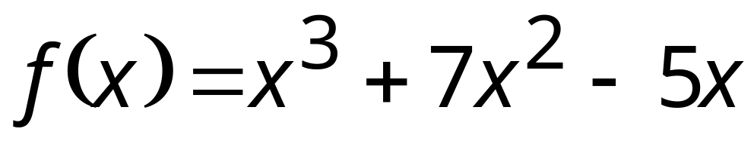
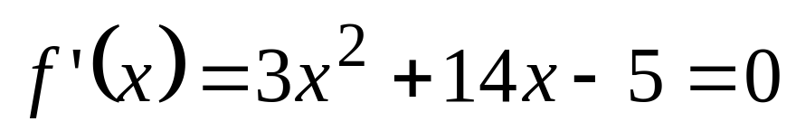
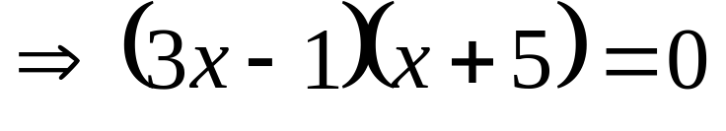
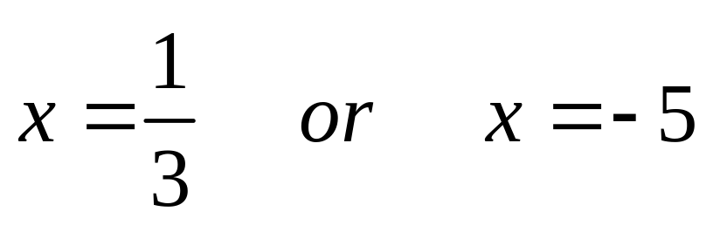
Example1
Find the absolute extrema of on
if .
Solution:
Step 1. Solve
.

Slide 13
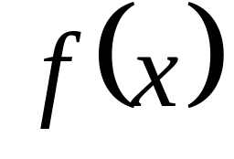
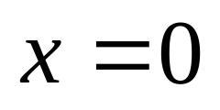
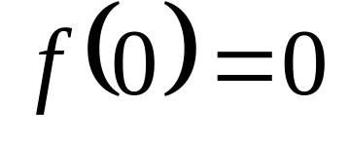
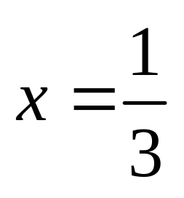
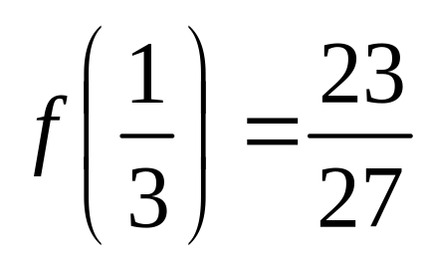
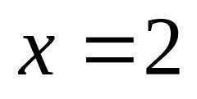
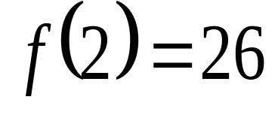
Step 2: Candidates for absolute extrema:
Conclusion
f has an absolute minimum value of 0 at x=0
f has an absolute maximum value of 26 at x=2

Slide 14
Steps in Solving Max-Min Problems
Step1. Understand the problem.
Read the problem carefully. Identify the information you need to solve the problem. What is unknown? What is given? What is required?
Step2. Develop a mathematical model of the problem.
Draw pictures and label the parts that are important to the problem. Introduce a variable to represent the quantity to be maximized or minimized. Write a function that relates the variable/s to the problem.

Slide 15
Step3 Find the domain of the function.
Determine what values of the variable make sense in the problem.
Step4 Identify the critical points and endpoints.
Step5 Solve the mathematical model
Step6 Interpret the solution

Slide 16
Example2
A piece of wire 10 feet long is cut into two pieces. One piece is bent into the shape of a circle and the other into the shape of the square. How should the wire be cut so that
the combined area of the two figures is as small as possible;
the combined area of the two figures is as large as possible?

Slide 17
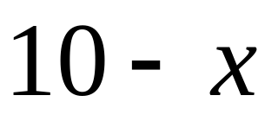

Total Length of Wire
=Circumference of Circle + Perimeter of Square
Total Area =Area of Circle + Area of Square

Slide 18
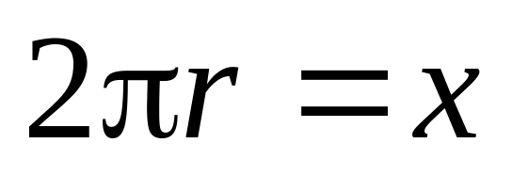
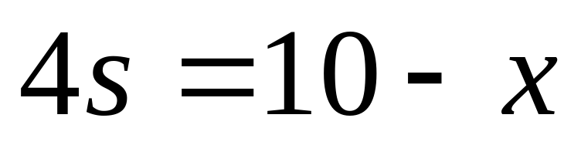
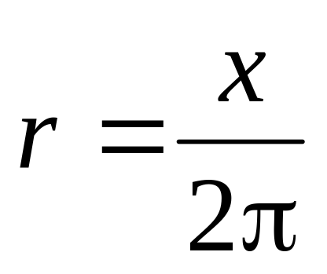
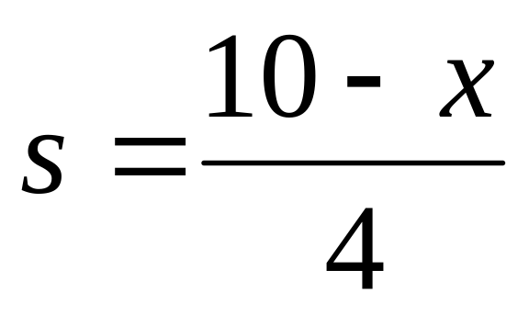
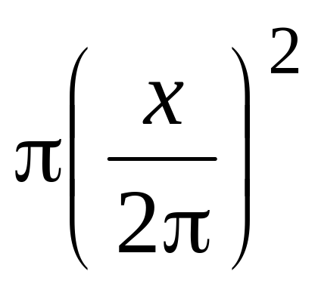
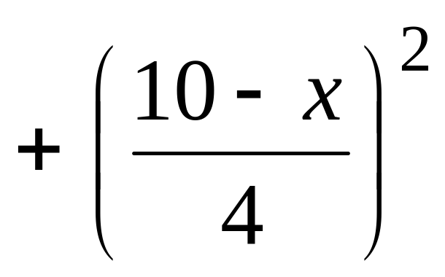
r
s
Total Area =

Slide 19
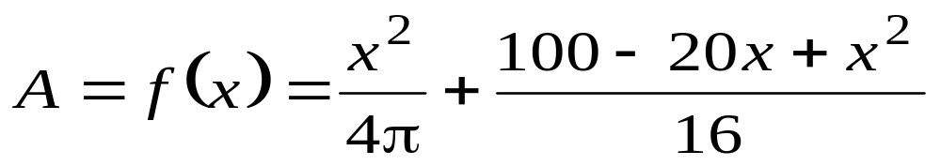
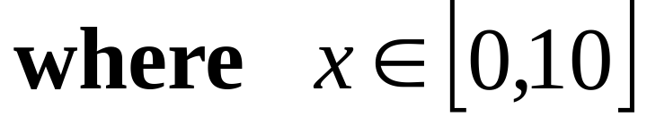
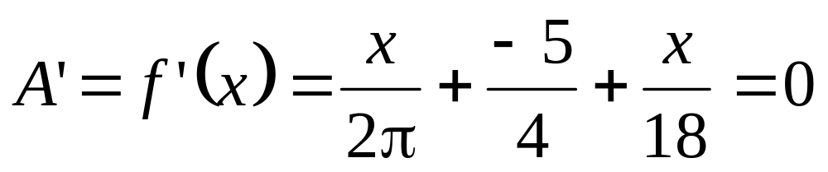
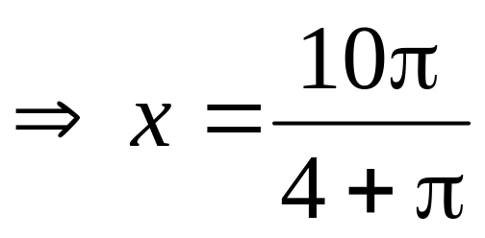
Total Area =

Slide 20
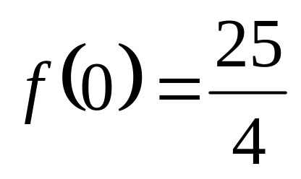
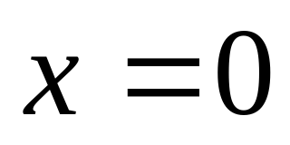
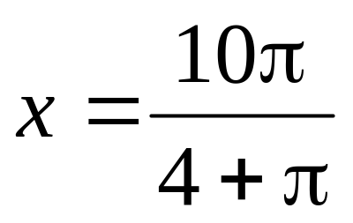
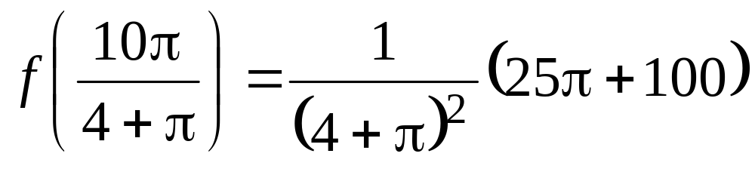
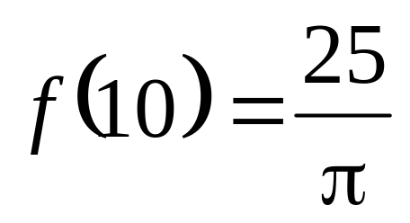
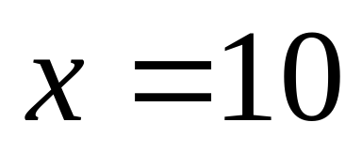
Total Area =

Slide 21
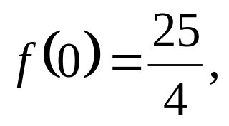
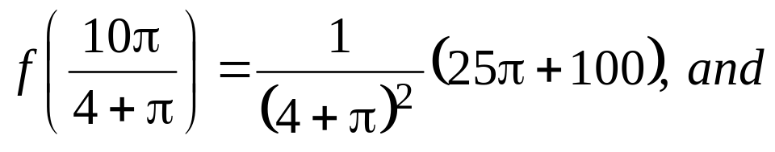
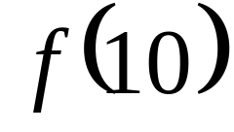
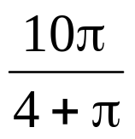
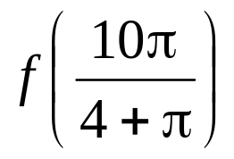
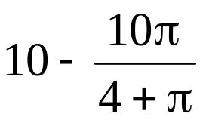
Since among
Largest : when we will use the whole wire to make a circle, then we will get the maximum sum of areas
Smallest : when we will use of the
wire to make a circle, and the remaining
for the square then we will get the minimum sum of areas

Slide 22
Theorem 4.4.2 Suppose a function f is continuous on an interval I containing the number c. If is a relative extremum of f on I and c is the only number in I for which f has a relative extremum, then is an absolute extremum of f on I.

Slide 23


Example3
A farmer has 2400 feet of fencing materials and wants to fence off a rectangular field that borders a straight river. He needs no fence along the river. What are the dimensions of the field that has the largest area?
Let l be the length (in feet) of the field parallel to the river
w be the width (in feet) of the rectangular field

Slide 24
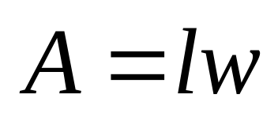
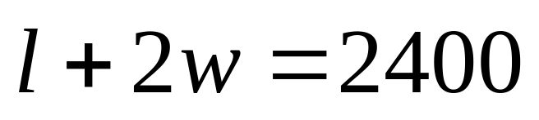
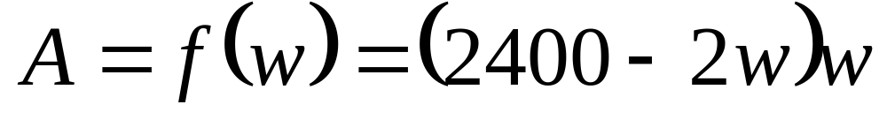
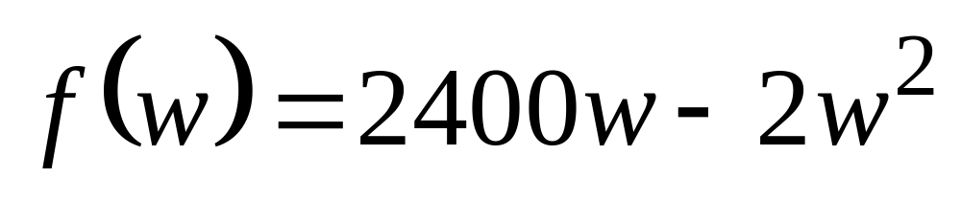
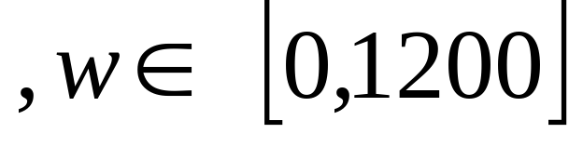
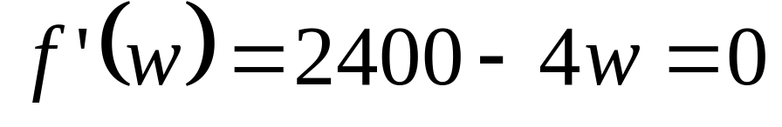
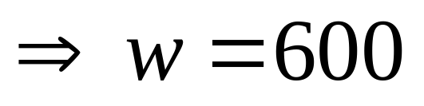
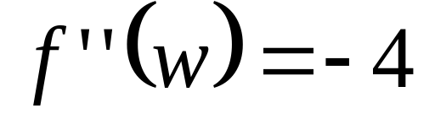

Solution:
If A is the area of the rectangular field, then
such that
Thus, f has a relative maximum value at w=600.

Slide 25

Since the only relative maximum value of f is at w=600, then the absolute maximum value of f occurs when w=600.
Therefore, the largest rectangular field in the problem that can be enclosed by 2400 feet of fencing materials has dimensions of 1200 ft by 600 ft.

Slide 26





Example4
Find two numbers whose difference is 100 and whose product is a minimum.
Solution:
Let x and y be the two numbers.
If we denote P to be the product of the two numbers, then
such that

Slide 27




Hence, f has a relative minimum value at x=50
Since the only relative minimum of f is when x=50, then f(50) is the absolute minimum value.
Therefore, the two numbers in the problem are 50 and -50.

