Slide 1
MATH 26
ANALYTIC GEOMETRY AND CALCULUS 1
Institute of Mathematical Sciences and Physics
College of Arts and Sciences
U. P. Los Baños

Slide 2
CHAPTER 5
Antidifferentiation and the Definite Integral

Slide 3
5.4 The Definite Integral and Area of a Plane Region

Slide 4
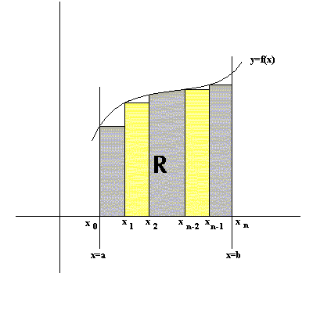
Consider the area R bounded by the graph of f, the lines x=a and x=b, and the x-axis

Slide 5
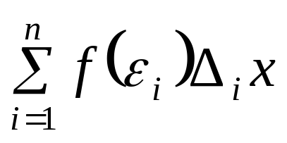
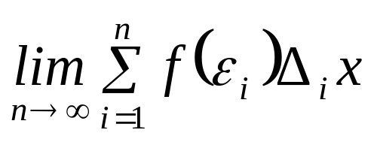
Note that
R is approximated by the Reimann Sum i.e.
and R is equivalent to

Slide 6
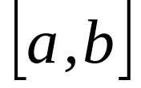

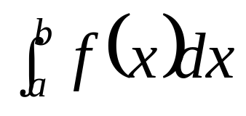
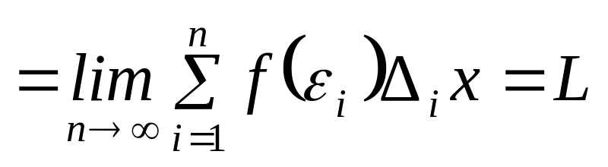
Def. If no matter how we subdivide and no matter which numbers ’s we choose in each subinterval, exists and is equal to a real number L, we say that f is integrable on and the number L is called the definite integral of f on . We denote this by writing

Slide 7
5.5 Theorems on Definite Integrals

Slide 8
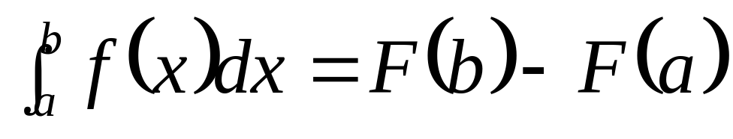
Thm 5.5.1 (The Fundamental Theorem of Calculus). Let the function f be continuous on the closed interval and F be an antiderivative of f on the interval . Then

Slide 9
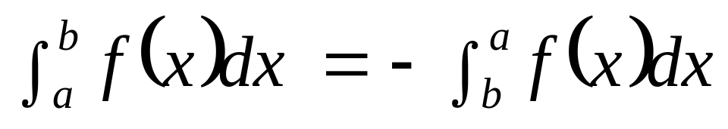
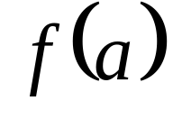
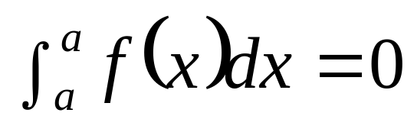
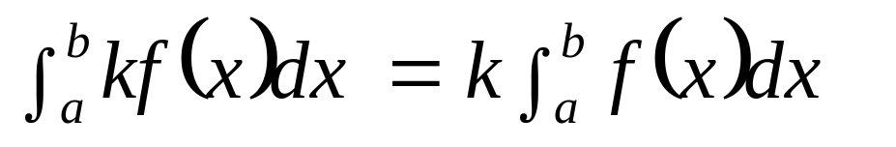
Thm 5.5.2
Thm 5.5.3 If is defined,
Thm 5.5.4 for any
real constant k.

Slide 10
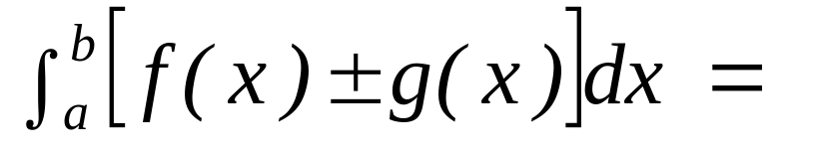
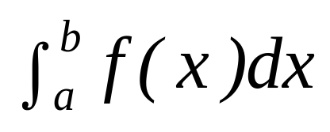
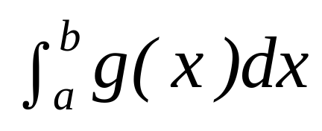
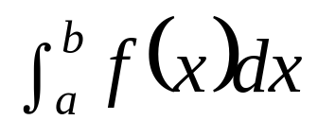
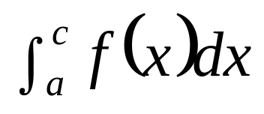
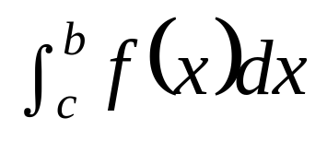
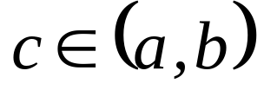
Thm 5.5.5
Thm 5.5.6 = + , for each .
±
.

Slide 11

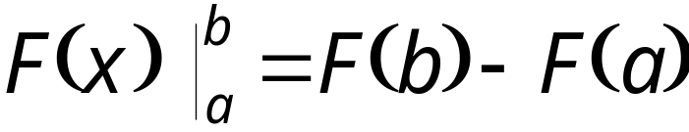
Remark
If a function F is defined at each number in
, .

Slide 12
Examples (give 5 examples)

Slide 13
5.6 Area of a Plane Region

Slide 14
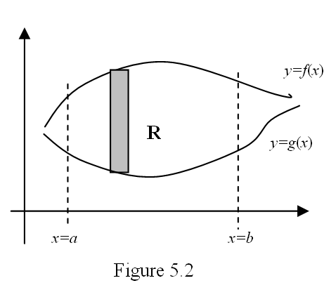
Consider the region bounded by the graph of y=f(x), y=g(x), x=a and x=b

Slide 15
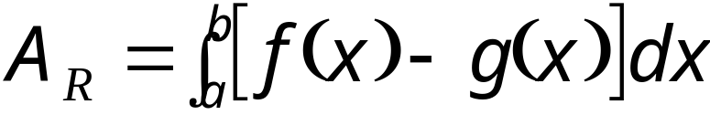
Then the area of that region R, using vertical strips, is given by

Slide 16
Examples

