Slide 1
1.7 General second degree equations
MATH 26
ANALYTIC GEOMETRY
AND CALCULUS I

Slide 2
GENERAL SECOND DEGREE EQUATIONS
A general second-degree equation in x and y is of the form
where A, B, C, D, E and F are constants and in which not all of A, B, and C are zero.

Slide 3
GENERAL SECOND DEGREE EQUATIONS
A second degree equation in two variables x and y, say
where A, B, C, D, E and F are constants, B = 0 and NOT BOTH A and C are zero is either a conic or a degenerate conic.

Slide 4
Ax² + Cy² + Dx + Ey + F = 0
If AC > 0 , the graph of the given equation is either an ellipse, a circle, a point, or the empty set;
If AC = 0, the graph of the given equation is either a parabola, two parallel lines, one line or the empty set
If AC < 0, the graph of the given equation is either a hyperbola or 2 intersecting lines.
please refer to TC7 by L. Leithold

Slide 5

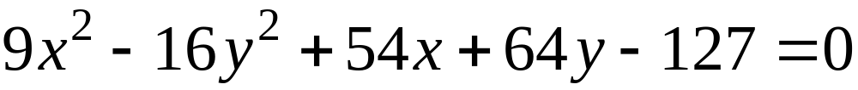

Example. Determine the type of conic section and write in standard form the equation:
SOLUTION
Since A = 9 and C = -16 then AC < 0.
Therefore, the graph is a hyperbola or two intersecting lines.

Slide 6
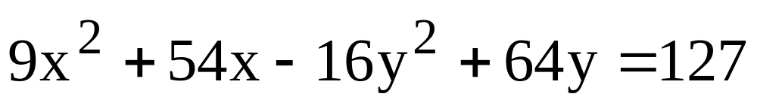
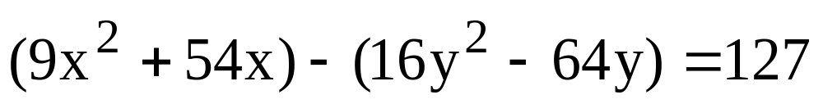
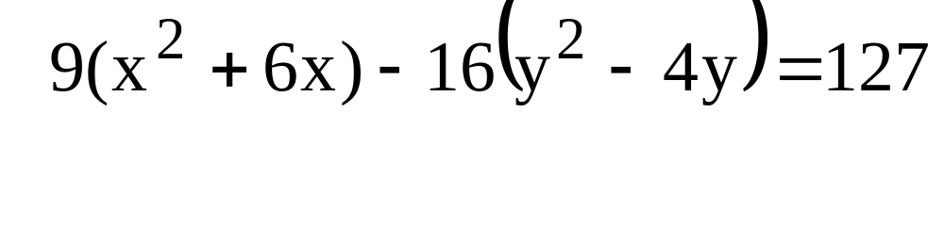
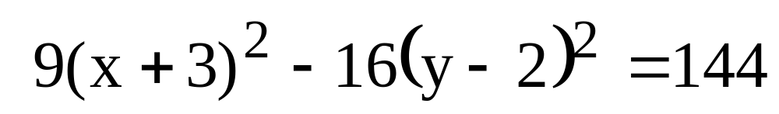
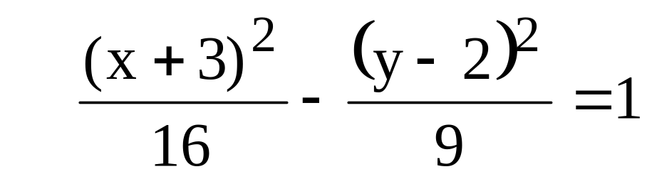
Continuation of SOLUTION…
hyperbola

Slide 7
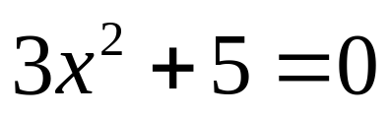
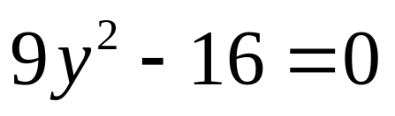
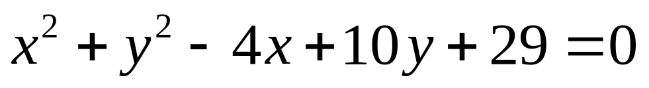
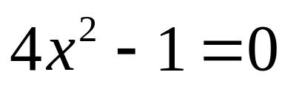
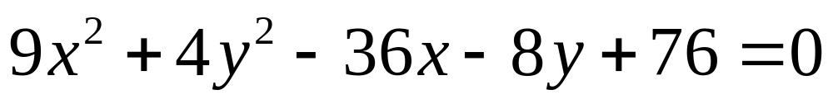
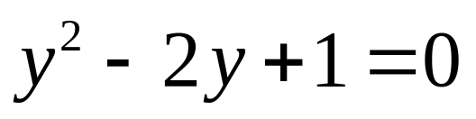
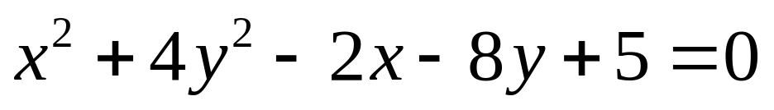
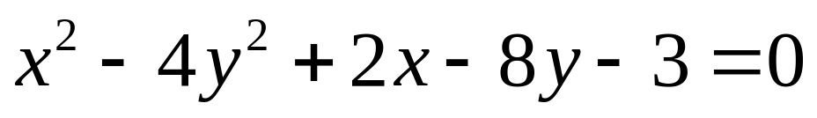
Example. Determine the graph of the following 2nd degree equations:
1.
2.
3.
4.
5.
6.
7.
8.

Slide 8
ANSWER:
1.
EMPTY SET
2 PARALLEL HORIZONTAL LINES
2.
3.
2 PARALLEL VERTICAL LINES
4.
1 HORIZONTAL LINE

Slide 9



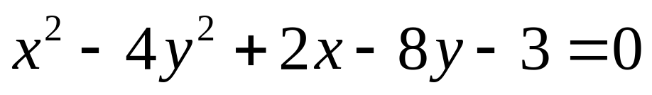
ANSWER:
Time to Think
5.
6.
7.
8.
POINT (2,-5)
EMPTY SET
POINT (1,1)
2 INTERSECTING LINES

Slide 10
---------------------END OF 1.7---------------------

