Slide 1
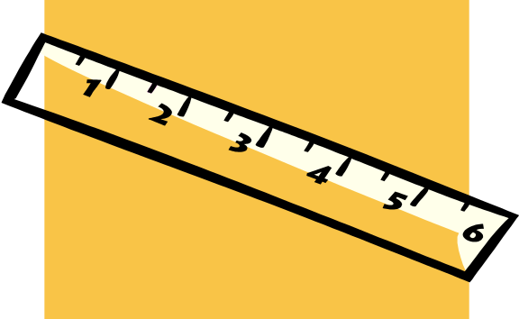
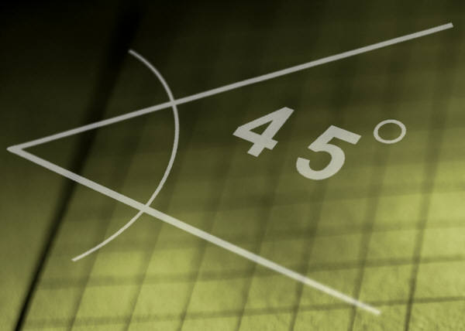

APPLICATIONS OF THE DERIVATIVE

Slide 2
Polya’s Heuristics
Understand the Problem
Devise a Plan
Carry Out the Plan
Look Back

Slide 3


RECTILINEAR MOTION
Rectilinear motion is movement along a straight line.
UNIT 4.1 RECTILINEAR MOTION ANALYTIC GEOMETRY AND CALCULUS 1

Slide 4
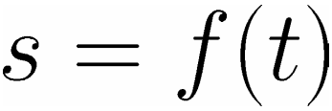

Suppose a particle is moving along a straight line.
Let be the distance of the particle from the origin at time .
UNIT 4.1 RECTILINEAR MOTION ANALYTIC GEOMETRY AND CALCULUS 1

Slide 5
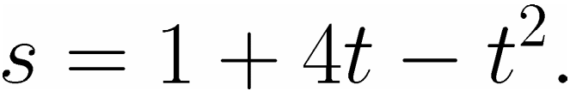







Let
UNIT 4.1 RECTILINEAR MOTION ANALYTIC GEOMETRY AND CALCULUS 1

Slide 6
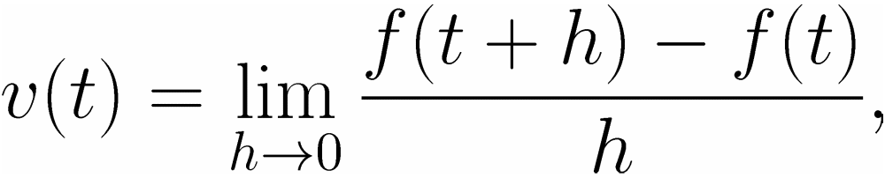
INSTANTANEOUS VELOCITY
The instantaneous velocity of the particle at time is given by
if this limit exists.
UNIT 4.1 RECTILINEAR MOTION ANALYTIC GEOMETRY AND CALCULUS 1

Slide 7



If then the particle is at REST.
If then the particle is moving to the RIGHT/UPWARD.
If then the particle is moving to the LEFT/DOWNWARD.
UNIT 4.1 RECTILINEAR MOTION ANALYTIC GEOMETRY AND CALCULUS 1

Slide 8
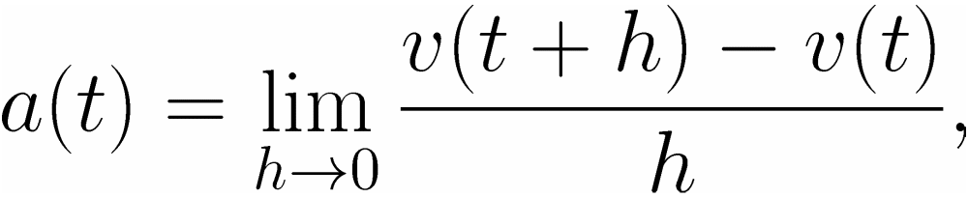
INSTANTANEOUS ACCELERATION
The instantaneous acceleration of the particle at time is given by
if this limit exists.
UNIT 4.1 RECTILINEAR MOTION ANALYTIC GEOMETRY AND CALCULUS 1

Slide 9


If then the particle has constant velocity.
If then the velocity of the particle is increasing.
UNIT 4.1 RECTILINEAR MOTION ANALYTIC GEOMETRY AND CALCULUS 1

Slide 10

If then the velocity of the particle is decreasing or the velocity of the particle is increasing but moving to the opposite direction.
UNIT 4.1 RECTILINEAR MOTION ANALYTIC GEOMETRY AND CALCULUS 1

Slide 11
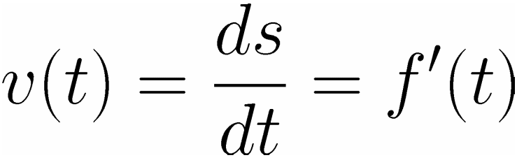
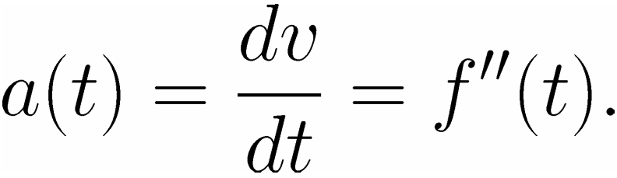
Note that, if then
and

Slide 12
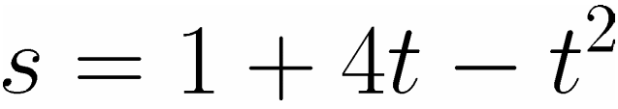

EXAMPLE. A particle is moving along a straight line according to the formula , where
meters is the distance of the particle from the origin at time seconds.
UNIT 4.1 RECTILINEAR MOTION ANALYTIC GEOMETRY AND CALCULUS 1

Slide 13

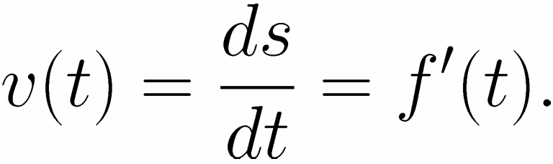
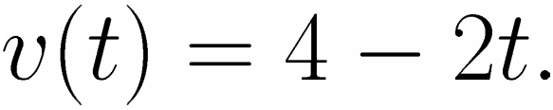

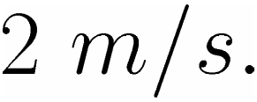
What is the instantaneous velocity of the particle at
If then
Now,
Hence, the instantaneous velocity at is
UNIT 4.1 RECTILINEAR MOTION ANALYTIC GEOMETRY AND CALCULUS 1

Slide 14
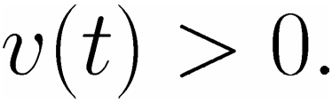


When is the particle moving to the right?
The particle is moving to the right if
Then,
Solving for will give
UNIT 4.1 RECTILINEAR MOTION ANALYTIC GEOMETRY AND CALCULUS 1

Slide 15
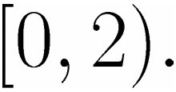
When is the particle moving to the right?
The particle is moving to the right on the time interval
UNIT 4.1 RECTILINEAR MOTION ANALYTIC GEOMETRY AND CALCULUS 1

Slide 16
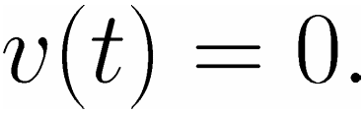


When is the particle at rest?
The particle is moving to the right if
Then,
Solving for will give
UNIT 4.1 RECTILINEAR MOTION ANALYTIC GEOMETRY AND CALCULUS 1

Slide 17
When is the particle at rest?
The particle is at rest at seconds.
UNIT 4.1 RECTILINEAR MOTION ANALYTIC GEOMETRY AND CALCULUS 1

Slide 18
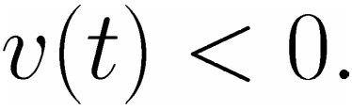


When is the particle moving to the left?
The particle is moving to the left if
Then,
Solving for will give
UNIT 4.1 RECTILINEAR MOTION ANALYTIC GEOMETRY AND CALCULUS 1

Slide 19
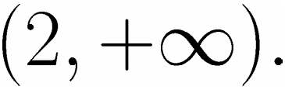
When is the particle moving to the left?
The particle is moving to the left on the time interval
UNIT 4.1 RECTILINEAR MOTION ANALYTIC GEOMETRY AND CALCULUS 1

Slide 20
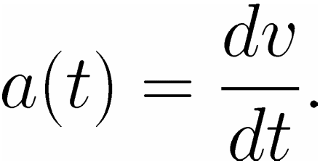
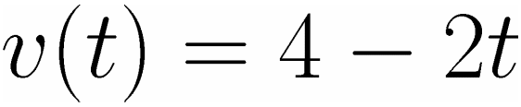
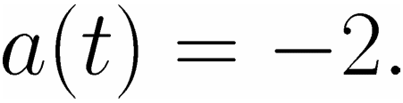
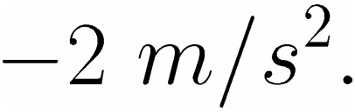
What is the instantaneous acceleration at
Given ,
Now,
Hence, the instantaneous acceleration at is
UNIT 4.1 RECTILINEAR MOTION ANALYTIC GEOMETRY AND CALCULUS 1

Slide 21
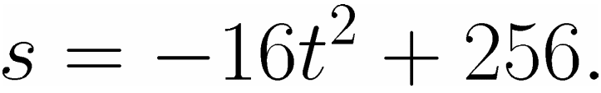
EXAMPLE. A stone is dropped from the top of a building. The stone’s distance (in feet) from the ground at time seconds is given by
UNIT 4.1 RECTILINEAR MOTION ANALYTIC GEOMETRY AND CALCULUS 1

Slide 22
a. What is the height of the building?
UNIT 4.1 RECTILINEAR MOTION ANALYTIC GEOMETRY AND CALCULUS 1

Slide 23

What is the instantaneous velocity
of the stone at
UNIT 4.1 RECTILINEAR MOTION ANALYTIC GEOMETRY AND CALCULUS 1

Slide 24
When will the stone hit the
ground?
UNIT 4.1 RECTILINEAR MOTION ANALYTIC GEOMETRY AND CALCULUS 1

