Slide 1
5.4 The Definite Integral and Area of a Plane Region

Slide 2
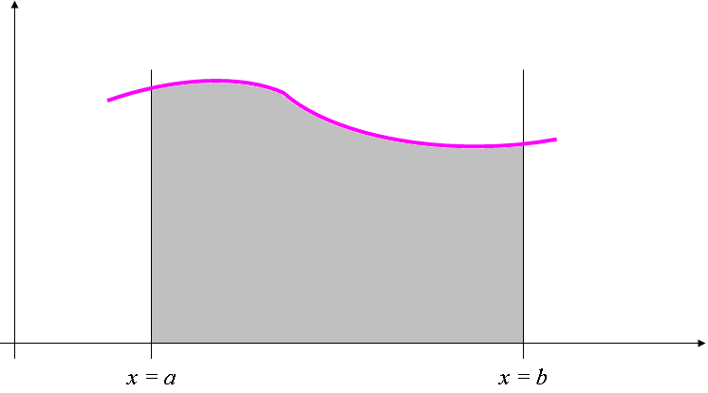

Consider the region R bounded by the graph of f, the lines x = a and x = b, and the x-axis.
Divide the interval [a,b] into n subintervals not necessarily equal in length.
R
Δ₁x
Δ₂x
Δ₃x
Δ_{n}x
ε₁
ε₂
ε₃
ε_{i}
ε_{n}
x₀
x₁
x₂
x₃
x_{i-1}
x_{i}
x_{n-1}
x_{n}
Area of the
Δ _{i} x = x_{i} – x_{i-1}
1st rectangle: f(ε₁) Δ₁x
3rd rectangle: f(ε₃) Δ₃x
2nd rectangle: f(ε₂) Δ₂x
i^{th} rectangle: f(ε_{i}) Δ_{i} x

Slide 3
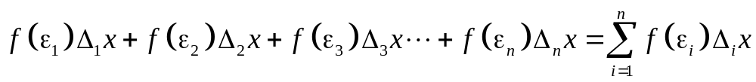


R
Δ₁x
Δ₂x
Δ₃x
Δ_{i}x
Δ_{n}x
ε₁
ε₂
ε₃
ε_{i}
ε_{n}
The area of R is approximated by the
Reimann Sum
The geometric interpretation of the Riemann sum is the sum of the areas of the rectangles with width and length

Slide 4
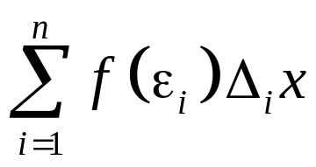
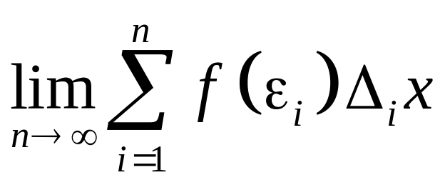
R
Δ₁x
Δ₂x
Δ₃x
Δ_{n}x
ε₁
ε₂
ε₃
ε_{i}
ε_{n}
Riemann sum:
The area of R is equivalent to

Slide 5
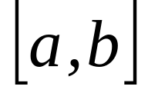

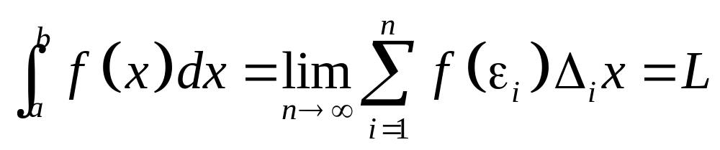
Definition. If no matter how we subdivide
and no matter which numbers ’s we choose in each subinterval,
exists and is equal to a real number L, we say that f is integrable on
and the number L is called the definite integral of f on . We denote this by writing

Slide 6
5.5 Theorems on
Definite Integrals

Slide 7
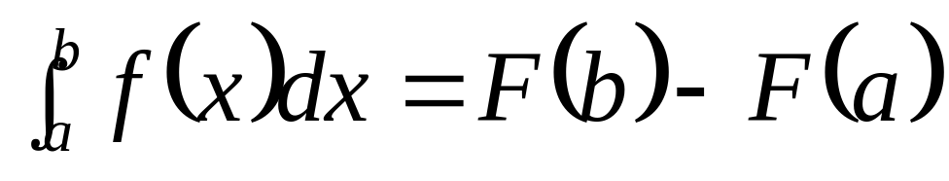
Theorem 1 The Fundamental
Theorem of Calculus
Let the function f be continuous on the closed interval and F be an antiderivative of f on the interval . Then

Slide 8
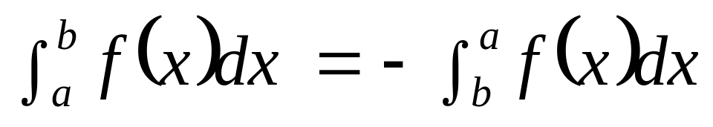
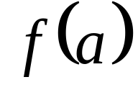
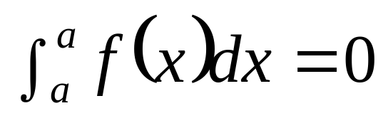
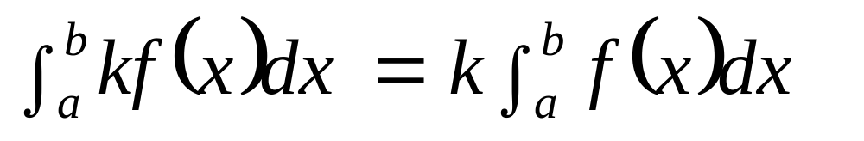
Theorem 2
Theorem 3 If is defined,
Theorem 4
for any real constant k.

Slide 9
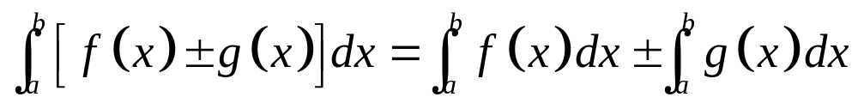
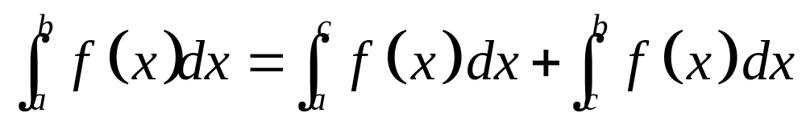
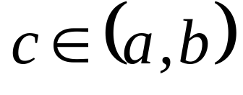
Theorem 5
Theorem 6
for each .

Slide 10
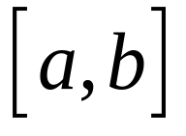
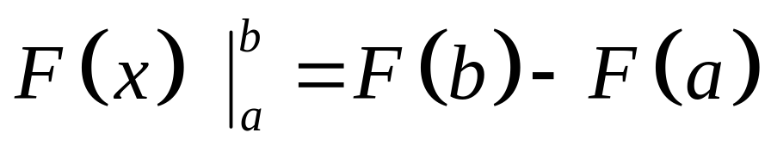
Remark
If a function F is defined at each number in , then

Slide 11
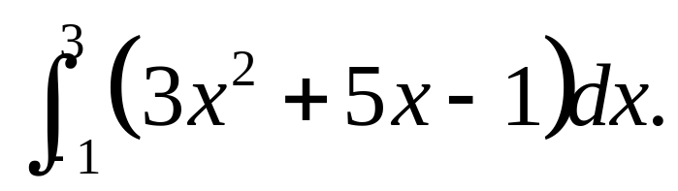
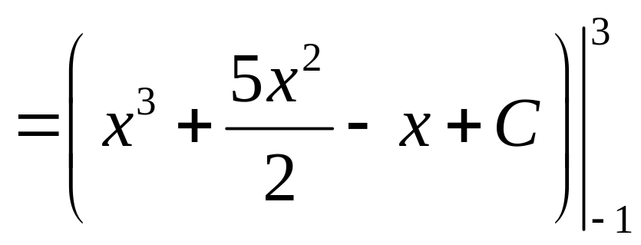
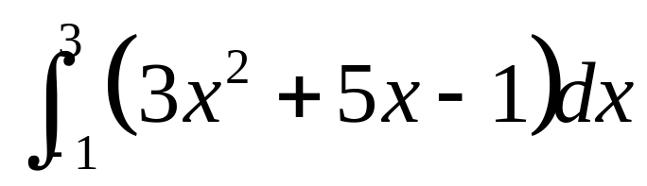
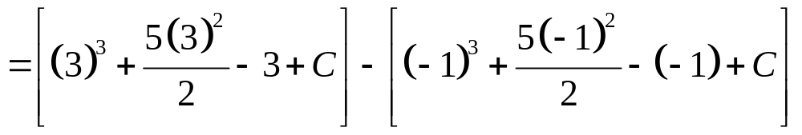
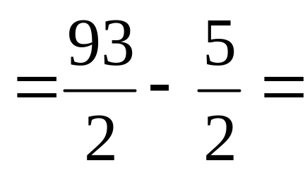
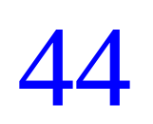
Example 1. Evaluate
Solution:

Slide 12
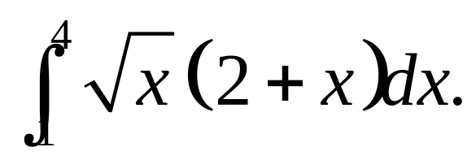
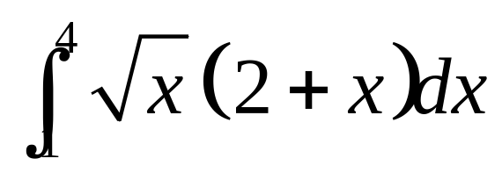
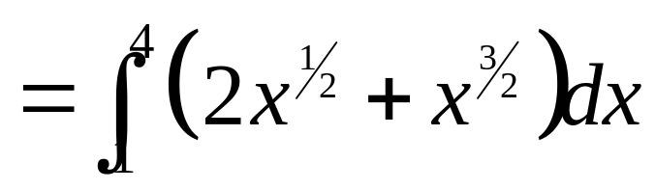
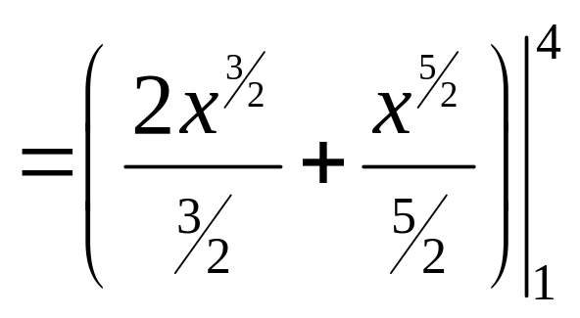
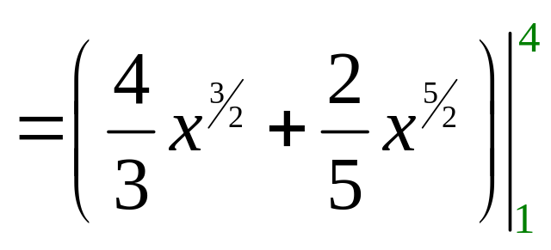
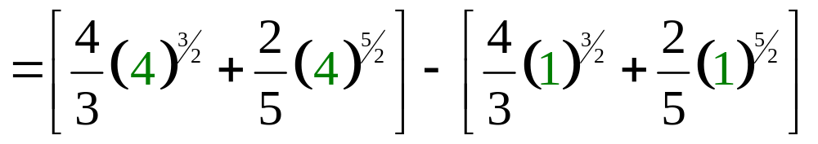
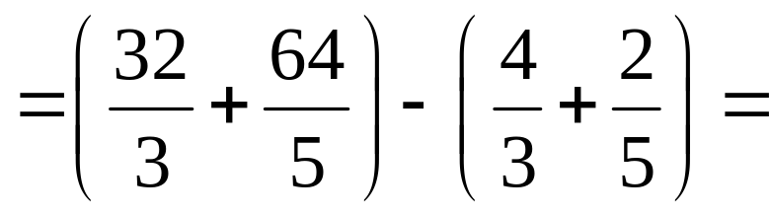
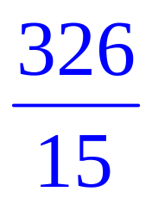
Example 2. Evaluate
Solution:

Slide 13
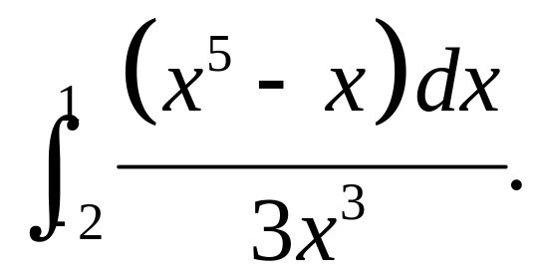
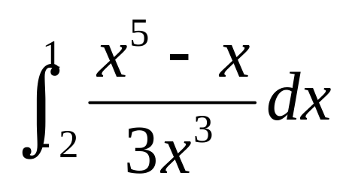
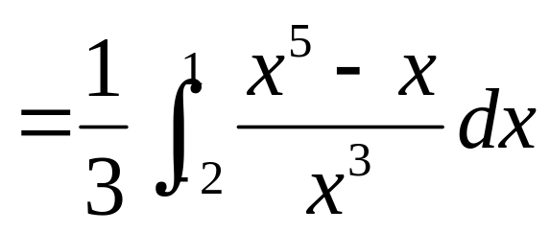
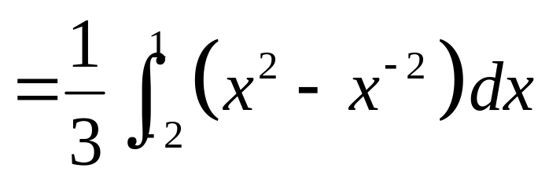
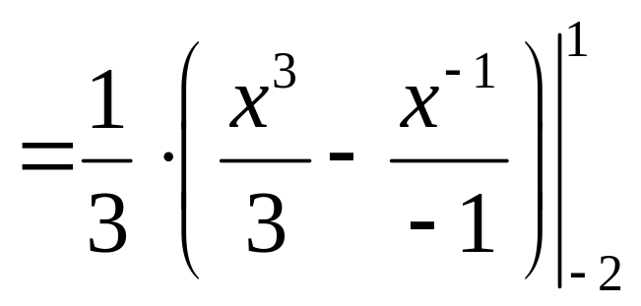
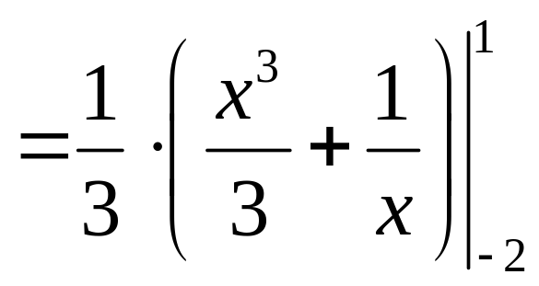
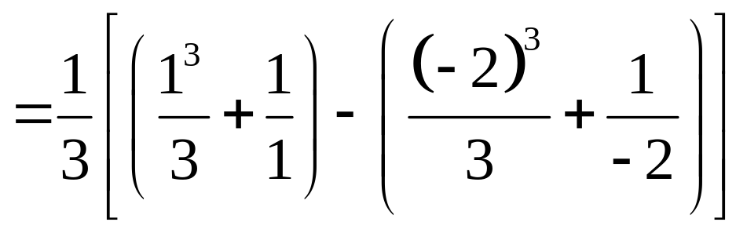
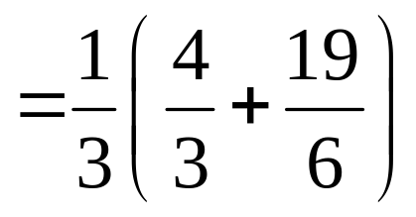
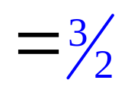
Example 3. Evaluate
Solution:

Slide 14
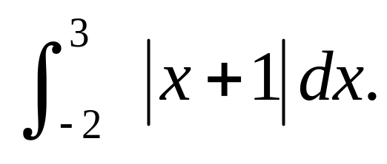
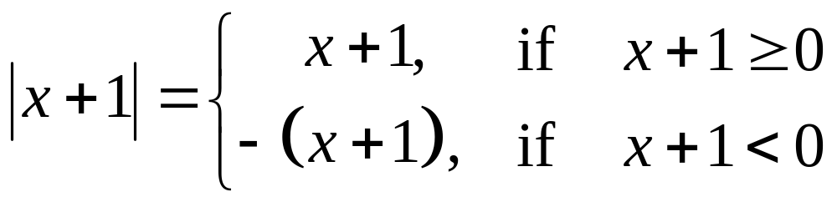
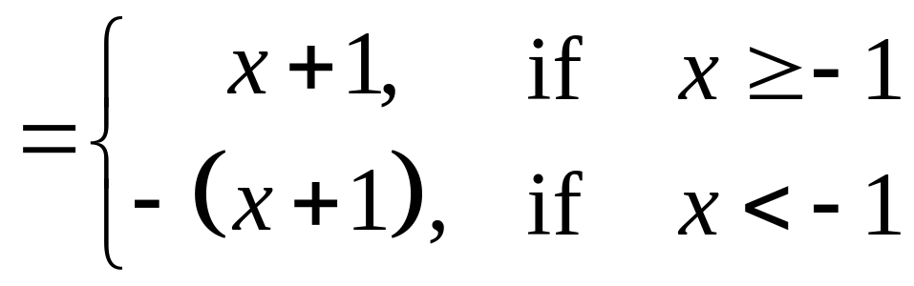
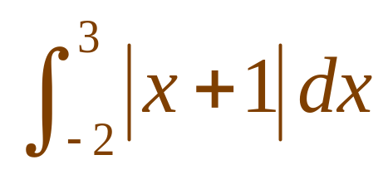
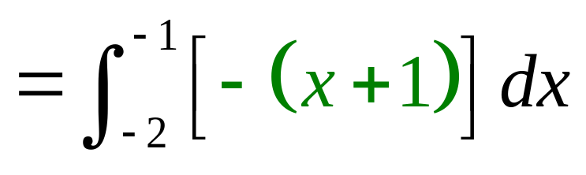
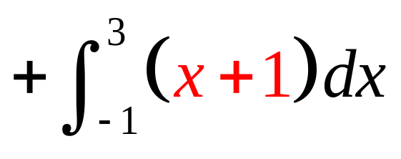
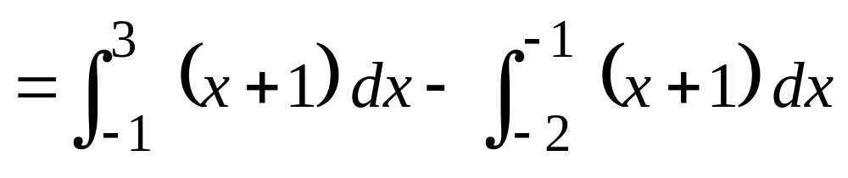
Example 4.
Evaluate
Solution:
-(x+1)
x+1
-2
-1
3

Slide 15
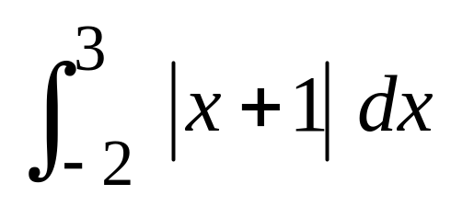
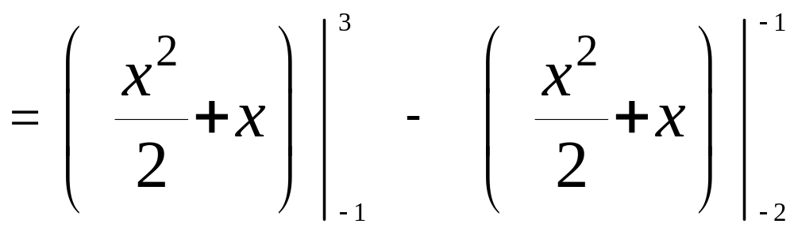
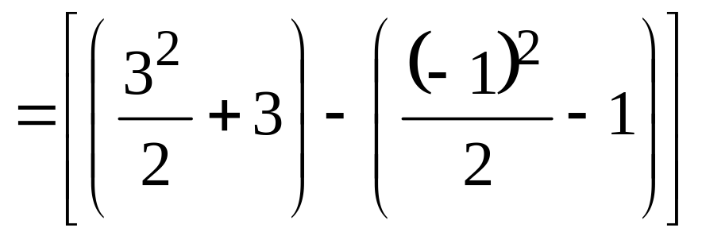
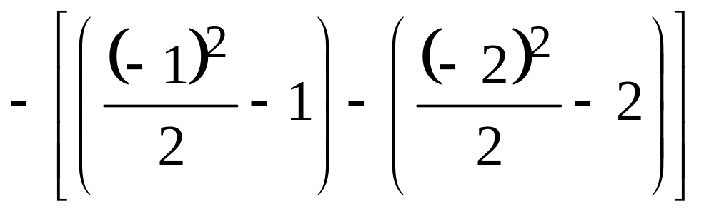



Slide 16














Example 5.
Evaluate
Solution:
Let

Slide 17






Example 5.
Evaluate
Alternative Solution:
Let

Slide 18










Example 6. Evaluate
Solution:
Let

Slide 19






Slide 20
5.6 Area of a Plane Region

Slide 21





Let f be a function of x which is continuous and non-negative on the closed interval
Subdivide the closed interval into n sub-intervals by choosing intermediate numbers , where

Slide 22
For example, if we want to subdivide [a,b] into 2 sub-intervals, we only choose one number x₁ between a and b.
|
|
|
a
x₁
b
If we want to subdivide [a,b] into 3 sub-intervals, we choose two numbers x₁ and x₂ between a and b.
|
|
|
|
a
x₁
x₂
b

Slide 23










y
Denote the ith sub-interval by I_{i} so that
y = f(x)
|
|
x
|
|
|
|
a
x₁
x_{i-1}
x_{i}
x_{n-1}
b
For each , choose a number

Slide 24






Denote the length of the ith sub-interval by
so that

Slide 25
y
Our objective is to find a formula for the area of the region R enclosed by the graph of f, the x-axis and the lines given by x = a and x = b.
y = f(x)
R
|
|
x
a
b

Slide 26




On the ith sub-interval, construct a rectangle of length and whose width is .
y
y = f(x)
|
|
|
x
|
|
|
a
x₁
x_{i-1}
x_{i}
x_{n-1}
b

Slide 27







The area of the ith rectangular region is
Thus, the sum of areas of all n rectangular regions is
or
The area of the region R is given by

Slide 28
y
y = f(x)
R
|
|
x
a
b

Slide 29


Thus, the area of the region R is given by
width of a rectangular element
Length of a rectangular element

Slide 30





Example 1
Using vertical strips find the area of the region bounded by , and the line
Solution

Slide 31







So,

Slide 32





Example 2
Find the area of the region bounded by
and the x-axis using vertical strips.
Solution
or
(Verify)

Slide 33








Example 3 Find the area of the region enclosed by the graphs of
Solution:
Thus, the area of the region is 7/3 sq. units.

Slide 34





Let g be a function of y which is continuous and non-negative on the closed interval
The area of the ith rectangular region is
y
y = d
The area of the region R is given by
x = g(y)
y = c
x

Slide 35





Example 4
Find the area of the region bounded by the curves and the lines
Solution

Slide 36



sq units

Slide 37












Example 5 Find the area of the region in the first quadrant enclosed by the graphs of
Solution:
Thus, the area of the region is 14/3 sq. units.

Slide 38






Theorem 3.1.1 Let f and g be functions continuous
on and for all
Consider the region bounded by the graph of the curves f and g and the lines given by
Then the area of the said region is given by

Slide 39








Slide 40




Example 3.1.4 Set-up the definite integral that gives the area of the region bounded by the graphs of and the y-axis.
Solution:
y=f(x) = 9
(2,9)
g(x) =x²+5

Slide 41






Theorem 3.1.2 Let f and g be functions continuous
on and for all
Consider the region bounded by the graph of f and g and the lines given by
Then the area of the said region is given by

Slide 42







Slide 43
















Example 3.1.5. Find the area of the region bounded by the graphs of
Solution:
Points of intersection:
(1,1)
Using vertical strips,
Using horizonal strips,
(Verify!)

Slide 44





Example 3.1.6 Set-up the definite integral that gives the area of the region bounded by the graphs of and y = x – 3.
Solution:
(5,2)
(2,-1)
x = y + 3
x = y² +1
y² = x - 1
y = x - 3

Slide 45
END

