Slide 1
Designing Web Applications

Slide 2
Objectives
At the end of the session, you should be able to:
  discuss n-tier architecture
  differentiate several design patterns used in web applications

Slide 3
_{mainframe}
_{terminals}
_{terminals}
_{Centralized, non-distributed}

Slide 4
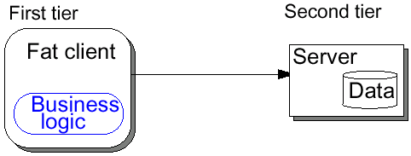

Slide 5
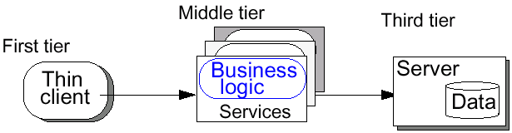

Slide 6
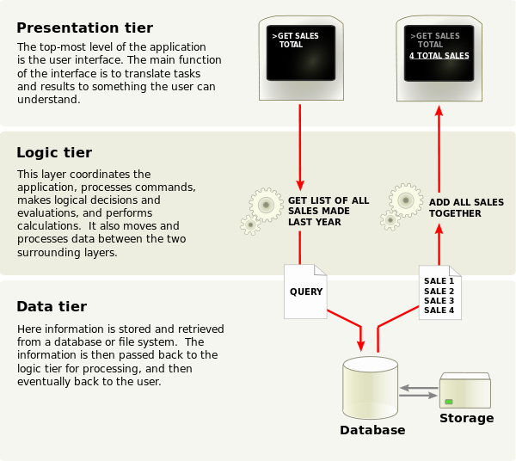

Slide 7
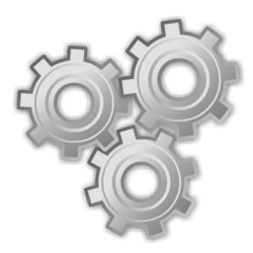
_{Internet Browser}
_{Web Server}
_{(HTTP Server)}
_{HTTP}

Slide 8
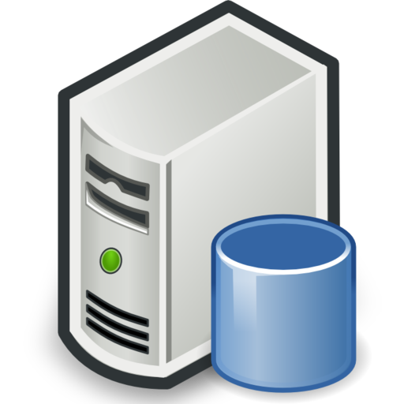
_{Internet Browser}
_{Web Server}
_{(HTTP Server)}
_{HTTP}
_{DB}

Slide 9

_{Internet Browser}
_{Web Server}
_{(HTTP Server)}
_{HTTP}

Slide 10
<% //script
connect to db
display on form/table …
%>

Slide 11
MVC
Model – Model receives input from the controller and decides what data it needed to fulfill the request raised by the controller. Model is also capable of doing transactions with databases or other persistent storage as needed. Once it gathers the required information, it informs the view (via controller) about the new data by raising appropriate events.
View – View hosts all the UI controls needed by the end-user to interact with the application. Its job is to monitor end-user gestures and pass it to the controller for further handling. View handles the event notification received from the Model and may request for any new data required to render it on the screen. However, in some variations, Controller can be designated to retrieve dataset from the Model, format it and send it to the View. Here the view’s job is to render the data received from the view without any other processing.
Controller – Controller can be imagined as an extension or a personal assistant to the view, all the events originated from the view is handled by the controller. Controller will also inform the Model on behalf of view that some event happened on the view and some new data might be required.

Slide 12
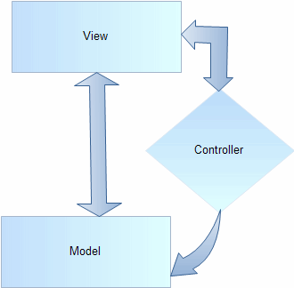
MVC
Ex:
Yii, Code Igniter

Slide 13
MVP
Model - Model can be thought of as the interface to the data. Any part of the program which needs some data to work on must go through the interface or functions defined by the developer who is maintaining the model part. Typically, model houses all the validation routines for the data submitted by the end user
View – View, as the name implies, is the part where end user interacts. The development of this part can be delegated to a specialized designer. A program may have any number of views.
Presenter – Presenter acts as an intermediary to make the decoupling possible. All the business logic required for responding to a user event is written inside the Presenter layer. Typically the view only has the event handler and the logic to call the appropriate presenter functions, helping the person working on the view to concentrate upon designing the user interface without worrying about the code behind file. Presenter is also responsible for retrieving the requested data from the model and formats it so that the view can render it without any overhead.

Slide 14
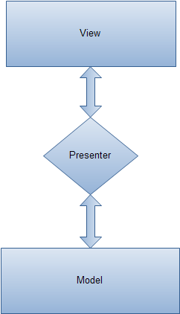
MVP
Ex: Vaadin implementation

Slide 15
MVC vs MVP
MVP Pattern
  View is more loosely coupled to the model. The presenter is responsible for binding the model to the view.
    Easier to unit test because interaction with the view is through an interface
  Usually view to presenter map one to one. Complex views may have multi presenters.
MVC Pattern
  Controller are based on behaviors and can be shared across views
  Can be responsible for determining which view to display

Slide 16
MVVM
View: as in the classic MVC pattern, the view refers to all elements displayed by the GUI such as buttons, labels, and other controls.
View model: the view model is a “model of the view” meaning it is an abstraction of the view that also serves in mediating between the view and the model which is the target of the view data bindings. It could be seen as a specialized aspect of what would be a controller (in the MVC pattern) that acts as a converter that changes model information into view information and passes commands from the view into the model. The view model exposes public properties, commands, and abstractions.

Slide 17
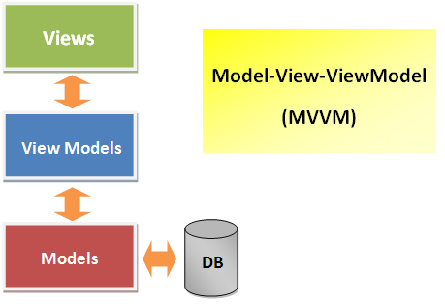
MVVM
Ex: .NET

Slide 18
MVP vs MVVM
one VM can have multiple views because it isn't tied to a view (multiple views can utilize one VM)
with MVP, you have to create a Presenter for every view

Slide 19
MVC Push vs Pull
Push and pull describe the relation between the View and the Controller
Push: user actions should be interpreted by the Controller which will generate the data and push it on to the View
Pull: The View will access the Controller in order to get the data it needs in order to display the user the kind of output he requested; the View is “pulling” data from the Controller

Slide 20
Web Application Frameworks

Slide 21
Objectives
At the end of the session, you should be able to:
  define Web Application Framework (WAF)
  discuss features that a WAF may provide

Slide 22
Web Application Framework (WAF)
a software framework that is designed to support the development of web applications
aims to alleviate the overhead associated with common activities performed in web development
many frameworks provide libraries for database access, templating frameworks and session management
promotes code reuse

Slide 23
Features of a WAF
May provide one or more of the following
Caching
Security
Database access,
mapping, and configuration
Scaffolding

Slide 24
Comparison of Web Application Frameworks
http://en.wikipedia.org/wiki/Comparison_of_web_application_frameworks

