Slide 1
Sales Report
Ferry M Suhendra
Data Analyst
23 January 2023

Slide 2
Agenda
01. Introduction
02. Data Visualization
Problem Statement
Objectives
Monthly Sales
Pareto & Regular Sales
Customer Value
03. Suggestions
04. Review
Business Suggestion
Further Analysis

Slide 3
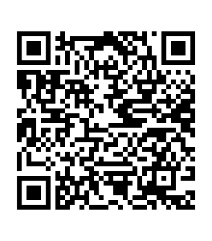
Introduction
Problems Statements
How does current sales metrics compares to Sales goal set beforehand?
Which customer should be prioritized in order to increase sales revenue?
Objectives
Visualize sales number in the last 3 years (2019-2021).
Identify high impact customers what affects sales the most.
Find patterns and trends in customer behavior.
Tableau Dashboard

Slide 4
Data Visualization

Slide 5
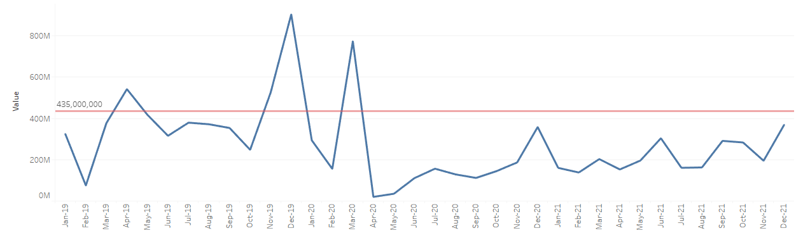
Monthly Sales

Slide 6

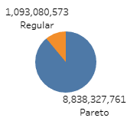
Yearly Sales
Pareto & Regular sales

Slide 7
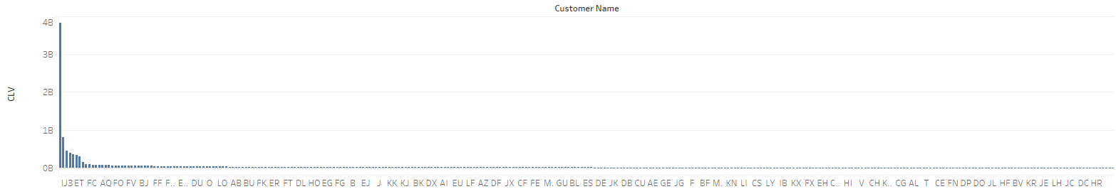
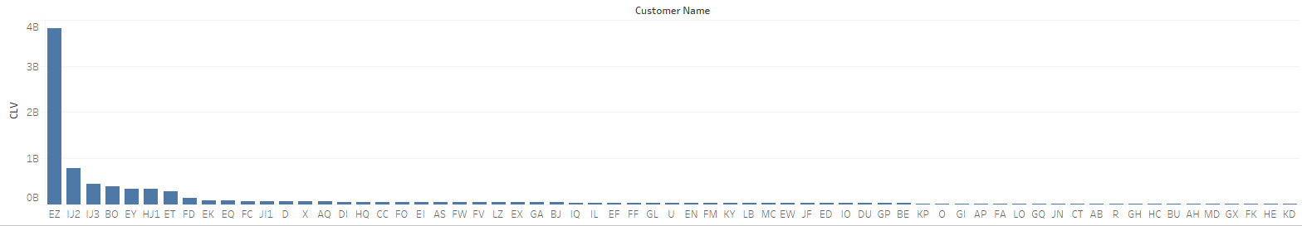
Customer Value
All Customers
Pareto Customers only

Slide 8
Customer Value (continued)

Slide 9
Sugestions
Business
Further Analysis
Increase customer satisfaction of Pareto Customer
Maintain communications with Pareto Customers
Plan marketing campaign for covid-19 recovery
Find reasons of customer churn
Survey customer satisfaction

Slide 10
Summary
Our business is good
Our customers keep coming back
Profits are up in the last quarter by 3%
We increased customer retention by 4%
We’re getting our work done
We’re leaders
We finished the consolidation project
We are top leaders in the industry
across the board
We’re delivering for our customers
Last year we supported thousands of customers and
sold 60,000 units

Slide 11

Thank you
Ferry M Suhendra

