Slide 1


Slide 2
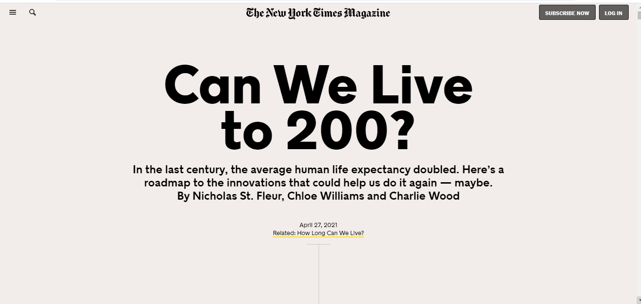

US government approves retirement for JavaScript developers at 165 years old.
WHAT?
Retired

