Slide 1
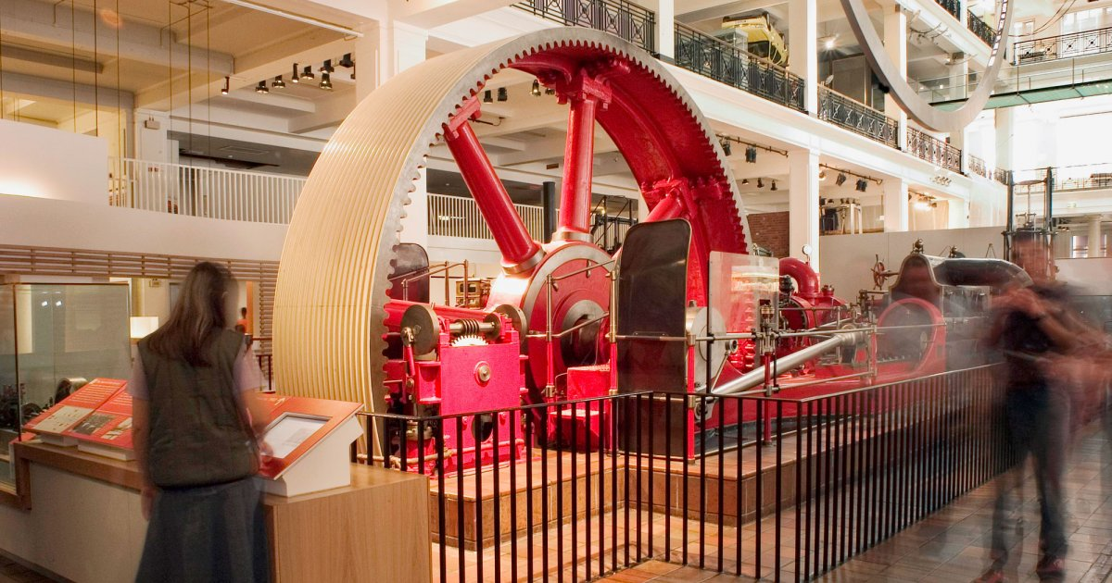
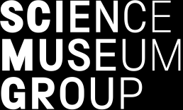
LEE/SEM Data Findings
Xi & Farah
Date of Presentation: 30 November, 2020

Slide 2



CONTENT
INTRODUCTION
AIMS, OBJECTIVES,METHODS
MAIN FINDINGS
CONCLUSIONS RECOMMENDATIONS
Notes:
Hi Everyone, today Farah and I will briefly introduce the Science engagement measures project we’ve been working on lately, some main findings and key conclusions as well as recommendations.

Slide 3
INTRODUCTION
Science Museum Exit Survey Data
2009-2019
Life Enhancing Experiences (LEE)
Science Engagement Measures (SEM)

Slide 4
2016: 3 changes
LIFE ENHANCING EXPERIENCES
Our visit today was enjoyable;
Our visit today was interesting (taken out from 2016/17);
The visit brought science and technology alive for me;
I have learnt something new today;
The visit made me want to learn more/continue exploring about some of the things discovered here;
During our visit we talked to each other about what we were looking at and what we were doing;
I feel the Science Museum is a place for me;
SCIENCE ENGAGEMENT MEASURES
Our visit today was enjoyable;
The visit brought science and technology alive for me;
I have found out something new today (reworded);
The visit made me want to learn more/continue exploring about some of the things discovered here;
During our visit we talked to each other about what we were looking at and what we were doing;
I feel the Science Museum is a place for me;
The things covered here are relevant to me and my life (added in from 2016/2017 onwards).

Slide 5
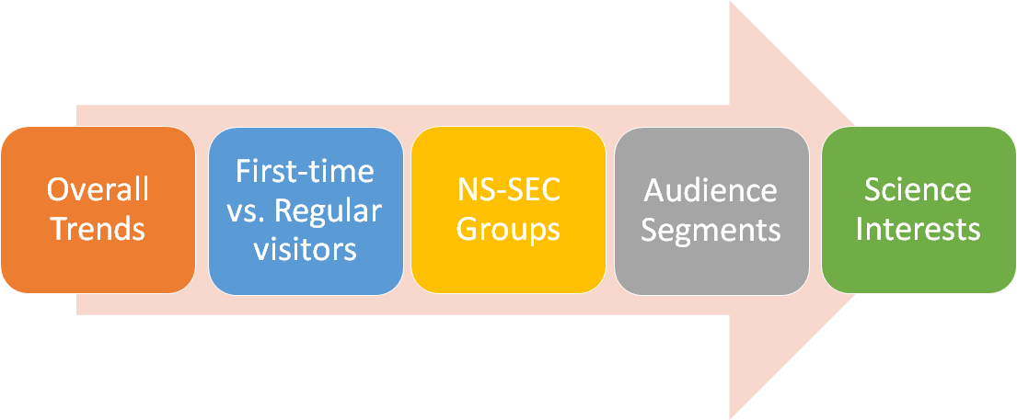
AIMS

Slide 6
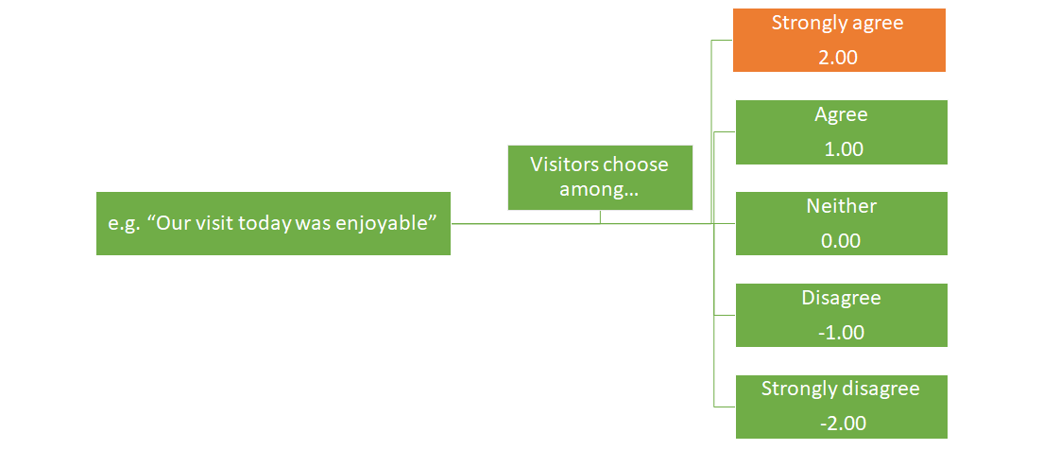
METHODS: “MEAN SCORE AVERAGE” & “PERCENTAGE OF STRONGLY AGREE”
Notes:
In the exit survey, the visitors were invited to choose options from strongly agree to strongly disagree, to indicate their strength of agreement with the statements (or) the science engagement measures like ‘Our visit today was enjoyable’. In the project, Farah and I mainly looked at two parameters, the percentage of ‘strongly agree’, and ‘mean score average’. The mean score average refers to a calculated parameter which could be used to indicate the strength of agreement, for example, if it is tending to 2.00, say, 1.5, then the responses shows a tendency of ‘strongly agree’ , if tending to 1.00, then ‘agree’.

Slide 7
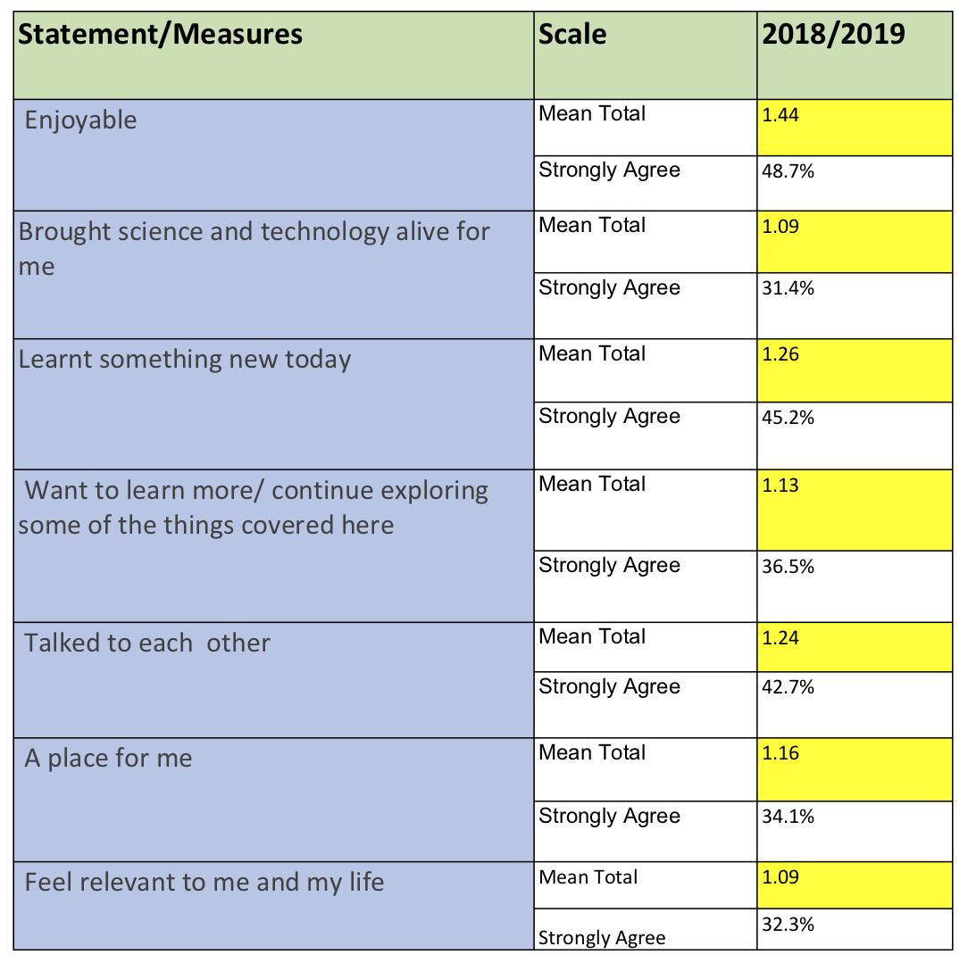
METHODS
1.19
A tendency towards a positive response – either agree or strongly agree
Quantitative Data Analysis

Slide 8

OVERALL TRENDS
How have visitors’ responses to the LEE/SEM changed over time?
What, if any trends, exist in the data?
Are there any points in time at which there has been a significant change in visitors’ response to the LEE/SEM?

Slide 9
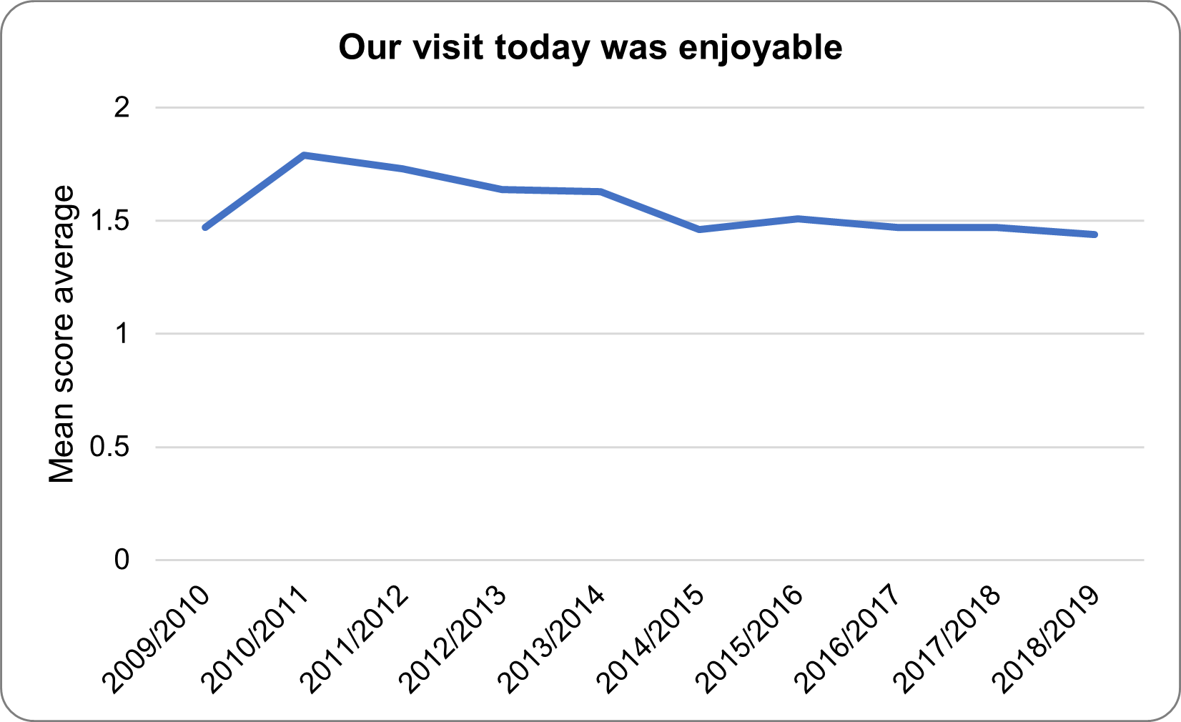
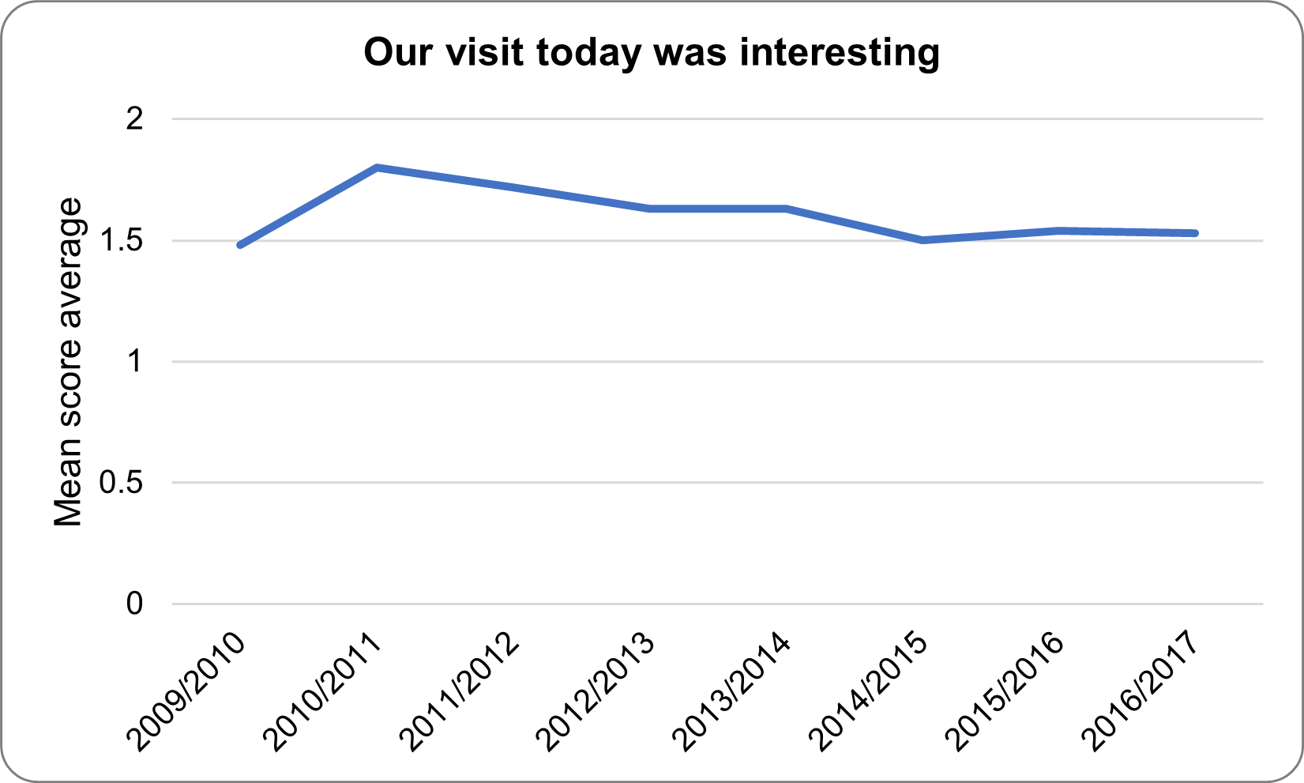
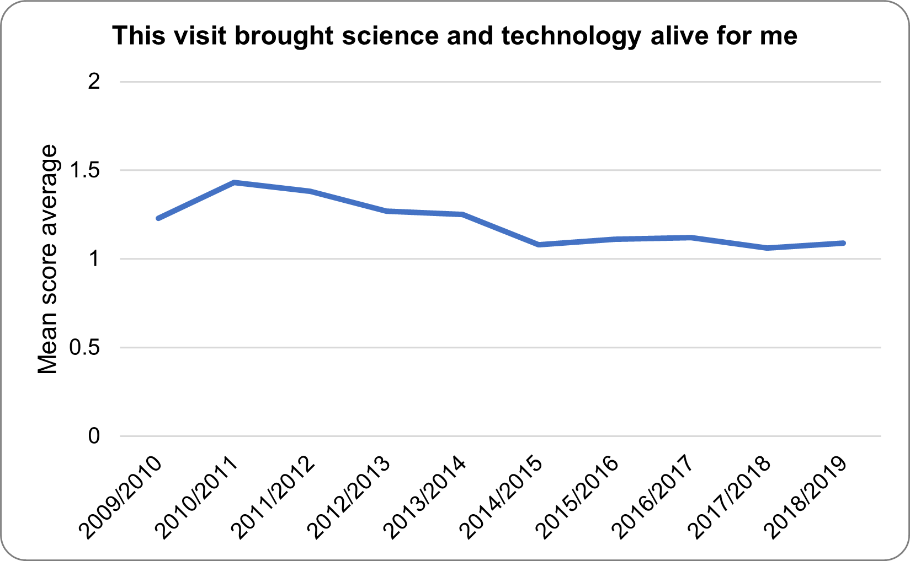
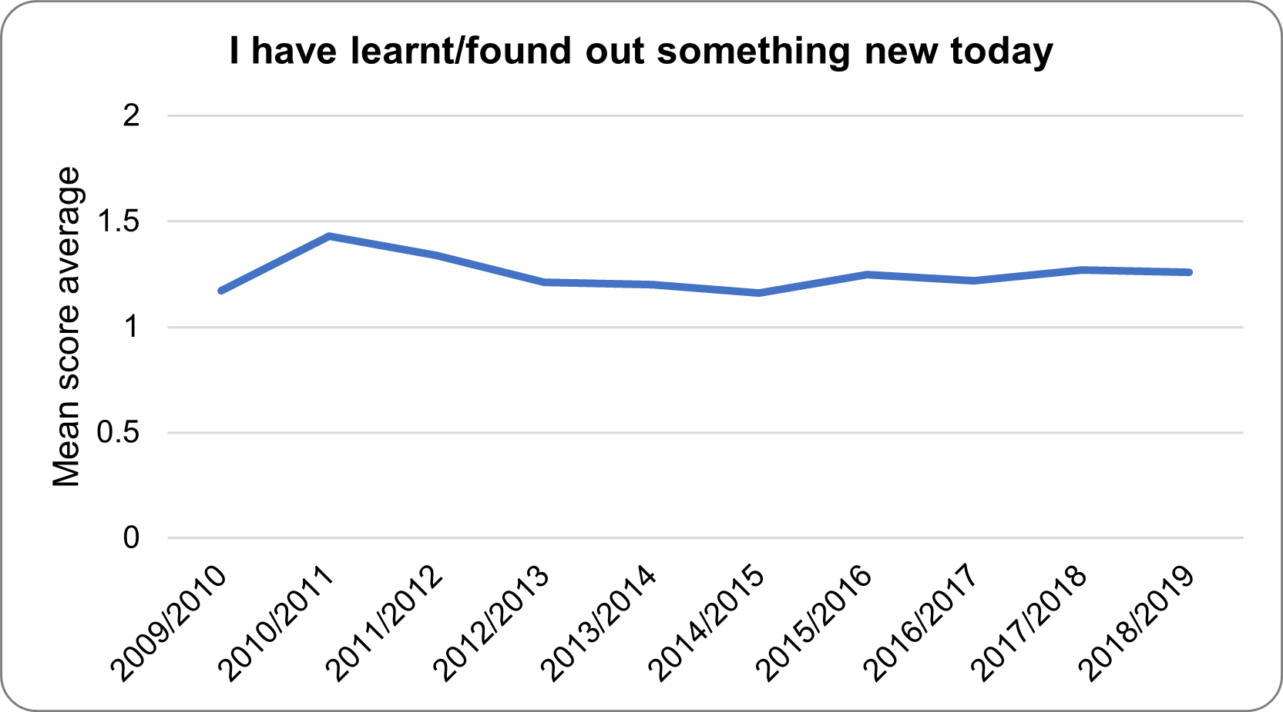
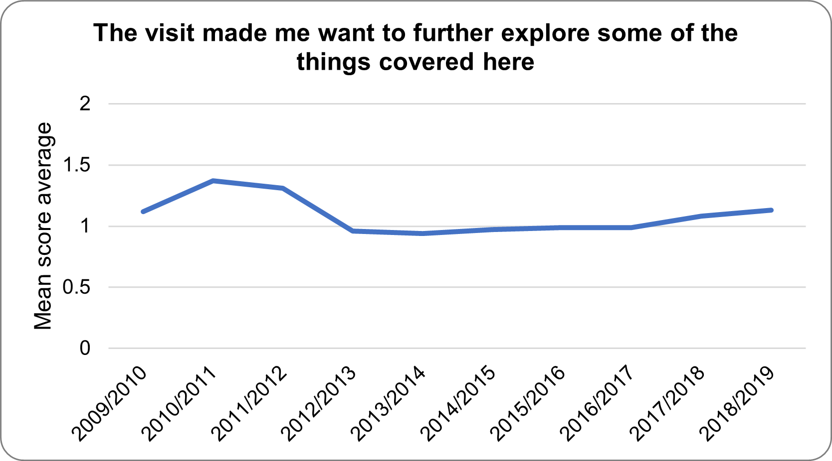
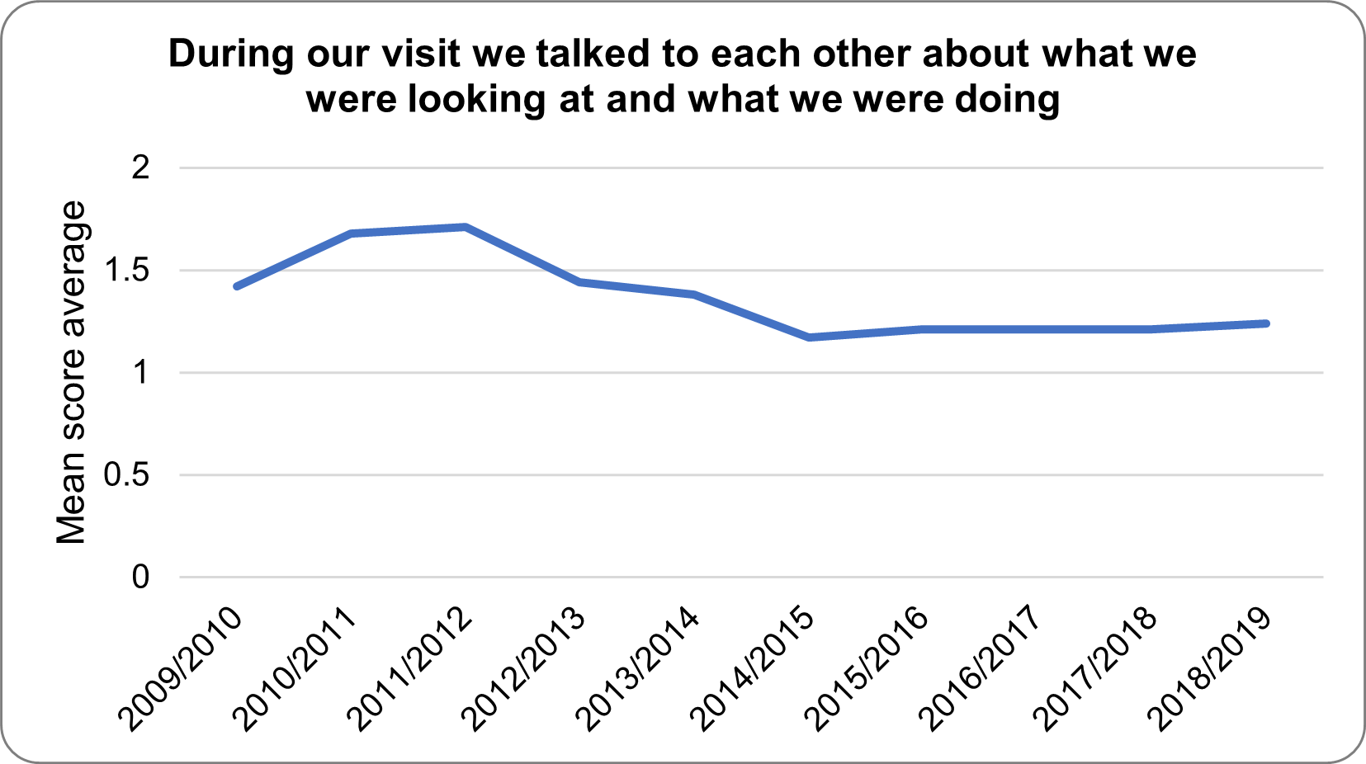
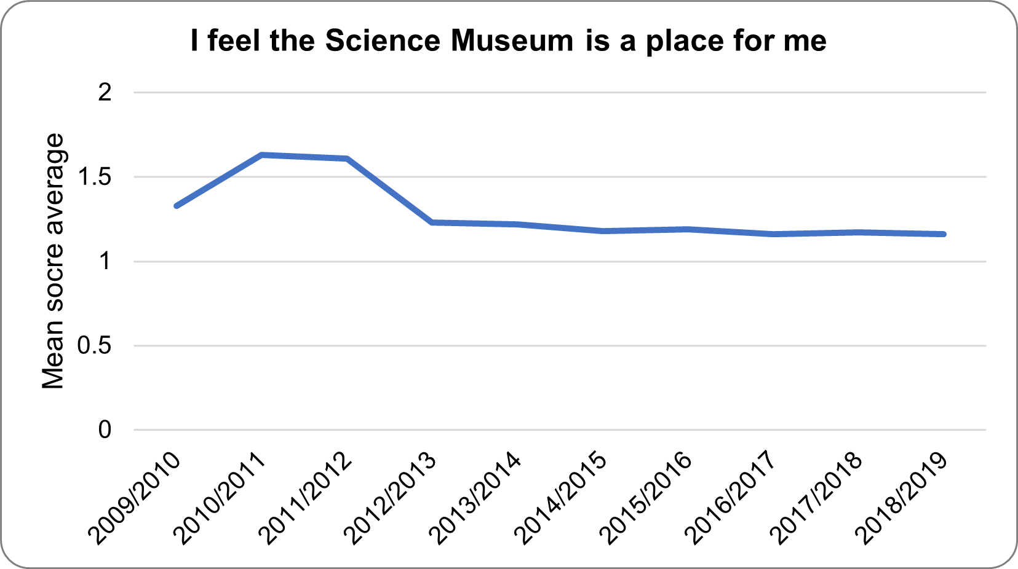
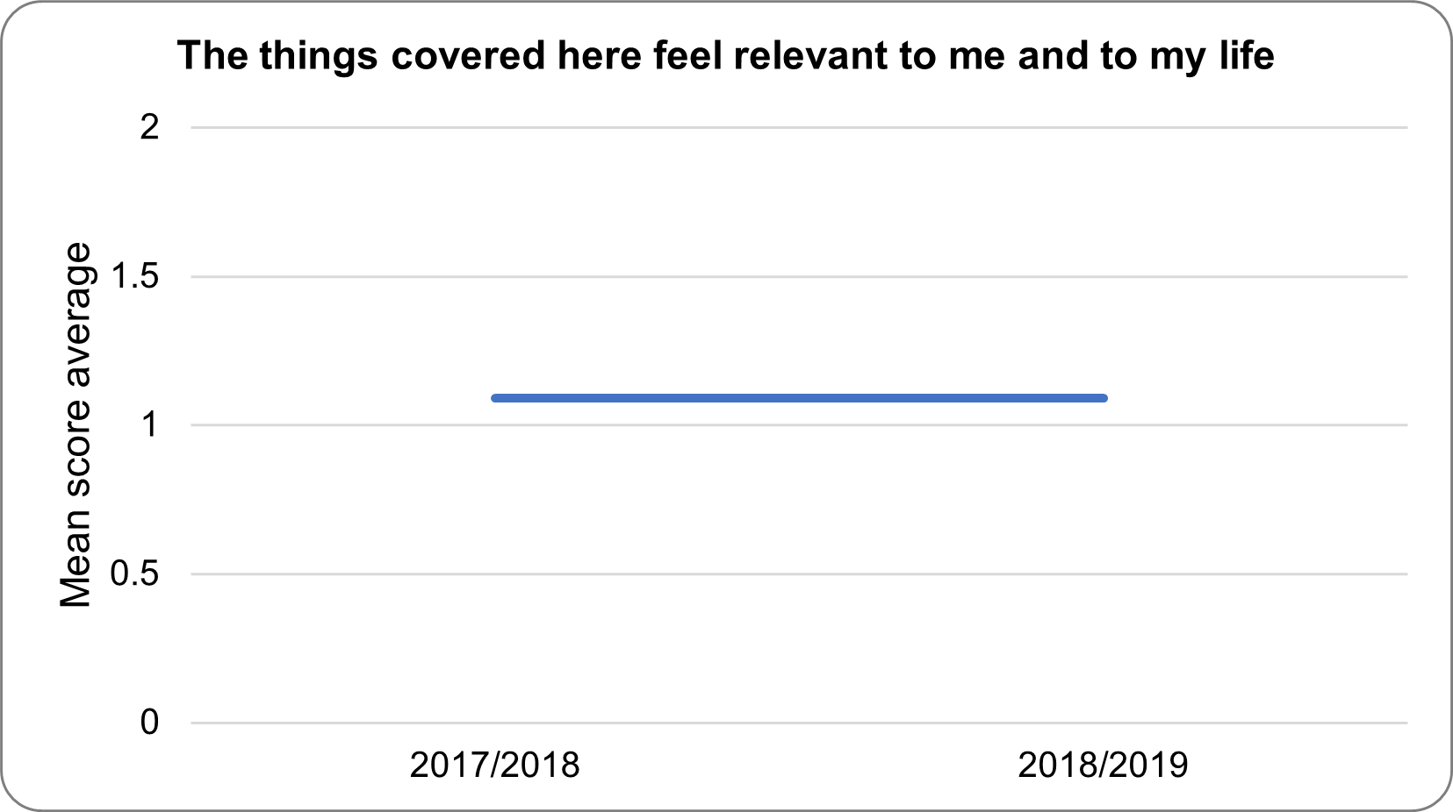
A GENERAL VIEW

Slide 10
A GENERAL LIST OF THE GALLERY/EXHIBITION OPENINGS
2010/2011
Redevelopment of the Wellcome Wing
Opened Atmosphere gallery
Relaunch of Who Am I? gallery
Relaunch of Antenna gallery
James Watt and Our World exhibition
First Time Out exhibition

Slide 11
FIRST-TIME VS. REGULAR VISITORS
How have first time visitors versus repeat visitors responded to the LEE/SEM?
Have they responded differently? if so how?
Does this change over time?

Slide 12

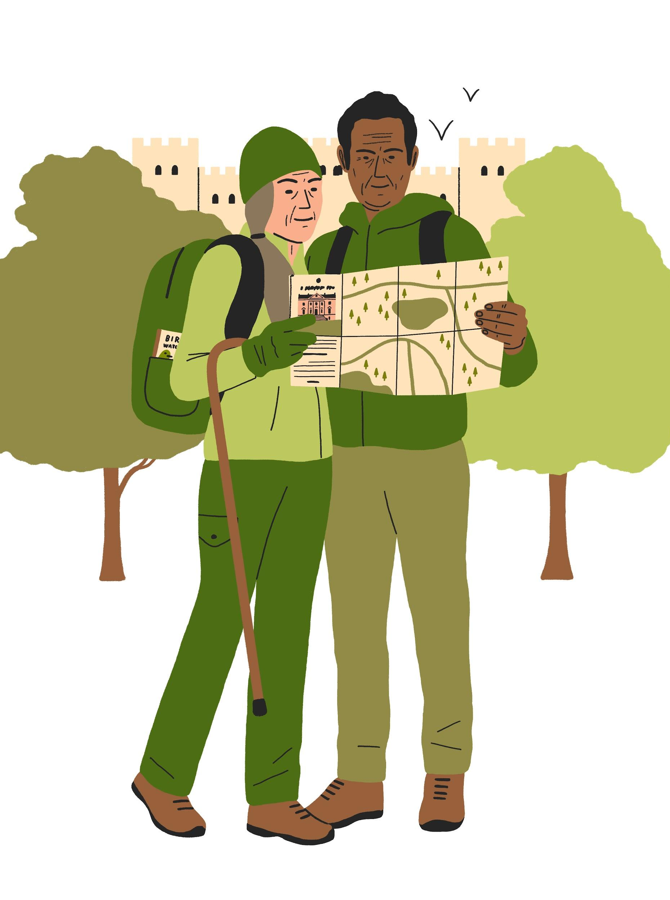

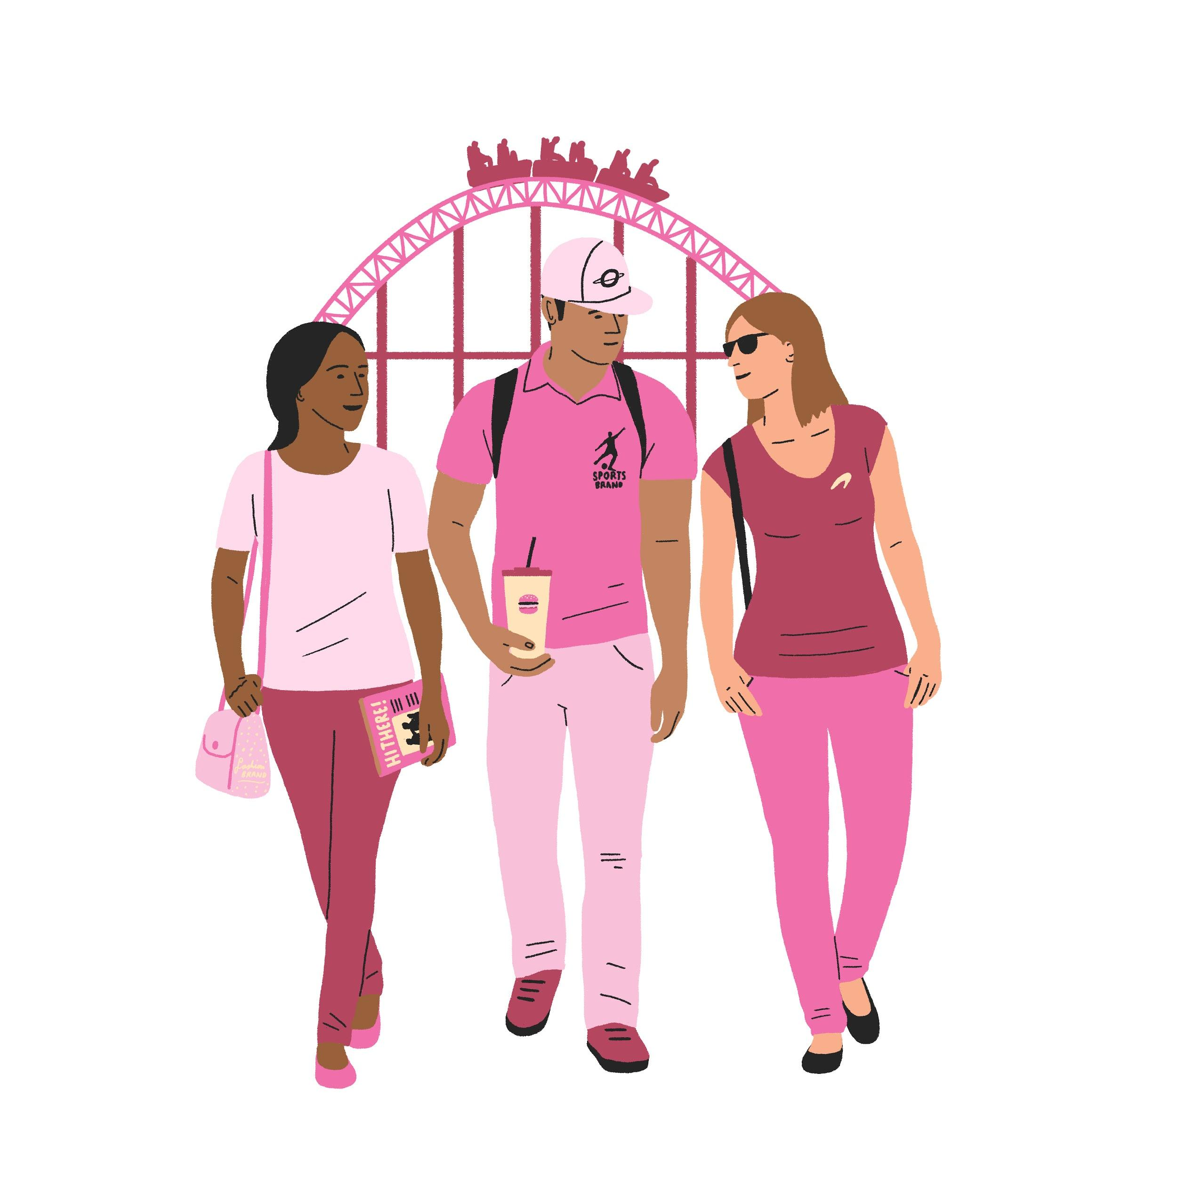
AUDIENCE SEGMENTS (FROM 2016)
Entertainment Seekers
Nostalgic Heritage Fans
Time Poor Aspirers
Engaged Community Drivers

Slide 13
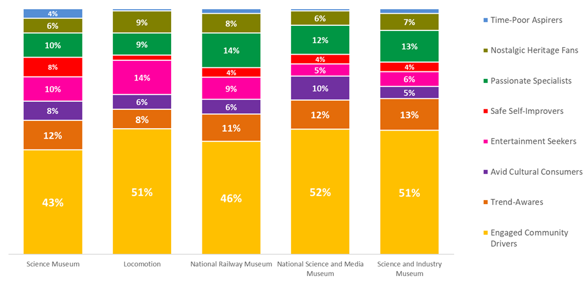
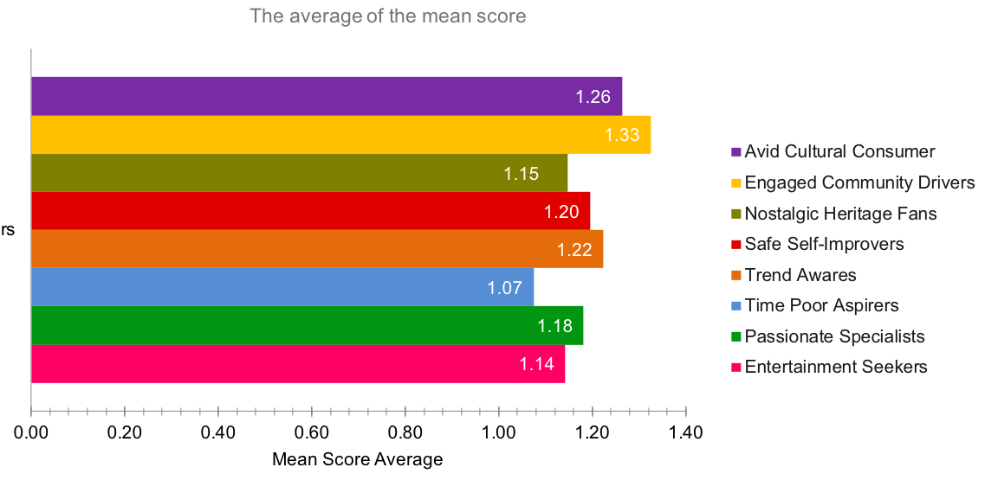


Slide 14
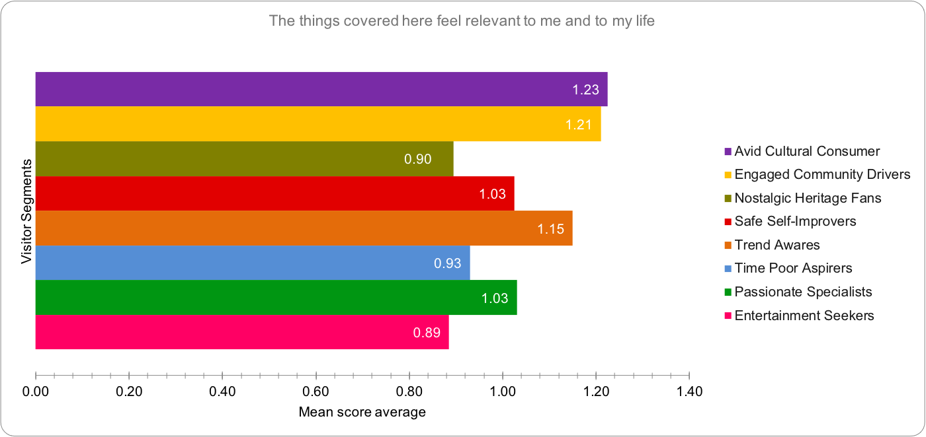

Slide 15
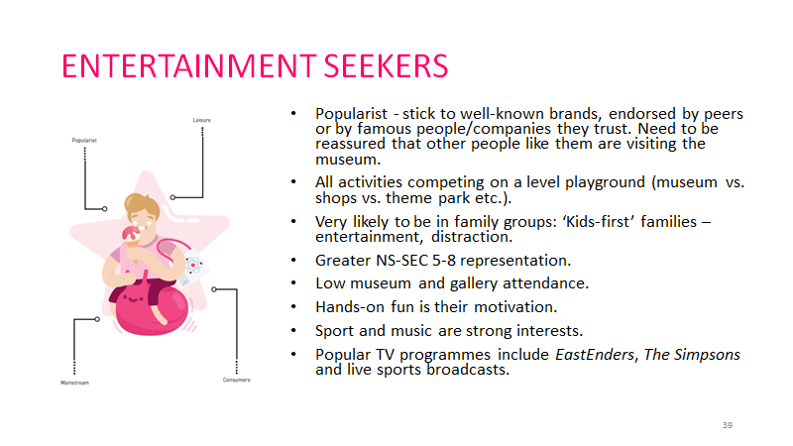

Slide 16
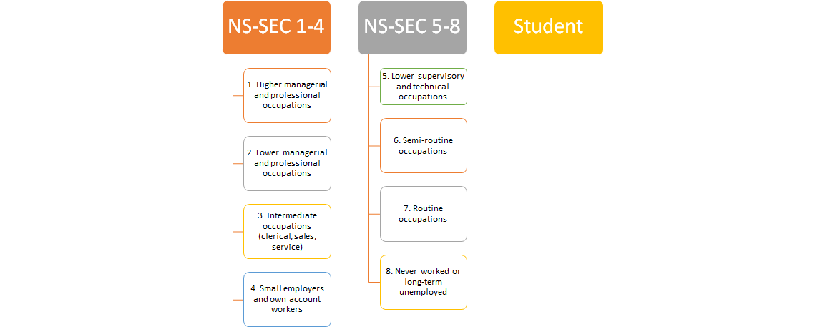
NS-SEC (NATIONAL STATISTICS SOCIO-ECONOMIC CLASSIFICATION) GROUP
It might be better for us to explore and understand more about our ‘non-visitors’ in the future.
Notes:
Moving to the NS-SEC Group section, Based on the 8-class version, the Science Museum has categorised the visitors into three interrelated groups: NS-SEC 1-4, NS-SEC 5-8 and Student, which is out of the national classification, but used by the organisation in the exit survey.

Slide 17
NS-SEC (NATIONAL STATISTICS SOCIO-ECONOMIC CLASSIFICATION) GROUP
Are there any differences in how NS-SEC 1-4/NS-SEC 5-8/Students respond to the to the LEE/SEM?
Do any of these responses change over time?
Notes:
Moving to the NS-SEC Group section, Based on the 8-class version, the Science Museum has categorised the visitors into three interrelated groups: NS-SEC 1-4, NS-SEC 5-8 and Student, which is out of the national classification, but used by the organisation in the exit survey.

Slide 18
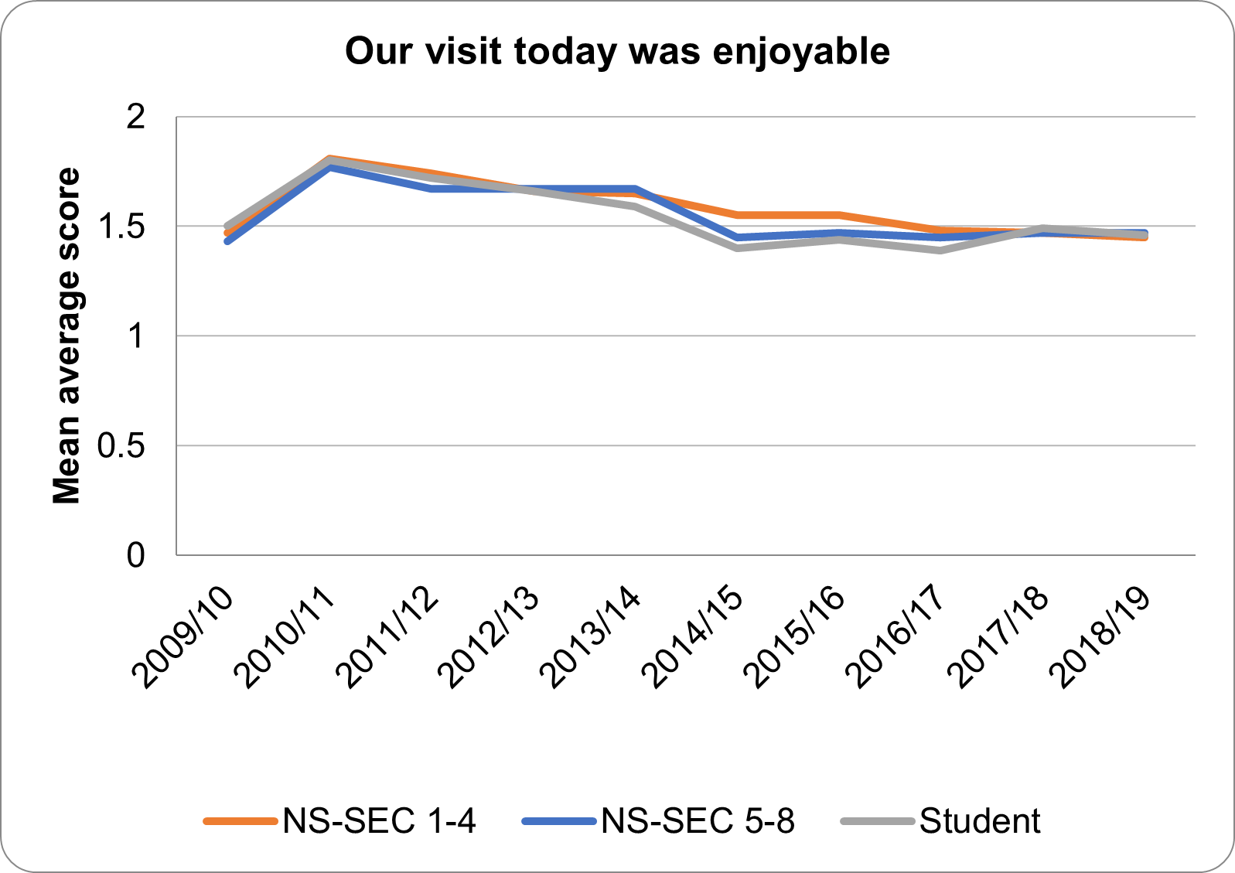
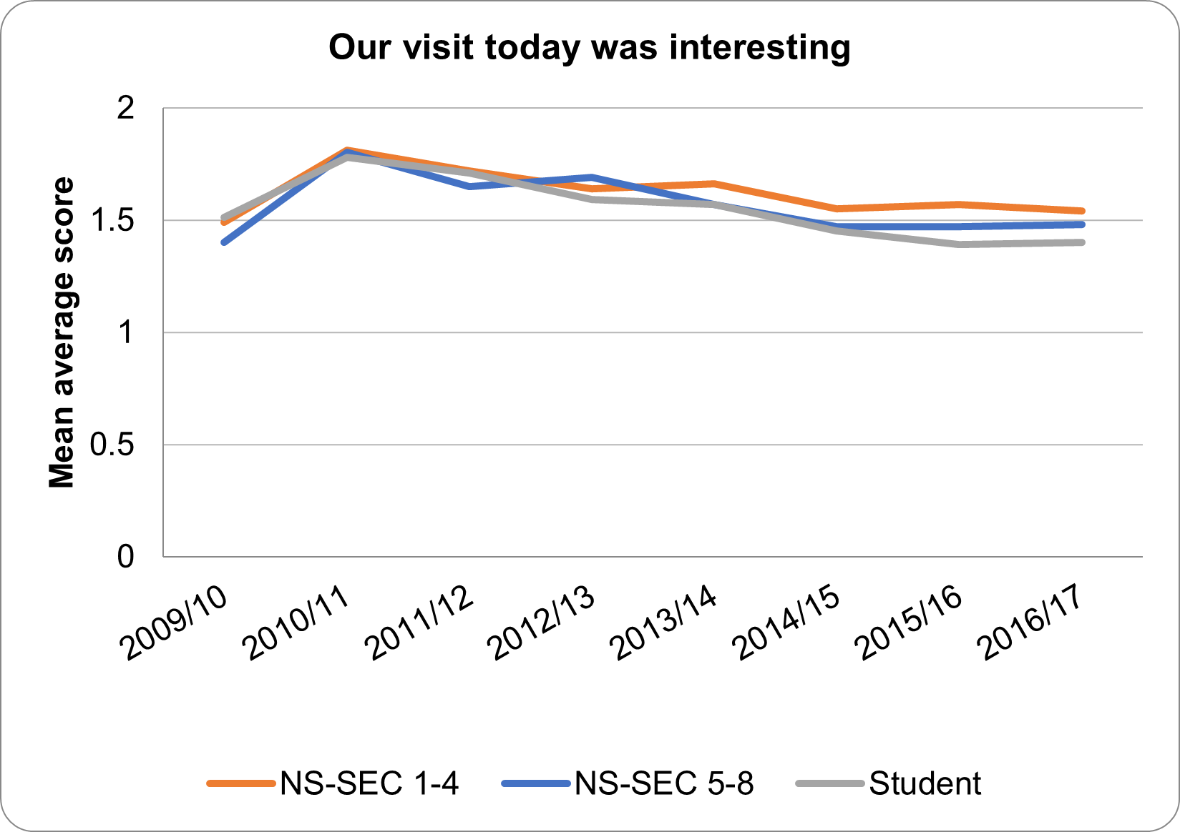
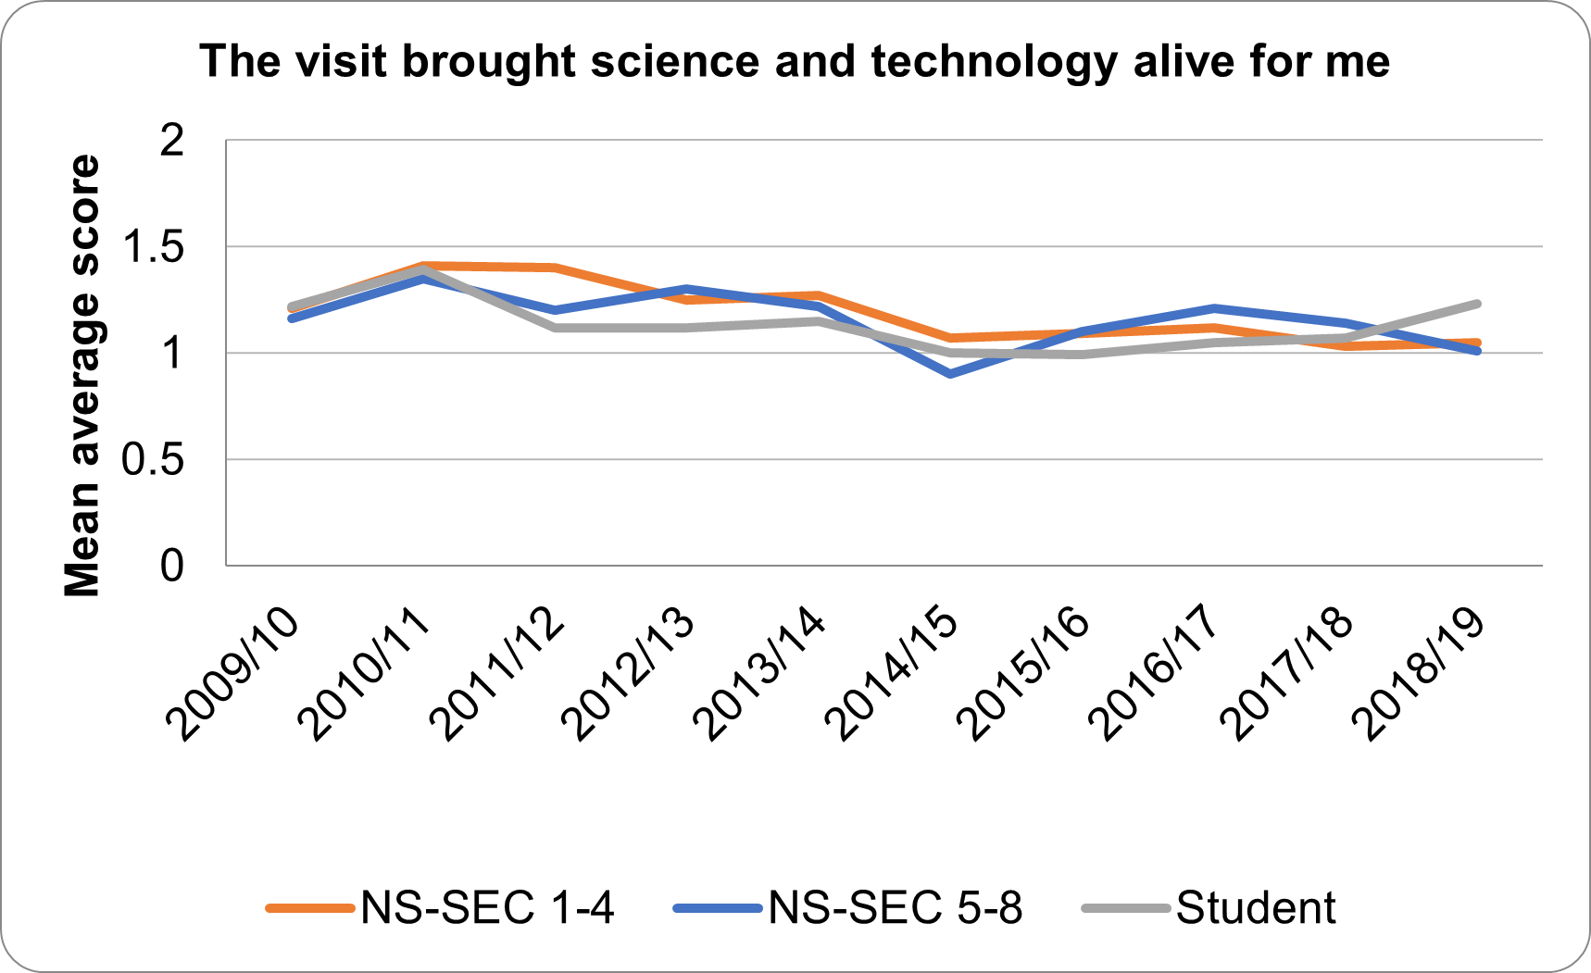
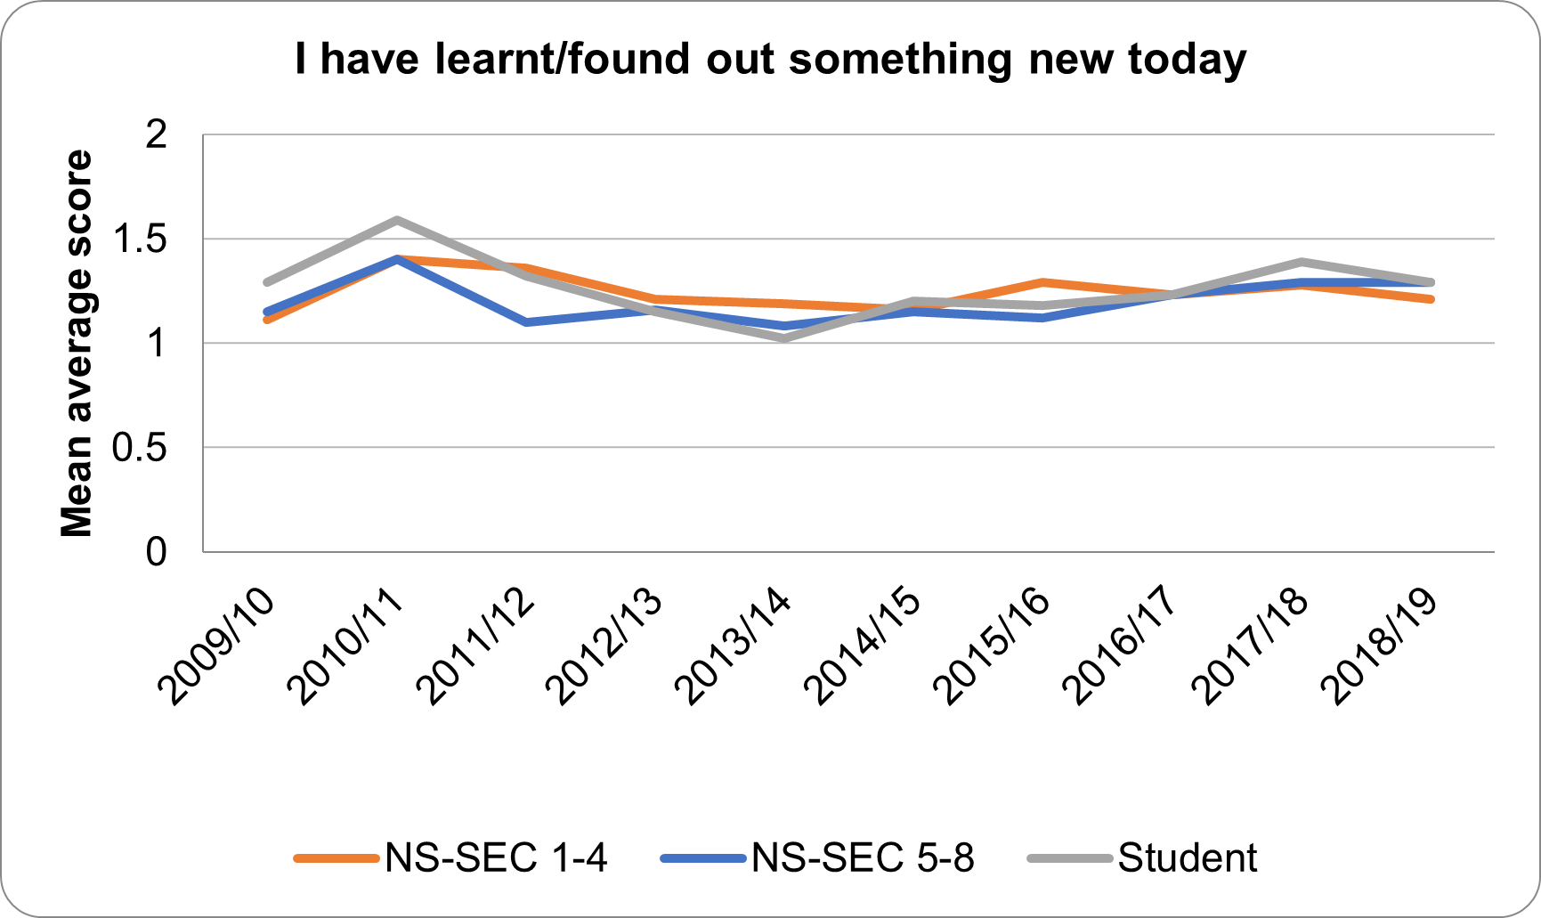
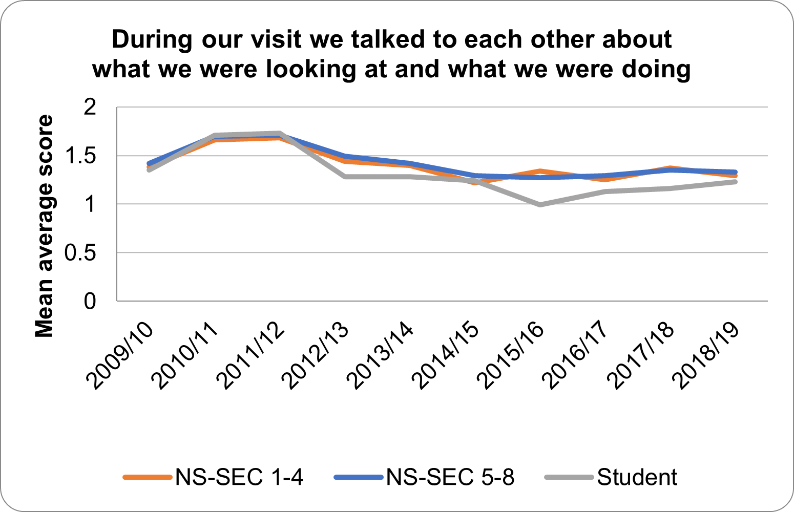
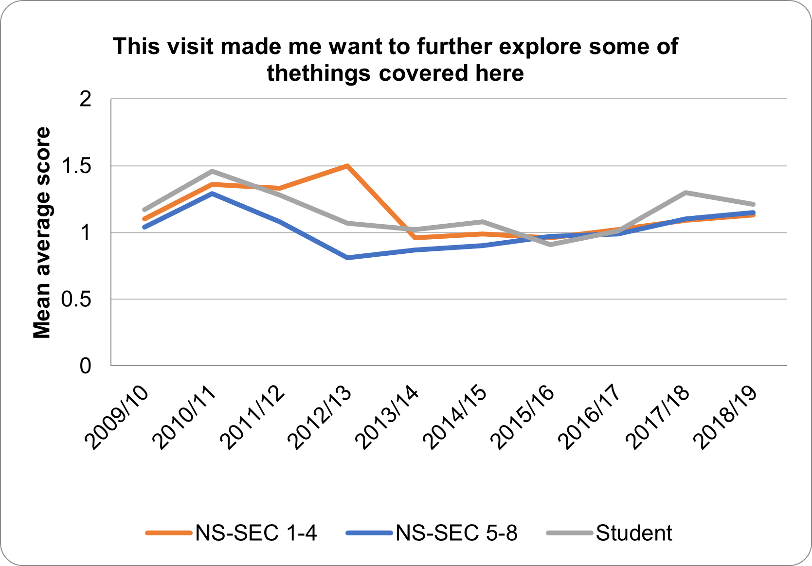
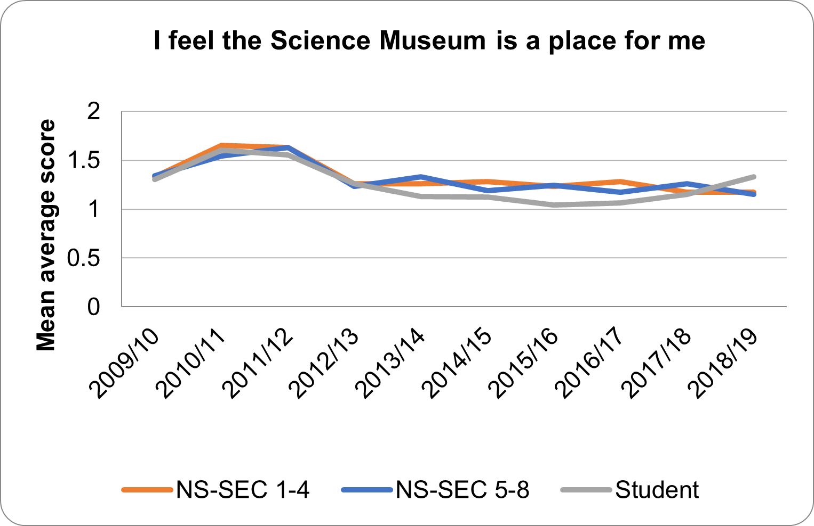
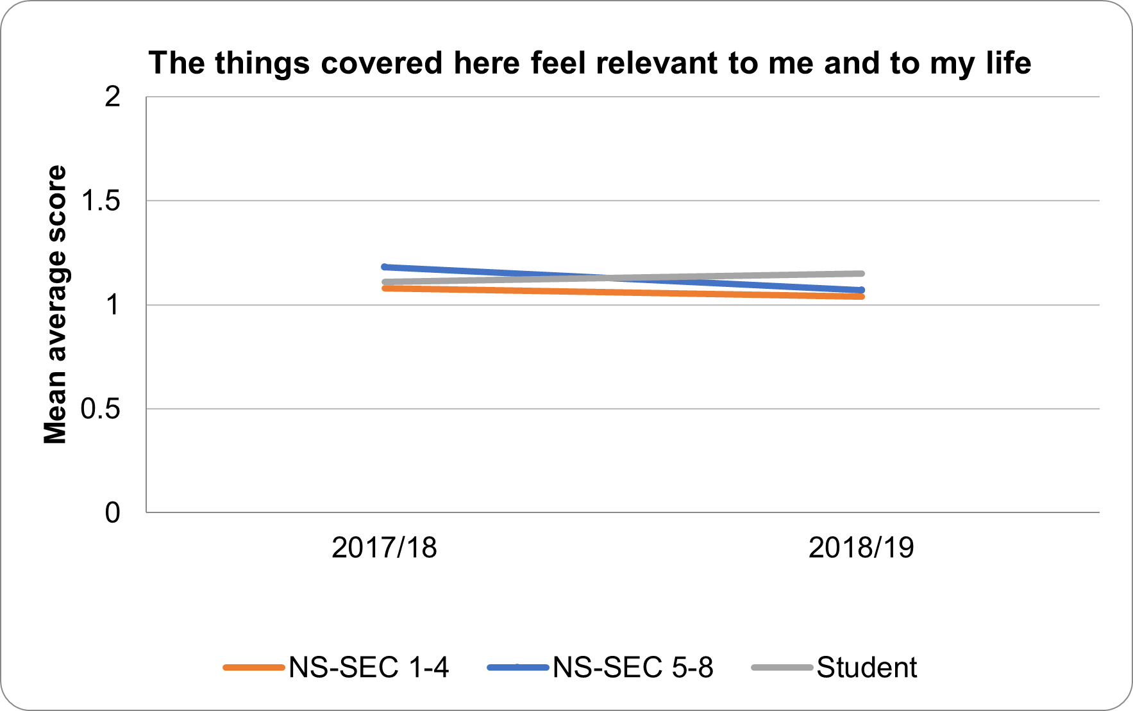
A GENERAL VIEW
The social economic status of our visitors might not influence how they respond as we would expect.
Students responded slightly more differently.
Notes:
❏ The differences in the responses of the three groups have been very subtle regarding “Our visit today was enjoyable” and “Our visit today was interesting” over the ten years.
Also, it is hard to conclude clear patterns from the fluctuations of different social/economic groups, especially NS/SEC ¼ and 5/8 in the data, for example, for some years, the NSSEC1/4 might rate higher, while the other years the NS/SEC ⅝ might give higher scores, and for some of the years, the two groups are so close to each other that we could hardly see any differences, this phenomenon might indicate that the social economic status of our visitors might not influence how they respond to the extent as we would expect.

Slide 19
More motivations to learn more and continue exploring.
In 2018/19, students suddenly become the ones who agree the most that Science Museum is a place for them.
Notes:
❏ Recent years, A good trend have started to show up, you can see that all the three groups have been tending to show more motivations to learn and continue exploring more about some of the things covered at the Science Museum, while the students seem to be motivated the most.
❏ In the earlier years, the students had been tending to agree the least that the Science Museum is a place for them. In 2018/19, however, they showed the highest degree of agreement with this statement.

Slide 20
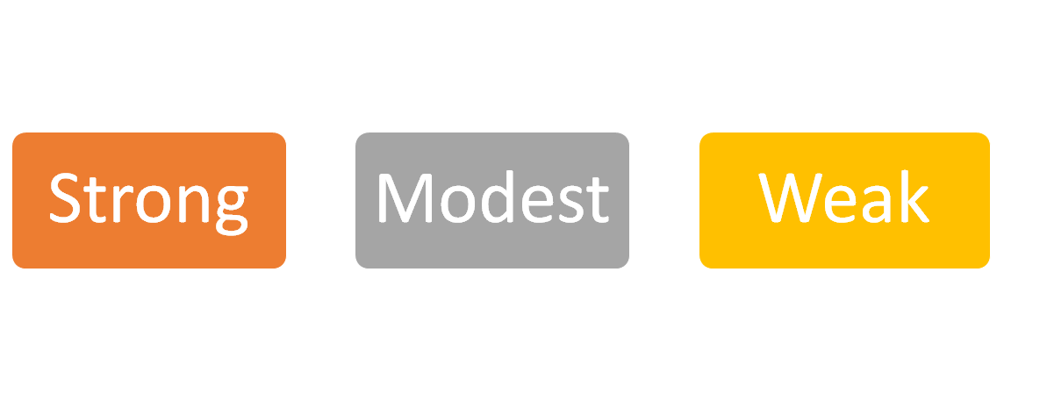
SCIENCE INTERESTS
Notes:
The visitors were invited to answer several science interests questions in the exit survey of the Science Museum. Based on the answers, the visitors were then categorised into three groups, each of which has different level of interests in Science subjects: Strong, Modest and Weak.

Slide 21
SCIENCE INTERESTS
Have visitors with different responses to the science interest questions also responded differently to the LEE/SEM? If so how?
Does this change over time?
Notes:
The research also looks into how this might influence their responses to the measures and changes over time.

Slide 22
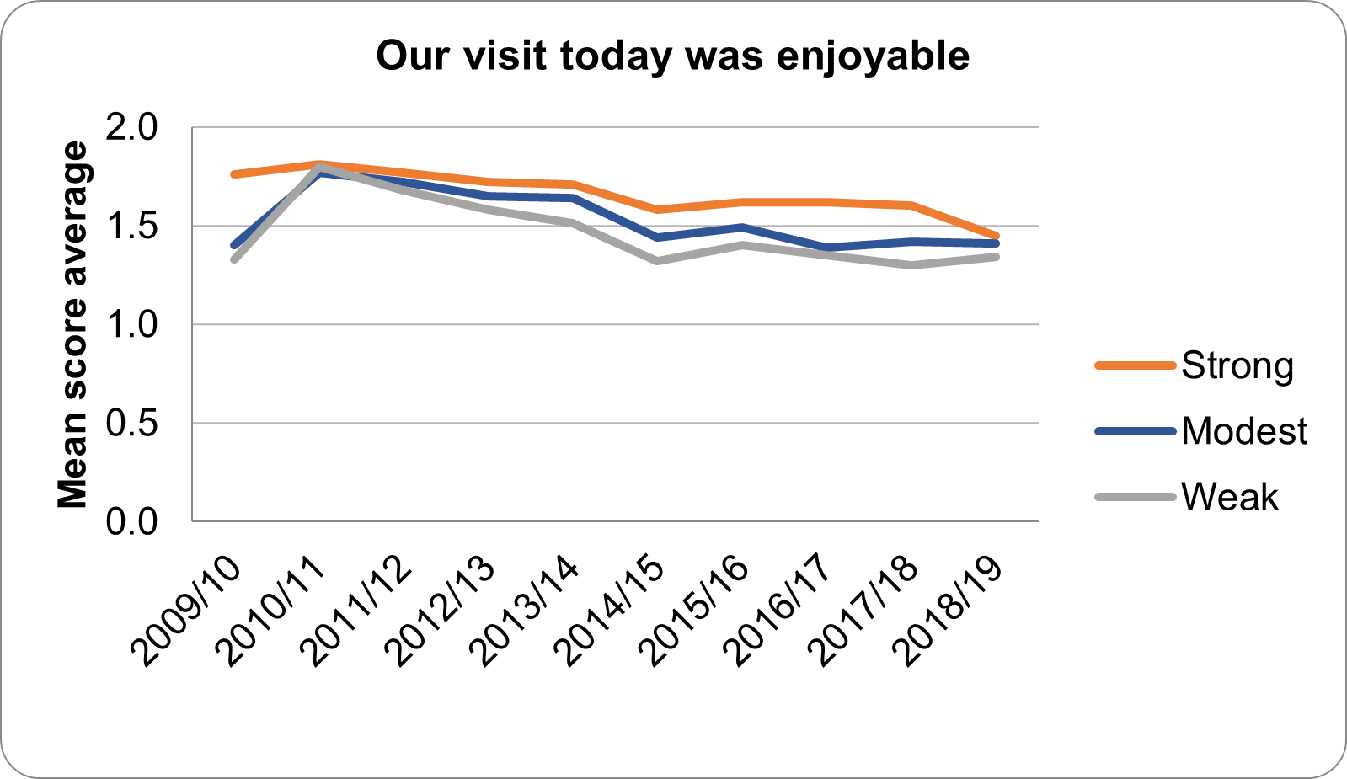
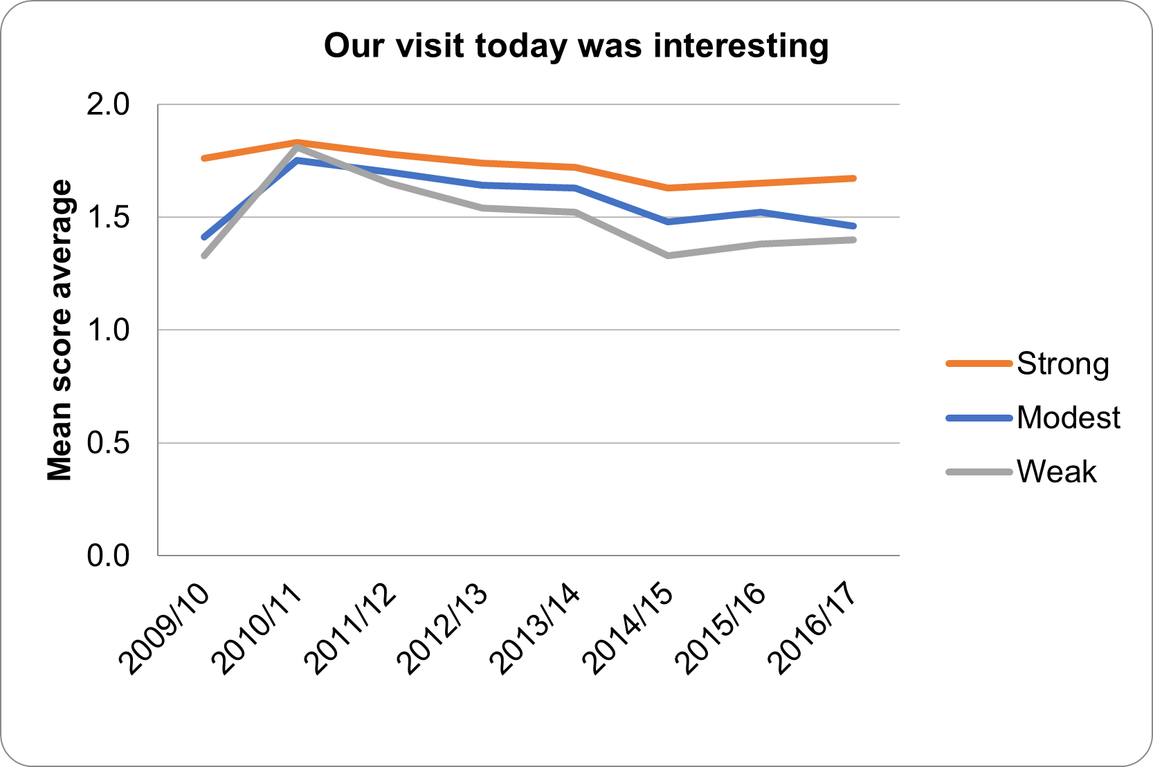
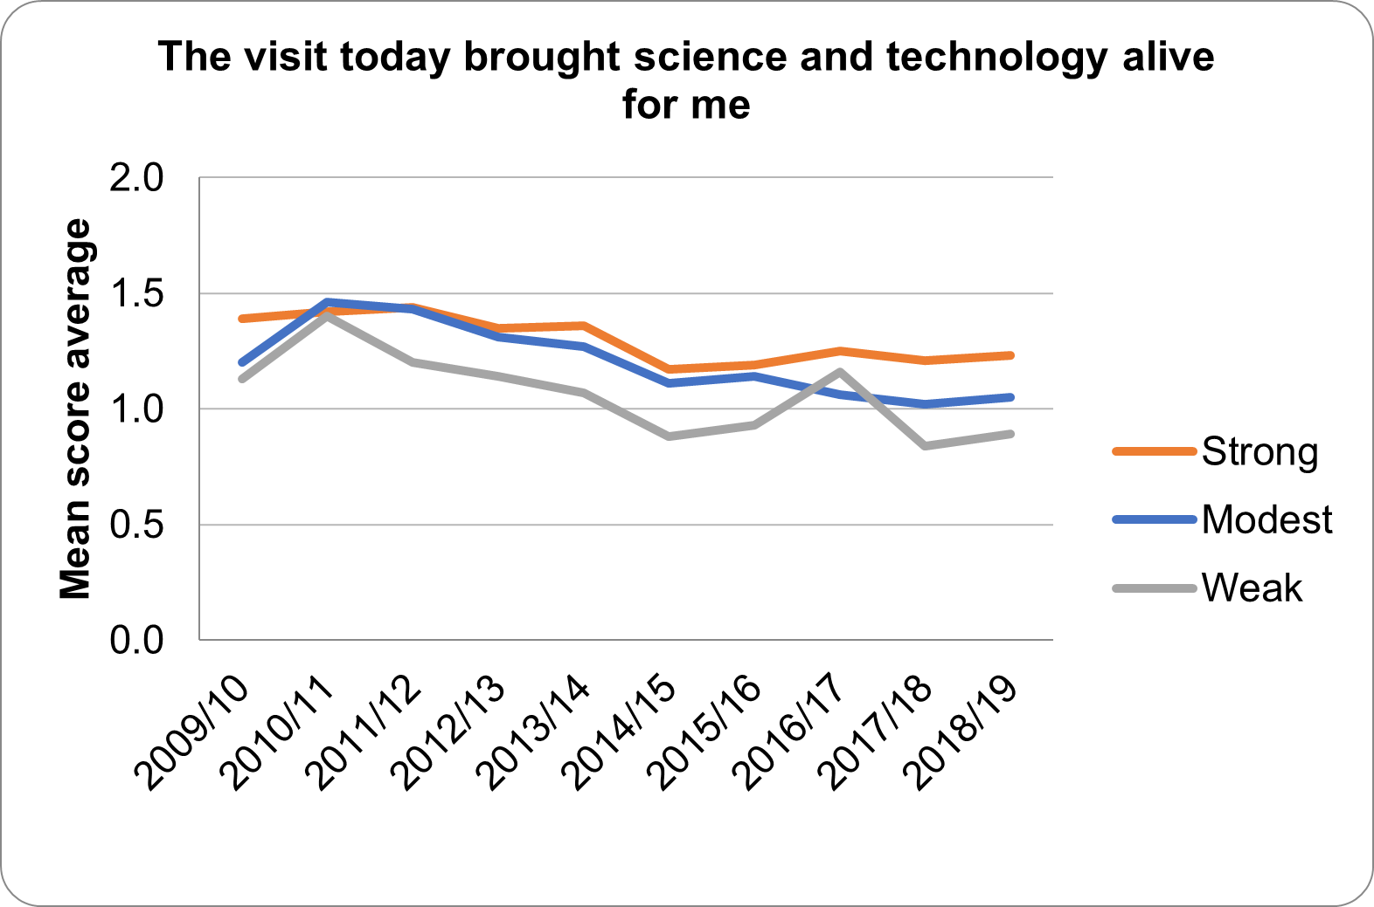
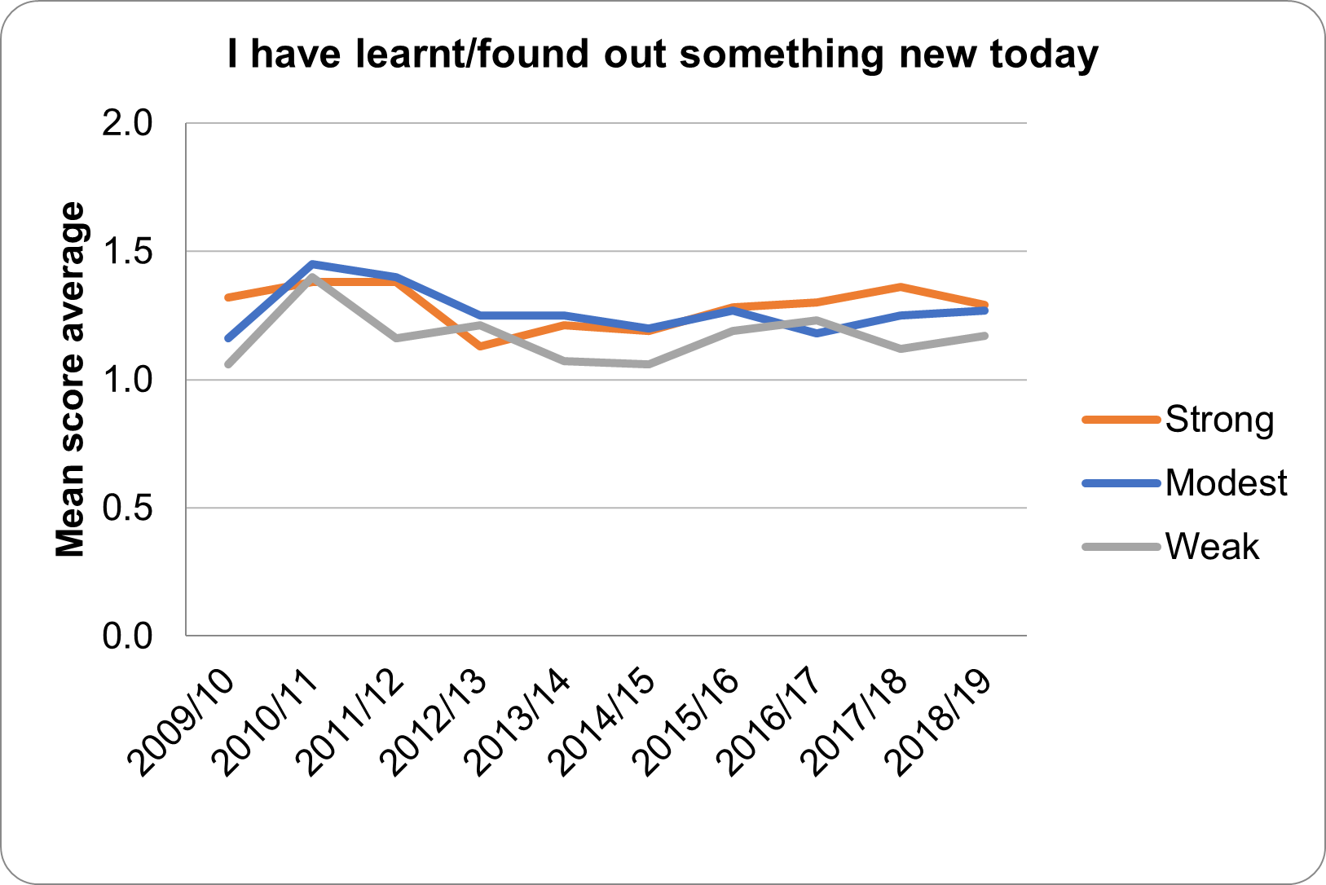
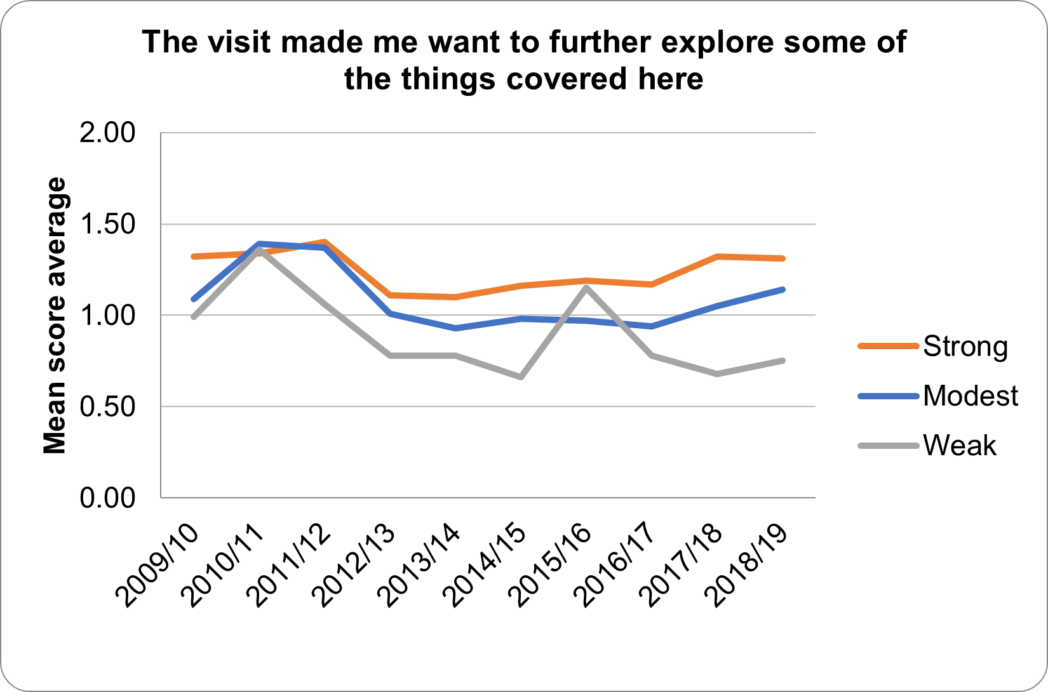
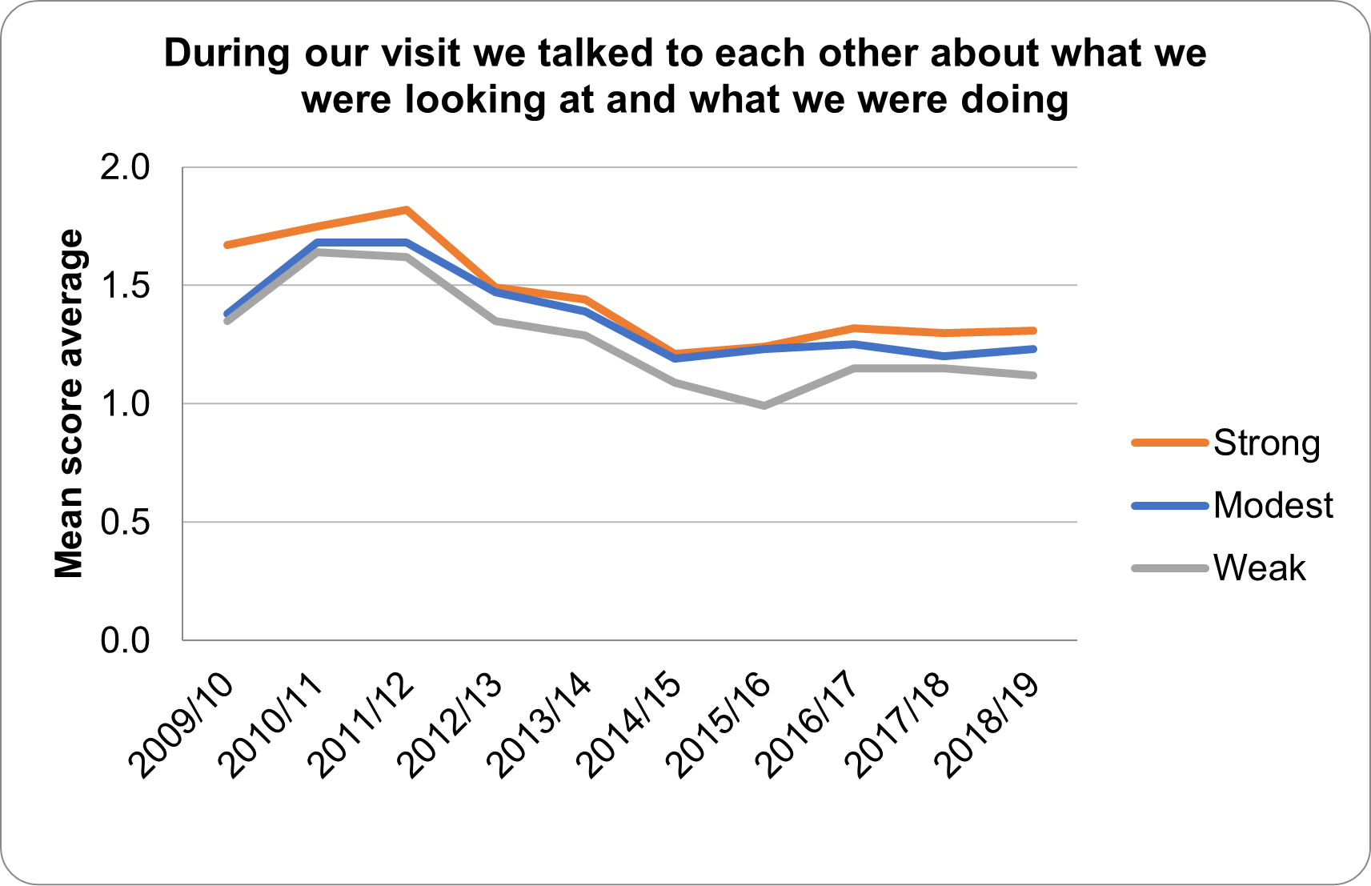
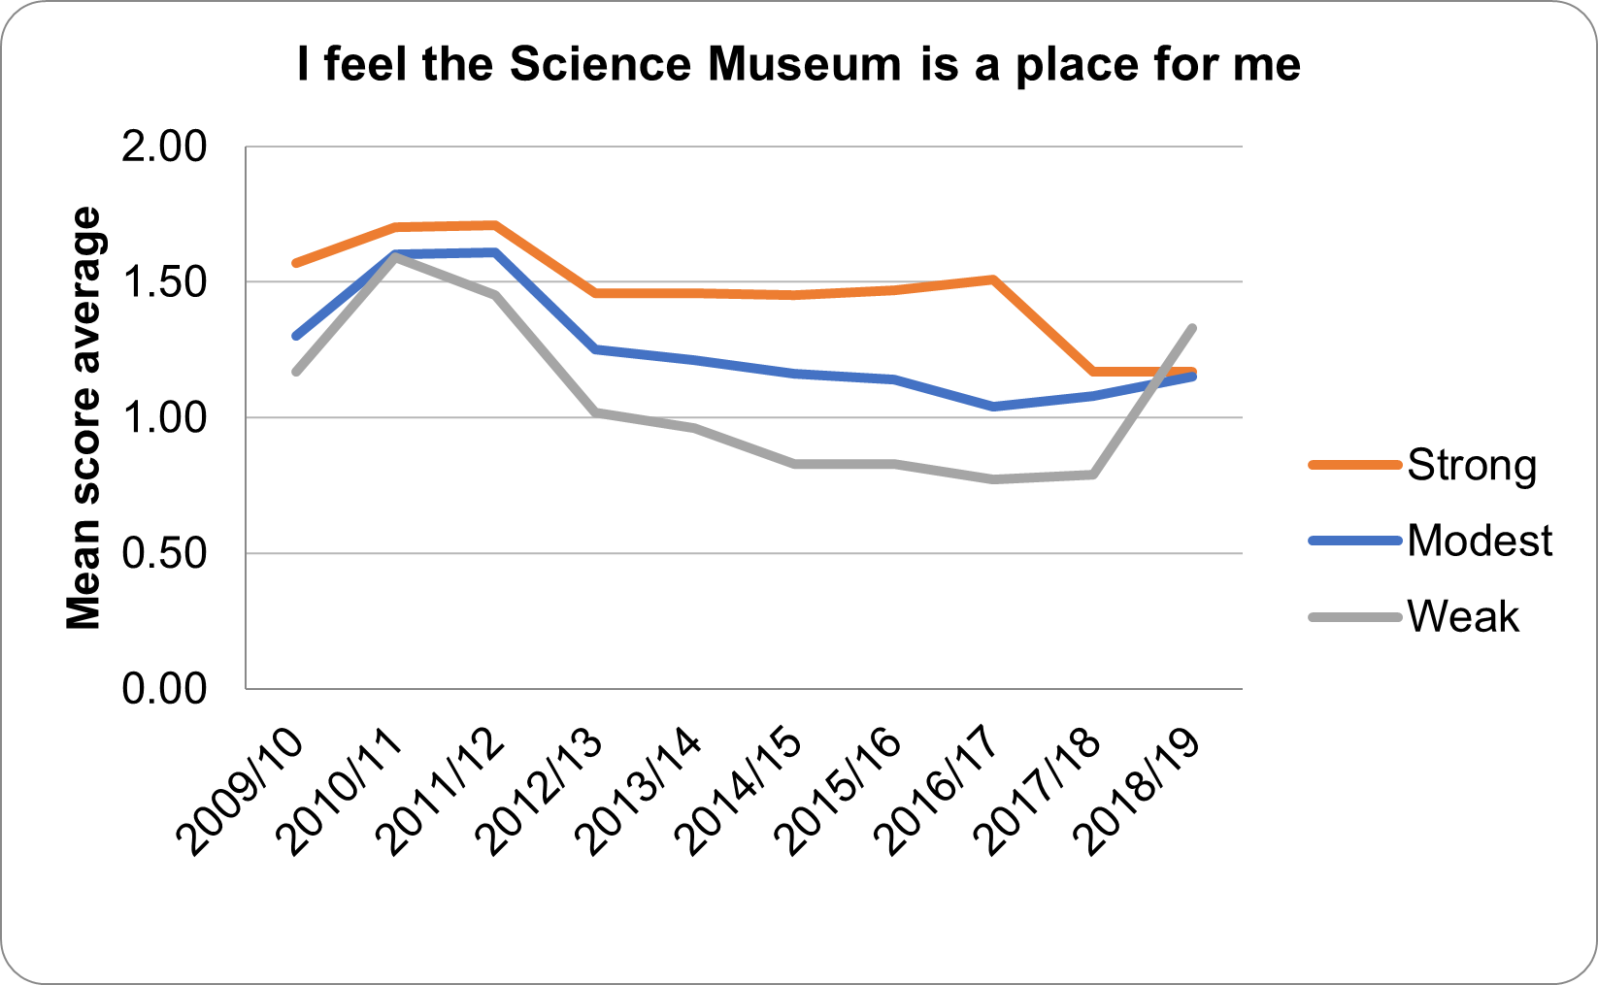
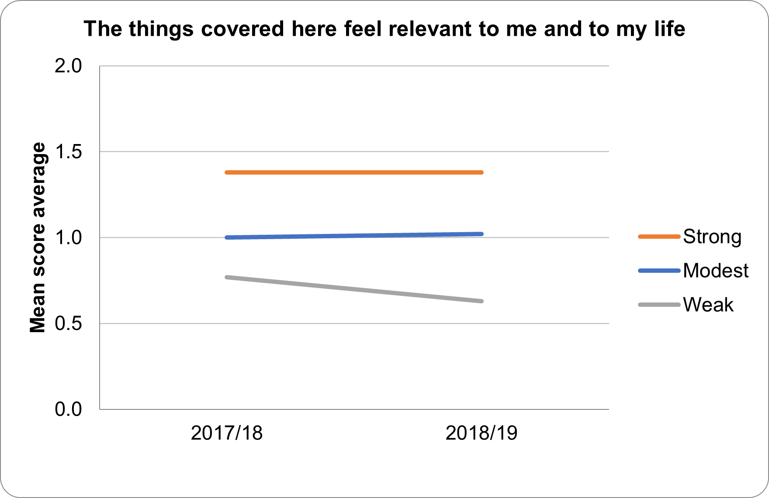
A GENERAL VIEW
Stronger interests, stronger agreement.

Slide 24
Wonder Lab opened since 2016/17!

Slide 25
Plan to enhance engagement of visitors with weak science interest?
Practices from 2016/2017
The year when Wonder Lab opens, also there have been…
Robots exhibition, Leonardo da Vinci The Mechanics of Genius exhibition, Wounded exhibition, Our Lives in Data exhibition, Beyond the Lab: The DIY Science Revolution opened, Tim Peake’s Soyuz capsule went on display. Power UP! Video gaming event…
Notes:
❏ Besides, if we want to enhance the engagement of visitors with weak science interest even more, 2016/17 is a high point for the visitors with weak science interests.

Slide 26
CONCLUSIONS AND RECOMMENDATIONS
2010/2011’s general practices and experiences created for the visitors;
There might be more potential for us to enhance the Entertainment Seekers’ science engagement; they are the ones who feel the things covered here the least relevant to them and their life;
The social economic status created little impact, while the students seem to respond more differently;
Regular visitors and those with more interests in science tend to agree more with most statements, except one, which is ‘I have learnt something new today’.
2016/17’s practices and the experiences that might have targeted visitors with lower science interests;
Future direction: Dig into the practices of year 2010/11, as well as the ones of year 2016/17; learn more about non-visitors.
Notes:
Generally, to enhance the engagement, it might be good to look into 2010/2011’s general practices and experiences created for the visitors;
Regarding different audience segments, there might be more potential for us to enhance the science engagement of Entertainment Seekers during their museum visits;
The social economic status create less impact than we expected, while the students do seem to respond more differently;
Regular visitors and those with more interests in science tend to agree more with most statements, except one, which is ‘I have learnt something new today’.
2016/17’s practices and the experiences that might have targeted visitors with lower science interests;

Slide 27
THANK YOU!

