Slide 1

Feature Selection
Advanced Machine Learning – Project 2
Patryk Rakus
Łukasz Tomaszewski
Michał Tomczyk

Slide 2
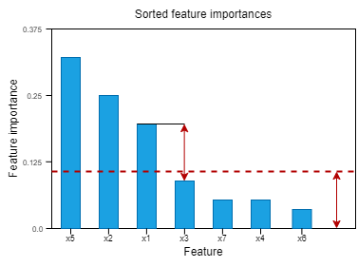
Feature selection methods
Random Forest
Lasso Logistic Regression
SHAP values
We also tried bagging and pipelining the methods above
Threshold of Random Forest method

Slide 3
Models
XGBoost
01
AdaBoost
02
LGBM
03
SVM
04

Slide 4
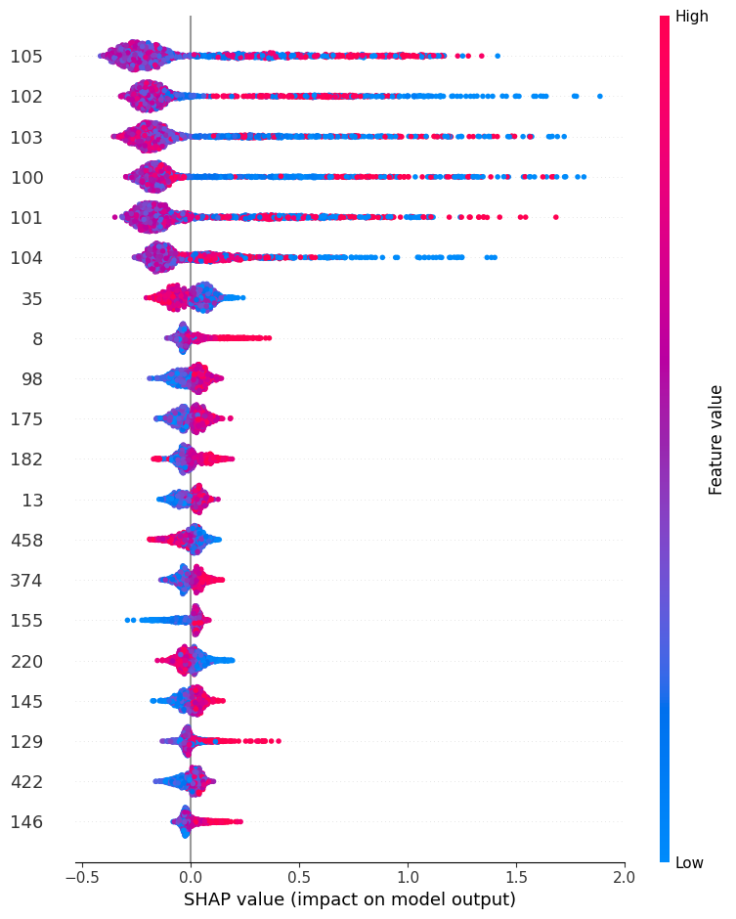
Results – variable selection
Logistic Regression and Random Forest left too many variables.
Good results for ensemble methods.
Similar columns selected with the use of ensemble methods and SHAP values.
Selected columns: 100, 101, 102, 103, 105

Slide 5
Results – prediction quality
Selection Method | Number of columns | Model | Score
L1 | 49 | XGB | -5066
RandomForestSelector | 14 | XGB | 4600
Bagging | 8 | XGB | 5700
SHAP | 5 | AdaBoost | 6355
Pipeline | 5 | XGB | 6600
SHAP | 5 | XGB | 6733
SHAP | 5 | LGBM | 6766
SHAP | 5 | SVM | 6966

Slide 6
Conclusions
Multiple feature selection methods
Selected 5 variables using the SHAP values selection method
Multiple models trained
SVM model provided the best results and was used for the final prediction

Slide 7
THANK YOU

