Slide 1
Customer Distribution and Deactivation Analyses
ASAS Project By Fery
Supervised By Mr. Hamid Rajaee

Slide 2
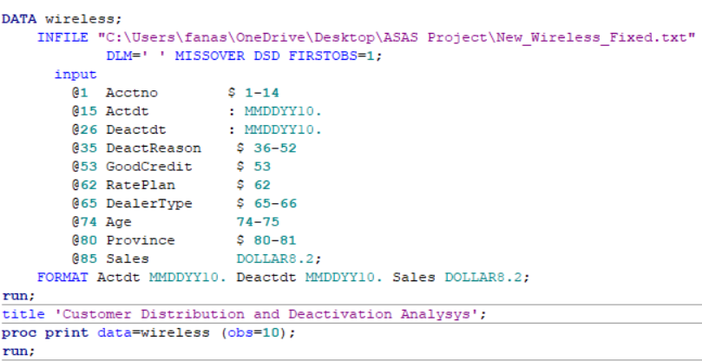
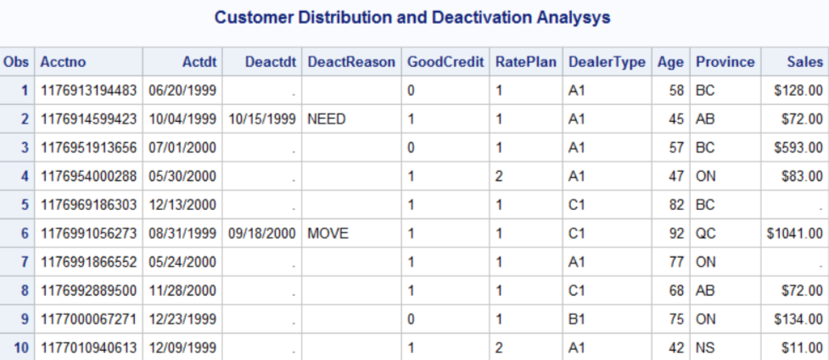

Slide 3
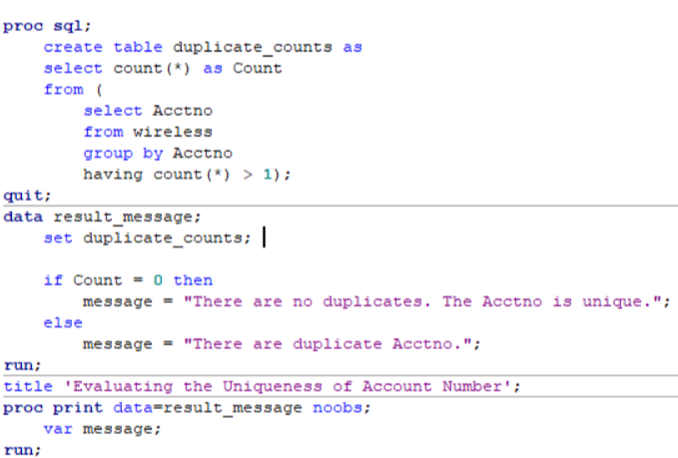
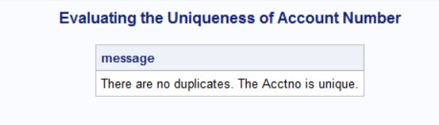
Is the acctno unique?

Slide 4
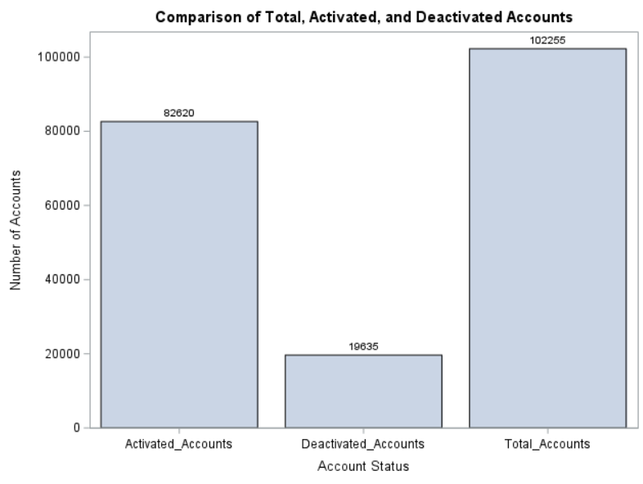
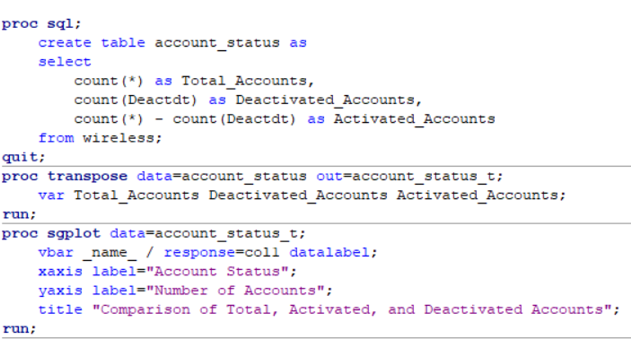
What is the number of accounts activated and deactivated?

Slide 5
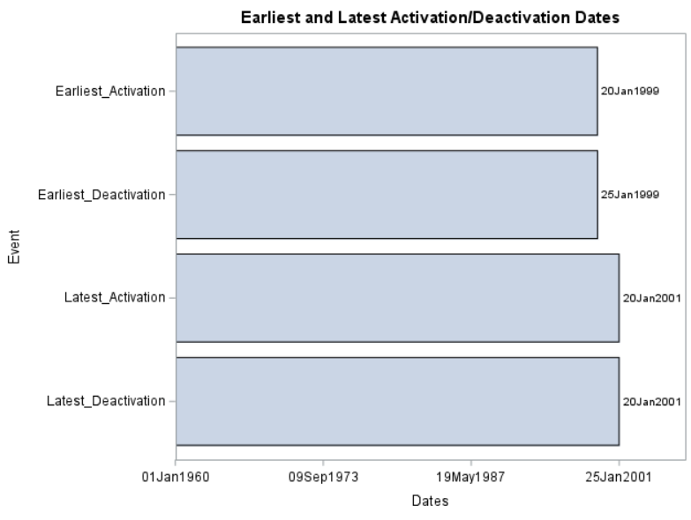
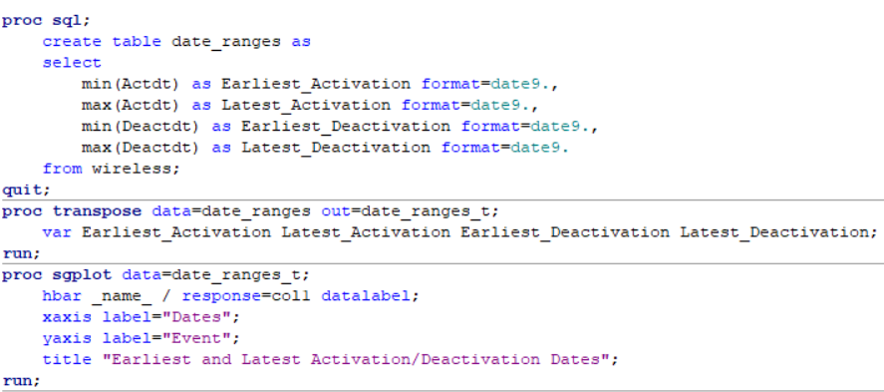
When are the earliest and latest activation/deactivation dates available?

Slide 6
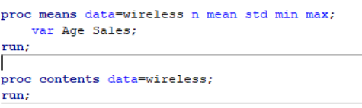
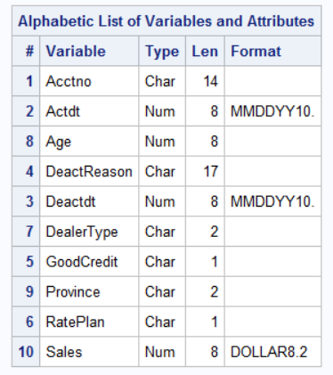
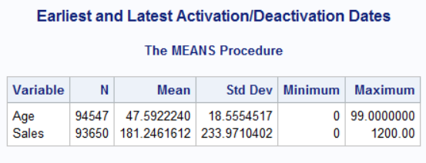
Statistical Summary

Slide 7
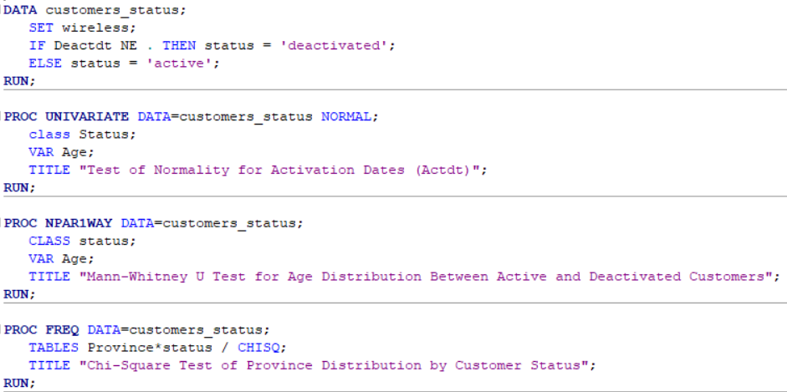
1.2) What are the age and province distributions of active and deactivated customers?

Slide 8
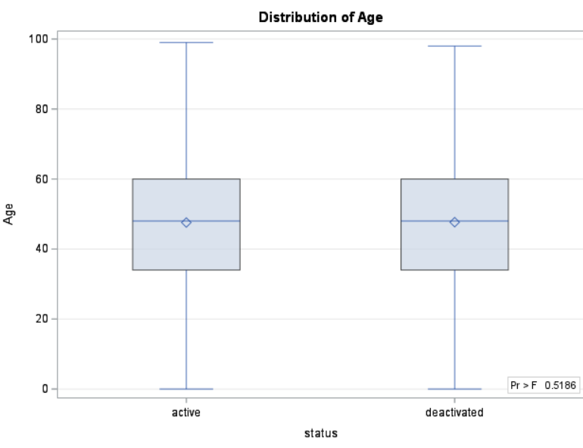
Checking Normality; H0: The data is normally distributed.
H0: There is no significant difference in the age distribution between active and deactivated customers. H0: There is no significant difference in the province distribution between active and deactivated customers.
Province * Status:
P-value = 0.98
Normality Test for Age :
P-value = 0.0100 < 0.05
H0 rejected;
conclude that the age is not normally distributed at 5% significant level.
"Since the p-value is greater than 0.05, we fail to reject the null hypothesis."

Slide 9
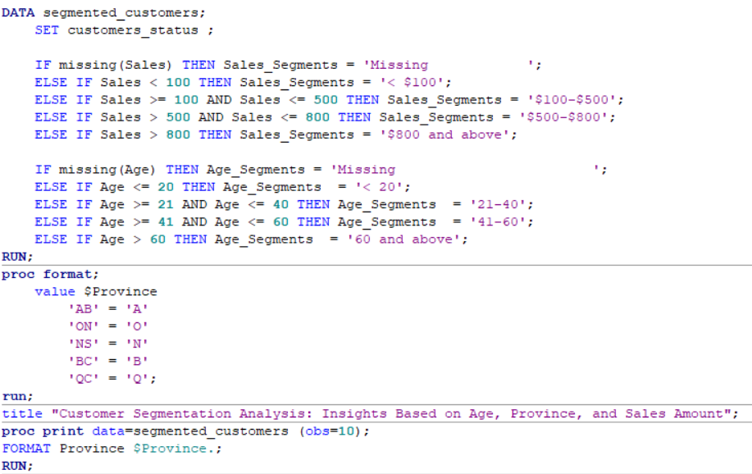
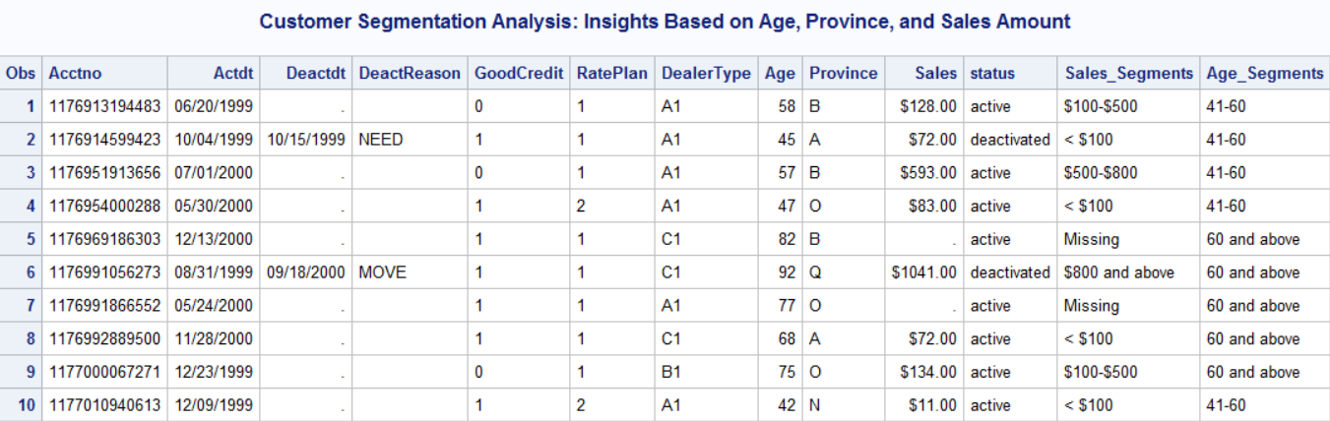
1.3) Segment the customers based on age, province, and sales amount:

Slide 10
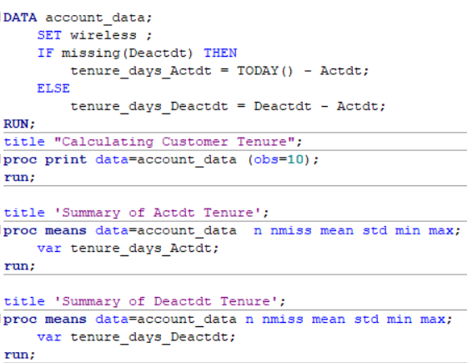
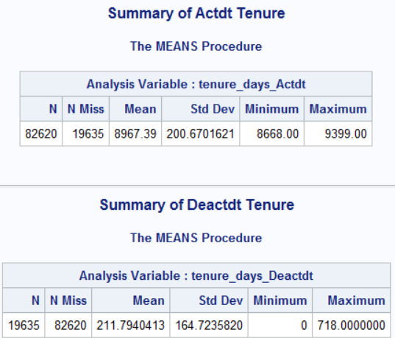
1.4.1) Calculate the tenure in days for each account and give its simple statistics.
Active customers tend to have much longer tenures, with an average tenure of nearly 25 years.
Deactivated customers have much shorter tenures on average, around 7 months

Slide 11
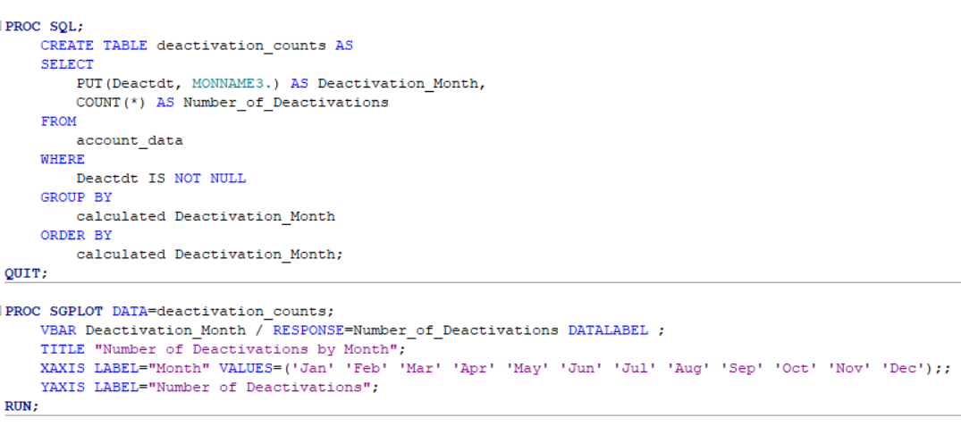
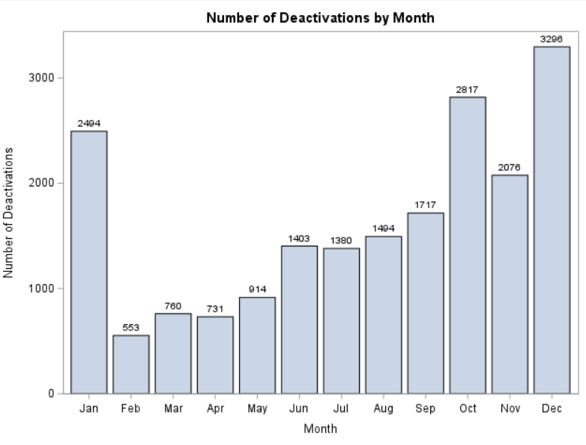
1.4.2) Calculate the number of accounts deactivated for each month.
Seasonal behavior, Holiday impact, Service changes.
Companies should focus on customer retention strategies at the end of the year

Slide 12
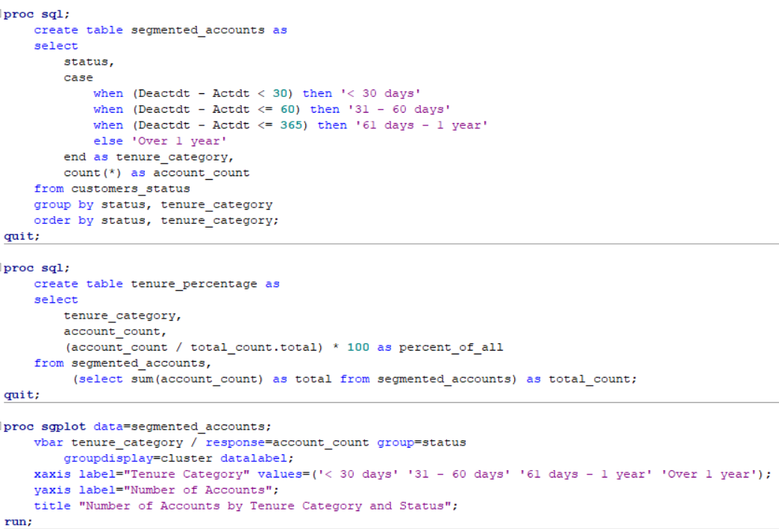
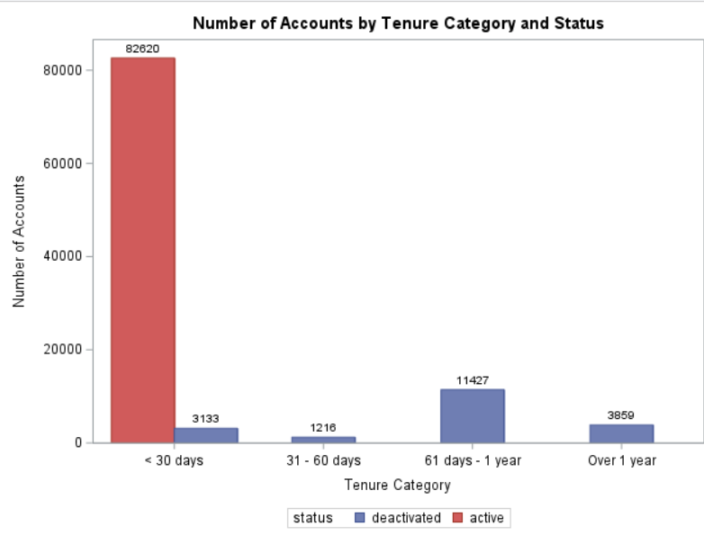
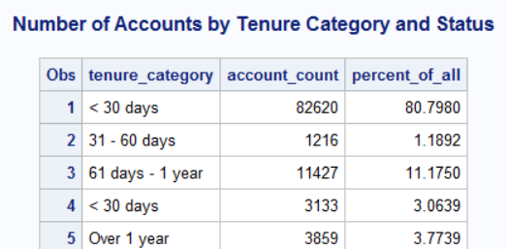
1.4.3) number of accounts of percent of all for each segment.
Fewer customers are leaving or closing their accounts within the first 30 days.
It indicates there isn't an immediate churn or dissatisfaction with the service.

Slide 13
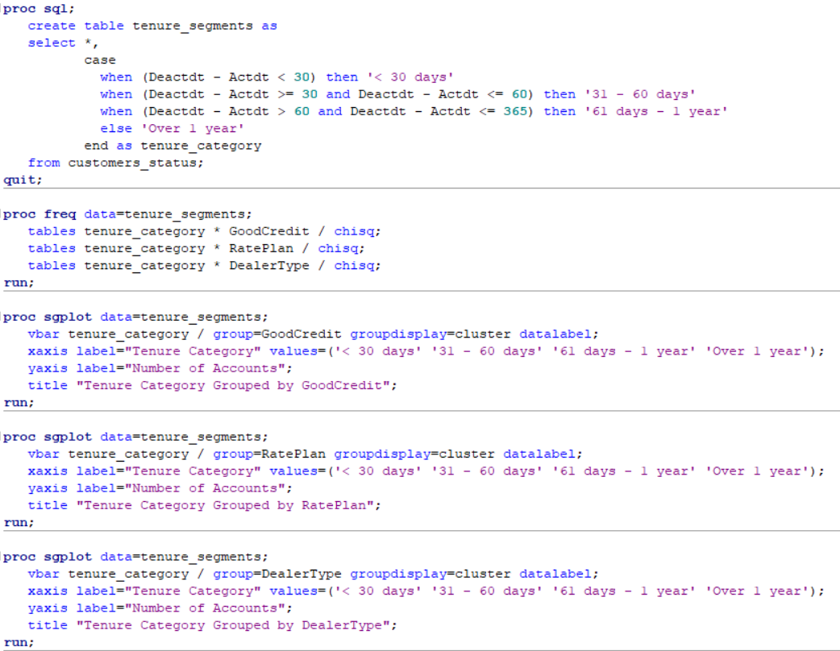
1.4.4) Test the general association between the tenure segments and “Good Credit” “RatePlan ” and “DealerType.

Slide 14
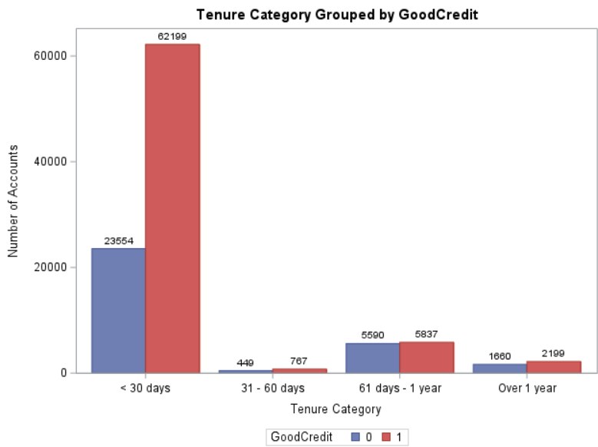
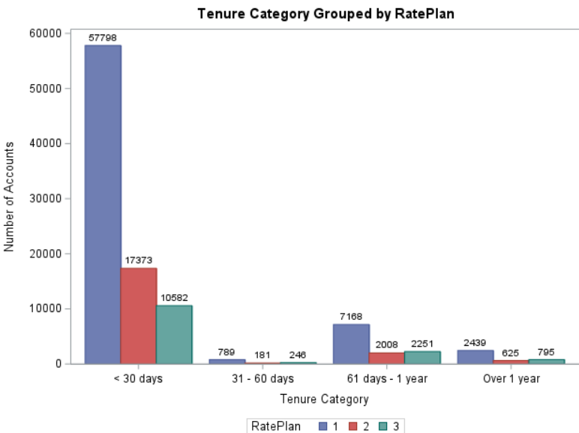
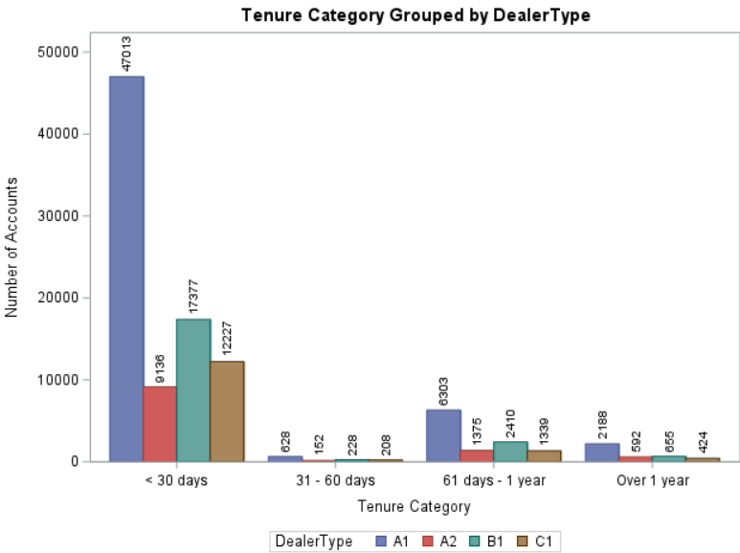
H0: There is no statistically significant relationship between Tenure segments and Good Credit. H0: There is no statistically significant relationship between Tenure segments and RatePlan. H0: There is no statistically significant relationship between Tenure segments and DealerType.
The p-values for all three variables are below 0.05, leading us to reject the null hypotheses.
This indicates statistically significant associations between tenure segments and each of the three variables.

Slide 15
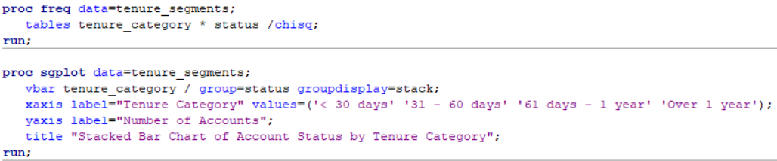
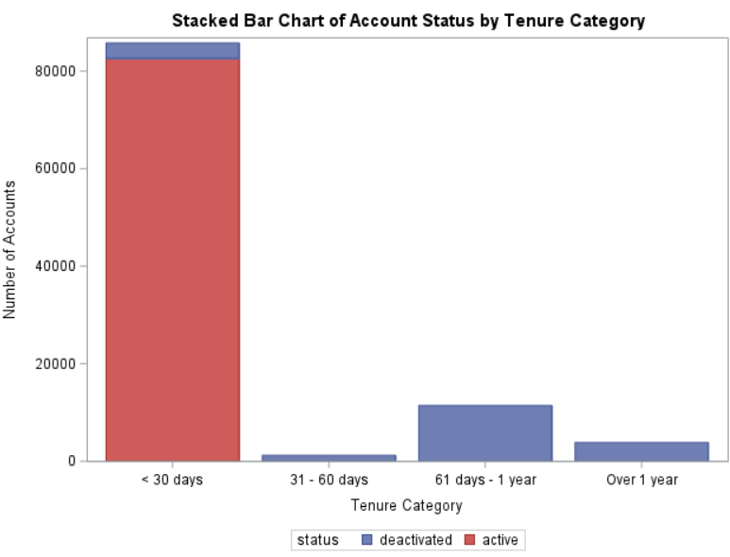
1.4.5.A) Is there any association between the account status and the tenure segments? H0: There is no statistically significant relationship between Tenure segments and account status.
Since p-value = 0.0001<0.05, we reject H0,
Concluded there is a statistically significant relationship between those two categorical variables at 0.05 significant level.

Slide 16
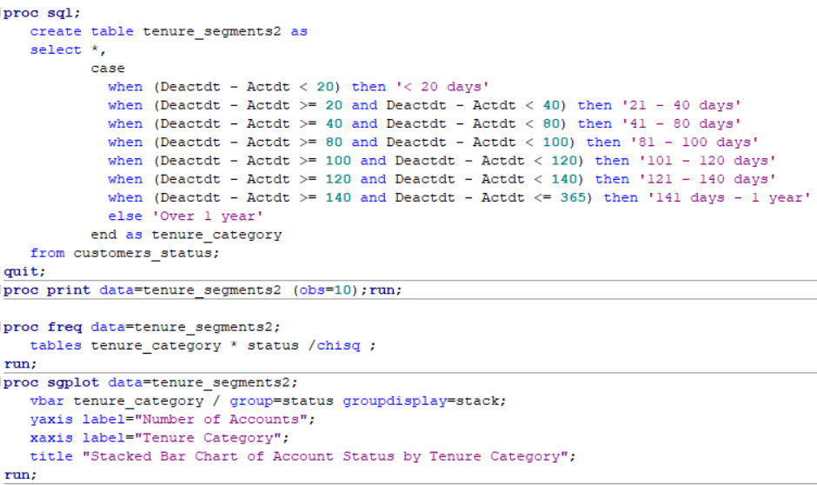
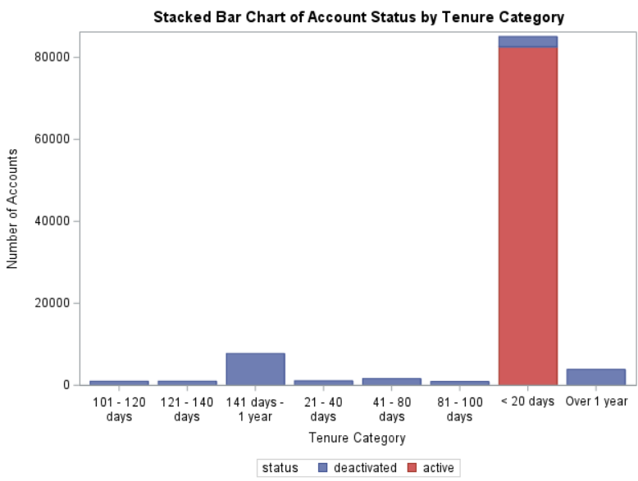
1.4.5.B) Could you find a better tenure segmentation strategy that is more associated with the account status?
Cramer’s V1: 0.8999
Cramer’s V2: 0.9212
Showing a higher level of dependency

Slide 17
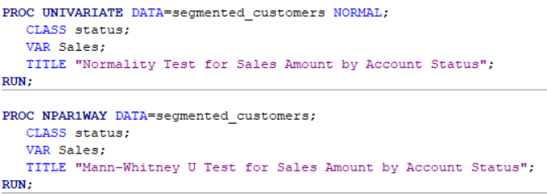
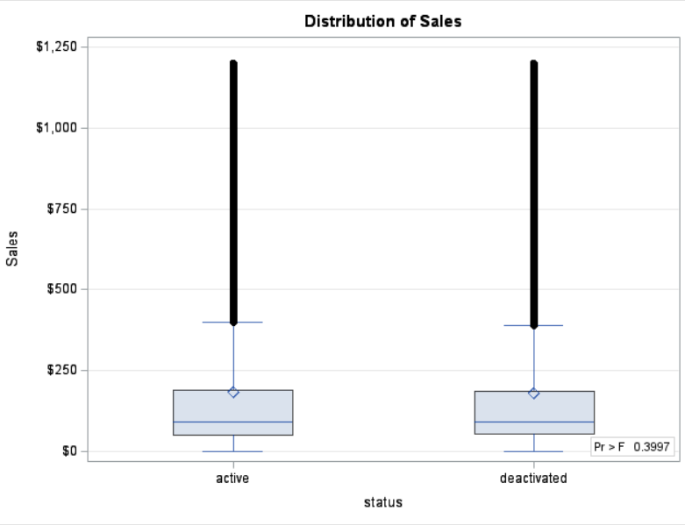
1.4.6) Does the Sales amount differ among different account statuses, GoodCredit, and customer age segments? Checking Normality; H0:The Sales amount is normally distributed within each account status group (active and deactivated). H0: There is no significant difference in the Sales amounts between the two groups.
Test of normality:
P-value: 0.0100 < 0.05
H0 rejected
Since the p-value exceeds the 0.05 threshold, we fail to reject the null hypothesis (H₀)

Slide 18
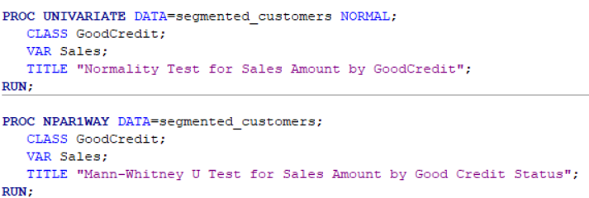
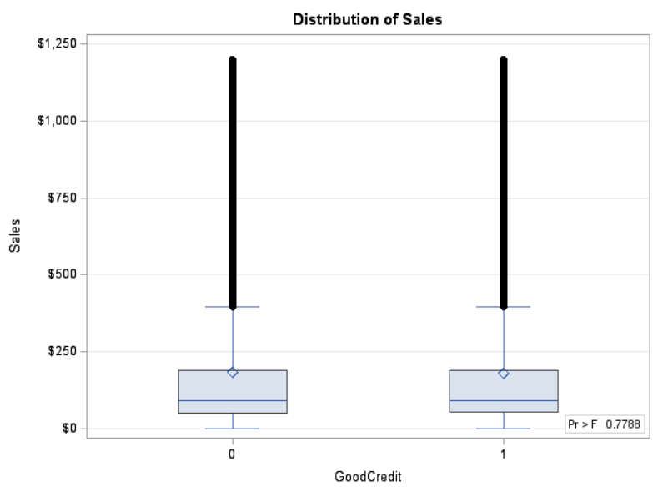
Checking Normality; H0:The Sales amount is normally distributed within two groups ("Good Credit" vs. "Bad Credit"). H0: There is no difference in the sales amounts between customers with good credit and bad credit.
Test of normality:
P-value: 0.0100 < 0.05
H0 rejected
Since the p-value is greater than the 0.05, we fail to reject the null hypothesis (H₀)

Slide 19
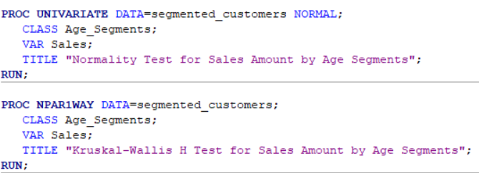
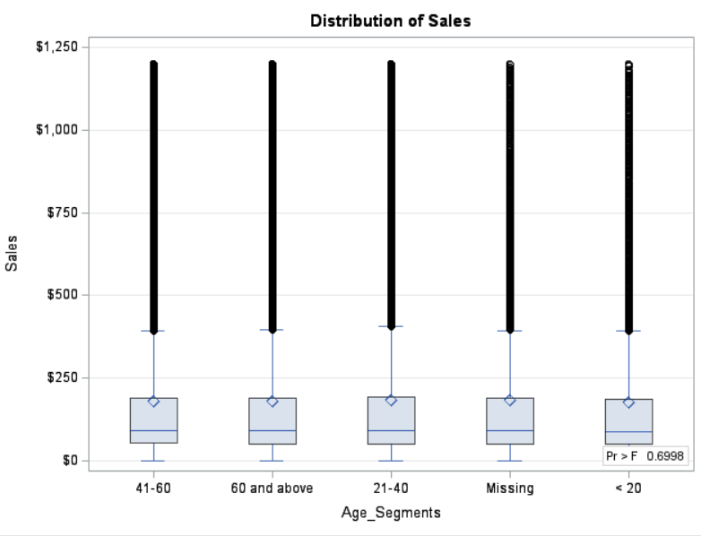
Checking Normality; H0: The Sales amounts are normally distributed within each group defined by the Age Segments variable. H0: The Sales amounts are the same across all Age Segments.
Test of normality:
P-value: 0.0100 < 0.05,
H0 rejected. Concluded Sales amounts are not normally distributed at 5% significant level
As the p-value is greater than 0.05, so we fail to reject the null hypothesis (H₀)

Slide 20
Recommendation
Focus on Retention: Prioritize customer loyalty by enhancing service quality and launching targeted retention programs, as demographic factors like age and account status show minimal impact on sales.
Refine Marketing Strategy: Conduct thorough market research to better understand the audience and align marketing campaigns, as current strategies may not effectively reach potential customers.
Expand Offerings: Explore new product lines or service enhancements to attract a broader customer base, potentially boosting sales and encouraging long-term customer engagement.

Slide 21
Conclusion
The analysis suggests that sales performance is not significantly influenced by account status, credit quality, or age, requiring improved customer retention strategies(the 80/20 rule) and product diversification.

Slide 22
Thank You

