Slide 1

Loan Approval Prediction in SAS
Prepared by: Fery

Slide 2
Agenda
Introduction – Objective & Dataset Overview
Data Exploration – Records, Data Types, Missing & Duplicates
Data Analysis – Outliers, Univariate and Bivariate Tests
Modeling – Train-Test Split & Logistic Regression
Evaluation – Performance Metrics & Insights
Conclusion – Key Findings

Slide 3

Business Statement
Primary Objective: To develop a predictive model for loan approval, helping the financial institution identify individuals who are more likely to repay their loans and reduce the risk of defaults.
Secondary Objective: To improve the accuracy of loan approvals by analyzing various features to optimize decision-making processes.

Slide 4
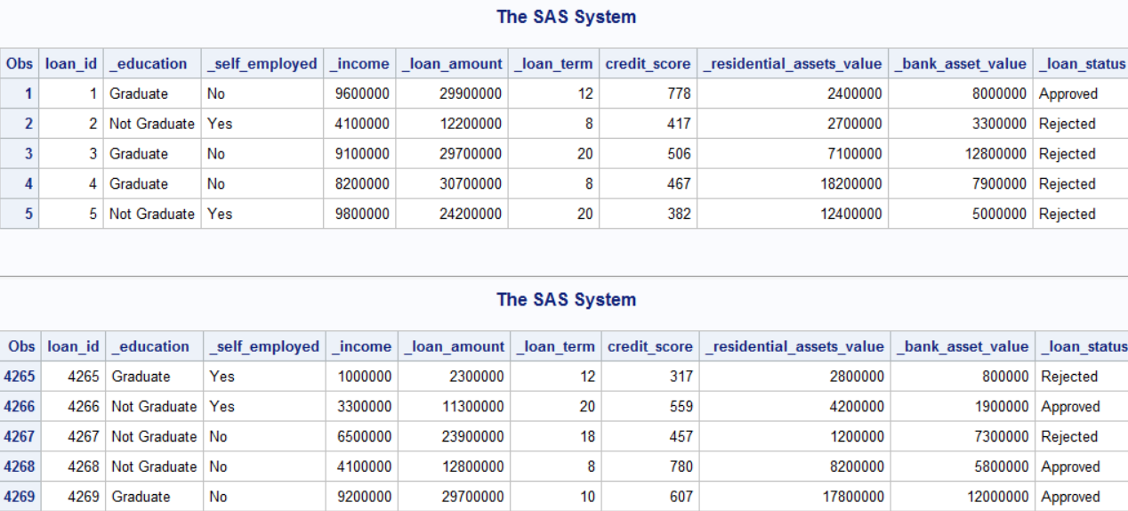
First 5 & Last 5 Records
Total Records: 4,269

Slide 5
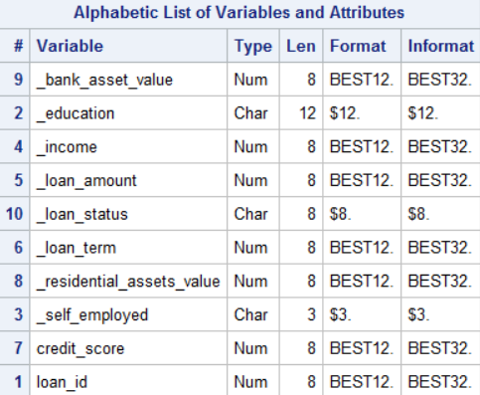
Data Types And Duplicates
No duplicate records found in the dataset.

Slide 6
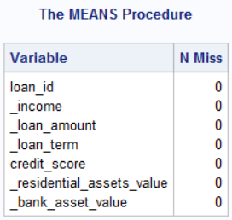
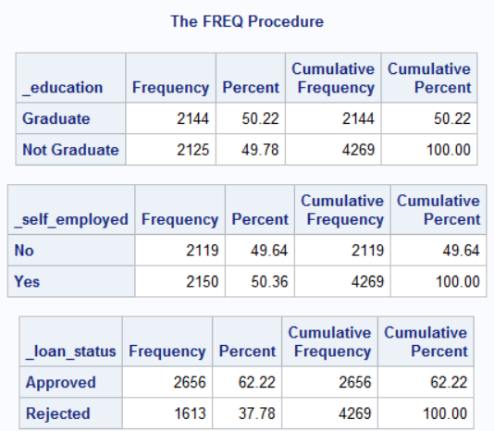
Missing Entries (Numeric, Cat.)

Slide 7
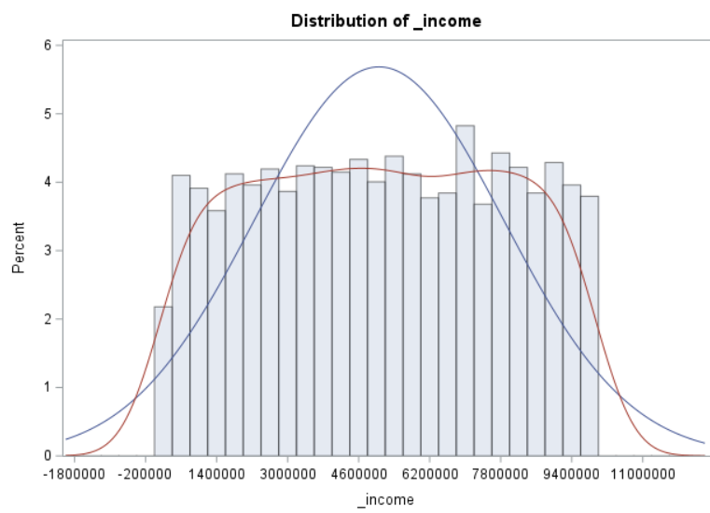
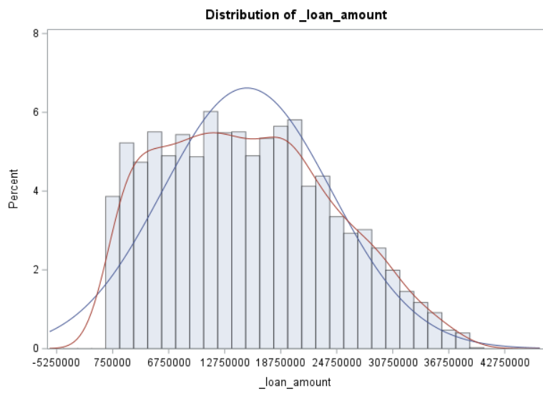
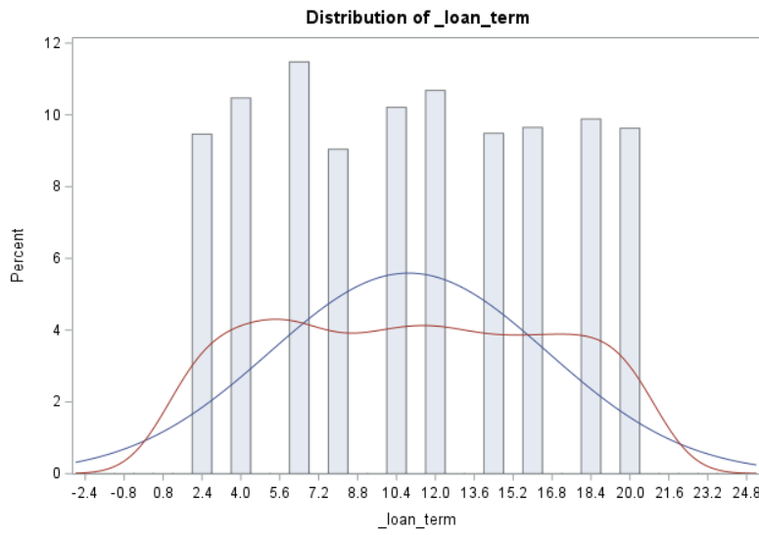
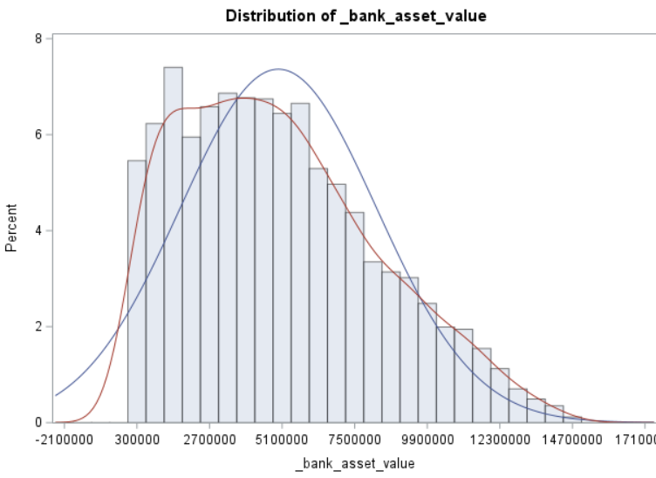
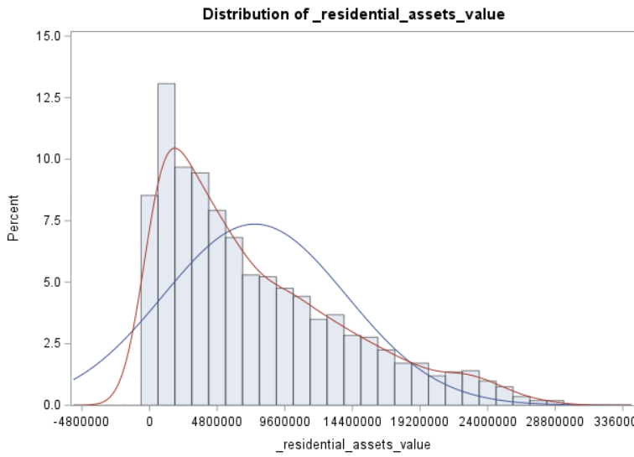

Univariate analysis(Numeric)

Slide 8
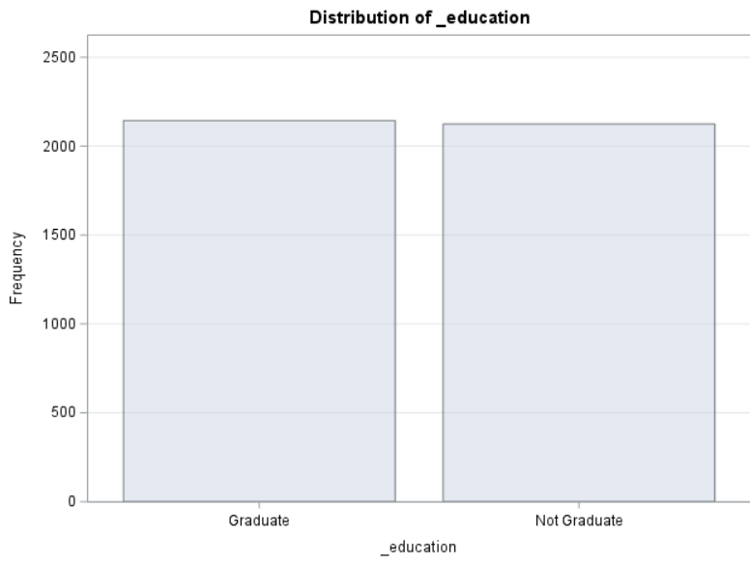
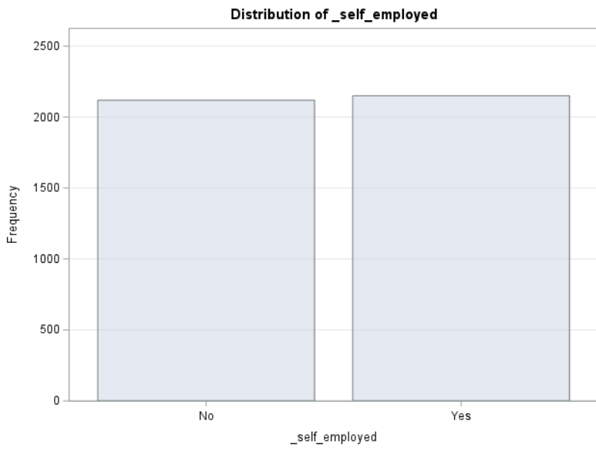
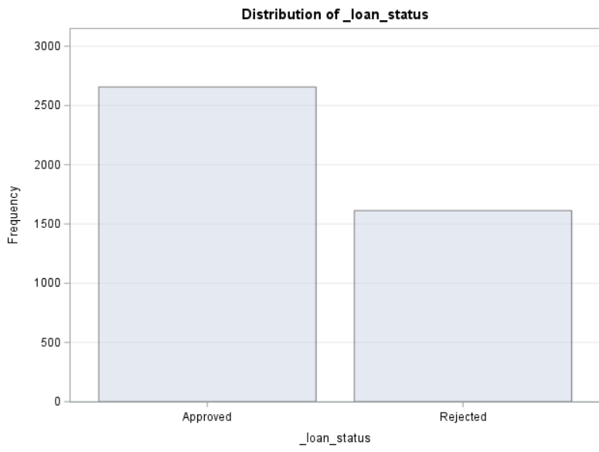
Univariate analysis(Categorical)

Slide 9
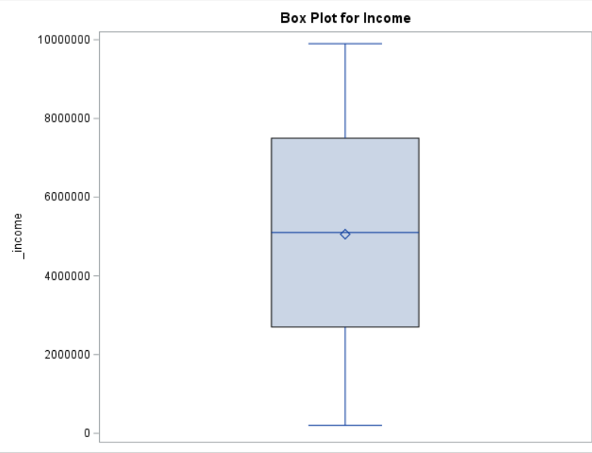
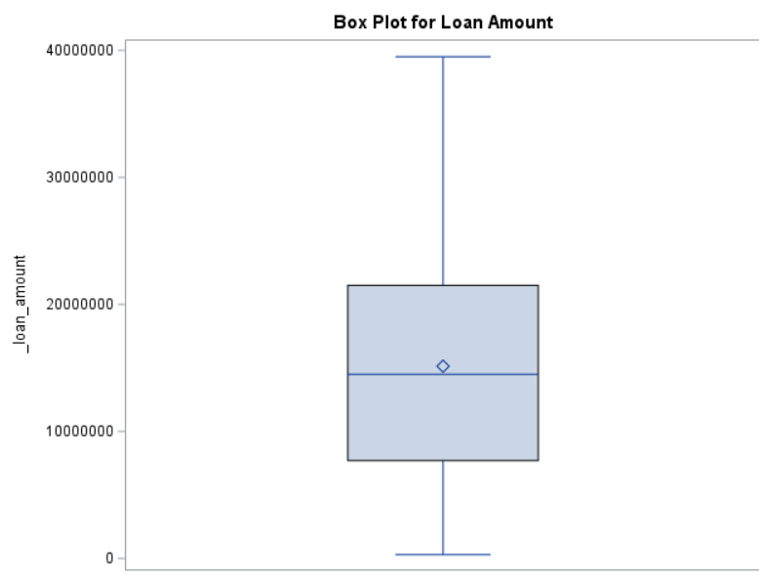
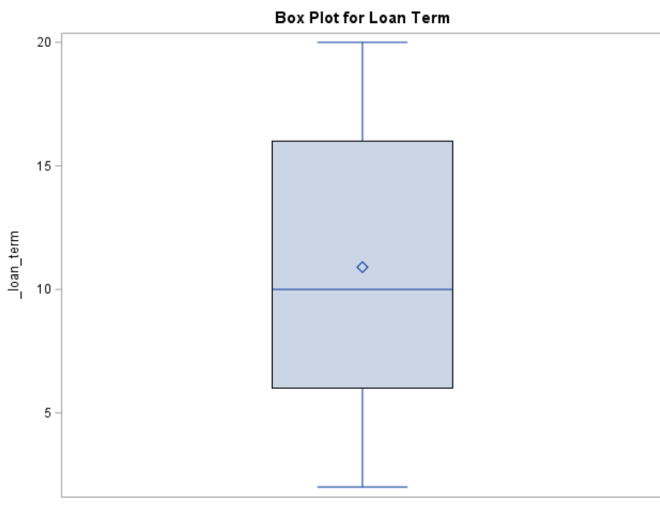
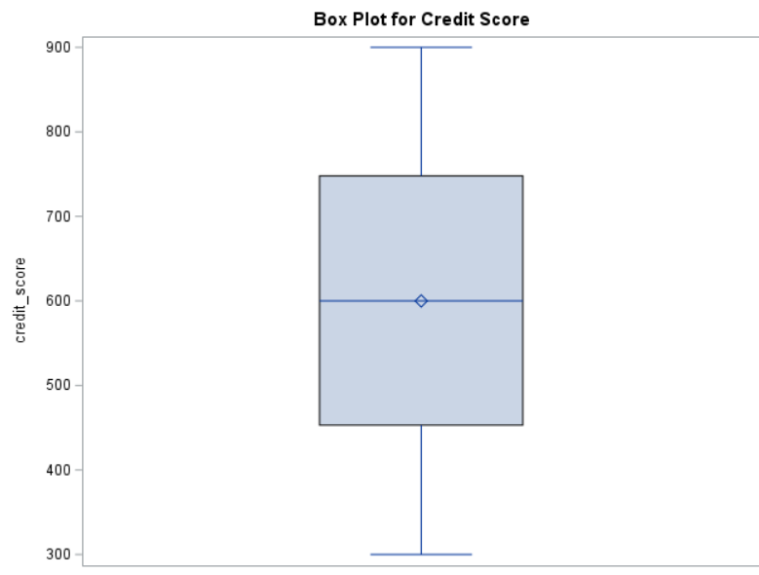
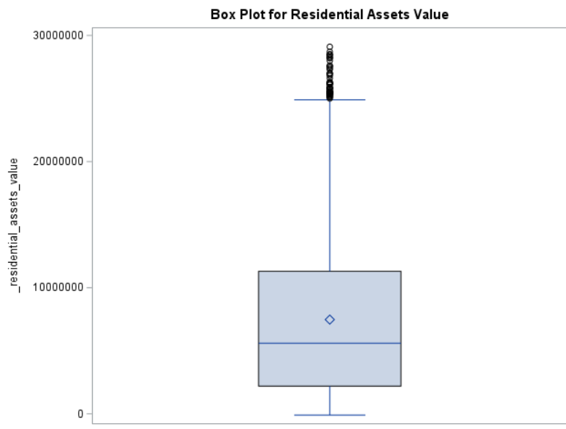
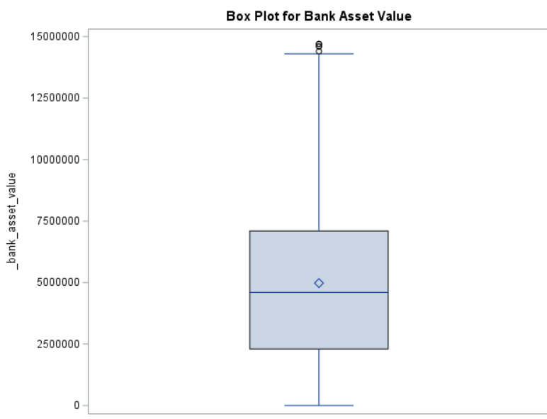
Outlier detection

Slide 10
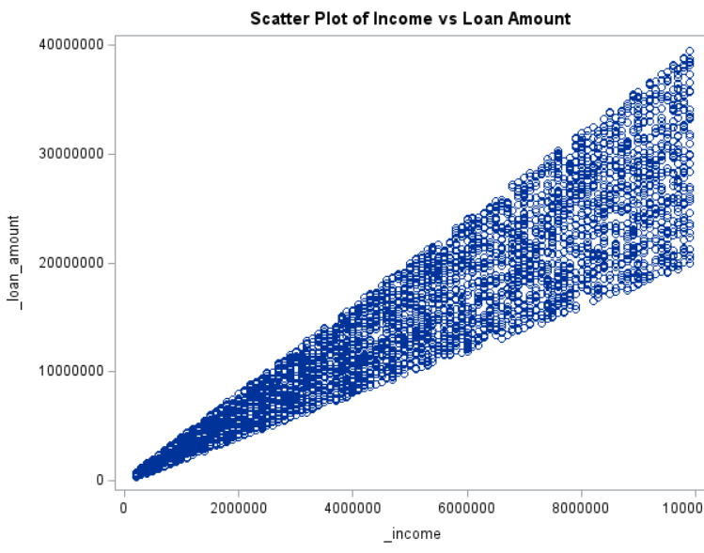
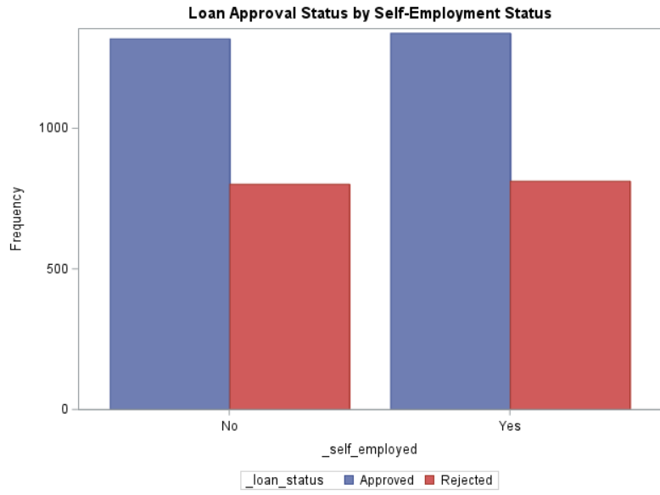
Bivariate analysis
Corr:0.93
H0:Self-employment status has no effect on loan approval status.
Chi-Square Test,P-value: 0.93>0.05, Fail to Reject H0

Slide 11
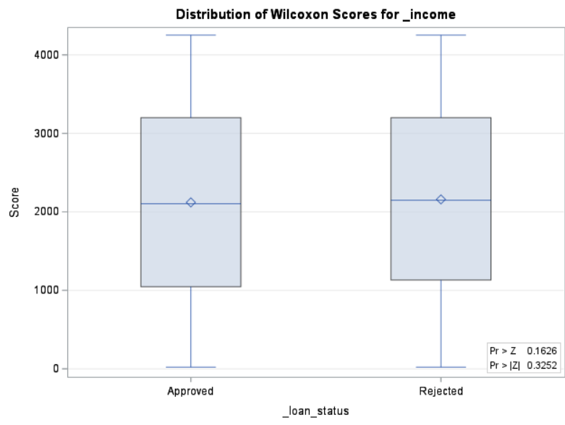
H0:The data is normally distributed. H0:The median income is the same for both loan_status groups.
Shapiro-Wilk: <0.0001
Mann-Whitney U test
Reject H0
Fail to Reject H0

Slide 12
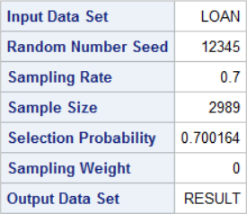
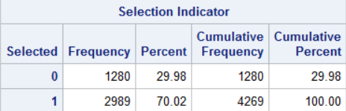
Split the dataset
Train Dataset: 70%
Test Dataset: 30%

Slide 13
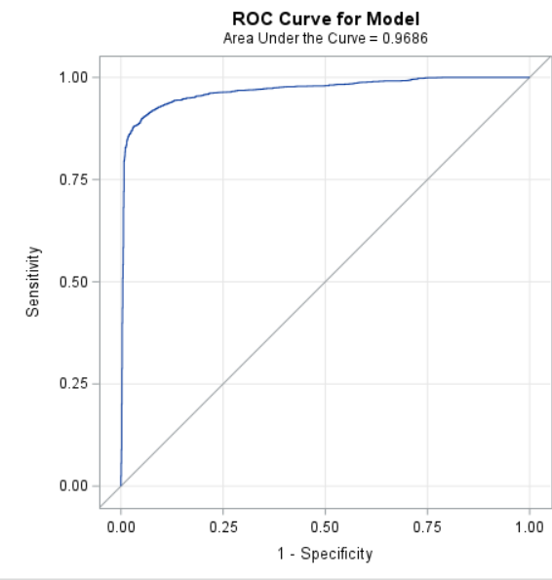
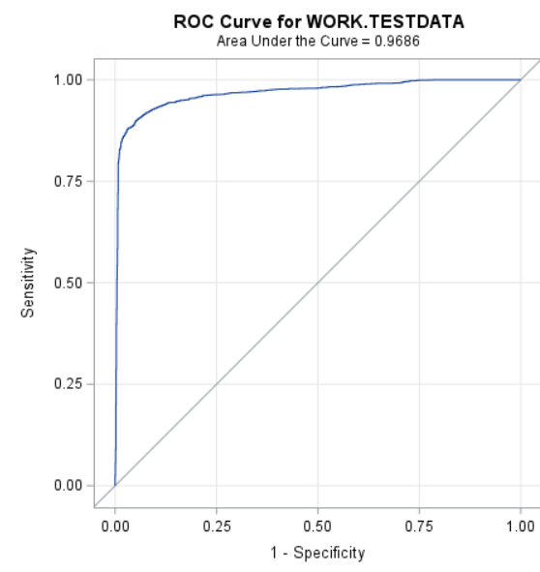
Model Performance
The model is performing excellently, and the consistency indicates good generalization.

Slide 14
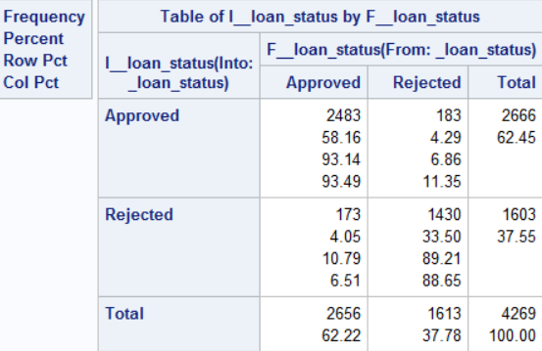

Evaluating The Model
The model performs well but mistakenly approves 183 (7%) risky applicants.

Slide 15
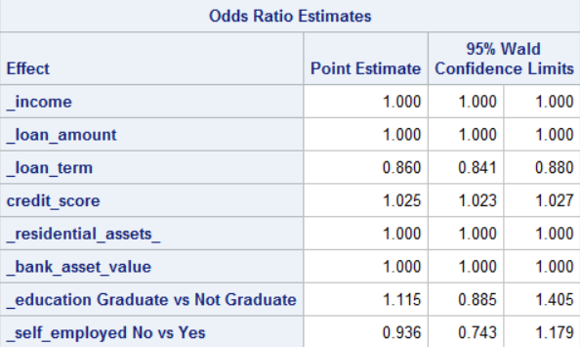
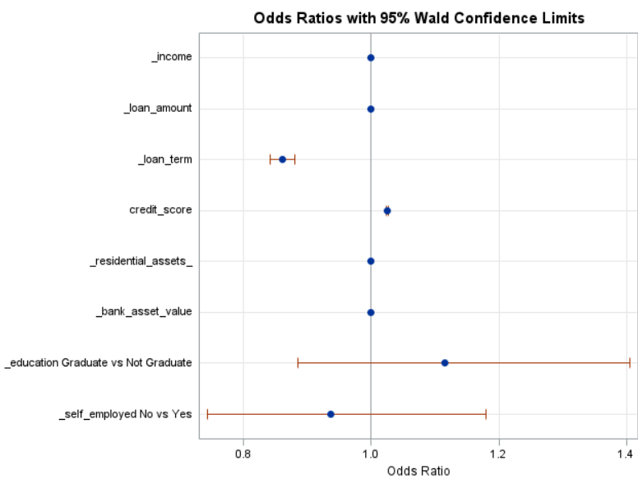
Odds Ratio Estimates
Significant predictors are loan term and credit score . Other variables have no significant impact on approval.

Slide 16
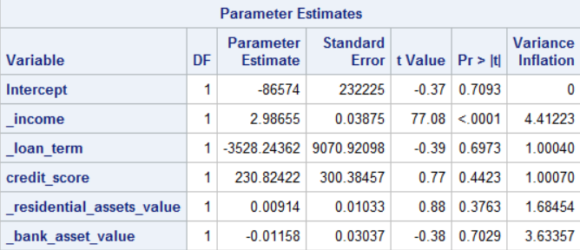
Multicollinearity
There is no severe multicollinearity in the model. Predictors are not highly correlated with each other.

Slide 17
Conclusion
The model is a reliable for loan decisions, helping to reduce financial risk and improve the approval process. Ongoing monitoring and adjustments will ensure its effectiveness and ability to adapt to new data and trends.

Slide 18
Thank You!

