Slide 1

US Weather Events (2016 - 2020) Project 3 – Group 4 August 16, 2021
Team Members:
Dany Roman
Francis Escamilla
Susan Quiros
Clay Swisher

Slide 2
US Weather Events 2016 -2021
Draft
Project Summary/Objective:
The team’s primary objective is to create an interactive dashboard page with visualizations identifying significant weather events/trends in the most populated US cities.
Project requirements: Postgres SQL, Pandas data queries, Java Script, HTML, Python Flask powered API, Leaflet, Plotly and JS Library (not covered in class)

Slide 3
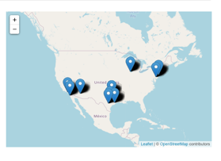
Map of top US cities
Draft
Draft

Slide 4
City-Wide Weather Events
Draft

Slide 5
Bar Chart
Draft

Slide 6

Questions & Recommendations
Draft

Slide 7
Resources/Back up
Draft
Data Source: https://www.kaggle.com/sobhanmoosavi/us-weather-events A nationwide dataset of 6.3 million weather events (2016 - 2020)
Project Focus: top 10 most populated cities in the US - Austin, Chicago, Dallas, Houston, Los Angeles, New York, Philadelphia, Phoenix, San Antonio, San Diego
Data cleaning: Original data file of 6.3M records was filtered to a manageable data record file of 54k: Data filtering by major US city, and group summarizations by: Year, City, Weather Type, and Average percent per year calculations.
Questions asked by the Team: Major US city climates impacted the least or greatest by rain, snow, cold, hail, fog, precipitation?
The following were noted as deviations from what would normally be expected:

