Slide 1

US WEATHER EVENTS (2016 - 2020) PROJECT 3 – GROUP 4 AUGUST 16, 2021
TEAM MEMBERS:
DANY ROMAN
FRANCIS ESCAMILLA
SUSAN QUIROS
CLAY SWISHER

Slide 2
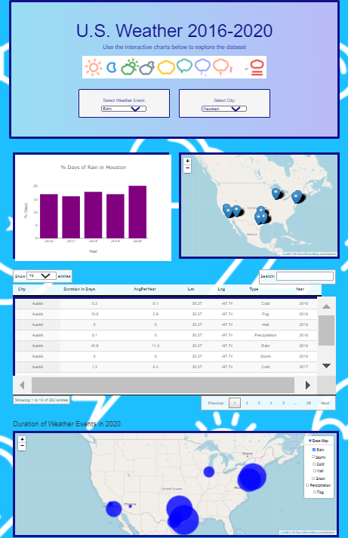
Project Summary
The team’s primary objective is to create an interactive dashboard page with visualizations identifying significant weather events/trends in the most populated US cities.
Key Question: Are major US cities impacted more or less by specific weather events, such as rain, snow?

Slide 3
Data Cleaning
Data Set: US Weather Events (2016 - 2020) from Kaggle
https://www.kaggle.com/sobhanmoosavi/us-weather-events
Top 10 most populated cities
6 million rows
56,000 rows
2016-2020
SQLAlchemy
JSON/JS
Pandas
PostgreSQL
Dashboard
Leaflet
Plotly
Datatable

Slide 4
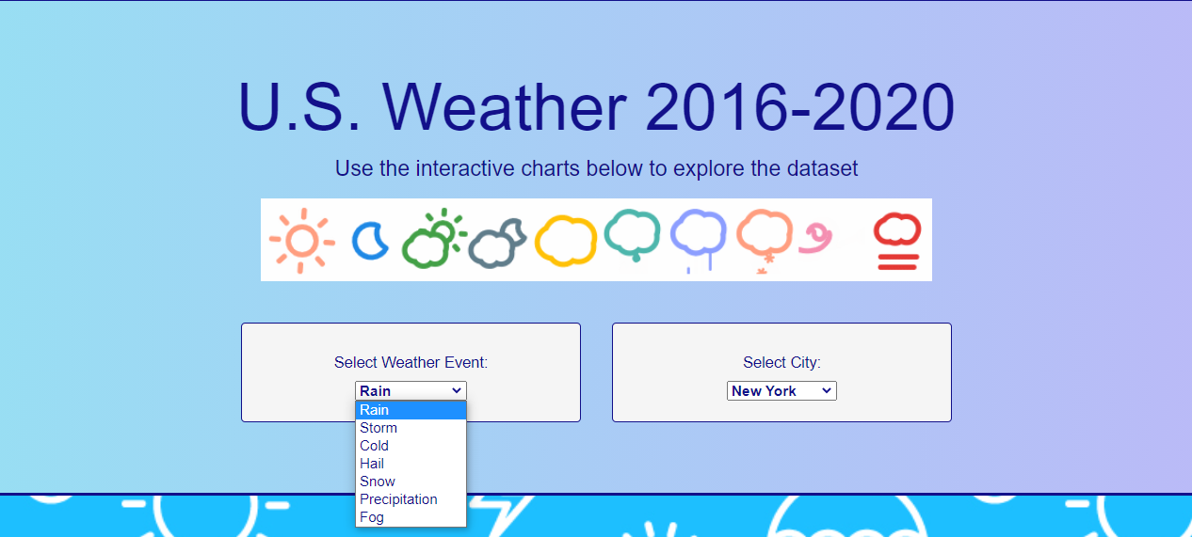
Weather Events
Cold
Fog
Hail
Rain
Snow
Storm
Precipitation

Slide 5
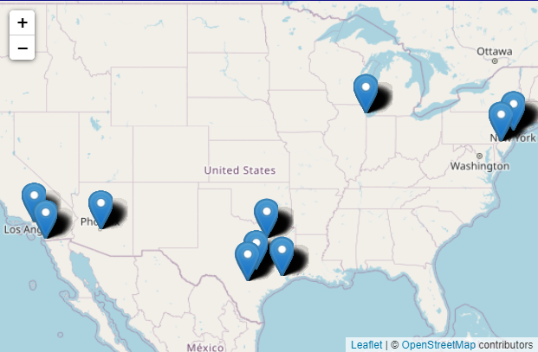
Top 10 Most Populated US Cities
New York
Philadelphia
Chicago
Dallas
San Antonio
Houston
Austin
Phoenix
Los Angeles
San Diego

Slide 6
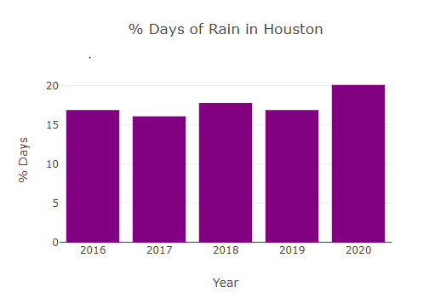

% Days of Weather

Slide 7
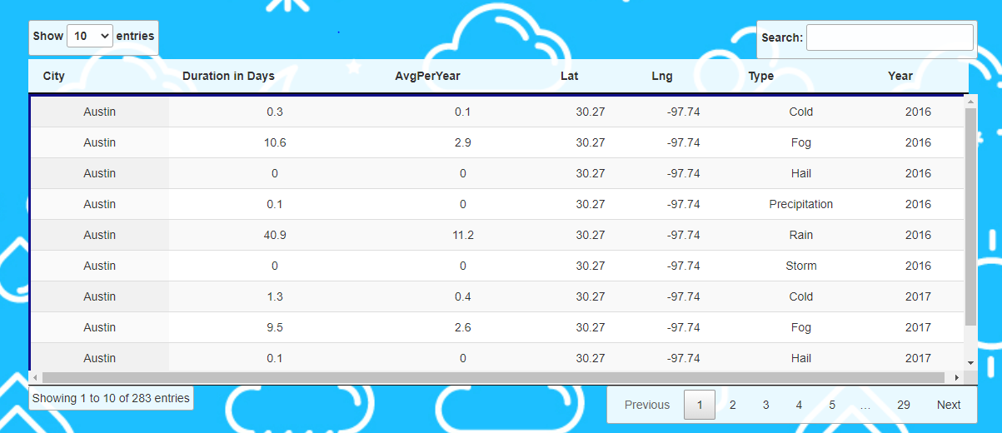
Summary Table

Slide 8
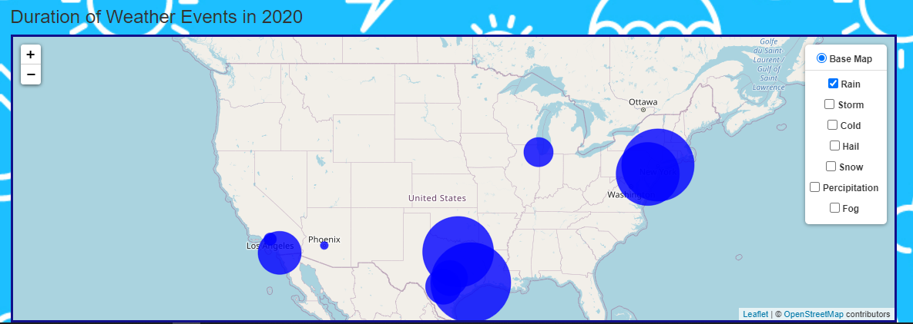
Bubble Map

Slide 9

Questions & Recommendations
Challenge
Time…
Setting up the API
If we had more time…
Other cities
Weather severity
Weather over the year

Slide 10
Resources/Back up
Data Source: https://www.kaggle.com/sobhanmoosavi/us-weather-events A nationwide dataset of 6.3 million weather events (2016 - 2020)
Citation of papers associated to dataset used:
Moosavi, Sobhan, Mohammad Hossein Samavatian, Arnab Nandi, Srinivasan Parthasarathy, and Rajiv Ramnath. “Short and Long-term Pattern Discovery Over Large-Scale Geo-Spatiotemporal Data.” In Proceedings of the 25th ACM SIGKDD International Conference on Knowledge Discovery & Data Mining, ACM, 2019.

Slide 11
Project Scope and Details
Project Focus: top 10 most populated cities in the US - Austin, Chicago, Dallas, Houston, Los Angeles, New York, Philadelphia, Phoenix, San Antonio, San Diego
Data cleaning: Original data file of 6.3M records was filtered to a manageable data record file of 54k: Data filtering by major US city, and group summarizations by: Year, City, Weather Type, and Average percent per year calculations.
Questions asked by the Team: Major US city climates impacted the least or greatest by rain, snow, cold, hail, fog, precipitation?
The following were noted as deviations from what would normally be expected:

