Slide 1

US Weather Events (2016 - 2020) Project 3 – Group 4 August 16, 2021
Team Members:
Dany Roman
Francis Escamilla
Susan Quiros
Clay Swisher

Slide 2
US Weather Events 2016 -2021
Project Summary/Objective:
The team’s primary objective is to create an interactive dashboard page with visualizations identifying significant weather events/trends in the most populated US cities.
Project requirements: Postgres SQL, Pandas data queries, Java Script, HTML, Python Flask powered API, Leaflet, Plotly and JS Library (not covered in class)

Slide 3
Description of Weather Events
Cold: The case of having low temperature
Fog: The case where there is low visibility condition as a result of fog or haze.
Hail: The case of having solid precipitation including ice pellets and hail.
Rain: The case of having rain, ranging from light to heavy.
Snow: The case of having snow, ranging from light to heavy.
Storm: The extremely windy condition, where the wind speed is at least 60 km/h.
Precipitation: Any other type of precipitation which cannot be assigned to previously described event types.

Slide 4
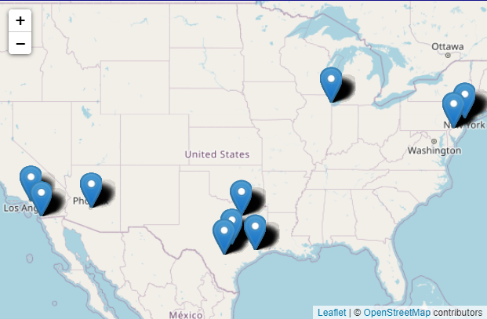
Top 10 US Cities

Slide 5
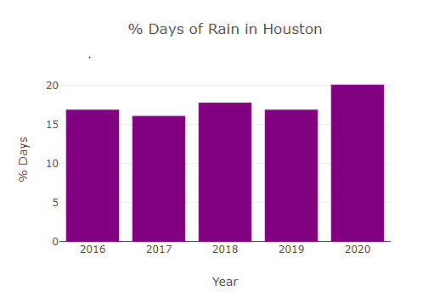
Bar Chart

Slide 6
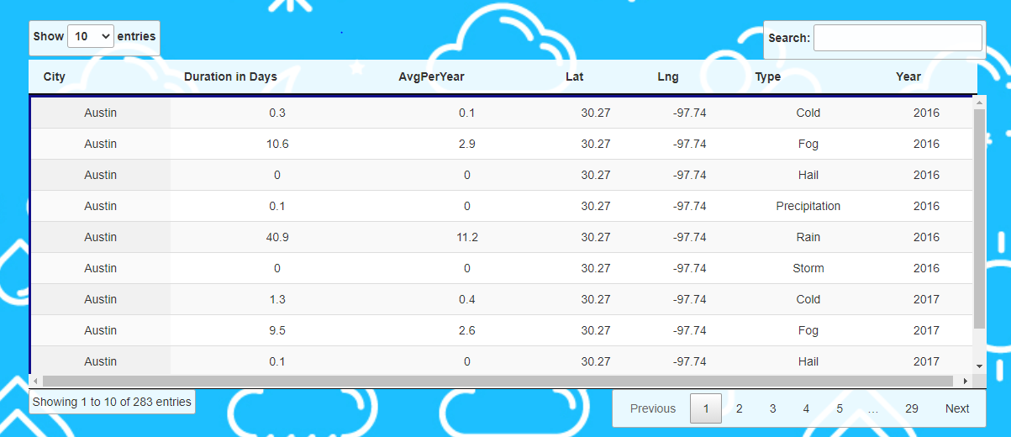
Weather Events Detailed Table

Slide 7
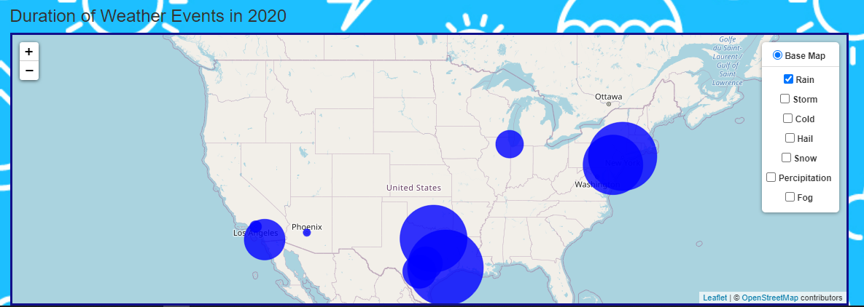
Bubble Map

Slide 8

Questions & Recommendations

Slide 9
Resources/Back up
Data Source: https://www.kaggle.com/sobhanmoosavi/us-weather-events A nationwide dataset of 6.3 million weather events (2016 - 2020)
Citation of papers associated to dataset used:
Moosavi, Sobhan, Mohammad Hossein Samavatian, Arnab Nandi, Srinivasan Parthasarathy, and Rajiv Ramnath. “Short and Long-term Pattern Discovery Over Large-Scale Geo-Spatiotemporal Data.” In Proceedings of the 25th ACM SIGKDD International Conference on Knowledge Discovery & Data Mining, ACM, 2019.

Slide 10
Project Scope and Details
Project Focus: top 10 most populated cities in the US - Austin, Chicago, Dallas, Houston, Los Angeles, New York, Philadelphia, Phoenix, San Antonio, San Diego
Data cleaning: Original data file of 6.3M records was filtered to a manageable data record file of 54k: Data filtering by major US city, and group summarizations by: Year, City, Weather Type, and Average percent per year calculations.
Questions asked by the Team: Major US city climates impacted the least or greatest by rain, snow, cold, hail, fog, precipitation?
The following were noted as deviations from what would normally be expected:

