Slide 1
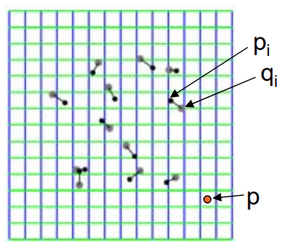
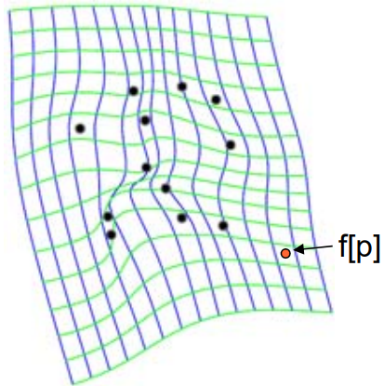
(a)
(b)

Slide 2

before
after

Slide 3
