Slide 1
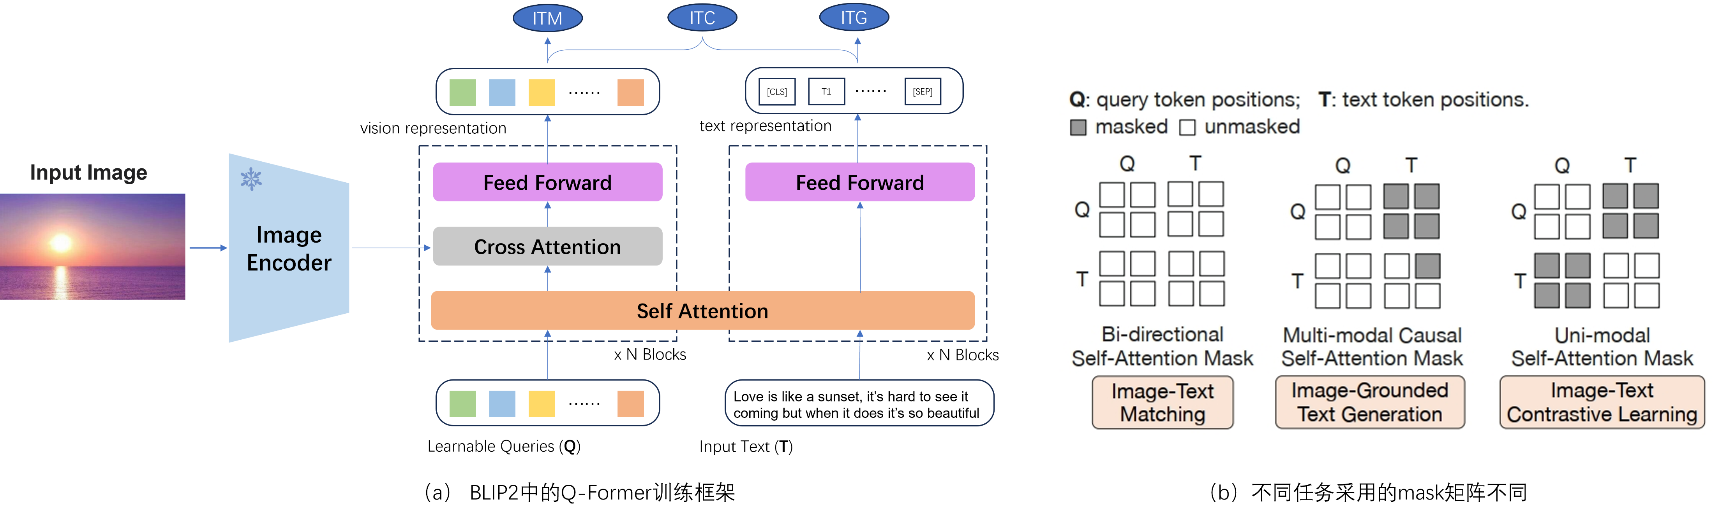

Slide 2


ITM
ITC
ITG
……
[CLS]
T1
……
[SEP]
vision representation
text representation
Input Image
Feed Forward
Feed Forward
Image Encoder
Cross Attention
Self Attention
x N Blocks
x N Blocks
……
Love is like a sunset, it’s hard to see it coming but when it does it’s so beautiful
Learnable Queries (Q)
Input Text (T)
BLIP2中的Q-Former训练框架

Slide 3
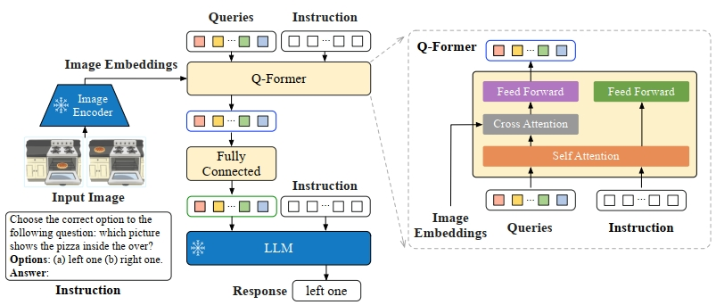
Large Language Model
Transferred vision representation
……
Input Image
Feed Forward
Write a romantic message that goes along this photo.
Image Encoder
Cross Attention
Self Attention
x N Blocks
……
Learnable Queries
（a） instructBLIP中采用的指令敏感Q-Former结构
（b） BLIP2中采用的指令无关的Q-Former设计

Slide 4
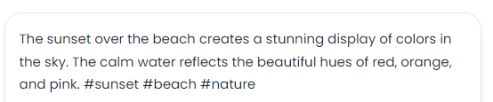
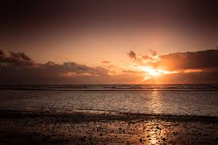

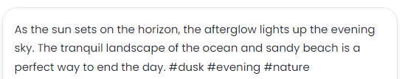
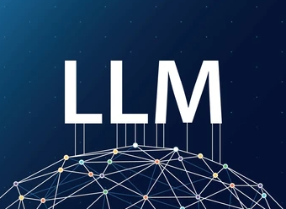

Image Caption
……
Powerful GPT4
Prompt: given the description of an image {}, please make a brief and informative summary
Image description summary (vision information)
MLLM

Slide 5
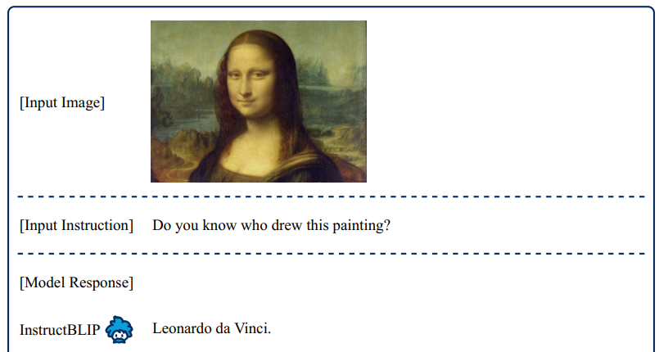
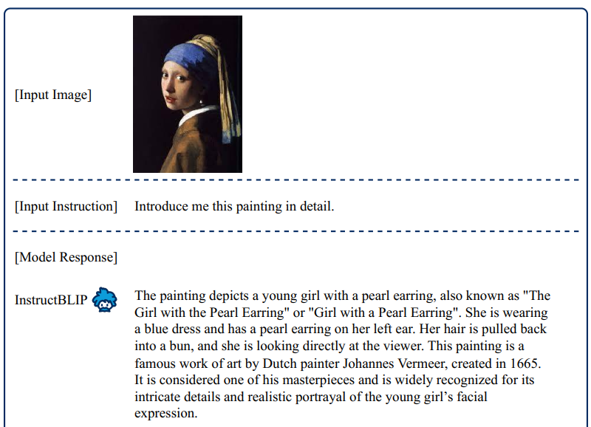
（a）对名画的作者咨询需求
（b）对名画的作画细节描述需求

