Slide 1

My Contribution and Progress at Gyzertech
CI/CD Implementation | Kubernetes | Monitoring
Presented by: Festus Okagbare
Date: 1/07/2025

Slide 2
Introduction
Joined as DevOps Engineer
Focused on automation, CI/CD, containerization, and monitoring

Slide 3
What I Was Tasked With
Implement CI/CD pipelines
Containerize applications (app1, app2)
Deploy to Azure VM and Kubernetes
Set up monitoring (New Relic)

Slide 4
What I Have Done So Far
CI/CD pipelines for app1 (Dev & Staging), app2 (Dev & Staging)
Dockerized applications
Deployed to Azure VM and Kubernetes Cluster
Set up monitoring using New Relic

Slide 5
Screenshots – What’s Working
CI/CD pipeline run status (Success)
Docker container running on Azure VM
Kubernetes pods active (kubectl get pods)
New Relic Dashboard showing live data

Slide 6
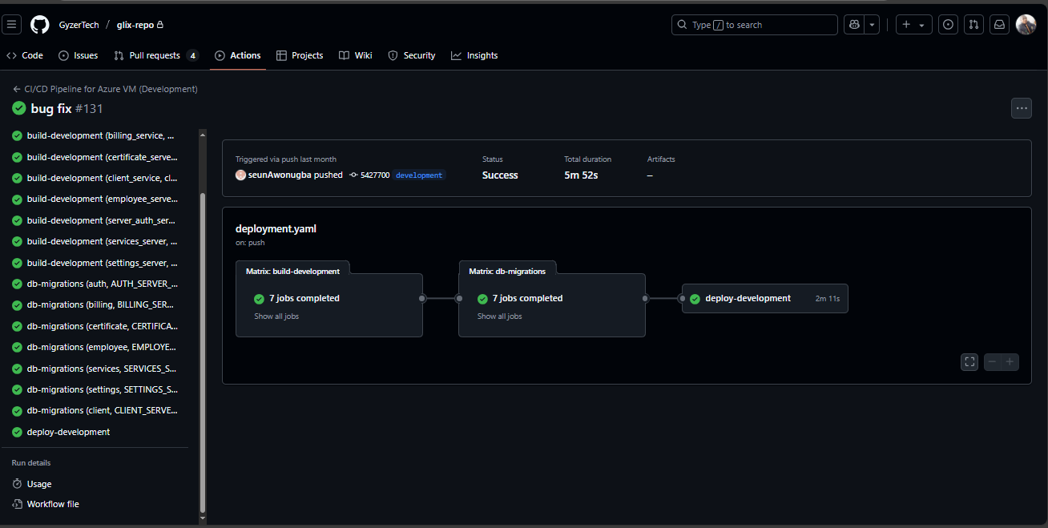
App1 development branch CICD successful deployment

Slide 7
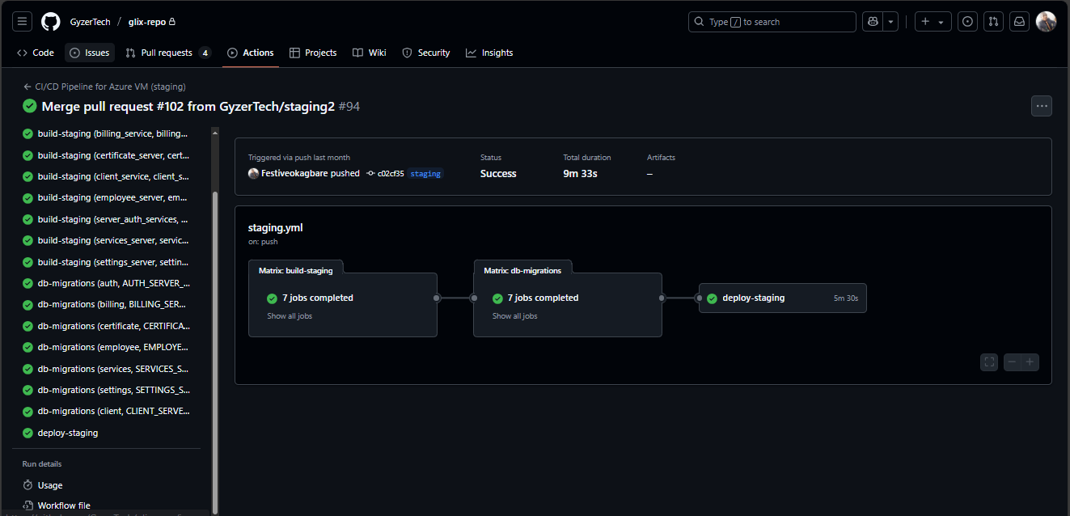
App1 staging branch CICD successful deployment

Slide 8
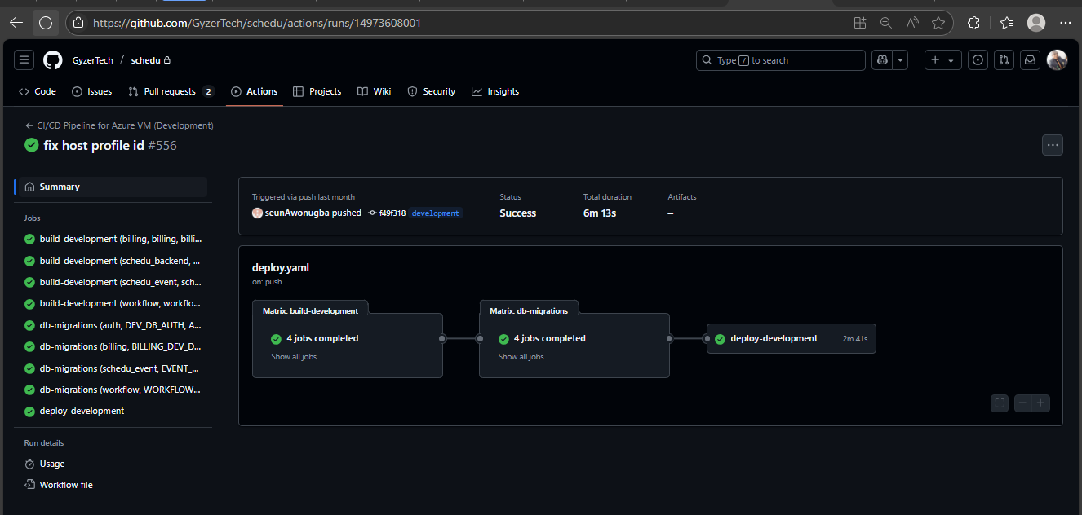
App2 Development branch CICD successful deployment

Slide 9
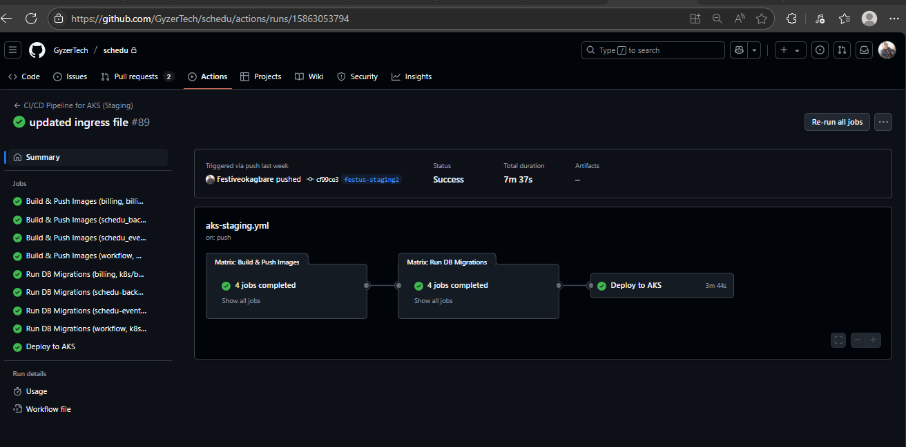
App2 Staging branch CICD successful deployment to AKS

Slide 10
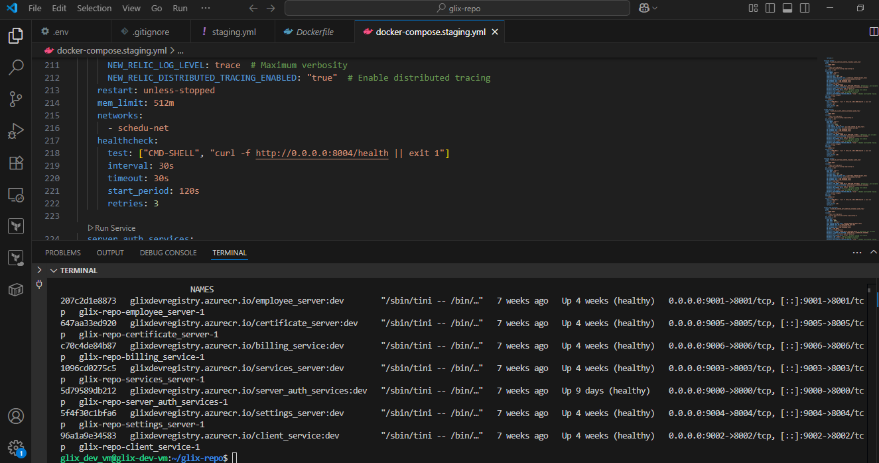
Containers running for App1 Dev Azure VM

Slide 11
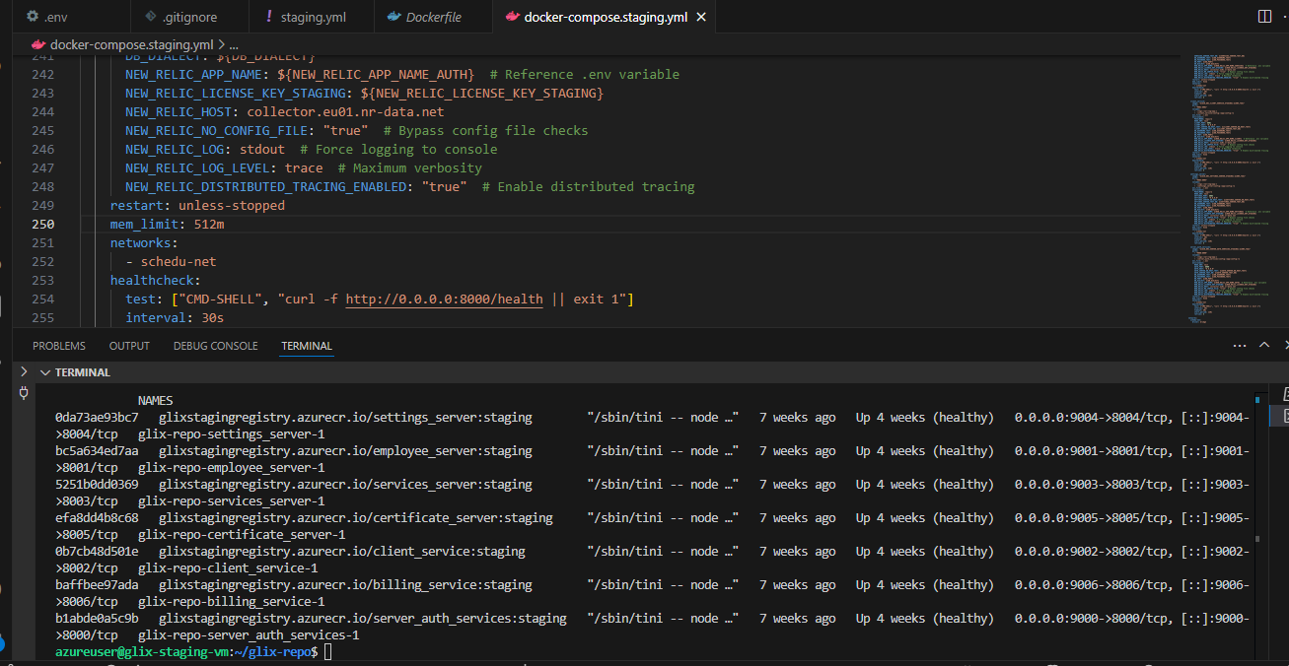
Containers running for App1 Staging Azure VM

Slide 12
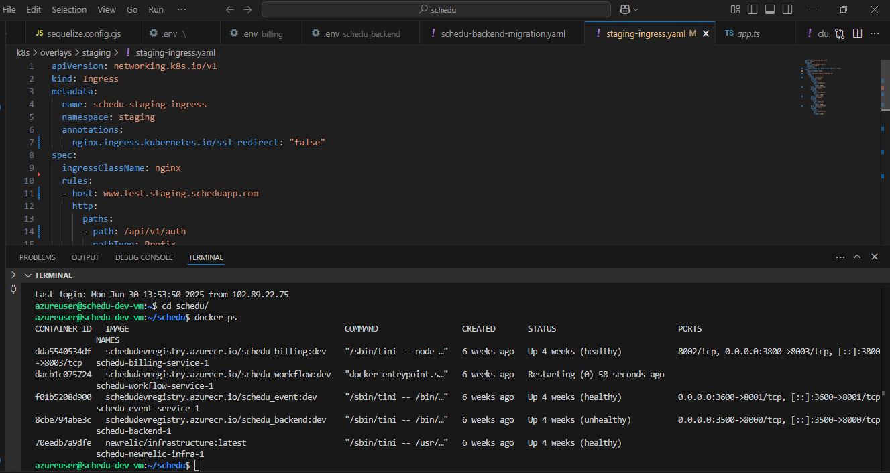
Containers running for App2 Dev Azure VM

Slide 13
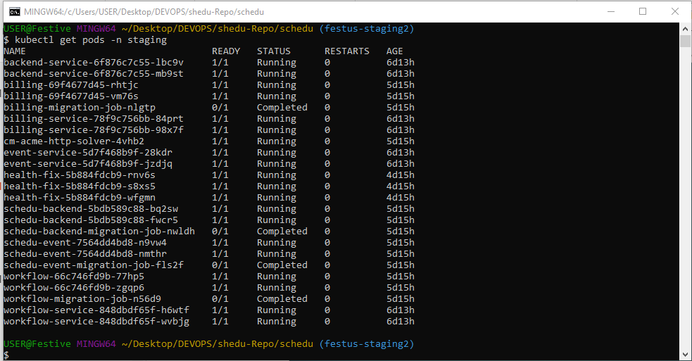
Apps Pods running on Kubernetes with 2 replicas each and db-migrations

Slide 14
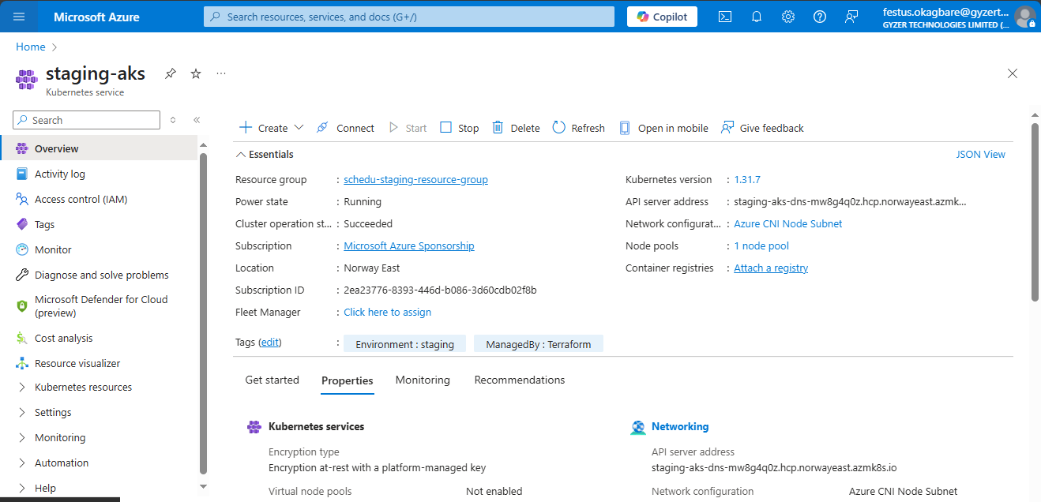
App1 staging-aks cluster infrasture provision with Terraform on Azure portal

Slide 15
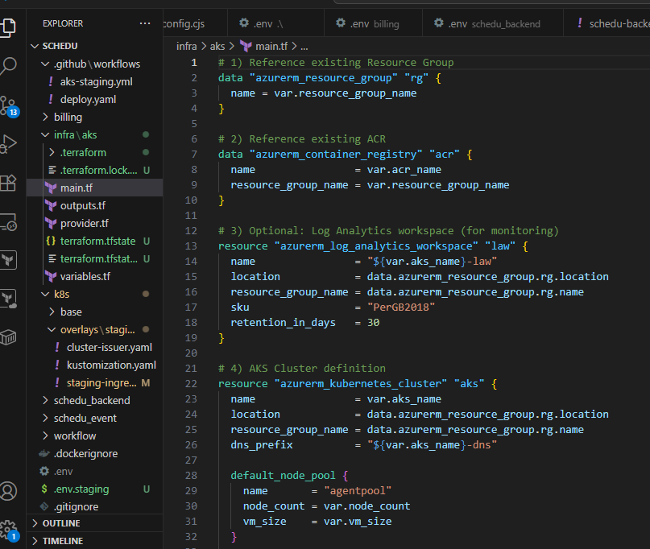
Terraform code used for provisioning aks cluster

Slide 16
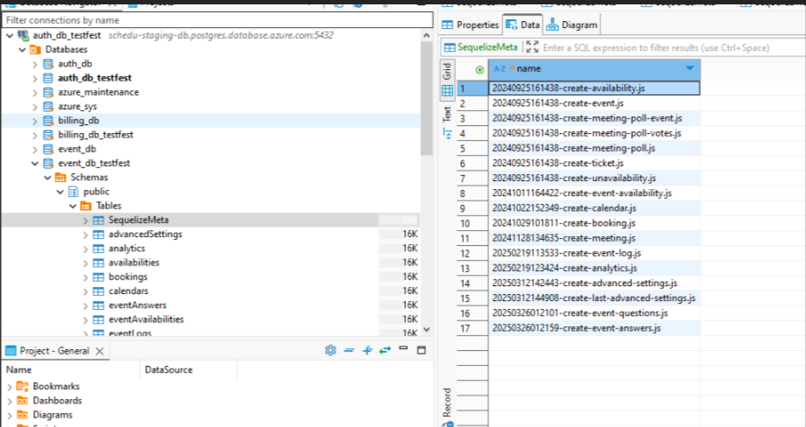
Dbeaver dashboard showing a successful database migration from the cicd deployment pipeline

Slide 17
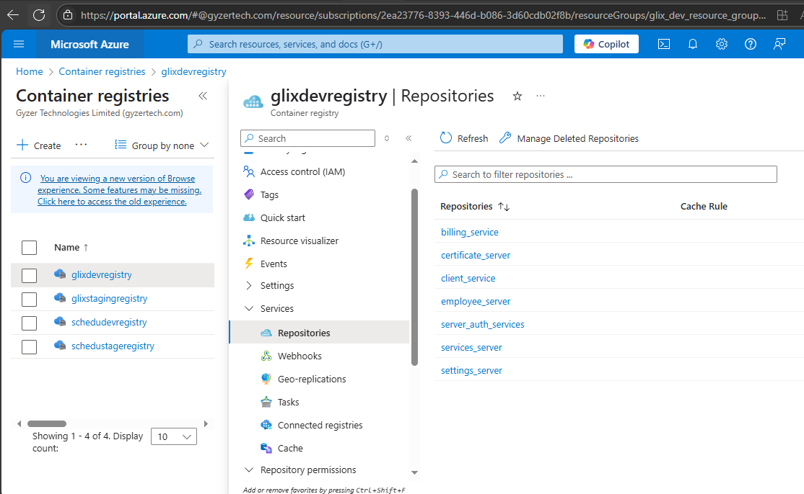
Successful docker Image push to app1 dev registry

Slide 18
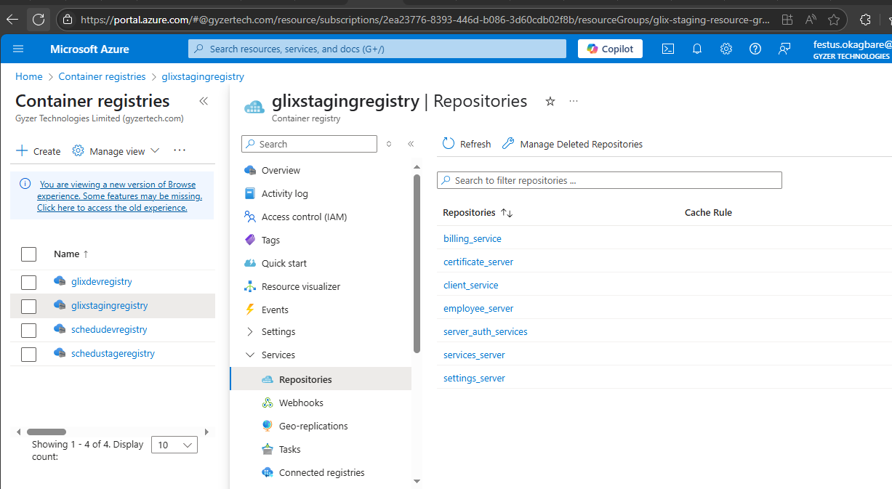
Successful docker Image push to app1 staging registry

Slide 19
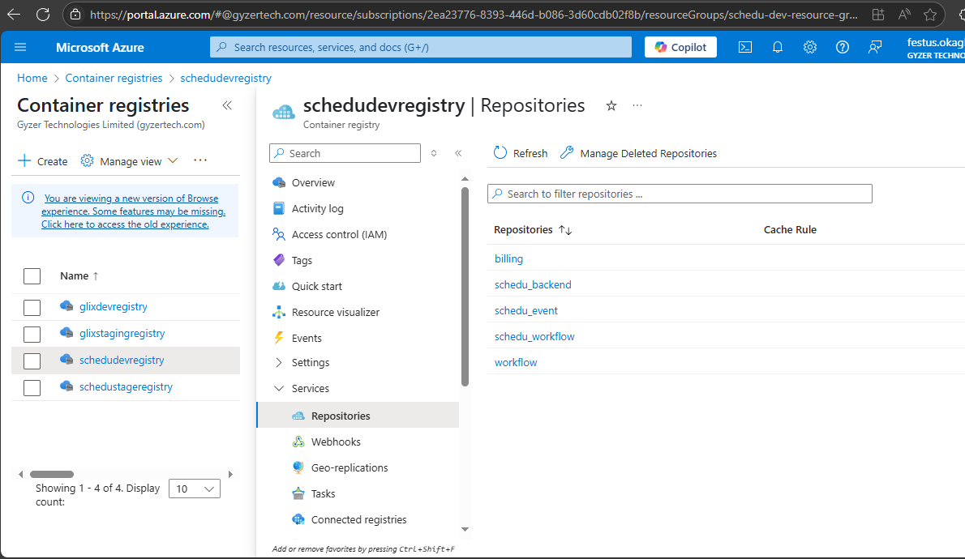
Successful docker Image push to app2 dev registry

Slide 20
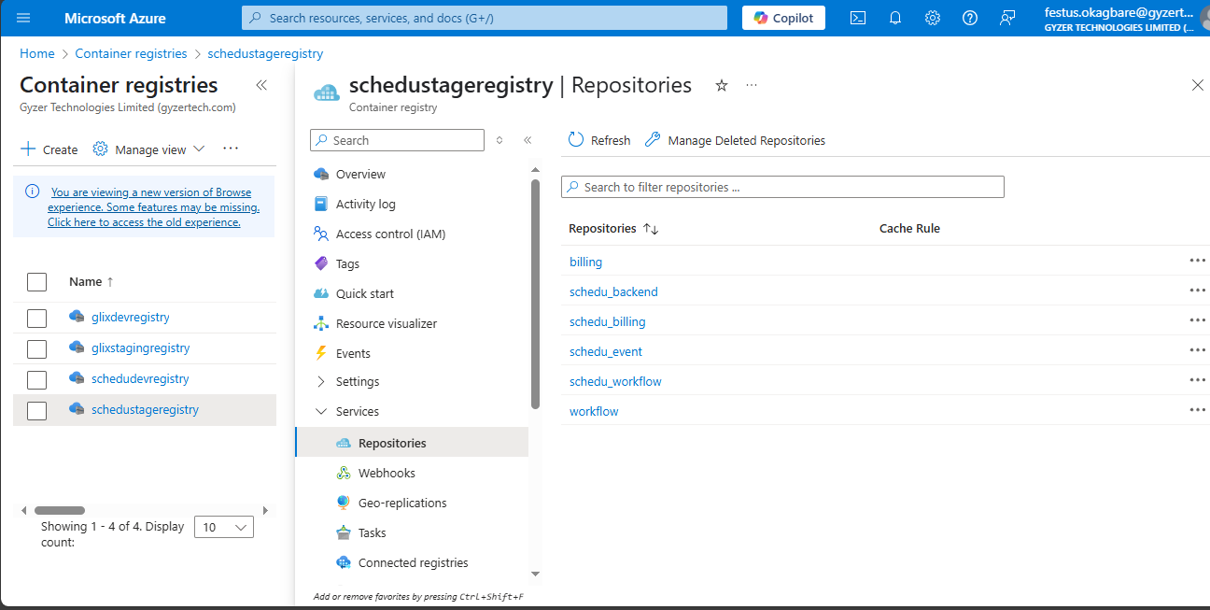
Successful docker Image push to app2 staging registry

Slide 21
Tools I Worked With
Docker
GitHub Repos
GitHub Actions
Azure VM
Kubernetes
New Relic

Slide 22
Self-Assessment
Delivered key DevOps results
Successfully built and deployed multiple CI/CD pipelines and containerized applications
Deployed infrastructure for Kubernetes orchestration and monitoring
Estimated contribution and performance: 80%+

Slide 23
Conclusion & Appreciation
THANK
YOU!

