Slide 1

Dr. Anteneh k
Chapter 3
CARDIOVASCULAR & RENAL DRUGS
Nov 2023

Slide 2
CVS and Renal drugs
1.Anti-Hypertensive agents
2.Drugs for Heart failure
3.Anti-anginal agents
4.Anti-arrhythmic drugs

Slide 3
Diuretics
Diuretics are drugs which increase renal excretion of salt and water: are principally used to remove excessive extracellular fluid from the body
Three mechanism involved in urine formation
Glomerular filtration
Tubular reabsorption
Tubular secretion
These processes maintain fluid volume, electrolyte concentration & pH of body fluid

Slide 4
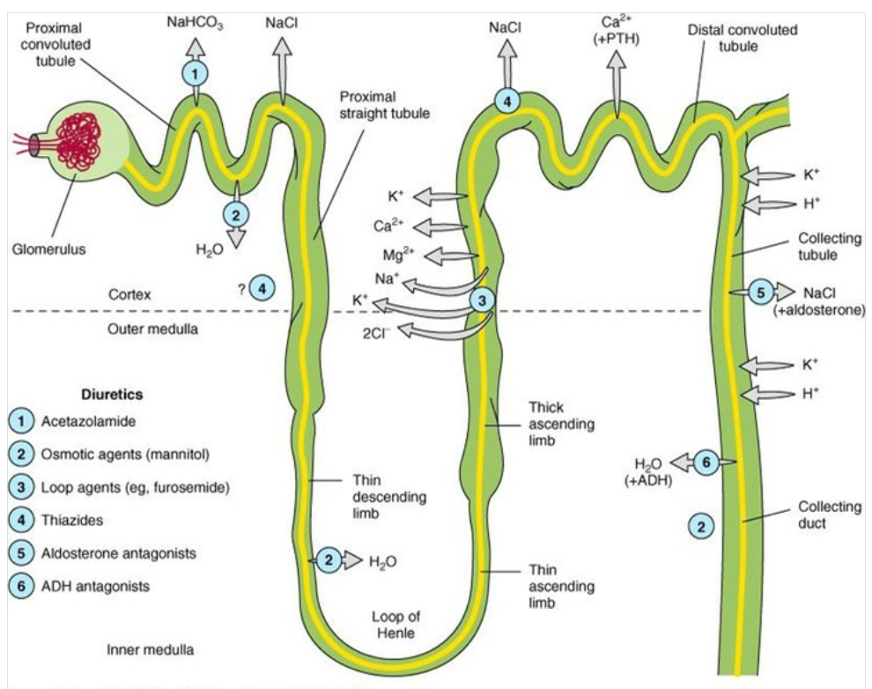
Nephron and site of actions of diuretics
Notes:
PT(60% of elect reab, 95% Hco3 reab)
LOH(25% Na reab)
DT(10% Na reab)
CT(5% Na reab)

Slide 5
Diuretics cont’d
Classification of diuretics
Most diuretics therapeutically act by interfering
with sodium reabsorption of the tubule
Thiazide diuretics: hydrochlorothiazide, chlorthalidone etc
Loop diuretics: e.g. frusemide, ethacrynic acid, etc
Potassium sparing diuretics or aldosterone blockers: e.g. triamterene, amiloride, spironolactone, etc
Carbonic anhydrase inhibitors: e.g. acetazolamide
Osmotic diuretics: e.g. mannitol, glycerol

Slide 6
Diuretics cont’d
Thiazide diuretics (E.g hydrochlorothiazide)
Inhibit NaCl symport at distal convoluted tubule
Mainly used in hypertension treatment
Adverse effect: epigastric distress, nausea, vomiting, weakness, fatigue, dizziness, impotence, jaundice, skin rash, Hyponatremia, hypokalemia, hypercalcemia, hyperuricemia, hyperglycemia and visual disturbance
Notes:
NaCl cotransport at DT, increases na & cl reab into interstitial cells then at the basal area sends na to circulation in exchange for K( via Na/K ATPase)….this will lead to increase Na in interstitial cell bc Na enters to it from lumen
Thiazides block NaCl channel thus decrease Na in the interstitial cells(low IC Na) leads to stimulation of Ca/Na exchanger which increase Na entry from circulation to interstitial cells (to increase IC Na) in exchange for Ca from lumen thus, Ca enters to circulation(Hypercalcemia).

Slide 7
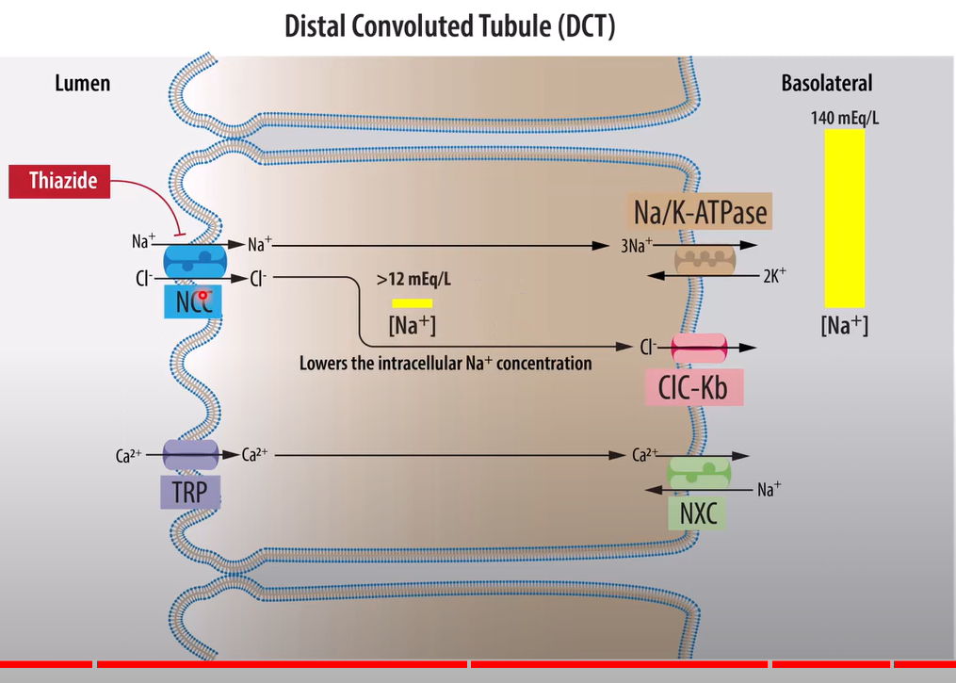

Slide 8
Diuretics cont’d
Loop diuretics (E.g. frusemide)
Inhibit Na⁺-k⁺-2Cl⁻ symporter in thick ascending limb of Henle
Therapeutic use:
Acute pulmonary edema, congested heart failure, hepatic and renal disease (but commonly used for the treatment of heart failure).
Hypertension
In other drug overdose it can be used to produce forced diuresis
Adverse effect:
Hypokalemia, hyponatremia, hypocalcemia, hyperuricemia, hyperglycemia, nausea, anorexia, vomiting, epigastric distress, fatigue, muscle cramp, drowsiness
Dizziness, hearing impairment and deafness: reversible
Notes:
Nakcl- symport- inc reab of na,k & 2cl- then k return back to lumen making net positive ion in lumen and then to lower lumen positivity ca2+ is reab thus decrease exc of ca
BUT LOOP diuretics block this process and no net positive in lumen thus inc exc of Ca leads to Hypocalcemia

Slide 9
Diuretics cont’d
Potassium sparing diuretics (E.g spironolactone)
It blocks aldosterone receptor at collecting tubule
Mild diuretic causing diuresis by increasing the excretion of sodium but decrease excretion of potassium
Therapeutic uses:
Used with conjunction with loop diuretics in edema due to cardiac failure, nephrotic syndrome and hepatic disease
Adverse effect:
GI disturbance, dry mouth, rashes, confusion, orthostatic hypotension, hyperkalemia, Hyponatremia

Slide 10
Diuretics cont’d
Carbonic anhydrase inhibitors (E.g. acetazolamide)
Inhibit the enzyme carbonic anhydrase in renal tubule cells and lead to increased excretion of bicarbonate, sodium and potassium ion in urine
For treatment of metabolic alkalosis
Used in acute angle glaucoma (in eye it cause reduction in formation of aqueous humor)
Adverse effect:
Drowsiness, hyponatremia, hypokalemia, metabolic acidosis and epigastric pain
Notes:
acidosis causes potassium to move from cells to extracellular fluid (plasma) in exchange for hydrogen ions.

Slide 11
Diuretics cont’d
Osmotic diuretics (E.g mannitol)
Freely filtered at the glomerulus and relatively inert pharmacologically and undergo limited reabsorption at renal tubules
Water content of plasma increases.
Sometimes they produce nausea, vomiting, electrolyte imbalances
They are used in cerebral edema and management of poisoning

Slide 12
I. Antihypertensive drugs
Hypertension - sustained elevation in blood pressure over 140/90
Etiology of hypertension
Primary (essential) hypertension – unknown etiology; >90% of cases
Secondary hypertension: <10% of cases.
Renal artery stenosis - excessive release of rennin
Pheochromocytoma
Tumor of the adrenal medulla
Cushing’s syndrome
Excess glucocorticoids: water reabsorption
Primary hyperaldosteronism

Slide 13
Antihypertensive cont’d
Complications of hypertension
The most dangerous complications are end organ damage.
Atherosclerosis (mainly arteries)
Aortic aneurysms
Cardiac failure
Renal failure
Stroke

Slide 14
Antihypertensive cont’d
Treatment of hypertension
A. Non-pharmacological RX
In patients with mild elevation in blood pressure, non-pharmacological treatment methods may be applicable (5-10mmHg reduction):
Stop smoking
Exercise and losing weight
Decrease in excessive alcohol consumption
Reduce salt intake
Non-pharmacological RX: safe; freedom from side effects compared with drug therapy
In higher BP; drugs should be started.

Slide 15
Antihypertensive cont’d
B. Pharmacological treatment of hypertension
1. Diuretics
Increase Na+ excretion & water loss, reducing plasma volume
Reduces the cardiac output, hence lowering blood pressure
Thiazides
Hydrochlorothiazide, chlorthalidone
With 6-8 wks they reduce Peripheral resistance as cardiac output and blood volume reduces
Loop diuretics
Furosemide, ethacrynic acid
The antihypertensive effect is mainly due to reduction of blood volume
K+ sparing diuretics: spironolactone; weak diuretic effect

Slide 16
Antihypertensive cont’d
2. Sympatholytic (Sympathoplegic) agents
Centrally acting antihypertensive (α₂ agonists)
α methyldopa [prodrug]:
Enters the CNS via active transport into the brain
Converted to α methyl NA…..α₂ agonist
Adverse effects:
Dreams, sedation, depression
Dry mouth, Hemolytic anemia
Clonidine:
Selective α₂ agonist
Can cause rebound hypertension on cessation
Both drugs cause very little postural hypotension

Slide 17
Antihypertensive cont’d
3. adrenoceptor antagonist
dilates blood vessels or decrease CO
reduce plasma triglyceride, reduce LDL; raise in HDL
i. α-blocker….reduce vasoconstriction
Prazosin
Terazosin
Adverse effects:
Postural hypotension (occurs on the first dose)
Failure to ejaculate

Slide 18
Antihypertensive cont’d
ii. β- Blockers
Reduce BP by: Blocking β₁ receptors of the heart and the kidney
Propranolol - non selective
Atenolol and Metoprolol- β₁ selective
Adverse effects:
Cold extremities and bronchospasm(↓ β₂ effect) mainly propranolol
Increased triglycerides since β receptors are also present in the liver to increase fat metabolism
Reduces libido
Withdrawal effect(e.g. Propranolol may result in tachycardia )
AV block and bradycardia
Labetalol- α₁ antagonist and a non-selective β antagonist (weak)
not used widely
Used for hypertensive emergencies
Useful in pre-eclampsia of pregnancy

Slide 19
Antihypertensive cont’d
4. Direct vasodilator
Hydralazine [Dilates arterioles]
Mechanism of action unknown
Combined with β-blocker (to prevent the cardiac effects) and a diuretic (to overcome the fluid retention).
Side effects:
Headache (due to vasodilation)
Tachycardia(Reflex stimulation of the heart: precipitate ischemic attack)
Angina
Lupus like condition in some people
Treatment restricted to Hypertensive people who are resistant to other drugs

Slide 20
Antihypertensive cont’d
Minoxidil
Relaxes blood vessels by opening K+ channels in the smooth muscle cells
Need to be used in conjunction with β blockers and diuretics
Adverse effects:
Salt retention
Tachycardia
Angina
Hypertrichosis and Hirsutism

Slide 21
Antihypertensive cont’d
Sodium nitroprusside
Releases NO - relaxes smooth muscle in blood vessels
Dilates arterial and venous vessels
Reserved for acute use only
It is light sensitive & the solution must be made up on the spot
The drug contains cyanide - cyanide poisoning may develop
Serious toxicity: metabolic acidosis, arrhythmias, excessive hypotension and cyanide poisoning and death

Slide 22
Antihypertensive cont’d
5. Calcium channel blockers
Relax arteriolar smooth muscle by reducing calcium entry
i. Dihydropyridines- more vascular selective
Nifedipine
Amlodipine
ii. Non-Dihydropyridines- more cardiac selective
Diltiazem
Verapamil
Adverse effects:
Flushing
Edema
Dizziness
AV blockade (with cardio selective agents)
Verapamil must never be used in conjunction with beta blocker

Slide 23
Antihypertensive cont’d
6. Angiotensin converting enzyme inhibitors
ACE inhibitors prevent the conversion of angiotensin I to II
Low Angiotensin II…low aldosterone…less Na+ reabsorption
ACE : also responsible for inactivation of bradykinin
Bradykinin can act as a local vasodilator agent. However, the adverse effects of bradykinin limit the usefulness of ACE inhibitors.
Captopril
Excreted by the kidneys
Orally available
65% bioavailability
Half life 2 hours

Slide 24
Antihypertensive cont’d
Enalapril
prodrug
Converted to enalaprilat via hepatic hydrolysis
Much longer half-life than captopril (20 - 24 hours)
ADR;
Dry cough (due to bradykinin)
Angioedema (due to bradykinin)
Hypotension
Hyperkalemia

Slide 25
Antihypertensive cont’d
7. Angiotensin II receptor antagonists (ARB)
Angiotensin II actions mainly come after binding to AT1 receptors
E.g of ARB-losartan, valsartan, candesartan
block AT1 rec, thus inhibit angiotensin II action
The drug Losartan
selective for AT1 receptors
more complete inhibition of angiotensin action
Similar efficacy to ACE inhibitors but without the bradykinin associated side effects:
There is no cough and no chance of angioedema
However, other side effects may be:
Have teratogenic effect
Hyperkalemia (due to decreased aldosterone)

Slide 26
Antihypertensive cont’d
SUMMRY OF ANTIHYPERTENSIVE DRUGS
Initial treatment with non-pharmacologic
Drug therapy in mild hypertension with monotherapy of:
Thiazide diuretic
beta blockers
Calcium channel blockers
Angiotensin converting enzyme inhibitor or ARB
Central sympathoplegic agent
Black patients respond well to diuretic and CCB than to beta-blockers and ACE inhibitors
If monotherapy is unsuccessful, thiazide diuretic can be combined with beta-blockers, CCB, or ACE inhibitors

Slide 27
Antihypertensive cont’d
Treatment of hypertensive emergency
Frusemide, sodium nitroprusside, hydralazine, labetalol can be indicated
Treatment of Hypertension in pregnancy
Hydralazine, methyldopa, labetalol

Slide 28
II. Drugs used in heart failure
Heart failure :
The heart is unable to pump sufficient blood to meet the needs of the body.
Its cardinal symptoms are dyspnea, fatigue, and fluid retention (edema).
Heart failure usually caused by:
Ischemic heart disease
Myocardial infarction
Hypertensive heart disease
Congenital heart disease
Valvular heart disease
Drugs used to treat heart failure:
Drugs with positive inotropic effect
Drugs without positive inotropic effect

Slide 29

Physiologic compensatory mechanisms in the progression of HF
To ↑ cardiac output.. this initially beneficial but long term deteriorates the heart
i. Increase SNS… NA and adrenaline
ii. Activate the renin–angiotensin–aldosterone system (RAAS)
iii. Myocardial hypertrophy- heart muscle hypertrophy and chamber dilates
NA and Aldosterone may lead to remodeling of cardiac tissue, loss of myocytes, hypertrophy, and fibrosis.

Slide 30
Acute (decompensated) HF
If the adaptive mechanisms adequately restore cardiac output, HF is said to be compensated.
If the adaptive mechanisms fail to maintain cardiac output, HF is decompensated and the patient develops worsening HF signs and symptoms.
HF signs and symptoms include dyspnea on exertion, orthopnea, paroxysmal nocturnal dyspnea, fatigue, and peripheral edema.

Slide 31
Chronic HF is typically managed by
Fluid limitations; Low dietary intake of sodium; Treatment of comorbid conditions (modify cardiovascular risk factor profile)
Long Term Management Of Chronic Heart Failure
Diuretics,
Inhibitors of the RAAS,
Inhibitors of the SNS.
ACE inhibitors & digitalis
Inotropic agents except digoxin are reserved for acute HF mostly in the inpatient setting
Drugs that may precipitate or exacerbate HF, such as NSAIDs, alcohol, nondihydropyridine CCB, and some antiarrhythmic drugs, should be avoided if possible.

Slide 32
Drugs with positive Inotropic effect
Positive inotropic drugs enhance cardiac contractility → ↑cardiac output.
Inotropics increase cytoplasmic calcium concentration this enhances contractility of cardiac muscle → reduced survival
These agents have reduced survival

Slide 33
Heart failure
Drugs with positive Inotropic effect
Cardiac glycosides
Includes digoxin
Mechanism: inhibition of Na⁺/K⁺ ATPase
Therapeutic use of cardiac glycosides
Heart failure
Atrial fibrillation & Atrial flutter
Paroxysmal atrial tachycardia
Toxicity
GI: anorexia, nausea, vomiting, diarrhea
Cardiac effect: bradycardia, heart block, arrhythmia
CNS: headache, malaise, hallucination, delirium, visual disturbance

Slide 34
Heart failure
Bipyridine derivative, e.g. amrinone & milrinone
Have a positive inotropic and vasodilator effects
Mechanism: inhibition of phosphodiesterase
Biperidine derivatives are used in cases of heart failure resistant to treatment with cardiac glycosides or vasodilator
Beta-adrenergic stimulants, e.g. dobutamine & dopamine
Stimulate ß1→ ↑ myocardial contractility and increase cardiac output
Positive chronotropic effect of these drugs minimizes their use
Reserved for the management of acute failure or failure resistant to other agents

Slide 35
Heart failure
Drugs without positive inotropic effect
Diuretics
Loop diuretics (e.g frusemide)
In acute failure, diuretic reduces plasma volume then decrease venous return to the heart (preload).
Reduction in venous pressure causes reduction in edema and its symptoms & reduction of cardiac size which leads to improved efficiency of pump function
Reduce the signs and symptoms of volume overload
pulmonary congestion and peripheral edema
orthopnea and paroxysmal nocturnal dyspnea

Slide 36
2. β-blockers
initially exacerbates HF symptoms ( BP, HR)
Avoid in Acute HF but can be given for chronic HF cases
prevent the changes that occur because of chronic activation of the SNS.
It decrease heart rate and inhibit release of renin in the kidneys.
β-blockers prevent the deleterious effects of norepinephrine on the cardiac muscle fibers, decreasing remodeling, hypertrophy, and cell death
Prevent remodeling of heart (increase survival of patients )

Slide 37
3. Vasodilators
They provide reduction in preload (through venous dilation) or reduction in afterload (through arteriolar dilation) or both
Vasodilator agents: reserved for patients who are intolerant of or who have contraindications to ACE inhibitors
Hydralazine: direct arteriodilator; reduce vascular resistance and increase cardiac output
Sodium nitroprusside: mixed venous and arteriolar dilator used for acute reduction of BP

Slide 38
Heart failure
4. Angiotensin converting enzyme (ACE) inhibitors and ARB
Angiotensin II and aldosterone involved in undesirable compensatory response to heart failure
ACE inhibitors and ARB reduce peripheral resistance and reduces salt water retention by way of reduction of aldosterone secretion
Prevent cardiac remodeling(improve survival of HF patients)
5. Aldosterone antagonists (e.g Spironolactone)
Thereby preventing salt retention, myocardial hypertrophy, and hypokalemia.
Aldosterone antagonists are indicated in patients with more severe HF and recent myocardial infarction.
Prevent heart remodeling (improve survival of HF patients)

Slide 39
II. Pharmacotherapy of angina pectoris
Angina pectoris develops as a result of an imbalance between the oxygen supply and oxygen demand of the myocardium
It is symptoms of myocardial ischemia
Drugs used in angina pectoris
Organic nitrates [e.g. nitroglycine, isosorbide dinitrate]
They are potent vasodilators
Nitrates act by mimicking the vasodilator action of nitric oxide → relax smooth muscle
Therapeutic use of nitrates: prophylaxis and treatment of angina pectoris
Adverse effect: flushing, hypotension, weakness, dizziness, tachycardia, palpitation, vertigo, sweating, syncope, localized burning with sublingual preparation

Slide 40
angina pectoris cont’d
Adrenergic blocking agents
Exercise and emotional excitement induce angina by increasing heart rate, BP and myocardial contractility through increased sympathetic activity
Beta receptor blocking agents [atenolol, propranolol, metoprolol, labetalol] prevent angina by blocking all these effects
Adverse effect: lethargy, fatigue, rash, cold hands and feet, nausea, breathlessness, nightmare and bronchospasm.
Selective beta-blockers have relatively less adverse effect
Therapeutic uses other than angina: hypertension, arrhythmia, and pheochromocytoma

Slide 41
angina pectoris cont’d
Calcium channel blockers
Interfere with calcium entry into myocardial and vascular smooth muscle
Nifedipine, felodipine, verapamil and diltiazem
Other therapeutic uses: hypertension, tachycardia
Adverse effect: flushing, nausea/vomiting, headache, ankle swelling, dizziness, constipation, etc
Miscellaneous drugs, e.g. aspirin
Decreases thromboxane A₂
75mg per day produce antiplatelet activity and reduce the risk of myocardial angina

Slide 42
IV. Antiarrhthmics
Electrophysiology of cardiac muscle:
Cardiac arrhythmias arise as a result of either of
Clinically, arrhythmia is disorder of impulse formation and/or
Disorder of impulse conduction
Arrhythmias are classified according to:
A. Their site of origin (atrial or ventricular)
B. Whether they cause bradycardia or tachycardia
Pharmacotherapy of cardiac arrhythmias:

Slide 43
Antiarrhthmics cont’d
Drugs used in the treatment of cardiac arrhythmias are traditionally classified into:
1. Class I: Na⁺ channel blockers [quinidine, lidocaine, flecainide, etc]
2. class II: beta-adrenergic blockers [propranolol, atenolol, etc]
3. class III: K⁺ channel blockers [amiodarone, beryllium, sotalol, etc]
4. class IV: Ca²⁺ channel blockers [verapamil, etc]
5. class V: digitalis [digoxin]…. Prolongs the effective refractory period AV node

Slide 44
Drugs used in hypotensive states and shock
Anti-hypotensive agents
Agents intended to increase the volume of blood in active circulation [iv fluid]
Vasoconstrictors [adrenaline, ephedrine, vasopressin, angiotensin]
RX of shock
Cardiogenic shock: dopamine
Anaphylactic shock: adrenaline [vasoconstrictor drug]
Hypovolemic shock: I.V fluid
Septic shock: antibiotic therapy in addition to other treatment measures

