Slide 1
Cardiovascular pathology

Slide 2
Part- I
Vascular Pathology

Slide 3
Outline
Vasculitis
Raynaud phenomenon
Arteriosclerosis
Hypertension
Aneurysms and arteriovenous fistula
Venous disease
Vascular neoplasms

Slide 4
VASCULITIS
The vasculitis are a group of systemic disorders with vessel wall inflammation and myriad clinical presentations.
Based on the size of the vessels involved:
1. Large Vessel Vasculitis
2. Medium Vessel Vasculitis
3. Small Vessel Vasculitis

Slide 5
1. Large Vessel Vasculitis
A. Takayasu arteritis
A granulomatous vasculitis characterized by ocular disturbances & marked weakening of the pulses in the upper extremities.
An autoimmune etiology is likely.
Occurs in younger patients (age <50 yrs.)
CFs-Initial sns and sxs usually are nonspecific,fatigue,weight loss, & fever.
Later, reduced upper-extremity BP and pulse strength; neurologic deficits; and ocular disturbances.
Microscopy-Transmural scarring & thickening of the aorta,with severe luminal
narrowing of the major branch vessels.

Slide 6
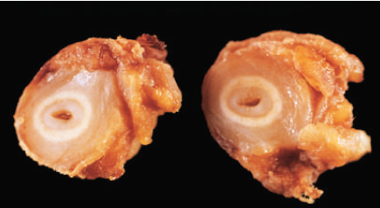
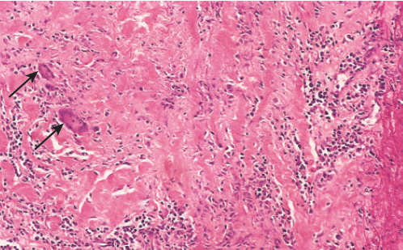
AAA
A
B
A,Marked intimal thickening and luminal narrowing. The white circles correspond to the
original vessel wall; the inner core of tan tissue is the area of intimal hyperplasia
B,Histologic appearance in active Takayasu aortitis illustrating destruction and fibrosis
of the arterial media associated with mononuclear infiltrates and giant cells (arrows).

Slide 7
B. Giant cell arteritis
Formerly called temporal arteritis, but the temporal arteries are not always involved.
The vertebral and ophthalmic arteries and aorta are often involved.
The most common form of vasculitis among older adults(>50yrs).
The typical presentation evolves from nonspecific symptoms (headache) to more severe symptoms (blindness).
Microscopically, there are inner media granulomas in classic cases.

Slide 8
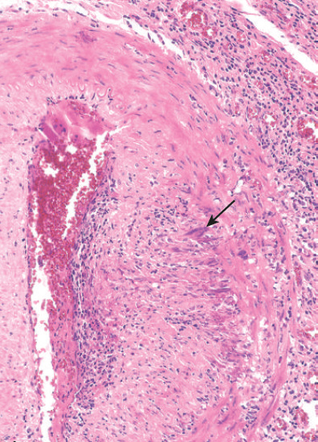
Hematoxylin-eosin-stained section of a temporal artery showing giant cells near the fragmented
Internal elastic membrane (arrow), along with medial and adventitial inflammation.

Slide 9
2. Medium Vessel Vasculitis
A. Kawasaki disease
Acute, febrile, usually self-limited illness of infancy and childhood associated with an arteritis of mainly to medium-sized vessels.
Approximately 80% of patients are younger than 4 years of age.
Presents with mucocutaneous symptoms & cervical lymph node enlargement.
Coronary arteritis can result in aneurysms that rupture or thrombose,
causing myocardial infarction.
Microscopically, there is transmural vascular inflammation.

Slide 10
B. Polyarteritis nodosa
Is a systemic necrotizing vasculitis, typically involves the renal and visceral vessels and spares the pulmonary circulation.
A disease of young adults but can occur in all age groups.
It has an association with hepatitis B virus.
The systemic findings—malaise, fever, and weight loss—are nonspecific.
A “classic” presentation rapidly accelerating hypertension due to renal
artery involvement, abdominal pain and bloody stools caused by
gastrointestinal lesions.
Renal involvement often is prominent and is a major cause of death.

Slide 11
3. Small Vessel Vasculitis
Granulomatosis with polyangiitis
A necrotizing vasculitis, characterized by granulomas of the lung & upper respiratory tract, glomerulonephritis, and a necrotizing granulomatous vasculitis.
The typical patient is a middle aged man, although women and individuals
of other ages can be affected.
Classic presentations include bilateral pneumonitis with nodules and
cavitary lesions (95%), chronic sinusitis (90%), mucosal ulcerations of the nasopharynx (75%), and renal disease (80%).
If untreated, the mortality rate at 1 year is 80%.

Slide 12
B. Churg-Strauss Syndrome
Also called allergic granulomatosis and angiitis.
A small-vessel necrotizing vasculitis associated with asthma, allergic rhinitis, lung infiltrates, peripheral eosinophilia, extravascular necrotizing granulomas, and a striking infiltration of vessels and perivascular tissues by eosinophils.
Eosinophil counts may be extremely high in peripheral blood.
Cutaneous involvement, gastrointestinal bleeding,and renal disease are
the major associations.
Cardiac involvement is seen in 60% of patients and is a major cause of
morbidity and death.

Slide 13
RAYNAUD PHENOMENA
Vasoconstriction of arteries and arterioles in the extremities, also
sometimes the nose, earlobes, or lips.
The restricted blood flow induces paroxysmal pallor or cyanosis.
1. Primary Raynaud Phenomenon
Caused by exaggerated central and local vasomotor responses to cold or emotion.
Affects 3% to 5% of the general population and has a predilection for young women.
In chronic cases, atrophy of the skin, subcutaneous tissues, and muscles may occur.
2. Secondary Raynaud Phenomenon
Is caused by arterial insufficiency secondary to an underlying disease such as scleroderma,SLE,Buerger disease & atherosclerosis.

Slide 14
ARTERIOSCLEROSIS
Arteriosclerosis is a group of diseases which cause arterial wall thickening
and loss of elasticity.
Four distinct types are recognized.
Mönckeberg Medial Calcific Sclerosis
Is a medial calcification of medium-sized (muscular) arteries, such as femoral, tibial, radial, and ulnar arteries.
It is asymptomatic but may be detected by x-ray.
Arteriolosclerosis
Refers to sclerosis of arterioles, it affects small arteries and arterioles.

Slide 15
Microscopically:-either
Hyaline arteriolosclerosis (pink, glassy arterial wall thickening with luminal narrowing- seen in benign hypertension, diabetes, and aging) or
Hyperplastic arteriolosclerosis (smooth-muscle proliferation resulting in concentric [“onion skin”] wall thickening and luminal narrowing- seen in
malignant hypertension) may occur.
Fibromuscular intimal hyperplasia
A non-atherosclerotic process that occurs in muscular arteries larger than arterioles.
Predominantly an SMC- and ECM-rich lesion driven by inflammation or
by mechanical injury.

Slide 16
Atherosclerosis
Is a common vascular disorder characterized by lipid deposition and intimal thickening of large and medium-sized (elastic and muscular) arteries
Resulting in fatty streaks and atheromatous plaques over a period of
decades (a type of chronic inflammatory condition).
In descending order of severity, atherosclerosis involves the
infrarenal abdominal aorta, the coronary arteries, the popliteal arteries,
the internal carotid arteries, and the vessels of the circle of Willis.

Slide 17
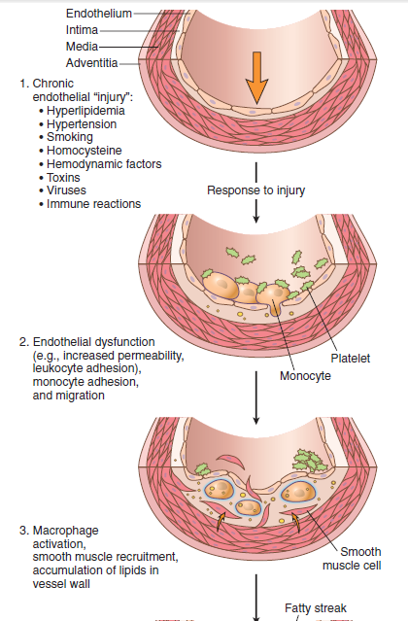
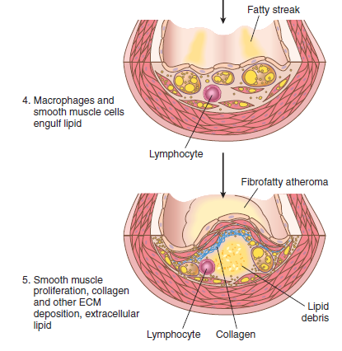

Slide 18
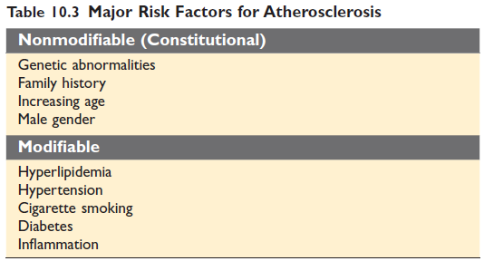
…cont…

Slide 19
Morphologic features of atherosclerosis:
Fatty streak
The earliest (clinically reversible) stage in atherosclerosis
Do not cause any significant flow disturbance.
Grossly- seen as a flat, yellow intimal streak.
Microscopically-seen as lipid-laden macrophages (foam cells).

Slide 20
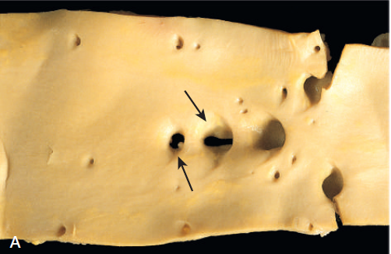
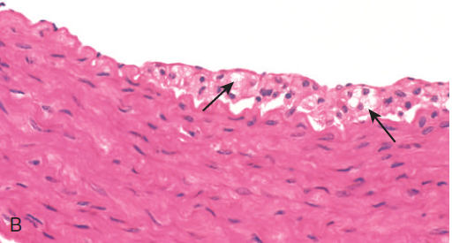
Fatty streaks. (A) Aorta with fatty streaks (arrows), mainly near the ostia of branch vessels.
(B) Demonstrating intimal, macrophage-derived foam cells (arrows).

Slide 21
Atherosclerotic Plaque
Are white to yellow raised lesions,they range from 0.3 to 1.5 cm in diameter.
Have three principal components:
1-Cells, including SMCs, macrophages, and T cells,
2-ECM, including collagen, elastic fibers, and proteoglycans&
3-Intracellular and extracellular lipid
Stable atheromatous plaques- have a dense fibrous cap, a small lipid core and less inflammation than their vulnerable counterparts. They cause chronic ischemia.
Vulnerable atheromatous plaques are at risk for rupture, thrombosis or embolization due to their composition (thin fibrous cap, large lipid core, dense inflammation).

Slide 22
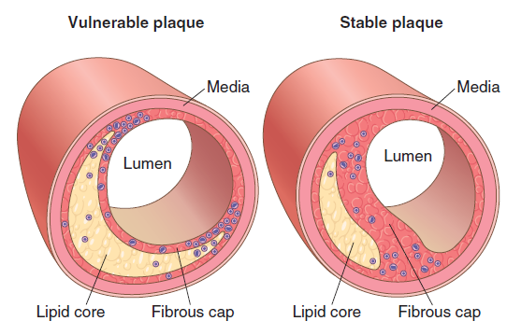

Slide 23
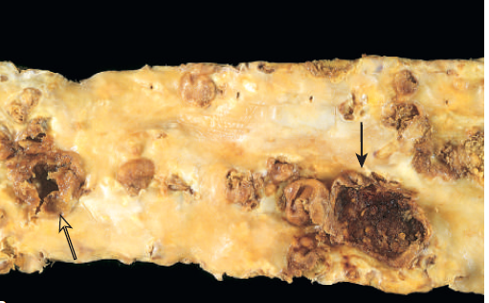
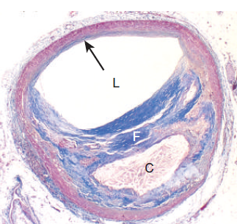
A
B
A-Aorta with severe diffuse complicated lesions, including an ulcerated plaque (open arrow),
and a lesion with overlying thrombus (closed arrow).
B-Atherosclerotic plaque, coronary artery. Overall architecture demonstrating fibrous cap (F) and a central necrotic (largely lipid) core (C),collagen (blue) is stained with Masson trichrome. The lumen (L) is moderately narrowed by this eccentric lesion, which leaves part of the vessel wall unaffected(arrow).

Slide 24
…cont…
Clinical complications of atherosclerosis
Ischemic heart disease (myocardial infarctions),
Cerebrovascular accidents (CVA),
Atheroemboli (transient ischemic attacks [TIAs] and renal infarcts),
Aneurysm formation; peripheral vascular disease and
Mesenteric artery occlusion.

Slide 25
HYPERTENSION (HTN)
Malignant (accelerated) hypertension accounts for 5% of the cases and is characterized by markedly elevated pressures (e.g., systolic pressure >180 mm Hg and/or diastolic >120 mm Hg), which can rapidly cause end-organ damage
Funduscopic examination may demonstrate retinal hemorrhages, exudates, and papilledema.
Malignant hypertension is a medical emergency; if untreated, most patients will die within 2 years from renal failure, intracerebral hemorrhage, or chronic heart failure

Slide 26
Epidemiology of Hypertension
Is very common, affecting 25% of the U.S. population.
African Americans tend to be more seriously affected than Caucasians, and the risk increases with age.
1. Idiopathic hypertension (essential hypertension)- 95% of cases
2. Secondary hypertension- related to renal disease,
pheochromocytoma, or other disease processes

Slide 27
Complications of hypertension
Mild to moderate elevations in blood pressure cause end-organ damage by damaging arterioles with hyaline arteriolosclerosis.
Late manifestations of hypertension include concentric left ventricular hypertrophy; congestive heart failure; accelerated atherosclerosis; myocardial infarction; aneurysm formation, rupture, and dissection; intracerebral hemorrhage; and chronic renal failure.

Slide 28
ANEURYSMS AND ARTERIOVENOUS FISTULAS
A. Aneurysms
Are congenital or acquired weakness of the vessel wall media, resulting in a localized dilatation or outpouching.
Complications include thrombus formation, thromboembolism, and compression of nearby structures. Rupture or dissection may cause sudden death.
Atherosclerotic aneurysms are due to weakening of the media secondary to atheroma formation, and typically occur in the abdominal aorta below the renal arteries.

Slide 29
Syphilitic aneurysms- involve the ascending aorta in tertiary syphilis (late stage).
Syphilitic (luetic) aortitis causes an obliterative endarteritis of the vasa vasorum, leading to ischemia and smooth-muscle atrophy of the aortic media.
Syphilitic aneurysms may dilate the aortic valve ring, causing aortic insufficiency.
Aortic dissecting aneurysm- occurs when blood from the vessel lumen enters an intimal tear and dissects through the layers of the media.
The etiology usually involves degeneration (cystic medial degeneration) of the tunica media.
Aortic dissecting aneurysm presents with severe tearing pain.

Slide 30
The dissecting aneurysm may compress and obstruct the aortic branches (e.g., renal or coronary arteries).
Hypertension and Marfan syndrome are predisposing factors.
Berry aneurysm- is a congenital aneurysm of the circle of Willis.
Microaneurysms-are small aneurysms commonly seen in hypertension and diabetes.
Mycotic aneurysms- are aneurysms usually due to bacterial or fungal infections.

Slide 31
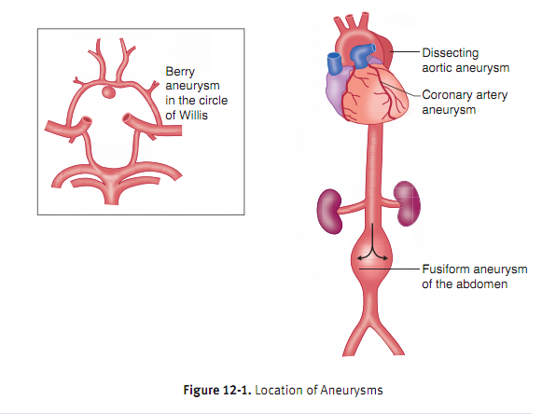

Slide 32
Arteriovenous (AV) Fistulas
Arteriovenous (AV) fistulas are a direct communication between a vein and an artery without an intervening capillary bed.
They may be congenital or acquired (e.g., trauma).
Potential complications include shunting of blood which may lead to high-output heart failure and risk of rupture and hemorrhage.

Slide 33
VENOUS DISEASE
Deep vein thrombosis (DVT) usually affects deep leg veins (90%), with iliac, femoral, and popliteal veins being particularly commonly affected.
Varicose Veins-are dilated, tortuous veins caused by increased intraluminal pressure.
A variety of veins can be affected, Superficial veins of the lower extremities are particularly vulnerable due to a lack of structural support from superficial fat and/or incompetent valve(s).
Varicosities of these superficial veins are very common (15% of the U.S. population); occur more frequently in females than males; and are common in pregnancy.

Slide 34
Esophageal varices are due to portal hypertension (usually caused by cirrhosis) and may be a source of life-threatening hemorrhage.
Varices of the anal region are commonly called hemorrhoids; are associated with constipation and pregnancy; and may be complicated by either bleeding (streaks of red blood on hard stools) or thrombosis (painful).

Slide 35
VASCULAR NEOPLASMS
Benign Tumors
Hemangiomas are extremely common, benign vascular tumors.
They are the most common tumor in infants appearing on the skin, mucous membranes, or internal organs.
The major types are capillary and cavernous hemangiomas.
Hemangiomas may spontaneously regress.

Slide 36
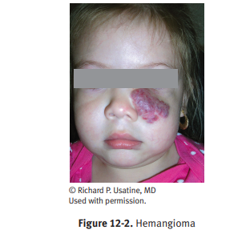

Slide 37
Hemangioblastoma
Are associated with von Hippel-Lindau disease, which may cause multiple hemangioblastomas involving the cerebellum, brain stem, spinal cord, and retina, as well as renal cell carcinoma.
Glomus tumors (glomangioma)
Are benign, small, painful tumors of the glomus body that usually occur under fingernails.

Slide 38
Malignant Tumors
Kaposi sarcoma is a malignant tumor of endothelial cells associated with Kaposi-sarcoma–associated virus (HHV8).
The condition causes multiple red purple patches, plaques, or nodules that may remain confined to the skin or may disseminate.
Microscopically, there is a proliferation of spindle-shaped endothelial cells with slit-like vascular spaces and extravasated erythrocytes
Angiosarcoma (hemangiosarcoma) is a malignant vascular tumor with a high mortality that most commonly occurs in skin, breast, liver, and soft tissues.

Slide 39
Part - II
Cardiac Pathology

Slide 40
ISCHEMIC HEART DISEASE (IHD)
Group of syndromes related to myocardial ischemia.
IHD is the leading cause of death in the US.
Usually due to atherosclerosis of coronary arteries, which decreases blood flow to the myocardium.
Risk factors for IHD are similar to those of atherosclerosis
Incidence increases with age.

Slide 41
A. Stable angina
Is chest pain that arises with exertion or emotional stress.
Due to atherosclerosis of coronary arteries with > 70% stenosis; decreased blood flow is not able to meet the metabolic demands of the myocardium during exertion.
Represents reversible injury to myocytes (no necrosis)
Presents as chest pain (lasting < 20 minutes) that radiates to the left arm or jaw, diaphoresis, and shortness of breath
EKG shows ST-segment depression due to subendocardial ischemia.
Relieved by rest or nitroglycerin

Slide 42
B. Unstable angina
Is chest pain that occurs at rest.
Usually due to rupture of an atherosclerotic plaque with thrombosis and incomplete occlusion of a coronary artery
Represents reversible injury to myocytes (no necrosis)
EKG shows ST-segment depression due to subendocardial ischemia
Relieved by nitroglycerin
High risk of progression to myocardial infarction

Slide 43
C. Prinzmetal angina
Is episodic chest pain unrelated to exertion.
Due to coronary artery vasospasm
Represents reversible injury to myocytes (no necrosis)
EKG shows ST-segment elevation due to transmural ischemia
Relieved by nitroglycerin or calcium channel blockers

Slide 44
D.MYOCARDIAL INFARCTION
Irreversible injury and necrosis of cardiac myocytes
The vast majority of MIs are caused by acute thrombosis
within coronary arteries.
Usually due to rupture of an atherosclerotic plaque with thrombosis and complete occlusion of a coronary artery
In 10% of MIs, however, transmural infarction occurs in the absence of occlusive atherosclerotic vascular disease.
Such infarcts are mostly ascribed to coronary artery vasospasm or to embolization from mural thrombi or from valve vegetations.

Slide 45
Clinical features
Severe, crushing chest pain (lasting > 20 minutes) that radiates to the left arm or jaw,
Diaphoresis, and
Dyspnea;
Symptoms are not relieved by nitroglycerin or rest.
Infarction usually involves the left ventricle (LV); right ventricle (RV) and both atria are generally spared.
Left anterior descending artery (LAD) is the most commonly involved artery in MI (45% of cases).

Slide 46
Based on the size of the involved vessel and the degree of collateral circulation MIs are classified as transmural, subendocardial, or microscopic.
Transmural infarction (most common type)
The full thickness of the ventricle and
Are caused by epicardial vessel occlusion.
It causes ST elevated MIs (STEMIs) due to atherosclerosis and
acute thrombosis.

Slide 47
Subendocardial infarction
Limited to the inner third of the myocardium.
Do not exhibit ST segment elevations or Q waves on the ECG (“NSTEMIs”).
They can have ST-segment depressions or T wave abnormalities.
Microscopic infarction
Is caused by small vessel occlusion due to vasculitis, emboli, or spasm.
ECG changes are not noted.

Slide 48
Laboratory tests
Elevated cardiac enzymes:
Troponin is the most sensitive and specific marker (gold standard)
for Ml.
CK-MB is useful for detecting reinfarction that occurs days after an initial MI.

Slide 49
SUDDEN CARDIAC DEATH
Unexpected death due to cardiac disease; occurs without symptoms or < 1 hour after symptoms arise.
Usually due to fatal ventricular arrhythmia
Most common etiology is acute ischemia; 90% of patients have preexisting severe atherosclerosis.
Less common causes include mitral valve prolapse, cardiomyopathy, and cocaine abuse.

Slide 50
CHRONIC ISCHEMIC HEART DISEASE
Also called ischemic cardiomyopathy, is progressive heart failure secondary to ischemic myocardial damage.
In most instances, there is a known clinical history of previous MI.
The heart failure of chronic IHD is typically severe and new episodes of angina or infarction.

Slide 51
CONGESTIVE HEART FAILURE (CHF)
Pump failure; divided into right- and left-sided failure
A. LEFT-SIDED HEART FAILURE
Causes include ischemia, hypertension, dilated cardiomyopathy, myocardial infarction, and restrictive cardiomyopathy.
Clinical features are due to decreased forward perfusion and pulmonary congestion.
Pulmonary congestion leads to pulmonary edema. i.e Results in dyspnea, paroxysmal nocturnal dyspnea (due to increased venous return when lying flat), orthopnea, and crackles ii. Small, congested capillaries may burst, leading to intraalveolar hemorrhage; marked by hemosiderin-laden macrophages
Decreased flow to kidneys leads to activation of renin-angiotensin system. i.e Fluid retention exacerbates CHF.

Slide 52
B. RIGHT-SIDED HEART FAILURE
Most commonly due to left-sided heart failure; other important causes include left to-right shunt and chronic lung disease (cor pulmonale).
Clinical features are due to congestion, includes:
Jugular venous distension
Painful hepatosplenomegaly which may lead to cardiac cirrhosis
Dependent pitting edema (due to increased hydrostatic pressure)

Slide 53
VALVULAR DISORDERS
The heart has four valves (tricuspid, pulmonary, mitral, and aortic) that prevent backflow.
Valvular lesions generally result in stenosis (decreased caliber of the valve orifice) or Insufficiency (regurgitation or backflow).
Stenosis is the failure of a valve to open completely, obstructing forward flow.
Insufficiency results from failure of a valve to close completely, thereby allowing regurgitation (backflow) of blood.
Can involve only one valve (the mitral valve being the most common target),
Or more than one valve.

Slide 54
VALVULAR HEART DISEASE
Bicuspid aortic valve
The most common congenital valvular lesion, containing only two functional cusps instead of the normal three.
It is heritable, and NOTCH1 mutations are associated with some cases. Although it is a congenital cardiac malformation, it sometimes does not cause morbidity until adult life.
In the majority of cases, it causes valve stenosis, but it can cause valvular insufficiency.
Infectious endocarditis and aortic dilatation and dissection are possible complications.

Slide 55
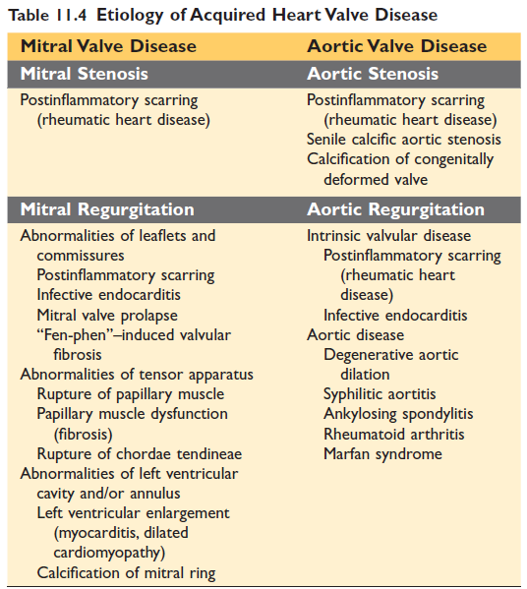

Slide 56
Degenerative calcific aortic valve stenosis
is a common valvular abnormality characterized by age-related dystrophic calcification, degeneration, and stenosis of the aortic valve.
It can lead to concentric left ventricular hypertrophy (LVH) and congestive heart failure with increased risk of sudden death.
Mitral valve prolapse has enlarged, floppy mitral valve leaflets that prolapse into the left atrium and microscopically show myxomatous degeneration.
The condition affects individuals with Marfan syndrome.
Complications include infectious endocarditis and septic emboli, rupture of chordae tendineae with resulting mitral insufficiency, and rarely sudden death.

Slide 57
Inflammatory Valvular Disease
Infective bacterial endocarditis (or more aptly infective endocarditis) refers to bacterial infection of the cardiac valves, characterized by vegetation on the valve leaflets.
Risk factors include rheumatic heart disease, mitral valve prolapse, bicuspid aortic valve, degenerative calcific aortic stenosis, congenital heart disease, artificial valves, indwelling catheters, dental procedures, immunosuppression, and intravenous drug use.
Acute endocarditis is typically due to a high virulence organism that can colonize a normal valve, such as Staphylococcus aureus.
Acute endocarditis produces large destructive vegetation (fibrin, platelets, bacteria, and neutrophils). The prognosis is poor, with mortality of 10–40%.

Slide 58
Subacute endocarditis
Infections by organisms of low virulence affecting a previously abnormal heart,especially scarred or deformed valves.
Most patients recover after appropriate antibiotic therapy.
Prophylactic antibiotics decrease risk of endocarditis.
Streptococcus viridans 50-60% in previously damaged valves.
The aortic and mitral valves are the most common sites of infection, although the tricuspid valve is a frequent target in the setting of intravenous drug abuse.

Slide 59
Staphylococcus aureus is the most common cause in IV drug abusers.
High-virulence organism that infects normal valves, most commonly the tricuspid.
Results in large vegetations that destroy the valve (acute endocarditis)
Staphylococcus epidermidis is associated with endocarditis of prosthetic valves.
HACEK organisms (Haemophilus, Actinobacillus, Cardiobacterium, Eikenella, Kingella) are associated with endocarditis with negative blood cultures.

Slide 60
Clinical features of bacterial endocarditis include
Fever - due to bacteremia
Murmur - due to vegetations on heart valve
Janeway lesions (erythematous nontender lesions on palms & soles,
Osler nodes (tender lesions on fingers or toes),
splinter hemorrhages in nail bed and Roth spots - due to embolization of septic vegetations
Anemia of chronic disease - due to chronic inflammation

Slide 61
Laboratory findings
Positive blood cultures
Anemia of chronic disease(↓Hb, ↓MCV; ↑ferritin, ↓TIBC, ↓serum iron, and ↓% saturation)
Transesophageal echocardiogram is useful for detecting lesions on valves

Slide 62
Nonbacterial thrombotic endocarditis
Is due to sterile vegetations that arise in association with a hypercoagulable state or underlying adenocarcinoma.
Vegetations arise on the mitral valve along lines of closure and result in mitral regurgitation.
Libman-Sacks endocarditis is due to sterile vegetations that arise in association with SLE. Vegetations are present on the surface and undersurface of the mitral valve and result in mitral regurgitation.

Slide 63
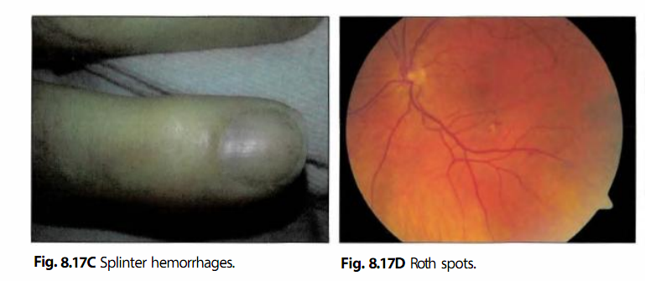
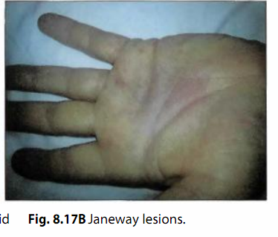

Slide 64
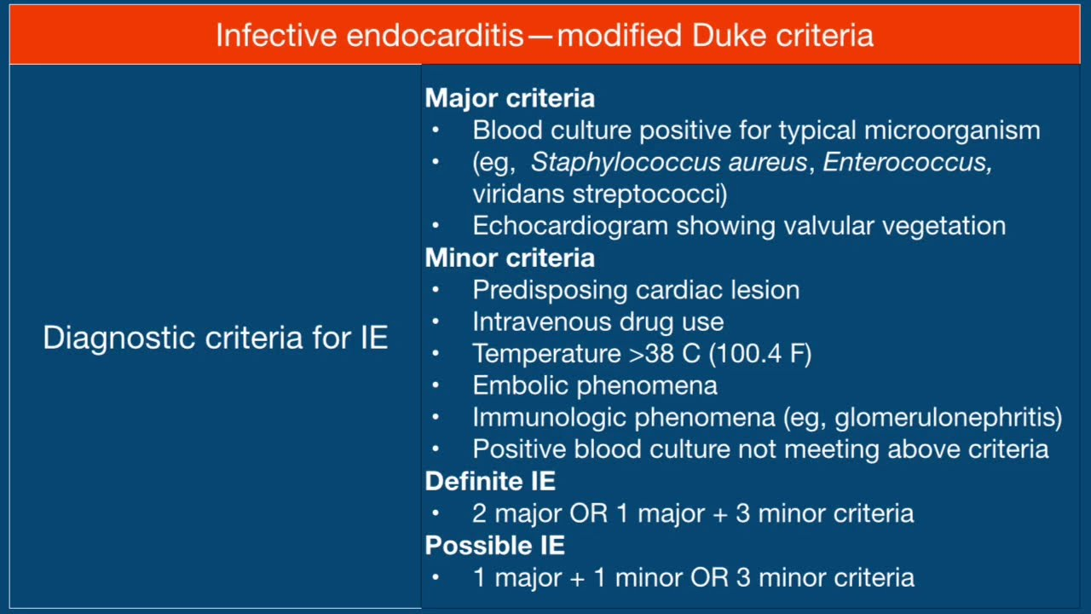

Slide 65
Rheumatic heart disease
Acute Rheumatic Fever (ARF)
Is a systemic recurrent inflammatory disease, triggered by a pharyngeal infection with Group A β-hemolytic streptococci.
In genetically susceptible individuals, the infection results in production of antibodies that cross-react with cardiac antigens & cause injury.
Rheumatic fever affects children (ages 5–15 years),
Symptoms occur 2–3 weeks after a pharyngeal infection;
Laboratory studies show elevated antistreptolysin O (ASO) titers.

Slide 66
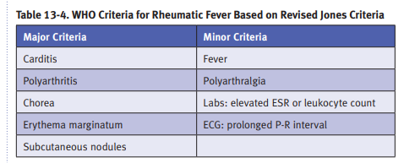
Diagnosis of rheumatic fever requires
2 major Or
1 major and 2 minor criteria, plus a preceding group A strep infection

Slide 67
Acute rheumatic heart disease affects myocardium, endocardium, and pericardium.
Myocardium can develop myocarditis, whose most distinctive feature is the Aschoff body (fibrinoid necrosis is surrounded by macrophages (Anitschkow cells), lymphocytes, and plasma cells).
Fibrinous pericarditis may be present.
Endocarditis -may be a prominent feature that typically involves mitral and aortic valves.

Slide 68
CHRONIC RHEUMATIC HEART DISEASE
Valve scarring that arises as a consequence of rheumatic fever
Aschoff bodies are replaced by fibrous scar so that these lesions
are rarely seen in chronic disease.
Results in stenosis with a classic 'fish-mouth' appearance
Almost always involves the mitral valve; leads to thickening of chordae tendineae and cusps .
Occasionally involves the aortic valve; leads to fusion of the commissures.
Complications include infectious endocarditis.

Slide 69
MYOCARDITIS
Myocarditis arises from infectious and immune causes.
Infectious causes include coxsackieviruses A and B, enteroviruses and Trypanosoma cruzi (Chagas disease), Toxoplasma gondii, and Borrelia burgdorferi (Lyme disease).
Noninfectious causes include systemic lupus erythematosus.

Slide 70
Clinically, the patient may be asymptomatic or may suffer from acute heart failure or even dilated cardiomyopathy.
In myocarditis, inflammatory infiltrates damage myocytes.
Clinically, the patient may be asymptomatic or may suffer acute heart failure with subsequent dilated cardiomyopathy or sudden death.
Some patients recover without complications

Slide 71
Reading assignment
Congenital heart disease(CHD)

Slide 72
References
Robbins and cotrans pathologic basics of disease 10th edition

Slide 73
Thank you!

