Slide 1
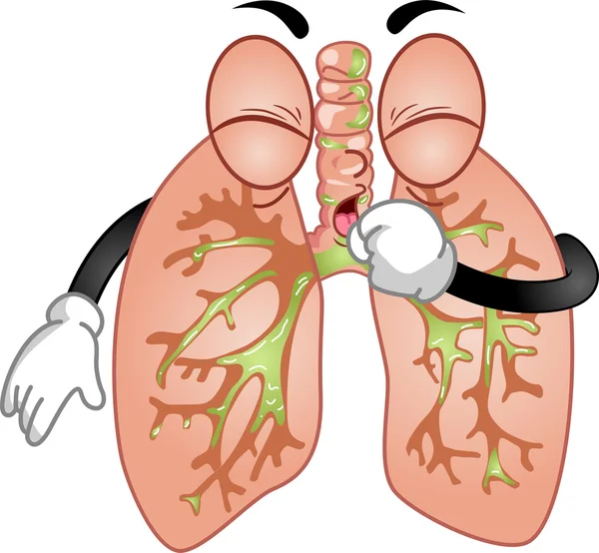
Chapter 2
DRUGS ACTING ON THE RESPIRATORY SYSTEM
Dr. Anteneh Kassahun
NOV/2023

Slide 2
DRUGS ACTING ON THE RESPIRATORY SYSTEM
Many conditions affect the respiratory system. Some of the conditions are life threatening, while many are chronic conditions which affect thousands of patients.
PNEUMONIA: Pneumonia is caused by an infection of the lung. like bacteria, viruses, fungus. Symptoms- cough, fever, chest pain.
ASTHMA : a condition usually caused by allergic reactions to substances in the environment, affects many people. The allergic reactions cause the bronchioles to spasm & have inflammation. Hence, the flow of air into and out of the lungs becomes impaired.
PULMONARY TUBERCULOSIS- caused by the bacterium Mycobacterium tuberculosis. TB is a contagious disease that can infect anyone exposed. Symptoms- breathing difficulty, chest pain, cough, coughing up blood, night sweating, fatigue, fever and weight loss.

Slide 3
Respiratory drugs cont’d
PULMONARY EDEMA: Pulmonary edema is a condition in which fluid collects in the interstitial spaces of the lungs and in the alveoli. Obviously, the exchange of gases in the alveoli becomes impaired. Pulmonary edema is usually caused when the left side of the heart fails to pump efficiently; when this happens blood backs up into the pulmonary circulation and causes fluid in the lungs.
Drugs for lung disease can be delivered
Topically to the nasal mucosa
Inhaled into the lungs, or
Given orally or parenterally for systemic absorption

Slide 4

Cough
Is a physiologic protective mechanism
Its function is to clear the tracheobronchial tree of excessive secretions and foreign body
Dry cough-
Productive cough-
Causes –URTI, LRTI(Pneumonia, TB), bronchitis, Asthma

Slide 5
Drugs for cough
1. Antitussive agents- for dry cough
Coughing is an important defense mechanism of the respiratory system to irritants
Causes of cause; Common cold, sinusitis, bacterial lung infection and chronic respiratory disease
Antitussives are agents that relieve or prevent coughing. These agents act on the central nervous system to depress the cough reflex center in the medulla of the brain.
Antitussives are used to reduce respiratory irritation. Such reduction of respiratory irritation results in the patient’s being able to rest better
i. Codeine
the most useful narcotic/opioid antitussive agent
aids in relieving the pain (that is, producing analgesia) associated with a hacking cough.
ADR: drowsiness, nausea, vomiting, constipation, dysphoria, dependence, addictive potential
the patient should not drink alcohol while taking the medication…drowsiness

Slide 6
Respiratory drugs cont’d
ii. Dextromethorphan, is another antitussive. It is found alone or in combination, usually with expectorants.
a synthetic derivative of morphine
ADR:
GIT upset,
safer side effect profile than codeine but
has dysphoria at high doses
It is free of analgesic and addictive properties.

Slide 7
Respiratory drugs cont’d
2. Expectorant agents- for productive cough
Expectorants are agents, which facilitate the removal of secretions of the bronchopulmonary mucous membrane.
Stimulates secretions in the respiratory tract. Expectorants are used to remove bronchial secretions which are purulent (containing pus), viscid (thick), or excessive.
The loosened material is then moved toward the pharynx through ciliary motion and coughing.
Expectorant Agents e.g.: Guaifenesin, Saturated Solution of Potassium Iodide, Ipecac alkaloid

Slide 8
Respiratory drugs cont’d
3. Mucolytics
Mucolytics: dissolve mucous by breaking down thick viscous mucus in the respiratory tract.
They are used by inhalation in an attempt to reduce the viscosity (thickness) of respiratory tract fluid.
The loosened material can then be moved toward the pharynx more easily by ciliary motion and coughing. Like the expectorants, the mucolytics are used in the treatment of respiratory disorders in which the secretions are purulent (contain pus), viscid, or excessive.
Acetylcysteine: This is a mucolytic given by inhalation or nebulization. Acetylcysteine has an unpleasant (like rotten eggs) smell. Side effects : nausea and vomiting and broncho-spasms with higher concentrations.

Slide 9
DRUGS USED TO TREAT ALLERGIC RHINITIS
Rhinitis is an inflammation of the mucous membranes of the nose
Symptoms; sneezing, itchy nose/eyes, watery rhinorrhea, nasal congestion, and sometimes, a nonproductive cough
Mechanism; mast cells release mediators, such as histamine, leukotrienes that promote bronchiolar spasm and mucosal thickening.
RX- Antihistamines, anticongestants and intranasal corticosteroids
I. Antihistamines (H1-receptor blockers)
Relives allergic rhinitis caused by histamine release (sneezing, watery rhinorrhea, itchy eyes/nose).
First-generation antihistamines, such as diphenhydramine and chlorpheniramine, are usually not preferred due to adverse effects, such as sedation
The second-generation antihistamines (fexofenadine, loratadine, desloratadine, cetirizine) are generally better tolerated.

Slide 10
II. Corticosteroids- Intranasal corticosteroids, such as beclomethasone, budesonide, fluticasone,
They improve sneezing, itching, rhinorrhea, and nasal congestion. Systemic absorption is minimal
III. α1-Adrenergic agonists- nasal decongestants
phenylephrine, constrict dilated arterioles in the nasal mucosa and reduce airway resistance.

Slide 11
Respiratory drugs cont’d
Decongestants
Decongestants: reduce congestion of nasal passages, which in turn open clogged nasal passages and enhances drainages of the sinuses. E. g of this drugs (α1 agonists)
Mechanisms of congestion; different mediators vasodilate which leads to fluids come out from vessels to surrounding tissue
α1 agonists- produce localized vasoconstriction on small blood vessels of the nasal membrane (act on α1 receptors)
Clinical uses: allergic rhinitis, hay fever, common cold. Drugs can be administered nasally or orally for longer duration of action.
α1 agonists; phenylephrine(topical), ephedrine(oral), pseudoephedrine (topical), xylometazoline(topical)

Slide 12
Respiratory drugs cont’d
BRONCHIAL ASTHMA
Pathophysiology of asthma
Airflow obstruction in asthma is due to
bronchoconstriction that results from contraction of bronchial smooth muscle,
Inflammation of the bronchial wall, and
increased secretion of mucus.
The underlying inflammation of the airways contributes to airway hyperresponsiveness, airflow limitation, respiratory symptoms, and disease chronicity.
Asthma attacks may be triggered by exposure to allergens, exercise, stress, and respiratory infections.
Symptoms- shortness of breath, cough, chest tightness, wheezing,

Slide 13
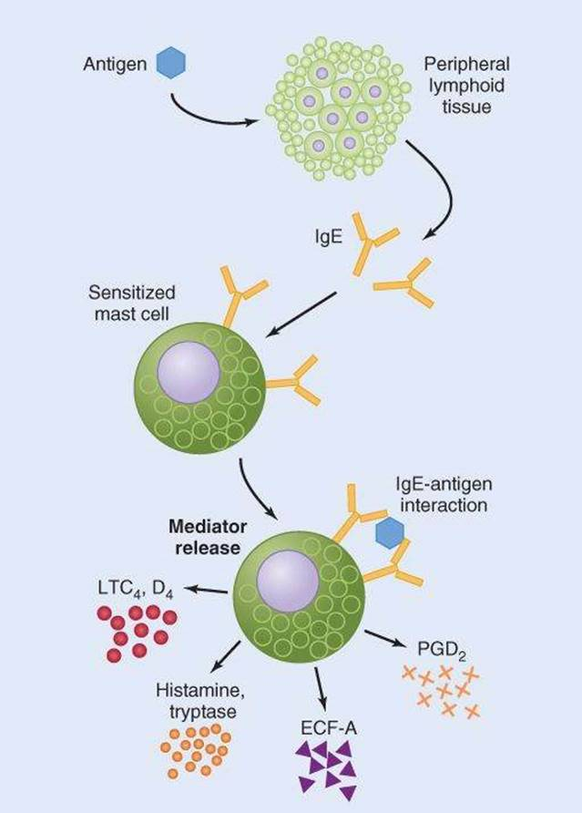

Slide 14
Respiratory drugs cont’d
PHARMACOTHERAPY OF BRONCHIAL ASTHMA
1. Bronchodilators
a. β2-adrenergic agonist
b. Methylxanthine: theophylline
c. Muscarinic receptor antagonists e.g. Ipratropium bromide
2. Anti-inflammatory agents: corticosteroids
3. Mast cell stabilizers e.g. cromolyn sodium, nedocromil, ketotifen

Slide 15
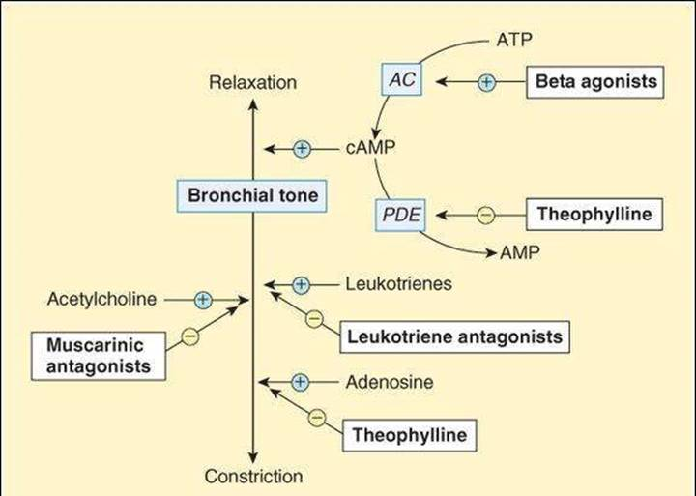

Slide 16
Respiratory drugs cont’d
1. Bronchodilator agents
The bronchodilators are agents that cause expansion of the air passages of the lungs. This allows the patient to breathe more easily and are of value in overcoming acute bronchospasms.
They are employed as adjuncts in prophylactic and symptomatic treatment of the individual complications of obstructive pulmonary diseases such as asthma, bronchitis, and emphysema.

Slide 17
Sympathomimetics: Sympathomimetic bronchodilators act by relaxing contractions of the smooth muscle of the bronchioles
Mechanism- bind with β2 receptors and ↑cAMP then relax/dilate bronchioles
i. Short-acting β2 agonists (SABAs)- Albuterol/salbutamol:
used for quick relief of bronchospasm and in the prevention of exercise-induced bronchospasm.
Albuterol is available as an inhalation aerosol, it is prescribed every 4 to 6hours. Albuterol is often used as “rescue therapy” due to its quick onset of action.
ii. long-acting β2 agonists (LABAs)-Salmeterol: is indicated for the same conditions as albuterol, but have long duration of action, providing bronchodilation for many hours
iii. Epinephrine: is used as a bronchodilator because of its beta effects on the bronchi. Epinephrine is employed for the treatment of acute attacks of bronchospasms associated with emphysema, bronchitis, or anaphylaxis. Epinephrine is usually administered I.V or S.C

Slide 18
B. Methylxanthine drugs: are adenosine receptor antagonists
directly relax the smooth muscle of the bronchi(bronchodilation) and pulmonary blood vessels
Mechanism- Inhibit PDE4 →↑cAMP and cGMP→relaxation of smooth muscle and also block adenosine rec
ADR- headache, arrhythmia, seizure
narrow therapeutic index thus theophylline blood levels monitored on a routine basis.
Theophylline: is often prescribed as the xanthine of choice for oral administration (tablets, capsules, syrup, or solution).
Aminophylline: is a xanthine derivative containing ~80% theophylline and 20% ethylenediamine. It is less potent and short acting than theophylline. It will also relieve bronchospasms associated with emphysema and bronchitis. Aminophylline is generally administered intravenously (I.V.) to relieve acute bronchospasms or status asthmaticus resistant to adrenergic drugs.

Slide 19
C. Muscarinic receptor antagonists:
- Competitively inhibit acetylcholine binding at muscarinic receptor
block vagal activity…less contraction of air way smooth muscle and reduce secretion of mucus
Systemic adverse effects as a result of rapid absorption include urinary retention, tachycardia, loss of accommodation and agitation and local effects like dryness of mouth limit its use.
- Ipratropium bromide is poorly absorbed and does not enter CNS thus permits the delivery of high doses; it can be used for bronchial asthma
- antimuscarinic antagonist drugs appear to be less effective than β-agonists in reversing asthmatic bronchospasm
- The antimuscarinic agents appear to be significant value in chronic obstructive pulmonary diseases more than asthma
- They are useful as alternative therapies for patients intolerant of β- agonists.

Slide 20
2. Anti-inflammatory agents- corticosteroids
- used both for the treatment and prophylactic purpose
- Mechanism: anti-inflammatory effect in part by inhibition of production of inflammatory mediators; they also potentiate the effects of β-receptor agonists and inhibit the lymphocytic-eosinophilic airway mucosal inflammation
- Effects on airways: decrease bronchial reactivity, increases airway caliber, decreases frequency of asthma exacerbation and severity of symptoms
- The corticosteroid commonly used is hydrocortisone, prednisolone, beclomethasone, triamcinolone and etc.
- The drugs can be taken by inhalation as aerosol, oral, or an iv administration
- Because of severe adverse effects when given chronically, oral and parenteral corticosteroids are reserved for patients who need urgent treatment and those who have not improved with bronchodilator

Slide 21
Corticosteroids:
aerosol treatment is the most effective way to decrease the systemic adverse effect of corticosteroid therapy
- abrupt discontinuation should be discouraged because of the fear of adrenal insufficiency
- doses should be decreased after improvement
- clinical uses in bronchial asthma
urgent treatment of severe asthma not improved with bronchodilator
Nocturnal asthma
Chronic asthma [regular aerosol corticoids]
Side effects:
suppression of hypothalamic –pituitary-adrenal axis
osteoporosis
cataract
impairment of growth in children
susceptibility of infection like oral candidiasis, tuberculosis

Slide 22
3. Other agents for asthma
(1) Cromolyn: is a unique product that works by inhibiting the release of histamine and other spasm-causing compounds from mast cells located in the lungs and prevents bronchoconstriction. It used in exercise and antigen induced asthma. It has no role once mediator is released and is used for casual prophylaxis.
(2) Leukotriene receptor blockers. The production of leukotrienes (immunologic proteins) and the binding on leukotriene receptors appears to be responsible for airway edema, smooth muscle constriction and increased inflammatory processes contributing to the signs and symptoms of asthma. For this reason, several new agents have been developed: Zafirlukast, montelukast, Zileuton

Slide 23
Tuberculosis(TB) treatment
Mycobacteria are rod-shaped aerobic bacilli that multiple slowly,
M. tuberculosis is slow growing and requires treatment for months to years.
Chemotherapy for tuberculosis
TB treatment generally includes four first-line drugs.
Second-line drugs are typically less effective, more toxic
They are used for patients who cannot tolerate the first-line drugs or who are infected with resistant TB.
Treatment for drug-susceptible TB lasts for at least 6 months, while
treatment of multidrug-resistant TB (MDR-TB) typically lasts for about 2 years.

Slide 24
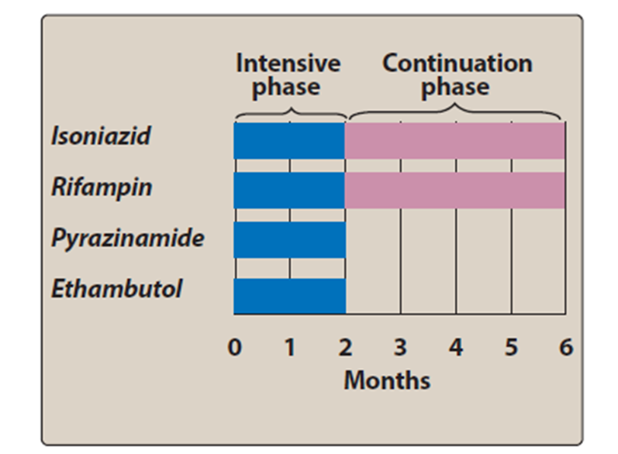
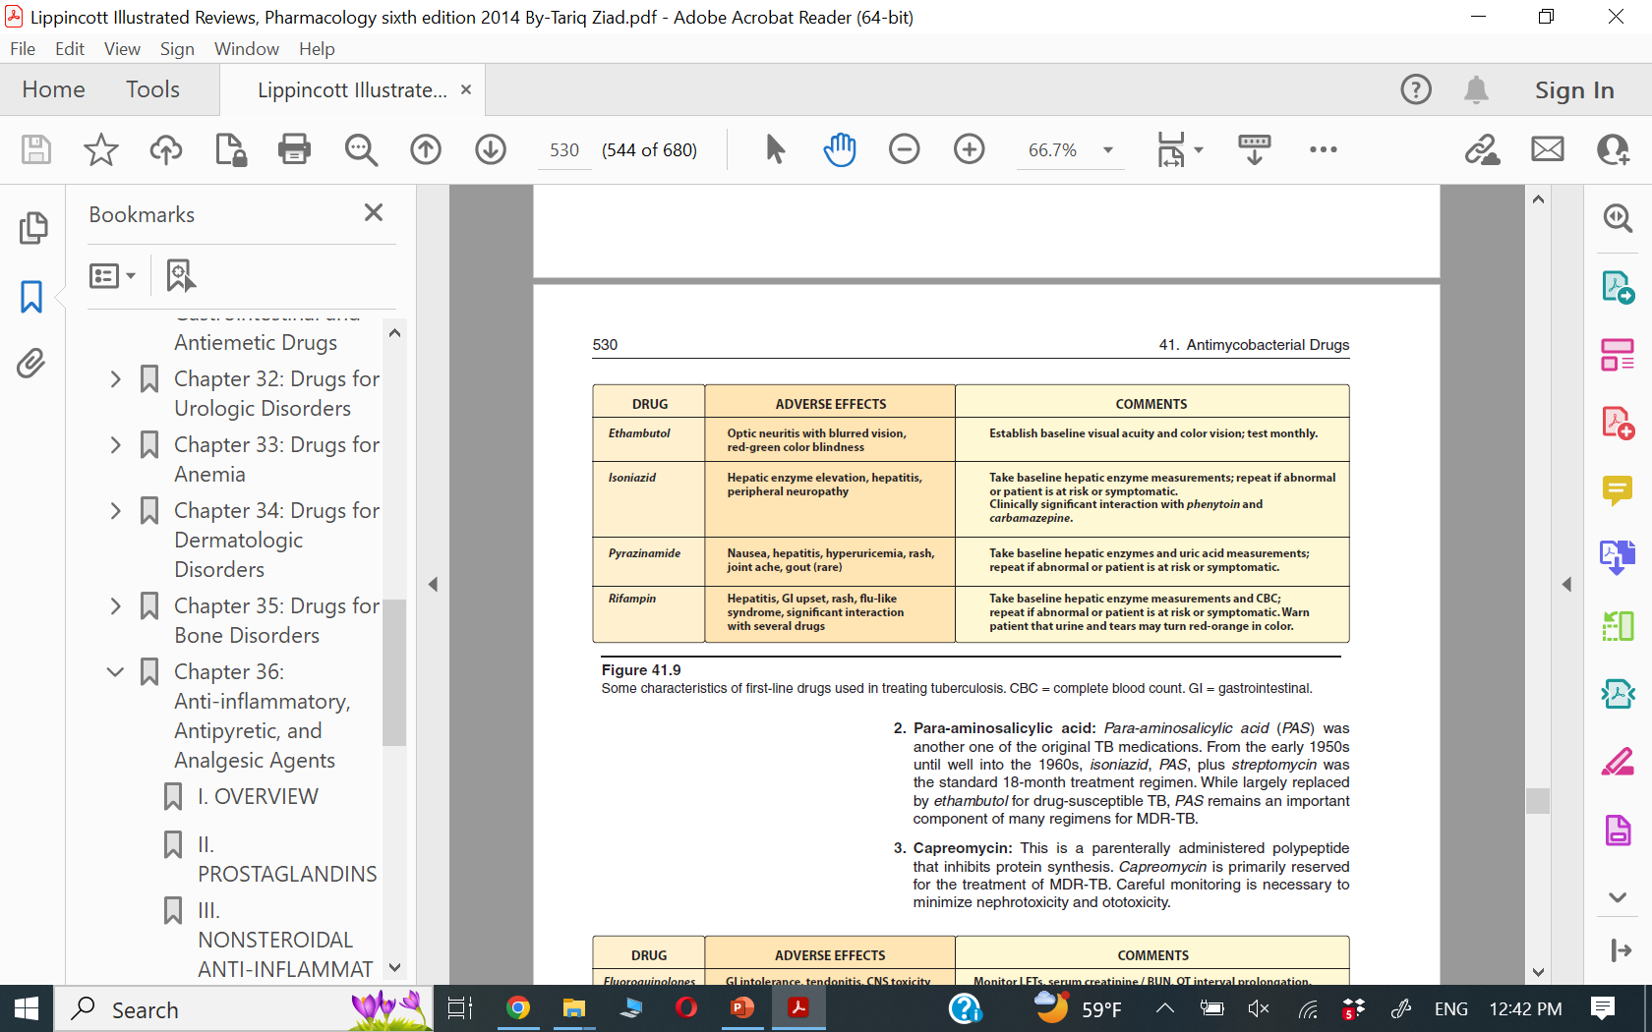
Notes:
Standard short-course chemotherapy for tuberculosis includes
isoniazid,rifampin, ethambutol, and pyrazinamide for 2 months (the
intensive phase), followed by isoniazid and rifampin for 4 months
(the continuation phase)

Slide 25
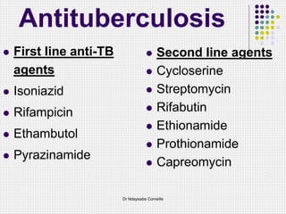
Second line regimens for MDR-TB (TB resistant to at least isoniazid and rifampin)

Slide 26
Mechanisms to decrease anti-TB drug resistance
Patient adherence to drugs
Directly observed therapy, also known as DOT
Patients take their medications while being watched by a member of the health care team
DOT has been shown to decrease drug resistance and to improve cure rates

