Slide 1
Pathology of Respiratory Disorders

Slide 2
Outline
Atelectasis
Pulmonary infections
Sarcoidosis
Obstructive lung disease
Restrictive lung disease
Neoplasms of lung

Slide 3
ATELECTASIS
Atelectasis, also known as collapse, is loss of lung volume
caused by inadequate expansion of air spaces.
It is reversible, but areas of atelectasis predispose for infection due to decreased mucociliary clearance.
Resorption atelectasis is collapse of lung due to resorption of air distal to an obstruction; examples include aspiration of a foreign body, chronic obstructive pulmonary disease (COPD), and postoperative atelectasis.
Compression atelectasis is atelectasis due to fluid, air, blood, or tumor in the pleural space.
Contraction atelectasis(or cicatrization atelectasis) is due to fibrosis and scarring of the lung.

Slide 4
PULMONARY INFECTIONS
A. Pneumonia
In bacterial pneumonia, acute inflammation and consolidation (solidification) of the lung are due to a bacterial agent.
Clinical signs and symptoms include
Fever and chills; productive cough with yellow-green (pus) or rusty (bloody) sputum; tachypnea; pleuritic chest pain; and decreased breath sounds, rales, and dullness to percussion.

Slide 5
Laboratory Studies typically show elevated white blood cell count with a left shift (an increase in immature leukocytes).
Chest x-ray for lobar pneumonia typically shows lobar or segmental consolidation (opacification), and for bronchopneumonia typically shows patchy opacification.
Pleural effusion may also be picked up on chest x-ray.

Slide 6
Lobar pneumonia
Is characterized by consolidation of an entire lobe.
The infecting organism is typically Streptococcus pneumoniae (95%) or Klebsiella
The 4 classic phases of lobar pneumonia are
1. Congestion-characterized by vascular engorgement, intraalveolar fluid with
few neutrophils and numerous bacteria.
2. Red hepatization-characterized by massive confluent exudation, as neutrophils, red cells, and fibrin fill the alveolar spaces.
3. Gray hepatization-degradation of red blood cells and fibrinosuppurative exudate , resulting in a color change to grayish-brown.
4. Resolution (healing).
In today’s antibiotic era, these changes are not generally observed in practice.

Slide 7
Bronchopneumonia
Is characterized by scattered patchy consolidation centered on bronchioles.
The inflammation tends to be bilateral, multilobar, and basilar
Susceptible populations include the young, old, and terminally ill.
Infecting organisms exhibit more variation than in lobar pneumonia, and include Staphylococci, Streptococci, Haemophilus influenzae, Pseudomonas aeruginosa, etc.

Slide 8
Atypical pneumonia
Is the term used for interstitial pneumonitis without consolidation.
It is more common in children and young adults.
Infecting organisms include Mycoplasma pneumoniae, influenza virus, parainfluenza virus, respiratory syncytial virus (RSV) (which is especially important in young children), adenovirus, cytomegalovirus (CMV) (which is especially

Slide 9
Complications of pneumonia include fibrous scarring and pleural adhesions, lung abscess, empyema (pus in a body cavity), and sepsis.

Slide 10
B. Lung abscess
Is a localized collection of neutrophils (pus) and necrotic pulmonary parenchyma.
Aspiration is the most common cause.
It tends to involve right lower lobe and typically has mixed oral flora (often both anaerobic and aerobic) for infecting organisms.

Slide 11
Pneumonia, especially one due to S. aureus or Klebsiella.
Airway obstruction (post obstructive) or
Deposition of septic emboli in the lung.
Complications of lung abscess include empyema, pulmonary hemorrhage, and secondary amyloidosis.

Slide 12
C. Tuberculosis (TB)
Is a communicable chronic granulomatous disease caused by Mycobacterium tuberculosis.
It usually involves the lungs but may affect any organ or tissue in the body.

Slide 13
Primary pulmonary TB
Develops in a previously unexposed and therefore unsensitized patient.
The Ghon focus of primary TB is characterized by sub pleural caseous granuloma formation, either above or below the interlobar fissure.
The term Ghon complex refers to the combination of the Ghon focus and secondarily-involved hilar lymph nodes with granulomas.
Most primary pulmonary tuberculosis lesions (95%) will undergo fibrosis and calcification

Slide 14
The primary tuberculosis either:
(1) Form foci of scarring that harbor viable bacilli for years, and thus be the nidus for reactivation at a later time when host defenses are compromised.
or
(2)Progress to progressive primary tuberculosis (develop in individuals who are immunocompromised e.g, AIDS).

Slide 15
Secondary pulmonary TB (also known as post primary or reactivation TB)
Occurs either with reactivation of an old, previously quiescent infection or with reinfection secondary to a second exposure to the mycobacteria.
In secondary pulmonary TB, the infection often produces a friable nodule at the lung apex (Simon focus) secondary to the high oxygen concentration present at that site, since the upper parts of the lung typically ventilate more efficiently than the lower parts.

Slide 16
Additionally, dissemination to other organ systems can occur in advanced TB via a hematogenous route that often results in a miliary pattern within each affected organ.
Sites that may become involved include meninges; cervical lymph nodes (scrofula) and larynx; liver/spleen, kidneys, adrenals, and ileum; lumbar vertebrae bone marrow (Pott disease); and fallopian tubes and epididymis.

Slide 17
Nontuberculous mycobacteria. M. avium complex (MAC) typically occurs in AIDS patients with low CD4 counts.
The diagnosis of TB requires identification of the bacilli.

Slide 18
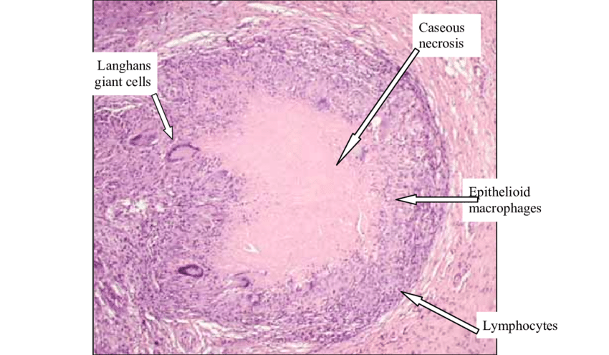

Slide 19
SARCOIDOSIS
Sarcoidosis is a systemic granulomatous disease of uncertain etiology.
The disease affects females more than males, with typical age 20–60. It is most common in African American women.
It may be asymptomatic, or presenting symptoms may include cough and shortness of breath; fatigue and malaise; skin lesions; eye irritation or pain; and fever or night sweats.
Most often, the disease is first detected on chest x-ray as bilateral hilar lymphadenopathy or parenchymal infiltrates.

Slide 20
The noncaseating granulomas that are characteristic of sarcoidosis may occur in any organ of the body.
In the lung, they typically form diffuse scattered granulomas; lymph node involvement may cause hilar and mediastinal adenopathy. Skin, liver and/or spleen, heart, central nervous system, bone marrow, and gastrointestinal tract are also frequent targets of the disease.
Eye involvement can be seen in Mikulicz syndrome (involvement of the uvea and parotid).

Slide 21
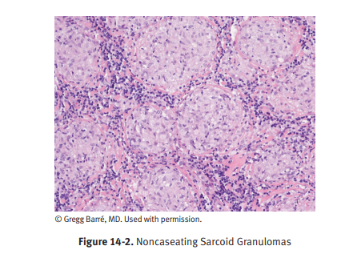

Slide 22
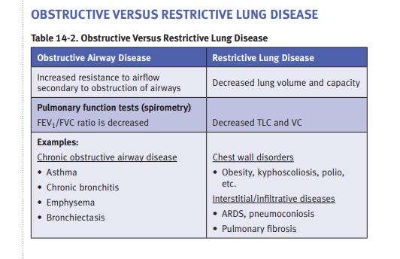

Slide 23
OBSTRUCTIVE PULMONARY DISEASE (COPD)
Chronic obstructive pulmonary disease (COPD) is a general term used to indicate chronic decreased respiratory function due to chronic bronchitis or emphysema.
Both diseases are associated with smoking.

Slide 24
Chronic Bronchitis
Is a clinical diagnosis made when a patient has a persistent cough and copious sputum production for at least 3 months in 2 consecutive years.
It is highly associated with smoking (90%).
Clinical findings include cough, sputum production, dyspnea, frequent infections, hypoxia, cyanosis, and weight gain

Slide 25
Microscopic examination demonstrates enlargement of mucus-secreting
glands, goblet cell metaplasia, and bronchiolar wall fibrosis.
Complications include increased risk for recurrent infections; secondary pulmonary hypertension leading to right heart failure (cor pulmonale) and lung cancer.

Slide 26
Emphysema
Characterized by permanent enlargement of the air spaces distal to the terminal bronchioles, accompanied by destruction of their walls without significant fibrosis.
The 4 types of emphysema are named for the anatomical distribution of the septal damage.
Centrilobular emphysema, the damage is in the proximal portion of the acinus and the cause is cigarette smoking.
Panacinar emphysema, the damage affects the entire acinus and the common cause is alpha-1 antitrypsin deficiency.
Distal acinar emphysema (unknown cause), proximal portion of the acinus is
normal but the distal part is primarily involved.
Irregular emphysema-the acinus is irregularly involved, is almost invariably
associated with scarring.

Slide 27
The etiology of emphysema involves a protease/antiprotease imbalance.
On gross examination, the lungs are overinflated and enlarged, and have enlarged, grossly visible air spaces.
Clinical findings include progressive dyspnea, pursing of lips and use of accessory respiratory muscles to breathe, barrel chest (increased anterior-posterior diameter), and weight loss.

Slide 28
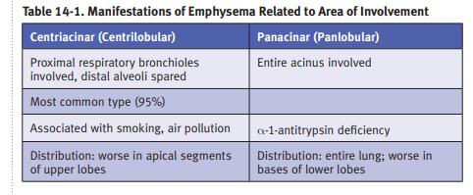

Slide 29
Asthma
Characterized by reversible bronchoconstriction caused by airway
hyperresponsiveness to a variety of stimuli.
Atopic (type I IgE-mediated hypersensitivity reaction) asthma (most common form) usually affects children and young adults.
There is often a positive family history.
Nonatopic asthma is triggered by processes including respiratory infections (usually viral), stress, exercise, or cold temperatures.
Drug-induced asthma affects about 10% of adults with a diagnosis of asthma.
Aspirin is a key example of a precipitating drug.
Occupational asthma is caused by workplace triggers including fumes and dusts.

Slide 30
An asthma attack is characterized by wheezing, severe dyspnea, and coughing.
Problems with expiration cause lung overinflation.
Status asthmaticus is a potentially fatal unrelenting attack of asthma.
Microscopic examination of sputum cytology may show Curschmann spirals (twisted mucus plugs admixed with sloughed epithelium), eosinophils, or Charcot-Leyden crystals (protein crystalloids from broken down eosinophils).

Slide 31
Bronchiectasis
Is an abnormal permanent airway dilatation due to chronic necrotizing inflammation.
Clinical findings include cough, fever, malodorous purulent sputum, and dyspnea.
Causes are diverse, and include bronchial obstruction by foreign body, mucus, or tumor, necrotizing pneumonias, cystic fibrosis, and Kartagener syndrome.
Cystic fibrosis patients often develop lung abscesses as a consequence of bronchiectasis.

Slide 32
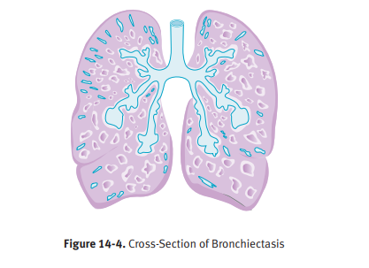

Slide 33
INFILTRATIVE RESTRICTIVE LUNG DISEASES (DIFFUSE INTERSTITIAL DISEASES)
Acute Respiratory Distress Syndrome (ARDS)
Acute respiratory distress syndrome (ARDS) refers to diffuse damage of alveolar epithelium and capillaries, resulting in progressive respiratory failure that is unresponsive to oxygen treatment.
ARDS may be caused by shock, sepsis, trauma, gastric aspiration, radiation, oxygen toxicity, drugs, or pulmonary infection. Activated neutrophils mediate cell damage

Slide 34
Clinically, patients show dyspnea, tachypnea, hypoxemia, cyanosis, and use of accessory respiratory muscles.
X-rays show bilateral lung opacity (“white out”).
On gross pathologic examination affected lungs are heavy, stiff, and noncompliant.
Microscopically, there is intra-alveolar edema, and hyaline membranes line the alveolar spaces. In resolving cases there is proliferation of type II pneumocytes and interstitial inflammation and fibrosis.
The prognosis is problematic even with good care, with overall mortality 40%.

Slide 35
Respiratory Distress Syndrome of the Newborn
Respiratory distress syndrome of the newborn (hyaline membrane disease) is caused by a deficiency of surfactant.
It is associated with prematurity (gestational age of less than 28 week has as 60% incidence).

Slide 36
Chronic Interstitial Lung Disease
Is a term describing heterogeneous lung disorders which share similar symptomology but vary in prognosis.
Patients present with dyspnea and cough.
Idiopathic pulmonary fibrosis (IPF)
Is prototypic of restrictive lung diseases.
It is characterized by patchy interstitial fibrosis, fibroblastic foci, and
formation of cystic spaces (honeycomb lung).
This histologic pattern is known as usual interstitial pneumonia(UIP).
The overall prognosis remains poor, lung transplantation is the
only definitive treatment.

Slide 37
Nonspecific interstitial pneumonia has a better prognosis than IPF. There is a cellular pattern and a fibrosing pattern.
Cryptogenic organizing pneumonia responds to steroids. Histologically, there are plugs of connective tissue inside the alveolar spaces.
Collagen vascular disease pneumonitis has varied patterns of parenchymal and pleural involvement. The prognosis is poor.

Slide 38
Hypersensitivity pneumonitis
After exposure to a sensitizing agent such as moldy hay, patients present with a febrile acute reaction or a chronic disease with weight loss.
Eosinophilic pneumonia describes a group of diseases with varying clinical features but a common histologic finding of a mixed septal inflammatory infiltrate and eosinophils within alveolar spaces.
Loffler's syndrome is a self-limiting type of eosinophilic pneumonia with peripheral blood eosinophilia.

Slide 39
Occupation-Associated Lung Disease
A common cause of chronic interstitial pneumonitis.
It is considered separately here to show the full spectrum of disease since neoplasia may occur during its course.
Pneumoconioses are fibrosing pulmonary diseases caused by inhalation of an aerosol (mineral dusts, particles, vapors, or fumes).
Key factors affecting their development include the type of aerosol and its ability to stimulate fibrosis; the dose and duration of exposure; and the size of the particle, with only particles

Slide 40
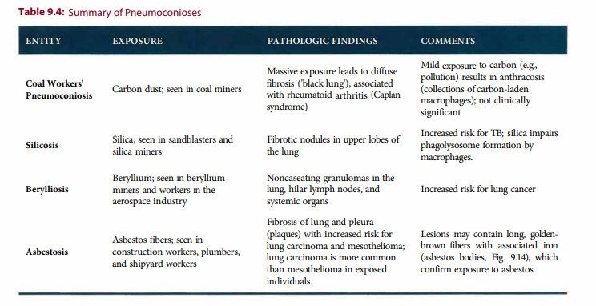

Slide 41
VASCULAR DISORDERS
A. Pulmonary Edema
Is fluid accumulation within the lungs, usually due to imbalance of Starling forces or endothelial injury.
Pulmonary edema due to increased hydrostatic pressure can be seen in left-sided heart failure, mitral valve stenosis, high altitude pulmonary edema, and fluid overload.
Pulmonary edema due to decreased oncotic pressure can be seen in nephrotic syndrome and liver disease.
Pulmonary edema due to increased capillary permeability can be due to infections, drugs (bleomycin, heroin), shock, and radiation.

Slide 42
The pathology grossly shows wet, heavy lungs (usually worse in lower lobes), while microscopic examination shows intra alveolar fluid, engorged capillaries, and hemosiderin-laden macrophages (heart-failure cells).

Slide 43
B. Pulmonary Hypertension
Is increased pulmonary artery pressure, usually due to increased vascular resistance or blood flow.
The etiology varies and can include
Chronic obstructive pulmonary disease and interstitial disease (hypoxic vasoconstriction).
Multiple ongoing pulmonary emboli
Mitral stenosis and left heart failure
Congenital heart disease with left to right shunts (atrial septal defect, ventricular septal defect, patent ductus arteriosus) and
Primary (idiopathic) pulmonary hypertension, typically in young women.

Slide 44
The pathology includes pulmonary artery atherosclerosis, small artery medial hypertrophy and intimal fibrosis, and plexogenic pulmonary arteriopathy.
Pulmonary hypertension may also damage the heart, leading to right ventricular hypertrophy and then failure (cor pulmonale).

Slide 45
PULMONARY TUMORS
A. Lung Cancer
Is the leading cause of cancer death among both men and women.
it has been increasing in women (increased smoking) in the past few decades.
It occurs most commonly age 50–80.
Major risk factors include cigarette smoking, occupational exposure (asbestosis, uranium mining, radiation, etc.), passive smoking, and air pollution.
Clinical features include cough, sputum production, weight loss, anorexia, fatigue, dyspnea, hemoptysis, and chest pain. Obstruction may produce focal emphysema, atelectasis, bronchiectasis, or pneumonia.

Slide 46
Intrathoracic spread of lung cancer is to lymph nodes, particularly hilar, bronchial, tracheal, and mediastinal; pleura (adenocarcinoma); and lung apex causing Horner syndrome (Pancoast tumor).
Obstruction of the superior vena cava by tumor causes superior vena cava syndrome, characterized by distended head and neck veins, plethora, and facial and upper arm edema.
Esophageal obstruction can cause dysphagia.
Recurrent laryngeal nerve involvement causes hoarseness, while phrenic nerve damage causes diaphragmatic paralysis.

Slide 47
Extrathoracic sites of metastasis include adrenal (>50%), liver, brain, and bone.
Treatment of non–small cell lung cancer is with surgery, and treatment of small cell lung cancer is with chemotherapy and radiation.
Despite treatment, the prognosis is poor, with overall 5-year survival 16%.

Slide 48
Adenocarcinoma
More commonly seen in women and nonsmokers.
Grossly, it causes a peripheral gray-white mass, and the tumor may develop in areas of parenchymal scarring (scar carcinoma).
Microscopically, common patterns include acinar, papillary, mucinous, and solid.
The precursor lesion—atypical adenomatous hyperplasia—progresses to adenocarcinoma in situ (noninvasive well-differentiated tumor).

Slide 49
Small cell carcinoma has a strong association with smoking, and affects males more than females.
This neuroendocrine tumor is very aggressive, with rapid growth and early dissemination.
Small cell carcinoma is commonly associated with paraneoplastic syndromes.
Pathologically, gross examination demonstrates central, gray-white masses.
Microscopic examination shows small round or polygonal cells in clusters, and electron microscopy shows cytoplasmic dense-core neurosecretory granules.

Slide 50
Squamous cell carcinoma (SCC)
Is strongly related to smoking and affects males more than females.
Squamous cell carcinoma arises from bronchial epithelium after a progression: metaplasia → dysplasia → carcinoma in situ → invasive carcinoma.
Pathologically, the tumor grossly causes a gray-white bronchial mass, usually centrally located.
Microscopically, well-differentiated tumors show invasive nests of squamous cells with intercellular bridges (desmosomes) and keratin production (“squamous pearls”).

Slide 51
Large cell carcinoma has large anaplastic cells without evidence of differentiation.

Slide 52
B.Bronchial carcinoids
Occur in a younger age group (mean age 40 years) and typically produce a polypoid intrabronchial mass or plaque.
Characterized on light microscopy by small, round, uniform cells growing in nests (organoid pattern), and on electron microscopy by cytoplasmic dense-core neurosecretory granules.
Atypical carcinoid is more aggressive than typical carcinoid.

Slide 53
C. Metastatic Tumors
Metastatic carcinoma is the most common malignant neoplasm in the lung.
It typically causes multiple, bilateral, scattered nodules; common primary sites include breast, stomach, pancreas, and colon.

Slide 54
D. Hamartomas
Are benign tumors; they occur more commonly in middle-aged adults but also occur in children.
They can appear as coin lesions on chest x-ray.
Microscopically, they are comprised of nonencapsulated fibromyxoid tissue.
Carney triad is the finding of a hamartoma with a predominantly cartilaginous component (pulmonary chondroma), an extra-adrenal paraganglioma and a gastric gastrointestinal stromal tumor.

Slide 55
DISEASES OF THE PLEURAL CAVITY
A. Fluid in the Pleural Space
Pleural effusion is the accumulation of fluid in the pleural cavity.
Exudative pleural effusion exists if laboratory analysis of thoracentesis fluid shows the following values:
protein/serum protein ratio >0.5,
lactate dehydrogenase (LDH)/serum LDH ratio >0.6, pleural fluid LDH level > two-thirds the upper limit of normal value for serum LDH.
Conditions causing an exudative pleural effusion include infections (TB), malignancy, and pulmonary embolism.

Slide 56
Transudative pleural effusions are sometimes assessed clinically, without laboratory pleural fluid analysis.
These effusions occur in clinical settings including left ventricular failure and cirrhosis.
Hemothorax is the presence of blood in the pleural cavity. Trauma is a common cause. There may be hypotension and shift of the trachea to the unaffected side.
Chylothorax is lymphatic fluid in the pleural cavity. Malignancy is a common cause.

Slide 57
B. Air in the Pleural Space
Pneumothorax is the term used for air in the pleural cavity.
It can be due to traumatic penetrating chest wall injuries or spontaneous rupture of apical blebs in typically tall young adults (spontaneous pneumothorax).
The term tension pneumothorax is used if a life-threatening shift of thoracic organs across midline occurs.

Slide 58
Tumors of pleura
Malignant mesothelioma
Is a rare, highly malignant neoplasm associated with occupational exposure to asbestos in 90% of cases.
It presents with recurrent pleural effusions, dyspnea, and chest pain.
The tumor grossly encases and compresses the lung;
Microscopic exam exhibits carcinomatous and sarcomatous elements (biphasic pattern), while electron microscopy shows long, thin microvilli on some tumor cells.
The prognosis of mesothelioma is poor.

Slide 59
References
Robbins and cotran’s pathologic basics of disease 10th
edition

Slide 60
Thank you!

