Slide 1
Outline on Infections of Genitourinary Tract
Infections of urinary tract include
Pyelonephritis: Kidneys
Urethritis: Urethra
Cystitis: Bladder
Prostatitis: Prostate
Upper
Lower

Slide 2
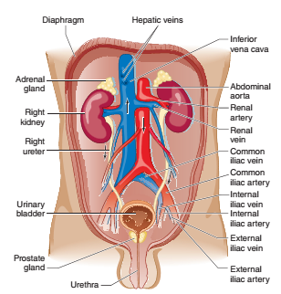
Urinary tract infection (UTI)
Active infection in any part of urinary tract
Beyond distal urethera (sterile)
UTIs can be divided
I. Upper UTIs
kidneys (pyelonephritis) and
Ureters (ureteritis)
II. Lower UTIs:
Urinary bladder (cystitis)
Urethra (urethritis)
In men, prostate (prostatitis)
Fig 1. Anatomy of urinary tract

Slide 3
The major defense against UTI
Complete emptying of bladder during urination
Urine acidity
Vesicoureteral valve, and
Various immunologic and mucosal barriers

Slide 4
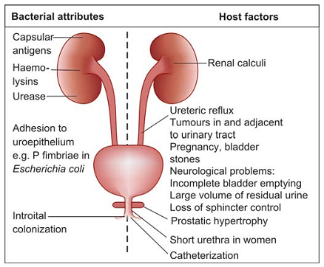
Factors Predisposing to UTI/Pathogenesis
Various bacterial attributes and host factors favour UTIs
Mechanical factors are important
Fig. 2. Bacterial attributes and host factors which favour UTI

Slide 5
Route
Ascending: pathogen moves upward from urethra or
Haematogenous: from bloodstream to kidneys
Infection via ascending | Infection via Haematogenous
Escherichia coli | Salmonella species
Proteus species | Mycobacterium species
Klebsiella specie | Schistosoma haematobium
Staphylococcus aureus | Histoplasma duboisii
Staphylococcus epidermidis | Cytomegalovirus
GBS | Adenovirus type II

Slide 6
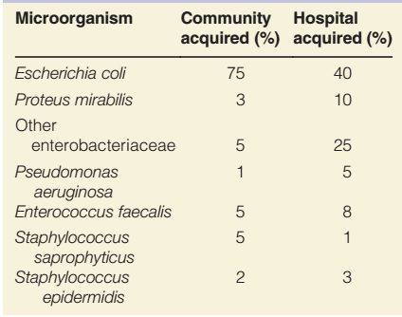
Causative Agents
A large number of organisms are capable of causing UTI
The most common causes are E. coli
Fimbriae/Nephritogenic strains: adherence to mucosal surfaces
Table: Common bacterial causes of UTI (~percentage)
Bacteria
Fungi
mycobacteria
Viruses, and
Parasites

Slide 7
S. saprophyticus
Coagulase and DNase (-ve)
Associated with UTI in sexually active young women (severe cystitis with haematuria)
Resistance to novobiocin

Slide 8
Proteus
The genus contains a number of species -P. mirabilis and P. vulgaris
Characteristics include:
-Non-lactose fermenting, produce pale colonies on MAC;
-Motile, tendency to ‘swarm’ on blood agar
-Associated with urinary tract stones
-Occasionally abdominal wound infection
Pseudomonas aeruginosa with urethral catheterisation
Notes:
MAC, MacConkey agar

Slide 9
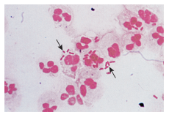
Symptom of UTI
A patient with a UTI presents with
Dysuria (difficulty or pain on urination)
Lumbar pain
Fever, and
Chills
UTIs may be acquired either within a;
Healthcare setting (HCA-UTIs) or
Elsewhere (Community-acquired UTIs) following urinary catheterization
Pyelonephritis

Slide 10
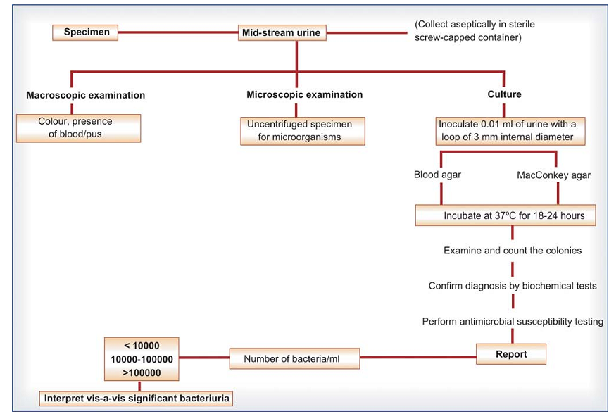
Diagnosis of UTI
Urinalysis
Sometimes urine culture
Fig. 3. Diagnosis of urinary tract infection

Slide 11
Outline
Infections of GUT include
Bladder
Kidney
Prostate
Infections of vagina, and STI

Slide 12
Bacterial STIs include
Syphilis
Chlamydial infections
Gonococcal infections
Chancroid
Lymphogranuloma venereum
Granuloma inguinale
Mycoplasmal infections
Viral STIs include
Genital and anorectal warts
Genital herpes
Molluscum contagiosum
HIV infection
Parasitic STI include
Trichomoniasis (caused by protozoa)
Scabies (caused by mites)
Pediculosis pubis (caused by lice)

Slide 13
Genital infections: Common term
Caused by a wide variety of microbes.
Bartholinitis: Inflammation of the Bartholin ducts in women.
Cervicitis: Inflammation of cervix
Endometritis: Inflammation of endometrium
Epididymitis: Inflammation of epididymis
Pelvic inflammatory disease (PID) : Inflammation of fallopian tubes; also known as salpingitis
Vaginitis: Inflammation of vagina.
Notes:
cervix (that part of uterus that opens into vagina), endometrium (the inner layer of uterine wall). epididymis (an elongated structure connected to testis).

Slide 14
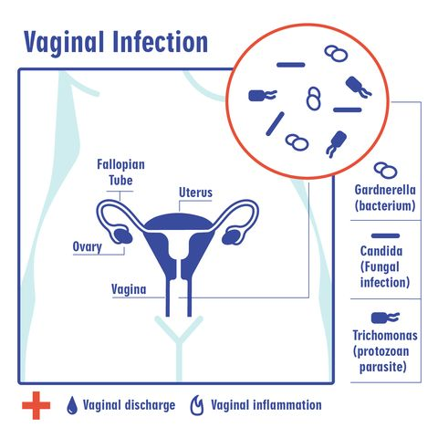
Vaginal Infections
Vaginal discharge (VD) is body’s means of maintaining a healthy vaginal mucosa.
A normal VD is usually clear or milky with no malodor
An infection caused by an overgrowth of organisms that are normal flora in vaginal mucosa
Bacterial vaginosis: Gardnerella vaginalis
Mycotic vulvovaginitis: Candida albicans (vaginitis)
Trichomoniasis: Trichomonas vaginalis

Slide 15
1. Bacterial vaginosis (BV)
Aetiology of BV
Occur due to reduction of vaginal lactobacilli and
Colonisation of vaginal mucosa by groups of abnormal mos. rather than one single pathogen.
Not associated with inflammation of vaginal mucosa
Facilitate HIV acquisition
Some of bacteria associated with BV include;
Gardnerella vaginalis (facultatively anaerobic GPR)
Mobiluncus and
Prevotella
Notes:
Mo. microorganism

Slide 16
Epidemiology
BV is most common cause of vaginal discharge.
It has been estimated that a third of women may develop BV sometime in their life.
Young age
Smoking
Vaginal douching and
Having multiple sexual partners
Associated with BV

Slide 17
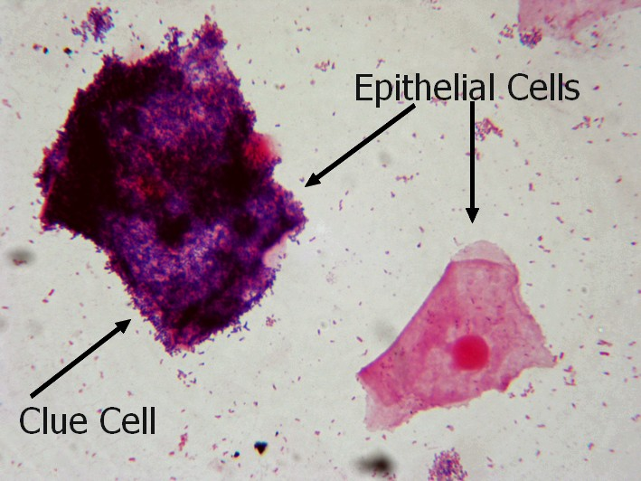
Diagnosis of BV
Amsel’s criteria have been used by many clinicians;
BV requires the presence of 3 of 4 criteria:
1. Viscid abnormal vaginal discharge;
2. Positive ‘whiff test’; fishy odour of vaginal fluid after addition of 10% KOH;
3. Presence of clue cells (epithelial cells embedded with bacteria with unidentified border) on microscopy of vaginal fluid;
4. Vaginal fluid pH of more than 4.5.

Slide 18
Treatment and Prevention of BV
Rx: metronidazole or clindamycin
Prevention: avoiding vaginal douching and avoiding multiple sexual partners
Notes:
Rx, treatment

Slide 19
Vulvo-vaginal candidiasis (VC); (‘ Thrush’ )
VC is caused by Candida albicans
common cause of vaginitis
It is not a STI
Clinical features
Itching and irritation, vaginal discharge, dyspareunia and dysuria
Factors
Pregnancy, obesity, DM, oral contraceptives, corticosteroids, antibiotic therapy, prolonged exposure to moisture, and poor feminine hygiene
Notes:
Painful intercourse is dyspareunia; STI, Sexual transmitted infection; Rx, treatment

Slide 20
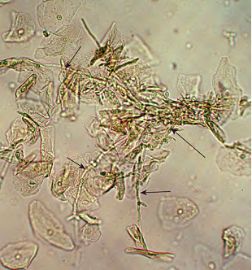
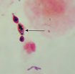
Cont.
Diagnosis
Vaginal fluid (wet mount, Gram stained) reveals yeasts
Culture
Topical azole/ fluconazole as Rx
Figure . A wet mount/GS from a VD containing a mass of C. albicans pseudohyphae (arrows).
Notes:
GS, gram stain

Slide 21
Sexually transmitted infections (STI)
STI replacing term sexually transmitted diseases (STD)
STIs divided into groups based on clinical presentation:
Genital ulcers (genital herpes, syphilis, and chancroid)
Urethritis and cervicitis (gonorrhea, chlamydial infections, and non-gonococcal urethritis), and
Other STIs (pelvic inflammatory disease [PID] and human papillomavirus infections [HPV]).
Notes:
PID,(Female) ascending spread of microorganisms from vagina and endocervix to endometrium, fallopian tubes, and other contiguous structures (N gonorrhoeae and C trachomatis serovars D and K)

Slide 22
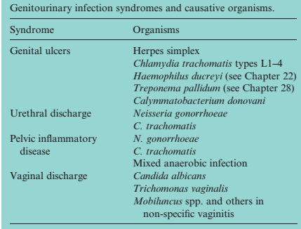

Slide 23
Genital ulcers
Three main causes for genital ulcer disease (GUD);
Infections,
Inflammatory diseases and
Malignancies
Infectious causes of GUD
Chancroid caused by Haemophilus ducreyi
Syphilis: Chancer
Herpes simplex virus (types 1 or 2)

Slide 24
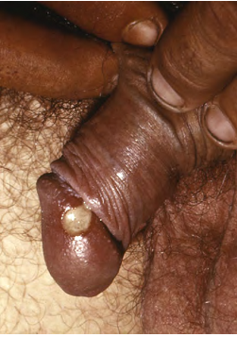
1. H. ducreyi
gram-negative coccobacillus
Causes genital ulcers (chancroid)
Painful necrotizing genital ulcers
Lack induration
A highly contagious but curable disease
A STI
Usually present in urban areas with a high incidence of prostitution
Rx: azithromycin
A penis with a soft chancre due to H. ducreyi.

Slide 25
2. Treponema pallidum
T. pallidum causes syphilis
Transmitted by sexually or congenitally
The related organisms;
T. pertenue cause yaws.
T. carateum cause pinta
They are spread by contact, usually in childhood.

Slide 26
Clinical features
T. pallidum penetrate intact skin or mucosa disseminating throughout body to cause disease in four stages:
Primary chancre: painless ulcer with a rubbery edge and regional lymphadenopathy (3 wks.):hard chancre
Secondary: Rash, lymphadenopathy (6–8 wks.)
Latent phase: which may last for many years (serologic test are positive for syphilis without symptom)
Tertiary: systemic lesions become symptomatic,
e.g. Aortitis, posterior cord degeneration and dementia
The characteristic syphilitic lesions (gummas), which consist of necrosis and obliterative endarteritis with firoblastic proliferation and lymphocyte infitration, are found throughout the body.

Slide 27
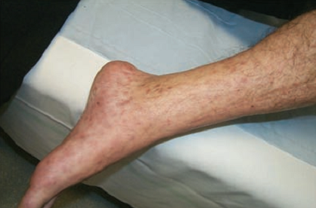
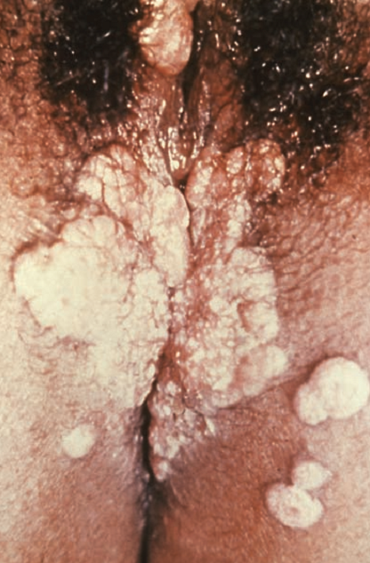
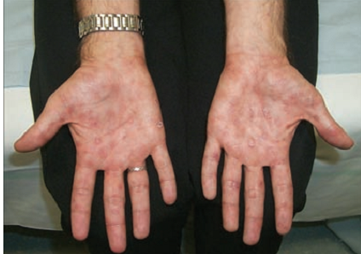
The rash of secondary syphilis
Condylomata lata
Tertiary syphilis presents in three basic forms
Gummatous syphilis
Cardiovascular syphilis
Neurosyphilis
The palmar rash of secondary syphilis

Slide 28
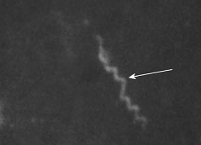
Cont.
Diagnosis
Primary: dark-ground microscopy or NAAT.
Later stages: EIA for specific IgG and IgM as well as cardiolipin agglutination (measures disease activity) and
Tests based on cultivated treponemes such as TPHA.
CSF testing : performed to detect early CNS involvement.
Neonatal: detection of IgM by Western blotting.
Treatment
Penicillin/azithromycin or tetracyclines
Fig. Treponema pallidum (arrow) using dark field microscopy.
Notes:
Treponemal haemagglutination test (TPHA), CNS: Central nerve system; EIA, Enzyme immuno assay

Slide 29
Serology for diagnosis of syphilis
Two types of serological tests:
1. Non-specific Ab test: VDRL,RPR
Detect IgM and IgG that develop against lipids released from T. pallidum during early stages of disease.
Cardiolipin-cholesterol-lecithin: Ag used in these assays
Initially extracted from beef heart and is not derived from treponemes
2. Specific treponemal assays: based on T. pallidum derived Ags.
FTA-abs
TPPA, TPHA
Notes:
VDRL, Venereal disease research laboratory; RPR, Rapid plasma regain; TPPA, Treponema pallidum particle agglutination assay; TPHA, Treponema pallidum hemagglutination; FTA-ABS, fluorescent treponemal antibody absorption

Slide 30
4. Herpesviruses
The family Herpesviridae
Comprises large, enveloped, dsDNA viruses
They are ubiquitous
Found in both animals and humans
Produce infections ranging from
Painful skin ulcers to chickenpox to encephalitis.

Slide 31
Eight members of the family infect humans:
Two herpes simplex viruses (HSV-1 and HSV-2),
Cytomegalovirus (CMV),
Varicella–zoster virus (VZV),
Epstein–Barr virus (EBV),
Human herpesvirus-6 (HHV-6), and
Human herpesvirus types 7 and 8 (HHV-7, HHV-8).
A simian herpesvirus, herpes B virus, has occasionally caused human disease.

Slide 32
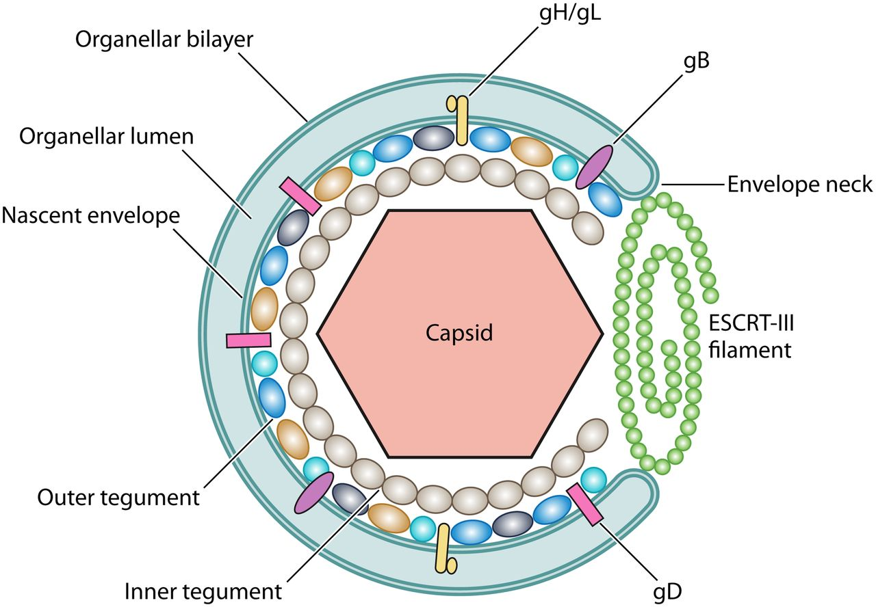
Group characteristics
Virology
Virion: Spherical, 150–200 nm in diameter (icosahedral)
Genome : Ds DNA, linear, 125–240 kbp, reiterated sequences
Proteins: More than 35 proteins in virion
Over the capsid is a protein-filled region called the tegument.
Envelope: Contains viral glycoproteins, Fc receptors
Replication: Nucleus, bud from nuclear membrane

Slide 33
Outstanding characteristics:
Encode many enzymes
Establish latent infections
Persist indefinitely in infected hosts
Frequently reactivated in immunosuppressed hosts
Some cause cancer

Slide 34
1. Herpes Simplex Virus
HSV-1 and HSV-2
Differences in glycoprotein gB (i.e, HSV-1; gB1 and HSV-2; gB2)
HSV Disease
Cause recurrent ulcers in areas of skin and mucous membranes.
Causing lesions “above the waist” (HSV-1) or “below the waist” (HSV-2).
HSV persists in a latent form and
Reactivates to cause viral excretion and/or disease.

Slide 35
Cont.
Epidemiology of HSV
Distributed worldwide
Humans appear to be only natural reservoir
Transmitted through direct contact with infected secretions
High seroprevalence among humans, which increases with age
Infection with HSV-2 linked to sexual activity

Slide 36
Pathogenesis
Acute Infections
Infection produces inflammation and giant cells
Virus can infect and spread in axons and ganglia
Latent Infection
No synthesis of early or late viral polypeptides in latent infection
Reactivation can be precipitated by sun exposure, fever, or trauma

Slide 37
Cont.
Manifestations of HSV-1
Vesicular lesions become pustular
Ulcerate Infections generally involve ectoderm
It usually cause gingivostomatitis
Recurrent cold sores usually unilateral
Virus in saliva with asymptomatic reactivation
Herpetic whitlow
Herpetic corneal and conjunctival infection
Herpes encephalitis (temporal lobe)
Notes:
Herpetic whitlow (infects the finger or nail area), ectoderm (skin, mouth, conjunctiva, nervous system).

Slide 38
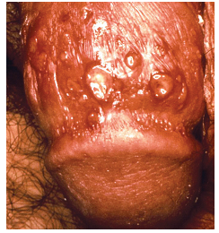
HSV-2
The most common cause of GUD
Primary Genital Herpes Infection
Multiple painful vesicopustular lesions
Recurrent Genital Herpes Infection
Prodromal paresthesias
Recurrent episodes common
Neonatal Herpes
Usually transmitted from mother at birth
High mortality if disseminated
HSV lesions on a penile shaft.
Notes:
paraesthesiae ; an abnormal sensation

Slide 39
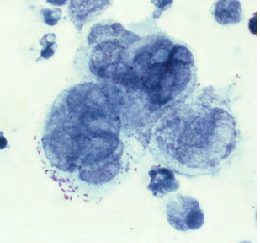
Diagnosis
Cell culture
Monoclonal antibodies
Tzanck test: intranuclear inclusions or multinucleated giant cells typical of herpes from lesion by histological stain.
EIA, immunofluorescence, and PCR
Treatment
Acyclovir
Prevention
Avoiding contact with lesions
Safe sex practices
Caesarean section to avoid neonatal infection
Fig. Giant cell scraped from a herpetic lesion.

Slide 40
Table. Characteristics that Differentiate Genital Ulcerative Diseases
Disease | Number and location | Tenderness | Ulcer Appearance | Adenopathy
HSV | Clusters of ulcers on labia and penis | Tender | Uniform size clean base erythematous border | Tender inguinal nodes
Syphilis | One or two lesions on vagina and penis | Little to no tenderness | Clean base indurated border | Rubbery, mildly tender
Chancroid | One or two lesions on labia and penis, may coalesce | Painful | Can be large, ragged, and necrotic base undermined edge | Very tender fluctuant inguinal nodes

Slide 41
Diseases Characterized by Urethritis or Cervicitis Gram-negative cocci
Neisseria
Two important human pathogens:
N. gonorrhoeae (gonococcus) and
N. meningitidis (meningococcus)
Some Neisseria species are commensals of human URT.
N. meningitidis | Meningitis, Bloodstream infection
N. gonorrhoeae | Urethritis, cervicitis , Epididymitis Pelvic inflammatory disease, Neonatal ophthalmia, bloodstream infection, Arthritis
Moraxella catarrhalis | Upper and lower respiratory tract infections

Slide 42
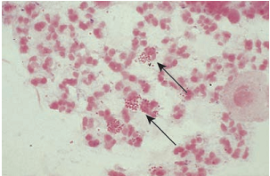
N. gonorrhoeae
GN kidney-shaped cocci, usually in pairs (diplococci)
Aerobic
Fig. Intracellular Gram-negative diplococci (arrowed) of Neisseria gonorrhoeae (0.8 mm diameter) in neutrophils.

Slide 43
Epidemiology
Obligate human parasite
Many women are asymptomatic (reservoir of infection)
Highly transmissible by sexual contact
Vertical transmission to neonates
Occurs worldwide
Infections are most common among sexually active young adults

Slide 44
Pathogenicity
Cell-surface pili, which aid adherence to mucosal surfaces, thus initiating infection
IgA proteases
Can survive intracellularly within PMNs and
Some strains are also able to resist serum lysis
Re-infections occur, because protective immunity does not develop
Notes:
mucosal surfaces of the cervix, urethra, rectum and URT; PMNs, poly morph nuclear cell

Slide 45
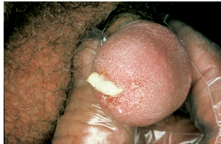
Associated infections
Genitourinary: urethritis, cervicitis
Gastrointestinal: proctitis (asymptomatic in many)
Occular: hyper-acute conjunctivitis, periorbital cellulitis
Blood: BSI (disseminated gonococcal infection)
Fig. Gonococcal urethral discharge.
Notes:
proctitis ; inflammation of the rectum and anus. BSI, Blood stream infection

Slide 46
Laboratory identification
Microscopy; Gram stain: kidney-shaped GN diplococci are seen in pus cells.
Specimens should be rapidly transported to laboratory
Cultures: selective media
Positive oxidase reaction, catalase production
Treatment and prevention
Ceftriaxone
No vaccine
Prevention includes sex education, promotion of public awareness, contact tracing
Shemse Sebre (BSc, MSc, PhD candidate)

Slide 47
3. Chlamydia
There are three species:
Chlamydia trachomatis: infects eye and genital tract
Two respiratory pathogens,
C. pneumonia
Chlamydophila psittaci
They are obligate, intracellular bacteria
Exist in two forms
Reticulate body: a non-infective, intracellular, vegetative form
Elementary body: an extracellular form that permits the organism to survive and be transmitted
which is derived from the reticulate body by binary fission.

Slide 48
Pathogenicity
Major outer membrane protein: attachment to mucosal cells.
A 60-kDa cysteine-rich protein also as virulence factor.
C. pneumoniae
Transmitted from person to person by respiratory route.
It produces pneumonia or bronchitis, clinically mild
Associated with pharyngitis, sinusitis and laryngitis.

Slide 49
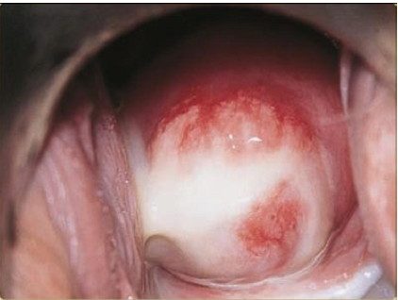
C. trachomatis
Multiple serotypes and associated with:
A–C: trachoma and neonatal conjunctivitis;
D–K: acute urethritis/cervicitis and pelvic inflammatory disease;
Serotypes L1–L3: lymphogranuloma venereum
Fig. Chlamydial cervicitis
Notes:
LGV: can invade and reproduce in regional lymph nodes.

Slide 50
Laboratory diagnosis
For C. trachomatis: NAAT, EIA and culture
Treatment and prevention
TTC, macrolides or quinolones: for uncomplicated case
Partners of patients with chlamydial infection need chlamydial screening and treatment
Notes:
TTC, Tetracycline

Slide 51
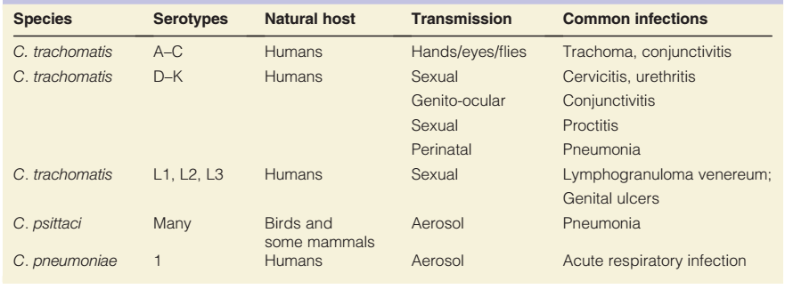
Table: Summary on Classification and common infections of Chlamydiaceae

Slide 52
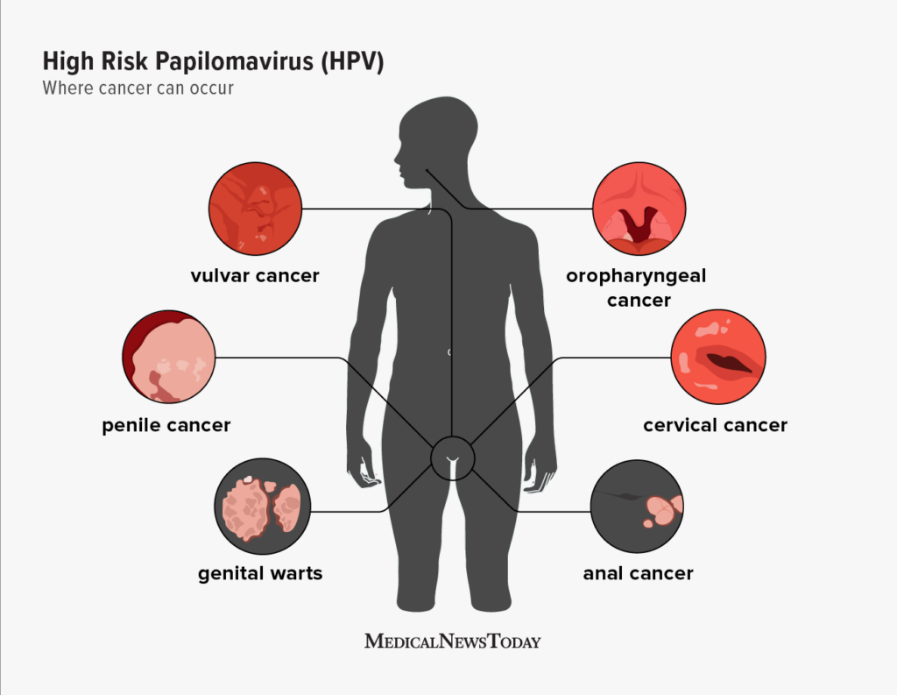
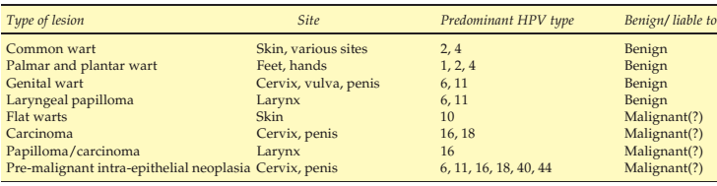
Genital warts
Caused by 30–40 types of Human papilloma virus (HPV)
Papovaviridae family of DNA viruses (human wart viruses).
HPV genotypes 16 and 18- associated with cervical cancer.
HPV are associated with lesions of specific morphology and at specific anatomic sites
Table: Lesions caused by HPV

Slide 53
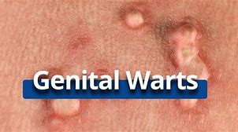
Reservoirs and mode of transmission.
Infected humans serve as reservoirs.
Transmission
Direct contact, usually sexual; through breaks in skin or mucous membranes
Mother to neonate during birth.

Slide 54
Laboratory diagnosis.
Genital warts are usually diagnosed clinically.
Molecular diagnostic procedures are available.
A vaccine (Gardasil) helps protect against
Two types of cancer-causing HPV and
Two types of HPV that cause genital warts.

Slide 55
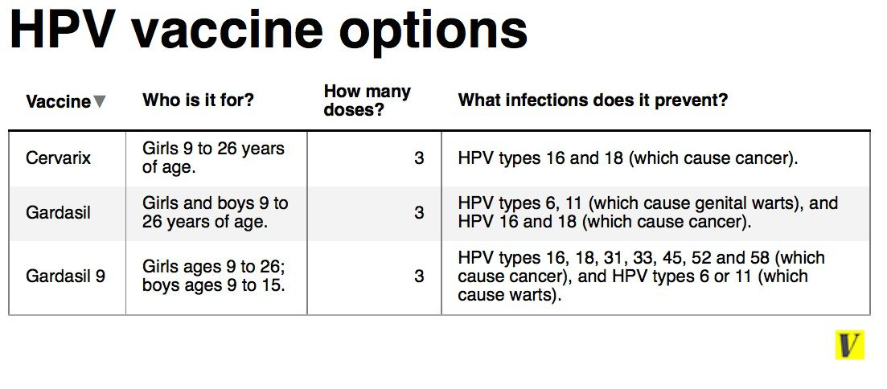

Slide 56
HIV Infection and AIDS
AIDS is caused by HIV (1983).
HIV is classified as a lentiviruses.
Two types have been identified:
Type 1 (HIV-1), most common, most virulent
Type 2 (HIV-2); less virulent found in west Africa
HIV viruses are ss RNA viruses in
The family Retroviridae (retroviruses)-reverse transcriptase

Slide 57



Reservoirs and mode of transmission
Infected humans serve as reservoirs.
Transmission
Direct sexual contact
Sharing of contaminated needles and syringes
Transfusion of contaminated blood/products
Perinatal transmission
Transplacental
Breast-feeding by HIV-infected mothers
During delivery through an infected birth cana
Transplantation of HIV-infected tissues or organs

Slide 58
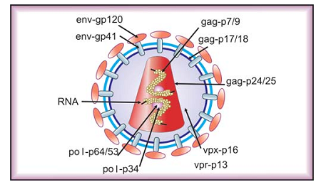
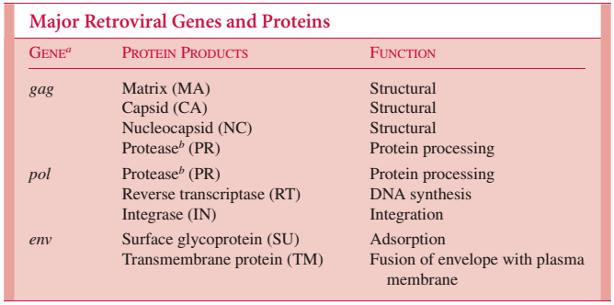
Pathogenicity
HIV-1 first invades dendritic cells in genital and oral mucosa.
These cells then fuse with CD4 + lymphocytes (helper T cells) and spread to deeper tissues.
Three genes are required for viral replication: gag, pol and env.
Fig. Structure of HIV virus

Slide 59
Clinical Course of Infection
Infection with HIV-1 is associated with
A progressive decrease of the CD4+ T cell count and
An increase in viral load.
The stage of infection can be determined by
Measuring patient’s CD4+ T cell count, and
The level of HIV in the blood
Acute infection: influenza/mononucleosis-like illness (28 day)
Clinical latency: viral particles reduce (2 wk. to 20yrs.)
Opportunistic microbes: CD4 + T cell numbers decline
AIDS: CD4 + T cell; 200 cells/ml and less
Notes:
Mononucleosis; fever, lymphadenopathy, pharyngitis, rash, myalgia, malaise, mouth and oesophageal sores

Slide 60
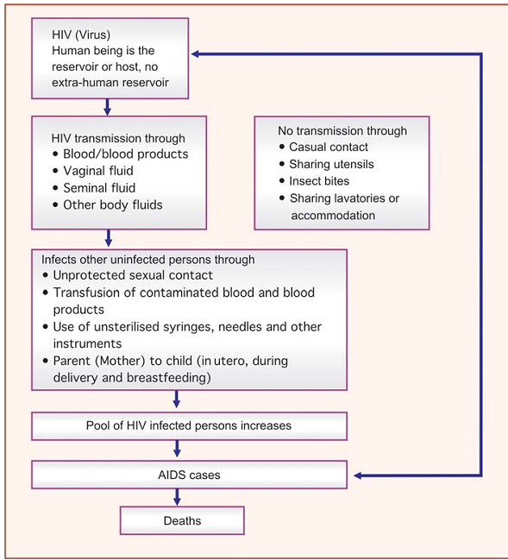
Fig. Transmission cycle of HIV

Slide 61
Laboratory Diagnosis
Window period (WP)
Time that elapses between entry of HIV into the body and detection of HIV specific Abs.
3 wk. to 3 month
1. Antibody Detection: ELISA
2. Antigen Detection
3. Virus Isolation
Screening Tests: ELISA and or rapid HIV tests

Slide 62
Cont.
Prevention
Prophylaxis of opportunistic infections is especially important
Education is the cornerstone of prevention
Screening for asymptomatic infection in pregnancy aids effective prophylaxis

