Slide 1
Pathology of the kidney and urinary system
Dr. Abdurrhman Kedir

Slide 2
Outline
Congenital renal disorders
Acute renal failure
Nephrotic syndrome
Nephritic syndrome
Urinary tract infection
Chronic renal failure
Renal neoplasia
Penis
Testis
Prostate

Slide 3
Congenital renal disorders
HORSESHOE KIDNEY Conjoined kidneys usually connected at the lower pole; most common congenital renal anomaly Kidney is abnormally located in the lower abdomen; horseshoe kidney gets caught on the inferior mesenteric artery root during its ascent from the pelvis to the abdomen. RENAL AGENESIS A. Absent kidney formation; may be unilateral or bilateral B. Unilateral agenesis leads to hypertrophy of the existing kidney; hyperfiltration increases risk of renal failure later in life. C. Bilateral agenesis leads to oligohydramnios with lung hypoplasia, flat face with low set ears, and developmental defects of the extremities (Potter sequence,);incompatible with life

Slide 4
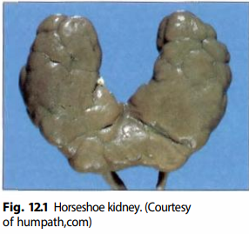
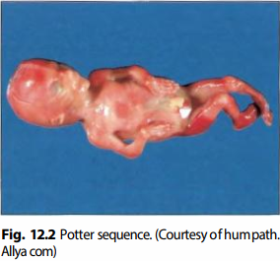

Slide 5
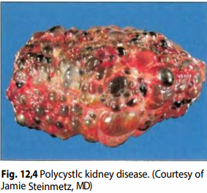
POLYCYSTIC KIDNEY DISEASE (PKD) A. Inherited defect leading to bilateral enlarged kidneys with cysts in the renal cortex and medulla B. Autosomal recessive form presents in infants as worsening renal failure and hypertension; newborns may present with Potter sequence. 1. Associated with congenital hepatic fibrosis (leads to portal hypertension) and hepatic cysts C. Autosomal dominant form presents in young adults as hypertension (due to increased renin), hematuria, and worsening renal failure. 1. Due to mutation in the APKD1 or APKD2 gene; cysts develop over time. 2. Associated with berry aneurysm, hepatic cysts, and mitral valve prolapse

Slide 6
ACUTE RENAL FAILURE (ARF)
A. Acute, severe decrease in renal function (develops within days)
B. Hallmark is azotemia (increased BUN and creatinine [Cr]), often with oliguria.
C. Divided into pre-renal, post-renal and intra-renal azotemia based on etiology.

Slide 7
PRERENAL AZOTEMIA
A. Due to decreased blood flow to kidneys (e.g., cardiac failure); common cause of ARF
B. Decreased blood flow results in ↓ GFR, azotemia, and oliguria.
C. Reabsorption of fluid and BUN ensues (serum BUN:Cr ratio > 15); tubular function remains intact (fractional excretion of sodium [FEN a] < 1% and urine osmolality [osm] > 500 mOsm/kg).

Slide 8
POSTRENAL AZOTEMIA
A. Due to obstruction of urinary tract downstream from the kidney (e.g., ureters)
B. Decreased outflow results in ↓GFR, azotemia, and oliguria.
C. During early stage of obstruction, increased tubular pressure "forces" BUN into the blood (serum BUN:Cr ratio> 15); tubular function remains intact (FENa < 1% and urine osm > 500 mOsm/kg).
D. With long-standing obstruction, tubular damage ensues, resulting in decreased reabsorption of BUN (serum BUN:Cr ratio< 15), decreased reabsorption of sodium (FEN a > 2%), and inability to concentrate urine (urine osm < 500 mOsm/kg).

Slide 9
ACUTE TUBULAR NECROSIS
A. Injury and necrosis of tubular epithelial cells; most common cause of acute renal failure (intrarenal azotemia)
B. Necrotic cells plug tubules; obstruction decreases GFR.
1. Brown, granular casts are seen in the urine.
C. Dysfunctional tubular epithelium results in decreased reabsorption of BUN (serum BUN:Cr ratio < 15), decreased reabsorption of sodium (FENa > 2%), and inability to concentrate urine (urine osm < 500 mOsm/kg).

Slide 10
D. Etiology may be ischemic or nephrotoxic.
1. Ischemia - Decreased blood supply results in necrosis of tubules.
i. Often preceded by prerenal azotemia
ii. Proximal tubule and medullary segment of the thick ascending limb are particularly susceptible to ischemic damage.

Slide 11
2. Nephrotoxic - Toxic agents result in necrosis of tubules.
i. Proximal tubule is particularly susceptible.
ii. Causes include aminoglycosides (most common), heavy metals (e.g., lead), myoglobinuria (e.g., from crush injury to muscle), ethylene glycol (associated with oxalate crystals in urine),radiocontrast dye, and urate (e.g., tumor lysis syndrome).
iii. Hydration and allopurinol are used prior to initiation of chemotherapy to decrease risk of urate-induced ATN.

Slide 12
Clinical features
1. Oliguria with brown, granular casts
2. Elevated BUN and creatinine
3. Hyperkalemia (due to decreased renal excretion) with metabolic acidosis
Notes:
Reversible, but often requires supportive dialysis since electrolyte imbalances can be
fatal
1. Oliguria can persist for 2-3 weeks before recovery; tubular cells (stable cells) take
time to reenter the cell cycle and regenerate..

Slide 13
ACUTE INTERSTITIAL NEPHRITIS
A. Drug-induced hypersensitivity involving the interstitium and tubules ; results in acute renal failure (intrarenal azotemia)
B. Causes include NSAIDs, penicillin, and diuretics.
C. Presents as oliguria, fever, and rash days to weeks after starting a drug; eosinophils may be seen in urine.
D. Resolves with cessation of drug
E. May progress to renal papillary necrosis

Slide 14
RENAL PAPILLARY NECROSIS
A. Necrosis of renal papillae
B. Presents with gross hematuria and flank pain
C. Causes include
1. Chronic analgesic abuse (e.g., long-term phenacetin or aspirin use)
2. Diabetes mellitus
3. Sickle cell trait or disease
4. Severe acute pyelonephritis

Slide 15
NEPHROTIC SYNDROME
A. Glomerular disorders characterized by proteinuria (> 3.5 g/day) resulting in
1. Hypoalbuminemia - pitting edema
2. Hypogammaglobulinemia - increased risk of infection
3. Hypercoagulable state - due to loss of antithrombin III
4. Hyperlipidemia and hypercholesterolemia - may result in fatty casts in urine

Slide 16
MINIMAL CHANGE DISEASE (MCD)
A. Most common cause of nephrotic syndrome in children
B. Usually idiopathic; may be associated with Hodgkin lymphoma
C. Normal glomeruli on H&E stain; lipid may be seen in proximal tubule cells.
D. Effacement of foot processes on electron microscopy
E. No immune complex deposits; negative immunofluorescence (IF)
F. Selective proteinuria (loss of albumin, but not immunoglobulin)
G. Excellent response to steroids (damage is mediated by cytokines from T cells)

Slide 17
FOCAL SEGMENTAL GLOMERULOSCLEROSIS (FSGS)
A. Most common cause of nephrotic syndrome in Hispanics and African Americans
B. Usually idiopathic; may be associated with HIV, heroin use, and sickle cell disease
C. Focal (some glomeruli) and segmental (involving only part of the glomerulus) sclerosis on H&E stain
D. Effacement of foot processes on EM
E. No immune complex deposits; negative IF
F. Poor response to steroids; progresses to chronic renal failure

Slide 18
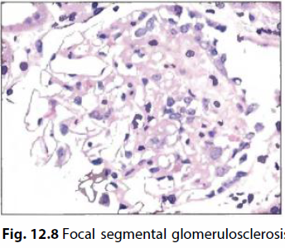
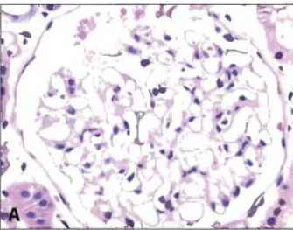

Slide 19
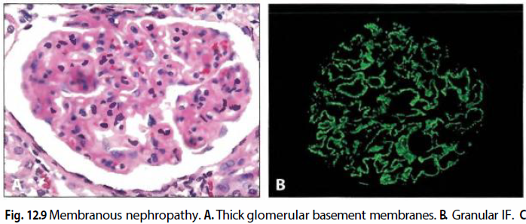
MEMBRANOUS NEPHROPATHY
A. Most common cause of nephrotic syndrome in Caucasian adults
B. Usually idiopathic; may be associated with hepatitis B or C, solid tumors, SLE, or drugs (e.g., NSAIDs and penicillamine)
C. Thick glomerular basement membrane on H&E
D. Due to immune complex deposition (granular IF); subepithelial deposits with 'spike and dome' appearance on EM
E. Poor response to steroids; progresses to chronic renal failure

Slide 20
MEMBRANOPROLIFERA TIVE GLOMERULONEPHRITIS
A. Thick glomerular basement membrane on H&E, often with 'tram-track' appearance
B. Due to immune complex deposition (granular IF)
C. Divided into two types based on location of deposits
1. Type I - subendothelial; associated with HBV and HCV
2. Type II (dense deposit disease) - intramembranous; associated with C3 nephritic factor (autoantibody that stabilizes C3 convertase, leading to overactivation of complement, inflammation, and low levels of circulating C3)
D. Poor response to steroids; progresses to chronic renal failure

Slide 21
DIABETES MELLITUS
A. High serum glucose leads to nonenzymatic glycosylation of the vascular basement membrane resulting in hyaline arteriolosclerosis.
B. Glomerular efferent arteriole is more affected than the afferent arteriole, leading to high glomerular filtration pressure.
1. Hyperfiltration injury leads to microalbuminuria.
C. Eventually progresses to nephrotic syndrome
1. Characterized by sclerosis of the mesangium with formation of Kimmelstiel-Wilson nodules
D. ACE inhibitors slow progression of hyperfiltration-induced damage.

Slide 22
SYSTEMIC AMYLOIDOSIS
A. Kidney is the most commonly involved organ in systemic amyloidosis.
B. Amyloid deposits in the mesangium, resulting in nephrotic syndrome.
C. Characterized by apple-green birefringence under polarized light after staining with Congo red

Slide 23
NEPHRITIC SYNDROME
A. Glomerular disorders characterized by glomerular inflammation and bleeding
1. Limited proteinuria (< 3.5 g/day)
2. Oliguria and azotemia
3. Salt retention with periorbital edema and hypertension
4. RBC casts and dysmorphic RBCs in urine
B. Biopsy reveals hypercellular, inflamed glomeruli.
1. Immune-complex deposition activates complement; C5a attracts neutrophils which mediate damage.

Slide 24
POSTSTREPTOCOCCAL GLOMERULONEPHRITIS (PSGN)
A. Nephritic syndrome that arises after group A β- hemolytic streptococcal infection of the skin (impetigo) or pharynx
1. Occurs with nephritogenic strains
2. May occur after infection with nonstreptococcal organisms as well
B. Presents 2-3 weeks after infection as hematuria (cola-colored urine), oliguria,hypertension, and periorbital edema
1. Usually seen in children, but may occur in adults

Slide 25
D. Mediated by immune complex deposition (granular IF); subepithelial 'humps' on EM
E. Treatment is supportive.
1. Children rarely (1%) progress to renal failure.
2. Some adults (25%) develop rapidly progressive glomerulonephritis (RPGN).

Slide 26
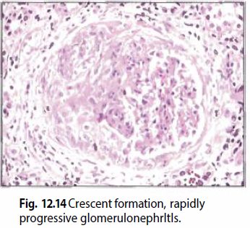
RAPIDLY PROGRESSIVE GLOMERULONEPHRITIS
A. Nephritic syndrome that progresses to renal failure in weeks to months.
B. Characterized by crescents in Bowman space (of glomeruli) on H&E stain; crescents are comprised of fibrin and macrophages.
C. Clinical picture and IF help resolve etiology.

Slide 27
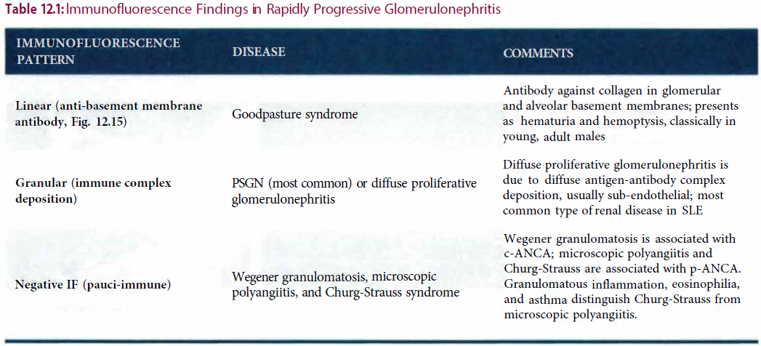

Slide 28
IgA NEPHROPATHY (BERGER DISEASE)
A. IgA immune complex deposition in mesangium of glomeruli; most common nephropathy worldwide
B. Presents during childhood as episodic gross or microscopic hematuria with RBC casts, usually following mucosal infections (e.g., gastroenteritis)
1. IgA production is increased during infection.
C. IgA immune complex deposition in the mesangium is seen on IF
D. May slowly progress to renal failure

Slide 29
ALPORT SYNDROME
A. Inherited defect in type IV collagen; most commonly X-linked
B. Results in thinning and splitting of the glomerular basement membrane
C. Presents as isolated hematuria, sensory hearing loss, and ocular disturbances

Slide 30
URINARY TRACT INFECTION
A. Infection of urethra, bladder, or kidney
B. Most commonly arises due to ascending infection; increased incidence in females
C. Risk factors include sexual intercourse, urinary stasis, and catheters.

Slide 31
CYSTITIS
A. Infection of the bladder
B. Presents as dysuria, urinary frequency, urgency, and suprapubic pain; systemic signs (e.g., fever) are usually absent.
C. Laboratory findings
1. Urinalysis - cloudy urine with > 10 WBCs/high power field (hpf)
2. Dipstick - Positive leukocyte esterase (due to pyuria) and nitrites (bacteria convert nitrates to nitrites)
3. Culture - greater than 100,000 colony forming units (gold standard)

Slide 32
D. Etiology
1. E coli (80%)
2. Staphylococcus saprophyticus - increased incidence in young, sexually active women (but E coli is still more common in this population)
3. Klebsiella pneumoniae
4. Proteus mirabilis - alkaline urine with ammonia scent
5. Enterococcus faecalis
E. Sterile pyuria is the presence of pyuria (> 10 WBCs/hpf and leukocyte esterase) with a negative urine culture.
1. Suggests urethritis due to Chlamydia trachomatis or Neisseria gonorrhoeae (dominant presenting sign of urethritis is dysuria)

Slide 33
PYELONEPHRITIS
A. Infection of the kidney
1. Usually due to ascending infection; increased risk with vesicoureteral reflux
B. Presents with fever, flank pain, WBC casts, and leukocytosis in addition to symptoms of cystitis
C. Most common pathogens are
1. E coli (90%)
2. Enterococcus faecalis
3. Klebsiella species

Slide 34
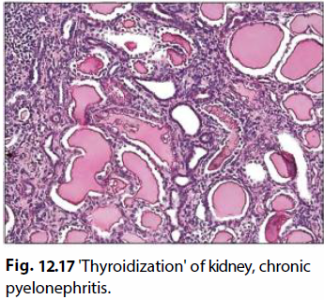
CHRONIC PYELONEPHRITIS
A. Interstitial fibrosis and atrophy of tubules due to multiple bouts of acute pyelonephritis.
B. Due to vesicoureteral reflux (children) or obstruction (e.g., BPH or cervical carcinoma)
C. Leads to cortical scarring with blunted calyces; scarring at upper and lower poles is characteristic of vesicoureteral reflux.
D. Atrophic tubules containing eosinophilic proteinaceous material resemble thyroid follicles ('thyroidization' of the kidney); waxy casts may be seen in urine.

Slide 35
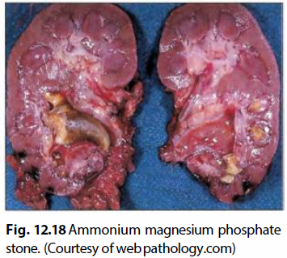
NEPHROLITHIASIS
A. Precipitation of a urinary solute as a stone
B. Risk factors include high concentration of solute in the urinary filtrate and low urine volume.
C. Presents as colicky pain with hematuria and unilateral flank tenderness
1. Stone is usually passed within hours; if not, surgical intervention may be required.

Slide 36
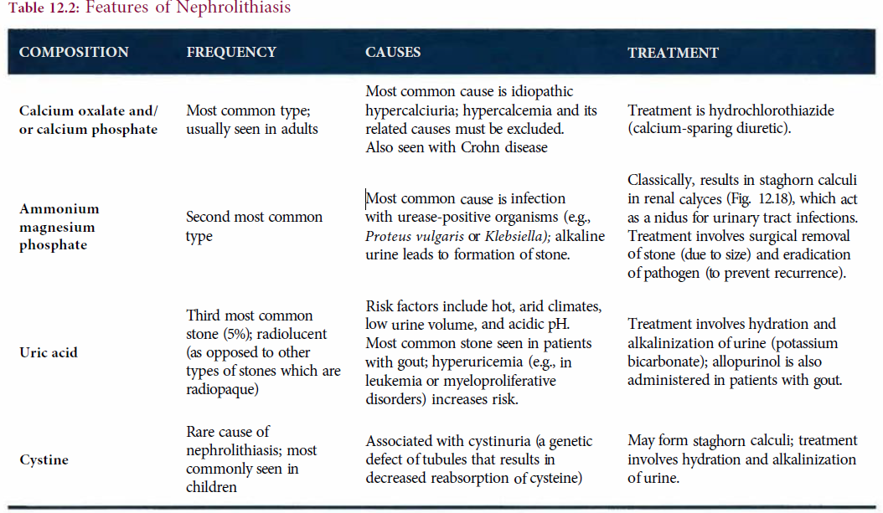

Slide 37
CHRONIC RENAL FAILURE
A. End-stage kidney failure
1. May result from glomerular, tubular, inflammatory, or vascular insults
2. Most common causes are diabetes mellitus, hypertension, and glomerular disease.
B. Clinical features
1. Uremia - Increased nitrogenous waste products in blood (azotemia) result in nausea, anorexia, pericarditis, platelet dysfunction, encephalopathy with asterixis, and deposition of urea crystals in skin.
2. Salt and water retention with resultant hypertension
3. Hyperkalemia with metabolic acidosis
4. Anemia due to decreased erythropoietin production by renal peritubular interstitial cells

Slide 38
5. Hypocalcemia due to decreased 1-alpha-hydroxylation of vitamin D by proximal renal tubule cells and hyperphosphatemia
6. Renal osteodystrophy due to secondary hyperparathyroidism, osteomalacia, and osteoporosis
C. Treatment involves dialysis or renal transplant.
1. Cysts often develop within shrunken end-stage kidneys during dialysis, increasing risk for renal cell carcinoma.

Slide 39
RENAL NEOPLASIA
ANGIOMYOLIPOMA
A. Hamartoma comprised of blood vessels, smooth muscle, and adipose tissue
B. Increased frequency in tuberous sclerosis

Slide 40
RENAL CELL CARCINOMA
A. Malignant epithelial tumor arising from kidney tubules
B. Presents with classic triad of hematuria, palpable mass, and flank pain
1. All three symptoms rarely occur together; hematuria is the most common
symptom.
2. Fever, weight loss, or paraneoplastic syndrome (e.g., EPO, renin, PTHrP, or ACTH) may also be present.
3. Rarely may present with left-sided varicocele
i. Involvement of the left renal vein by carcinoma blocks drainage of the left
spermatic vein leading to varicocele.
ii. Right spermatic vein drains directly into the IVC; hence, right-sided varicocele is not seen.

Slide 41
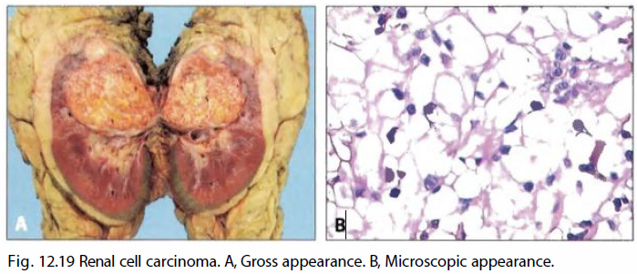
C. Gross exam reveals a yellow mass ; microscopically, the most common variant exhibits clear cytoplasm (clear cell type).
D. Pathogenesis involves loss of VHL (3p) tumor suppressor gene, which leads to increased IGF-1 (promotes growth) and increased HIF transcription factor(increases VEGF and PDGF).
E. Tumors may be hereditary or sporadic.
1. Sporadic tumors classically arise in adult males (average age is 60 years) as a single tumor in the upper pole of the kidney; major risk factor for sporadic tumors is cigarette smoke.

Slide 42
2. Hereditary tumors arise in younger adults and are often bilateral.
i. Von Hippel-Lindau disease is an autosomal dominant disorder associated with inactivation of the VHL gene leading to increased risk for hemangioblastoma of the cerebellum and renal cell carcinoma.
F. Staging
1. T-based on size and involvement of the renal vein (occurs commonly and increases risk of hematogenous spread to the lungs and bone)
2. N- spread to retroperitoneal lymph nodes

Slide 43
WILMS TUMOR
A. Malignant kidney tumor comprised of blastema (immature kidney mesenchyme),primitive glomeruli and tubules, and stromal cells.
1. Most common malignant renal tumor in children; average age is 3 years.
B. Presents as a large, unilateral flank mass with hematuria and hypertension (due to renin secretion)
C. Most cases (90%) are sporadic; syndromic tumors may be seen with
1. WAGR syndrome - Wilms tumor, Aniridia, Genital abnormalities, and mental and motor Retardation; associated with deletion of WT1 tumor suppressor gene (located at 11p13)

Slide 44
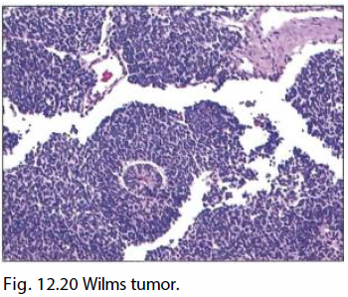
2. Denys-Drash syndrome - Wilms tumor, progressive renal (glomerular) disease,and male pseudohermaphroditism; associated with mutations of WT1
3. Beckwith-Wiedemann syndrome - Wilms tumor, neonatal hypoglycemia, muscular hemihypertrophy, and organomegaly (including tongue); associated with mutations in WT2 gene cluster (imprinted genes at 11p15.5), particularly IGF-2

Slide 45
UROTHELIAL (TRANSITIONAL CELL) CARCINOMA
A. Malignant tumor arising from the urothelial lining of the renal pelvis, ureter, bladder, or urethra
1. Most common type of lower urinary tract cancer; usually arises in the bladder
B. Major risk factor is cigarette smoke; additional risk factors are naphthylamine, azo dyes, and long-term cyclophosphamide or phenacetin use.
C. Generally seen in older adults; classically presents with painless hematuria

Slide 46
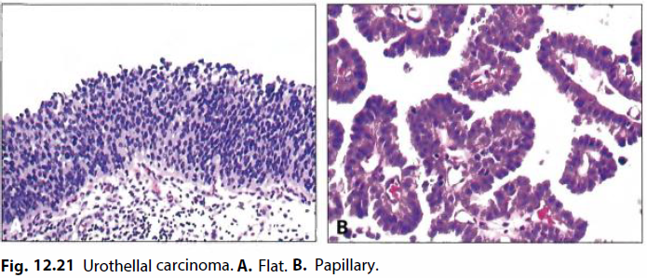
D. Arises via two distinct pathways.
1. Flat - develops as a high-grade flat tumor and then invades; associated with early p53 mutations
2. Papillary - develops as a low-grade papillary tumor that progresses to a high grade papillary tumor and then invades; not associated with early p53 mutations
E. Tumors are often multifocal and recur ("field defect").

Slide 47
SQUAMOUS CELL CARCINOMA
A. Malignant proliferation of squamous cells, usually involving the bladder
B. Arises in a background of squamous metaplasia (normal bladder surface is not lined by squamous epithelium)
C. Risk factors include chronic cystitis (older woman), Schistosoma haematobium infection (Egyptian male), and long-standing nephrolithiasis.

Slide 48
ADENOCARCINOMA
A. Malignant proliferation of glands, usually involving bladder
B. Arises from a urachal remnant (tumor develops at the dome of the bladder), cystitis glandularis, or exstrophy (congenital failure to form the caudal portion of the anterior abdominal and bladder walls)

Slide 49
MALE GENITAL PATHOLOGY
Penis
HYPOSPADIAS
A. Opening of urethra on inferior surface of penis
B. Due to failure of the urethral folds to close
EPISPADIAS
A. Opening of urethra on superior surface of penis
B. Due to abnormal positioning of the genital tubercle
C. Associated with bladder exstrophy

Slide 50
CONDYLOMA ACUMINATUM
A. Benign warty growth on genital skin
B. Due to HPV type 6 or 11; characterized by koilocytic change
LYMPHOGRANULOMA VENEREUM
A. Necrotizing granulomatous inflammation of the inguinal lymphatics and lymph nodes
B. Sexually transmitted disease caused by Chlamydia trachomatis (serotypes L1-L3)
C. Eventually heals with fibrosis; perianal involvement may result in rectal stricture.

Slide 51
SQUAMOUS CELL CARCINOMA
A. Malignant proliferation of squamous cells of penile skin
B. Risk factors
1. High risk HPV (2/3 of cases)
2. Lack of circumcision - Foreskin acts as a nidus for inflammation and irritation if not properly maintained.
C. Precursor in situ lesions
1. Bowen disease - in situ carcinoma of the penile shaft or scrotum that presents as leukoplakia
2. Erythroplasia of Queyrat - in situ carcinoma on the glans that presents as erythroplakia
3. Bowenoid papulosis - in situ carcinoma that presents as multiple reddish papules
i. Seen in younger patients (40s) relative to Bowen disease and erythroplasia of Queyrat
ii. Does not progress to invasive carcinoma

Slide 52
TESTICLE
CRYPTORCHIDISM
A. Failure of testicle to descend into the scrotal sac
1. Testicles normally develop in the abdomen and then "descend" into the scrotal sac as the fetus grows.
B. Most common congenital male reproductive abnormality; seen in 1% of male infants
C. Most cases resolve spontaneously; otherwise, orchiopexy is performed before 2 years of age.
D. Complications include testicular atrophy with infertility and increased risk for seminoma.

Slide 53
ORCHITIS
A. Inflammation of the testicle
B. Causes
1. Chlamydia trachomatis (serotypes D-K) or Neisseria gonorrhoeae - Seen in young
adults. Increased risk of sterility, but libido is not affected because Leydig cells are
spared.
2. Escherichia coli and Pseudomonas - Seen in older adults; urinary tract infection
pathogens spread into the reproductive tract.
3. Mumps virus (teenage males) - increased risk for infertility; testicular
inflammation is usually not seen in children < 10 years old.
4. Autoimmune orchitis - characterized by granulomas involving the
seminiferous tubules

Slide 54
TESTICULAR TORSION
A. Twisting of the spermatic cord; thin-walled veins become obstructed leading to congestion and hemorrhagic infarction.
B. Usually due to congenital failure of testes to attach to the inner lining of the scrotum (via the processus vaginalis)
C. Presents in adolescents with sudden testicular pain and absent cremasteric reflex

Slide 55
VARICOCELE
A. Dilation of the spermatic vein due to impaired drainage
B. Presents as scrotal swelling with a "bag of worms" appearance
C. Usually left sided; left testicular vein drains into the left renal vein, while the right testicular vein drains directly into the IVC.
1. Associated with left-sided renal cell carcinoma; RCC often invades the renal vein.
D. Seen in a large percentage of infertile males

Slide 56
HYDROCELE
A. Fluid collection within the tunica vaginalis
1. Tunica vaginalis is a serous membrane that covers the testicle as well as the internal surface of the scrotum.
B. Associated with incomplete closure of the processus vaginalis leading to communication with the peritoneal cavity (infants) or blockage of lymphatic drainage (adults)
C. Presents as scrotal swelling that can be transilluminated.

Slide 57
TESTICULAR TUMORS
A. Arise from germ cells or sex cord-stroma
B. Present as a firm, painless testicular mass that cannot be transilluminated
C. Usually not biopsied due to risk of seeding the scrotum; removed via radical orchiectomy
1. Most testicular tumors are malignant germ cell tumors.

Slide 58
GERM CELL TUMORS
A. Most common type of testicular tumor (> 95% of cases)
B. Usually occur between 15-40 years of age
C. Risk factors include cryptorchidism and Klinefelter syndrome.
D. Divided into seminoma and nonseminoma
1. Seminomas (55% of cases) are highly responsive to radiotherapy, metastasize late, and have an excellent prognosis.
2. Nonseminomas (45% of cases) show variable response to treatment and often metastasize early.

Slide 59
E. Seminoma is a malignant tumor comprised of large cells with clear cytoplasm and central nuclei (resemble spermatogonia); forms a homogeneous mass with no hemorrhage or necrosis.
1. Most common testicular tumor; resembles ovarian dysgerminoma
2. Rare cases may produce β- hCG.
3. Good prognosis; responds to radiotherapy

Slide 60
F. Embryonal carcinoma is a malignant tumor comprised of immature, primitive cells
that may produce glands; forms a hemorrhagic mass with necrosis.
1. Aggressive with early hematogenous spread
2. Chemotherapy may result in differentiation into another type of germ cell tumor (e.g., teratoma).
3. Increased AFP or β-hCG may bep resent.
G. Yolk sac (endodermal sinus) tumor is a malignant tumor that resembles yolk sac elements.
1. Most common testicular tumor in children
2. Schiller-Duval bodies (glomerulus-like structures) are seen on histology.
3. AFP is characteristically elevated.

Slide 61
H. Choriocarcinoma is a malignant tumor of syncytiotrophoblasts and cytotrophoblasts (placenta-like tissue, but villi are absent).
1. Spreads early via blood
2. β-hCG is characteristically elevated; may lead to hyperthyroidism or gynecomastia (α-subunit of hCG is similar to that of FSH, LH, and TSH)
I. Teratoma is a tumor composed of mature fetal tissue derived from two or three embryonic layers.
1. Malignant in males (as opposed to females)
2. AFP or β-hCG may be increased.
J. Mixed germ cell tumors
1. Germ cell tumors are usually mixed.
2. Prognosis is based on the worst component.

Slide 62
SEX CORD-STROMAL TUMORS
A. Tumors that resemble sex cord-stromal tissues of the testicle; usually benign.
B. Leydig cell tumor usually produces androgen, causing precocious puberty in children or gynecomastia in adults.
1. Characteristic Reinke crystals may be seen on histology.
C. Sertoli cell tumor is comprised of tubules and is usually clinically silent.
LYMPHOMA
A. Most common cause of a testicular mass in males > 60 years old; often bilateral
B. Usually of diffuse large B-cell type

Slide 63
PROSTATE
A. Small, round organ that lies at the base of the bladder encircling the urethra
B. Sits anterior to the rectum; posterior aspect of prostate is palpable by digital rectal exam (DRE).
C. Consists of glands and stroma (Fig. 14.9)
1. Glands are composed of an inner layer of luminal cells and an outer layer of basal cells; secrete alkaline, milky fluid that is added to sperm and seminal vesicle fluid to make semen.
2. Glands and stroma are maintained by androgens.

Slide 64
ACUTE PROSTATITIS
A. Acute inflammation of the prostate; usually due to bacteria
1. Chlamydia trachomatis and Neisseria gonorrhoeae are common causes in young adults.
2. Escherichia coli and Pseudomonas are common causes in older adults.
B. Presents as dysuria with fever and chills
C. Prostate is tender and boggy on digital rectal exam.
D. Prostatic secretions show WBCs; culture reveals bacteria.

Slide 65
CHRONIC PROSTATITIS
A. Chronic inflammation of prostate
B. Presents as dysuria with pelvic or low back pain
C. Prostatic secretions show WBCs, but cultures are negative.

Slide 66
BENIGN PROSTATIC HYPERPLASIA (BPH)
A. Hyperplasia of prostatic stroma and glands
B. Age-related change (present in most men by the age of 60 years); no increased risk for cancer
C. Related to dihydrotestosterone (DHT)
1. Testosterone is converted to DHT by 5 α - reductase in stromal cells.
2. DHT acts on the androgen receptor of stromal and epithelial cells resulting in hyperplastic nodules.
D. Occurs in the central periurethral zone of the prostate

Slide 67
E. Clinical features include
1. Problems starting and stopping urine stream
2. Impaired bladder emptying with increased risk for infection and hydronephrosis.
3. Dribbling
4. Hypertrophy of bladder wall smooth muscle; increased risk for bladder diverticula
5. Microscopic hematuria may be present.
6. Prostate-specific antigen (PSA) is often slightly elevated (usually less than 10 ng/mL) due to the increased number of glands; PSA is made by prostatic glands and liquefies semen.

Slide 68
F. Treatment
1. α1-antagonist (e.g., terazosin) to relax smooth muscle
i. Also relaxes vascular smooth muscle lowering blood pressure
ii. Selective α 1A-antagonists (e.g., tamsulosin) are used in normotensive individuals to avoid α1B effects on blood vessels.
2. 5α-reductase inhibitor
i. Blocks conversion of testosterone to DHT
ii. Takes months to produce results
iii. Also useful for male pattern baldness
iv. Side effects are gynecomastia and sexual dysfunction.

Slide 69
PROSTATE ADENOCARCINOMA
A. Malignant proliferation of prostatic glands
B. Most common cancer in men; 2nd most common cause of cancer-related death
C. Risk factors include age, race (African Americans > Caucasians > Asians), and diet high in saturated fats.
D. Prostatic carcinoma is most often clinically silent.
1. Usually arises in the peripheral, posterior region of the prostate and, hence, does not produce urinary symptoms early on.
2. Screening begins at the age of 50 years with DRE and PSA.
i. Normal serum PSA increases with age due to BPH (2.5 ng/mL for ages 40-49 years vs. 7.5 ng/mL for ages 70-79 years)
ii. PSA > 10 ng/mL is highly worrisome at any age.
iii. Decreased % free-PSA is suggestive of cancer (cancer makes bound PSA).

Slide 70
E. Prostatic biopsy is required to confirm the presence of carcinoma.
1. Shows small, invasive glands with prominent nucleoli.
2. Gleason grading system is based on architecture alone (and not nuclear atypia).
i. Multiple regions of the tumor are assessed because architecture varies from area to area.
ii. A score (1-5) is assigned for two distinct areas and then added to produce a final score (2-10).
iii. Higher score suggests worse prognosis.

Slide 71
F. Spread to lumbar spine or pelvis is common; results in osteoblastic metastases that present as low back pain and increased serum alkaline phosphatase,PSA, and prostatic acid phosphatase (PAP)
G. Prostatectomy is performed for localized disease; advanced disease is treated with hormone suppression to reduce testosterone and DHT.
1. Continuous GnRH analogs (e.g., leuprolide) shut down the anterior pituitary gonadotrophs (LH and FSH are reduced).
2. Flutamide acts as a competitive inhibitor at the androgen receptor.

Slide 72
Resources
Pathoma, fundamentals of pathology, Hussian Sattar, 2021

