Slide 1
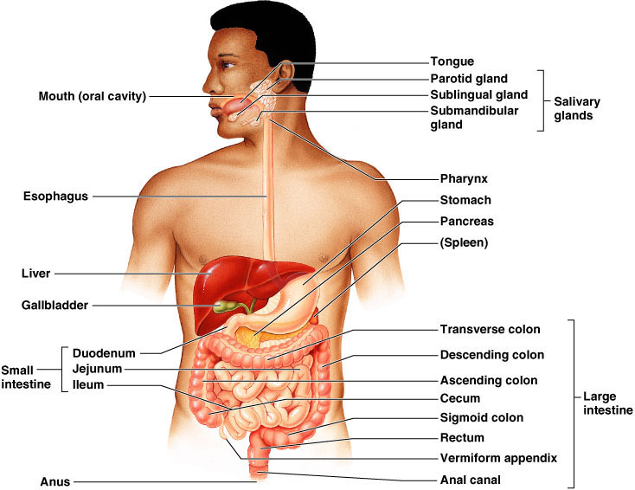
Digestive system

Slide 2
The digestive system performs six basic processes:
Ingestion:
taking foods and liquids into the mouth (eating).
Secretion:
cells with in the walls of the GI tract and accessory digestive organs secrete about total 7liters of water, acid, buffers, and enzymes into the lumen of the tract.
Mixing and propulsion.
Alternating contractions and relaxations of smooth muscle

Slide 3
Digestion:
Mechanical and chemical processes break down ingested food into small molecules.
In mechanical digestion :the teeth cut and grind food before it is swallowed, and then smooth muscles of the stomach and small intestine churn the food.
As a result, food molecules become dissolved and thoroughly mixed with digestive enzymes.
In chemical digestion: the large carbohydrate, lipid, protein, and nucleic acid molecules in
food are broken down into smaller molecules by digestive enzymes.

Slide 4
Absorption:
The entrance of ingested and secreted fluids, ions, and the products of digestion into the epithelial cells lining the lumen of the GI tract
Defecation:
Wastes, indigestible substances, bacteria, cells eliminating from the lining of the GI tract,

Slide 5
Anatomically and functionally, the digestive system
can be divided into:
  a tubular digestive tract, or (GI tract)
  accessory organs.
The GI tract
  It include
    oral cavity -stomach
    pharynx -small intestine,
    esophagus -large intestine.
Accessory digestive organs
  it include
    the teeth -liver
    tongue - gallbladder
    salivary glands - pancreas.

Slide 6
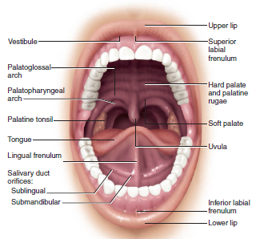
Mouth
Also known as the oral or buccal cavity .
It is formed by the cheeks, lips, hard and soft palates, tongue.
The oral cavity is divided into
  the vestibule
  the mouth proper.
The vestibule
  is the area b/n the cheeks and lips externally and the gums and teeth internally.
The mouth proper
  is the space bounded by the teeth.
  The mouth is lined by nonkeratinized stratified squamous epithelium.

Slide 7
Palate:-
  the roof of the oral cavity and consists of the bony
Soft palate
  the mobile fibromuscular part (posterior 1/3 rd)
  attached to the posterior edge of the hard palate.
Hard palate
  anterior 2/3 rd and formed by the palatine process of maxilla and the horizontal plate of palatine bone.
The uvula
  is a conical process (cone-shaped projection) suspended from the middle inferior border of the soft palate.
  The soft palate and uvula are drawn upward against the wall of the pharynx, thereby closing the nasophaynx and preventing food and fluid from entering the nasal cavity (regurgitation).

Slide 8
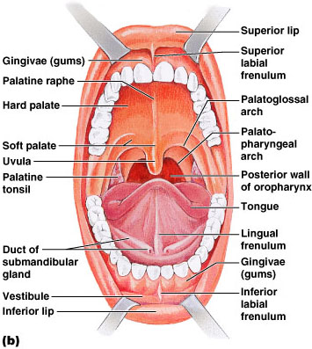

Slide 9
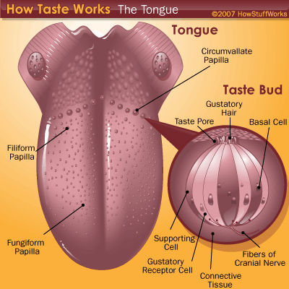
  Tongue
The tongue is a mobile muscular organ that can have a variety of shapes and positions.
The tongue is partly in the oral cavity proper and partly in the oropharynx
The tongue mainly composed of muscles and covered by mucous membrane
The tongue has a root, a body, an apex
  The function of the Tongue
mastication (chewing)
Taste
deglutition (swallowing)
articulation (speech), and oral cleansing.

Slide 10
Types of Papillae
The mucous membrane on the anterior part of the tongue is rough because of the presence of numerous lingual papillae
Vallate papillae are large and flat topped; they lie directly anterior to the terminal groove and are surrounded by deep moat-like trenches, the walls of which are studded by taste buds sometimes is called Circumvallate
It is V-shaped row in back of tongue
Foliate papillae are small lateral folds of lingual mucosa; they are poorly developed in humans.
The posterior part of the tongue divided into two half from right & left lingual frenulum

Slide 11
Types of Papillae……
Filiform papillae are long, numerous, thread-like and scaly; they contain afferent nerve endings that are sensitive to touch.
Fungiform papillae are mushroom-shaped and appear as pink or red spots
they are scattered among the Filiform papillae but are most numerous at the apex and sides (margins) of the tongue
NB : The Vallate, foliate, and most of the Fungiform papillae contain taste receptors in the taste buds

Slide 13
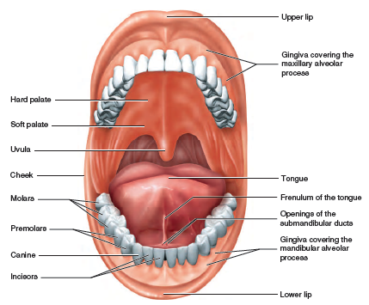
Teeth (dentes)
The teeth, or dentes are accessory digestive organs located in sockets of the alveolar processes of the mandible and maxillae.
The alveolar processes are covered by the gingivae or gums, which extend slightly into each socket.
The sockets are lined by the periodontal ligament or membrane which consists of dense fibrous connective tissue that anchors the teeth to the socket walls.

Slide 14
A typical tooth has three major external regions:
the crown, root, and neck.
The crown is the visible portion above the level of the gums that always wash in teeth brush
The root consists of one to three projections embedded in the socket.
The neck is the junction line of the crown and root, near the gum line.
Internally the teeth has three major internal regions:
dentin – major portion
Enamel-the dentin of the crown is covered by enamel that consists primarily of _{Ca3} (PHO4)₂
white in color and the hardest

Slide 15
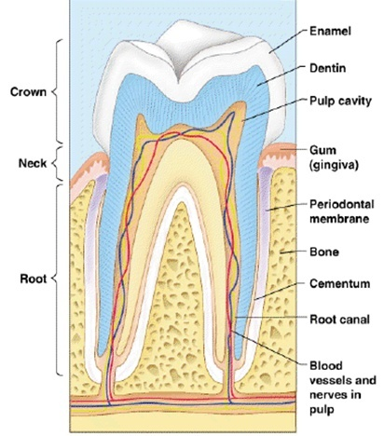
Pulp cavity- a space in the crown filed with pulp, a connective tissue containing blood vessels nerves, and lymphatic vessels.

Slide 16
Cont..
Humans as other mammals have heterodont dentition,
i.e. the teeth vary structurally and are adapted to handle food in different ways.
An adult human has four types of teeth:
  Incisors, Canines ,Premolars (bicuspids) & Molars (six pairs)
  Humans have two dentitions
  Formula for deciduous dentition of humans
  I-2/2, C -1/1 , DM -2/2 = 10 x 2 = 20 (DM = deciduous molar)
  Permanent dentition
  I- 2/2, C- 1/1, P- 2/2, m-3/3 = 16x2 = 32

Slide 17
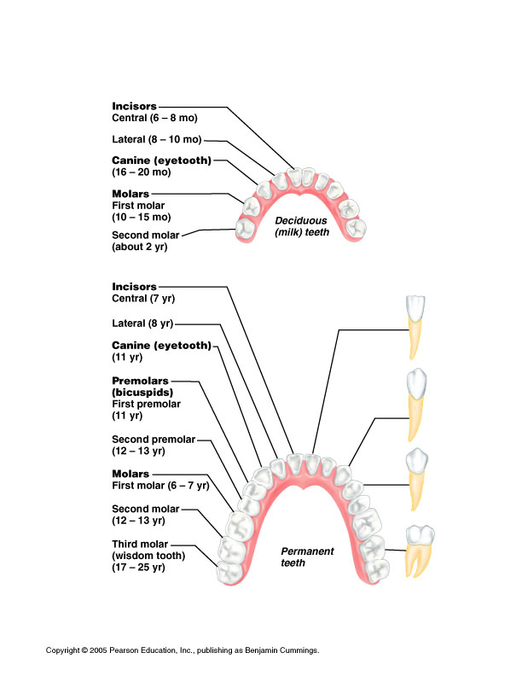

Slide 18
  Salivary Glands
The salivary glands include the parotid, submandibular, and sublingual glands they secret saliva
Saliva, the clear, tasteless, odorless viscid fluid secreted by these glands and the mucous glands of the oral cavity:
Function of salivary glands
Keeps the mucous membrane of the mouth moist.
Lubricates the food during mastication.
Begins digestion of starches.
Serves as an intrinsic mouthwash (cleansing the teeth)
Plays a significant role in the prevention of tooth decay and in the ability to taste

Slide 19
The parotid gland
The parotid glands ( par- near; to- ear)
  is the largest salivary glands
  is located anterior and inferior to the auricle(ear). between the skin and the masseter muscle.
  The parotid duct, which is about 4cm long drains into the oral cavity opposite the 2nd upper molar.
The parotid gland secrets the salivary amylase to digest starch
With in the saliva only 0.5 % is amylase 99.5% is water

Slide 20
The submandibular glands
  are U- shaped salivary glands lie along the body of the mandible on its inner side.
  Their duct opens into the floor of the mouth on both lateral sides of the lingual frenulum.
  It secrets salivary amylase like parotid glands
The sublingual glands
  are the smallest and the most deeply located (in the floor of the mouth)
  both of them unite to form a horseshoe shaped glandular mass around the lingual frenulum.
It secrets mucous and little salivary amylase to lubricate food to assist swallowing

Slide 21
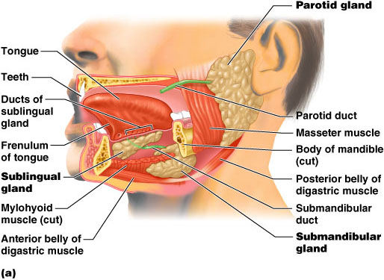

Slide 22
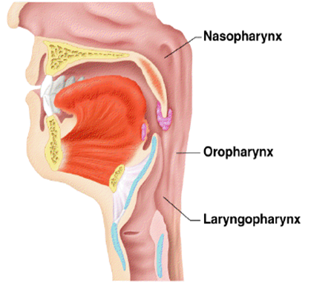
The pharynx - Serve as a passageway for air and food.
Food is propelled to the esophagus by two muscle layer
  Longitudinal inner layer
  Circular outer layer
Food movement is by alternating contractions of the muscle layers (peristalsis)
Nasopharynx- not part of the digestive system
Oropharynx- posterior to oral cavity
Laryngopharynx- below the oropharynx and connected to the esophagus

Slide 23
  Histological Layers of the GIT
  are similar throughout the alimentary canal, Which starts the lower part of the esophagus
  but display characteristic regional specialization
A. Mucosa- inner most layer
  1. Epithelium
  lines the lumen of the alimentary canal.
  2. Lamina propria
  consists of loose connective tissue housing glands and lymphoid accumulations.
  3. Muscularis mucosae
    is composed of one to three layers of smooth muscle.
    is responsible for the motility of the mucosa

Slide 24
B. Submucosa
  consists of dense irregular collagenous or fibroelastic connective tissue.
  contains glands only in the esophagus and duodenum houses of blood vessels and nerve plexus, which is primarily responsible for its innervation some times also called the brain of the gut(nerve plexus)
C. Muscularis
  is composed of two layers of smooth muscle (three layers in the stomach) in the esophagus,
  is responsible for gut motility, which is controlled by, innervation, stretching of the muscle, and several paracrine hormones.

Slide 25
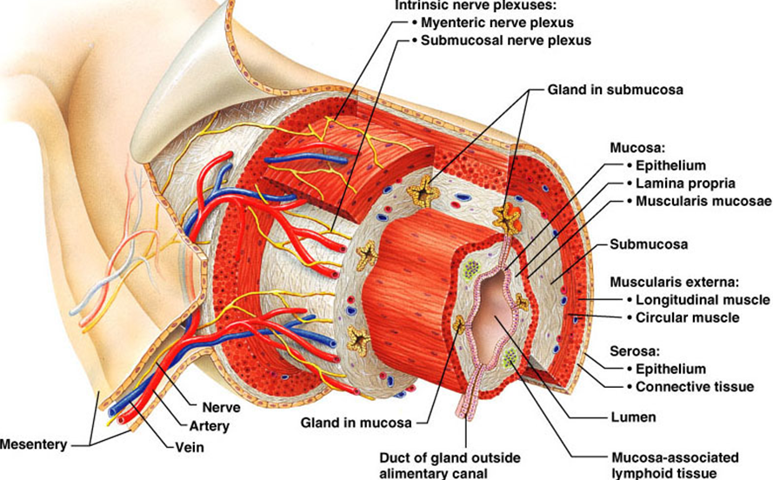
D. Serosa- the outer most layer
  1. Serosa consists of a mesothelial lining (peritoneum) over a layer of loose connective tissue.
  2. Adventitia consists only of loose connective tissue.

Slide 26
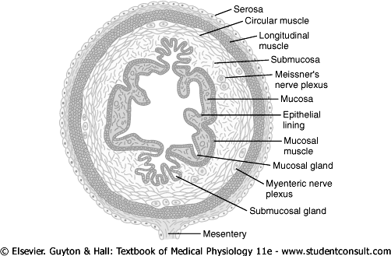

Slide 27
Esophagus
  This is a collapsible muscular tube (25cm) that connects the pharynx to the stomach, and located posterior to the trachea.
  It passes through the diaphragm is an opening called esophageal hiatus.
  The esophagus is lined with a nonkeratinized stratified squamous epithelium.
  it has two portion
    thoracic(major)
    small terminal branch inferior to the diaphragm(abdominal part)

Slide 28
  Cont..
  The upper third of the esophagus contains skeletal muscle
  the middle third contains both skeletal and smooth muscle
  The terminal portion contains only smooth muscle.
  The lumen of the terminal portion of the esophagus is slightly narrowed due to the presence of the lower esophageal (gastro esophageal) sphincter
  This prevents regurgitation of stomach contents into the esophagus.

Slide 29
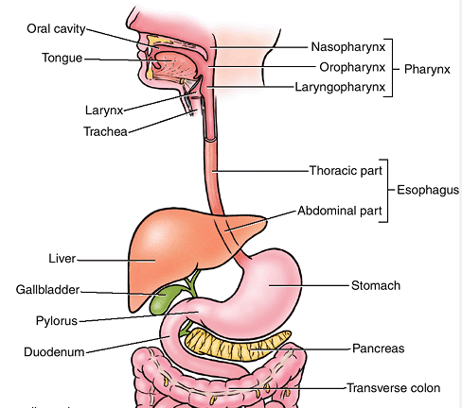

Slide 30
Stomach
It acts as a food blender and reservoir; its chief function is chemical enzymatic digestion.
The gastric juice gradually converts a mass of food into a semiliquid mixture, chyme (G. juice),
  it is a J-shaped pouch and is the most distensible part of the GIT.
  The functions of the stomach are:
    to store food as it is mechanically churned with gastric secretions
    to initiate(start) the digestion of proteins
    to carry out limited absorption(aspirin , alcohol , water)
    Secretion of gastric juice

Slide 31
    to move food into the small intestine as a chyme (pasty material)
The stomach is divided into four regions
  Cardia: - the narrow upper region immediately below the gastroesophageal sphincter
  Fundus: - the dome shaped portion to the left and in direct contact with diaphragm
  Body: - the lager central portion
  Pylorus:- the funnel shaped terminal portion.
    The pylorus communicates with the duodenum through a pyloric sphincter or b/n stomach and duodenum
When the stomach is empty, the mucous lies in large folds forms -rugae

Slide 32
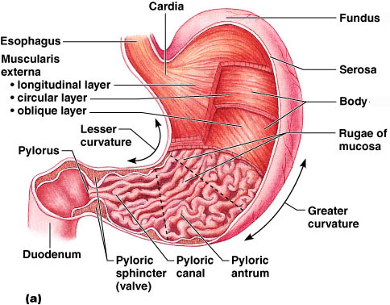

Slide 33
The gastric glands contain three types of exocrine
gland cells
Mucous neck cells – produce sticky alkaline mucous
Chief cell – produce protein digesting enzymes (pepsinogen)
Parietal cells – produce hydrochloric acid (HCl)
Endocrine cells – produce gastrin
The secretions of the mucous, chief, and parietal cells are collectively is called gastric juice
The G cells, a fourth type of cell in the gastric glands, secrete the hormone gastrin
into the bloodstream.
NB: Only alcohol , some water , ion, aspirin are absorbed in stomach

Slide 34
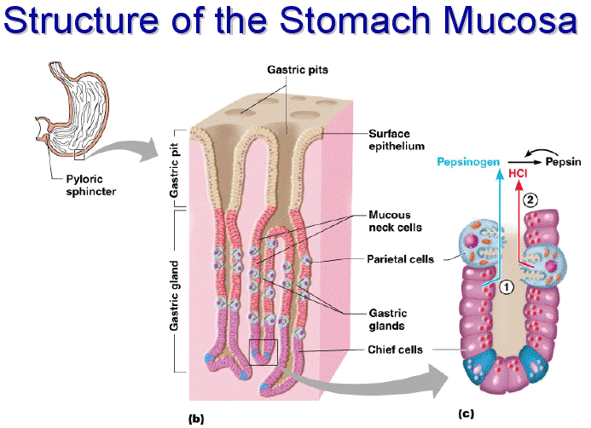

Slide 35
The peritoneum
The peritoneum) is the largest serous membrane of the body; it consists of a layer of simple squamous epithelium (mesothelium) with an underlying supporting layer of areolar connective tissue.
The peritoneum is divided into the parietal peritoneum, which lines the wall of the abdominopeivic cavity, and the visceral peritoneum
peritoneal cavity - the space with in the peritoneum
Retroperitoneal –behind the peritoneum(kidney , ascending & descending colon)
There are five major peritoneal folds: the greater omentum, falciform ligament, lesser omentum, mesentery, and mesocolon.

Slide 36
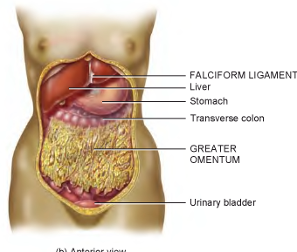

Slide 37
Small intestine
It is the portion of the GIT b/n the pyloric sphincter of the stomach and the ileocecal valve opening into the large intestine.
  is the site where digestion is completed and nutrients are absorbed.
  It is supported, except for the first portion, by the mesentery.
  Enclosed within the mesentery are blood vessels, nerves and lymphatic vessels that supply the intestinal wall.
  About 90% absorption is takes place

Slide 38
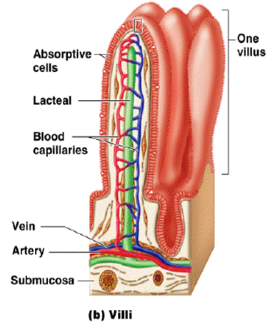
Structural modifications of the small intestine wall increase surface area by:
  Plicae circulares: deep circular folds of the mucosa and submucosa, further increase surface area
  Villi – fingerlike extensions
  of the mucosa
  Microvilli – tiny projections of absorptive mucosal cells’ plasma membranes

Slide 39
The functions the small intestine are
  the reception of the secretions from the liver and pancreas,
  mechanical breakdown of chyme,
  absorption of nutrients and
  transportation of the remaining undigested material to the large intestine.
The small intestine is divided into three regions
These are
  the duodenum
  jejunum and
  ileum.

Slide 40
The duodenum
is also the widest and most fixed part
  is a relatively fixed C- shaped tube (25cm long)
  extend from the pyloric sphincter to the duodenojejunal flexure
  Its left concave surface receives bile secretions through the common bile duct from the liver and gallbladder, and pancreatic secretions through the duct of the pancreas.
  Both ducts unite to form a common entry into the duodenum called the hepatopancreatic ampulla (ampulla of Vater), which pierces the duodenal wall and drains into the duodenum from an elevation called the duodenal papilla.
Duodenal glands (Brunner’s glands)
  produce mucus, buffers

Slide 41
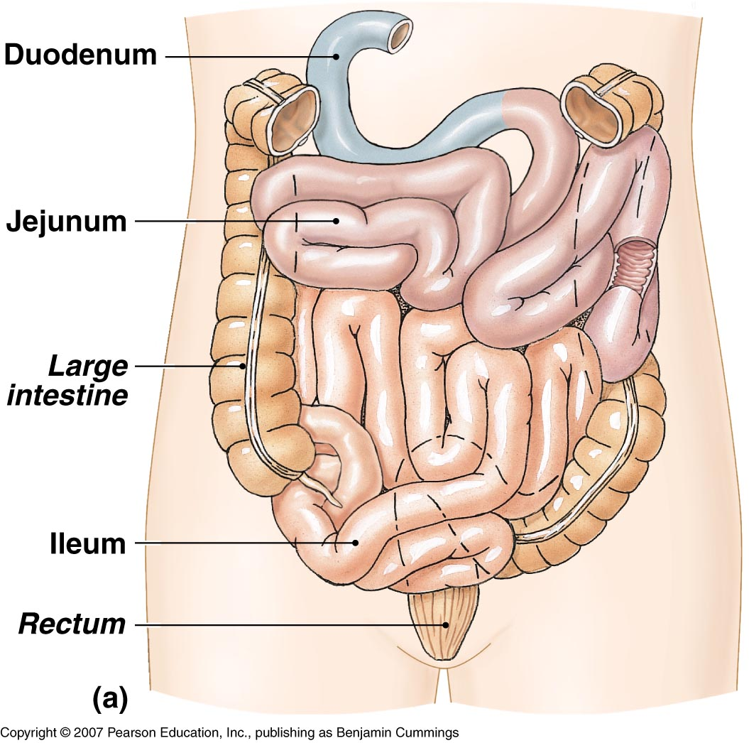

Slide 42
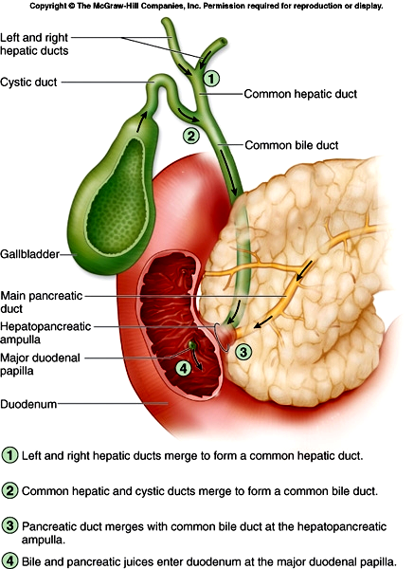

Slide 43
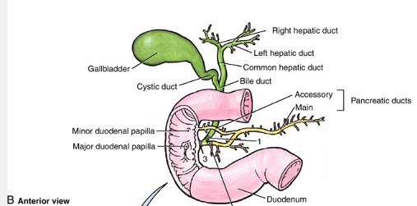

Slide 44
The jejunum
  (1m long) extends from the duodenum to the ileum.
  It has a slightly larger lumen and more internal folds than the ileum.
The ileum
  (2m long) makes up the remaining part of the small intestine.
  The terminal portion of the ileum empties into the medial side of the cecum through the ileocecal valve.
  The walls of the ileum have an abundance of lymphatic tissue aggregated into nodules called mesenteric (peyer’s) patches

Slide 45
Large Intestine
  The large intestine (about 1.5m long) begins at the terminal end of the ileum and terminates at the anus
  The mesocolon, a specialized portion of the mesentery, supports the transverse portion of the large intestine along the posterior abdominal wall.
  The large intestine has little or no digestive functions.
  It functions
    to absorb water and electrolytes from the remaining chyme and forms, stores, and expels feces from the body.

Slide 46
Large intestine- microscopic anatomy
Mucosa- smooth tube- no villi
Contains numerous globlet cells
Lined with simple columnar epithelial tissue
Epithelium changes at anal canal becomes stratified squamous epithelium
Submucosa and muscularis – contain lymphatic nodules
Muscular layer
- internal circular layer
- outer longitudinal muscle
Serosa = visceral peritonium
Appendix- contains large amounts of lymphatic tissue

Slide 47
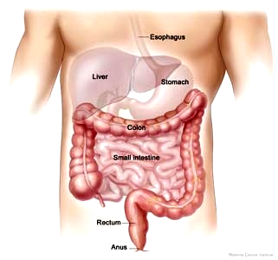

Slide 48
The large intestine is structurally divided into four
  cecum
  colon
  rectum
  anal canal.
The cecum
  is the dilated pouch that hangs inferiorly slightly below the ileocecal valve.
  The ileocecal valve is a fold of mucus membrane at the junction of the small and large intestine that prohibits the back flow of chyme.
  The appendix (9cm) is attached to the inferior medial margin of the cecum.
  It has an abundance of lymphatic tissue which serves to resist infection.

Slide 49
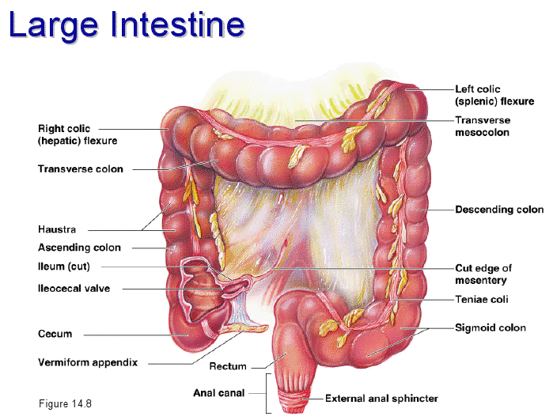

Slide 50
The colon
  consists of ascending, transverse, descending, and sigmoid portions.
  The ascending colon extends superiorly from the cecum along the right abdominal wall to the inferior surface of the liver.
  Hence the colon bends sharply to the left and transversely crosses the upper abdominal cavity as the transverse colon.
  At the left abdominal wall, it bends at a right angele the latter marks the beginning of the descending colon.
  This passes inferiorly along the left abdominal wall to the pelvic region where it bends medially from the pelvic brim to form an S- shaped curve called the sigmoid colon.

Slide 51
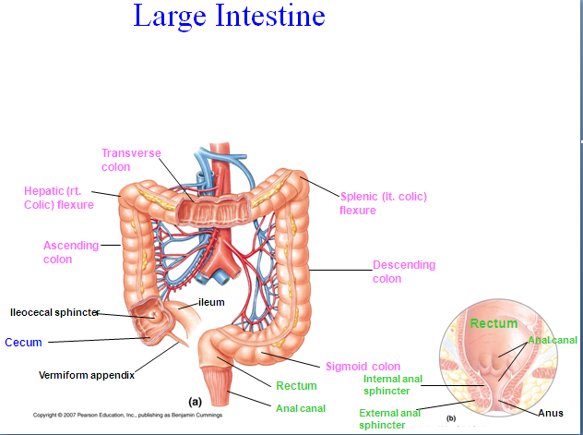

Slide 52
The terminal (20cm) portion of the GIT is the rectum of which the last 2 to 3 cm is called the anal canal.
The anus is the external opening of the anal canal.
Two sphincter muscles guard the anal opening:
  the internal anal
  external anal sphincter
Composed of smooth muscle fibers and the composed of skeletal muscle respectively.
The mucus membrane of the anal canal is a ranged into highly vascular longitudinal folds called anal columns

Slide 53
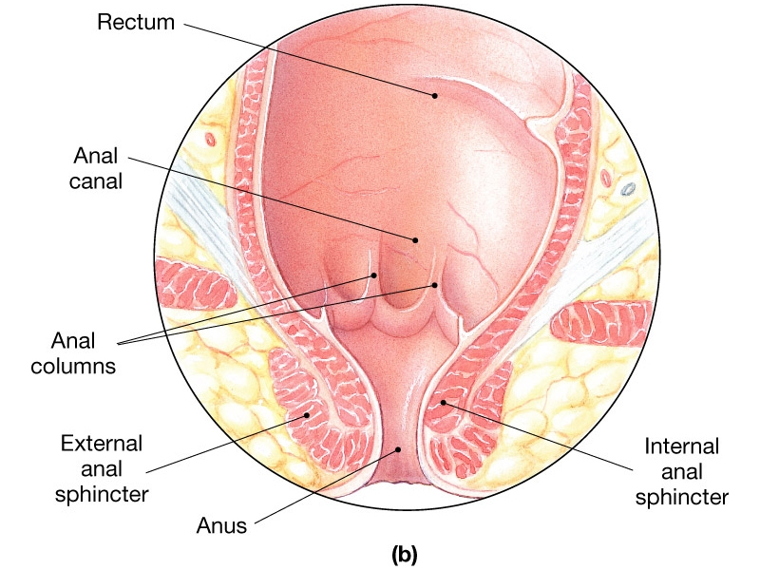

Slide 54
  Accessory digestive organs
  These organs aid in the chemical break down of food.
  These are
    the liver
    gallbladder, and
    pancreas.
  The liver and pancreas function as exocrine glands in this process because their secretions are transported to the lumen of the GIT via ducts.

Slide 55
Liver
  The liver is the largest internal organ (viscera) of the body
  weighing about 1.3 kg in an adult.
  It is reddish-brown in color because of its great vascularity.
  The liver has two major lobes and
    The right lobe
    The left lobe
    Which is separated by falciform ligament

Slide 56
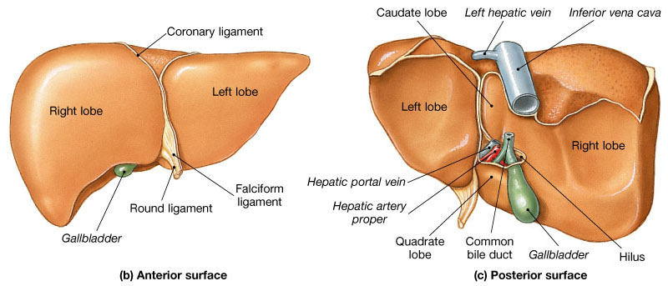

Slide 57
The porta:
the place in the liver which is the hepatic artery, portal vein, lymphatic, and nerves enter to the liver and where the hepatic ducts exit.
The liver carries out numerous functions:
  synthesis, storage, and release of glycogen;
  synthesis of blood proteins;
  phagocytosis of old red blood cells
  Detoxify toxic substances; and
  production of bile.

Slide 58
Gall bladder
  is a sack like organ attached to the inferior surface of the liver.
  It stores and concentrates bile, which drains to it from the liver by way of the, hepatic duct, bile ducts and cystic duct, respectively.
  Bile is a yellowish-green fluid containing
  bile salts bilirubin (a product resulting from a breakdown of blood), cholesterol and other compounds.
  Bile is continuously produced by the liver and drains through the hepatic and common bile ducts to the duodenum for the emulsification and absorption of fats.
  When the small intestine is empty of food, the sphincter of ampulla constricts and bile is forced up the cystic duct to the gallbladder for storage.

Slide 59
Pancreas
  The pancreas (12.5cm long and 2.5cm thick)
  is a soft, lobulated, glandular organ that has both exocrine and endocrine function.
  The endocrine function is performed by clusters of cells called the pancreatic islets (islets of langerhans) that secrete the hormones insulin and glucagons into the blood.
  The pancreas, as an exocrine gland, also secretes pancreatic juice through the pancreatic duct into the duodenum.
  It is positioned along the posterior abdominal wall, adjacent to the greater curvature of the stomach.
  It has an expanded head near the duodenum, a centrally located body, and a tapering tail near the spleen.

Slide 60
