Slide 1
Outline
Common term GIT
Common ethological agents
Bacteria
Virus
Parasite
Detail on each microbes that cause GIT

Slide 2
Common microbes causing Gastrointestinal infections (GIT)

Slide 3
Infectious Diseases of GIT
GIT-long tube with many expanded areas
Designed:
Digestion of food
Absorption of nutrients, and
Elimination of undigested material
Transient and resident microbes present in GIT
Most of mos. ingested with food are destroyed;
Low pH (gastric pH of 1.5)- stomach and duodenum and
Inhibited by resident microbiota (microbial antagonism)

Slide 4
Terms relating to GIT infection
Colitis: Inflammation of colon (large intestine).
Diarrhea: An abnormally frequent discharge of semisolid or fluid fecal matter.
Dysentery: Frequent watery stools, accompanied by abdominal pain, fever, and dehydration.
The stool specimens contain blood or mucus.
Gastritis: Inflammation of mucosal lining of stomach
Gastroenteritis: Inflammation of mucosal linings of stomach and intestines.
Hepatitis: Inflammation of liver; viral infection /toxic agents

Slide 5
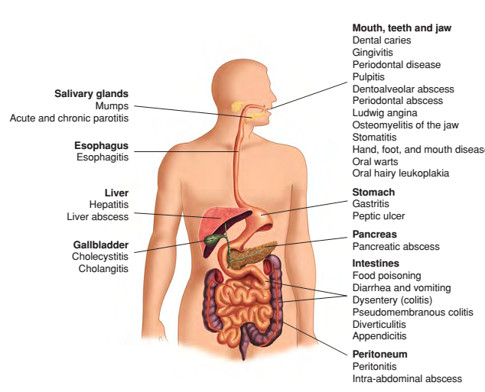
Terms relating to GIT infection
Fig. A schematic of GIT, from mouth to anus. Listed are many diseases that are associated with GI and hepatobiliary systems

Slide 6
What mean by Diarrhea?
What mean by Dysentery?
List out some bacterial ethological agents that cause Diarrhea and Dysentery

Slide 7
1. Diarrhoea caused by E. coli
VTEC (verocytotoxin-producing E. coli)/ EHEC : diarrhoea and HUS
Enteropathogenic (EPEC): cause of infantile diarrhoea
Enterotoxigenic (ETEC): travellers’ diarrhoea, non-invasive
Enteroinvasive (EIEC): causes dysentery-like illness
Enteroaggregative (EAEC): watery diarrhoea without fever.

Slide 8
What are other infection caused by E. coli?
Discuses about the microbiology of E.coli.

Slide 9
2. Salmonella
The genus contains a large number of serotypes.
Salmonella serotype Typhi: Typhoid
Salmonella serotype Paratyphi: Paratyphoid
Other salmonellae cause enteritis.
Cause Enteric fever

Slide 10
What do you think about antigenic structure of Salmonella spp?

Slide 11
Classification of Salmonella
Over 2,000 serotypes
Most of which belong to species S. enterica
Salmonella typhimurium and Salmonella enteritidis
Salmonella spp. have both H and O antigens
S. Typhi - Vi’ (for virulence), which is related to invasiveness.

Slide 12
Epidemiology
Commensals of many animals (poultry, domestic pets, birds and humans).
Transmission is via the faecal-oral route
The infective dose is relatively high ID (10⁶)
Multiplication in food is important
A chronic carrier state can occur

Slide 13
Pathogenicity
Salmonella spp. can survive acidic pH of stomach
Invade gut, resulting in an inflammatory response and subsequent diarrhoea.
Associated infections
Salmonella infections:
Non-typhoid salmonellae; Enterocolitis/gastroenteritis
Enteric fever (S. Typhi and S. Paratyphi)

Slide 14
Laboratory diagnosis
Motile and produce acid, and occasionally gas, from glucose and mannose
Enterocolitis: culture of stool samples on selective media (XLD, DCA); Phage typing
Enteric fever
Isolation of S. Typhi or S. Paratyphi
Blood cultures : 1St week of infection
Urine: 2nd week or
Faeces: 1St week onwards
Serology (Widal’s test) is now rarely performed, because of unreliable results.

Slide 15
Discuses the principle of Widal’s test?
Drawback?

Slide 16
Treatment and prevention
Enteric fever: ciprofloxacin
Enterocolitis: self-limiting; antibiotics
Typhoid immunisation; avoidance of contaminated water/food

Slide 17
3. Shigella
The main pathogenic species;
S. sonnei,
S. boydii,
S. dysenteriae and
S. flexneri.
They are distinguished by biochemical reactions and antigenic characteristics (‘O’ antigens).

Slide 18
Epidemiology
Obligate human pathogens with no animal reservoirs;
Transmission via faecal-oral route with low ID (10–200 mos.).
Direct person-to-person spread is common;
Chronic carrier state is rare.
Pathogenicity
Intestinal adherence factor: aids colonisation within the gut.
Produce an enterotoxin (cytotoxin) known as Shiga toxin
Shiga toxin: cause microangiopathy, HUS and thrombocytopenic purpura.
Notes:
ID-Infectious disease

Slide 19
Associated infections
Self-limiting diarrhoeal illness,
Dysentery (diarrhoea with blood and pus, fever, abdominal pain)
Laboratory diagnosis
Stool culture on selective media, e.g. XLD.
Treatment
Antibiotics (e.g. ciprofloxacin) reserved for severe cases (often caused by S. dysenteriae).

Slide 20
What are other cause of Dysentery?

Slide 21
Outline
Campylobacter,
Helicobacter and
Vibrio

Slide 22
1. Campylobacter
Spirally curved, GN bacilli;
Motile with single polar flagella;
Non-sporing; non-capsulated;
Microaerophilic
several species
C. jejuni
C. coli
C. fetus: causes systemic infection in persons with immune deficiency
Cause acute enterocolitis

Slide 23
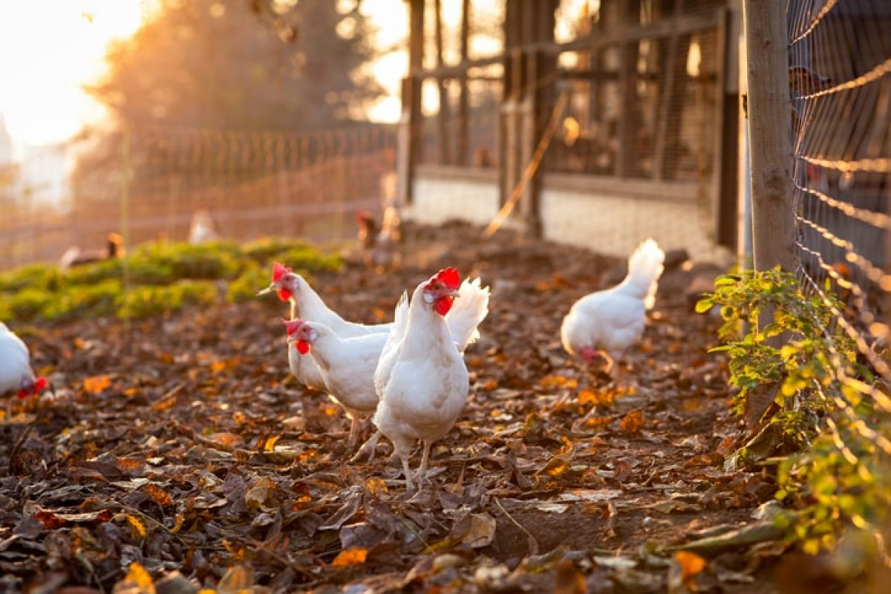
Cont.
Epidemiology
Worldwide distribution
Zoonosis (birds, poultry, cattle, sheep, pigs and pets)
Broiler chickens are a major source
Pathogenicity
Endotoxins
Cytopathic extracellular toxins and enterotoxins
They cause acute inflammation of intestinal mucosa
Abs to GM1 ganglioside are associated with GBS.
IP-3 days
Infection is self limiting
Notes:
Abs-Antibodies ; Guillain–Barré syndrome (GBS)

Slide 24
Cont.
Associated conditions
Campylobacter enteritis: mimic acute appendicitis
Reactive arthritis and Guillain Barre syndrome (GBS)
GBS: polyneuropathy with paralysis as complications
Arise during the recovery phase of illness
Laboratory diagnosis
Culture of faeces at 42 °C
Under microaerophilic conditions
Serology for serum antibodies
Treatment
Rehydration
Erythromycin or ciprofloxacin only for severe illness.

Slide 25
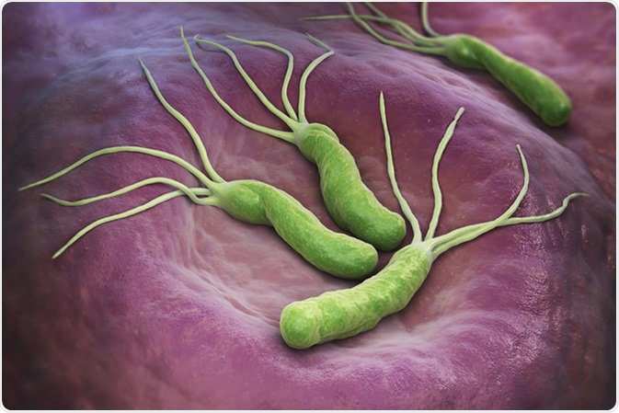
2. Helicobacter
H. pylori
Curved GN bacilli;
Motile (4-6 mono-polar sheathed flagella) moved to gastric mucus ;
non-sporing; non-capsulated;
Microaerophilic
Epidemiology
Infects human gastric epithelial cells
Humans are the main reservoir
Acquired in early childhood and becomes chronic,
Often life-long

Slide 26
Cont.
Transmission
Faecal-oral or oral–oral routes
Associated with close contact (intrafamilial) and
Poor sanitation
Pathogenicity
Urease: neutralise gastric acid through the production of ammonia from urea
Associated infections
Duodenal ulceration and
Gastric cancer
H. pylori damages antral D cells that release somatostatin

Slide 27
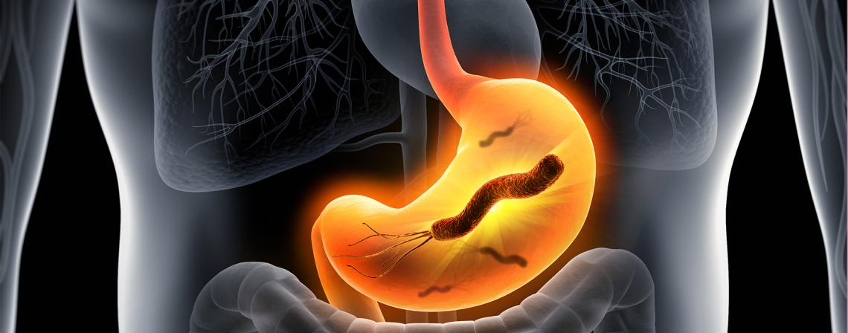
Gastritis -upper abdominal pain with nausea or heartburn
Duodenal ulcers - experience gnawing, burning, aching, mild-to-moderate pain just below the breastbone, an empty feeling, and hunger
The pain usually occurs when the stomach is empty.
Drinking milk, eating, or taking antacids generally relieves the pain, but it usually returns 2 or 3 hours later.
Gastritis+ Duodenal ulcer= peptic ulcers
Complications of peptic ulcers include penetration, perforation, bleeding, and obstruction

Slide 28
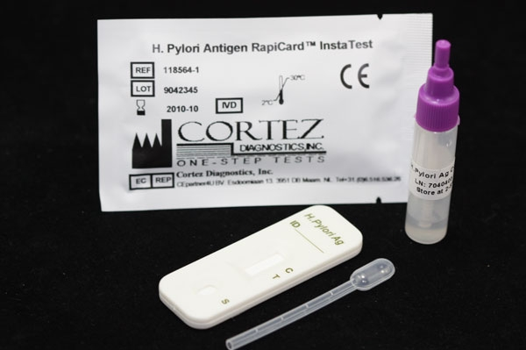
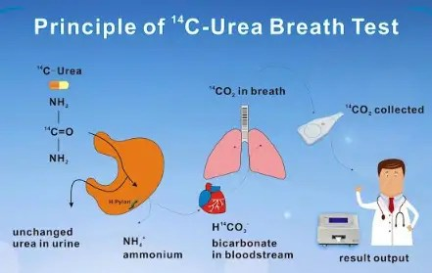
Diagnosis of H. pylori
1. Invasive tests: require gastric biopsy
Histopathological appearance;
Culture on selective media
Rapid urease test
PCR
2. Non-invasive tests
Urea breath test:
Highly sensitive and specific
¹³C- or ¹⁴C -labeled urea is given to the patient;
If H. pylori is present, urease splits the urea,
producing labeled CO2, which is detected in expired air.
Stool antigen
Serology

Slide 29
Cont.
Treatment
Combination treatment is required due to
Poor antibiotic penetration into the gastric mucosa,
Gastric acidity and
Increasing antimicrobial resistance.
Proton pump inhibitor, e.g. omeprazole, that reduces gastric acidity
Coupled with two antimicrobials
Amoxicillin, clarithromycin, metronidazole, doxycycline, levofloxacin, rifabutin or bismuth salt

Slide 30
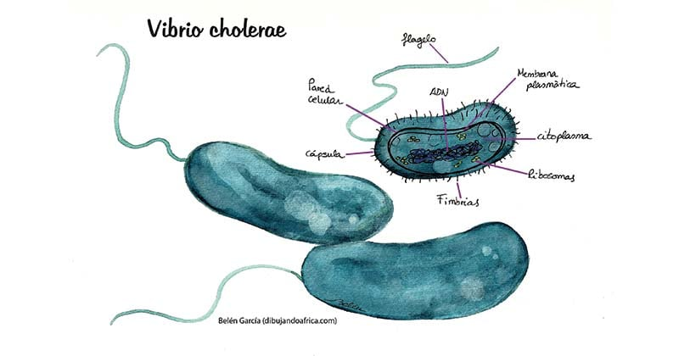
Vibrio
GN; comma-shaped bacteria;
Aerobic and facultatively anaerobic;
Grow in alkaline conditions;
Motile; ferment carbohydrates; oxidase-positive.
The main species of medical importance are
Vibrio cholerae,
V. parahaemolyticus,
V. vulnificus and
V. alginolyticus
Main human pathogens

Slide 31
1. V. cholerae
V. cholerae strains are subdivided according to O-antigens.
V. cholerae O1 is the cause of cholera.
Other V. cholerae (non-O1) strains occasionally cause diarrhoea
V. cholerae O1 has a number of biotypes
Classic’ strain, cause of cholera until the mid-1960s.
‘El Tor’ responsible for most cases of cholera over the last two decades
O139 caused epidemics in Southeast Asia (1990s)

Slide 32
Cont.
Epidemiology
Found in water contaminated with human faeces
No animal reservoirs
The cause of severe infection in developing countries,
Where potable water and sewage systems are poor;
Transmitted via consumption of contaminated food or water

Slide 33
Pathogenicity
Enterotoxin
Acts on intestinal epithelial cells,
Stimulating adenyl cyclase activity.
This results in water and sodium ions passing into the gut lumen to produce profuse,
Watery diarrhoea (rice-water appearance)
Associated infections
Acute enteritis.
The clinical features of cholera include: • Massive, painless, fluid diarrhoea (up to 20 L per day); • Vomiting; • Severe dehydration and electrolyte imbalance.

Slide 34
Laboratory diagnosis
Isolation of microorganism from faeces on selective media (TCBS)
Prevention
Safe water supplies are the mainstay of prevention.
Community education reduces spread.
Avoidance of contaminated food;
Oral vaccines suitable for travellers.
Treatment
Rehydration; ciprofloxacin shortens duration of illness.

Slide 35
2. V. parahaemolyticus
A cause of food poisoning 12–18 hrs after
The ingestion of contaminated seafood, particularly oysters.
The illness is characterised by vomiting and diarrhoea.
Treatment
By rehydration and a quinolone in severe cases.

Slide 36
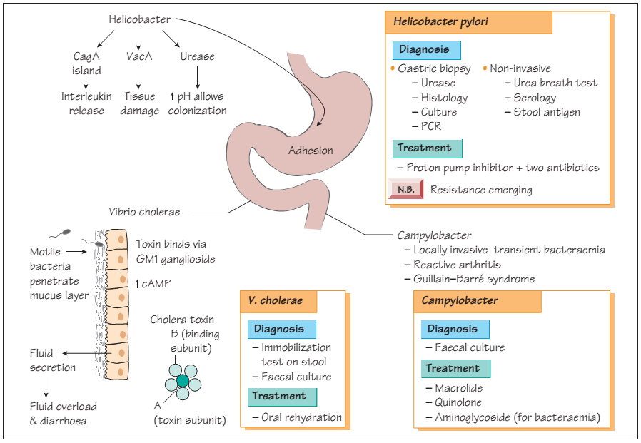

Slide 37
C. difficile
Ubiquitous in the environment
Colonises intestine of healthy neonates (50%) and adults (4%).
A major cause of HCAIs; patients taking antibiotics (cephalosporins, clindamycin)
Increased risk of C. difficile antibiotic associated diarrhoea due to;
Suppression of normal bowel flora and
Subsequent overgrowth of C. difficile
Infection may be endogenous or exogenous (spore)

Slide 38
Pathogenicity
Produces two major toxins:
Toxin A (enterotoxin): induces cytokine production with hypersecretion of fluid.
Toxin B (cytotoxin):induces depolymerisation of actin with loss of cytoskeleton.
Adhesin factor
Hyaluronidase

Slide 39
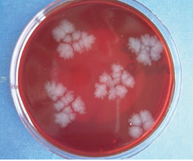
Laboratory diagnosis
Direct detection of toxin in faece: Serology
Culture on selective agar: Cycloserine cefotaxime fructose Agar
Motile; sub-terminal spores.
Forms colonies with irregular edges and
A ground glass appearance on blood agar.
Fig. Colonies of C. difficile on blood agar.
Notes:
Colonies have a typical ‘horse manure’ odour

Slide 40
Associated infections
Gastrointestinal:
Antibiotic associated diarrhoea,
Pseudomembranous colitis and Fulminant colitis.
Treatment and prevention
Oral Vancomycin or Metronidazole
Clinical awareness, judicious use of antibiotics
Infection control strategies

Slide 41
Viruses of Diarrhea

Slide 42
Viruses of Diarrhea
Acute diarrheal disease is an illness, usually of rapid evolution (within several hours), that lasts less than 3 weeks.
20 to 25% of these case is caused by virus.
The common virus that cause acute diarrheal disease are :
Rotaviruses,
Caliciviruses,
Astroviruses, and
some Adenoviruses

Slide 43
General features
Viral diarrhea was a diagnosis of exclusion
Many viral particles seen in stool by electron microscopy
Confirmation by EIA or PCR is now possible
Multiple criteria used for establishing etiologic relationship
Establish that the virus is detected in ill patients
Demonstrate significant humoral or secretory antibody responses
Reproduce the disease by experimental inoculation
Exclude other known causes of diarrhea
Based on above criteria Rotaviruses, caliciviruses, astroviruses, and adenoviruses are established

Slide 44
Cont.
Vomiting commonly follows short incubation period
Acute viral gastroenteritis to describe the syndrome associated with these agents.
1. ROTAVIRUSES
Account for 40 to 60% of cases of acute gastroenteritis
Most common cause of winter gastroenteritis in children ˂2 years of age
Virology
The rotaviruses belong to the family Reoviridae
A genome containing 11 segments of Ds RNA viruses
Shaped like a wheel (rota) because of the outer capsid.
Antigenic types are based on capsid proteins VP4 and VP7, which are targets for neutralizing antibodies.

Slide 45
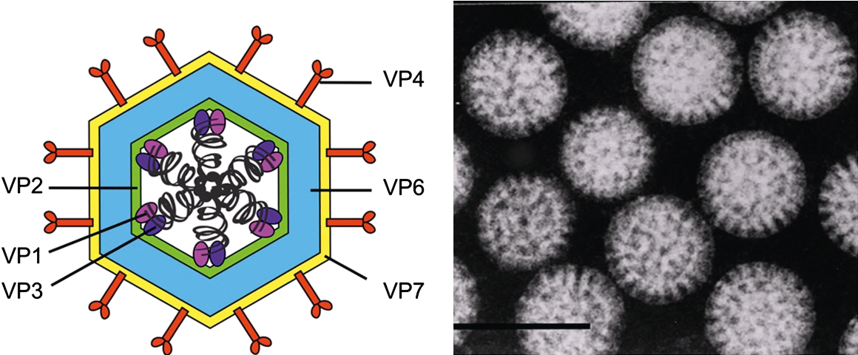
Cont.
Rotaviruses can replicate in the cytoplasm of infected cell cultures.
Animal rotaviruses produce diarrhea but interspecies spread not demonstrated in nature
Reassortment of the 11 RNA segments readily occurs
Live vaccine accounts for variation
Epidemiology
Primarily infants and children in colder months
Most older children and adults are immune

Slide 46
Cont.
Pathogenesis
Destroys villus cells of jejunum and duodenum
Absorptive surface is decreased
Enterotoxin-like effects are also present
Manifestations
Short incubation period, vomiting, and watery diarrhea can lead to dehydration
Diagnosis
Electron microscope or EIA detect virus
Treatment and prevention
Live, attenuated, or recombinant vaccines are feasible
Intussusception is vaccine safety concern
Rigorous hygienic measures

Slide 47
2. CALICIVIRUSES
The original virus was called the Norwalk agent in Norwalk, Ohio, in 1968
Virology
Small, round unenveloped RNA viruses are hardy
Two genera: “Norwalk-like” and “Sapporo-like” that cause diarrhea
Their infectivity persists after exposure to acid, ether, and heat.
Four serotypes were found but not yet grown
Epidemiology
Sharp outbreaks include older children and adults
Transmission is by fecal–oral route
Outbreaks have also been associated with consumption of contaminated water, uncooked shellfish, and other foods.

Slide 48
Cont.
Pathogenesis
Both the pathogenesis are similar to those described for rotaviruses
Unlike rotavirus Enterotoxic features are not present
Clinical picture and diagnostic tests are similar to rotavirus
These viruses can be detected by electron microscopy
No treatment or vaccine exists
Prevention requires good hygienic measures.

Slide 49
ADENOVIRUSES, ASTROVIRUSES, AND “CANDIDATE” VIRUSES
I. Some adenoviruses account for an estimated 5 to 15% of all viral gastroenteritis in young children.
Serotypes 40 and 41 are commonly found
II. Astroviruses have a shape that resembles a 5- or 6-pointed star.
These have been known since 1975.
A causes of often mild gastroenteritis outbreaks, primarily among toddlers, school children and elderly nursing home residents
III. Other agents associated with gastrointestinal diseases include coronavirus-like agents, toroviruses, and some group A coxsackieviruses

Slide 50
Outline
Hepatitis Viruses
HAV
HBV
HCV
HDV
HEV

Slide 51
Hepatitis Viruses
Hepatitis: inflammations of the liver (hepatocyte)
The causes of hepatitis viruses, bacteria, and protozoa, as well as drugs and toxins
Caused by at least five different viruses:
Hepatitis viruses A, B, C, D, E, and G
EBV and CMV, cause inflammation of liver, but hepatitis is not primary disease.
Yellow fever is associated with hepatitis but is now uncommon.

Slide 52
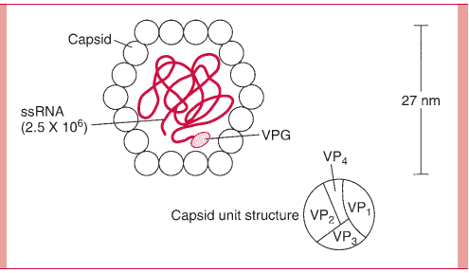
1. Hepatitis A
Virology
Unenveloped, ss RNA virus with cubic symmetry and a diameter of 27 nm.
The virus resists inactivation and stable at –20°C with low pH.
Genus of picornaviruses as a hepatovirus.
Only one serotype
Cultivated in liver cell cultures and monkey kidney cell.
The protein capsid is made up of four viral polypeptides (VP1 to VP4).
Inside the capsid is a ss RNA , which has a genomic viral protein (VPG) on the 5 end.
Fig. structure of the HAV

Slide 53
Hepatitis A disease
Termed infectious hepatitis or short-incubation hepatitis.
Spread by fecal–oral route
Outbreaks associated with contaminated food or water.
The illness is subclinical in up to one half of infected adults.
When symptomatic – show fever and jaundice.
Epidemiology
Humans is the major natural hosts
No chronic carriage

Slide 54
Diagnosis
IgM-specific antibody denotes acute infection
Treatment and prevention
There is no specific treatment
Supportive measures include adequate nutrition and rest.
Avoidance of exposure to contaminated food or water
Immune serum globulin (ISG) (Passive immunity)
Inactivated virus vaccine confers long-term protection

Slide 55
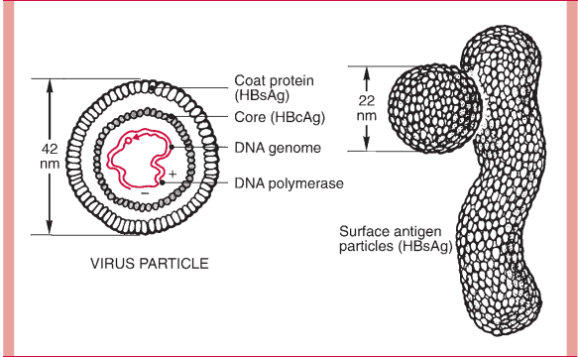
2. Hepatitis B Virus
Structure
Enveloped DNA virus, smallest known human DNA virus
The complete virion is a 42-nm.
The 27-nm core comprises;
A nucleocapsid contains DNA genome.
A core antigen (HBcAg) and early antigen (HBeAg)
The envelope contains surface antigen (HBsAg)
Fig. The 42-nm particle is “Dane particle” /HBV.
The 22-nm particles are filamentous and circular forms of HBsAg or protein coat.

Slide 56
Cont.
HBV DNA-detected in serum and indication of infectious virions.
In infected liver tissue, evidence of HBcAg, HBeAg, and hepatitis B DNA is found in nuclei of infected hepatocytes.
HBsAg is found in cytoplasm of infected hepatocytes
In great abundance in in serum during infection.

Slide 57
Cont.
HBV have unique replication using a reverse transcriptase step
Humans are the major hosts
Hepatitis B disease
Formerly known as “serum hepatitis.”
Association with needle use or blood transfusion
It is usually an asymptomatic or
Limited illness with fever and jaundice for days to weeks.
It becomes chronic in up to 10% of patients and
It may lead to cirrhosis or hepatocellular carcinoma

Slide 58
Cont.
Epidemiology
HBV infection is found worldwide
Chronic carriers are main reservoir of infection
About 10% of patients with HIV infection are chronic carriers of HBV.
Needle-stick transmission is a risk for HCWs
Vertical transmission usually occurs
Strong association between chronic infection and hepatocellular carcinoma

Slide 59
Cont.
The major mode of acquisition is contact with body fluids
Virus found in blood, saliva, and semen
Antibody to HBsAg is protective
Chronic infection leads to progressive fibrosis and cirrhosis
Manifestations
Average IP is 10 weeks; range 7–160 days
Chronic hepatitis - early infancy or childhood
Acute HB -fatigue, loss of appetite, nausea and pain, and fullness in right upper abdominal quadrant.

Slide 60
Cont.
Diagnosis
Acute episode of disease
HBsAg, HBeAg, HBcAg and HBV DNA detected
With resolution of acute hepatitis B:
HBsAg and HBeAg disappear from serum
Development of Abs (anti-HBs and anti-HBe).
Anti-HBs
Associated with elimination of infection and
protection against reinfection.

Slide 61
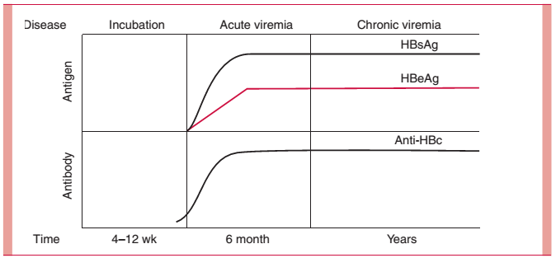
Cont.
Anti-HBc
Detected early in course of disease
Persists in serum for years.
1. Acute infection:
Appearance of anti-HBc IgM
who develop jaundice
HBsAg detected in serum.
2. Past infection:
IgG anti-HBc,
Anti-HBs, or both
3. Chronic infection:
HBsAg persistence and
no development of anti-HBs
anti-HBc is detected
Fig. Sequence of appearance of viral Ag and Ab

Slide 62
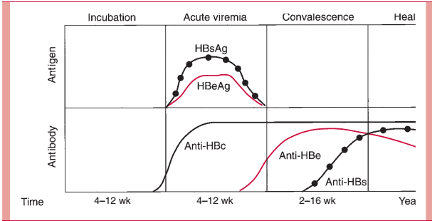
Two types of chronic hepatitis can be distinguished:
HBsAg is detected but not HBeAg; minimal liver dysfunction.
Both antigens; continued hepatic damage result in cirrhosis.
Chronic infection - persistence of HBsAg > 6 to 12 months.

Slide 63
Cont.
Treatment
No specific treatment
Interferon alpha lamivudine and adefovir are of benefit.
A high-calorie diet is desirable.
Prevention
Post-exposure treatment- HBIG temporarily reduces risk
Recombinant vaccine- for children and high-risk person
Combination of HBIG and vaccine significantly reduces vertical transmission

Slide 64
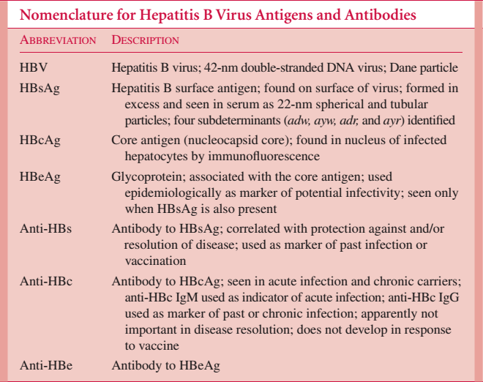

Slide 65
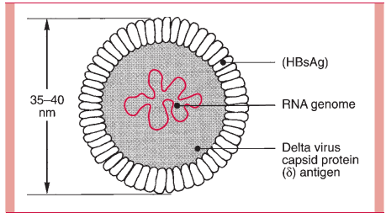
3. Delta Hepatitis (Hepatitis D)
Virology
Delta hepatitis is caused by the HDV.
This small ss RNA virus requires the presence of HBsAg for its transmission
It is thus found only in persons with acute or chronic HB
Virus uses HBsAg for assembly
Greatest risk among injection drug abusers.
Manifestations
Simultaneous hepatitis B and D infections cause more severe disease
Fig. delta hepatitis virus. Note outer layer derived from HBsAg.

Slide 66
Cont.
Diagnosis
Diagnosis is made most commonly by demonstrating IgM or IgG Abs, or both, to the delta Ag in serum.
IgM Abs appear within 3 weeks of infection and persist for several weeks.
IgG Abs persist for years.
Treatment and prevention
Major for prevention of HB also prevent hepatitis

Slide 67
4. Hepatitis C Virus
Virology
HCV is an RNA virus in the flavivirus family, with six major genotypes.
Major transmission was from blood and blood products but is now from “needle sharing”
Manifestations
Acute illness usually not apparent
Chronic infection is common
Manifestations
The incubation period of HCV averages 6–12 weeks.
Acute illness usually not apparent
Chronic infection is common
Cirrhosis and hepatocellular carcinoma are late sequelae of chronic hepatitis.
Chronic hepatitis tends to wax and wane, is often asymptomatic, and may be associated with either elevated or normal ALT values in serum.

Slide 68
Cont.
Diagnosis
Antigens of hepatitis C are not detectable in blood
Diagnostic tests attempt to demonstrate antibody
Hepatitis C RNA can be detected and quantitated by PCR and used for
diagnosis,
estimating prognosis,
predicting interferon responsiveness, and
monitoring therapy
Treatment and prevention
Combination therapy can benefit some persons with chronic infection (with interferon alpha and ribavirin)
Avoidance of injection drug use and
Screening of blood products are important preventive measures.
Immune globulin may not be protective;
No vaccine exists

Slide 69
5. Hepatitis E
Hepatitis E- spread by the fecal-oral route
27 to 34 nm in size, and unenveloped and exhibit spikes on their surface.
Usually associated with contaminated drinking water
IP- 40 days
Diagnosis
specific IgM antibody
No treatment is available
Liver transplant the only recourse in seriously ill patients
6. Hepatitis G
RNA virus members of the flavivirus family and similar to hepatitis C
Role in human disease is currently uncertain

