Slide 1
Pathology of the GI system
Dr. Abdurrhman Hamza

Slide 2
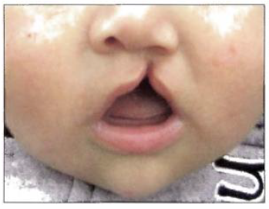
ORAL CAVITY
CLEFT LIP AND PALATE
A. Full-thickness defect of lip or palate.
B. Due to failure of facial prominences to fuse
C. Cleft lip and palate usually occur together.
Notes:
1. During early pregnancy, facial prominences (one from superior, two from the
sides, and two from inferior) grow and fuse together to form the face.
; isolated cleft lip or palate is less common.

Slide 3
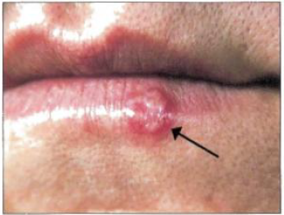
ORAL HERPES
A. Vesicles involving oral mucosa that rupture, resulting in shallow, painful, red ulcers
B. Usually due to HSV-1
C. Primary infection occurs in childhood;
D. Stress and sunlight cause reactivation of the virus, leading to vesicles that often arise on the lips (cold sore).
Notes:
lesions heal, but virus remains dormant in ganglia of the trigeminal nerve.

Slide 4
SQUAMOUS CELL CARCINOMA
A. Malignant neoplasm of squamous cells lining the oral mucosa
B. Tobacco and alcohol are major risk factors.
C. Floor of mouth is the most common location.
D. Oral leukoplakia and erythroplakia are precursor lesions.
1. Leukoplakia is a white plaque that cannot be scraped away; often represents squamous cell dysplasia
2. Leukoplakia is distinct from oral candidiasis (thrush) and hairy leukoplakia.
3. Erythroplakia (red plaque) represents vascularized leukoplakia and is highly suggestive of squamous cell dysplasia
Notes:
i. Oral candidiasis is a white deposit on the tongue, which is easily scraped away (Fig. 10.4); usually seen in immunocompromised states
ii. Hairy leukoplakia is a white, rough ('hairy') patch that arises on the lateral tongue. It is usually seen in immunocompromised individuals (e.g., AIDS) and is due to EBY-induced squamous cell hyperplasia; not pre-malignant
.4. Erythroplakia and leukoplakia are often biopsied to rule out carcinoma

Slide 5
SALIVARY GLAND
A. Salivary glands are exocrine glands that secrete saliva.
B. Divided into major (parotid, submandibular, and sublingual glands) and minor glands (hundreds of microscopic glands distributed throughout the oral mucosa)

Slide 6
MUMPS
A. Infection with mumps virus resulting in bilateral inflamed parotid glands
B. Orchitis, pancreatitis, and aseptic meningitis may also be present.
SIALADENITIS
A. Inflammation of the salivary gland
B. Most commonly due to an obstructing stone (sialolithiasis) leading to Staphylococcus aureus infection; usually unilateral
Notes:
1. Serum amylase is increased due to salivary gland or pancreatic involvement.
2. Orchitis carries risk of sterility, especially in teenagers.

Slide 7
PLEOMORPHIC ADENOMA
A. Benign tumor composed of stromal (e.g., cartilage) and epithelial tissue; most common tumor of the salivary gland
B. Usually arises in parotid; presents as a mobile, painless, circumscribed mass at the angle of the jaw.
WARTHIN TUMOR
A. Benign cystic tumor with abundant lymphocytes and germinal centers (lymph nodelike
stroma); 2nd most common tumor of the salivary gland.
MUCOEPIDERMOID CARCINOMA
A. Malignant tumor composed of mucinous and squamous cells; most common
malignant tumor of the salivary gland
B. Usually arises in the parotid; commonly involves the facial nerve
Notes:
C. High rate of recurrence; extension of small islands of tumor through tumor capsule
often leads to incomplete resection (Fig. 10.5).
D. Rarely may transform into carcinoma, which presents with signs of facial nerve
damage (facial nerve runs through parotid gland)

Slide 8
ESOPHAGUS
TRACHEOESOPHAGEAL FISTULA
A. Congenital defect resulting in a connection between the esophagus and trachea
B. Most common variant consists of proximal esophageal atresia with the distal esophagus arising from the trachea.
1. Presents with vomiting, polyhydramnios, abdominal distension, and aspiration

Slide 9
ESOPHAGEAL VARICES
A. Dilated submucosal veins in the lower esophagus
B. Arise secondary to portal hypertension
C. Asymptomatic, but risk of rupture exists
1. Presents with painless hematemesis
2. Most common cause of death in cirrhosis
Notes:
1. Distal esophageal vein normally drains into the portal vein via the left gastric vein.
2. In portal hypertension, the left gastric vein backs up into the esophageal vein, resulting in dilation (varices).

Slide 10
GASTROESOPHAGEAL REFLUX DISEASE (GERD)
A. Reflux of acid from the stomach due to reduced LES tone
B. Risk factors include alcohol, tobacco, obesity, fat-rich diet, caffeine, and hiatal hernia.
C. Clinical features
1. Heartburn (mimics cardiac chest pain)
2. Asthma (adult-onset) and cough
3. Damage to enamel of teeth
4. Ulceration with stricture and Barrett esophagus are late complications.

Slide 11
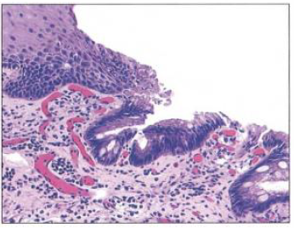
BARRETT ESOPHAGUS
A. Metaplasia of the lower esophageal mucosa from stratified squamous epithelium to nonciliated columnar epithelium with goblet cells (Fig. 10.8); seen in 10% of patients with GERD
1. Response of lower esophageal stem cells to acidic stress

Slide 12
ESOPHAGEAL CARCINOMA
A. Subclassified as adenocarcinoma or squamous cell carcinoma
B. Adenocarcinoma is a malignant proliferation of glands; most common type of esophageal carcinoma in the West
1. Arises from preexisting Barrett esophagus; usually involves the lower one-third of the esophagus
C. Squamous cell carcinoma is a malignant proliferation of squamous cells; most common esophageal cancer worldwide

Slide 13
1. Usually arises in upper or middle third of the esophagus; major risk factors include
i. Alcohol and tobacco (most common causes)
ii. Very hot tea
iii. Achalasia
iv. Esophageal web (e.g., Plummer-Vinson syndrome)
v. Esophageal injury (e.g., lye ingestion)

Slide 14
D. Esophageal carcinoma presents late (poor prognosis).
1. Symptoms include progressive dysphagia (solids to liquids), weight loss, pain,and hematemesis.
2. Squamous cell carcinoma may additionally present with hoarse voice (recurrent laryngeal nerve involvement) and cough (tracheal involvement).

Slide 15
STOMACH
GASTROSCHISIS
A. Congenital malformation of the anterior abdominal wall leading to exposure of abdominal contents.
II. OMPHALOCELE
A. Persistent herniation of bowel into umbilical cord
B. Due to failure of herniated intestines to return to the body cavity during development
1. Contents are covered by peritoneum and amnion of the umbilical cord.
III. PYLORIC STENOSIS
A. Congenital hypertrophy of pyloric smooth muscle; more common in males
B. Classically presents two weeks after birth as
1. Projectile nonbilious vomiting
2. Visible peristalsis
3. Olive-like mass in the abdomen
C. Treatment is myotomy.

Slide 16
ACUTE GASTRITIS
A. Acidic damage to the stomach mucosa
B. Due to imbalance between mucosal defenses and acidic environment
C. Risk factors
1. Severe burn (Curling ulcer) - Hypovolemia leads to decreased blood supply.
2. NSAIDs (decreased PGE)
3. Heavy alcohol consumption
4. Chemotherapy
5. Increased intracranial pressure (Cushing ulcer) - Increased stimulation of vagus nerve leads to increased acid production.
6. Shock - Multiple (stress) ulcers may be seen in ICU patients.
D. Acid damage results in superficial inflammation, erosion (loss of superficial epithelium), or ulcer (loss of mucosal layer).
Notes:
1. Defenses include mucin layer produced by foveolar cells, bicarbonate secretion by surface epithelium, and normal blood supply (provides nutrients and picks up leaked acid).

Slide 17
CHRONIC GASTRITIS
A. Chronic inflammation of stomach mucosa
B. Divided into two types based on underlying etiology: chronic autoimmune gastritis and chronic H pylori gastritis
C. Chronic autoimmune gastritis is due to autoimmune destruction of gastric parietal cells, which are located in the stomach body and fundus.
2. Clinical features
i. Atrophy of mucosa with intestinal metaplasia.
ii. Achlorhydria with increased gastrin levels and antral G-cell hyperplasia
iii. Megaloblastic (pernicious) anemia due to lack of intrinsic factor
iv. Increased risk for gastric adenocarcinoma (intestinal type)
Notes:
1. Associated with antibodies against parietal cells and/or intrinsic factor; useful for diagnosis, but pathogenesis is mediated by T cells (type IV hypersensitivity)

Slide 18
D. Chronic H pylori gastritis is due to H pylori-induced acute and chronic inflammation; most common form of gastritis (90%)
1. H pylori ureases and proteases along with inflammation weaken mucosal defenses; antrum is the most common site.
2. Presents with epigastric abdominal pain; increased risk for ulceration (peptic ulcer disease), gastric adenocarcinoma (intestinal type), and MALT lymphoma
3. Treatment involves triple therapy.
i. Resolves gastritis/ulcer and reverses intestinal metaplasia
ii. Negative urea breath test and lack of stool antigen confirm eradication of H pylori.

Slide 19
PEPTIC ULCER DISEASE
A. Solitary mucosal ulcer involving proximal duodenum (90%) or distal stomach (10%)
B. Duodenal ulcer is almost always due to H pylori (> 95%); rarely, may be due to ZE syndrome
1. Presents with epigastric pain that improves with meals
2. Diagnostic endoscopic biopsy shows ulcer with hypertrophy of Brunner glands.
3. Usually arises in anterior duodenum; when present in posterior duodenum, rupture may lead to bleeding from the gastroduodenal artery or acute pancreatitis

Slide 20
C. Gastric ulcer is usually due to H pylori (75%); other causes include NSAIDs and bile reflux.
1. Presents with epigastric pain that worsens with meals
2. Ulcer is usually located on the lesser curvature of the antrum.
3. Rupture carries risk of bleeding from left gastric artery.
D. Differential diagnosis of ulcers includes carcinoma.
1. Duodenal ulcers are almost never malignant (duodenal carcinoma is extremely rare).
2. Gastric ulcers can be caused by gastric carcinoma (intestinal subtype).
Notes:
i. Benign peptic ulcers are usually small(< 3 cm), sharply demarcated ("punched-out"), and surrounded by radiating folds of mucosa.
ii. Malignant ulcers are large and irregular with heaped up margins.
iii. Biopsy is required for definitive diagnosis.

Slide 21
GASTRIC CARCINOMA
A. Malignant proliferation of surface epithelial cells (adenocarcinoma)
B. Subclassified into intestinal and diffuse types
C. Intestinal type (more common) presents as a large, irregular ulcer with heaped up margins;
1. Risk factors include intestinal metaplasia (e.g., due to H pylori and autoimmune gastritis), nitrosamines in smoked foods (Japan), and blood type A.
D. Diffuse type is characterized by signet ring cells that diffusely infiltrate the gastric wall ; desmoplasia results in thickening of stomach wall (linitis plastica,)
1. Not associated with H pylori, intestinal metaplasia, or nitrosamines
Notes:
most commonly involves the lesser curvature of the antrum (similar to gastric ulcer)

Slide 22
E. Gastric carcinoma presents late with weight loss, abdominal pain, anemia, and early satiety; rarely presents as acanthosis nigricans or Leser-Trélat sign
F. Spread to lymph nodes can involve the left supraclavicular node (Virchow node).
G. Distant metastasis most commonly involves liver; other sites include
1. Periumbilical region (Sister Mary Joseph nodule); seen with intestinal type
2. Bilateral ovaries (Krukenberg tumor); seen with diffuse type

Slide 23
SMALL BOWEL
DUODENAL ATRESIA
A. Congenital failure of duodenum to canalize; associated with Down syndrome
B. Clinical features
1. Polyhydramnios
2. Distension of stomach and blind loop of duodenum ('double bubble' sign,)
3. Bilious vomiting
MECKEL DIVERTICULUM
A. Outpouching of all three layers of the bowel wall (true diverticulum, Fig. 10.16)
B. Arises due to failure of the vitelline duct to involute
C. 'Rule of 2s'
Notes:
1. Seen in 2% of the population (most common congenital anomaly of the GI tract)
2. 2 inches long and located in the small bowel within 2 feet of the ileocecal valve
3. Can present during the first 2 years of life with bleeding (due to heterotopic gastric mucosa), volvulus, intussusception, or obstruction (mimics appendicitis); however, most cases are asymptomatic.

Slide 24
VOLVULUS
A. Twisting of bowel along its mesentery
B. Results in obstruction and disruption of the blood supply with infarction.
C. Most common locations are sigmoid colon (elderly) and cecum (young adults).
INTUSSUSCEPTION
A. Telescoping of proximal segment of bowel forward into distal segment
1. Telescoped segment is pulled forward by peristalsis, resulting in obstruction and disruption of blood supply with infarction.
B. Associated with a leading edge (focus of traction)
Notes:
1. In children, the most common cause is lymphoid hyperplasia (e.g., due to rotavirus); usually arises in the terminal ileum, leading to intussusception into the cecum
2. In adults, the most common cause is tumor.

Slide 25
SMALL BOWEL INFARCTION
A. Small bowel is highly susceptible to ischemic injury.
1. Transmural infarction occurs with thrombosis/embolism of the superior mesenteric artery or thrombosis of the mesenteric vein.
2. Mucosal infarction occurs with marked hypotension.
B. Clinical features include abdominal pain, bloody diarrhea, and decreased bowel sounds.

Slide 26
LACTOSE INTOLERANCE
A. Decreased function of the lactase enzyme found in the brush border of enterocytes
1. Lactase normally breaks down lactose into glucose and galactose.
B. Presents with abdominal distension and diarrhea upon consumption of milk products; undigested lactose is osmotically active.
C. Deficiency may be congenital (rare autosomal recessive disorder) or acquired (often develops in late childhood); temporary deficiency is seen after small bowel infection (lactase is highly susceptible to injury).
Notes:
Celiac disease, tropical sprue, Whipple disease, Abetalipoprotienemia

Slide 27
CARCINOID TUMOR
A. Malignant proliferation of neuroendocrine cells; low-grade malignancy
B. Can arise anywhere along the gut; small bowel is the most common site.
1. Grows as a submucosal polyp-like nodule
C. Often secretes serotonin
Notes:
Tumor cells contain neurosecretory granules that are positive for chromogranin.
1. Serotonin is released into the portal circulation and metabolized by liver monoamine oxidase (MAO) into 5-HIAA.
2. 5-HIAA is excreted in the urine.

Slide 28
D. Metastasis of carcinoid tumor to the liver allows serotonin to bypass liver metabolism.
1. Serotonin is released into the hepatic vein and leaks into systemic circulation via hepato-systemic shunts, resulting in carcinoid syndrome and carcinoid heart disease.
2. Carcinoid syndrome is characterized by bronchospasm, diarrhea, and flushing of skin;
3. Carcinoid heart disease is characterized by right-sided valvular fibrosis(increased collagen) leading to tricuspid regurgitation and pulmonary valve stenosis; left-sided valvular lesions are not seen due to presence of monoamine oxidase (metabolizes serotonin) in the lung.
Notes:
symptoms can be triggered by alcohol or emotional stress, which stimulate serotonin release from the tumor.

Slide 29
APPENDIX
ACUTE APPENDICITIS
A. Acute inflammation of the appendix; most common cause of acute abdomen
B. Related to obstruction of the appendix by lymphoid hyperplasia (children) or a
fecalith (adults)
C. Clinical features include
1. Periumbilical pain, fever, and nausea; pain eventually localizes to right lower
quadrant (McBurney point).
2. Rupture results in peritonitis that presents with guarding and rebound tenderness.
3. Peri appendiceal abscess is a common complication.

Slide 30
INFLAMMATORY BOWEL DISEASE
A. Chronic, relapsing inflammation of bowel
B. Possibly due to abnormal immune response to enteric flora
C. Classically presents in young women (teens to 30s) as recurrent bouts of bloody diarrhea and abdominal pain
D. Diagnosis of exclusion; symptoms mimic other causes of bowel inflammation (e.g., infection).
E. Subclassified as ulcerative colitis or Crohn disease
Notes:
1. More prevalent in the West, particularly in Caucasians and Eastern European Jews

Slide 31
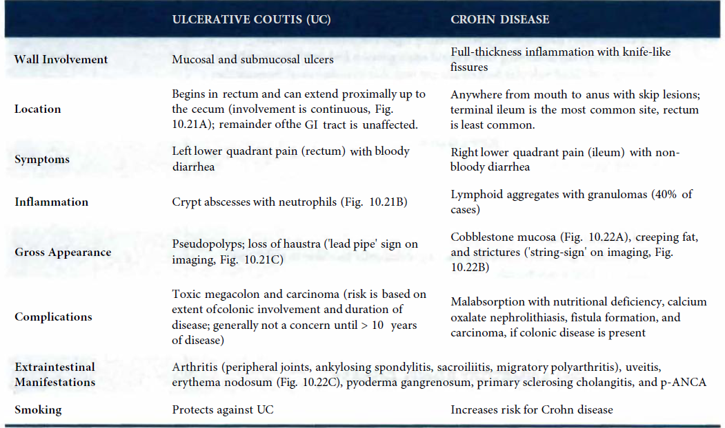

Slide 32
COLON
HIRSCHSPRUNG DISEASE
A. Defective relaxation and peristalsis of rectum and distal sigmoid colon
1. Associated with Down syndrome
B. Due to congenital failure of ganglion cells (neural crest-derived) to descend into myenteric and submucosal plexus
C. Clinical features are based on obstruction.
1. Failure to pass meconium
2. Empty rectal vault on digital rectal exam
3. Massive dilatation (megacolon) of bowel proximal to obstruction with risk for rupture
D. Rectal suction biopsy reveals lack of ganglion cells.
E. Treatment involves resection of the involved bowel; ganglion cells are present in the bowel proximal to the diseased segment.
Notes:
1. Myenteric (Auerbach) plexus is located between the inner circular and outer longitudinal muscle layers of the muscularis propria and regulates motility.
2. Submucosal (Meissner) plexus is located in the submucosa and regulates blood flow, secretions, and absorption.

Slide 33
COLONIC DIVERTICULA
A. Outpouchings of mucosa and submucosa through the muscularis propria (false diverticulum)
B. Related to wall stress
C. Usually asymptomatic; complications include
1. Rectal bleeding (hematochezia)
2. Diverticulitis - due to obstructing fecal material; presents with appendicitis-like symptoms in the left lower quadrant
3. Fistula - Inflamed diverticulum ruptures and attaches to a local structure.
Notes:
1. Associated with constipation, straining, and low-fiber diet; commonly seen in older adults (risk increases with age)
2. Arise where the vasa recta traverse the muscularis propria (weak point in colonic wall); sigmoid colon is the most common location.
Colovesicular fistula presents with air (or stool) in urine.

Slide 34
COLONIC POLYPS
A. Raised protrusions of colonic mucosa
B. Most common types are hyperplastic and adenomatous polyps.
1. Hyperplastic polyps are due to hyperplasia of glands; classically show a 'serrated’ appearance on microscopy
i. Most common type of polyp; usually arise in the left colon (rectosigmoid)
ii. Benign, with no malignant potential
2. Adenomatous polyps are due to neoplastic proliferation of glands;2nd most common type of colonic polyp
i. Benign, but premalignant; may progress to adenocarcinoma via the adenoma carcinoma sequence
3. Adenoma-carcinoma sequence describes the molecular progression from normal colonic mucosa to adenomatous polyp to carcinoma.

Slide 35
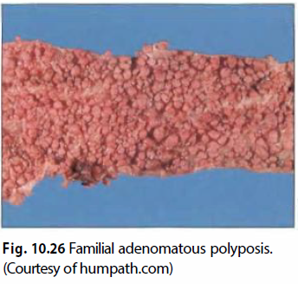
FAMILIAL ADENOMATOUS POLYPOSIS (FAP)
A. Autosomal dominant disorder characterized by 100s to 1000s of adenomatous colonic polyps .
B. Due to inherited APC mutation (chromosome 5); increases propensity to develop adenomatous polyps throughout colon and rectum
C. Colon and rectum are removed prophylactically; otherwise, almost all patients develop carcinoma by 40 years of age.
D. Gardner syndrome is FAP with fibromatosis and osteomas.
E. Turcot syndrome is FAP with CNS tumors (medulloblastoma and glial tumors).
Notes:
1. Fibromatosis is a non-neoplastic proliferation of fibroblasts; arises in retroperitoneum (desmoid) and locally destroys tissue
2. Osteoma is a benign tumor of bone that usually arises in the skull.

Slide 36
COLORECTAL CARCINOMA
A. Carcinoma arising from colonic or rectal mucosa; 3rd most common site of cancer and 3rd most common cause of cancer-related death
1. Peak incidence is 60-70 years of age.
B. Most commonly arises from adenoma-carcinoma sequence; a second important molecular pathway is microsatellite instability (MSI).
1. Microsatellites are repeating sequences of noncoding DNA; integrity of sequence (stability) is maintained during cell division.
2. Instability indicates defective DNA copy mechanisms (e.g., DNA mismatch repair enzymes).
3. Hereditary nonpolyposis colorectal carcinoma (HNPCC) is due to inherited mutations in DNA mismatch repair enzymes.
Notes:
i. Increased risk for colorectal, ovarian, and endometrial carcinoma
ii. Colorectal carcinoma arises de novo (not from adenomatous polyps) at a relatively early age; usually right-sided

Slide 37
D. Carcinoma can develop anywhere along entire length of colon.
1. Left-sided carcinoma usually grows as a 'napkin-ring' lesion; presents with decreased stool caliber, left lower quadrant pain, and blood-streaked stool
2. Right-sided carcinoma usually grows as a raised lesion; presents with iron deficiency anemia (occult bleeding) and vague pain. An older adult with iron deficiency anemia has colorectal carcinoma until proven otherwise.
F. Staging
1. T - depth of invasion;
2. N - spread to regional lymph nodes
3. M - distant spread; most commonly involves the liver
Notes:
tumors limited to the mucosa generally do not spread due to lack of lymphatics in the mucosa.

Slide 38
Thank You

