Slide 1
Autonomic Nervous System(ANS)
CNS consists of the brain and spinal cord
PNS is divided in to ANS and somatic nervous system
The autonomic nervous system(ANS) consists of two large divisions:
Sympathetic (thoracolumbar) outflow, and
Parasympathetic (craniosacral) outflow.

Slide 2
ANS-responsible for control of involuntary or visceral bodily functions
Cardiovascular, Respiratory, Digestive, Urinary, Reproductive functions
Sympathetic nervous system
Allow body to function under stress (Fight or flight)
Parasympathetic nervous system
Feed or breed ( rest and digest)
Constant opposition to sympathetic system

Slide 3
Major components of ANS
Neuron
Sensory – Afferent
Motor neurons- Efferent
Neurotransmitter
Chemical substance which travels across a synaptic junction to act on a target cell
Effector organs
Specific tissues stimulated by the autonomic nervous system

Slide 4
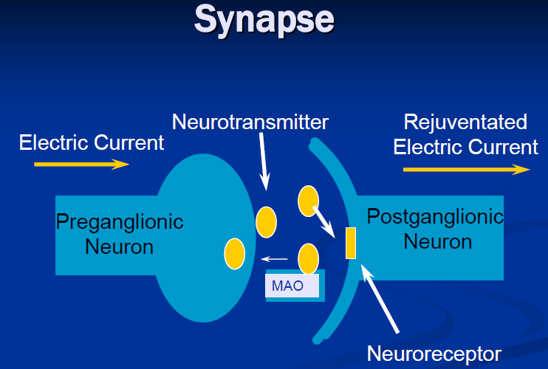
Neurotransmitters:-
- chemicals/substances made in the neurons that are released when an action potential comes down the neurons

Slide 5
Neurotransmitters
The autonomic nerve fibers can be divided into two based on the type of neurotransmitter released
PSNS-All preganglionic and postganglionic PSNS neurons secret acetylcholine….These are termed as CHOLINERGIC
A few sympathetic fibers, such as those involved in sweating, are cholinergic
SNS-postganglionic sympathetic neurons secret norepinephrine…These neurons are termed as ADRENERGIC
I.e-
CHOLINERGIC:- Neurons which secret acetylcholine
ADRENERGIC:- Neurons which secret noradrenaline/ norepinephrine

Slide 6
Receptors of ANS and drugs acting on them
Adrenergic receptors - receive noradrenaline
Alpha/beta receptors….GPCR signaling
2. Cholinergic Rec- receptors which receive acetylcholine
Nicotinic Rec (Ligand gated ionic channel signaling)
Muscarinic Rec (GPCR signaling)

Slide 7
Adrenergic receptors - receive norepinephrine (NE)..GPCR signaling
A. Alpha 1 Rec:
Location: blood vessels and kidney and sphincters(e.g urethral sphincter)
Examples of action:
Constriction of blood vessels…vasoconstriction
Constricts sphincters
Constriction of radial muscle of the iris, which causes dilation of the pupil of the eye (Mydriasis)
B. Alpha 2 Rec;
Location: CNS and periphery
They produce hyperpolarization therefore they are inhibitory(inhibit SNS by decreasing SNS outflow, decreasing NE and Ach release)
Examples of function:
Inhibits insulin and enzyme secretion from the pancreas
Decrease BP

Slide 8
C. Beta 1 Rec;
Location: heart, kidney
They are excitatory
Examples of action: increase heart rate and strength of contraction & increase Secretion of renin from JG cells of kidney
D. Beta 2 Rec;
Location: blood vessels & bronchioles of the lungs
Are excitatory
E.g of its action- blood vessel dilation(vaso-dilation)
- bronchodilation

Slide 9
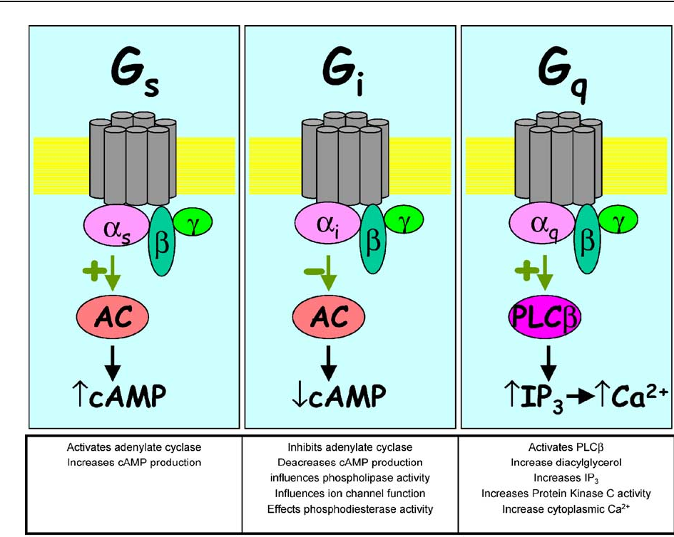
α1…Gq
α2…Gi
ß1…Gs
ß2…Gs

Slide 10
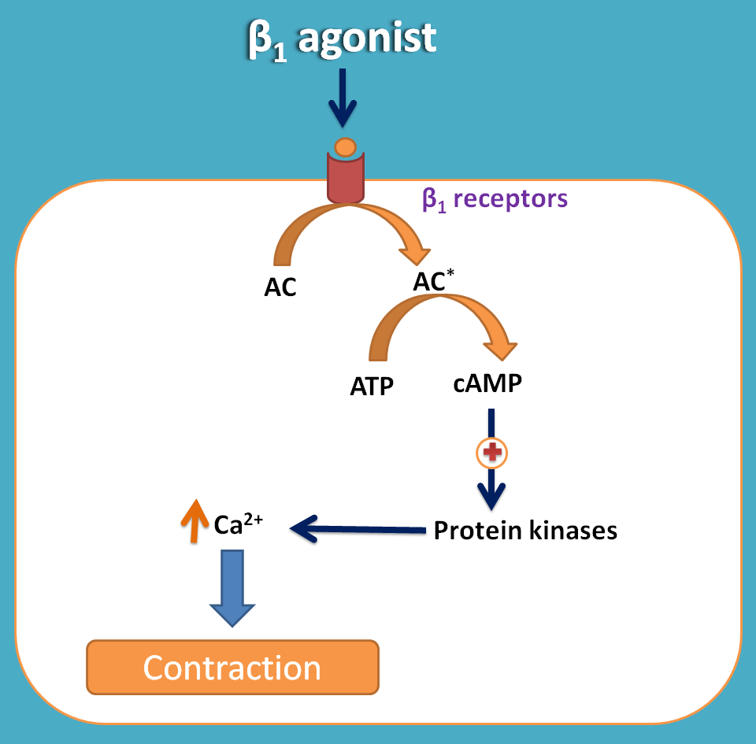
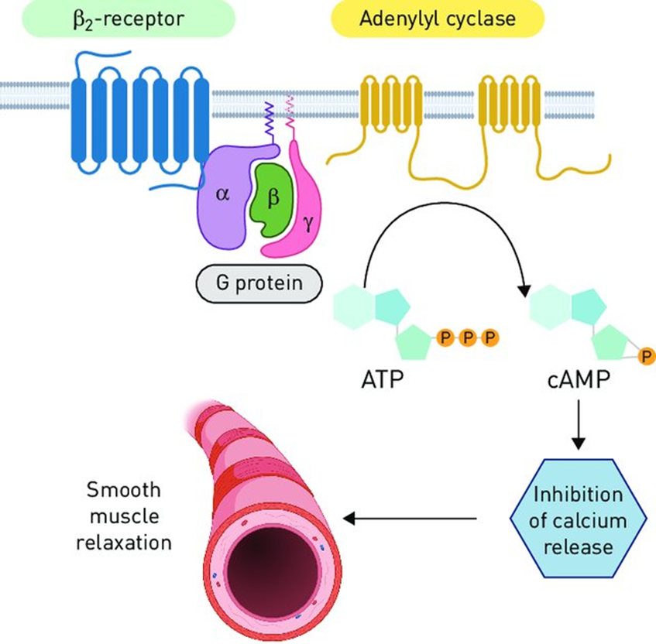

Slide 11
Adrenergic agonists
Albuterol Amphetamine
Dobutamine*
Dopamine *
Epinephrine *
Isoproterenol *
Norepinephrine*
Metaraminol
Metaproterenol
Methoxamine
Phenylephrine * Catecholamines
Ritodrine
Terbutaline
Clonidine

Slide 12
α-adrenergic blocking agents/ α-blockers
Decrease peripheral vascular resistance (dec BP)
Reflex tachycardia
Phenoxybenzamine
Nonselective, linking covalently to both α1 - postsynaptic & α2- presynaptic receptor
CVS – Prevents vasoconstriction, reflex tachycardia
Therapeutic uses: pheochromocytoma
Raynaud’s disease
Adverse effect:
-Postural hypotension - Nausea & vomiting
- Nasal stuffiness - Inhibit ejaculation
- Induce tachycardia

Slide 13
phentolamine
-Competitive blocker of α₁& α₂ –receptor
- Duration of action 4hrs
-Used in diagnosis of pheochromocytoma
-Trigger arrhythmias & anginal pain, contraindicated in patients with decreased coronary perfusion.
Prazosin, terazosin & doxazosin
- Selective competitive blockers of α₁-receptor, used in HTN.
- doxazosin is longest acting
- Alternative to surgery inpatients with symptomatic benign prostatic hyperplasia (BPH)
-Adverse effect: Dizziness, nasal congestion, headache drowsiness & orthostatic hypotension, retain Na+ & fluid (prazosin used along with diuretic)

Slide 14
ß-adrenergic blocking agents/ ß-blockers
The names of β blockers end with “-lol”
Has negative inotropic & chronotropic effect
Bronchoconstriction
Nonselective ß-antagonists
Propranolol
ADR- Bronchoconstriction
Selective ß1-antagonist
Acebutolol, atenolol, metoprolol & esmolol

Slide 15
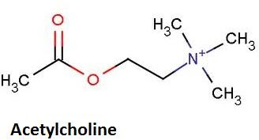
Acetylcholine Receptors/Cholinergic recs
Cholinergic System
Acetylcholine
Postganglionic neurotransmitter in the PNS Preganglionic neurostranmitter for both SNS and PNS
Ach/Cholinergic receptor
Muscarinic receptor (M) Nicotinic receptor (N)

Slide 16
Cholinergic Rec- receptors which receive acetylcholine
Nicotinic Rec (Ligand gated ionic channel signaling)
Location: skeletal muscle, dendrites of postganglionic neurons, adrenal medulla
Examples of action: skeletal muscle contraction, generation of action potential on postganglionic neuron, stimulation of adrenal gland and secretion of norepinephrine and epinephrine
Muscarinic Rec (GPCR signaling)
Location: effectors innervated by postganglionic parasympathetic neurons (E.g glands, heart, lungs, GIT, etc)
E.g of action- gland secretion, dec. HR, bronchoconstriction, miosis

Slide 17
Direct acting cholinergic drugs/muscarinic agonists
Acetylcholine- short duration of action
Methacholine: used in Asthma diagnosis
Carbachol, bethanechol:
extremely resistant to hydrolysis by acetylcholinesterase enzyme and have longer duration of action.
Use-Urinary retention treatment
Pilocarpine
Use- for glaucoma treatment

Slide 18
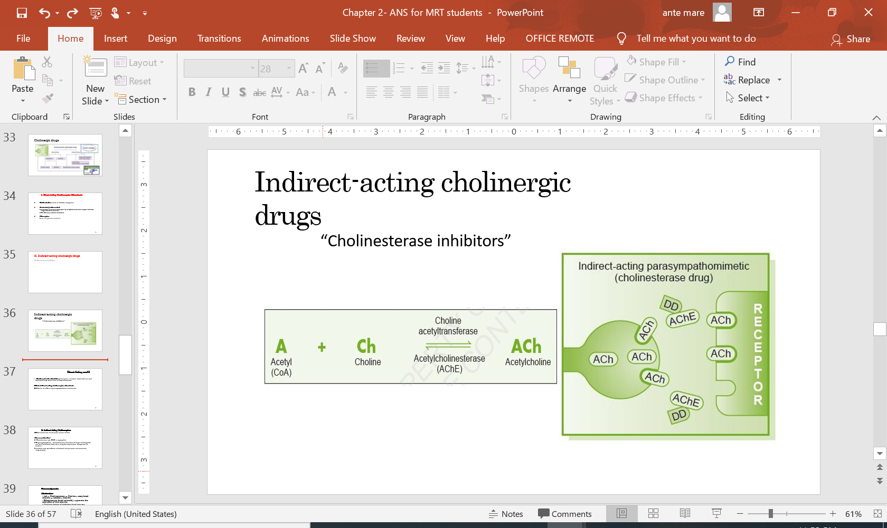
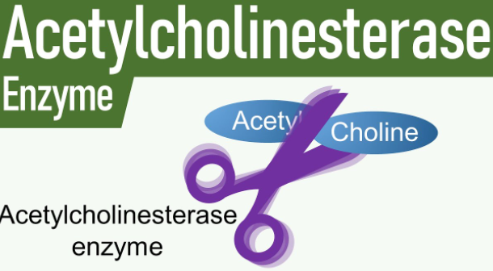
Indirect-acting cholinergic drugs
Cholinesterase(AChE) terminates
action of Ach
Cholinesterase inhibitors- ↑ Ach
A. reversible cholinesterase inhibitors
-e.g neostigmine, physostigmine
B. Irreversible cholinesterase inhibitors
Organophosphates (Parathion, Malathion)

