Slide 1
Central Nervous System Pathology

Slide 2
NEURAL TUBE DEFECTS
Arise from incomplete closure of the neural tube
Neural plate invaginates early in gestation to form the neural tube, which runs along the cranial-caudal axis of the embryo.
The wall of the neural tube forms central nervous system tissue, the hollow lumen forms the ventricles and spinal cord canal, and the neural crest forms the peripheral nervous system.
Associated with low folate levels prior to conception.
Detected during prenatal care by elevated alpha-fetoprotein (AFP) levels in the amniotic fluid and maternal blood.

Slide 3
Anencephaly
Malformation of the anterior end of the neural tube.
Absence of the forebrain and the top of the skull.
Leads to a 'frog-like' appearance of the fetus.
Spina bifida
Is failure of the posterior vertebral arch to close, resulting in a vertebral defect (disruption of the caudal end of the neural tube).
Spina bifida occulta
Presents as a dimple or patch of hair overlying the vertebral defect.
2. Spina bifida
Presents with cystic protrusion of the underlying tissue through the vertebral defect.
Meningocele - protrusion of meninges.
Meningomyelocele - protrusion of meninges and spinal cord.

Slide 4
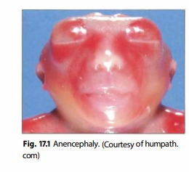
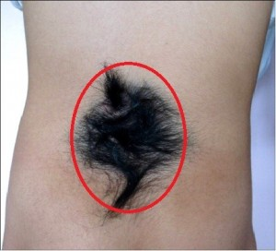

Slide 5
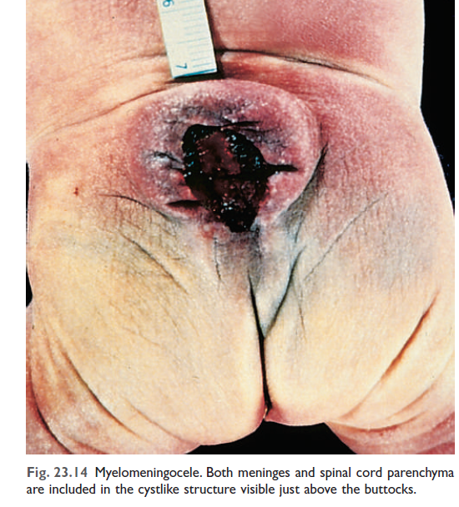

Slide 6
CEREBRAL AQUEDUCT STENOSIS
Congenital stenosis of the channel that drains cerebrospinal fluid (CSF) from the 3rd ventricle into the 4th ventricle
Leads to accumulation of CSF in the ventricular space; most common cause of hydrocephalus in newborns
CSF is produced by the choroid plexus lining the ventricles.
Flows from the lateral ventricles into the 3rd ventricle via the interventricular foramen of Monro
Flows from the 3rd ventricle into the 4th ventricle via the cerebral aqueduct
Flows from the 4th ventricle into the subarachnoid space via the foramina of Magendie and Luschka
Presents with enlarging head circumference due to dilation of the ventricles (cranial suture lines are not fused)

Slide 7
DANDY-WALKER MALFORMATION
Congenital failure of the cerebellar vermis to develop.
Presents as a massively dilated 4th ventricle (posterior fossa) with an absent cerebellum often accompanied by hydrocephalus.

Slide 8
ARNOLD-CHIARI MALFORMATION (TYPE II)
Congenital downward displacement of cerebellar vermis and tonsils through the foramen magnum.
Obstruction of CSF flow commonly results in hydrocephalus.
Often associated with meningomyelocele.

Slide 9
MENINGITIS
Inflammation of the leptomeninges
Meninges consist of three layers (dura, arachnoid, and pia) that lie between the brain and the skull.
Pia and arachnoid together are termed leptomeninges.
Presents with classic triad of headache, nuchal rigidity, and fever.
photophobia, vomiting, and altered mental status may also be present.

Slide 10
Most commonly due to an infectious agent
Group B streptococci, E coli, and Listeria monocytogenes (neonates)
N meningitidis (children and teenagers),
Streptococcus pneumoniae (adults and elderly), and
H influenza (nonvaccinated infants)
Coxsackievirus (children; fecal-oral transmission)
Fungi (immunocompromised individuals)

Slide 11
Diagnosis is made by lumbar puncture (sampling of CSF)
CSF findings:-
1. Bacterial meningitis- ↑neutrophils with ↓CSF glucose; gram stain
and culture often identify the causative organism.
2. Viral meningitis -↑ lymphocytes with normal CSF glucose
3. Fungal meningitis -↑ lymphocytes with ↓ CSF glucose

Slide 12
Complications are usually seen with bacterial meningitis.
Death - herniation secondary to cerebral edema
Hydrocephalus, hearing loss, and seizures - sequelae related to fibrosis

Slide 13
CEREBROVASCULAR DISEASE
Neurologic deficit due to cerebrovascular compromise; major cause of morbidity and mortality
Due to ischemia (85% of cases) or hemorrhage (15% of cases)
Neurons are dependent on serum glucose as an essential energy source and are particularly susceptible to ischemia (undergo necrosis within 3-5 minutes).

Slide 14
Major etiologies
1. Low perfusion (e.g., atherosclerosis)
2. Acute decrease in blood flow (e.g., cardiogenic shock)
3. Chronic hypoxia (e.g., anemia)
4. Repeated episodes of hypoglycemia (e.g., insulinoma)
Clinical features are based on duration and magnitude of the insult.
Mild global ischemia results in transient confusion with prompt recovery
Severe global ischemia results in diffuse necrosis; survival leads to a 'vegetative state.'

Slide 15
ISCHEMIC STROKE
Regional ischemia to the brain that results in focal neurologic deficits lasting > 24 hours
If symptoms last < 24 hours, a transient ischemic attack (TIA).
Subtypes include thrombotic, embolic, and lacunar strokes.
Thrombotic stroke
Is due to rupture of an atherosclerotic plaque.
Atherosclerosis usually develops at branch points (e.g., bifurcation of internal carotid and middle cerebral artery in the circle of Willis).
Results in a pale infarct at the periphery of the cortex.

Slide 16
2. Embolic stroke
Is due to thromboemboli.
Most common source of emboli is the left side of the heart (e.g., atrial fibrillation).Usually involves the middle cerebral artery.
Results in a hemorrhagic infarct at the periphery of the cortex.
3. Lacunar stroke
Occurs secondary to hyaline arteriolosclerosis, a complication of HTN.
Most commonly involves lenticulostriate vessels, resulting in small cystic areas of infarction
Involvement of the internal capsule leads to a pure motor stroke.
Involvement of the thalamus leads to a pure sensory stroke

Slide 17
INTRACEREBRAL HEMORRHAGE
Bleeding into brain parenchyma
Classically due to rupture of Charcot-Bouchard microaneurysms of the lenticulostriate vessels
Complication of hypertension
Basal ganglia is the most common site
Presents as severe headache, nausea, vomiting, and eventual coma

Slide 18
SUBARACHNOID HEMORRHAGE
Bleeding into the subarachnoid space
Presents as a sudden headache ("worst headache of my life") with nuchal rigidity.
Lumbar puncture shows xanthochromia (yellow hue due to bilirubin).
Most frequently (85%) due to rupture of a berry aneurysm; other causes include AV malformations and an anticoagulated state.
Most frequently located in the anterior circle of Willis at branch points of the anterior communicating artery.

Slide 19
TRAUMA
EPIDURAL HEMATOMA
Collection of blood between the dura and the skull
Classically due to fracture of the temporal bone with rupture of the middle meningeal artery; bleeding separates the dura from the skull.
Lens-shaped lesion on CT-scan.
Lucid interval may precede neurologic signs.
Herniation is a lethal complication.

Slide 20
SUBDURAL HEMATOMA
Collection of blood underneath the dura; blood covers the surface of the brain.
Due to tearing of bridging veins that lie between the dura and arachnoid; usually arises with trauma.
Crescent-shaped lesion on CT.
Presents with progressive neurologic signs.
Increased rate of occurrence in the elderly due to age-related cerebral atrophy, which stretches the veins.
Herniation is a lethal complication.

Slide 21
HERNIATION
Displacement of brain tissue due to mass effect or increased intracranial pressure
Tonsillar herniation
Involves displacement of the cerebellar tonsils into the foramen magnum.
Compression of the brain stem leads to cardiopulmonary arrest.
Subfalcine herniation
Involves displacement of the cingulate gyrus under the falx cerebri.
Compression of the anterior cerebral artery leads to infarction.

Slide 22
Uncal herniation
Involves displacement of the temporal lobe uncus under the tentorium cerebelli.
Compression of cranial nerve III (oculomotor) leads to the eye moving "down and out" and a dilated pupil.
Compression of posterior cerebral artery leads to infarction of occipital lobe (contralateral homonymous hemianopsia).
Rupture of the paramedian artery leads to Duret (brainstem) hemorrhage.

Slide 23
DEMYELINATING DISORDERS
Myelin insulates axons, improving the speed and efficiency of conduction.
Oligodendrocytes myelinate the central nervous system.
Schwann cells myelinate the peripheral nervous system.
Demyelinating disorders are characterized by destruction of myelin or oligodendrocytes; axons are generally preserved.

Slide 24
MULTIPLE SCLEROSIS
Autoimmune destruction of CNS myelin and oligodendrocytes.
Most common chronic CNS disease of young adults (20-30 years of age).
More commonly seen in women.
Associated with HLA-DR2.
Presents with relapsing neurologic deficits with periods of remission.

Slide 25
Clinical features include:
1. Blurred vision in one eye (optic nerve).
2. Vertigo and scanning speech mimicking alcohol intoxication (brainstem).
3. Internuclear ophthalmoplegia (medial longitudinal fasciculus).
4. Hemiparesis or unilateral loss of sensation (cerebral white matter, usually
periventricular).
5. Lower extremity loss of sensation or weakness (spinal cord).
6. Bowel, bladder, and sexual dysfunction (autonomic nervous system).

Slide 26
Diagnosis is made by MRI and lumbar puncture.
1. MRI reveals plaques (areas of white matter demyelination).
2. Lumbar puncture shows increased lymphocytes, increased
immunoglobulins with oligoclonal IgG bands on high resolution
electrophoresis, and myelin basic protein.

Slide 27
SUBACUTE SCLEROSING PANENCEPHALITIS
Progressive, debilitating encephalitis leading to death.
Due to slowly progressing, persistent infection of the brain by measles virus.
Infection occurs in infancy; neurologic signs arise years later (during childhood).
Characterized by viral inclusions within neurons (gray matter) and oligodendrocytes (white matter).

Slide 28
PROGRESSIVE MULTIFOCAL LEUKOENCEPHALOPATHY
JC virus infection of oligodendrocytes (white matter).
Immunosuppression (e.g., AIDS or leukemia) leads to reactivation of the latent virus.
Presents with rapidly progressive neurologic signs (visual loss, weakness, dementia) leading to death.

Slide 29
CENTRAL PONTINE MYELINOLYSIS
Focal demyelination of the pons (anterior brain stem).
Due to rapid intravenous correction of hyponatremia.
Occurs in severely malnourished patients (e.g., alcoholics and patients with liver disease).
Classically presents as acute bilateral paralysis ("locked in" syndrome).

Slide 30
DEMENTIA AND DEGENERATIVE DISORDERS
Characterized by loss of neurons within the gray matter; often due to accumulation of protein which damages neurons.
Degeneration of the cortex leads to dementia.
Degeneration of the brainstem and basal ganglia leads to movement disorders.

Slide 31
ALZHEIMER DISEASE (AD)
Degenerative disease of cortex; most common cause of dementia.
Slow-onset memory loss and progressive disorientation.
Loss of learned motor skills and language.
Changes in behavior and personality.
Patients become mute and bedridden; infection is a common cause of death.
Focal neurologic deficits are not seen in early disease.
Most cases (95%) are sporadic and seen in the elderly.

Slide 32
Diagnosis is made by clinical and pathological correlation.
Presumptive diagnosis is made clinically after excluding other causes.
Confirmed by histology at autopsy (when possible).

Slide 33
PARKINSON DISEASE
Degenerative loss of dopaminergic neurons in the substantia nigra of the basal ganglia.
Nigrostriatal pathway of basal ganglia uses dopamine to initiate movement.
Common disorder related to aging; seen in 2% of older adults.
Protein accumulation and aggregation,mitochondrial abnormalities, and neuronal loss in the substantia nigra and elsewhere in the brain.

Slide 34
Clinical features ('TRAP')
Tremor-at rest; disappears with movement.
Rigidity-cogwheel rigidity in the extremities.
Akinesia/bradykinesia-slowing of voluntary movement; expressionless face.
Postural instability and shuffling gait.
Histology reveals loss of pigmented neurons in the substantia nigra and round, eosinophilic inclusions of α- synuclein (Lewy bodies) in affected neurons.
Dementia is a common feature of late disease.
Early-onset dementia is suggestive of Lewy body dementia, which is characterized by dementia, hallucinations and parkinsonian features; histology reveals cortical Lewy bodies.

Slide 35
HUNTINGTON DISEASE
Degeneration of GABAergic neurons in the caudate nucleus of the basal ganglia.
Autosomal dominant disorder (chromosome 4) characterized by expanded trinucleotide repeats (CAG) in the huntingtin gene.
Presents with chorea that can progress to dementia and depression; average age at presentation is 40 years.
Suicide is a common cause of death.

Slide 36
CNS TUMORS
Can be metastatic (50%) or primary (50%)
Metastatic tumors characteristically present as multiple, well-circumscribed lesions at the gray-white junction.
Lung, breast, and kidney are common sources.
Primary tumors are classified according to cell type of origin (e.g., astrocytes, meningothelial cells, ependymal cells, oligodendrocytes, or neuroectoderm).
In adults, primary tumors are usually supratentorial.
Most common tumors in adults are glioblastoma multiforme, meningioma, and schwannoma.
In children, primary tumors are usually infratentorial.
Most common tumors in children are pilocytic astrocytoma, ependymoma, and medulloblastoma.
Primary malignant CNS tumors are locally destructive, but rarely metastasize.

Slide 37
References
Robbins and cotrans pathologic basics of disease 10th edition

Slide 38
Thank you!!!

