Slide 1
Endocrine system
Prepared by Assaye Desalegn

Slide 2
Endocrine system
Is a group of specialized organs and body tissues that produce, store and secrete chemical substances known as hormones
Function
Regulating the body’s growth and development
Controlling the function of various tissues
Supporting pregnancy and other reproductive functions
Regulating metabolism
Endocrine glands are ductless glands

Slide 3
Some are examples of endocrine organs
  Pituitary gland
  Pineal gland
  Thyroid
  Parathyroid and
  Adrenal gland

Slide 4
Pituitary gland
Lies below the hypothalamus and attached by a stalk (infendibulum)
Lies in hypophyseal fossa of sella turcica of body of sphenoid bone
It has a size and shape of pea and often referred as a master gland (secrets several hormones that regulate the function of the other endocrine glands)
Has two lobes; anterior and posterior

Slide 5
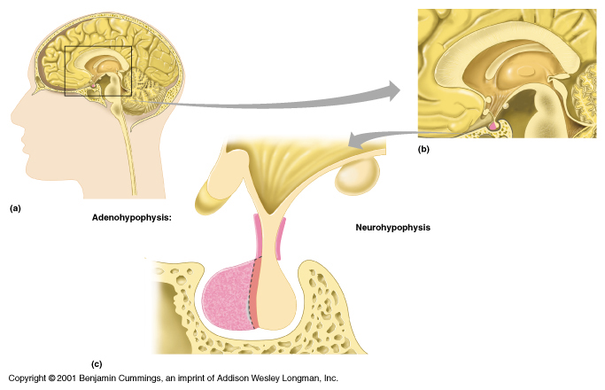

Slide 6
secretes the following major hormones
  thyroid stimulating hormone(TSH)- act on thyroid gland
  adrenocorticotropic hormone (ACTH)- act on adrenal gland
  follicle stimulating hormone (FSH)- stimulates primary ovarian follicles in an ovary
  lutenizing hormone (LH) – stimulates ovulation
  melanocyte stimulating hormone (MSH) – causes the synthesis of melanin
  growth hormone and prolactin (lactogenic) hormone- stimulates growth and milk production

Slide 7
Posterior lobe (neurohypophysis)
has three parts
  pars nervosa
  infundibular stalk
  median eminence
secretes two hormones
antiduretic hormone (ADH)- accelerates reabsorption of water from urine in the kidneys or it controls water balance in the body
oxytocin – stimulates contraction of smooth muscles of the pregnant uterus

Slide 8
Thyroid gland
Butter fly shaped gland located in the anterior neck (anterior and lateral surface of trachea below larynx
It’s the largest pure endocrine gland, composed of two lobes connected by an isthmus
Consists of many spherical hollow sacs called thyroid follicles . These follicles are lined with a simple cuboidal epithelium composed of follicular cells that synthesize the two principal thyroid hormones
b/n the follicles are epithelial cells called para follicular cells that produce a hormone called calcitonin
Secretes hormones in response to stimulation by TSH from the pituitary gland

Slide 9
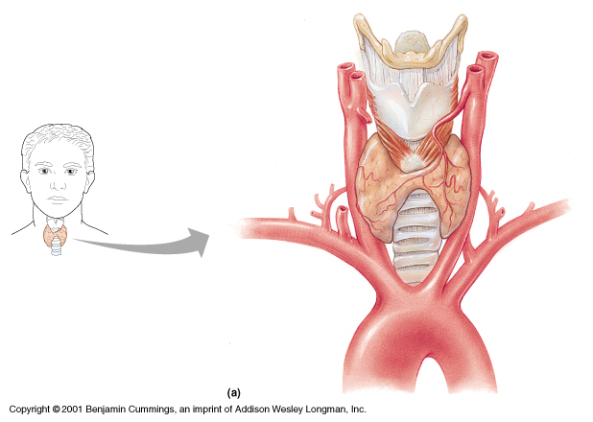
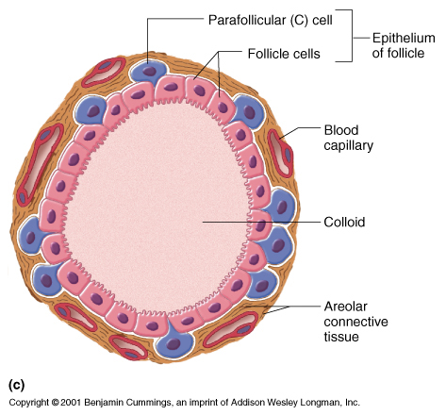

Slide 10
Secretes thyroxine (T4) and triiodo thyronine (T3) , these hormones contain the element iodine, which is essential to the function of hormone
  Their main function is increasing the basal metabolic rate (the rate at which the body uses oxygen to transform nutrients in to energy)
  Secrets calcitonin- when blood calcium levels are high calcitonin lowers blood levels of Ca²⁺ by slowing the calcium releasing activity of osteoclasts in bone and increasing calcium excretion by the kidney
  Independent of pituitary gland hormones

Slide 11
Goiter-a disease characterized by the enlargement of thyroid gland , can result from insufficient levels of iodine in the diet the thyroid requires iodine to synthesize the hormone thyroxine and an iodine deficiency causes thyroid to swell.

Slide 12
Parathyroid gland
Four small glands that lie on the posterior surface of the thyroid gland
Composed of two types of cells; chief cells and oxyphil cells
Chief cells - small basophilic cells, arranged in clusters
Synthesize and secrete parathyroid hormone (PTH)
High blood calcium level inhibit production of PTH
PTH- stimulate osteoclasts ↑ca+
    ↓excretion of calcium by the kidney

Slide 13
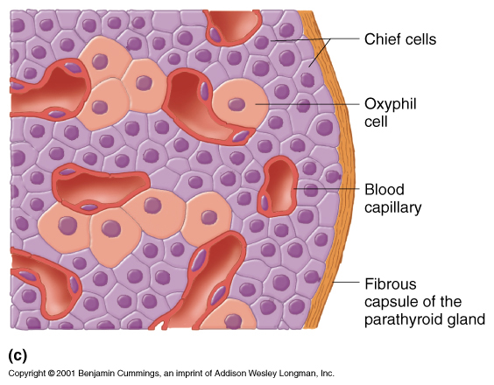

Slide 14
2. Oxyphil cells- large eosinophilic cells those are present singly or in small clusters
- Have no known function but their number increases with age

Slide 15
Adrenal or suprarenal gland
the paired adrenal or supra renal glands are pyramidal or crescent shaped organs , lie on the superior surface of the kidneys
consists of two divisions (portions)
A. adrenal cortex
  the outer thickest region of adrenal gland
  makes up 80- 90% of the volume of gland
  synthesize and secrete various steroid hormones
  histologicaly divided in to three concentric regions

Slide 16
1. zona glomerulosa
synthesize and secrete mineralocorticoides e.g. Aldosterone
control the amount of minerals in the blood
2. Zona fasciculate
synthesize and secretes glucocorticoides e.g. cortisol
Hormone production is stimulated by ACTH
maintain normal glucose concentration
3. zona reticularis
synthesize and secrete small amount of sex hormones
Hormone production is stimulated by ACTH

Slide 17
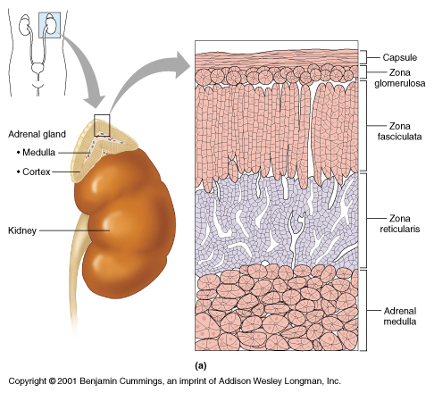

Slide 18
B. Adrenal medulla
Contains chromaffin cells, which secrete the catecholamine (epinephrine and norepinephrine)
Catecholamines released in response to intense emotional reaction , important for fight or flight activities.

Slide 19
pineal gland (pineal body )
is a small, pine cone shaped structure on the roof of the diencephalons
composed of cells called pinealocytes which secrete melatonin (night ) and serotonin (day)
it also influences reproductive system and gonadal activities
it’s activity is influenced by daily cycle of light and dark

Slide 20
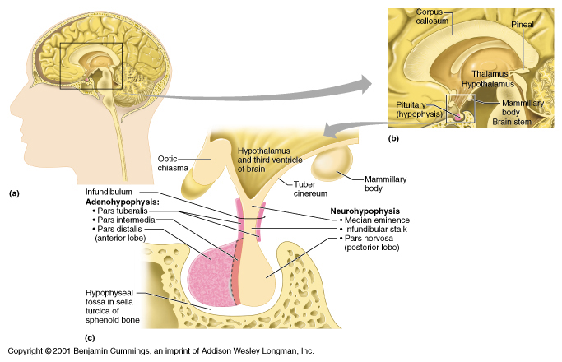

Slide 21
Hypothalamus
it is the neuroendocrine gland
actual production of ADH and oxytocin occurs here
it controls the release of ADH and oxytocin in to the blood
it also secretes many hormone like substances that control body functions such as body temperature , appetite , thirst etc..

Slide 22
The pancreas
Position in the upper abdomen, just under the stomach
The major part of the pancreas, called the exocrine pancreas functions as an exocrine gland, secreting digestive enzymes in to GIT
The endocrine cells of the pancreas are contained in spherical bodies called pancreatic islets or islets of langerhans
The main cell types in the islets are alpha and beta cells

Slide 23
alpha or A cells – secrete glucagons (increase blood glucose level)
beta or B cells – secrete insulin(decrease blood glucose level)
    the pancreatic islets also contain two rare cell types
delta or D cells – secrete somatostatin (a hormone that inhibits the secretion of glucagons and insulin by the near by alpha and beta cells
F cells (PP) cells – secrete pancreatic polypeptide , a hormone that may inhibit the exocrine activity of pancreas

Slide 24
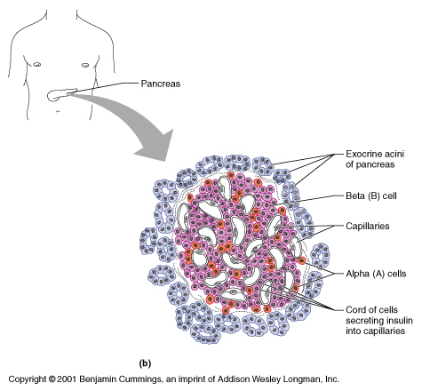

Slide 25
The gonads
Gonads are organs that produce gametes
    sperm in males
    oocytes in female
female sex glands
The two ovaries are the women’s sex glands , located in the pelvic cavity
Each ovary contains two different structures
1. ovarian follicles – secrete estrogen
2. corpus luteum- chiefly secretes progestrone and some estrogen
estrogens maintain the reproductive organs and secondary sex characteristics of females

Slide 26
Progestrone signals the uterus to prepare for pregnancy
These female sex hormones (with FSH and LH )
  regulate menstrual cycle
  regulate oogenesis
  maintain pregnancy
  prepare mammary glands for lactation
  establish and maintain feminine secondary sex characterstics (e.g. breast and wide pelvis

Slide 27
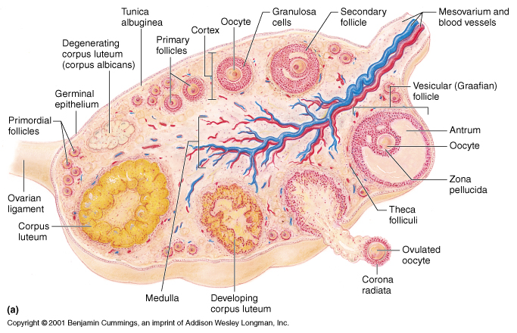

Slide 28
Male sex glands
the male gonads (testes) are oval glands that lie in scrotum, produce sperm and also secrete number of male sex hormones or androgens
the most important androgen is testestrone
the interstial cells in the testis secrete testosterone
testosterone gives the following functions
  masculinizes the individual
  maintain the reproductive organs and accessory organs
  stimulates secondary sex characterstics of males
  promote the formation of sperm
  stimulates descent of testes before birth

Slide 29
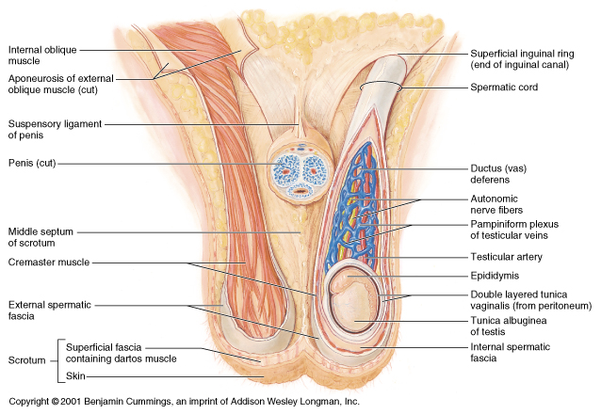

Slide 30
Placenta
Secrets several steroid and protein hormones including estrogen , progestrone and HCG (Human Chorionic Gonadotropin).
During pregnancy the kidneys excrete large amount of chorionic gonadotropins in the urine. This led to pregnancy testes

