Slide 1
Radiologic Image Interpretation for ANAESTHEASIA Students
Ermias A
Radiology resident R3
2021

Slide 2
Course objectives
Name nature and source of radiation
Describe how radiological images are formed
Describe how to prevent or minimize radiation hazards
Interpret common and uncomplicated radiological images

Slide 3
Introduction
Radiology is a medical specialty that employ Medical Imaging Technologies to Diagnose and Treat patients.
Different types of medical images can be made by varying the types of energies used and the acquisition technology.
The different modes of making images are referred to as modalities.
Imaging modalities used in the field of radiology.
Plain x-ray. -- CT scan
MRI -- Nuclear imaging
Ultrasound -- Mammography
Angiography -- Fluoroscopy
Each modality has its own applications in medicine.
Most of the technique use ionizing(electromagnetic ) radiation.

Slide 4
Radiation
The term radiation applies to the emission and propagation of energy through space or material medium
There are two types of radiation
1) Particle radiation
2)Electromagnetic Radiation
Particle radiation
Have definite rest mass
Is the radiation of energy by means of fast moving particles that have energy and mass
E.g -Alpha particle, Beta particle, Neutron, Positrons

Slide 5
Electromagnetic Radiation(EMR)
Consist of energy in small packets called photons.
Example;- Light wave, radio waves, infrared waves, ultraviolet rays, X-ray and gamma-rays
PROPERTIES OF EMR
are composed of transverse vibrations of electric and magnetic fields.
have a wide range of wavelengths and frequencies.
all travel through a vacuum with the same velocity
3 x 10⁸m/s(speed of light)

Slide 6
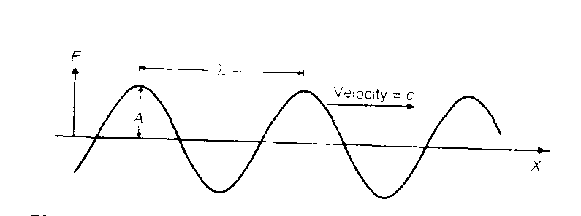
Cont..
travel in straight lines.
EMR waves are transverse wave like wave on string
All EMR wave posses the same three characteristics,
Wave length,
Frequency and
Velocity

Slide 7
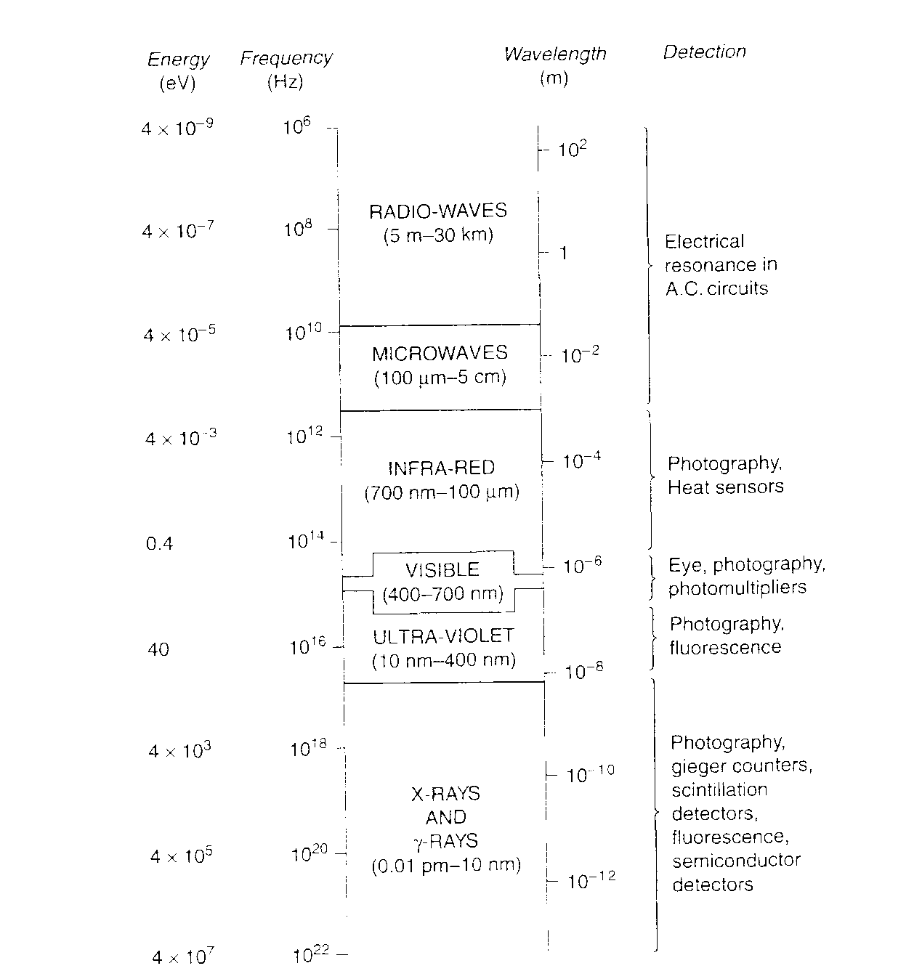
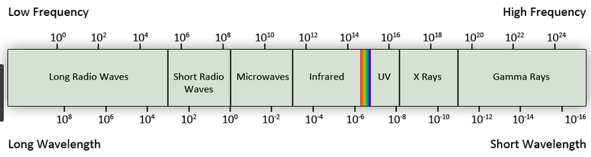
EM wave carry a very wide range of frequencies and wave lengths. (spectrum)

Slide 8
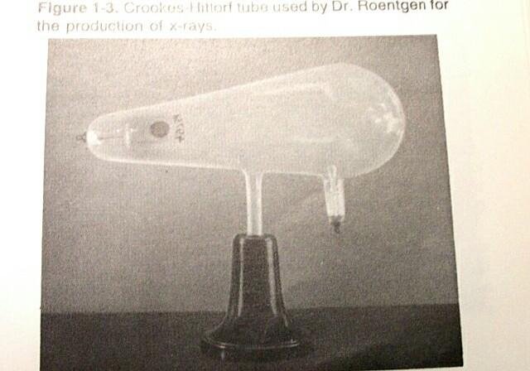
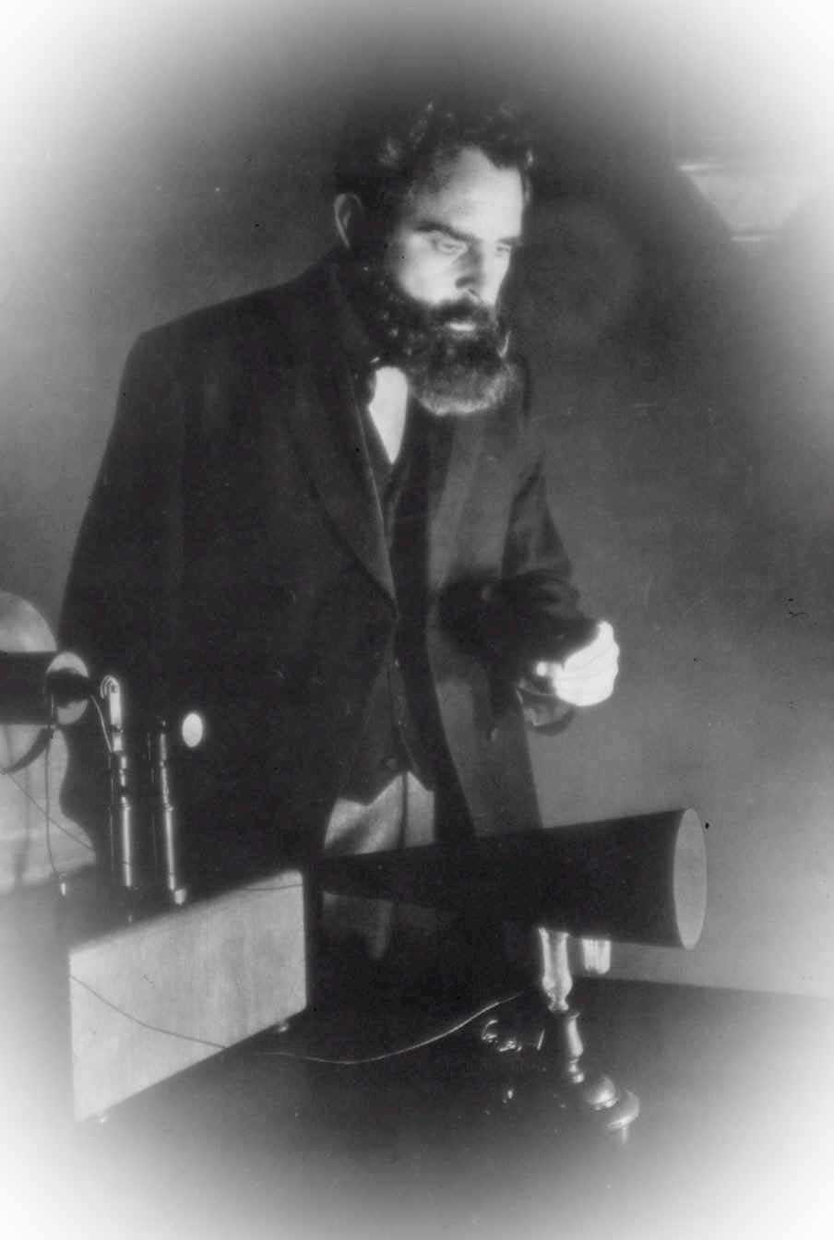
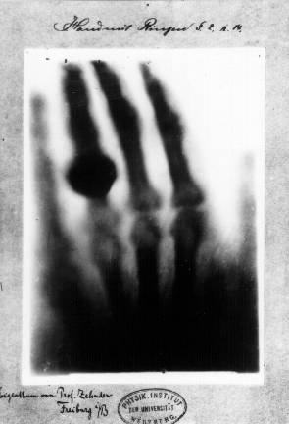
Radiography
Was the first medical imaging technology
Physicist Wilhelm Roentgen discovered x-rays on November 8, 1895.
observed and further documented X-rays while experimenting with vacuum tubes
he observed that certain rays were emitted during the passing of the current through discharge tube.
Made the first radiographic images of human anatomy.
The hand of Röntgen's wife. The image displayed both her wedding ring and bones.
Notes:
he observed that certain rays were emitted during the passing of the current through discharge tube.

Slide 9
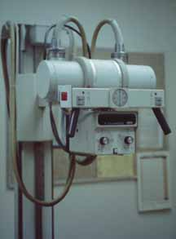
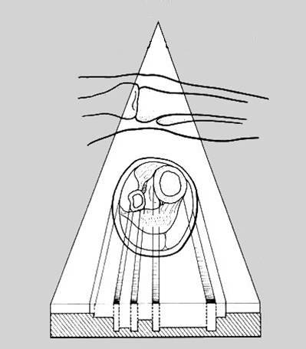
Cont’d
X-ray source
X-ray tube
X-ray beam
Patient
Interaction
Detector
Radiographic film
Electronic detector
Radiography is performed with an x-ray Source on one side of the patient, and a x-ray detector on the other side.
large fraction of the x-rays interacts in the patient, and some of the x-rays pass through the patient and reach the detector, where a radiographic image is formed.

Slide 10
X-Ray Tube
Source of X-ray
Converts electrical energy into
1. Heat energy
→ 99% of incident energy
→ Bad , may destroy the tube ultimately
→ Eliminated by cooling system of the tube
2. X-Rays
→ < 1% of incident energy
→ Good , desired product
X-rays are produced by deceleration of high velocity electrons

Slide 11
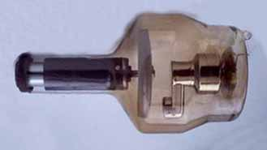
X-Ray Tube Components
*
Housing
Visible part of tube
Insulator and non conductor
Glass Enclosure (insert)
Vacuum
Electrodes
Cathode
Filament
Anode
Target

Slide 12
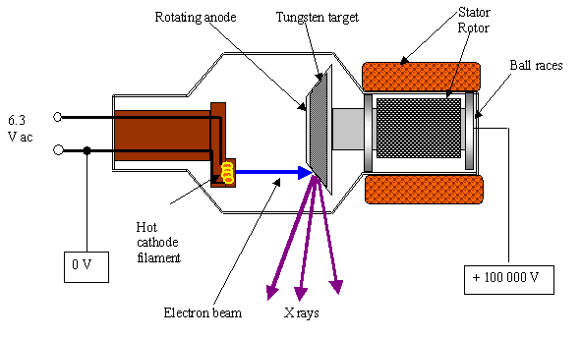
Cathode
Function :- to expel electron from the electrical circuit and focus them into a well defined beam aimed at the anode
The cathodes assembly consists of small coil of wire (filament).
The filament is made up of Tungsten wire.
Tungsten will readily emit electrons by thermionic emission
The cathode assembly is connected to the negative high voltage area.
The filament is heated electronically to a high temperature so that electrons are boiled off from its surface. These electrons form a tube current

Slide 13
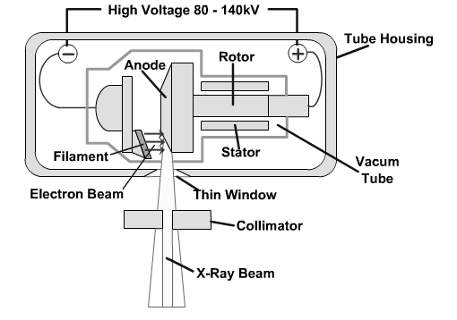
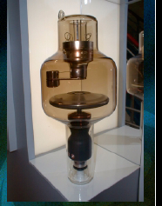
Anode
The anode has two primary functions:
to convert electronic energy into x-radiation
to dissipate the heat created in the process
Consists of a disc made of
Tungsten, molybdenum, rhenium, and graphite are used in the design of anode

Slide 14

X Ray Tube Principles
Artificially X rays are produced by decelerating high-velocity electrons. The apparatus, called X-ray tube, therefore has a source of electrons, a means of accelerating them to high velocities and something to stop them so that they lose their energy.
The electron source is the cathode, heated by a filament. The heated cathode emits electrons.
The anode has a positive voltage (thousands of volts) and attracts the electrons so that they reach a high velocity.
The disc-like surface of the anode also stops the electrons. The X-rays produced go out through the window.
Only a small fraction of the energy is in the form of X-rays, a lot is ‘wasted’ as heat. The anode is specially designed to withstand the heat and the ‘tube’also has a cooling mechanism.
The picture shows only the basic plan of the X-ray tube to illustrate the principle.
Notes:
X-Ray Tube Principle
•Positive (high) voltage applied to anode relative to filament
–electrons accelerate toward anode target
•Gain kinetic energy
–electrons strike target
•electrons‟ kinetic energy converted to
–heat
–x-rays

Slide 15
X-ray interaction
As X-rays from the source pass through the body they interact with a tissue and lose their energy.

Slide 16
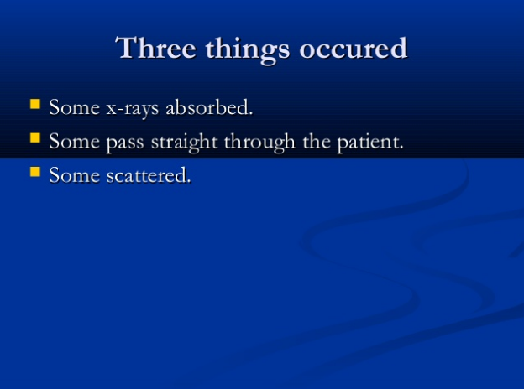
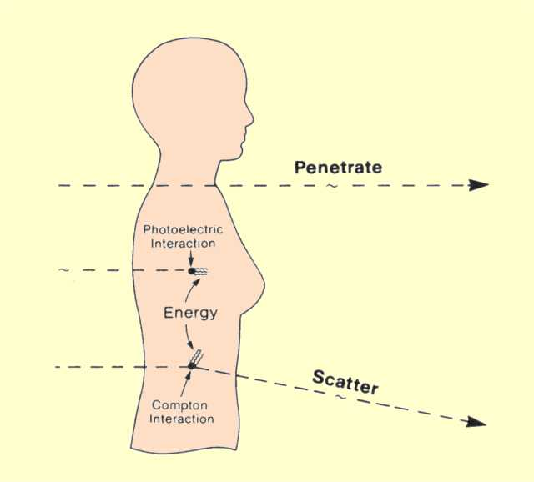

Slide 17
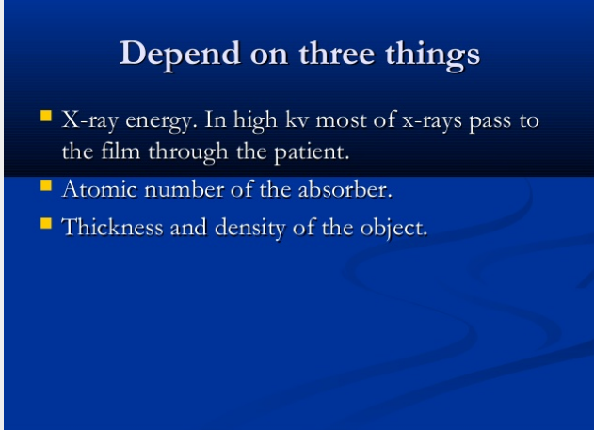
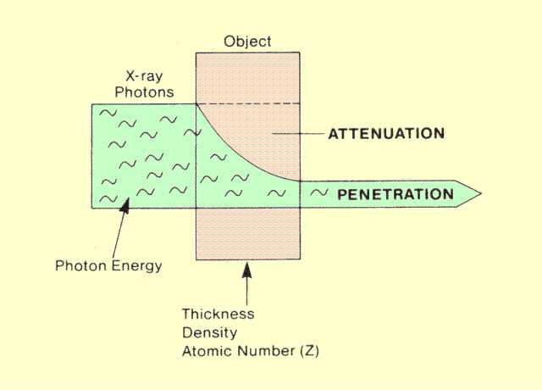

Slide 18
The loss of energy called Attenuation depends on some tissue characteristics.
There are two kinds of interactions through which photons deposit their energy. (with electron)
Photoelectric Interaction ;-The
photon loses all its energy
2. Compton effect (scattering)
It loses a portion of its energy,
and the remaining energy is
scattered.
Notes:
Photon Phate
•absorbed
completely removed from beam
ceases to exist
•scattered
change in direction
no useful information carried
source of noise
•Nothing
Photon passes

Slide 19
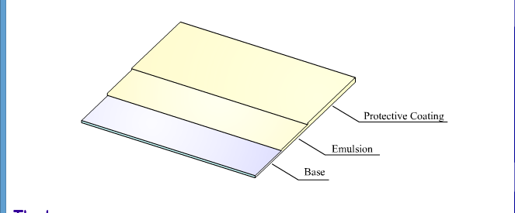
X-ray films
X-rays, after having passed through the body, are made to strike a photographic film.
Provides permanent record of x-ray image.
Made of three layers
1. BASE- part of material on which other material built on
-made of clear, flexible plastic (provide support),
-not radiation sensitive & not for recording
-Adhesive layer- to adhere emulsion layer
2.Emulsion layer-sensitive to radiation and make
latent image
-made of Silver halide (bromide/chloride)
grains
3.PROTECTIVE LAYER-from scratch on film process

Slide 20
Cont’d
The film has a coating of halides (chlorides/bromides) of silver.
The halides affected by X-rays are reduced to metallic silver after treatment with “developers”.
The unaffected (“unexposed”) halides are washed out chemically and the film, rinsed with water, is dried.
The finely particulate silver actually appears dark (rather than shiny!).
Thus, areas of the film exposed by X-rays are dark, unexposed areas are transparent.

Slide 21
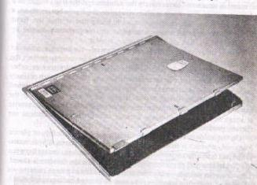
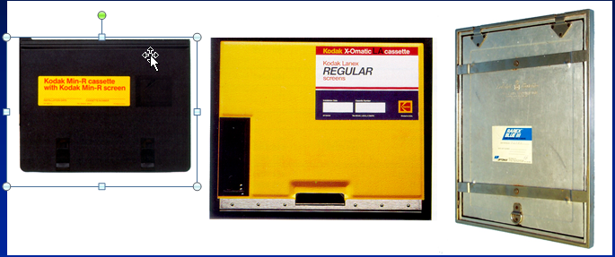
Radiographic cassette
Cassette is small flat box used for film transport.
Cassettes are used in association with intensify screen.
Cassettes have 3 related purposes
(a) Maintain close uniform contact b/n screen and film
(b)Exclude light (light tight)
(c) Protect screen from physical damage(rigid)

Slide 22
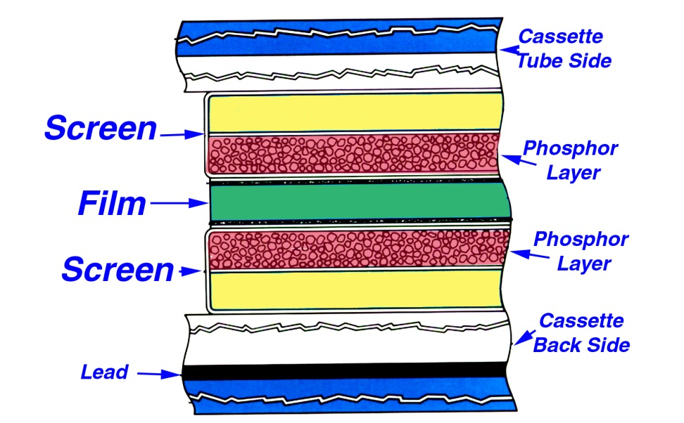
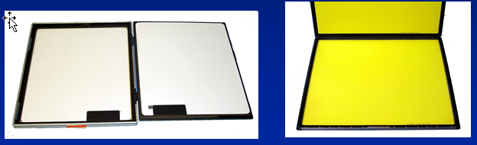
Intensifying screen
When x-rays fall upon a certain substance- light is emitted
Placed in direct contact with the film during exposure
Function is to reinforce the action of x-rays
subject the emulsion(film) to
- light
- radiation

Slide 23
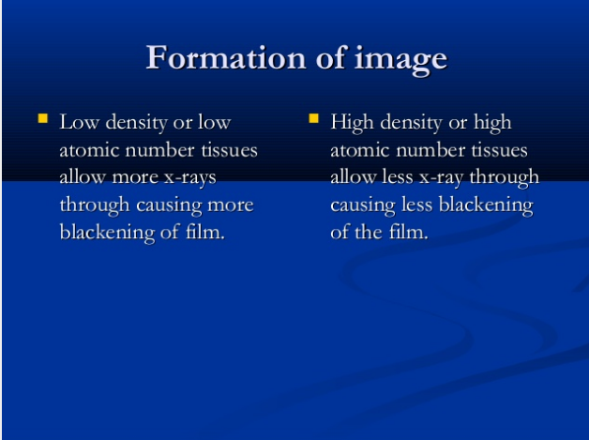

Slide 24
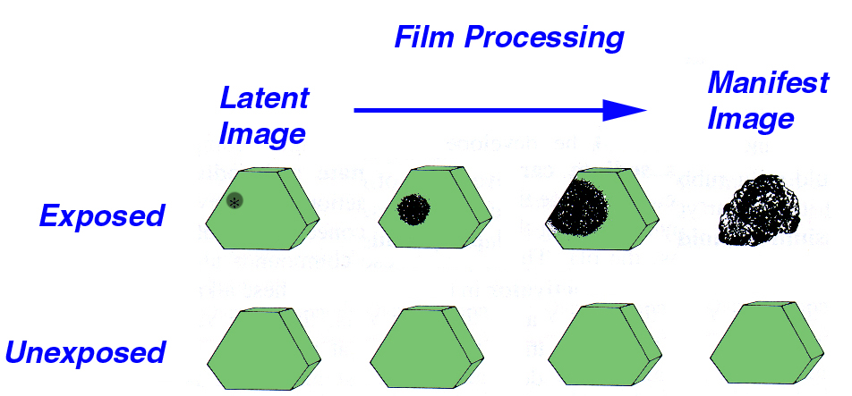
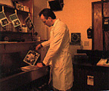
Film processing
Film processing is a
series of chemical
reactions that result
in the formation of a
manifest image
The processing will
convert the exposed
silver crystal into neutral
or metallic silver which
is black
The film is processed in a Dark room.

Slide 25
Steps in Film Processing
Step | Purpose | Manual (Time) | Automatic (time)
Development | Production of a manifest image from the latent image, silver halide grains in the emulsion which have been exposed to light become converted to metallic silver while those which have not exposed remain unchanged e.g methol | 5 min | 22 s
Fixing | Removal of remaining silver halide from the emulsion and hardening of the gelatin e.g . Sodium sulphate | 30 s | 22 s
Washing | Removal of Excess Chemicals By plane or pipe water | 15 min | 20 s
Drying | Removal of water and preparation of the radiograph for viewing, by electric dryer machine or air | 20 min | 26 s

Slide 26
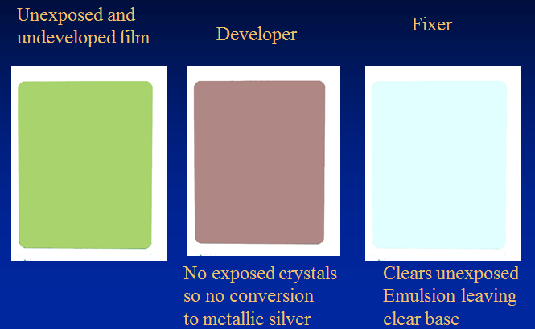
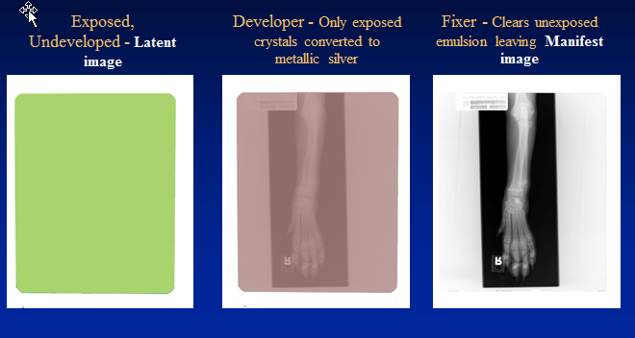
Cont’d

Slide 27
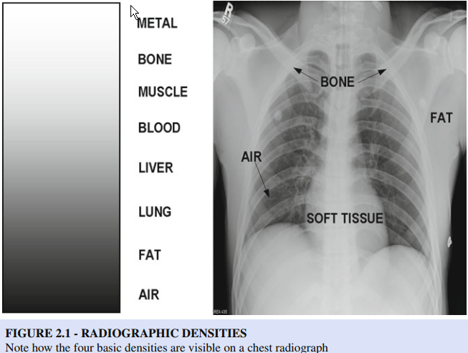
Radiographic Densities
Four basic densities, bone, soft tissue, fat, and air are created on conventional radiograph.
1.Bone– This is the most dense of the four basic densities and appears white or “radiodense”(radiopaque)
2.Soft tissue– All fluids and soft tissues have the same density on a conventional radiograph. This density is slightly less than bone but slightly greater than fat.

Slide 28
Cont’d
3.Fat– This density may seem the least obvious to you. Fat can be seen interposed between various soft tissue and fluid densities. Allows us to see the edges of various soft tissue structures since the fat is slightly less dense than the organs themselves.
4. Air– The lungs, the tracheal lumen, the intestine and the air surrounding the patient are exps of air densities. Air densities are generally quite dark, almost black on the radiograph. Thus, the lungs are not radiodense but are instead said to be “radiolucent.”

Slide 29
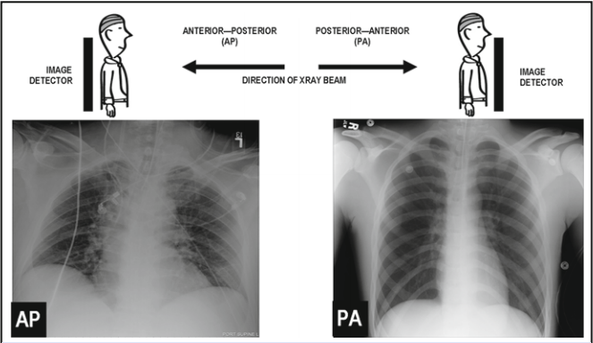
The Radiograph Projection
Named according to the direction in which the X-ray beam passes through the body of the patient when the radiograph is taken.
If the X-ray detector was placed behind the patient and the X-ray tube was placed in front of the patient, the X-rays would pass from the front of the patient through the back of the patient onto the X-ray detector in an anteroposterior ( AP) radiograph.
PA postero anterior --Lateral ( Rt. Or Lt) --Olique

Slide 30
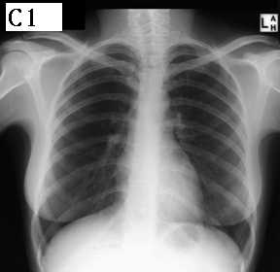
A Chest X-ray
This is a PA view of the thorax.
observe the blackness of the air outside the body.
see the bone (a part of the clavicle) in the oval .
In the oval B, the end of the clavicle is formed by a thin solid plate with a large centre of “spongy” bone.
3.see the appearance of the rib “flat across” the X-ray beam at C and compare with the arrowheads D where greater lengths of the ribs are across the X-ray beam, as the ribs curve around the thorax.
A
B
C
D
Key Points : Think of the anatomy of the structure being viewed. Even bone can have different appearances depending on the thickness it presents to the X-ray beam.

Slide 31
A Chest X-ray
→difference between the air outside the body and air in the lungs – lungs are soft tissue filled with air!
The shape of the heart is unmistakable – notice how the thick muscle wall and the blood that fills the heart create a white image – in places whiter than bone.
Structures in the hilum of the lung can be seen with variable clarity as at A. Again, a blood vessel “end-on” is more opaque than one “across” the beam.
The cervical and upper thoracic vertebrae can be seen in the oval B. The lower thoracic vertebrae are sometimes lost in the heart image, but here they are seen, along with the descending aorta, as a band running down the heart.
B
A
Key Points :
Air containing structures ‘darken’ other superimposed structures.
Thickness makes the heart as opaque as bone!

Slide 32
A Chest X-ray
Now see how thickness matters.
Observe the images of the breasts. The right breast is indicated by the curved line. Note how the image of the breast is pronounced on the lateral and lower side. It is just skin, connective tissue and fat, yet the thickness casts an image. This also tells you that this image is that of a female subject.
Also observe how the thick musculature around the shoulder appears white.
As important, see how the abdominal organs also appear white.
The different shades between black and white in an X-ray image are also referred to as “densities” or “shadows”. We thus speak of bone density, soft tissue density ,air densities
Key Points :
All that is white is not bone!
Understand contrast!

Slide 33
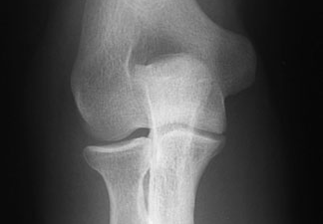
Cartilage
Appreciate joint-forming surfaces of bone are covered by hyaline cartilage. Even though cartilage is tough tissue, it does not have calcium, and radiologically similar to ‘soft’ tissues. The clear bands (arrows) between the bones are areas of cartilage. This is an image of the elbow.
Key Points :
Cartilage is tough, but not opaque to X-rays!
Superimposed parts of two bones appear whiter.

Slide 34
End of part 1
Qns???

