Slide 1

INFERTILITY
Dr Geremew - OB-Gyn R3
SEP 8, 2025

Slide 2
Outline
Definition
Causes
Evaluation
History
Physical Examination
Workup
Treatment approaches

Slide 3
DEFINITIONS
INFERTILITY- the inability to conceive after 1 year of unprotected intercourse of reasonable frequency.
affects 10 to 15% of reproductive-aged couples.
primary infertility-no prior pregnancies, and
secondary infertility-infertility following at least one prior conception.
Most couples will ultimately conceive if given enough time. ➔ SUBFERTILE, rather than infertile
This concept of subfertility can be reassuring to couples
In those attempting conception, approximately
50 % of women will be pregnant at 3 months,
75% will be pregnant at 6 months, and
> 85% will be pregnant by 1 year (Guttmacher, 1956; Mosher, 1991).

Slide 4
DEFINITIONS
FECUNDABILITY is the ability to conceive,
data from large population studies have shown a monthly probability of conceiving of 20 to 25 %.
Fecundity - the probability that a single menstrual cycle will result in a live birth
STERILITY: inability to become/ be induced to become pregnant or to induce pregnancy

Slide 5
Etiology
Female infertility
Ovulatory Dysfunction
Tubal /Peritoneal Factor
Uterine Factor
Cervical Factors
Vaginal Factors
Chronic systemic diseases
Social personal habit(illicit drugs)
Unexplained
Male factors
Pre-testicular
Testicular
Post-testicular
Idiopathic

Slide 6
Etiology of Infertility
Male factor-------25%
Ovulatory----------27%
Tubal/ uterine----22%
Other---------------9%
Unexplained------17%

Slide 7
Ovulatory Dysfunction
Hypothalamic Disorders
Anterior pituitary disorders
Ovarian Abnormalities
Premature Ovarian Failure (POF)
Androgen excess
Polycystic ovarian syndrome
Nonclassic congenital adrenal hyperplasia
Androgen-secreting tumors NMS
Decreased ovarian reserve

Slide 8
Ovulatory Dysfunction
1. Hypothalamic Disorders
result in Hypogonadotropic Hypogonadism
Acquired-
eating disorders,
stress or
extreme exercise
Inherited-
Kallmans Syndrome/ idiopathic hypothalamic hypogonadism

Slide 9
OVULATORY DYSFUNCTION
2.Anterior Pitutary Disorders
Result in Hypogonadotropic hypogonadism
Adenomas –
most commonly prolactinomas
Others that may compress gonadotropes or anterior P stalk
Destruction by infiltrating tumors, sarcoidosis, TB, inflammation
Hyperprolactinemia
Medications (many medication classes, including antipsychotics that are dopamine receptor antagonists; a typical example is haloperidol)
Pituitary tumors
Hypothyroidism (Increased thyrotropin-releasing hormone [TRH] secretion stimulates prolactin secretion.) NMS

Slide 10
OVULATORY DYSFUNCTION
3. Ovarian abnormalities-
Premature Ovarian Failure (POF)- loss of ovarian function before 40
At 35 1/ 250 at 40 1/ 100 woman
POF results in Hypergonadotropic Hypogonadism
↑ LH, FSH, ↓ E, P
menst irregularity,amenorrhoea,
Symptoms of Hypoestroginism-hot flashes, genital atrophy
Family history of POF, up to 10% of cases of POF may be familial.

Slide 11
OVULATORY DYSFUNCTION
POF causes
Chromosomal
45X0 (Turner’s Syndrome)
Mosaicism ( 45X/46XX, 45X/ 46XY)
46XX with defective X chromosome
→ long arm deletion, Partial X chr Deletion, Fragile X chromosome syndrome, ---
Gondal agenesis 46XX
Gonadal dysgenesis 46XY
Other POF causes
Autoimmunity, Infection,
Iatrogenic→ chemo/radiotherapy, surgical removal of ovaries
Resistant ovary syndrome
Enzyme deficiencies ( 17 alpha OH, aromatase)
Galactosemia ( toxic to oogonia)
Idiopathic

Slide 12
OVULATORY DYSFUNCTION
4. Habits
Smoking
accelerated follicle depletion + mutation in gametes (and early embryos)
Alcohol
heavy alcohol intake decreases fertility in women
Based on a number of studies, 5 to 8 drinks per week negatively impacts female fertility
MALE-heavy alcohol intake has been associated with a decrease in sperm counts and increase in sexual dysfunction in men
Caffein- increased dose response r/nship b/n Caffein and infertility and miscarriage
illicit drugs

Slide 13
Ovulatory Dysfunction
5. Age related Infertility (Depletion of Ovarian reserve)
Advancing age→ loss of viable oocytes ( depletion of ovarian reserve + genetic abnormality in the remaining like mitochondrial deletions )→ decreased fertility/ increased misscarriage/Infertility
Miscarriage risk at> 40yrs ~ 50-75%
No of follicles
7million at mid gestation
3m at birth
300,000at puberty
< 1000 at onset of menopause

Slide 14
Female Aging and Infertility
Female Age (years) Infertility
20–29 8.0%
30–34 14.6%
35–39 21.9%
40–44 28.7%

Slide 15
TUBAL + PERITONEAL FACTORS
Pelvic adhesion and/ tubal obstruction
Manifest with chronic pelvic pain and dysmenorrhoea
Interfer with tubal motility, ovum pick up and transport of fertilized ovum
RFs
Hx of Pelvic infections/PID
Hx of ectopic pregnancy- tubal damage even with medical treatment
Hx pelvic surgery- residual adhesions are inevitable
Emdometriosis -chronic bleeding and inflammation→ tubal obstruction or pelvic adhesion

Slide 16
UTERINE FACTORS
Congenital Anomalies
In general, developmental uterine anomalies are not causative for infertility, but may be associated with miscarriage or later fetal loss, creating a management dilemma
Acquired Abnormalities
Endometrial Polyps-3-5% of women
Intermenstrual and postcoital bleeding
Leiomyomas- implantation
Ashermans Syndrome/ synechae

Slide 17
Cervical Factor
Mucus inadequacy/ hostile mucus
Chronic infection,
cervical surgery Eg Chryotherapy, LEEP, Conization
anti E rx ( Chlomiphe Citrate for OI),
Sperm antibodies
Unexplained ( most)

Slide 18
EVALUATION OF PATIENT

Slide 19
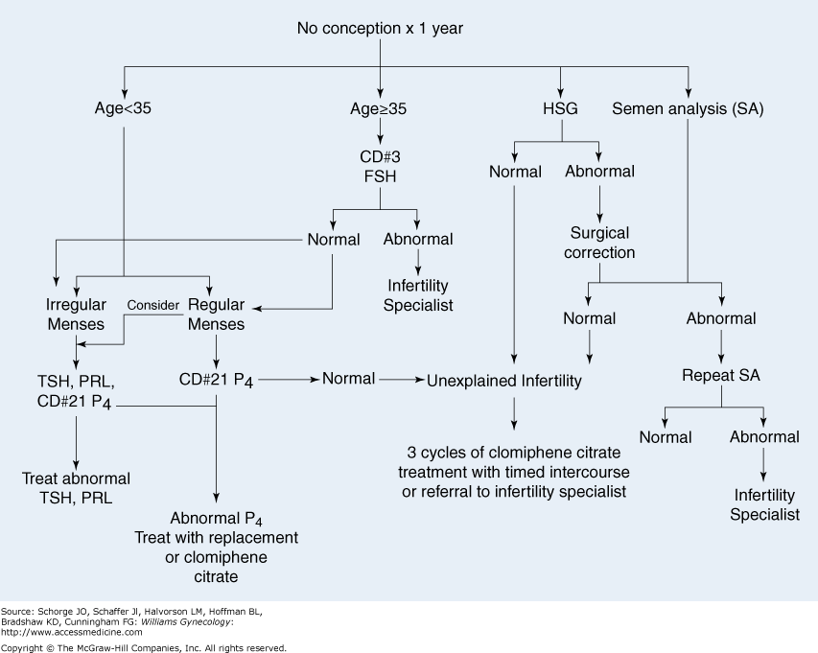

Slide 20
Evaluation
The infertility evaluation can be conceptually simplified into confirmation of:
ovulation,
normal female reproductive tract anatomy, and
normal semen characteristics.

Slide 21
Evaluation
Timing
After an attempt to conceive for one year
Earlier initiation ( as soon as possible) of evaluation is recommended for
those with Hx PID or pelvic surgery
anovulatory woman (with irregular or absent menses)
old age (>35-40),
heavy smokers or in women with a history of ovarian surgery, chemotherapy, or pelvic irradiation
stigmata of chromosomal abnormalities(eg turners syndrome) or
a significant history in the male partner

Slide 22
Female History
GYNECOLOGIC
Duration of infertility, 1⁰ Vs 2^{0 infertility}
Menstrual history-
Frequency, duration, recent changes in pattern, dysmenorrhoea, hot flashes
Coital HX
Frequency , dyspareunea (? Endometriosis)
Prior use of contraceptives
Hx of recurrent ovarian cysts, endometriosis, leiomyoma, STI/ PID
Prior conception ( tubal patency and ovulation HX)
Pregnancy complications
eg. miscarriage, EP, preterm delivery, retained placenta, postpartum D & C, chorioamnionitis or fetal anomalies should be noted
Abnormal pap smears + cervical conization→ abnormal cervical mucus + cervical incompetence

Slide 23
Female History
Gynecologic Hx.
Menstrual Pattern- ovulation is likely with
cyclic menses Q 25-35 days, 3-7 days duration
MITTELSCHMERZ,
midcycle pelvic pain associated with ovulation
MOLIMINAL SYMPTOMS
breast tenderness, acne, food cravings, and mood changes
DYSMENORRHEA,
Ovulatory cycles are more likely to be associated with dysmenorrhea, although severe dysmenorrhea may suggest the presence of endometriosis

Slide 24
Female History
Medical
Symptoms of hyperprolactinemia, hypothyroidism, Kallmans s
Symptoms of androgen excess
Eg hirsuitism, acne→ PCO, CAH
Prior chemo / and radiotherapy → ovarian failure
Medications Eg.
NSAIDS ( ovulation inhibition → luteinized unruptured follicle syndrome
antipsychotics ( phenothyazines??→block dopamine Rs →↑PRL
MAOs→ ↓catecholamines→↑PRL→annovulation + amenorrhoea
SURGICAL
History of pelvic and abdominal surgery→ pelvic adhesion, tubal blockage, Intraux adhesion

Slide 25
Female History
SOCIAL
Eating habits ( AN , BN), exercise and stress
→ hypothalamic functional amrnorrhoea + anovulation
BMI <17 & >25 associated with GnRH and gonadotropin secretion Abnormalities
Smoking
accelerated follicle depletion + mutation in gametes (and early embryos)
High failure rate of ART
Increased miscarriage + trisomy 21
Alcohol
heavy alcohol intake decreases fertility in women
Based on a number of studies, 5 to 8 drinks per week negatively impacts female fertility
heavy alcohol intake has been associated with a decrease in sperm counts and increase in sexual dysfunction in men

Slide 26
Female History- SOCIAL CONTD
CAFFEIN
1cup of coffee ~ 115 mg caffein
Caffeine consumption has also been linked to decreased fecundability.
Most studies suggest that consumption of > 250 mg caffein per day by the female partner is associated with a modest, but statistically significant, decrease in fertility and increase in time to conception.
Caffeine intake greater than 500 mg per day has also been demonstrated to increase recurrent miscarriage rates

Slide 27
Female History-SOCIAL CONTD
Illicit drugs may also impact fecundability.
Marijuana suppresses the H-P- gonadal axis in both men and women, and
cocaine can impair spermatogenesis
Env’tal Exposures
Heavy metals and Pesticides should also be avoided, may decrease fertility rates as well as increase the risk of recurrent miscarriage (Orejuela, 1998).
Although uncommon, fecundability is reduced with occupational exposure to the dry cleaning fluid Perchloroethylene, and to Toluene used in the printing business.

Slide 28
Female History
FAMILY HISTORY
of infertility, POF, recurrent miscarriage, or fetal anomalies may point to a genetic etiology.
Although the inheritance pattern is complex, data suggest that both PCOS and endometriosis occur in familial clusters

Slide 29
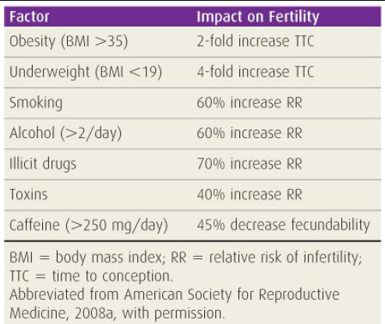
Obesity and Environmental Factors Vs Fertility

Slide 30
Female PE
Vital signs, height, and weight
BMI <17 & >25 associated with GnRH and gonadotropin secretion Abnormalities
Hirsutism, alopecia, or acne indicates the need to measure androgen levels.
Acanthosis nigricans is consistent with insulin resistance associated PCOS or much less commonly, Cushing syndrome.
Galactorrhea- Hyperprolactinemia
Skin Hyperpgmentation~~ adrenal insufficiency
Stigmata of Turners syndrome- short sture, schield chest
thyroid abnormalities- Goitre~~Aimmune Thyroiditis

Slide 31
Female PE
A PELVIC EXAM
Inability to place a speculum through the introitus may raise doubts about coital frequency.
Estrogen Adequacy- moist and ruggated vagina, and a reasonable amount of cervical mucus ,
Hypoestrogenism-atrophic vaginitis
uterus-
enlarged or irregularly shaped uterus ~ leiomyomas,
fixed uterus ~ presence of pelvic scarring due to endometriosis or prior pelvic infection.
Uterosacral nodularity or ovarian masses may additionally implicate endometriosis.

Slide 32
Female PE
All women should have a normal Pap smear result within the year preceding treatment.
Cultures for Neisseria gonorrhoeae and Chlamydia trachomatis should be Negative --> to avoid ascending infection on cervical manipulation .
Breast- bilateral discharge→ galactorrhoea due to hyperprolactinemia

Slide 33
Laboratory
The initial laboratory tests to consider for the female partner include
CBC, blood type and antibody screen,
Cervical cytology,
TSH , serum prolactin
Routine prenatal labs including rubella antibodies,HBSAG , HIV and rapid plasma reagent (RPR).

Slide 34
Summary of Workup
Ovulatory dysfunction
Serum midluteal progesterone
Ovulation predictor kit
Early follicular FSH ± estradiol level (ovarian reserve)
+ Serum AMH level
± Serum measurements (TSH, prolactin, androgens)
± Ovarian sonography
Follicle Dvt & collapse→ovulation
Early F antral follicle count- < 10→ ↓ ovarian reserve→↓response for gonadotropin stimulation
PCOS
± Basal body temperature chart
± Endometrial biopsy (luteal phase defect)???

Slide 35
Summary of Workups
Tubal/pelvic disease
HSG
Laparoscopy with chromotubation
Uterine factors
HSG
Transvaginal sonography
Saline-infusion sonography
MRI
Hysteroscopy
Laparoscopy
Cervical factor
± Postcoital test
Male factor
Semen analysis

Slide 36
Evaluation of the male Partner
History
Pubertal development
Sexual dysfunction
Erectile D + decreased beard→ low testosterone level
Ejacualtory dysfunction , dev’tal anomalies
Eg Hypospadia→ sboptimal semen diposition
STI, GU infections ( Epidimytis,Prostatitis)→ VD obstruction
Mumps→ abnormal sperm stem cells 2⁰ to testicular inflammation
Cryptorchidism, testicular torsion . Trauma→ abnormal spermatogenesis
Varicocele → increased scrotal temprature
Effect of V on fertility- controversial

Slide 37
Evaluation of the male Partner
Illicit drugs,
alcohol, environmental toxins
Anabolic steroids→ supress intratesticular Testosterone production→decreased sperm production ( may have irreversible effect)
Medical Hx
DM, HTN, Neurologic disorders→ Erectile dysfunction, Retrograde ejaculation
Chemo or localized radiotherapy
Medications that worsen semen parameters
Eg cimetidine, erythromycin, TTc, Gentamycin, spironlactone

Slide 38
Evaluation of the male Partner - PE
As signs of testosterone production, normal SSCs.
Gynecomastia or eunuchoid habitus
The penile urethra should be at the tip of the glans
Testicular length should be at least 4 cm with a minimal testicular volume of 20 mL.
A testicular mass may indicate testicular cancer
The epididymis should be soft and nontender to exclude chronic infection. Epididymal fullness may suggest vas deferens obstruction.
pampiniform plexus of veins should be palpated for varicocele (Jarow, 2001).
The prostate should be smooth, nontender, and normal size.

Slide 39
Male Workups
Causes of male infertility can roughly be categorized as
Abnormalities of sperm production,
Abnormalities of sperm function, and
Obstruction of the ductal outflow tract.

Slide 40
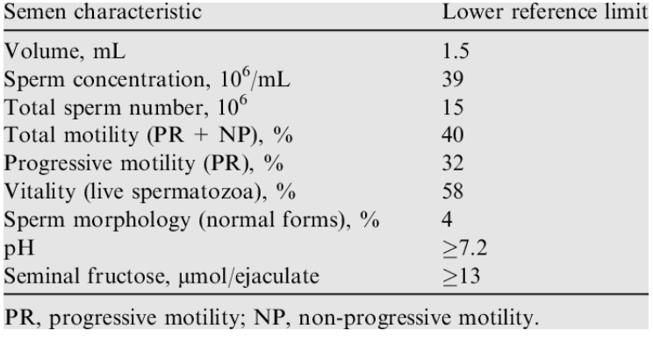
Male Workup- Semen analysis
Reflects events of the past 3months
spermatogenesis requires an overall 90days
Refrain from coitus for 2-3 days- masterbate/ Elastic non lubricated condom--Sample to lab within one hr
Ideally the test is done 2x- at least a month apart (once if N result)
The standard semen analysis consists of the following:
Semen volume and pH
Microscopy for:
Sperm concentration, count, motility, and morphology
Debris and agglutination
Leukocyte count
Immature germ cells

Slide 41
Male Infertility Workup
Other workups for male infertility include
Antisperm antibodies assay
DNA Fragmentation test
Sperm Function assays
Mannose fluoresence assay
Hemizonal assay
Sperm penetration assay
Acrosomal reaction
Hormonal Tests
FSH
Testosterone
Prolactin
Tyroid Function Tests
Testicular Biopsy
Male Genetic testing

Slide 42
TREATMENT

Slide 43
Infertility Rx
Treatment of infertility depends on
cause
Duration of problem
Age (esp. of females)

Slide 44
Infertility Rx
Life style Therapy
Correction of identified causes
Correction of ovarian dysfunction
Ovulation Induction- Stimulation of ovulation
Common ovulation inductions agents
Clomiphene citrate
CC + glucocorticoids
Insulin sensitizers--Biguanides and Thiazolidinediones
Gonadotropins
Aromatase inhibitors
Hyperprolactinomeia rx
Correction of Anatomic Abnormalities
ART- Assisted reproductive technology
Invitro Fetilization( IVF )
Intracytoplasmic Sperm Injection (ICSI)
Gestational Carrier Surrogacy
Egg donation
Gamete Intrafallopian Transfer (GIFT)

Slide 45
THANK YOU

