Slide 1
PELVIC ORGAN PROLAPSE AND URINARY INCONTINENCE
Dr. Edimealem (OB-GYN Year 3 Resident)

Slide 2
Outline
Definition
Classification
Diagnosis
Management

Slide 3
Pelvic organ prolapse
Pelvic organ prolapse is a common condition that can lead to genital tract dysfunction and diminished quality of life.
For POP to be considered a disease state in a given individual, sxs should be attributable to pelvic organ descent such that surgical or nonsurgical reduction relieves the symptoms, restores function and improves quality of life.

Slide 4
Risk factors for the development of POP
Pregnancy
Vaginal childbirth
Menopause
Aging
Hypoestrogenism
Chronically increased IAP
COPD
Constipation
Obesity
Pelvic floor trauma
Genetic factors
Race
Connective tissue disorders

Slide 5
Pelvic support structures
Bones: Ilium, ischium and pubis fusion
Ligaments: Uterosacral-Cardinal Complex
Fascial: Endopelvic (pubocervical & rectovaginal)
Muscles
Obturator internis muscle
Arcus tendineus levator ani or white line
Levator ani muscles
Urethral and anal sphincter muscles

Slide 6
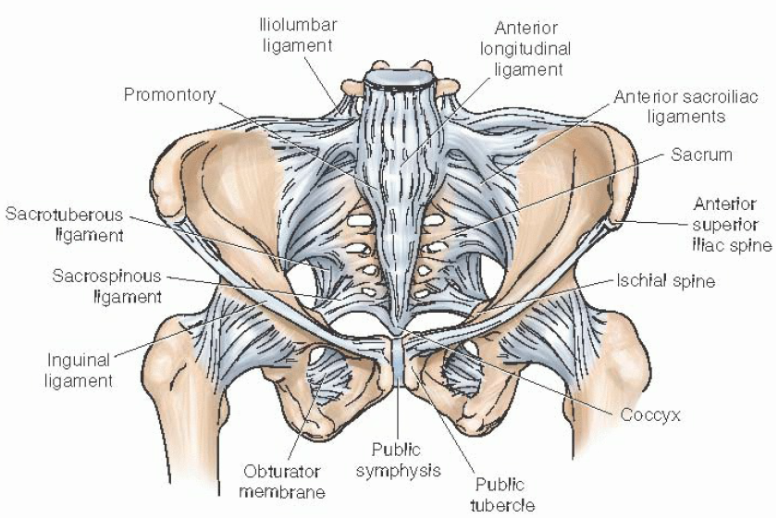
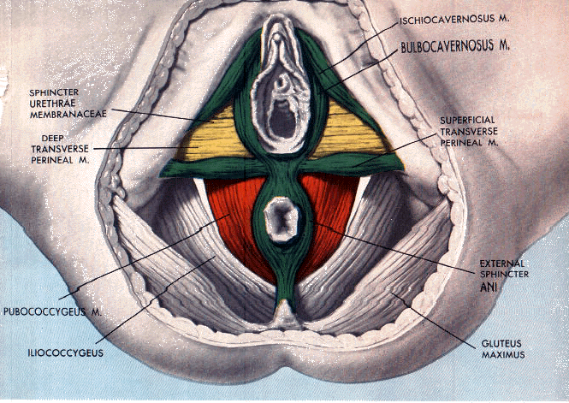

Slide 7
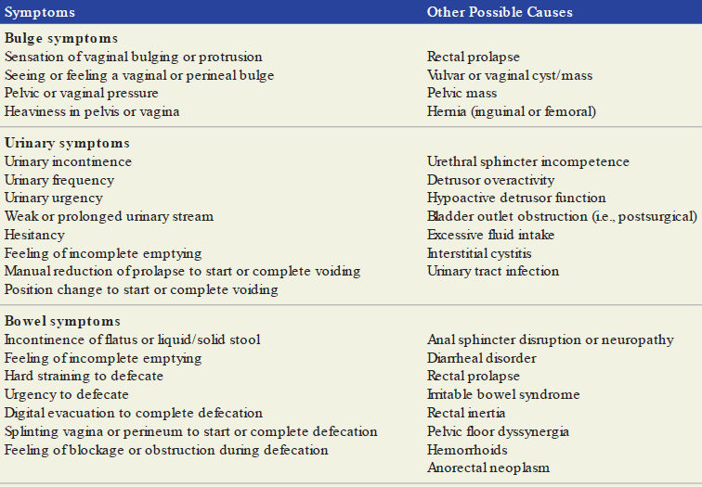
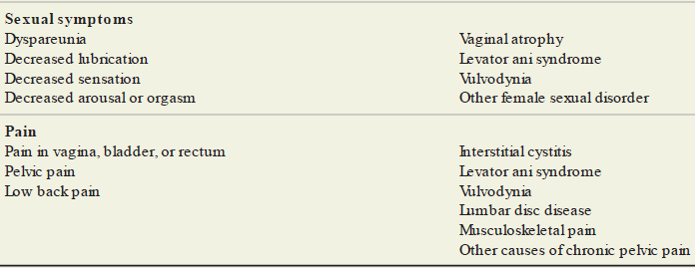
Clinical manifestation

Slide 8
PHYSICAL EXAMINATION
Perineal examination
Bulbocavernosus reflex
Anal wink reflex
Vaginal examination
Visual inspection
Speculum examination
Bimanual pelvic examination
Rectovaginal examination
Neuromuscular examination

Slide 9
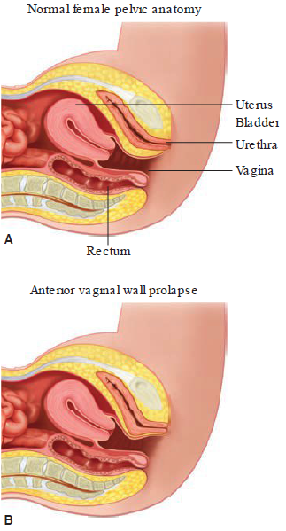
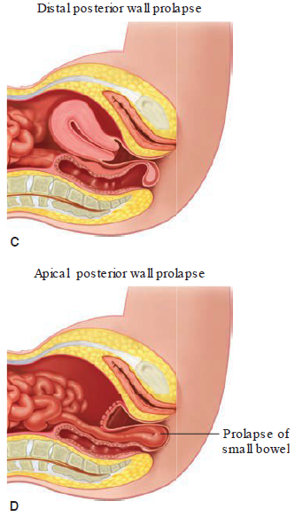
Sagittal view of pelvic anatomy
Normal pelvic anatomy.
Anterior vaginal wall prolapse or cystocele.
Distal posterior wall prolapse or rectocele.
Apical posterior wall prolapse or enterocele.

Slide 10
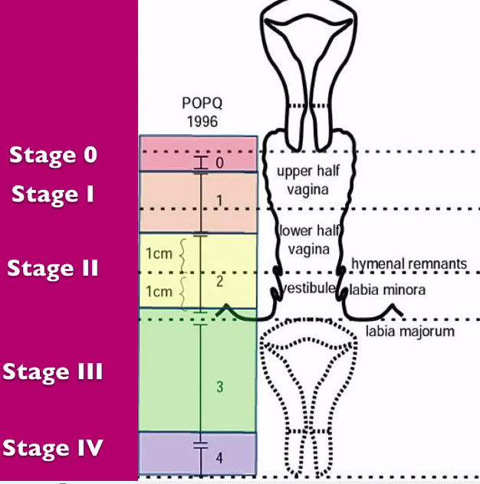
POP-Q staging system of pelvic organ support
STAGE 0: No prolapse is demonstrated during maximal straining.
STAGE I: The most distal portion of the prolapse is >1 cm above hymen (< -1 cm).
STAGE II
The most distal portion of prolapse is ≤1 cm proximal to or extends 1 cm through the plane of hymen (≥ -1 cm, but ≤ +1 cm).
STAGE III
The most distal portion of the prolapse is > 1cm below hymen but no further than 2 cm less than the TVL (there is not complete vaginal eversion) => ( > +1 cm, but < + [TVL-2] cm).
STAGE IV
Complete eversion of the vagina (≥ + [TVL-2] cm). In most, the leading edge of stage IV prolapse is the cervix or vaginal cuff scar.

Slide 11
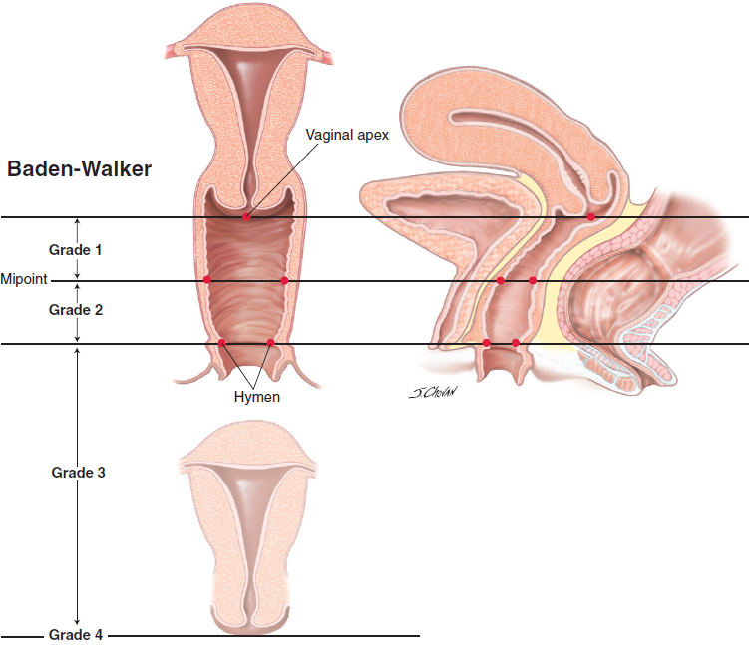
Baden-Walker halfway system for staging POP
This descriptive tool is also used to classify prolapse during physical examination and is widely used.
The most dependent position of the pelvic organs during maximum straining or standing & descent of the anterior vaginal wall, posterior vaginal wall, or apical prolapse can be graded with this system.
Grade 0 => No prolapse
Grade 1 => Halfway to hymen
Grade 2 => To hymen
Grade 3 => Halfway past hymen
Grade 4 => Maximum descent

Slide 12
Approach to treatment
Treatment choice depends on the
Type and severity of symptom
Age and medical comorbidities
Desire for future sexual function and/or fertility and
Risk factors for recurrence.
Treatment goals strive to provide symptom relief, but therapy benefits should always outweigh risks.

Slide 13
TREATMENT APPROACH
There are 4 modes of mx.
Expectant
Mildly symptomatic and asymptomatic.
Patient counseling.
Rx of worsening condition.
Estrogen replacement.
Pelvic floor exercise.
Periodic evaluation.
Nonsurgical: Kegel's exercise; pessaries
Surgical: abdominal: vaginal.
Pharmacologic: estrogen; rx of promoting factors; modification of urinary complaint.

Slide 14
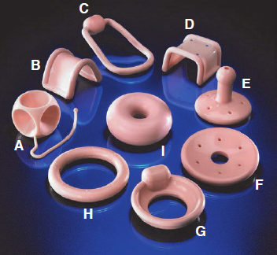
Types of Milex pessaries
Cube pessary
Gehrung pessary
Hodge with knob pessary
Regula pessary
Gellhorn pessary
Shaatz pessary
Incontinence dish pessary
Ring pessary
Donut pessary

Slide 15
URINARY INCONTINENCE

Slide 16
Definition
Urinary incontinence is defined as involuntary leakage of urine.
This is in contrast to urine that leaks from extraurethral sources, such as with fistulas or congenital malformations of the LUT.

Slide 17
Cont’…
Urinary incontinence can significantly impair quality of life and lead to
Disrupted social relationships
Embarrassment and frustration
Hospitalizations due to skin breakdown and UTI and
Nursing home admission.
An incontinent elderly woman is 2.5x more likely to be admitted to a nursing home than a continent one.

Slide 18
Classification
Among ambulatory women with urinary incontinence
The most common type is SUI => 29 – 75% of cases
UUI accounts for 33% of cases
The remainder is attributable to mixed forms.

Slide 19
Risk factors
Age
Obesity
Smoking
Pregnancy
Childbirth
Menopause
Urinary symptoms
Cognitive impairment
Functional impairment
Chronically IAP:
Chronic cough
Constipation
Occupational lifting

Slide 20
Causes of two main types of incontinence
Stress incontinence
Urgency incontinence
Low closure pressure in the urethra
IAP (cough, sneeze)
Impairment
Urethral sphincter insufficiency
Endopelvic fascial stretch or tear
Levator ani muscle weakness
Pudendal neuropathy
Uncontrolled detrusor ms contractions
Impairment
Increased bladder sensation
Urinary tract infections
Poorly compliant bladder wall
Idiopathic

Slide 21
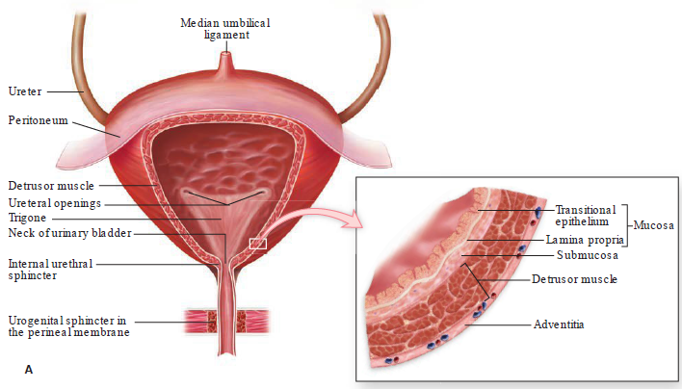
Bladder anatomy
Bladder wall contains mucosal, submucosal, muscular & adventitia.
The plexiform arrangement of muscle fibers of detrusor ms cause difficulty in defining its 3 distinct layers

Slide 22
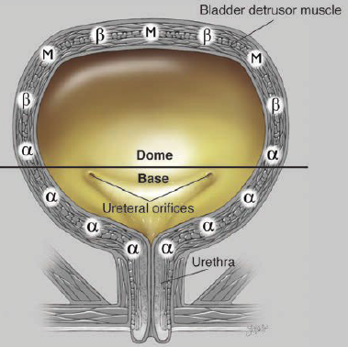
The bladder dome is rich in
Parasympathetic muscarinic receptors (M) &
Sympathetic β-adrenergic receptors (β).
The bladder neck contains greater density of sympathetic α-adrenergic receptors.

Slide 23
DIAGNOSIS
History: Symptom clustering
Urinary sxs complaints may be collected through direct conversation but can be augmented with patient questionnaires.
Two common forms are Pelvic Floor Distress Inventory and Pelvic Floor Impact Questionnaire.
Both are available in long & short forms and evaluate urinary, bowel & prolapse sxs.

Slide 24
The three Incontinence Questions (3IQ)
During the last 3 months, have you leaked urine (even a small amount)?
a. Yes (continue questions)
b. No (questionnaire completed)
During the last 3 months, did you leak urine: (mark all that apply)
a. When you were performing some physical activity, such as coughing, sneezing, lifting, or exercise?
b. When you had the urge or feeling that you needed to empty your bladder, but you could not get to the toilet fast enough?
c. Without physical activity and without a sense of urgency?
During the last 3 months, did you leak urine most often: (mark only one)
a. When you were performing some physical activity, such as coughing, sneezing, lifting, or exercise?
b. When you had the urge or feeling that you needed to empty your bladder, but you could not get to the toilet fast enough?
c. Without physical activity and without a sense of urgency?
d. About equally as often with physical activity as with a sense of urgency?
The response to question 3 with (a) or (b) indicates stress-predominant or urgency-predominant incontinence, respectively, whereas (d) indicates mixed and (c) suggests another cause of incontinence.

Slide 25
Voiding diary
Recorded for 3 – 7 days
Moreover, this diary information can serve as a baseline against which treatment effectiveness can be assessed.
Bladder Diary: Please record the time and amount of your oral intake, UOP, urine leakage, and pad changes for 3 days
Time | Oral intake | Voided urine | Urine leakage or pad change

Slide 26
Past medical history
Urinary symptoms
Urinary frequency
Nocturia
Urinary retention
Inability to void or impeded urinary stream
Volume of urine lost
Postvoid dribbling
Hematuria
Dementia/delirium
Infection
Atrophic vaginitis
Psychological
Pharmacologic
Endocrine
Restricted mobility
Stool impaction

Slide 27
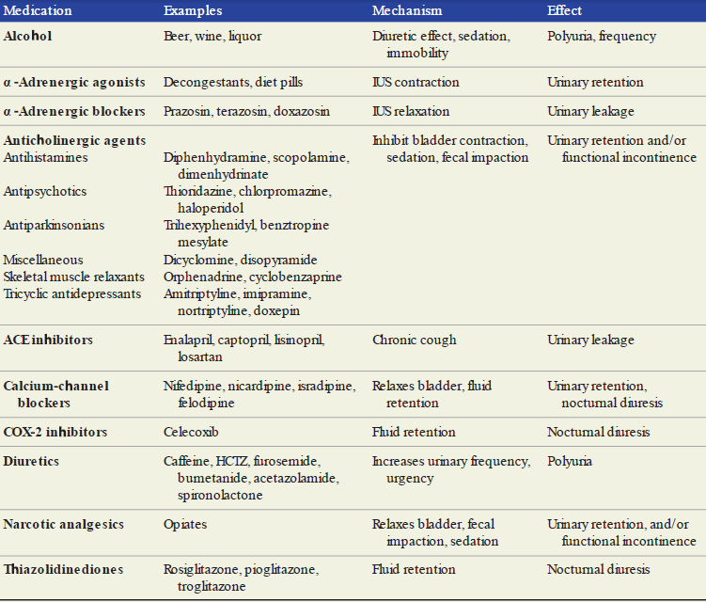
Medications that may contribute to incontinence

Slide 28
Physical examination
General inspection and neurologic evaluation
Pelvic support assessment- Q-tip test
Bimanual and rectovaginal examination

Slide 29
Diagnostic tests
Urinalysis and culture
Postvoid residual volume
Urodynamic studies
Simple cystometrics
Multichannel cystometrics
Uroflowmetry
Cystometrography
Pressure flowmetry

Slide 30
Treatment
Expectant
Pessary
Pharmacologic
Surgical

Slide 31




መልካም አዲስ አመት ፤ እንቁጣጣሽ!

