Slide 1
Acquired heart disease in children
Dr.Michael D.(R3)

Slide 2
Acquired heart disease in children
Rheumatic fever/ Rheumatic heart disease
Infective endocarditis
Myocarditis
Cardiomyopathy
Pericarditis

Slide 3
Acute Rheumatic Fever
Most Common acquired heart disease in developing countries 300 - 500/100,000
Patients 5 - 14 years consist of 72% of the cases
Mortality dropped from 8 - 30% to zero
“ Acute Rheumatic Fever licks the joint and bites the heart”

Slide 4
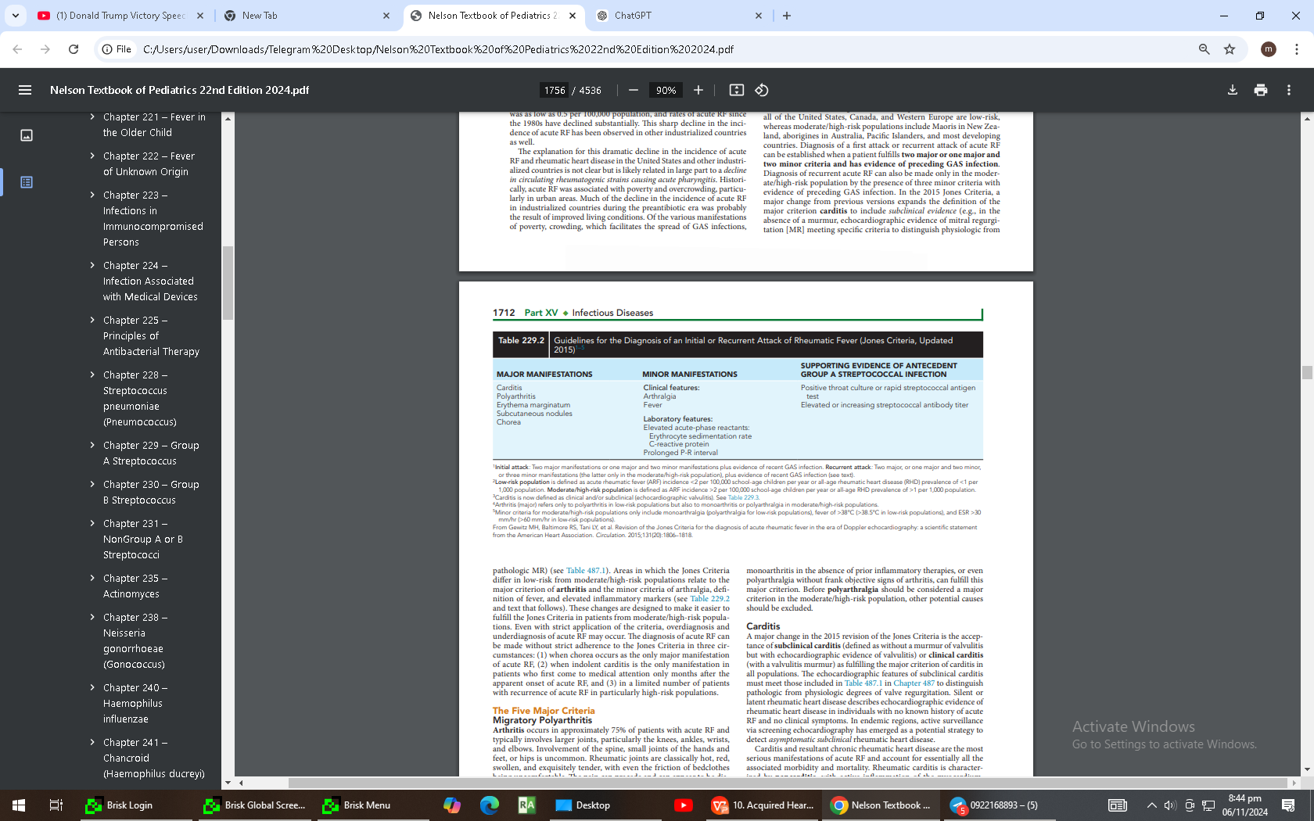
Jones Criteria

Slide 5
ARF – Carditis
Found in 60% - 90% of cases, Mainly Valvulitis
30 - 70% long term morbidity
Mitral Valve most commonly affected
Aortic Valve more specific for diagnosis
Acute heart damage is not influenced by the treatment

Slide 6
ARF – Arthritis
2 - 5 weeks latent period post group A streptococcus infection
Large joint migratory polyarthritis
Rapid response to anti-inflammatory treatment
No long term morbidity

Slide 7
ARF– Sydenham Chorea
Inflammation involving the basal ganglia, cerebral cortex and cerebellum
Diagnostic as single criteria
Self limited disease

Slide 8
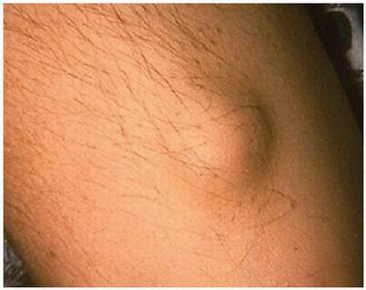
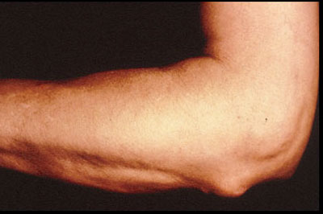
Subcutaneous Nodule

Slide 9
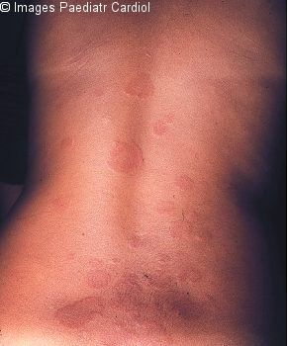
Erythema Marginatum
-Will appear in less than 5% of cases
-Associated with carditis

Slide 10
Rheumatic Attack Rate after GAS Tonsillitis
0.3% - GAS tonsillitis treated with Penicillin
3% - GAS tonsillitis untreated
60% - known rheumatic patients with GAS tonsillitis

Slide 11
Primary Treatment
10 days penicillin to eradicate GAS
High dose Aspirin (50 - 100 mg/kg/day)
Until clinical and laboratory evidence of inflammation resolve
If severe carditis – Steroid (prednisone 2mg/kg/day for 2 weeks and taper down)

Slide 12
Prophylaxis
1º - prevents 1st episode of RF
2º - prevents recurrences of RF
PCN VK 250 mg BID
Benzathine PCN 1.2 MU q 21 – 28 days
Duration of 2º prophylaxis
Arthritis - at least 5 years
Carditis - at least 10 years (recurrence free & no residual heart disease)

Slide 13
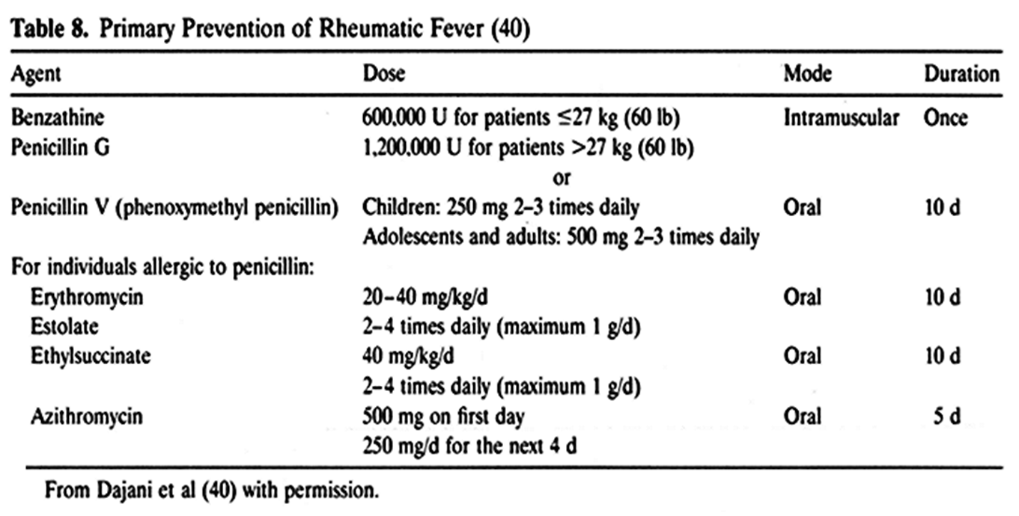
ARF-Treatment dose

Slide 14
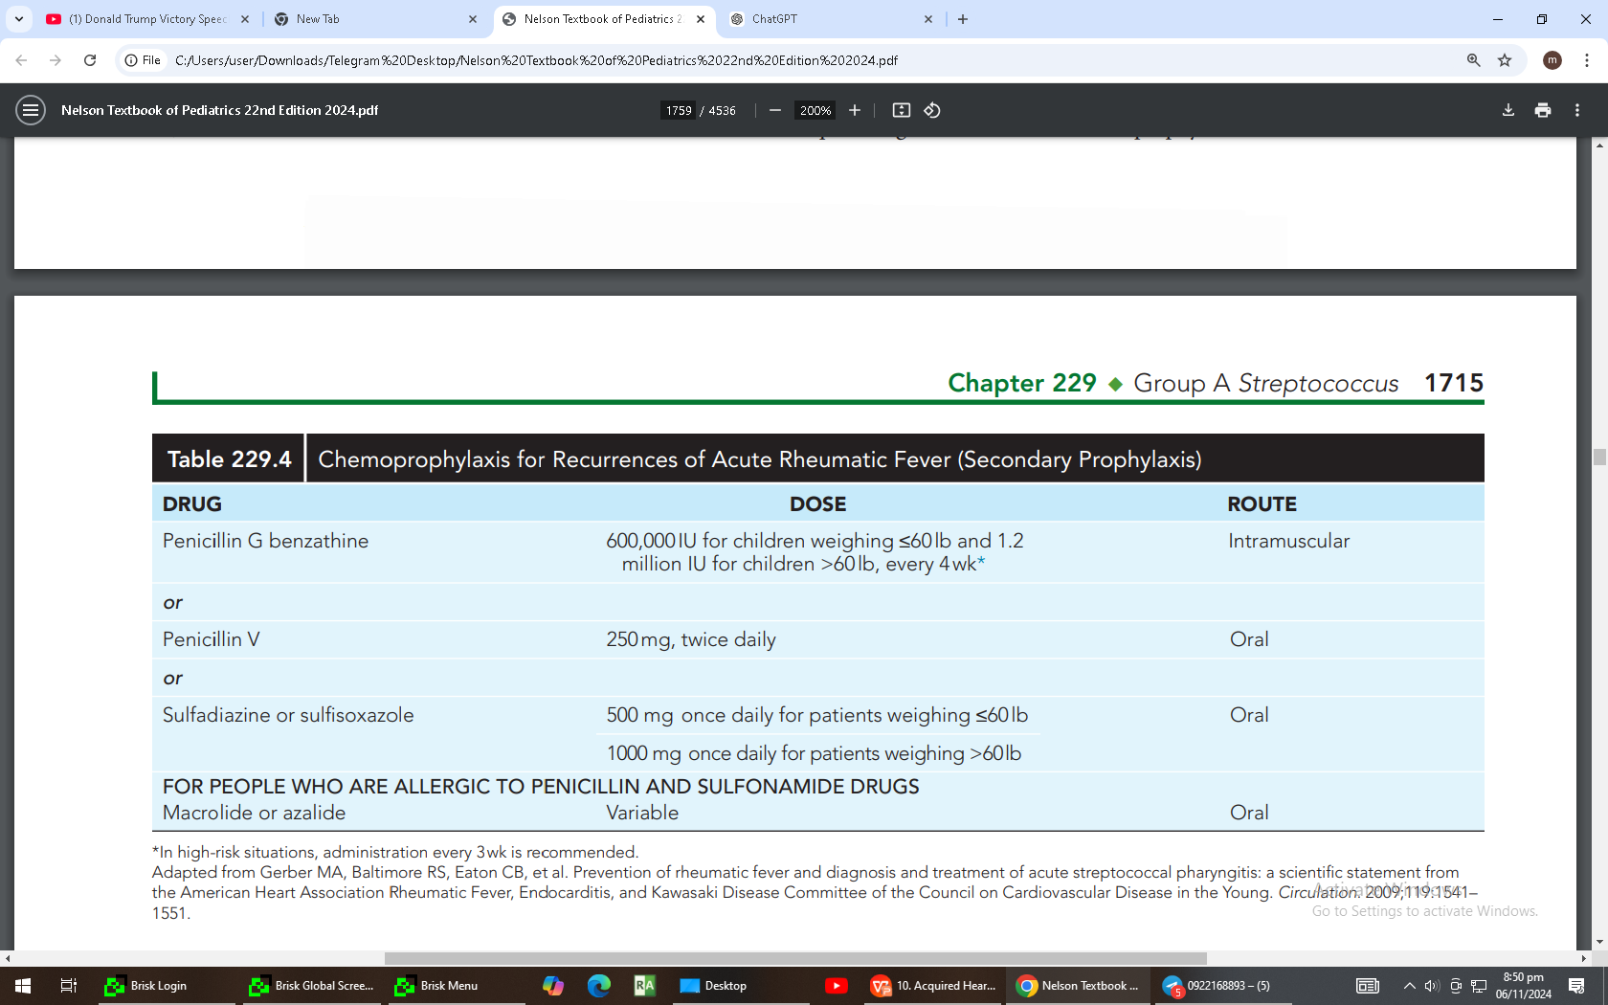

Slide 15
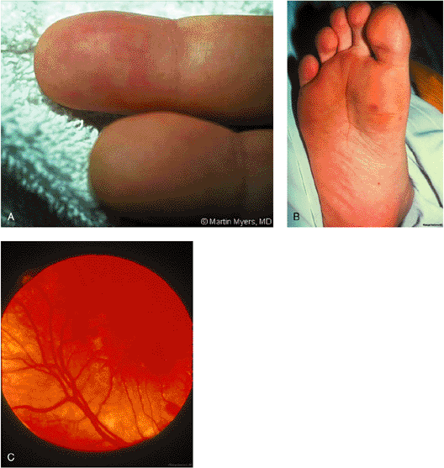
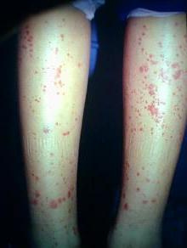
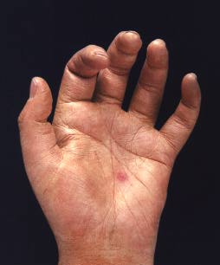
Infective Endocarditis

Slide 16
Infective Endocarditis
Types:
Bacterial Endocarditis(Acute & Subacute)
Nonbacterial Endocarditis ( viruses, fungi, and other agents)
Risk Groups:
Intravenous drug users
Cardiac surgery survivors, especially with mechanical prostheses
Immunosuppressed patients
Patients with chronic intravascular catheters

Slide 17
Etiology of Infective Endocarditis
Most Common Pathogens:
Viridans-type Streptococci (S. mitis, S. anginosus, S. mutans, S. salivarius, S. bovis, S. sanguinis)
Staphylococcus aureus
Less Common Organisms:
Other bacteria and fungi (varies by patient group)
Blood cultures: Negative in ~6% of cases

Slide 18
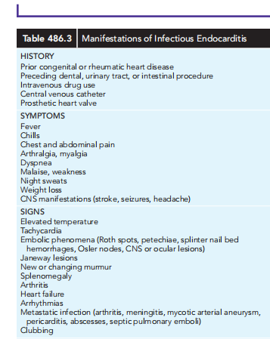
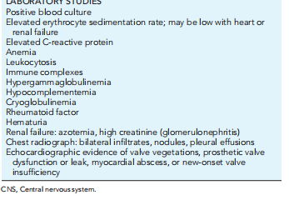
Infective Endocarditis

Slide 19
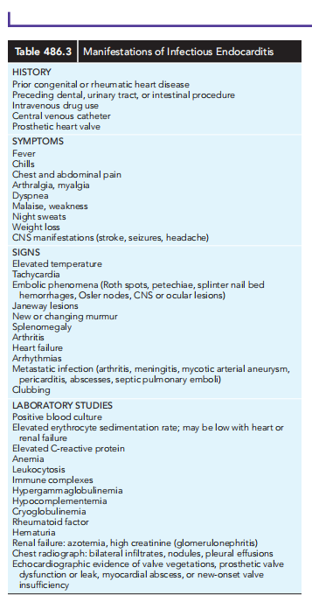

Slide 20
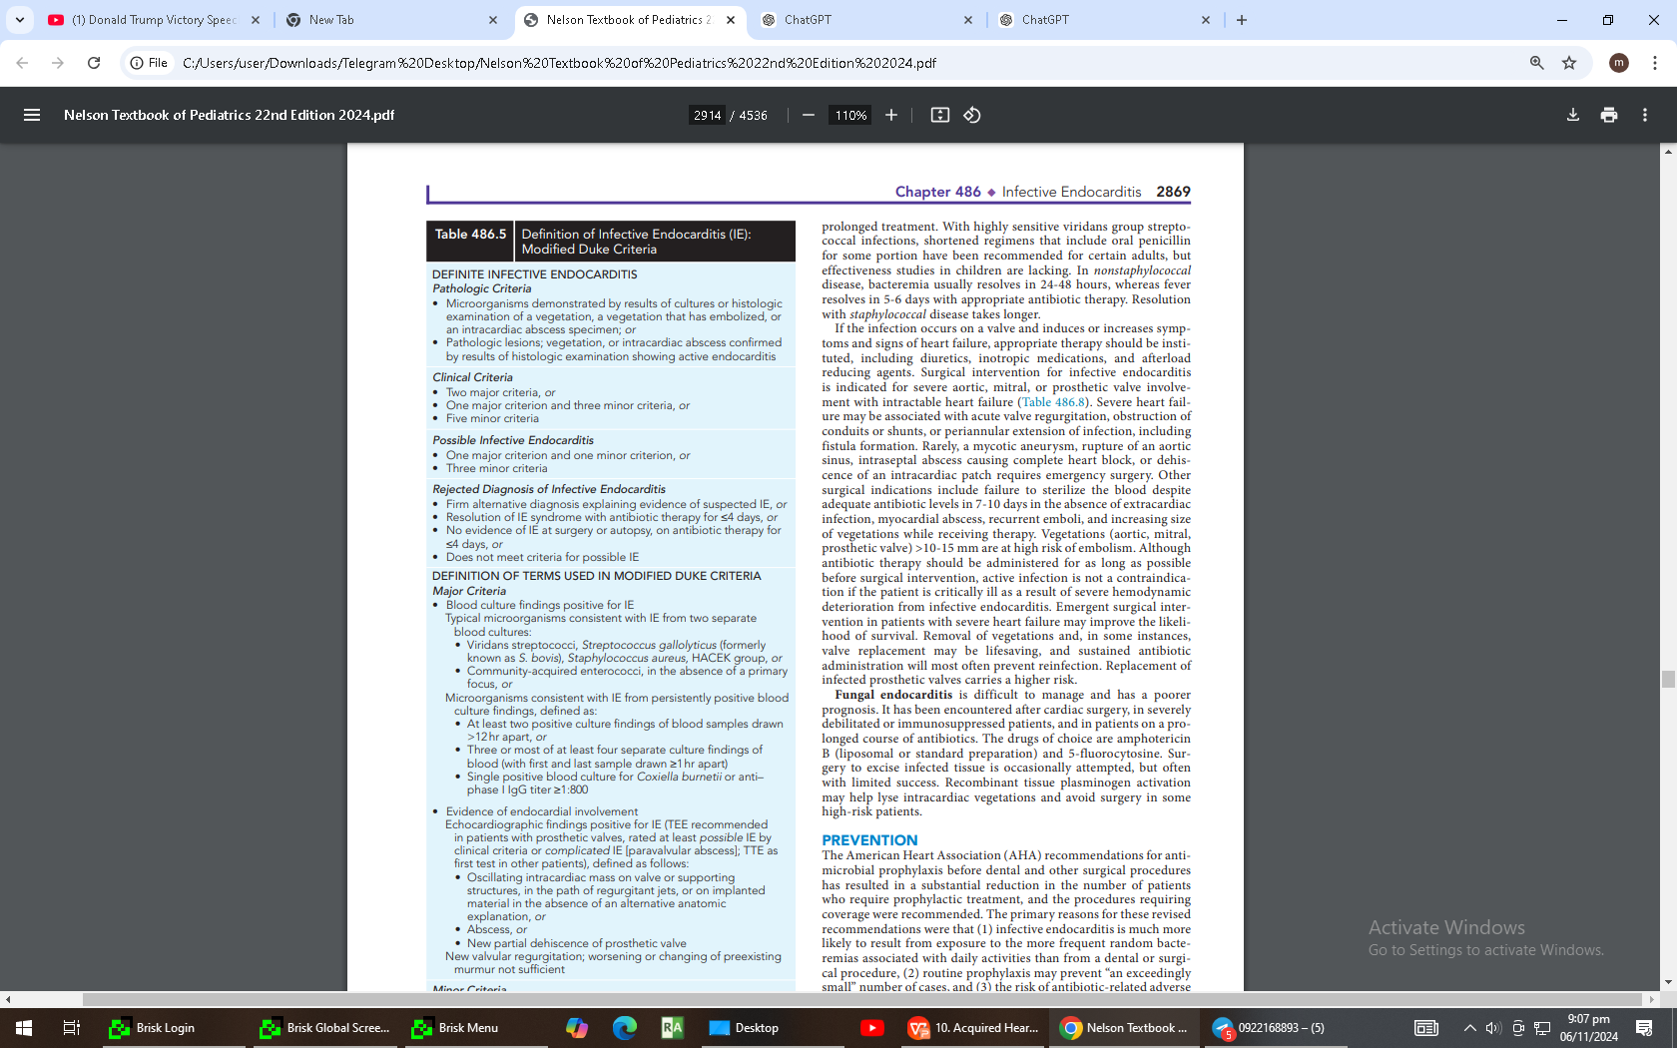
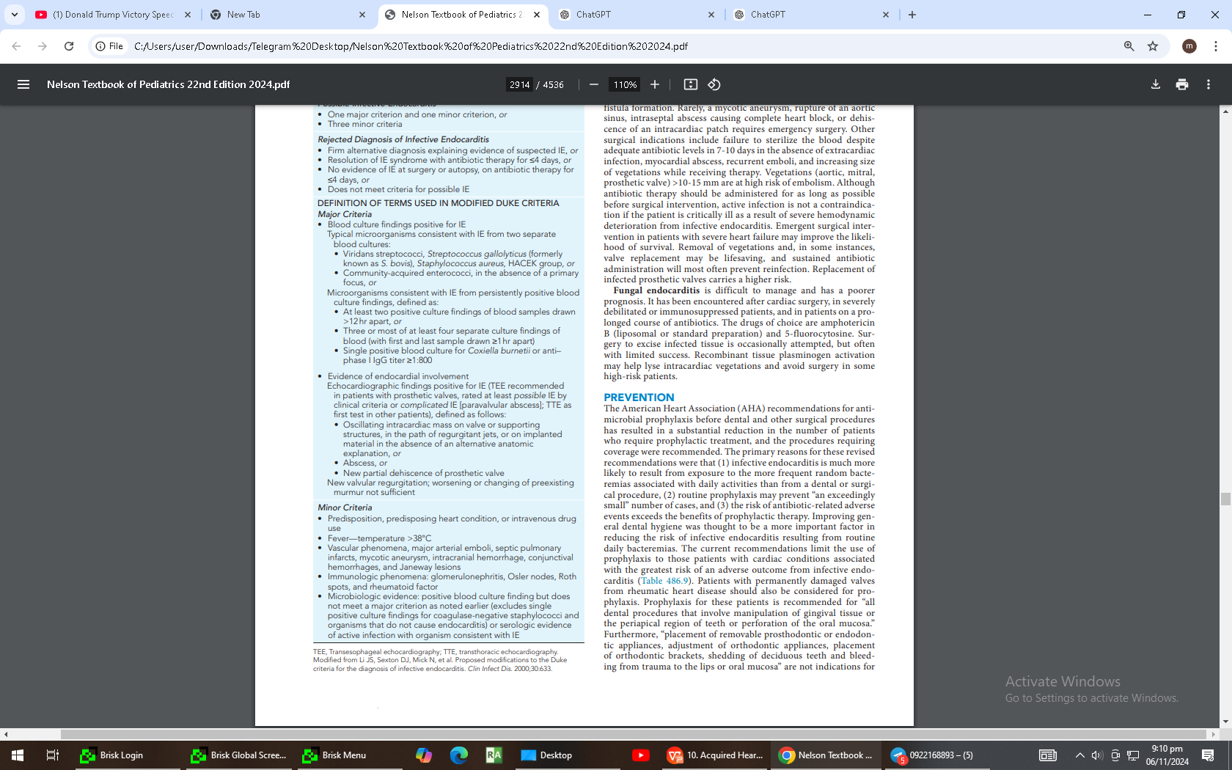

Slide 21
Antibiotic Therapy for Infective Endocarditis
Start antibiotic therapy immediately after a definitive diagnosis of infective endocarditis is made.
Duration of Treatment:4-6 weeks
Goal:To eradicate the infection and prevent complications.

Slide 22
Acute Myocarditis
Develops directly at the time of viral infection or soon after such infection
The severe forms are observed predominantly at the age below 3 years
The forms of the moderate severity may be observed both in early age and in preschool and school age children
The mild forms are recorded predominantly in preschool and school age children

Slide 23
Acute Myocarditis
Pale skin, weakness, headache, decline of appetite, fever, shortness of breath
Chest pain due to coexisting pericarditis
Enlarged heart, tachycardia, weakness of heart tones, soft systolic murmur on the apex, decreased arterial pressure

Slide 24
Investigation
ECG: decrease of waves voltage, conduction impairments, arrhythmias
Echocardiography: myocardium is diffusely thick, dilatation of chambers, reduced myocardial contractility, possible presence of liquid in pericardium
Increased levels of LDG1, LDG2, CPK (creatine phosphokinase), BNP (brain natriuretic peptide)

Slide 25
SUBACUTE CARDITIS
occurs through 3 - 4 mo. after acute carditis or is diagnosed occasionally
Unpleasant feelings, interruptions of the heart, palpitation
Moderate cardiomegaly mainly due to the LV dilation
Weakness of heart tones, arrhythmias, functional systolic murmur
moderate signs of HF (heart failure)
ECG: arrhythmias, conduction impairments, signs of hypoxia of myocardium
Echo: signs of CF, hypokinesia of the left ventricle

Slide 26
Chronic Myocarditis
More frequently is diagnosed as primary-chronic with the signs of chronic left heart failure
Possibly occurs after acute or subacute carditis lasting more than 12 – 18 months
Signs of HF, cardiomegaly, tachycardia - bradycardia, weakeness of cardiac tones, cardiac hump
Physical retardation, encephalopathy, anaemia

Slide 27
Chronic Myocarditis
ECG: arrhythmias, hypertrophy of the LV
Echocardiography: dilatation of the LV, decreased retractive function, decreased of ejection fraction, reduce myocardial contractility

Slide 28
Clinical manifestations
Manifestations of myocarditis range from asymptomatic or nonspecific illness to acute cardiogenic shock and sudden death
Infants and young children often have a fulminant presentation with fever, respiratory distress, tachycardia, hypotension, gallop rhythm and cardiac murmur
Associated findings may include a rash or signs of hepatitis, aseptic meningitis

Slide 29
Cont..
Patients with acute or chronic myocarditis may present with
chest discomfort, fever, palpitations, easy fatigability, or syncope
Hepatic enlargement, peripheral edema, and pulmonary findings such as wheezes or rales ,with decompensated congestive heart failure

Slide 30
Cardiomyopathies
An idiopathic abnormality of myocardial function
There are several types of cardiomyopathies defined by the WHO:
“Dilated cardiomyopathy” or DCM
“Hypertrophic cardiomyopathy” or HCM
“Restrictive cardiomyopathy” or RCM

Slide 31
Incidence and Prognosis
3 - 10 cases per 100,000
1% of all pediatric cardiac disease
During infancy incidence is 10 times higher than older children
death from progressive pump failure 1year 25% 2year 35-40% 5year 40-80%
stabilization observed in 20-50% of patient
Complete recovery is rare

Slide 32
WHO Classification Cardiomyopathies
Primary
-those resulting from genetic abnormalities of cardiac muscle)
Dilated
Hypertrophic
Restrictive
Secondary
Infections
Metabolic and nutritional diseases
Endocrine disorders
Neuromuscular diseases
Blood diseases
Tumors

Slide 33
Idiopathic Dilated Cardiomyopathy
Characterized by varying degrees of dilatation of ventricles, most prominently the left .
LV dilatation & systolic dysfunction pathology
Increased heart size and weight
Ventricular dilatation, normal wall thickness

Slide 34
Dilated Cardiomyopathy
The cause - a genetic basis or are the sequelae of viral myocarditis
In 20 - 50% of cases, the disease is recognized as familial
Autosomal dominant inheritance

Slide 35
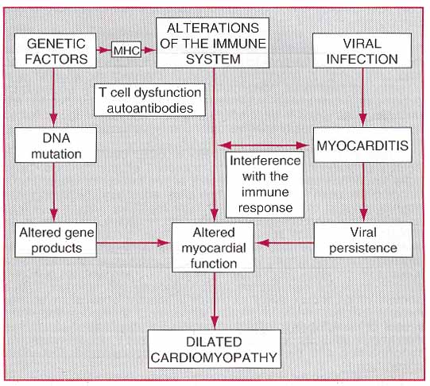

Slide 36
Clinical Manifestations
All age group may be affected
The onset is insidious, but sometimes symptoms of heart failure occur suddenly
Irritability, anorexia, abdominal pain, cough from pulmonary congestion and dyspnea with exertion are common
Infants and younger children have respiratory symptoms and failure to thrive

Slide 37
Clinical Manifestations
The skin is cool and pale
The arterial pulse is decreased, tachycardia, palpitation is present
JVP is increased, hepatomegaly, edema are common Cardiomegaly
Holosystolic murmurs of mitral and tricuspid insufficiency may be present
Blood pressure may be low, pulse pressure narrow
A gallop rhythm is audible

Slide 38
DIAGNOSIS OF CMP
Clinical signs
Chest x-ray
CT Scan
Echocardiogram
12-lead ECG
Heart biopsy
MRI (magnetic resonance imaging)
Cardiac catheterization

Slide 39
Serious complications
Include ventricular arrhythmias leading to syncope and sudden death
Pulmonary or systemic emboli from intracardiac thrombi
Development of pulmonary vascular disease from chronically elevated left atrial pressure

Slide 40
Prognosis
The course of disease is progressively down hill, although some patients may remain stable for years
Treatment of HF may result in temporary remission, but relapses are common and in time – patients become resistant to therapy
Prognosis for survival beyond a year is poor

Slide 41
Management of DCM
Limit activity based on functional status
Salt restriction of a 2g Na⁺ (5g NaCl) diet
Fluid restriction for significant low Na⁺
Initiate medical therapy
ACE inhibitors, diuretics
Digoxin, metoprolol, carvedilol
Hydralazine/nitrate combination

Slide 42
Management of DCM
Consider adding ß-blocking agents if symptoms persists
Anticoagulation (history of thromboemboli, presence of mural thrombi)
Intravenous dopamine / dobutamine
Cardiac transplantation

Slide 43
Acute Pericarditis
This is inflammation of the pericardium
May be idiopathic or secondary to
- Viruses (cocksakie, flu, epistein-barr, mumps)
- Bacteria (pneumonia, rheumatic fever, TB, staph, streps)
- Fungi
- MI
- Drugs(penicillin, isoniazid, hydralazine, antineoplastic agents)
- Others(Uremia, RA, SLE, Myxedema, Malignancy, sarcoidosis)

Slide 44
Clinical Features
Chest pain
- central
- worse on inspiration or lying flat
- Relief with sitting forward
- Pericardial friction rub
- Signs of pericardial effusion
- cardiac tamponade
- Fever may be

Slide 45
Cont..
ECG
- Saddle shaped ST segment elevation but may be normal also
Blood
- FBC, ESR, U & E
- Cardiac enzymes (troponin may be elevated)
- Blood culture, check autoantibodies, viral serology, thyroid function test
CXR (Cardiomegaly = pericardial effusion)
ECHO (pericardial effusion)

Slide 46
Management
Analgesia (Ibuprofen)
Colchicine/steroid (but increase risk of recurrence)/ immunosuppressant

Slide 47


