Slide 1
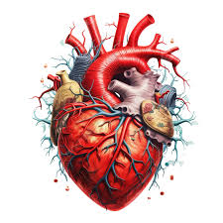
CONGENITAL HEART DISEASES
MICHAEL D(MD,R3)
November 2024

Slide 2
OUTLINES
classification
The epidemiology
pathophysiology
clinical presentation
The principles of management

Slide 3
Fetal circulation
The right and left ventricles exist in a parallel circuit.
In the fetus gas and metabolite exchange are provided by the placenta
Parallel circuit maintained
Foramen ovale
Ductus arteriosus
Ductus venosus

Slide 4
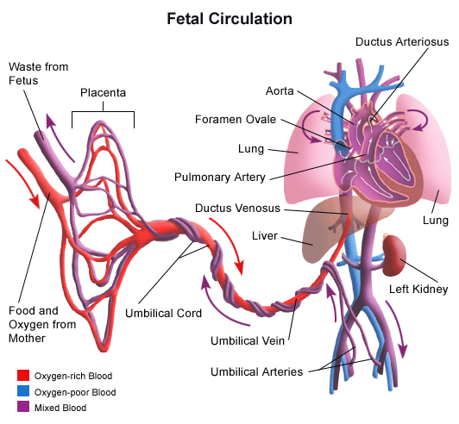
Foetal Circulation
Arterial blood leaves the placenta via the umbilical vein
This branches and delivers blood to the IVC by way of the ductus venosus
Blood then goes into the right atrium, 30% goes across the foramen ovale, the rest to the RV then to PA
Instead of going to the lungs, 85% goes through the PDA to the aorta

Slide 5
Transitional circulation
Interruption of Umbilical cord
Removal of the low resistance placental circulation result in an Increased systemic vascular resistance
lack of blood flow through the placenta leads to closure of Ductus venosus (the ligamentum venosum)
Notes:
PDA: Functionally closed at 10 to 15 hrs after birth. Increased oxygen saturation and reduced prostaglandin level lead to closure
If bloods still shunts away from the lungs PPHN , Persistant PDA , Failure of foramen ovale to close leading to ASD may lead to lung congestion .

Slide 6
Transitional circulation
Expansion of lungs :
Mechanical expansion of the lungs and increased arterial P02 result in a rapid decrease in pulmonary vascular resistance.
The increased blood volume from the pulmonary circulation increased the LA volume and pressure sufficiently to close the foramen ovale (fossa ovalis)
PDA closure : The ductus flow become left to right and later the ductus will obliterated.(ligamentum arteriosus)

Slide 7
Transitional circulation
The right ventricle is coupled with low resistance pulmonary circulation and its wall thickness and mass decreased
The left ventricle coupled to high resistance systemic circulation and its wall thickness and mass increased and deliver the entire systemic cardiac out put.
There is a change from fetal haemoglobin to adult haemoglobin

Slide 8
Introduction:Congenital Heart disease
Structural or functional heart disease that present at birth.
The incidence is higher in abortus and still births
Estimate in live birth range from 4-10.2 per 1000live birth.
Notes:
It is not static ,there is always a continuous anatomical or physiological change

Slide 9
Cont….
The incidence of specific type of CHD varies from one country to another
Specific aetiology only known 10%
8% genetic
2% environmental (rubella, foetal-alcohol syndrome
90% Multifactorial inheritance

Slide 10
Prevalence of Congenital heart Disease (chart review)
 | Developed countries | Ethio-Swedish 1986 | TASH 2003-08
VSD | 28.3% | 41 | 28.4%
PDA | 12% | 13% | 16.5%
ASD | 10.7% | 13.6% | 13%
COA | 8.8% | <2% | 1.8%
TOF | 7% | 9% | 5.7%
PS | 6% | 9.9% | 8.8%
AS | 2.3% | 3.5% | 3.4%

Slide 11
cont.….
The risk of recurrence in siblings varies from 1-4%
Third Pregnancy 20-30%
Parents with CHD 4-6%
Varies with type of inheritance
Except PDA and ASD males are more affected than females.

Slide 12
Congenital Heart Disease ;Types
Increased Pulmonary Blood Flow
Decreased Pulmonary Blood Flow
Inadequate Systemic Flow

Slide 13
Common Congenital Heart Diseases
Acynotic
Shunts ( L to R) :
ASD
VSD
PDA
AVSD
Stenosis:
AS
PS
Coarctation
cyanosis
TOF
TGA
Tricuspid atresia
Truncus
TAPVR
Ebstein’s
Single ventricle eg. HLHS

Slide 14
Clinical manifestation of CHD
CHD suspected in any child with:
Feeding difficulty
Recurrent attack of RTI
Growth failure
Cyanosis unresponsive to 100% oxygen
Tachycardia
Respiratory distress
Rhythm disturbance
Murmur ( absence of murmur doesn't rule out or in CHD)

Slide 15
Management of CHD
General principle
1) Treatment of Congestive Heart Failure
-Diuretics,Inotropic support,After load reduction
2) Correction of underlying defect
3)Prevention and treatment of complication
-Pulmonary HPT ,Infective endocarditis:polycythemia

Slide 16
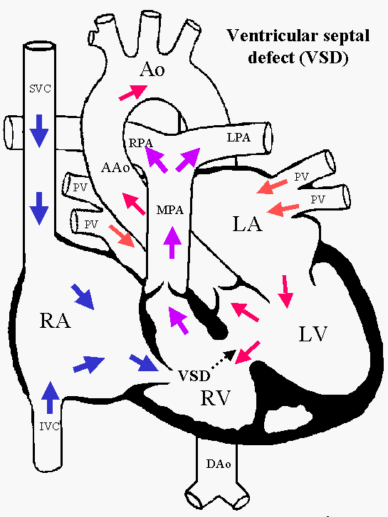
Ventricular Septal Defect
Most common CHD
Both sexes are equally affected
Incidence of 1/3000
Can be single or multiple
Can be associated with other congenital heart diseases

Slide 17
VSD cont.…
Types of VSD:
70% membranous close to pulmonary valve and Pulmonary artery
20% muscular
5% Aortic valve (sub aortic)
5% near junction of Mitral and tricuspid valve (A-V canal defect)

Slide 18
Clinical manifestations
) Asymptomatic:
Small VSD
Loud harsh Holosystolic murmur at LLSB, with thrill
X-ray is normal
ECG normal
II ) Large defects:
pulmonary hypertension
Dyspnea, feeding difficulty
Poor growth
Profuse perspiration
Recurrent pulmonary infection

Slide 19
Physical Examination:
Prominence of the precordium
Palpable parasternal lift
Holosystolic murmur at LLSB less harsh and more blowing
Diastolic murmur at the apex
Apical trust with systolic thrill
Increased P2 indicate pulmonary HPT.

Slide 20
VSD
Chest X-Ray
Cardiomegally (LA, LV,RV,PA)
Increased vascular marking
ECHO
Position and size of VSD
Chamber size
Pressure gradient across the defect
Direction of shunt
ECG:
P wave peaked and notched
Left ventricular hypertrophy (biventricular)

Slide 21
Treatment
Small size
Reassurance
No surgical treatment
Maintain integrity of primary and permanent teeth
anti- infective endocarditis prophylaxis
Large VSD:
Control CHF
Prevent development of Pulmonary vascular disease.
-Surgical closure,
-Device closure or
-Palliative

Slide 22
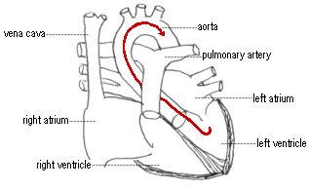
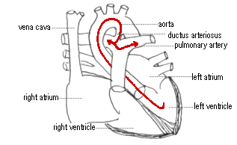
Patent Ductus Arteriosus(PDA)
During foetal life blood from PA shunted through the DA in to the Aorta.
After birth closed functionally
Prematurity and hypoxia predispose for patencey
Female are more affected than males Commonly associated with rubella of the mother
Isolated PDAs are common in high altitude

Slide 23
Clinical manifestation
Depend on the :
Size of the defect and direction of flow
Small defects no symptom
Large defect result in Large left to right shunt
CHF
Growth Failure
Repeated ARI
Reversal of shunt ,(Eisenmengers ) result in dyspnoea and cyanosis

Slide 24
Physical EXAMINATION
Bounding pulse
Wide pulse pressure
Heave , thrill in the 2nd ics
Continuous machinery murmur 2nd ics
X-ray: prominent PA, increases PA marking enlarged chambers(LA,LV),
EKG: bi-ventricular hyperthrophy
ECHO: size of the PDA, direction of flow, chamber size
Catheterization: a step up oxygen saturation, PDA anatomy in angiography

Slide 25
Treatment
Medical therapy:
Congestive heart failure treatment
infective endocarditis prophylaxis
Surgical closure of the PDA (banding)
Closure of the PDA coil embolization or device closure without thoracotomy

Slide 26
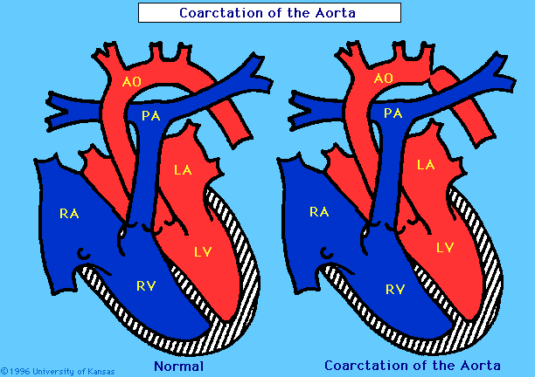
Coarctation of the Aorta
Occurs at any point from transverse arch to iliac bifurcation
98% below the origin of left sub clavian at the origin of Ductus
Male to female ratio: 2:1
Associated with:
Turner syndrome
Bi cuspid aortic valve (70%)
Mitral valve abnormality
Sub aortic stenosis

Slide 27
Clinical Manifestations
Severe critical stenosis, the neonate present with evidence of CHF if not corrected surgically result in death.
Past the neonatal period Usually asymptomatic
Older children:
Headaches
Epistaxis
Claudication, cold feet

Slide 28
Coarctation of the Aorta
Physical Examination
Weak or absent femoral pulses
Increased B/P in the upper extremities
B/P difference between upper and lower extremities
Radio Femoral pulse delay ( Collaterals)
Chest x_ray:
Dilated descending Aorta, enlarged LV.
Rib notching
ECG: normal in childhood, later LV hypertrophy.
ECHO
Measure the stenotic area
gradient

Slide 29
Physical Examination:
Weak or absent femoral pulses
Increased B/P in the upper extremities
B/P difference between upper and lower extremities
Radio Femoral pulse delay ( Collaterals)
A2 is loud , systolic murmur 3rd and 4th ULSB

Slide 30
Treatment
Neonatal: closure of the ductus lead to hypo perfussion and acidosis, thus give infusion of prostaglandin to reopen the ductus, after stabilization surgical treatment.
Older children with CHF and no hypertension medical treatment followed by surgery or angioplasty.
Re -stenosis balloon angioplasty is safe.

Slide 31
Cyanotic Heart Diseases

Slide 32
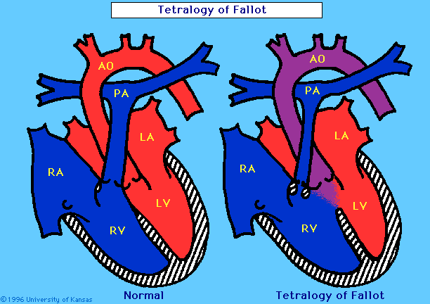
Tetralogy of Fallot
Common cyanotic congenital cardiac anomaly
Four anatomical components of TOF:
VSD
Overriding Aorta
Right ventricular outflow obstruction
Right ventricular hypertrophy

Slide 33
CM
-Variable depend on RVOT obstruction
pink to cyanosis
CHF is not a usual manifestation of TOF
Squatting
Dyspnoea on exertion
Hypoxic spells
Growth failure
Physical Examination:
Cyanosis variable
Clubbing
Usually S2 is single,
Quite precordium
Thrill at the pulmonary area(-+)
Systolic ejection murmur at the pulmonary area (LUSB)

Slide 34
IMAGING
Chest x ray
Normal sized, boot shaped heart.
Reduced pulmonary vascular marking (oligemic depend on the degree of RVOT obstruction.
ECG
Right axis deviation
Right atrial and right ventricular enlargement
ECHO
Location and size of the VSD
The aortic override
The degree of RVOT obstruction
The size of pulmonary valve annulus
Look for other associated anomalies

Slide 35
Complications
Cardiovascular accidents
Brain abscess
Infective endocarditis
Polycythemia

Slide 36
Management
Medical management:
A) Neonatal period =give prostaglandin to prevent ductal closure and followed by palliative shunt (B-T Shunt)
B)Recognition and treatment of hyper cyanotic spell.
Knee chest positioning of the patient
Administration of oxygen
Volume expansion
Correction of acidosis
Sedation with morphine
Propranolol
C)Treat infective endocarditis
D) correct Anemia
E) correct Severe polycythemia
Surgical Management

Slide 37
Medical management:
A) Neonatal period =give prostaglandin to prevent ductal closure and followed by palliative shunt (B-T Shunt)
B)Recognition and treatment of hyper cyanotic spell.
Knee chest positioning of the patient
Administration of oxygen
Volume expansion
Correction of acidosis
Sedation with morphine
Propranolol
C) Treat infective endocarditis
D) correct Anemia
E) correct Severe polycythemia

Slide 38
Transposition of the Great Arteries

Slide 39
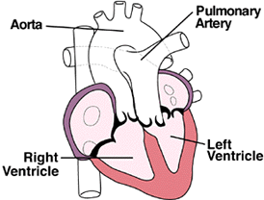
Transposition of the Great Arteries
TGA occurs in 8-9% of CHD
Male are affected than Females
Different variety exist

Slide 40
Transposition of the Great Arteries
Clinical features:
Cyanosis detected 87% of the neonates immediately ; rest later at the age of 1 to 3 month and is progressive.
Clubbing
Squatting only 20% of patients
Dyspnoea
Cardiac failure
Cough
Physical findings
TGA with no VSD
Cyanosis intense
Precordial lift
Loud first sound
Splitted S2
Murmur may not be heard

Slide 41
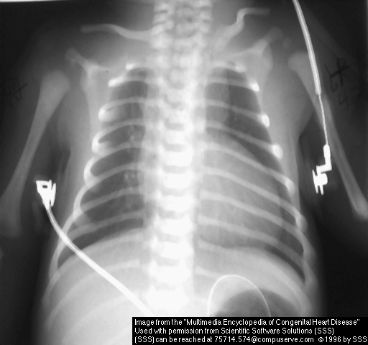
Radiology
CXR
Increased pulmonary
vascular marking
Large heart with
egg - on side appearance.
ECG
Right ventricular hypertrophy
Right axis deviation
ECHO
pulmonary artery from the LV
Aorta from RV
Associated lesions like VSD and ASD be identified.
Coronary artery anatomy

Slide 42
Management
Medical management:
Prostaglandin to keep the DA open until palliation done
Give oxygen
Treat metabolic acidosis with bicarbonate.
Surgical:
Palliative balloon septostomy creating /increasing ASD Rashkind procedure.
Arterial Switch (Jaten Procedure)
Atrial switch ( Mustard procedure)

Slide 43


