Slide 1
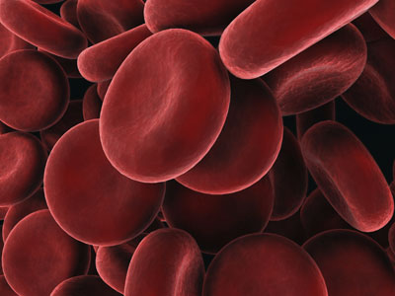
Anemia
Anemia
Badr Mesbah
Prof. of Pediatrics
Suez Canal University
Dr Henock Hailu
Dept . of Pediatrics and Child health
Addis Ababa University

Slide 2
Definition
Reduction of the red blood cell volume or hemoglobin concentration below the range of values occurring in normal persons

Slide 3
Physiological Adjustments
Increased cardiac output
Increased oxygen extraction
Shunting of blood to vital organs
Increased concentration of 2,3-DPG in RBCs
Higher levels of erythropoietin

Slide 4
Classification of Anemia
By etiology:
- Decreased RBSc production
- Increased RBCs loss
- RBCs destruction

Slide 5
Classification of Anemia
By RBCs morphology
- Microcytic: e.g. iron deficiency anemia
- Normocytic: e.g. anemia of chronic
disease
- Macrocytic; e.g. B12 and folate deficiency

Slide 6
Iron Deficiency Anemia
The most common hematologic disease of infancy and childhood
The body of a newborn contains 0.5 g of iron, whereas the adult content is 5 g
10% of dietary iron is absorbed

Slide 7
Iron Deficiency Anemia
Etiology
Low birth weight and unusual perinatal hemorrhage
Inadequate dietary iron
Decreased absorption of iron
Blood loss

Slide 8
Iron Deficiency Anemia
Clinical manifestations
Pallor
Irritability
Pagophagia
Anorexia
Effects on cognitive functions
Tachycardia, cardiac dilatation, systolic murmers

Slide 9
Iron Deficiency Anemia
Laboratory findings
In progressive iron deficiency:
1 - The tissue iron stores disappears
2 - Decreased serum iron level, increased
iron binding capacity ( transferrin)
3 – Increased FEP
4 – Smaller RBCs, decreased Hgb content

Slide 10
Iron Deficiency Anemia
Laboratory findings
Microcytosis, hypochromia, poikilocytosis
Increased RDW
Reticulocytes: normal or moderately increased
WBCs: normal
Platelets: normal, sometimes thrombocytosis

Slide 11
Iron Deficiency Anemia
Treatment
Iron therapy
- Oral : 4 – 6 mg/kg elemental iron/day
continue therapy for 8/52 after blood
values retturn to normal
- parenteral : Not more rapid nor
complete than oral iron

Slide 12
Megaloblastic Anemia
Almost all cases in children are due to folic acid or vitamin B12 deficiency
Rarely it may be caused by inborn error of metabolism
B12 and folate are necessary for the synthesis of nucleoproteins

Slide 13
Megaloblastic Anemia
Folic acid deficiency:
- Inadequate intake (common)
- Decreased absorption: chronic diarrhea,
inflammatory disease, anticonvulsants
- Drug induced abnormalities in folate
metabolism: methotrexate, trimethoprim,
pyrimethamine

Slide 14
Megaloblastic Anemia
B12 deficiency:
- Inadequate intake (rare)
- Lack of intrinsic factor
- Impaired absorption: Inflammatory disease, surgery, bacterial overgrowth

Slide 15
Megaloblasstic Anemia
Clinical picture:
- Manifestations of anemia
- irritability
- Inadequate weight gain
- Chronic diarrhea
- In B12 deficiency: glossitis, neurological manifestations (subacute combined degeneration of the cord)

Slide 16
Megaloblasstic Anemia
Laboratory findings:
- macrocytic normochromic anemia
- variation in RBCs shape and size
- Large neutrophils, hypersegmented nuclei
- Elevated serum LDH
- decreased serum B12 or folic acid levels

Slide 17
Megaloblasstic Anemia
Treatment
- Folic acid: 0.5 – 1 mg/day for 4/52 , maintenance with multivitamin containing 0.2mg of folate is adequate
- B12 : 1mg/d IM for 2/52 9if neurologic involvement) then 1mg IM/ month

Slide 18
Hemolytic Anemia
Hemolysis : Premature destruction of RBCs
RBCs survival time is 110 -120 days
0.85% of the RBCs are removed and replaced each day
The marrow can increase its output 2-3 folds acutely in response to hemolysis, in long-standing hemolysis the output can increase 6 - 8 folds

Slide 19
Hemolytic Anemia
Anemia, hyperbilirubinemia, reticulocytosis
Hemoglobinuria
Low haptoglobin, and hemopexin
Excess urobilinogen in urine and stercobilinogen in stools
Erythroid hyperplasia in bone marrow
Spleen enlargment

Slide 20
Hemolytic Anemia
Classification
1 - Cellular : Abnormalities of membrane, hemoglobin or enzymes
Most cellular defects are inherited
2 - Extracellular : antibodies, mechanical factors or plasma factors

Slide 21
Hereditary Spherocytosis
Usually autosomal dominant
A defect in the cell membrane causing sphering of the RBCs and increase in cation permeability, ATP use and glycolysis
Spherocytes have decreased deformability
Premature destruction of RBCs in spleen

Slide 22
Heriditary Spherocytosis
Clinical Manifestations
Severity of symptoms variable
May present with severe hemolytic disease of the newborn or may be asymptomatic till adulthood
Splenomegaly after infancy
Gallstones in 50% of unsplenectomized
Aplastic crisis

Slide 23
Heriditary Spherocytosis
Laboratory findings
Evidence of hemolysis
Spherocytes in blood film (usually 15% - 20% of cells)
Osmotic fragility test
Membrane protein analysis

Slide 24
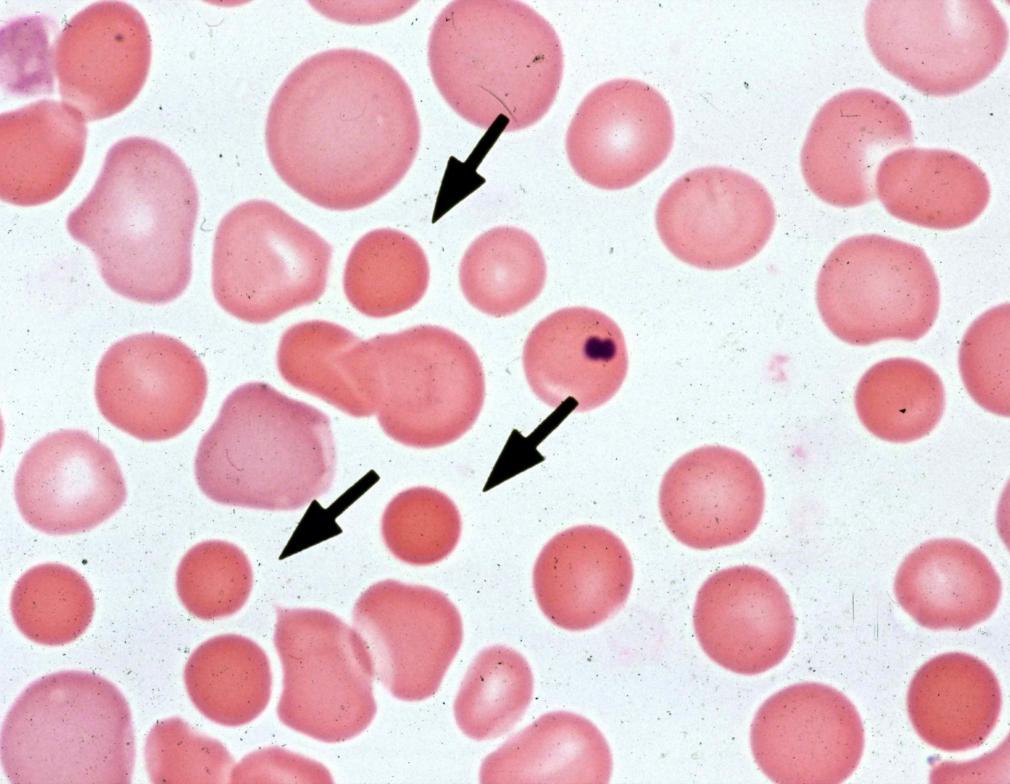
Hereditary Spherocytosis

Slide 25
Heriditary Spherocytosis
Differential diagnosis
Isoimmune and autoimmune hemolytic anemia
Thermal injury
Clostridial septicemia oxemiaexotwit
Wilson disease

Slide 26
Heriditary Spherocytosis treatment
Folic acid supplementation
Splenectomy after 5 – 6 ys of age

Slide 27
HEMOGLOBINOPATHIES
Hemoglobin molecule is a tetramere made of two pairs of polypeptide chains
Abnormalities in these proteins are referred to as hemoglobinopathies

Slide 28
HEMOGLOBINOPATHIES
Normally
Hb F (α2 γ2) accounts for 70% of the total Hb at birth
Hb A (α2 β2) accounts for 30% of Hb at birth
Hb A2 (α2 δ2) accounts for <1% at birth
The normal final Hb distribution pattern is:
≥95% Hb A, ≤3.4% Hb A2, <2.5% Hb F

Slide 29
Thalassemia Syndromes
Genetic disorders of globin chain production
In β thalassemia there is reduction or absence of β globin chain
In α thalassemia there is reduction or absence of α globin chain
The primary patholgy stems from the quantity of globin production

Slide 30
β-Thalassemia Major
Homozygous β thalassemia, Cooley anemia
Inadequate β globin production → ↓ level of normal Hb (Hb A)
Imbalance of α and β- globin production
Ineffective erythropoiesis
Excess α globin chain relative to β chain → α tetramere → inclusions that react with cell membrane → ↓ RBCs survival

Slide 31
β-Thalassemia major
Clinical Manifestations
Symptoms usually at 6 months of age
Chronic hemolysis
Thalassemia facies: maxillary hyperplasia, flat nasal bridge, frontal bossing
Hepatosplenomegaly

Slide 32
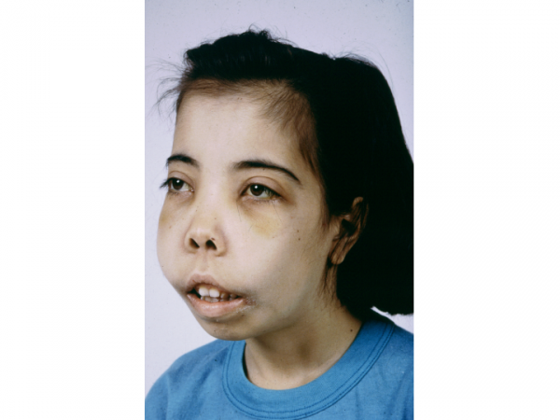
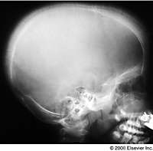
β-Thalassemia major
Clinical Manifestations

Slide 33
β-Thalassemia major
Laboratory Findings
Hypochromic microcytic anemia
Reticulocytes usually < 8%
Elevated unconjugated bilirubin
↓ haptoglobin, ↑ ferritin
Hb electrophoresis: elevated Hb F, no or trace Hb A

Slide 34
β-Thalassemia major
Complications
Hemosiderosis: Iron overload due to increased absorption and blood transfusion
- Heart : leading to arrhythmias and heart failure; Liver leading to cirrhosis; pituitary leading to growth retardation; parathyroid leading to tetany; thyroid leading to hypothyroidism; adrenal gland leading to adrenal insufficiency

Slide 35
β-Thalassemia major
Complications
Other complications of repeated transfusion:
- Transimissionof infectious agents as hepatitis B and C, malaria, AIDS, CMV, toxoplasmosis
- circulatory overload
Secondary hypersplenism
Pathological bone fractures
Aplastic crisis, gall stones, chronic leg ulcers

Slide 36
β-Thalassemia major
Treatment
Transfusion of packed RBCs
- hypertransfusion: Hb 10.5-11 g/dl at alltime
- supertransfusion: Hb above 12 g/dl
Iron chelating therapy
- Subcutaneous desferioxamine
- Oral chelating therapy

Slide 37
β-Thalassemia major
Treatment
Splenectomy: in huge spleen or hypersplenism
Supportive care
folic acid, hepatitis B vaccine, Endocrine
intervention
Bone marrow transplantation

Slide 38
β-Thalassemia major
Cause of death
Heart failure is the main cause of death
Liver failure
Infection after splenectomy

Slide 39
β-Thalassemia trait
Heterozygous β – thalassemia
Anemia is mild (Hb 9 – 11 g/dl), hypochromic microcytic that does not respond to iron therapy
Hb electrophoresis: diagnostic elevation of Hb A2 (≥ 4%), predominant Hb A, variable elevation of Hb F

Slide 40
Sickle cell disease
Autosomal recessive
Presence of abnormal Hb called Hb S
Hb S is the same as Hb A, but valine replaces glutamic acid in position number 6 in the β globin chain
At low O2 tension Hb S precipitates in the form of long filaments, the RBCs become sickle shaped, rigid
Homozygous stat leads to sickle cell anemia
Heterozygous state leads to sickle cell trait

Slide 41
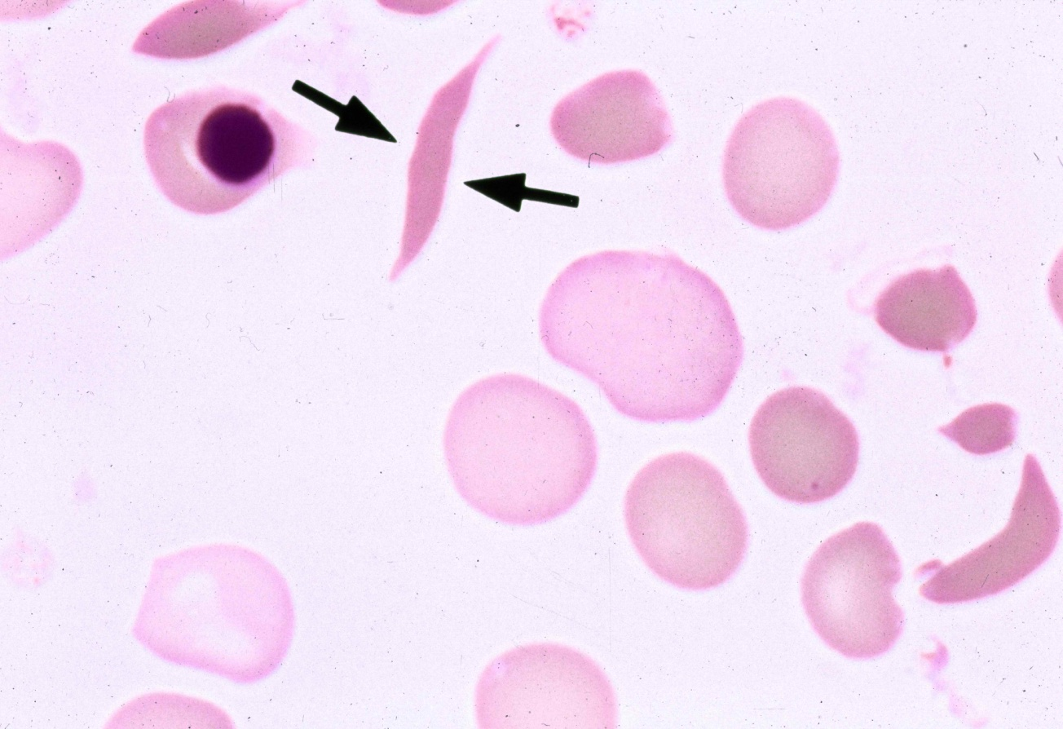
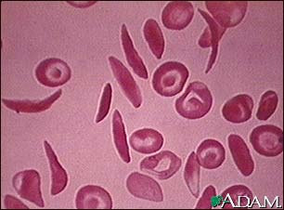

Slide 42
Sickle cell anemia
Clinical manifestations
Manifestations start after 6 months of age
Chronic hemolytic anemia
Splenomegaly in early childhood but later disappear due to repeated infarctions
The cardinal manifestation is pain due to repeated vaso-occlusive episodes
Hand-foot syndrome (dactylitis) is often the first mainfestation of pain

Slide 43
Sickle cell anemia
Clinical manifestations
Thrombotic crisis leading to: abdominal pain Mesenteric vein thrombosis, stroke (cerebral blood vessels), pulmonary infarction
Acute splenic seqestration: mainly in infants, rapid increase in spleen size, hypovolemia, decline of Hb level, may be fatal

Slide 44
Sickle cell anemia
Clinical manifestations
Aplastic crisis: sudden attack of bone marrow aplasia lasts for 10-14 days
Hemolytic crisis (uncommon)
Abnormal immune functions may lead to bacterial sepsis:
- Functional asplenia - deficient serum opsonins against pneumococci
Increased sucebtibility to salmonella osteomyelitis, pneumococcal septicemia
Resistance to falciparum malaria

Slide 45
Sickle cell anemia
Laboratory findings
Anemia, reticulocytosis, and hyperbilirubinemia
Sickling test is positive
Hb electrophoresis: Hb S is as high as 90%, no Hb A

Slide 46
Sickle cell anemia
Treatment
Blood transfusion
Iron chelating agents may be needed
Protection against and proper management of infection
Analgesics for painful crisis
Splenectomy: repeated sequestration

Slide 47
Sickle cell trait
Heterozygous state
RBCs contain a mixture of Hb A and Hb S (<50%)
Sickling occurs only in situation of severe hypoxia
Normal life span, no anemia
Complications: sudden death during exercise, hematuria, hyposthenuria, bacteruria, renal medullary carcinoma

Slide 48
G6PD Deficiency
X-linked recessive
G6PD is a central enzyme in the hexose monophosphate shunt of glucose metabolism to produce NADPH
NADPH is necessary to maintain glutathione in the reduced state

Slide 49
G6PD Deficiency
Reduced glutathione is necessary for inactivation of oxidant compounds such as H2O2
In the absence of reduced glutathione Hb becomes denatured and precipitate in RBCs (heinz bodies)
Acute hemolysis results from:
- Damage to RBCs membrane from precipitated Hb, the oxidant agent, and the action of the spleen

Slide 50
G6PD Deficiency
Hemolysis occurs when the RBCs are exposed to oxidants as:
- Drugs such as sulphonamide, aspirin, primaquine, synthetic vit. K, nitrofurantoin
- Fava Bean
- Infection such as bacterial or viral infections

Slide 51
G6PDD
Clinical picture
Acute hemolysis with pallor, irritability, vomiting, sometimes fever, dark urine, and jaundice
Heart failure may develop
Uncommonly it may present as chronic hemolytic anemia

Slide 52
G6PDD laboratory findings
Normochromic normocytic anemia
Reticulocytosis
Heinz bodies are seen in RBCs
Bloof film reveals fragmented cells
G6PD enzyme assay: ≤ 10% of normal

Slide 53
G6PDD
Prevention and Treatment
Avoidance of offending drugs and food
Supportive therapy may require packed RBCs transfusion although recovery is the rule when the oxidant agent is discontinued

Slide 54
Thank you

