Slide 1

DeepIterator
A.Huebl¹, R.Widera¹, H. Burau^{1,2}, S.T. Hahn^{1,2}
¹ Helmholtz-Zentrum Dresden - Rossendorf
² Technische Universität Dresden
HZDR, Dresden
Notes:
- OpenSource
- Manicore
- Worlds Fastest PIC Code

Slide 2
1. Challenges, Objectives and Terms
2. Users View at DeepIterator
    Simple Example
    Kernel FillGaps
3. Developers View at DeepIterator
    Traits
    Categories
Notes:
- compete with conventional accelerators
Needs:
- high energy
- mono-energetic
- directed beams
- not yet achieved
- one concept are MLT

Slide 3
Challenges and Objectives
Notes:
- compete with conventional accelerators
Needs:
- high energy
- mono-energetic
- directed beams
- not yet achieved
- one concept are MLT

Slide 4
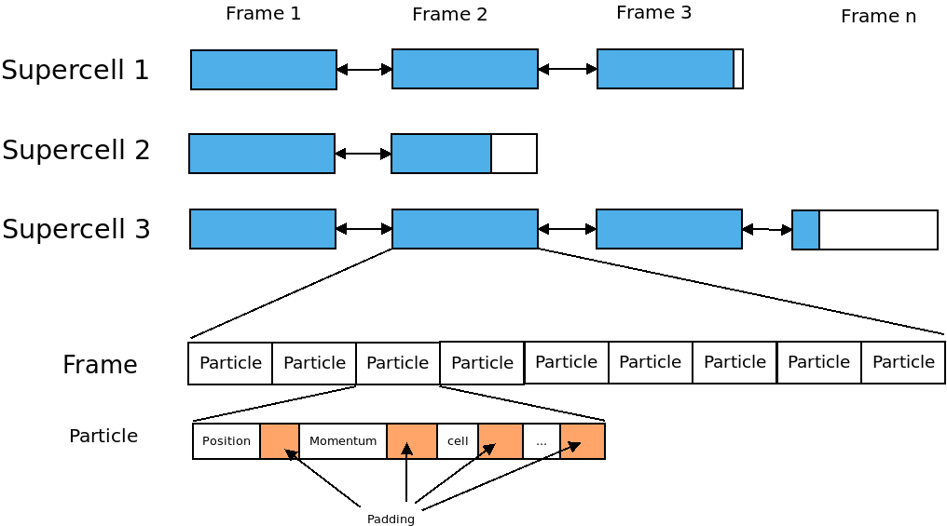

Slide 5
Objectives
Support of Heterogeneous Datastructures
Support of Heterogeneous Hardware
Highly Configurable for Developers
High Level API for Users
Reusable

Slide 6
Prescription
Notes:
- compete with conventional accelerators
Needs:
- high energy
- mono-energetic
- directed beams
- not yet achieved
- one concept are MLT

Slide 7
Motivation
//Iterate over all Particles in Supercell
for(frame in supercell)
for(particle in frame)
// do something

Slide 8
Motivation
//Iterate over all Particles in Supercell
for(frame in supercell)
for(particle in frame)
// do something
Problems:
1. Need knowledge
2. Every time the same
Solution: Prescription

Slide 9
Motivation
//Iterate over all Particles in Supercell
for(frame in supercell)
for(particle in frame)
// do something
A Prescription defines the movement
through the data in a hierarchical way.
It consists of an Accessor, a Navigator
and a optional Prescription.
A Prescription defines a concept of
how a iterator moves through the
datastructure.
Problems:
1. Need knowledge
2. Every time the same
Solution: Prescription

Slide 10
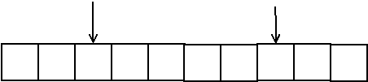
Accessor
An Accessor describes the current element
Access to the element
Compare with another positions (<, >, ==, !=)
Accessor (at positions 2 and 7)

Slide 11
Navigator
Describe the movement of the iterator
First, last element,
Next, previous element,
After-the-last-Element,
Before-the-first-element
Offset/Jumpsize/Slice
Offset: Distance from the beginning of the container to the first position of the iterator.
Jumpsize: Distance between two Elements
Slice: Restrict the container
Offset and Jumpsize can be used for parallel access.

Slide 12



Offset
Offset: Distance from the beginning of the container to the first position of the iterator.
Example:
Offset = 0
Offset = 2
Offset = 4

Slide 13


Jumpsize
Jumpsize: Distance between two Elements
Example:
Jumpsize = 0
Jumpsize = 2
Jumpsize = 4

Slide 14





Slice
Slice: Restrict the container. Two supported types: Distance and Ignore Last Elements
distance = 0
Ignore = 0
distance = 2
Ignore = 2
distance= 4
Ignore= 4

Slide 15
Slice
Slice: Restrict the container. Two supported types: Distance and Ignore Last Elements
Slice is applied after Offset and Jumpsize
distance = 0
Ignore = 0
distance = 2
Ignore = 2
distance= 4
Ignore= 4

Slide 16

Combined Examples
Off=1, Jump=2, Ignore=1
Off=1, Jump=2, Distance=1
Off=2, Jump=1, Ignore=2
Off=2, Jump=1, Distance=2

Slide 17



Combined Examples Solution
Off=1, Jump=2, Ignore=1
Off=1, Jump=2, Distance=1
Off=2, Jump=1, Ignore=2
Off=2, Jump=1, Distance=2

Slide 18
A stacked Prescription
An example with two layers
Notes:
- compete with conventional accelerators
Needs:
- high energy
- mono-energetic
- directed beams
- not yet achieved
- one concept are MLT

Slide 19
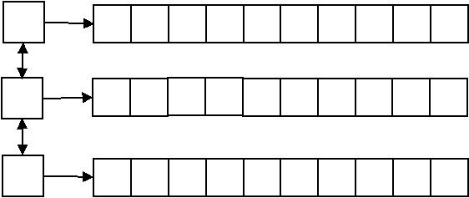
A list<array<int> > Container

Slide 20
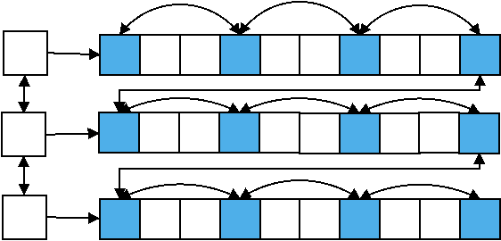
An Example of a Supercell
Each Frame: Offset(0)/Jumpsize(1)
Each third Particle: Offset(0)/Jumpsize(3)

Slide 21
Source for a 2D-Prescription
Each Frame: Offset(0)/Jumpsize(1)
Each third Particle: Offset(0)/Jumpsize(3)
auto && prescription = makeIteratorPrescription(
makeAccessor(),
makeNavigator(
Offset(0),
Jumpsize(1)
),
makeIteratorPrescription(
makeAccessor(),
makeNavigator(
Offset(0),
Jumpsize(3)
)
)
);

Slide 22
Introduction of View
An example with two layers
Notes:
- compete with conventional accelerators
Needs:
- high energy
- mono-energetic
- directed beams
- not yet achieved
- one concept are MLT

Slide 23
The View
The View binds a prescription
to a container.
The View has functionality
similar to a STD-Container
// example
auto && view = makeView(
supercell,
prescription
)

Slide 24
The View
rend()
begin()
// example
auto && view = makeView(
supercell,
prescription
)
end()
rbegin()

Slide 25
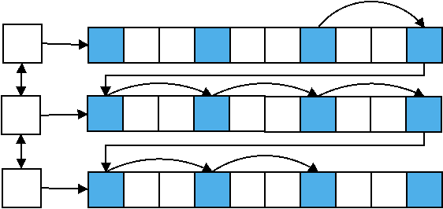
View: Iterator examples
for( auto it = view.begin()+2; it <= view.end()-1; ++it)

Slide 26
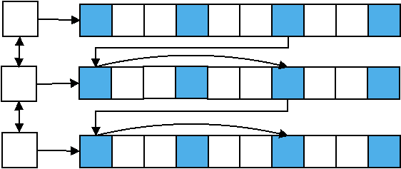
View: Iterator examples
for( auto it = view.begin()+2; it <= view.end()-1; it+=2)

Slide 27
Technicals example driven by kernel FillGaps
Prescription
View
Iterator
Notes:
- compete with conventional accelerators
Needs:
- high energy
- mono-energetic
- directed beams
- not yet achieved
- one concept are MLT

Slide 28
Include the DeepIterator
Two additional includes are necessary
#include “Deepiterator/Deepiterator.hpp”

Slide 29
Prescription in Kernel FillGaps
// define a compiletime Offset type, start at the first frame
using Offset = deepiterator::IdentityValue<
uint_fast32_t,
0
>;
// define a compiletime Jumpsize type, iterate over all frames
using Jumpsize = deepiterator::IdentityValue<
uint_fast32_t,
1
>;
// create the prescription
auto && prescription = deepiterator::makeIteratorPrescription(
deepiterator::makeAccessor(),
deepiterator::makeNavigator(
Offset(),
Jumpsize()
)
);

Slide 30
Create a View in Kernel MoveAndMark
A View binds a prescription to a container.
// create a container. In this case we had written a wrapper around the particle box pb
//1. define the wrapper. This is your container.
// 2. specialize all traits which are needed (comes later)
FrameWrapper frameWrapper(
acc, // accelerator
pb, // particle memory, contains the frames
mapper // functor to map a block to a supercell
);
// create the view
auto && view = pmacc::makeView(
frameWrapper, // The container
prescription // the describtion of the iteration
);

Slide 31
Create the Iterator
The View can be used like a container from the STL.
The DeepIterator support the common operations:
++, ==, !=, - >
- -
-=, +=, +, -, <, >, >=, <=, []
// We create an iterator and set its pointer to the last frame.
auto && it = view.rbegin();
// We could also start at the first frame
// auto && it = view.begin()

Slide 32
Check if frames exist
Before:
// end kernel if we have no frames
if( !frame.isValid( ) )
return;
Now:
// end kernel if we have no frames
if( it == view.rend() )
return;

Slide 33
Iterate over all frames
Before:
while( frame.isValid( ) )
{
// loop over all particles in the frame
ForEachIdx< ParticleDomCfg >{ workerIdx }
(
{
ParticleFunctor(
acc,
*frame,
…
)
}
)
frame = pb.getPreviousFrame(frame)
}
Now:
for(;it != view.rend(); --it)
{
// loop over all particles in the frame
ForEachIdx< ParticleDomCfg >{ workerIdx }
(
{
ParticleFunctor(
acc,
*it,
…
)
}
)
}

Slide 34
Traits and Categories
Notes:
- compete with conventional accelerators
Needs:
- high energy
- mono-energetic
- directed beams
- not yet achieved
- one concept are MLT

Slide 35
Needed Traits for DeepIterator
Iterator Traits
Componenttype
HasConstantSize
NumberElements
IsBidirectional
IsRandomAccessable
IndexType,
RangeType
      Accessor Traits
Get
Equal
Ahead
Behind
      Navigator Traits
FirstElement
NextElement
AfterLastElement
LastElement
PreviousElement
BeforeFirstElement

Slide 36
Needed Traits for DeepIterator
Iterator Traits
Componenttype
HasConstantSize
NumberElements
IsBidirectional
IsRandomAccessable
IndexType,
RangeType
      Accessor Traits
Get
Equal
Ahead
Behind
      Navigator Traits
FirstElement
NextElement
AfterLastElement
LastElement
PreviousElement
BeforeFirstElement
(Possible) expensive for lists

Slide 37
Traits: Categories
Each Container need the following traits
Componenttype
HasConstantSize
NumberElements
The following Traits could be grouped by categories
IsBidirectional
IsRandomAccessable
IndexType,
RangeType
    Accessor Traits
get
equal
ahead
behind
    Navigator Traits
firstElement
nextElement
afterLastElement
lastElement
previousElement
beforeFirstElement
Categorie:
ArrayLike
SupercellLike
DoublylinklistLike

Slide 38
Conclusion?
Notes:
- compete with conventional accelerators
Needs:
- high energy
- mono-energetic
- directed beams
- not yet achieved
- one concept are MLT

Slide 39
Definitions
Accessor: Describes the access to a value inside the container
Navigator: Describes the way to move inside the container
Layer: A flat container (example vector<int>)
Prescription: Describes the behavior of one or more layer.
View: binds a Prescription to a container.
DeepIterator: Move through the Data

Slide 40
Usage
Specialize the Traits
Create a Prescription
Create a View by binding a container to a Prescription
Use the View like a std container

Slide 41
Questions?
Notes:
- compete with conventional accelerators
Needs:
- high energy
- mono-energetic
- directed beams
- not yet achieved
- one concept are MLT

Slide 42
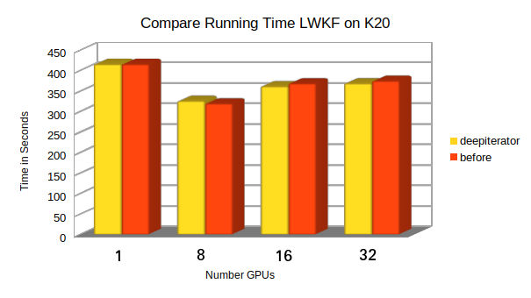
Running Time

Slide 43
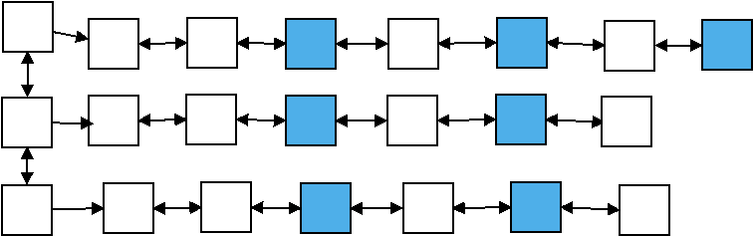
Why is Backward expensiv?
Example: Offset(2), Jumpsize(2)
Task: Find the previous / last element

Slide 44
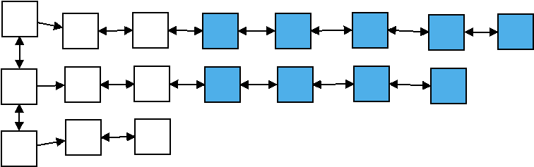
Why is Backward expensiv?
Example: Offset(2), Jumpsize(1)
Task: Find the last element
Last Element of iterator
Last Element of data structure

Slide 45
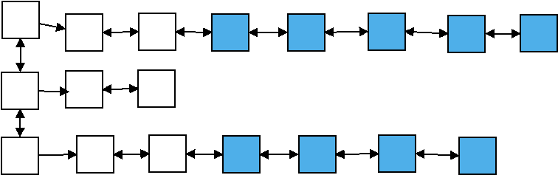
Why is Backward expensiv?
Example: Offset(2), Jumpsize(1)
Task: Find the previous element
Could also Forward happen

